Slide 1
Predicting Limit Order
Fill Probability
10,000 orders
50 pre-submission snapshots per order
Chronological 14 / 3 / 3 day split
Across 5, 30 and 60 seconds
Execution probability, not price direction
Synthetic AAPL limit order book study
Technical presentation
Notes:
Source: AI_Order_Execution_Project.pdf, pages 1-2 and 7.
Source: README.md and notebooks 01-08.
The data are deterministic synthetic teaching data and do not represent live AAPL or Nasdaq execution.

Slide 2
Two-file dataset and leakage-safe design
Every predictor must be available before the observation time
Orders workbook
50-snapshot history
10,000 active orders
72 order-level columns
Static queue, LOB and recent-flow state
Eligibility and targets for 5s, 30s and 60s
10,000 order objects
500,000 pre-submission snapshots
Price, spread, depth, imbalance and events
History features form feature set D
Joined one-to-one by order_id
TRAIN | VALIDATION | TEST
7,000 orders | first 14 days Fit models and preprocessing | 1,500 orders | next 3 days Select model, calibration and threshold | 1,500 orders | final 3 days One frozen evaluation
Synthetic AAPL teaching data
2
Notes:
Sources: AI_Order_Execution_Project.pdf, pages 2-4 and 6.
Sources: data audit and history feature notebooks 01 and 03.
Leakage controls: supplied chronological split, eligibility filtering before target use, no post-t0 features, and no test access before policy freeze.

Slide 3
Longer horizons are easier to rank
Best validation PR-AUC within each model family
All learned families beat the baseline
Logistic: 0.248 at 5s | 0.599 at 30s
Random Forest: 0.789 at 60s
Feature set D did not produce a stable validation gain over the best non-history candidate
Synthetic AAPL teaching data
3
Notes:
Source: results/rq1_model_comparison.csv.
Source for history conclusion: results/validation_candidate_summary.csv.
The labels show PR-AUC. Feature sets were selected independently within each model family for this comparison.

Slide 4
Test performance holds at 30 and 60 seconds
The 5-second model shows the largest validation-to-test drop
Horizon | Model | PR-AUC | Brier | F1 | Recall
5s | Logistic B | 0.170 | 0.102 | 0.158 | 0.122
30s | RF C | 0.600 | 0.230 | 0.611 | 0.746
60s | RF C | 0.805 | 0.205 | 0.789 | 0.985
5s: 21 true positives and 151 missed fills
60s: recall is high, but 96.4% of eligible orders are classified as fills
Test ECE: 0.014 | 0.035 | 0.028
Synthetic AAPL teaching data
4
Notes:
Sources: results/final_test_metrics.csv and results/validation_test_comparison.csv.
Frozen policy: Logistic Regression B at 5 seconds, Random Forest C at 30 and 60 seconds, each with sigmoid calibration.
Thresholds were selected on validation F1 before test access.

Slide 5
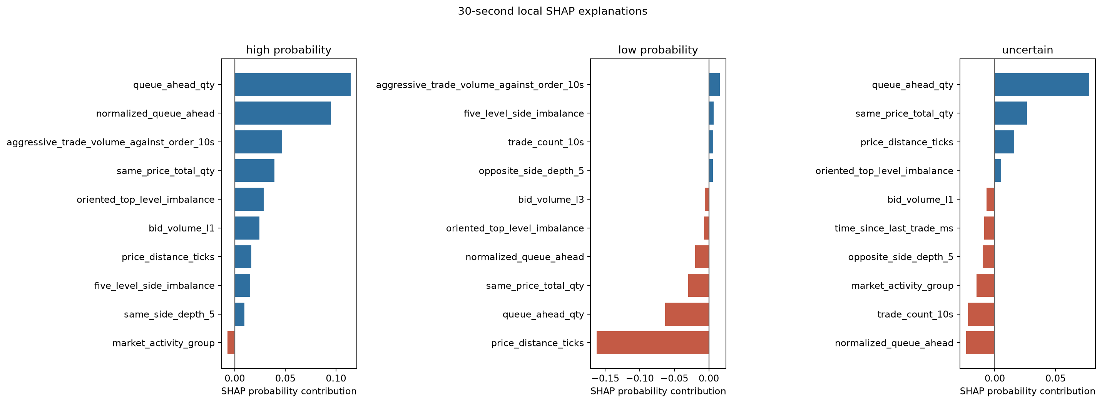
ORD007710 sits near the 30-second decision boundary
Random Forest probability 0.500 | actual outcome: fill
Base probability
0.451
Low queue-ahead quantity provides the strongest positive contribution
Normalized queue position and recent trade count offset that signal
Tree path
queue ahead <= 250.5
aggressive flow <= 248
LIME: mean top-feature Jaccard 0.821 across five seeds
Synthetic AAPL teaching data
5
Notes:
Sources: results/shap_local_explanations_30s.csv, results/decision_tree_paths_30s.csv and results/lime_stability_30s.csv.
SHAP values are probability contributions for feature set C Random Forest. Values shown are rounded.
SHAP and LIME explain model behavior and do not establish causality.

Slide 6
Queue priority explains most of the predictive signal
What the study answers
Limits
RQ1 Learned models beat the empirical baseline
RQ2 Fifty-snapshot history adds no stable lift
RQ3 Recent aggressive flow matters more at 30s and 60s
RQ4 Ranking and calibration are close, but not identical
RQ5 Side and day results are broadly similar, with subgroup variation
Synthetic single-symbol data
Correlated LOB features complicate attribution
The 5-second model misses most fills
The 60-second F1 threshold predicts fills very often
Explanations describe association, not causality
For this dataset, a static order-book plus recent-flow model offers the best balance of performance, simplicity and interpretability
Synthetic AAPL teaching data
6
Notes:
Sources: results/rq1_model_comparison.csv, results/validation_candidate_summary.csv, results/final_test_slice_metrics.csv and results/brief_completion_summary.json.
The survival-analysis extension remains optional and was not required for the completed fixed-horizon deliverables.
The findings apply to the supplied deterministic synthetic dataset only.

