Slide 1

Control Statements
Week 1, Session 3
Institut Teknologi Del
Jl. Sisingamangaraja
Sitoluama, Laguboti 22381
Toba – SUMUT
http://www.del.ac.id
TMP
teamsar.panggabean@del.ac.id
1132102 – Pemrograman Berbasis Objek

Slide 2
Learning Outcomes
At the end of this module you will be able to understand:
use Selection Statements
i.e. if statements, if...else statements and switch statements to make choices in a program;
use Repetition Statements
i.e. repeat a section of code with a for loop, a while loop, and do...while loop;
learn the usage of break and continue
select the most appropriate construct for selection and iteration in a particular program;
TMP - PBO

Slide 3
1. Selection Statements
if Statements
switch Statements
TMP - PBO

Slide 4
1. Selection Statements (Cont’d)
if Statements
General Form:
if (booleanExpression) {
statement1;
} else {
statement2;
}
Example:
if (num % 2 == 0) {
System.out.println(“Even”);
} else {
System.out.println(“Odd”);
}
TMP - PBO

Slide 5
1. Selection Statements (Cont’d)
Practice:
Create a program to decide students score given a range below:
80< num < =100 : A
65< num <= 80 : B
50< num <= 65 : C
35< num <= 50 : D
num <= 35 : E
TMP - PBO

Slide 6
1. Selection Statements (Cont’d)
switch Statements
General Form:
switch(expression) {
case value1:
// statement1
break;
case value2:
// statement2
break;
..
..
case valueN:
// statementN
break;
default:
//default statement sequence
}
TMP - PBO

Slide 7
1. Selection Statements (Cont’d)
Example:
public class VowelsAndConsonants {
public static void main(String[] args) {
for(int i = 0; i < 100; i++) {
char c = (char)(Math.random() * 26 + 'a');
System.out.print(c + ": ");
switch(c) {
case 'a':
case 'e':
case 'i':
case 'o':
case 'u':
System.out.println("vowel");
break;
case 'y':
case 'w':
System.out.println(
"Sometimes a vowel");
break;
default:
System.out.println("consonant");
}
}
}
}
TMP - PBO

Slide 8
2. Repetition Statements
while Statements
do-while Statements
for Statements
break and continue
TMP - PBO

Slide 9
while Loop
2. Repetition Statements (Cont’d)
The form for a while loop is:
while(Boolean-expression){
statement
}
continuation-condition
TMP - PBO

Slide 10
Example
2. Repetition Statements (Cont’d)
Here’s a simple example that generates random numbers until a particular condition is met:
// WhileTest.java
public class WhileTest {
public static void main(String[] args){
double r = 0;
while(r < 0.99d) {
r = Math.random();
System.out.println(r);
}
}
}
TMP - PBO

Slide 11
do-while Statements
2. Repetition Statements (Cont’d)
The form for do-while is:
do {
//statement
}while(Boolean-expression);
The sole difference between while and do-while is that the statement of the do-while always executes at least once, even if the expression evaluates to false the first time. In a while, if the conditional is false the first time the statement never executes.
TMP - PBO

Slide 12
for Statements
2. Repetition Statements (Cont’d)
A for loop performs initialization before the first iteration. Then it performs conditional testing and, at the end of each iteration, some form of “stepping.” The form of the for loop is:
for(initialization; Boolean-expression; step) {
//statement ;
}
TMP - PBO

Slide 13
Example → for
2. Repetition Statements (Cont’d)
// ListCharacters.java
// Demonstrates "for" loop by listing
// all the ASCII characters.
public class ListCharacters {
public static void main(String[] args) {
for( char c = 0; c < 128; c++)
if (c != 26 ) // ANSI Clear screen
System.out.println(
"value: " + (int)c +
" character: " + c);
}
}
TMP - PBO

Slide 14
multiple variables in for
2. Repetition Statements (Cont’d)
You can define multiple variables within a for statement, but they must be of the same type:
for(int i = 0, j = 1; i < 10 && j != 11; i++, j++) {
/* body of for loop */;
}
TMP - PBO

Slide 15
3. break and continue
Inside the body of any of the iteration statements you can also control the flow of the loop by using break and continue.
break quits the loop without executing the rest of the statements in the loop.
continue stops the execution of the current iteration and goes back to the beginning of the loop to begin the next iteration.
TMP - PBO

Slide 16
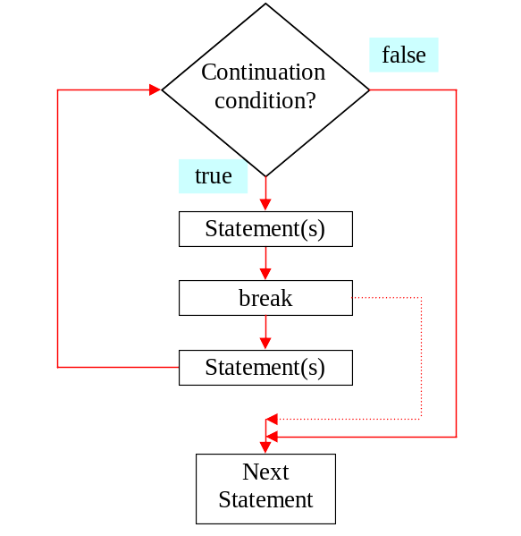
The break Keyword
3. break and continue (Cont’d)
TMP - PBO

Slide 17
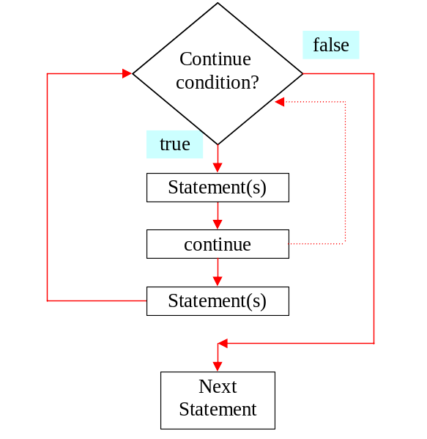
The continue Keyword
3. break and continue (Cont’d)
TMP - PBO

Slide 18
Break, continue and label
3. break and continue (Cont’d)
Java has no goto.
However, it does have something that looks a bit like a jump tied in with the break and continue keywords.
It’s not a jump but rather a way to break out of an iteration statement.
The reason it’s often thrown in with discussions of goto is because it uses the same mechanism: a label.
A label is an identifier followed by a colon, like this:
label1:
TMP - PBO

Slide 19
label
3. break and continue (Cont’d)
label1:
outer-iteration {
inner-iteration {
//...
break; // case 1
//...
continue; // case 2
//...
continue label1; // case 3
//...
break label1; // case 4
}
}
TMP - PBO
Notes:
In case 1, the break breaks out of the inner iteration and you end up in the outer iteration. In case 2, the continue moves back to the beginning of the inner iteration. But in case 3, the continue label1 breaks out of the inner iteration and the outer iteration, all the way back to label1. Then it does in fact continue the iteration, but starting at the outer iteration. In case 4, the break label1 also breaks all the way out to label1, but it does not re-enter the iteration. It actually does break out of both iterations.

Slide 20
label
3. break and continue (Cont’d)
In case 1, the break breaks out of the inner iteration and you end up in the outer iteration.
In case 2, the continue moves back to the beginning of the inner iteration.
But in case 3, the continue label1 breaks out of the inner iteration and the outer iteration, all the way back to label1. Then it does in fact continue the iteration, but starting at the outer iteration.
In case 4, the break label1 also breaks all the way out to label1, but it does not re-enter the iteration. It actually does break out of both iterations.
TMP - PBO

Slide 21
Example
3. break and continue (Cont’d)
// LabeledWhile.java
// Java's "labeled while" loop.
public class LabeledWhile {
public static void main(String[] args) {
int i = 0;
outer:
while(true) {
prt("Outer while loop");
while(true) {
i++;
prt("i = " + i);
if(i == 1) {
prt("continue");
continue;
}
TMP - PBO

Slide 22
if(i == 3) {
prt("continue outer");
continue outer;
}
if(i == 5) {
prt("break");
break;
}
if(i == 7) {
prt("break outer");
break outer;
}
} // while
} // while
} // main
static void prt(String s) {
System.out.println(s);
}
} //class
TMP - PBO

Slide 23
Out put ?
Why don’t you try it ?
TMP - PBO

Slide 24
It’s easy isn't it?
Thank You
TMP - PBO

