Slide 1

Multithreaded Programming
Tennov Simanjuntak

Slide 2
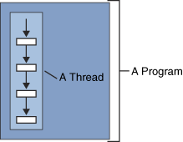
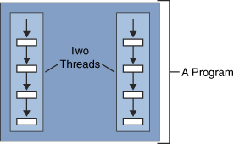
What is a Thread
A thread (also called execution context or lightweight process) is a single sequential flow of control within a program.

Slide 3
Implementing a Thread
There are two ways to implement Thread:
  Subclassing java.lang.Thread and overriding run method
  Implementing Runnable interface

Slide 4
Subclassing Thread: example (1)
public class ThreadExample extends Thread {
public ThreadExample(String a_name) {
super(a_name);
}
public void run(){
for (int i=0;i<10;i++){
System.out.format("%d %s %n", i, this.getName());
try {
Thread.sleep(1000);
} catch (InterruptedException e) {
e.printStackTrace();
}
}
System.out.format("Finished: %s%n",this.getName());
}
}

Slide 5
Subclassing Thread: example (2)
public class Test {
public static void main (String[] args) {
new ThreadExample("Thread1").start();
new ThreadExample("Thread2").start();
}
}

Slide 6
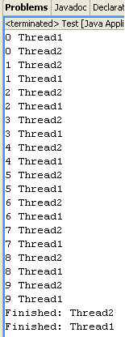
Subclassing Thread: example (3)
Output

Slide 7
Implementing Runnable Interface (1)
public class Clock extends java.applet.Applet implements Runnable {
private static final long serialVersionUID = 1L;
private Thread clockThread = null;
public void init() {
this.setBackground(Color.white);
}
public void start() {
if (clockThread == null) {
clockThread = new Thread(this, "Clock");
clockThread.start();
}
}
/* Updates time every second*/
public void run() {
Thread myThread = Thread.currentThread();
while (clockThread == myThread) {
repaint();
try {
Thread.sleep(1000);
} catch (InterruptedException e){ }
}
}

Slide 8
Implementing Runnable Interface (2)
/* Gets the current time and draws it to the screen */
public void paint(Graphics g) {
Calendar calendar= new GregorianCalendar();
g.drawString(calendar.get(Calendar.HOUR) + ":" +
calendar.get(Calendar.MINUTE) + ":" +
calendar.get(Calendar.SECOND), 5, 10);
}
@Override
public void stop() {
clockThread = null;
}
}

Slide 9
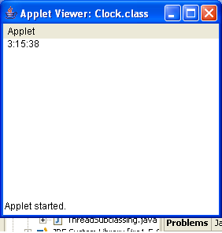
Implementing Runnable Interface (3)
Output

Slide 10
Synchronizing Thread
Until now, we have discussed independent–asynchronous threads.
  Each thread have their own data and resources for the execution
  Each thread running without concern for the state or activities of the other running threads
How if:
  Several thread running concurrently and share the same critical resources/ shared data

Slide 11
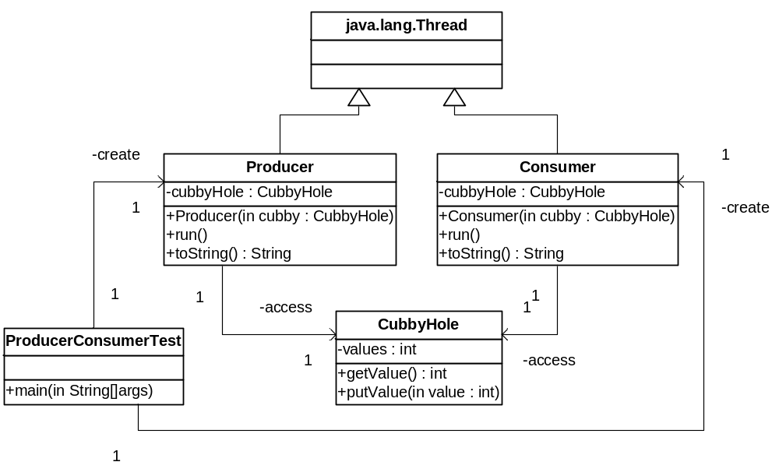
Producer-Consumer Scenario

Slide 12
Producer-Consumer NOT syn (1)
public class CubbyHole {
private int values;
/* Method used by the consumer to get a value */
public int getValue() {
return values;
}
/* Method used by the consumer to put a value */
public void putValue(int value) {
values = value;
}
}

Slide 13
Producer-Consumer NOT syn (2)
public class Producer extends Thread {
private CubbyHole cubbyHole; // shared data
public Producer(CubbyHole c) {
cubbyHole = c;
}
public void run() {
for (int i = 0; i < 10; i++) {
System.out.println(this + " put: " + i);
cubbyHole.putValue(i); // Accesses shared data
try {
sleep((int)(Math.random() * 100));
} catch (InterruptedException e) { }
}
}
public String toString(){
return "Producer #1";
}
}

Slide 14
Producer-Consumer NOT syn (3)
public class Consumer extends Thread {
private CubbyHole cubbyHole; // shared data
public Consumer(CubbyHole cubby) {
cubbyHole = cubby;
}
public void run() {
int value = 0;
for (int i = 0; i < 10; i++) {
value = cubbyHole.getValue(); // Accesses shared data
System.out.println( this + " got: " + value);
}
}
public String toString(){
return "Consumer #1";
}
}

Slide 15
Producer-Consumer NOT syn (4)
public class ProducerConsumerTest {
public static void main(String[] args) {
CubbyHole cubbyHole = new CubbyHole();
Producer producer = new Producer(cubbyHole);
Consumer consumer = new Consumer(cubbyHole);
producer.start();
consumer.start();
}
}

Slide 16
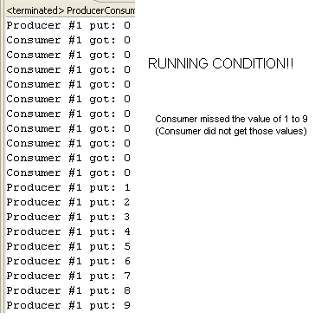
Producer-Consumer NOT syn (4)
output

Slide 17
Synchronizing threads
Locking mechanism
A thread prevent the access to an object by locking the object.
One way to synchronize thread.
  add synchronized keyword to the critical method of the object to be locked.
  The threads must do coordination to ensure data integrity. java.lang.Object provide method wait(), notify(), and notifyAll() for this purpose.

Slide 18
Producer-Consumer syn (1)
public class CubbyHoleSyn {
private int values;
private boolean isAvailable;
public synchronized int getValue(){
while (!isAvailable){
try {
this.wait();
}catch(InterruptedException e){
e.printStackTrace();
}
}
this.isAvailable=false;
this.notifyAll();
return values;
}
public synchronized void putValue(int value){
while (isAvailable){
try{
this.wait();
}catch (InterruptedException e){
e.printStackTrace();
}
}
this.isAvailable=true;
this.values=value;
this.notifyAll();
}
}

Slide 19
Producer-Consumer syn (2)
public class ProducerConsumerTest {
public static void main(String[] args) {
//CubbyHole cubbyHole = new CubbyHole();
CubbyHoleSyn cubbyHole = new CubbyHoleSyn();
Producer producer = new Producer(cubbyHole);
Consumer consumer = new Consumer(cubbyHole);
producer.start();
consumer.start();
}
}

Slide 20
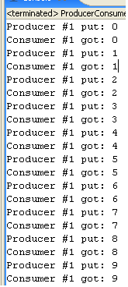
Producer-Consumer syn (3)
Output

