Slide 1
Thread
Week 14 Session 1

Slide 2
Outlines
Running faster
Multithreading
Multithreading in Java
An example

Slide 3
Running faster
A long running program may caused by:
Tons of the incoming inputs.
Inefficient treatment (complex algorithm).
Serial execution.
Fixing the above last two problems will surely generate a blazing fast program.
Efficient algorithm and make it runs parallel.

Slide 4
Multithreading
A program can be split into small tasks for parallel execution.
In the low level system (the OS) these workers are threads running on top of the CPUs.
Today’s CPU core can handle up to 4 threads.
This multithreading capability is supported and available in Java.
The problem is how to split things up?

Slide 5
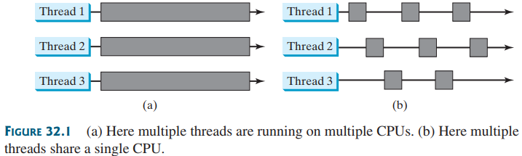
Multithreading
Threads on the application level are mapped to the underlying CPU cores.

Slide 6
Multithreading in Java
In Java, there are two possible options:
extending the java.lang.Thread or
implementing the java.lang.Runnable interface , this option is the most recommended.

Slide 7
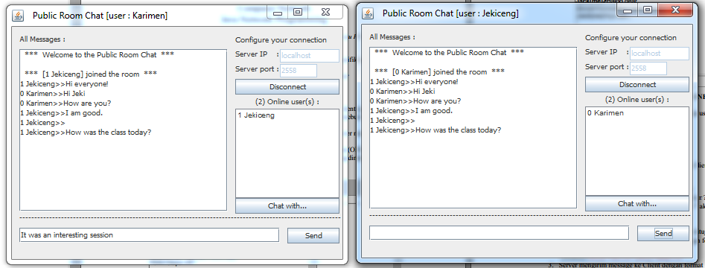
Chat application as an example
The chat application running on at least two threads per party.
The server and the client side have two threads.

Slide 8
References
Introduction to Java Programming, Liang.
See chapter 32

