Slide 1
JavaFX
Pemrograman Berorientasi Objek

Slide 2
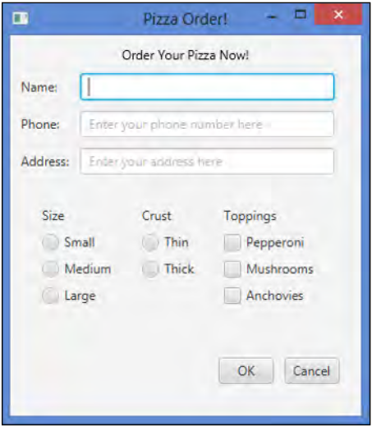
JavaFX - Example

Slide 3
What is JavaFX?
Framework for developing GUI programs
Replaced Java Swing
Similar conceptually to other graphics libraries

Slide 4
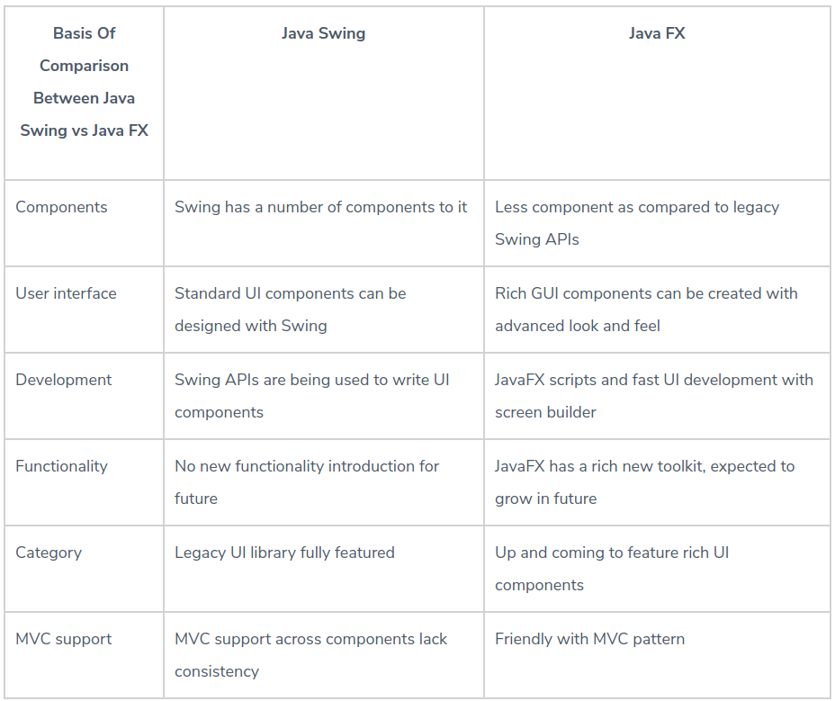
Java Swing vs. JavaFX
https://www.educba.com/java-swing-vs-java-fx/

Slide 5
How to run a JavaFX program
Eclipse
Command Line

Slide 6
Basic Structure
The main class for a JavaFX application extends the javafx.application.Application class.
The start() method is the main entry point for all JavaFX applications (not main(), like in other Java applications).
The launch(args) in main() is just launching the application.
Notes:
Application is an abstract class. Some of methods have already been implemented, and others need to be overridden.

Slide 7
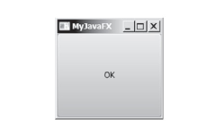
How to build?

Slide 8
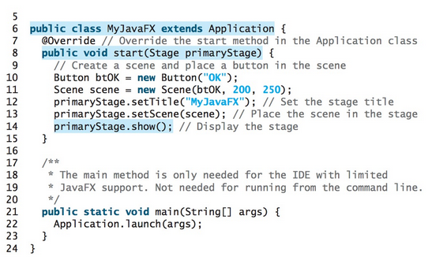

Slide 9
Stage, Scene, Node
A JavaFX application defines the user interface container by means of a stage and a scene.
The JavaFX Stage class is the top-level JavaFX container. Think of it as a stage on which a play is enacted. It is a window on our screen.
The JavaFX Scene class is the container for all content. Think of it as a scene in a play.
Nodes are the actors to perform in the scene.

Slide 10
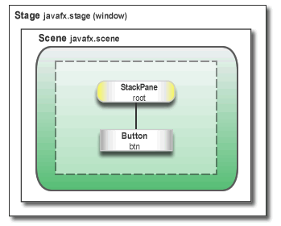
JavaFX Scene graph

Slide 11
Java FX Scene
The Main class is an extension of the javafx.application.Application class. Its start method is overridden and receives a Stage object (a top-level GUI container) as its only parameter.
The root node (in this case, an instance of the javafx.scene.Stackpane class) is created and passed to the scene's constructor, along with the scene's width, and height.
The stage's title, scene, and visibility are all set.

Slide 12
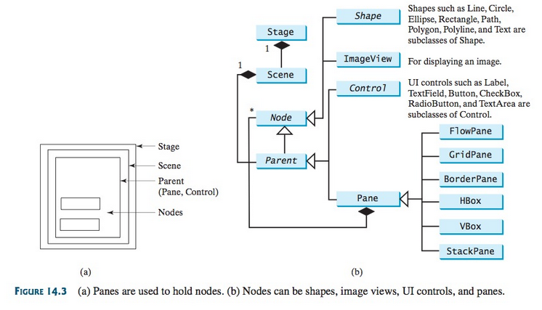
Notes:
From Introduction to Java Programming by Daniel Liang

Slide 13
Coordinates
The Origin is at the top left in JavaFX

Slide 14
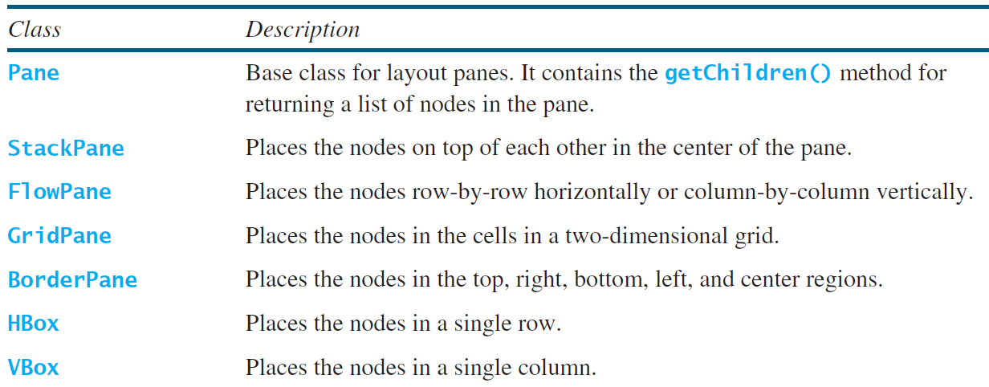
Layout Panes
JavaFX provides many types of panes for organizing nodes in a container.

Slide 15
Event-Driven Programming
A paradigm where the flow of the program is driven by events such as:
User actions (buttons, mouse clicks, etc.)
Sensor input
Network traffic
Messages from other programs or threads
Very common in software with graphical user interfaces

Slide 16
Event Handler
event handler is a callback subroutine that handles inputs received in a program (called a listener in Java).
Each event is a piece of application-level information from the underlying framework, typically the GUI toolkit.
GUI events include key presses, mouse movement, action selections, and timers expiring. Event handlers are a central concept in event-driven programming.

Slide 17
Event Handler
EventHandler is a class that implements
void handle(T event)
Invoked when a specific event of the type for which this handler is registered happens.
btn.setOnAction(new EventHandler<ActionEvent>() {
@Override
public void handle(ActionEvent e) {
newScreen(stage); //action for button
}
});
//We will look at a more concise version later

Slide 18
Java FX program snippet
class Main extends Application {}
Add method start(Stage primaryStage) that works like main (String[] args) to Main
Add a Scene to the primaryStage in start()
Add a JavaFX Node object (such as a grid) to the Scene
Add button to the Node object
Add onAction code (event Handler) to the button
Display the primaryStage on the computer display

Slide 19
Q & A

