Slide 1

Stream I/O Operations
Week 6 Session 1

Slide 2

Contents
What a stream is and what the main classes that Java provides to support stream operations are
What stream readers and writers are and what they are used for
How to read data from the keyboard
How to format data to the command line

Slide 3
What a Stream is (1)
A stream is an abstract representation of an input or output device that is a source of, or destination for, data
You can write data to a stream and read data from a stream. You can visualize a stream as a sequence of bytes that flows into or out of your program

Slide 4
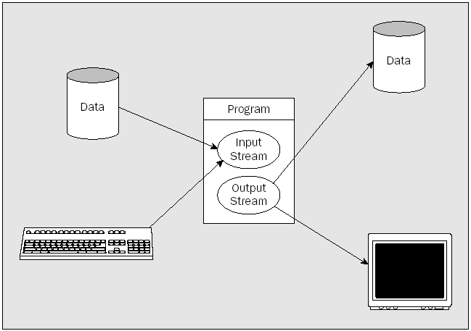
What a Stream is (2)

Slide 5
What a Stream is (3)
When you write data to a stream, the stream is called an output stream
The output stream can go to any device to which a sequence of bytes can be transferred to such as:
  a file on a hard disk, or a phone line connecting a system to a remote system.
  display screen – the command line not the graphical output
Notes:
Note that while a printer can be considered notionally as a stream, printing in Java does not work this way.
A printer in Java is treated as a graphical device, so sending output to the printer is very similar to displaying
graphical output on your display screen.

Slide 6
What a Stream is (4)
Normally, file input and output for the machine on which the program is executing is available only to Java applications. It’s not available to Java applets except to a strictly limited extent
An IOException will normally be thrown by any attempted operation on disk files on the local machine in a Java applet
Notes:
If this were not so, a malicious Java applet embedded in a web page could trash your hard disk.

Slide 7
What a Stream is (5)
Using a stream as the basis for input and output operations makes the program code for these operations independent of the device involved
The advantages:
  We don’t have to worry about the detailed mechanics of each device
  The program will work for a variety of input/output devices without any changes to the code
Notes:
A single object is simply an instance of a class
Which are taken care of behind the scenes

Slide 8
What a Stream is (6)
Stream input and output methods generally permit very small amounts of data to be written or read in a single operation
Transferring data to or from a stream like this may be extremely inefficient, so a stream is often equipped with a buffer in memory, in which case it is called a buffered stream
A buffer is simply a block of memory that is used to batch up the data that is transferred to or from an external device
Notes:
. Reading or writing a stream in reasonably large chunks will reduce the number of input/output operations necessary and thus make the process more efficient.

Slide 9
What a Stream is (7)
When you write to a buffered output stream, the data is sent to the buffer and not to the external device
The data is usually sent to the device when the buffer is full
If the data in the buffer to want to be sent to the device before the buffer is full, and methods are provided to do this. This operation is usually termed flushing the buffer

Slide 10
What a Stream is (8)
A read operation for the device that is the source of data for the stream will be read only when the buffer is empty and the program has requested data
When this occurs, a complete buffer-full of data will be read automatically from the device, if sufficient data is available
Notes:
Any read operation on a buffered input stream will read data from the buffer.

Slide 11
Binary & Character Stream (1)
The java.io package supports two types of streams:
  binary streams, which contain binary data, sometimes referred to as byte streams
  character streams, which contain character data

Slide 12
Binary & Character Stream (2)
When you write data to a binary stream, the data is written to the stream as a series of bytes, exactly as it appears in memory – 4 bytes for each value of type int, 8 bytes for each value of type long, 8 bytes for each value of type double, and so on.
Character streams are used for storing and retrieving text. All binary numeric data has to be converted to a textual representation before being written to a character stream
Notes:
. This involves generating a character representation
of the original binary data value. Reading numeric data from a stream that contains text involves much
more work than reading binary data. When you read a value of type int from a binary stream, you
know that it consists of 4 bytes. When you read an integer from a character stream, you have to determine
how many characters from the stream make up the value. For each numerical value you read from
a character stream, you have to be able to recognize where the value begins and ends and then convert
the token—the sequence of characters that represents the value—to its binary form.

Slide 13
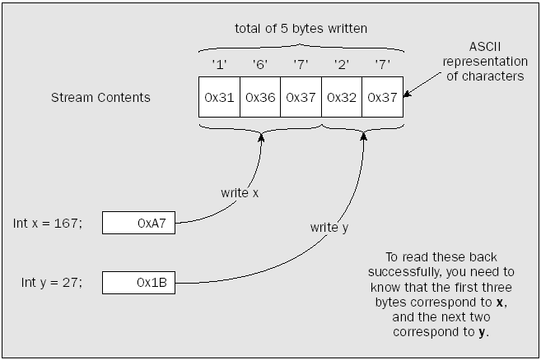
Binary & Character Stream (3)

Slide 14
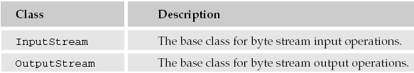
Classes for Input & Output
The package java.io contains the classes that provide the foundation for Java’s support for stream I/O:
InputStream and OutputStream are both abstract classes

Slide 15
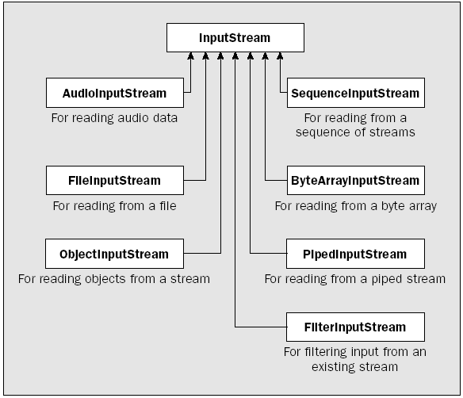
Basic Input Stream Classes

Slide 16
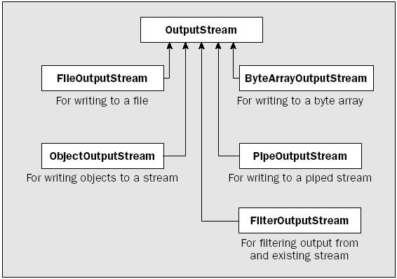
Basic Output Stream Classes

Slide 17
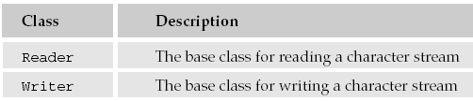
Stream Readers and Writers
Stream readers and writers are objects that can read and write byte streams as character streams.
The base classes for stream readers and writers are:
Notes:
So a character stream is essentially a byte stream fronted by a reader or a writer.

Slide 18
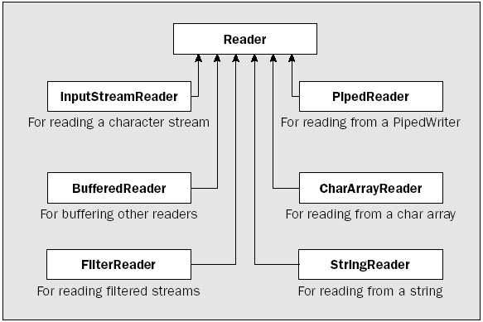
Basic Reader Classes

Slide 19
The Standard Streams
A standard input stream
  usually corresponds to the keyboard by default. This is encapsulated by the in member of the System class and is of type InputStream
A standard output stream
  corresponds to output on the command line. This is encapsulated by the out member of the System class and is of type PrintStream
A standard error output stream
  for error messages that usually maps to the command-line output by default. This is encapsulated by the err member of the System class and is also of type PrintStream

Slide 20
Reading Console Input
Console input is accomplished by reading from System.in which is wrapped in a BufferedReader object:
BufferedReader(Reader inputReader);
BufferedReader br =
new BufferedReader(new
InputStreamReader(System.in));

Slide 21
Reading Characters (1)
To read a character from BufferedReader, use:
Returns the character as an integer value and -1 when encounters the end of the stream and can throw IOException
int read() throws IOException;

Slide 22
Reading Characters (2)
import java.io.*;
class ReadCharacters {
public static void main(String[] args)
throws IOException
{
char c;
BufferedReader br = new BufferedReader(new InputStreamReader(System.in));
System.out.println(“Enter character, ‘q’ to quit.”);
// read characters
do {
c = (char) br.read();
System.out.printl(c);
} while (c != ‘q’);
}
}

Slide 23
Reading Strings (1)
To read a string from a keyboard, use
String readLine() throws IOException;

Slide 24
Reading Strings (2)
import java.io.*;
class ReadStrings {
public static void main(String[] args)
throws IOException
{
String str;
BufferedReader br = new BufferedReader(new InputStreamReader(System.in));
System.out.println(“Enter lines of text. ”);
System.out.println(“Enter ‘stop’ to quit.”);
do {
str = br.readLine();
System.out.printl(str);
} while (str.equals(“stop”));
}
}

Slide 25
Scanner Class (1)
The Scanner class is a new feature in JDK 1.5, which allows the user to read values of various types (keyboard or file)
Must import java.util.Scanner;
The Scanner looks for tokens in the input
A token is a series of characters that ends with what Java calls whitespace. A whitespace character can be a blank, a tab character, a carriage return, or the end of the file

Slide 26
Scanner Class (2)
If we read a line that has a series of numbers separated by blanks, the scanner will take each number as a separate token
Whitespace characters (blanks or carriage returns) act as separators

Slide 27
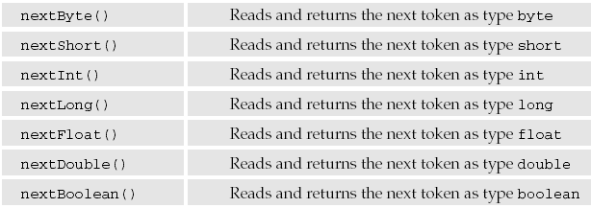
Scanner Class (3)
By default, a Scanner object reads tokens assuming they are delimited by whitespace

Slide 28
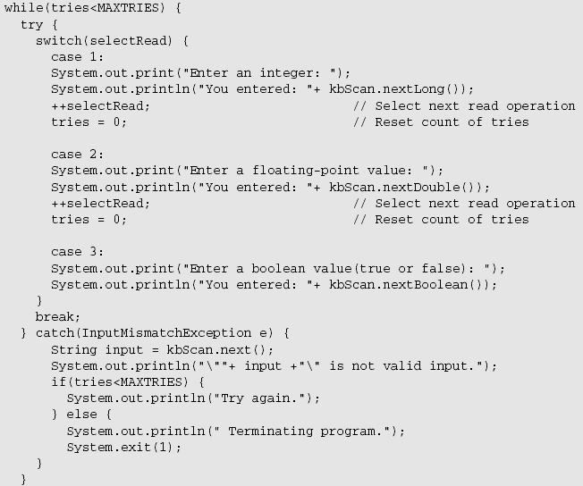
Scanner Class (4)

Slide 29
Reading & Writing Files
To open the files, use:
To read from the files, use:
To write to the files, use:
To close the file, use
FileInputStream (String fileName) throws FileNotFoundException
FileOutputStream (String fileName) throws FileNotFoundException
int read() throws IOException
void write(int byteval) throws IOException
void close() throws IOException

Slide 30
Reading a File
import java.io.*;
class ShowFile {
public static void main (String[] args) throws IOException {
int i;
FileInputStream fin;
try {
fin = new FileInputStream(args[0]);
} catch (FileNotFoundException e) {
System.out.println(“File not found.”);
return;
} catch (ArrayIndexOutOfBoundsException e) {
System.out.println(“Usage: Showfile file”);
return;
}
do {
i = fin.read();
if (i!= -1) System.out.print((char) i);
} while (i!=-1);
fin.close();
}
}

Slide 31
Writing a File (1)
import java.io.*;
class CopyFile {
public static void main(String args[]) throws IOException
{
int i;
FileInputStream fin; FileOutputStream fout;
try {
try {
fin = new FileInputStream(args[0]);
} catch (FileNotFoundException e) {
System.out.println("Input file not found.");
return;
}
try {
fout = new FileOutputStream(args[1]);
} catch (FileNotFoundException e) {
System.out.println("Error opening output file.");
return;
}

Slide 32
Writing a File (2)
} catch (IndexOutOfBoundsException e) {
System.out.println("Usage: CopyFile from .. to ..");
return;
}
try {
do {
i = fin.read();
if (i!=-1)
fout.write(i);
} while (i!= -1);
} catch (IOException e) {
System.out.println("File error.");
}
fin.close();
fout.close();
}
}

Slide 33
Writing to Command Line
The out object in the expression System.out.println() is of type PrintStream which outputs data of any of the basic types as a string
Another class doing the same thing is PrintWriter class
The principle difference between the two classes is PrintWriter class will flush the stream buffer only when one of the println() methods is called, if automatic flushing is enabled
A PrintStream object will flush the stream buffer whenever a newline character is written to the stream, regardless of whether it was written by a print() or a println() method

Slide 34
The printf() Method (1)
The printf() method that is defined in the PrintStream and PrintWriter classes will produce formatted output for an arbitrary sequence of values of various types, where the formatting is specified by the first argument to the method
printf(String format, Object ... args)

Slide 35
The printf() Method (2)
General form of format:
Possible value for conversion:
%[argument_index$][flags][width][.precision]conversion
‘d’, ‘o’, and ‘x’ : decimal, octal, or hexadecimal,
‘f’, ‘g’, and ‘a’ : decimal notation, scientific notation (with an exponent), or hexadecimal with an exponent
‘c’ : character
‘s’ : string
‘b’ : boolean value
‘h’ : hashcode (in hexadecimal form.)
‘n’ : the platform line separator (“%n” = “\n”)

Slide 36
The printf() Method (3)
argument_index identifies one of the arguments that follow the format string by its sequence number, where “1$” refers to the first argument, “2$” refers to the second argument, and so on
Use “<” to specify that the format specification applies to the argument specified by the preceding format specification in the format string

Slide 37


The printf() Method (4)
What is the output of this code?
Notes:
x = 27.500000 y = 33.750000 a = 5 b = f c = 377
x = 33.750000 y = 27.500000 a = 255 b = 5 c = 17
a = 255 b = ff c = 377

Slide 38
Any questions?

