Slide 1
String Manipulation
Week 7 Session 2

Slide 2
Contents
How to create String objects
How to create and use arrays of String objects
What operations are available for String objects
What StringBuffer objects are and how they relate to operations on String objects
What operations are available for StringBuffer objects
HES/String Manipulation

Slide 3
String Literal (1)
Java does not supply or support a primitive string type, implemented as an array of char
Java supplies two String classes; the java.lang.String class provides an unchangeable String object and the java.lang.StringBuffer class provides a String which can be amended
HES/String Manipulation

Slide 4
String Literal (2)
A string literal is a sequence of characters between double quotes:
An escape character is a character that has a special meaning instead of literal meaning
“This is a string literal!”
\n : new line character
\t : tab character
\b : backspace character
HES/String Manipulation

Slide 5
Creating String Object (1)
A String variable is simply a variable that stores a reference to an object of the class String
This declares the variable myString as type String and initializes it with a reference to a String object encapsulating the string “My inaugural string”
String myString = “My inaugural string”;
HES/String Manipulation

Slide 6
Creating String Object (2)
String objects are said to be immutable—which means that you cannot extend or otherwise modify the string that an object of type String represents
When you execute a statement that combines existing String objects, you are always creating a new String object as a result and throw away the reference to the old string and replace it with a reference to a new one
myString = “Strings can be knotty”;
HES/String Manipulation

Slide 7
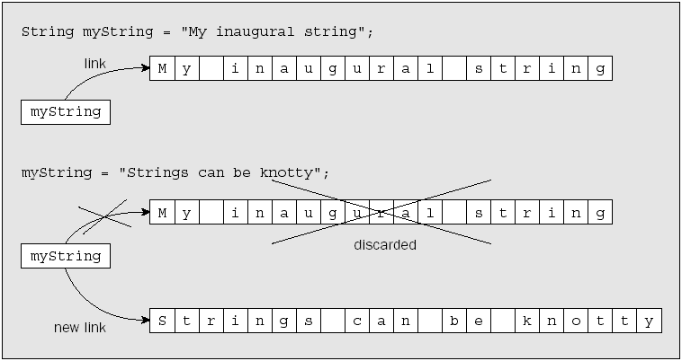
Creating String Object (3)
HES/String Manipulation
Notes:
A single object is simply an instance of a class
Which are taken care of behind the scenes

Slide 8
Creating String Object (4)
We can declare a variable of type String in a method without initializing it:
However, if we try to compile a program that attempts to use anyString before it has been initialized by some means, we will get an error — we must initialize it to a special null value:
String anyString;
String anyString = null;
HES/String Manipulation

Slide 9
Creating String Object (5)
Attempting to use a variable that has not been initialized is an error
You can use the literal null when you want to discard a String object that is currently referenced by a variable
HES/String Manipulation

Slide 10
Array of Strings (1)
We can create arrays of strings with the same mechanism that we used to declare arrays of elements for the basic types
For example:
String[] names = new String[5];
String[] colors = {“red”, “orange”,
“yellow”, “green”, “blue”, “indigo”, violet”};
HES/String Manipulation

Slide 11
Array of Strings (2)
public class LuckyStars {
public static void main(String[] args) {
String[] stars = {
“Robert Redford” , “Marilyn Monroe”,
“Boris Karloff” , “Lassie”,
“Hopalong Cassidy”, “Trigger”
};
System.out.println(“Your lucky star for today is “
+ stars[(int)(stars.length*Math.random())]);
}
}
Your lucky star for today is Hopalong Cassidy
HES/String Manipulation

Slide 12
String Concatenation (1)
String concatenation
  To join two String objects to form a new, single string you use the + operator
The + operation generates a completely new String object that is separate from the two original String objects that are the operands, and this new object is stored in myString
myString = “The quick brown fox”
+ “ jumps over the lazy dog”;
HES/String Manipulation
Notes:
. This involves generating a character representation
of the original binary data value. Reading numeric data from a stream that contains text involves much
more work than reading binary data. When you read a value of type int from a binary stream, you
know that it consists of 4 bytes. When you read an integer from a character stream, you have to determine
how many characters from the stream make up the value. For each numerical value you read from
a character stream, you have to be able to recognize where the value begins and ends and then convert
the token—the sequence of characters that represents the value—to its binary form.

Slide 13
String Concatenation (2)
If one of the operands for the + operator is not a String object or literal, then the compiler will convert into a string and interpret the operation as string concatenation
String secondString = “hands “;
String thirdString = “make light work”;
int numHands = 99;
myString = numHands + “ “ + secondString + thirdString;
System.out.println(myString);
HES/String Manipulation

Slide 14
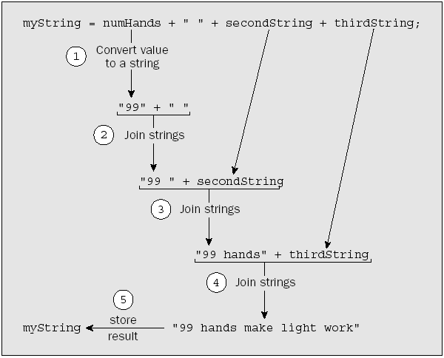
String Concatenation (3)
HES/String Manipulation

Slide 15
String Concatenation (4)
Consider the following sentence
Which sentence will produce string “55” or “10”?
myString = “The number is ” + 5 + 5;
myString = 5 + 5 + “ is a number”;
HES/String Manipulation

Slide 16
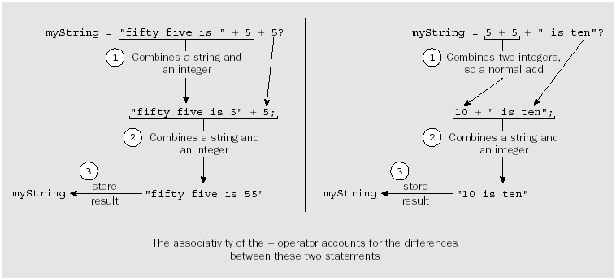
String Concatenation (5)
HES/String Manipulation

Slide 17
String Concatenation (6)
If a String variable that you use as one of the operands to + contains null, then this will automatically be converted to the string “null”
String date = “31st “;
String month = null;
String lastDay = date + month;
“31st null”
HES/String Manipulation

Slide 18
String Concatenation (7)
String concatenation
  Use the += operator to concatenate strings
This does not modify the string “Too many”. The string that is referenced by phrase after this statement has been executed is a completely new String object
String phrase = “Too many”;
phrase += “ cooks spoil the broth”;
HES/String Manipulation

Slide 19
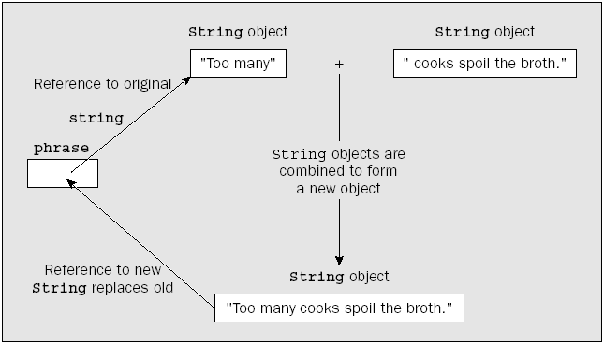
String Concatenation (8)
HES/String Manipulation

Slide 20
String Concatenation (9)
The String class also defines a static method, valueOf(), that will create a String object from a value of any of the basic types
For example:
String doubleString = String.valueOf(3.14159);
HES/String Manipulation

Slide 21
Comparing String (1)
The == operator does not apply to String objects (or any other objects)
The expression string1 == string2 will check whether the two String variables refer to the same string
If they reference separate strings, this expression will have the value false, regardless of whether or not the strings happen to be identical
HES/String Manipulation
Notes:
In other words, the expression above does not compare the strings themselves; it compares the references to the strings, so the result will be true only if string1 and string2 both refer to one and the same string

Slide 22
Comparing String (2)
Consider the following code
String string1 = “Too many “;
String string2 = “cooks”;
String string3 = “Too many cooks”;
string1 += string2;
if(string1 == string3) // Now test for identity
System.out.println(“string1 == string3 is true.” +
“ string1 and string3 point to the same string”);
else
System.out.println(“string1 == string3 is false.” +
“ string1 and string3 do not point to the same string”);
HES/String Manipulation

Slide 23
Comparing String (3)
Look again to this code
Can you explain what’s the result?
string3 = string1;
if(string1 == string3)
System.out.println(“string1 == string3 is true.” +
“ string1 and string3 point to the same string”);
else
System.out.println(“string1 == string3 is false.” +
“ string1 and string3 do not point to the same string”);
HES/String Manipulation

Slide 24

Comparing String (4)
To compare two String variables, that is, to decide whether the strings they reference are equal or not, use the equals() method
boolean equal (Object anObject)
// Return true if the String are equal; false otherwise
HES/String Manipulation

Slide 25
Comparing String (5)
The equals() method does a case-sensitive comparison of corresponding characters in the strings and returns true if the strings are equal and false otherwise
Two strings are equal if
  They are the same length, that is, have the same number of characters
  Each character in one string is identical to the corresponding character in the other
HES/String Manipulation

Slide 26
Checking the Start and End of a String
To test whether a string contains a particular character sequence use the following method
boolean startsWith (string prefix)
// Tests if this string starts with the specified prefix
boolean startsWith(String prefix, int toffset)
// Tests if this string starts with the specified prefix
// beginning a specified index
boolean endsWith (String suffix)
// Tests if this string ends with the specified suffix
String string1 = “Too many cooks”;
if(string1.startsWith(“Too”))
System.out.println(“The string start with \”Too\”!”);
HES/String Manipulation

Slide 27
Sequencing String (1)
To check whether one string is greater than or less than another, use compareTo() method
int compareTo (String anotherString)
// Return:
// 0 if both string is equal
// negative if this string is less than the string
// argument
// positive if this string is greater than the
// string argument
HES/String Manipulation
Notes:
The method compares the String object for which it is called with the String argument you pass to it and returns an integer that is negative if the String object is less than the argument that you passed, zero if the String object is equal to the argument, and positive if the String object is greater than the argument

Slide 28
Sequencing String (2)
The comparison is based on the Unicode value of each character in the strings
String str1 = “mad dog”
String str2 = “mad cat”
String str3 = “catamaran”
String str4 = “cat”
str1.compareTo(str2) return positive
str4.compareTo(str3) return negative
HES/String Manipulation

Slide 29
Extracting String Characters
To extract a character from a String object use the following method
An attempt to use an index that is less than 0 or greater than the index for the last position in the string will cause an exception to be thrown, which will cause the program to be terminated
char charAt(int index)
// Returns the char value at the specified index
HES/String Manipulation

Slide 30
Searching Strings for Characters
To search a character, use:
int indexOf (char ch)
// Return the index of the first occurrence of ch
int indexOf(int ch, int fromIndex)
// Return the index of the first occurrence of ch
// start form fromIndex
int lastIndexOf (char ch)
// Return the index of last occurrence of ch
int lastIndexOf(int ch, int fromIndex)
// Return the index of last occurrence of ch, searching
// backward starting from the fromIndex
HES/String Manipulation

Slide 31
Searching for Substring
To search for a substring, use:
int indexOf (String str)
// Return the index of the first occurrence of str
int indexOf(String str, int fromIndex)
// Return the index of the first occurrence of str
// start form fromIndex
int lastIndexOf (String str)
// Return the index of last occurrence of str
int lastIndexOf(String str, int fromIndex)
// Return the index of last occurrence of str, searching
// backward starting from the fromIndex
HES/String Manipulation

Slide 32
Extracting Substring
To extract a substring, use:
String subString (int beginIndex)
// Returns a new string starts form beginIndex until the
// end of string
String subString (int beginIndex, int endIndex)
// Returns a new string starts from beginIndex
// until endIndex - 1
"unhappy".substring(2) returns "happy"
"Harbison".substring(3) returns "bison"
"emptiness".substring(9) returns "" (an empty string)
"hamburger".substring(4, 8) returns "urge"
"smiles".substring(1, 5) returns "mile"
HES/String Manipulation

Slide 33
Mutable String (1)
Java has two other standard classes that encapsulate strings, the StringBuffer class (from java.lang.StringBuffer) and the StringBuilder class (from java.lang.StringBuilder), and both StringBuffer and StringBuilder objects can be altered directly
HES/String Manipulation

Slide 34
Mutable String (2)
The difference between StringBuffer and StringBuilder is that StringBuffer objects are safe for use by multiple threads, whereas StringBuilder objects are not
Operations will be faster and easier using mutable objects
HES/String Manipulation
Notes:
threads are just independent execution processes within a program
that can execute concurrently. For example, an application that involves acquiring data from several
remote sites could implement the data transfer from each remote site as a separate thread. This would
allow these relatively slow operations to execute in parallel, sharing processor time in a manner determined
by the operating system. This usually means that the elapsed time for acquiring all the data from
the remote sites would be much less than if the operations were executed sequentially in a single thread
of execution.
Of course, if concurrent threads of execution access the same object, there is potential for problems.
Complications can arise when one thread might be accessing an object while another is in the process of
modifying it. When this sort of thing is possible in your application, you must use the StringBuffer
class to define mutable strings if you want to avoid trouble. The StringBuffer class operations have
been coded to prevent errors arising from concurrent access by two or more threads. If you are sure that
your mutable strings will be accessed only by a single thread of execution, then you should use
StringBuilder objects because operations on these will be faster than with StringBuffer objects.

Slide 35
Creating StringBuffer (1)
To create a new StringBuffer use new operator
When you create a StringBuffer object from an existing string, the capacity will be the length of the string plus 16
StringBuffer aString =
new StringBuffer(“A stitch in time”);
String phrase = “Experience is what you get when you’re
expecting something else.”;
StringBuffer buffer = new StringBuffer(phrase);
HES/String Manipulation

Slide 36
Creating StringBuffer (2)
Default capacity of StringBuffer is16 characters. To find out the buffer capacity, use capacity() method
The capacity of a StringBuffer object is not fixed. To specify the initial capacity when creating a StringBuffer object, use:
StringBuffer newString = new StringBuffer(50);
HES/String Manipulation

Slide 37
Adding to a StringBuffer Object (1)
Use append() method to add a string to the end of existing string
StringBuffer sb = new StringBuffer(“A stitch in time”);
Sb.append(“ saves nine”);
StringBuffer proverb = new StringBuffer();
proverb.append(“Many”).append(“ hands”).append(“ make”).
append(“ light”).append(“ work.”);
HES/String Manipulation

Slide 38
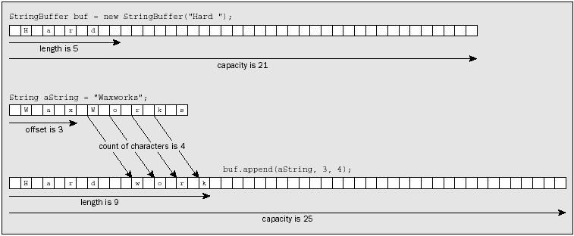
Adding to a StringBuffer Object (2)
StringBuffer buf = new StringBuffer(“Hard “);
String aString = “Waxworks”;
buf.append(aString, 3, 4);
HES/String Manipulation

Slide 39

Replacing the Substring
Use the replace() method to replace a contiguous sequence of characters with a given string
The string will be extended as necessary if the replacement string contains more characters than the substring being replaced
HES/String Manipulation

Slide 40
Creating a String from StringBuffer
To produce a String object from a StringBuffer object by using the toString() method of the StringBuffer class
String saying = proverb.toString();
String saying = “Many” + “ hands” + “ make” + “ light”
+ “ work”;
String saying = new StringBuffer().append(“Many”).
append(“ hands”).append(“ make”).append(“ light”).
append(“ work”).toString();
HES/String Manipulation

Slide 41
Summary
A String object stores a fixed character string that cannot be changed. However, you can assign a given String variable to a different String object
The String class provides methods for joining, searching, and modifying strings—the modifications being achieved by creating a new String object
StringBuffer and StringBuilder objects support the same set of operations. StringBuffer objects are safe when accessed by multiple threads of execution whereas StringBuilder object are not
We can change both the length and the capacity for a StringBuffer object
HES/String Manipulation

Slide 42
Any questions?
HES/String Manipulation

