Slide 1

A Nonparametric Method with Applications on Montreal, Toronto, and New York
Mobility and COVID-19 Spread: Solving the Puzzle
Yigit Aydede (SMU) & Mutlu Yuksel (DAL)
Research Portal on Machine Learning for Social and Health Policies – MLPortal
A part of RNS funded project - March 5, 2021

Slide 2
Non-Pharmaceutical Interventions: Mobility Restrictions
Mobility restrictions are the only effective tool to control for the viral transmission so far.
None of the studies able to quantify the effectiveness of NPI’s that can be used to measure:
When the varying delays in its effect on the spread are identified properly, what would be the overall effect of mobility restrictions?
If mobility restrictions have any effect; how long does it take to start seeing some positive effects?
The overall social response to the COVID-19 pandemic consisted of a mix of voluntary and government mandated behavioral changes.
Without accounting for this dynamic structure, a naive calculation of correlations with any level of lagged mobility variations shows a strong negative relationship: as the mobility goes down, cases go up.

Slide 3
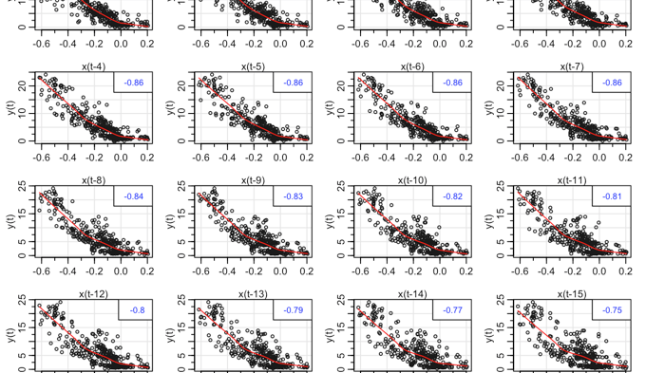
PUZZLE: mobility goes down, cases go up.

Slide 4
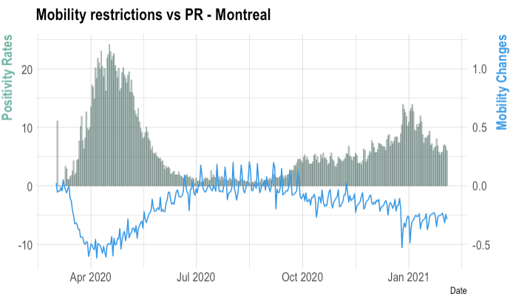
Data: Positivity Rates and Mobility Changes
Three major cities: Montreal, Toronto, and New York City.
We use positivity rates (PR) that reflect the spread.
Facebook mobility data which measures positive or negative changes in movement relative to baseline.

Slide 5
Three time-varying metrics that measure the effect of social mobility on the spread
The correlation that reflects the nature of relationship between mobility restrictions and positivity rates.
01
The elasticity that measures how effectively that relationship is utilized to curb the spread.
02
The average delay in the effect of these restrictions that reflects how efficient the contact tracing is.
03

Slide 6
Dynamic Functional Connectivity (DFC)
It refers to the observed phenomenon that functional connectivity changes over a short time.
It has been suggested to be a more accurate representation of functional brain networks and the main tool in neuroimaging.
We apply a modified DFC to the relationship between restrictions and PR by using advance machine learning methods.
The first methodological framework to identify the local differences in the efficacy of mobility related public health policies.

Slide 7
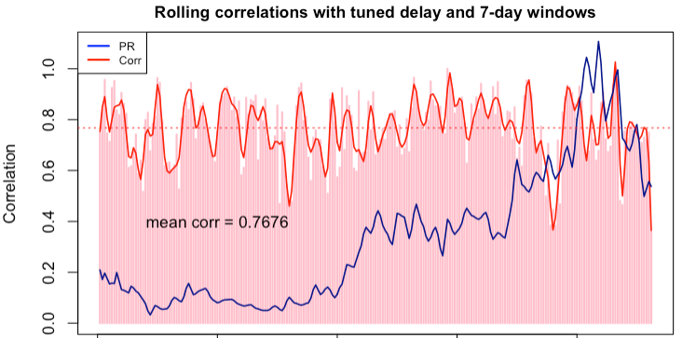
Correlation is positive and high
0.77 in Montreal,
0.70 in Toronto,
0.73 in New York.

Slide 8
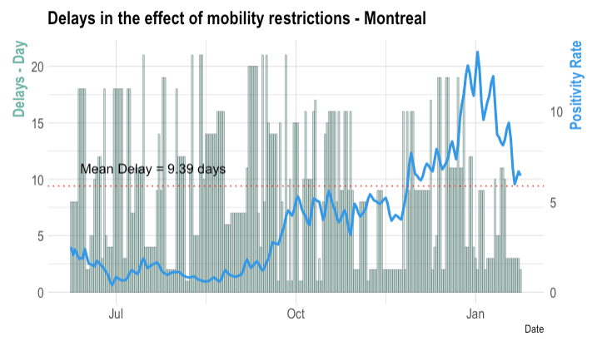
Varying delays in the effect of mobility restrictions
We observe the immediate effects of mobility when contact tracing is effective.
9.69 days in NYC,
9.75 days in Toronto,
9.39 days in Montreal

Slide 9
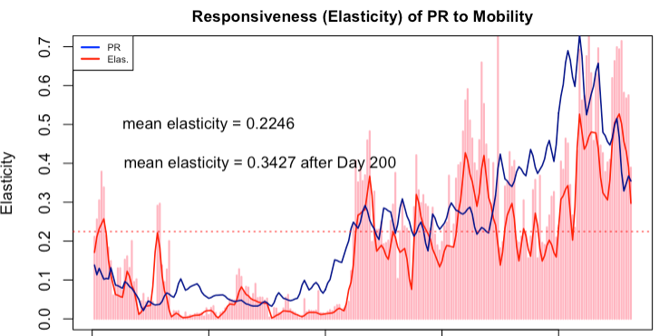
Restrictions are not effective in Montreal
Correlation measures the nature of a relationship; Elasticity measures how effectively that relationship is utilized.
Elasticities: 0.34, 0.79, and 0.62, Montreal Toronto and NYC, respectively during the 2nd wave
10% fall in mobility reduces PR 3.4% in Montreal and 7.9% in Toronto.

Slide 10
What’s different in Montreal?
Our counter-factual simulation shows that:
Significantly lower public sensitivity to COVID-19,
Insufficient reduction in mobility in terms of its speed and magnitude.
When PR rates are very low at the onset, the public orders for mobility restrictions may have a very poor effect on the spread

