Slide 1

Machine Learning & AI
Yigit Aydede – SMU
Winter 2025

Slide 2
Hard to find a good definition…
It is hard finding a good description for a field where the level of interest is jaw-dropping.
As of today, 7,496,227 already enrolled in the Machine Learning course offered online at Coursera
Even finding a good definition for Machine Learning has become a subtle job as “machine learning” seems increasingly an overloaded term implying that a robot-like machine predicts the things by learning itself without being explicitly programmed.

Slide 3
Simple Definition
Machine Learning is an interdisciplinary science that focuses on the development of algorithms and statistical models that enable computers to improve their performance on a specific task through experience.

Slide 4
What does it do?
Prediction …
And helps identify the important predictors.
But it does not yield a causal interpretation
Ice cream sales are good predictors for local crime rates (true!), but it doesn’t cause the crime☺
See http://tylervigen.com/spurious-correlations, but all useful predictors!

Slide 5
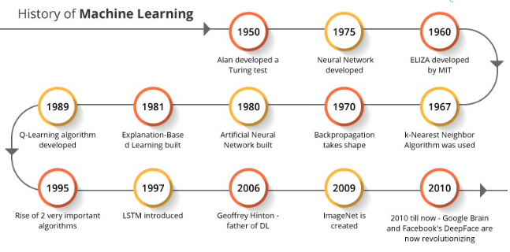
Not new ... But,
Machine Learning is not a monolithic concept but a collection or tools and techniques which have their own separate origins throughout the past 70 years or more.

Slide 6
Let’s try…
(from Introduction of Machine Learning – MIT Press)
Machine learning is programming computers to optimize a performance criterion using example data or past experience.
We have a model defined up to some parameters, and learning is the execution of a computer program to optimize the parameters of the model using the training data of past experience.
Machine learning uses the theory of statistics in building mathematical models, because the core task is making inference from sample.
The role of computer science is twofold: First, in training, we need efficient algorithms to solve the optimization problem, as well as to store and process the massive amount of data we generally have. Second, once the model is learned, its representation and algorithmic solution for inference needs to be efficient as well.
Hence, there are no “mysterious” machines that learn and act alone, but well-defined statistical models for predictions that are optimized by efficient algorithms and executed by powerful machines, as know as computers.

Slide 7

Statistical Learning by Machines
The task is to build a model that predicts an “unseen” outcome from “seen” data. Learning is the key concept here:
1. Start with an initial model,
2. Test its predictions on unseen data,
3. Get prediction errors,
4. Learn from your mistakes (prediction error),
5. Adjust your model
6. Go back to step 2,
7. Stop when the improvement in the error is minimum
As you can see learning a recursive process. But it’s much faster with machines. This process is called “training”. When the model is “trained” and efficient, we use it to predict unseen outcomes.

Slide 8

Why it’s getting more popular…
With the data explosion in recent decades accompanied by the advent of big data and huge strides made in the sector of performance computing

Slide 9
Big Data?
Analysts predict that by 2025, there will be 17,200 gigabytes of data on every person in the world.
On average, people send about 500 million tweets per day.
The average U.S. customer uses 1.8 gigabytes of data per month on his or her cell phone plan.
Walmart processes one million customer transactions per hour.
Amazon sells 600 items per second.
On average, each person who uses email receives 88 emails per day and send 34. That adds up to more than 200 billion emails each day.
MasterCard processes 74 billion transactions per year.
Commercial airlines make about 5,800 flights per day.

Slide 10
5 V’s
Volume: The sheer amount of data generated and stored. It's not just terabytes but could be petabytes or exabytes of data.
Velocity: The speed at which new data is generated and the pace at which data moves. It includes the rapid ingestion of data from sources like social media or sensors.
Variety: The different types of data, which could be structured, unstructured, or semi-structured. This variety includes everything from text and images to log files and video.
Veracity: The quality and accuracy of the data.
Value: The usefulness of the data in making decisions.

Slide 11
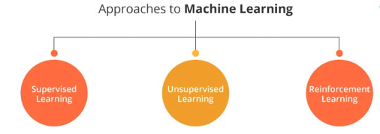
3 Types
Machine Learning algorithm takes labeled data as input and then predicts output for an unlabeled set of data
The algorithm is expected to mine the data and derive patterns and relationships to formulate the context
A type of machine learning where an agent learns to make decisions by performing actions in an environment to achieve some goal.

Slide 12
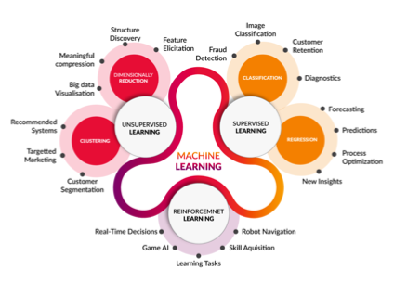

Slide 13
One needs…
R and Python are the main platforms for ML applications
There are multiple “packages” for each ML model in those languages
But high-level data management skills are also needed
Stata 18 is more user-friendly but less customizable
There are hundreds of 2-week online courses but most of them lacks statistical rigor
A university-level (online) course with statistical emphases is the best, but EdX is also the one we recommend for online micro-credits
I also teach Introduction to Applied Machine Learning with R at SSB and Summer Schools at MLPortal
Ready-to-use platforms:
H2O: https://youtu.be/ynrygvcYeFc
Amazon: https://aws.amazon.com/machine-learning/
Google: https://cloud.google.com/products/ai
IBM: https://www.ibm.com/cloud/ai
Look at the list here: https://www.g2.com/products/h2o/competitors/alternatives

Slide 14

Repositories offering services/hosting a variety of machine learning models.
Hugging Face: Specializes in transformers models for NLP tasks and has expanded to include models for other domains as well.
TensorFlow Hub: Hosts a wide range of TensorFlow models, including those for image classification, object detection, NLP, and more.
PyTorch Hub: A similar repository for PyTorch models, offering a collection of pre-trained models for various machine learning tasks.
Model Zoo: Part of various deep learning frameworks, these are collections of pre-trained models. Examples include Caffe Model Zoo, TensorFlow Model Zoo, etc.
Papers with Code: Offers links to code repositories for machine learning papers, often including pre-trained models.
GitHub: Many researchers and developers publish their models and code on GitHub, making it a rich source for machine learning models.
Google AI Hub: Provides a platform to host, share, and use machine learning pipelines and models.
AWS Marketplace for Machine Learning: Offers a variety of machine learning models and algorithms optimized for AWS.
ONNX Model Zoo: Hosts pre-trained models in the ONNX (Open Neural Network Exchange) format, which is a format for machine learning models that is framework agnostic.
DeepAI: Offers a variety of APIs and pre-trained models for different AI tasks.
Kaggle

Slide 15

How ML “models” are different than others?
Models must be “trainable” and flexible in searching the feature space for having self-learning capabilities
A trainable model includes “hyperparameter(s)”.
For example, an ordinary OLS estimation of $y_{i}=β_{1}x_{i1}+β_{2}x_{i2}+⋯+β_{p}x_{ip}+ε_{i}$ finds the parameters by minimizing $RSS=∑_{i=1}^{n} {\left(y_{i}−f\left(x_{i}\right)\right)}^{2}$ and not trainable.
But a RIDGE estimation of the same function using $L_{\text{ridge} }(\overset{ˆ}{β})=∑_{i=1}^{n} {\left(y_{i}−f\left(x_{i}\right)\right)}^{2}+λ∑_{i−1}^{m} {\overset{ˆ}{β}}_{i}^{2}$ trainable due to $λ$, called as ”tuning” or “hyperparameter”

Slide 16
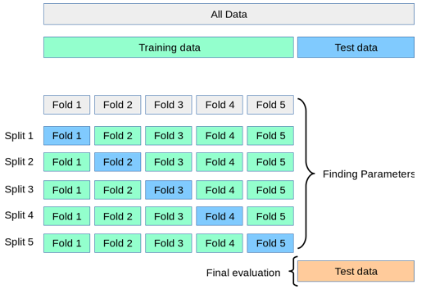
Typical training: cross-validation

Slide 17
Why training is important: Overfitting
Problem: if we find a model that “fits” Sample 1 very well – that is, although it’s unbiased and predicts Y’s in the sample very well - that model would be too specific for the sample and may not be generalizable for other data (like Sample2) not in the sample
Population: {Y;X’}
Sample 1
Sample 2
Objective: find a predictive model/algorithm
using the sample that predict unobserved Y’s in the population

Slide 18
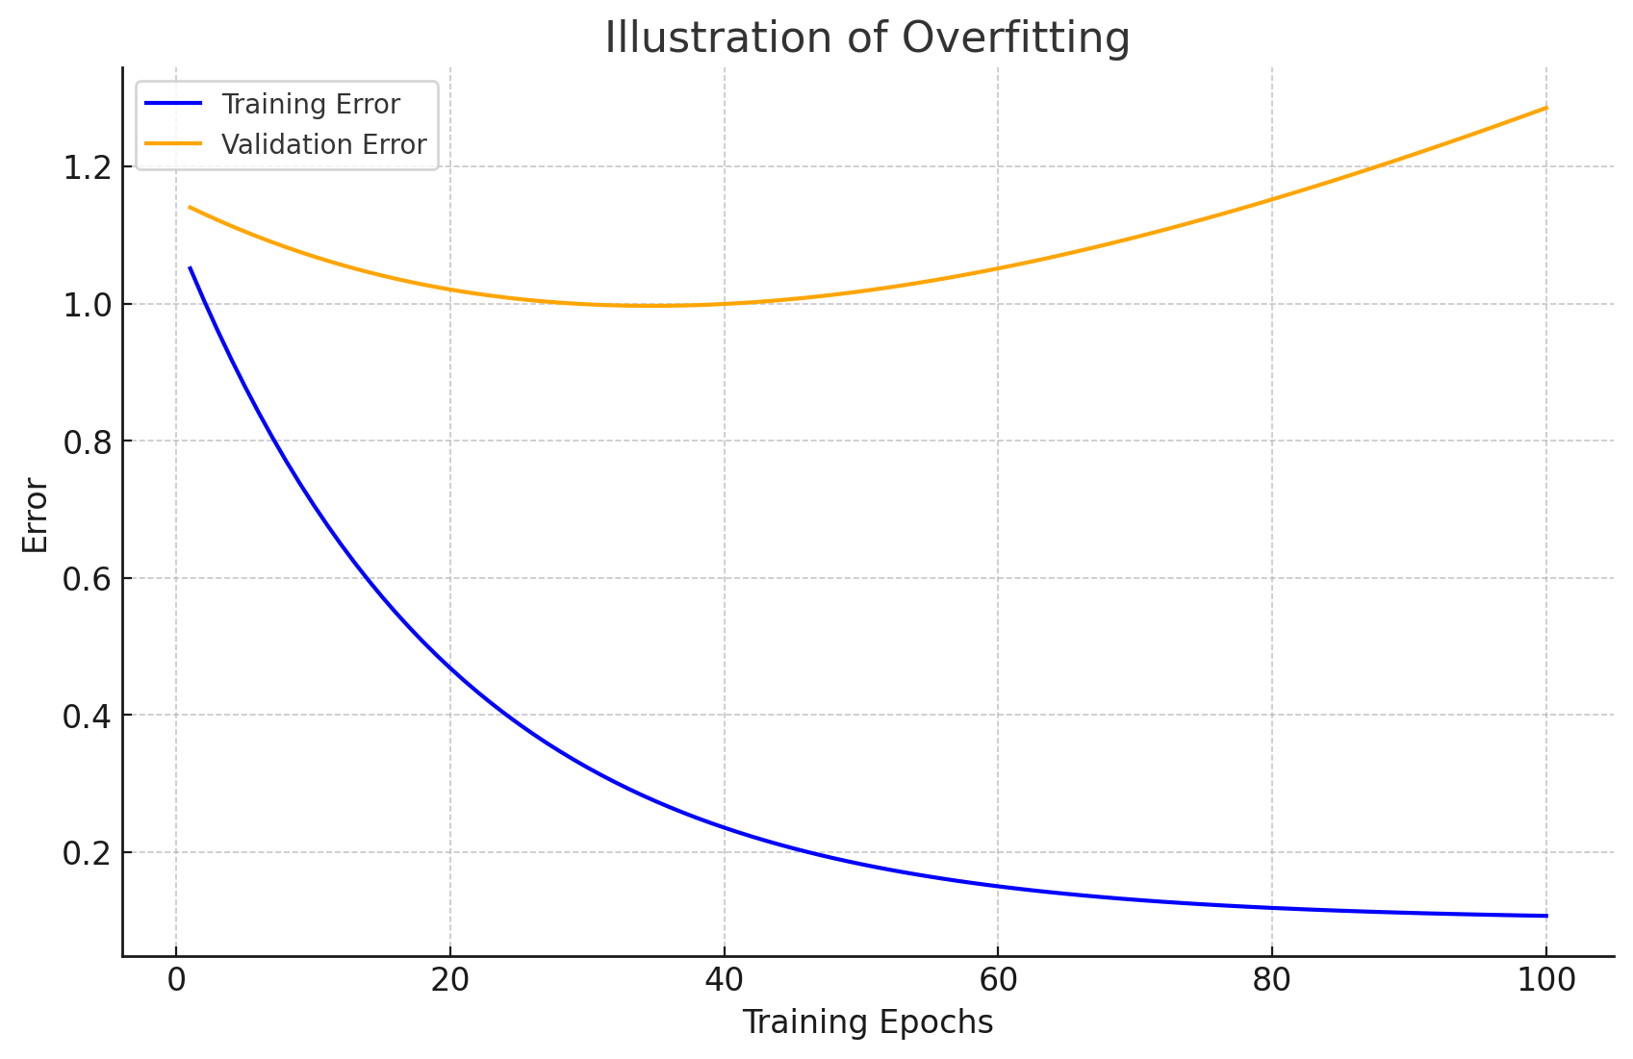
Overfitting
The number of epochs is the number of times the algorithm works through the complete training dataset.
We need multiple passes through the entire data because updating the weights with gradient descent in a single pass (one epoch) is not enough.
But, when the number of epochs goes up, the algorithm updates the weights more.
As a result, the curve goes from underfitting (very few runs) to overfitting (too many runs).

Slide 19
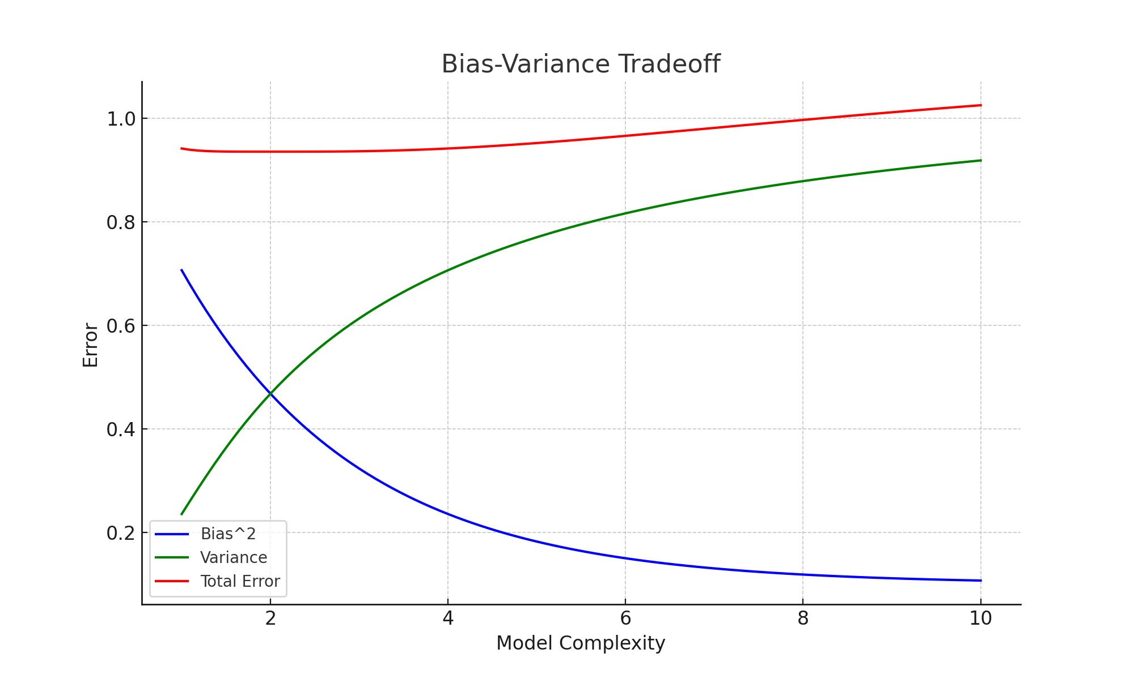
Overfitting is related to Bias – Variance Tradeoff

Slide 20
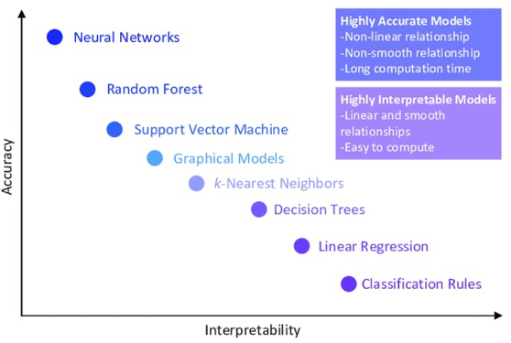
Interpretability vs. Accuracy

Slide 21
Black Box
Interpretable Machine Learning refers to methods and models that make the predictions understandable. What are the main predictors, their importance and effect?
Interpretation of a predictor is DIFFERENT than an explanatory variable .
The ice cream sales - crime rate example
Interpretation of an unbiased estimator or causal-treatment coefficient is VERY DIFFERENT than predictive coefficient if you have one (in a parametric ML model like lasso)!

Slide 22
ML in Business
1. Customer Lifetime Value Modeling: to identify, understand, and retain the company's most valuable customers, whether that means the biggest spenders, the most loyal advocates of your brand, or both.
2. Churn Modeling: help you identify which of your customers are likely to stop engaging with your business and why. The results of a churn model can range from churn risk scores for individual customers to drivers of churn ranked by importance.
3. Dynamic Pricing: Dynamic pricing, also known as demand pricing, is the practice of flexibly pricing items based on factors like the level of interest of the target customer, demand at the time of purchase, or whether the customer has engaged with a marketing campaign.

Slide 23
Recommendation Engines
Imagine you're browsing an online store, and you see a section titled "Customers who bought this also bought..." or "Recommended for you." That's a recommendation engine at work!
In fact, Netflix values the recommendation engine powering its content suggestions at $1 billion per year and Amazon says its system drives a 20-35% lift in sales annually.
That’s because recommendation engines sift through large quantities of data to predict how likely any given customer is to purchase an item or enjoy a piece of content and then suggest those things to the user.
Examples of Recommendation Engines in Action:
  E-commerce: Amazon, eBay (product recommendations)
  Streaming services: Netflix, Spotify (movies, music)
  Social media: Facebook, Instagram (friends, content)
  News websites: Suggesting articles based on reading history

Slide 24
ML in Scientific Research
Use of new unconventional data
Better data management
New variables (like, text mining – Image reading)
Missing data recovery
Better proxy with new predicted variables
Dimension reduction
Model selection
Non-parametric estimations for functional form detection
Better classification
Forecasting
All of them are more relevant when the data is large
n << p

Slide 25
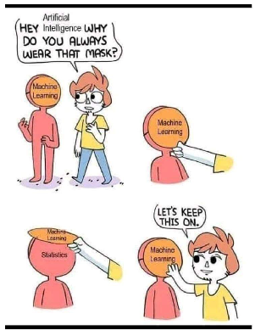
Different Language
Features
To train an algorithm, tuning a model
Training set, test set, validation set
Labels
Regression problem
Classification
Bias-Variance Trade-off
Overfitting

Slide 26
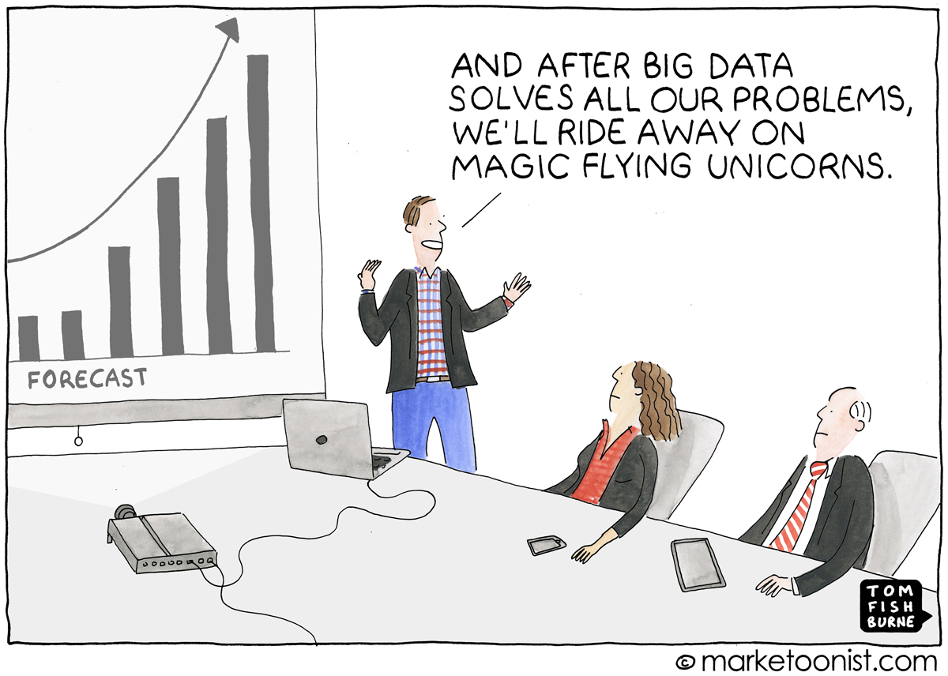
Is Machine Learning Always Better?

