Slide 1
Introduction to NLP and Large Language Models (LLMs)
Understanding the Basics and Their Relevance in Social Sciences
Dr. Yigit Aydede (GitHub)
August 28, 2024

Slide 2

Agenda
The basic concepts of NLP and LLMs, their history, and their significance.
Presentation on the evolution of NLP.
Overview of LLMs like GPT-3, BERT, Mistral, Llama and their mechanisms.
LM Studio, Hugging Face
Discussion on the relevance of NLP in social sciences.
The goal of this session is to provide an introductory understanding of how NLP works, what LLMs are, and why they’re becoming so significant, particularly in the field of social sciences.

Slide 3
What is Natural Language Processing (NLP)?
NLP is a field of AI focused on the interaction between computers and human languages.
Its purpose is to extract meaningful insights from text data and enabling machines to understand and generate human language.
For those in social sciences, understanding and utilizing these tools can significantly enhance research methodologies by analyzing text data at scale—whether it’s survey responses, social media data, or policy documents.

Slide 4

Discussion on the relevance of NLP/LLM in social sciences
1. Content Analysis and Textual Data:
Example: LLMs can analyze large volumes of textual data like social media posts, news articles, or historical documents. This helps identify trends, sentiment, and discourse patterns related to social issues.
Reference: "Can Large Language Models Transform Computational Social Science?" (MIT Press Direct) - This paper discusses how LLMs can enhance content analysis in social science research, providing prompts and evaluation pipelines.
2. Qualitative Data Analysis:
Example: LLMs can aid in coding and categorizing qualitative data like interview transcripts or open-ended survey responses, saving researchers time and improving consistency.
Reference: "Introduction to Large Language Models (LLMs) in Social Sciences" (ACSPRI) - This workshop offers practical experience on using LLMs for qualitative data analysis, including theme extraction and sentiment analysis.
3. Survey Design and Response Generation:
Example: LLMs can generate diverse survey questions and potential response options, aiding in questionnaire development and ensuring a wider range of perspectives.
Reference: "Automated Social Science: Language Models as Scientist and Subjects" (NBER) - This paper explores using LLMs to generate hypotheses and test them in simulated social environments, relevant to survey design.
4. Agent-Based Modeling and Simulations:
Example: LLMs can simulate social interactions and behaviors by creating virtual agents that interact based on pre-defined rules. This allows for the exploration of social dynamics and potential outcomes.
Reference: "Social-network Simulation System with Large Language Model-Empowered Agents" - This research uses LLM-based agents to simulate social networks, providing insights into social phenomena.
5. Literature Review and Knowledge Synthesis:
Example: LLMs can summarize vast amounts of research literature, identify relevant studies, and extract key findings, speeding up the literature review process.
Reference: "LLMs in Social Science" (Data Skeptic podcast) - This episode discusses the potential of LLMs in social science, including their use in literature review and synthesis.

Slide 5
Evolution of NLP
Early NLP systems relied heavily on rule-based and symbolic methods. (e.g., ALPAC, 1966).These systems struggled with ambiguity, context, and scalability. (Riverbank – is it a financial institution?)
Shift from Rules to Statistics (1990): Introduction of probabilistic models and statistical methods: Hidden Markov Models (HMMs), N-grams for language modeling, Statistical machine translation (e.g., IBM Model).
Machine Learning in NLP (2000s): Applying algorithms like Support Vector Machines (SVMs) and decision trees to NLP tasks. Named entity recognition (NER). Required significant feature engineering and struggled with capturing deeper semantic meaning.

Slide 6

Evolution of NLP
The Deep Learning Revolution (2010s): It’s the era of Neural Networks - shifting from feature engineering to deep representations. Key Architectures:
Recurrent Neural Networks (RNNs): Used for sequence data.
Long Short-Term Memory (LSTM) Networks: Overcame limitations of traditional RNNs.
Convolutional Neural Networks (CNNs) for text classification.
Enabled models to capture complex patterns, context, and deeper semantic relationships in text.

Slide 7

Evolution of NLP
The Transformer Era (2017 - Present)
Game-Changing Paper: "Attention is All You Need" (Vaswani et al., 2017).
Introduction of the Transformer Model:
Key Concepts: Attention mechanisms, self-attention, positional encoding.
Impact: Ability to handle long-range dependencies, parallelization, and scalability.
Popular Models: BERT (Bidirectional Encoder Representations from Transformers): Pre-training and fine-tuning paradigm.
GPT-3: Massive-scale generative models.
Mistral, Llama, and others.
Applications: Chatbots, text generation, translation, and more.

Slide 8
The Future of NLP
Beyond Transformers: Exploring models like mixture-of-experts, retrieval-augmented generation.
Multimodal Learning: Combining NLP with vision and other modalities.
Ethical Considerations: Bias, fairness, and transparency in NLP systems.
Open Research Areas: Few-shot learning, interpretability, and efficiency.

Slide 9
Overview of LLMs like GPT-3, BERT, Mistral, Llama and their mechanisms
GPT-3 (Generative Pre-trained Transformer 3): Developed by OpenAI. Auto-regressive language model based on the Transformer architecture.
Trained on 175 billion parameters.
BERT (Bidirectional Encoder Representations from Transformers): Developed by Google. Transformer-based model using bidirectional context (reads text in both directions) for pre-training.
Trained on 340 million parameters.
Pre-training involves tasks like Masked Language Modeling (MLM) and Next Sentence Prediction (NSP).
Mistral: A more recent model developed as an alternative LLM. A startup based in France, founded by a group of former researchers and engineers from companies like Meta (Facebook) and Google DeepMind. Built on efficient Transformer variants aimed at reducing computational overhead.
Designed for faster and more efficient inference while maintaining performance.
Focuses on balancing performance and resource requirements.
Llama (Large Language Model Meta AI): Developed by Meta (formerly Facebook). Uses a transformer architecture with optimizations for both training efficiency and scalability. LLaMA (LLaMA 2 and beyond) Offers models with fewer parameters than GPT-3 but achieves competitive performance through optimization.

Slide 10
Metric | Description | Purpose / Task | Examples
Contextual Coherence | Measures how consistent and contextually relevant the generated text is across longer conversations. | Conversational models, dialogue systems | GPT-3, LLaMA
Prompt Sensitivity | Evaluates the sensitivity of the model's output to slight variations in input prompts. | Prompt-based generation, instruction-following | GPT-3, LLaMA, Mistral
Calibration Error | Assesses how well the model‚Äôs confidence scores reflect the true likelihood of correct predictions. | Ensuring reliability and interpretability | GPT-3, BERT
Win Rate | In A/B testing, measures the percentage of cases where human evaluators prefer one model over another. | Comparative evaluations between different LLMs | GPT-3 vs. GPT-4, Mistral vs. LLaMA
Toxicity Score | Quantifies the degree of harmful, biased, or toxic content generated by the model. | Safety and ethical evaluation | GPT-3, Mistral, BERT
Faithfulness | Measures how factually correct and grounded in reality the generated content is. | Summarization, information retrieval | GEMINI, BERT, GPT-3
Human Evaluation | Direct human assessment of the model‚Äôs outputs for qualities like fluency, accuracy, and relevance. | Comprehensive quality checks | All LLMs
Self-BLEU | Measures the diversity of generated text across multiple outputs from the same input. | Evaluating overfitting and repetitiveness | GPT-3, LLaMA
Perplexity (Per Sentence) | A refined version of perplexity focused on evaluating sentence-level coherence. | Sentence generation, language modeling | GPT-3, LLaMA
Memory Efficiency | Tracks the computational and memory resources required during inference and training. | Model deployment and scaling | Mistral, GEMINI
Hallucination Rate | Measures the frequency with which the model generates incorrect or fabricated information. | Fact-based text generation, summarization | GPT-3, GEMINI, Mistral
Latency and Inference Speed | Evaluates how quickly the model generates outputs. | Real-time applications, deployment scenarios | Mistral, LLaMA, GEMINI

Slide 11
Open Source or Not?
Open-Source LLMs:
The primary goal of open-source LLMs is to make advanced AI technologies accessible to everyone, fostering collaboration, innovation, and transparency.
LLaMA (Meta): Released by Meta as an open-source model, LLaMA provides accessible, high-performing models without the constraints of proprietary systems. Researchers and developers can fine-tune it for various tasks.
Hugging Face’s Transformers Library: Offers open-source versions of models like BERT, GPT-2, and T5, allowing easy access and implementation for research and development.
Mistral: An efficient open-source LLM focusing on delivering high performance while remaining accessible to the community.
Profit-Based LLMs:
Profit-driven models are typically developed by companies aiming to commercialize AI by providing premium services, subscription models, and enterprise solutions.
GPT-4o (OpenAI): The model itself is primarily available through paid API access.
Claude (Anthropic): A profit-oriented LLM designed with safety and enterprise applications in mind, offering premium tiers for API access.
PaLM (Google): Google’s proprietary LLM used for various commercial products, including Google Cloud AI services and integrated features across Google’s ecosystem. Later it became GEMINI

Slide 12

Hugging Face is a pivotal player in the world of NLP and LLMs. Hugging Face is now best known for its Transformers library and model repository, which host thousands of pre-trained models.
Transformers Library: This is the most popular library for NLP, providing easy access to a wide range of pre-trained models like GPT-3, BERT, T5, and more. The library supports multiple frameworks like PyTorch, TensorFlow, and JAX.
Model Hub: Hugging Face hosts an extensive repository of pre-trained models, including transformers, vision models, and even reinforcement learning agents. Developers can find models tailored to specific tasks like sentiment analysis, text summarization, translation, and question answering.
Datasets Library: Hugging Face offers a growing library of datasets, which are pre-processed and ready to use for tasks such as training, fine-tuning, and evaluation. This feature allows researchers to share and access datasets easily.
Spaces: Hugging Face Spaces are cloud-hosted platforms where you can deploy applications, demos, and machine learning models using Streamlit, Gradio, or static websites. It’s a great way to showcase your models or projects in an interactive format.
Inference API: This API allows you to integrate Hugging Face models into your applications with ease. It provides out-of-the-box inference for models hosted on Hugging Face’s platform.

Slide 13
An example Visit the Hugging Face Model Hub (https://huggingface.co/models) to explore and choose from thousands of pre-trained models.
from transformers import pipeline
summarizer = pipeline("summarization")
result = summarizer("Your long text here", max_length=50, min_length=25, do_sample=False) print(result)
Here is summary of the steps for installing all the necessary libraries for PyTorch and related operations on an M1 Mac using Conda.
Install Miniforge (recommended for M1 Macs):
brew install miniforge
2. Create a new Conda environment:
conda create -n pytorch_env python=3.9
3. Activate the environment:
conda activate pytorch_env
4. Install PyTorch and related libraries:
conda install pytorch torchvision torchaudio -c pytorch-nightly
5. This installs the latest nightly build of PyTorch optimized for M1 Macs. Install transformers and other necessary libraries:
pip install transformers numpy pandas matplotlib scikit-learn
6. Verify the installation: python
import torch
print(f"PyTorch version: {torch.__version__}")
print(f"MPS (Metal Performance Shaders) available: {torch.backends.mps.is_available()}")
Optional: Install Jupyter if you want to use notebooks:
conda install jupyter

Slide 14
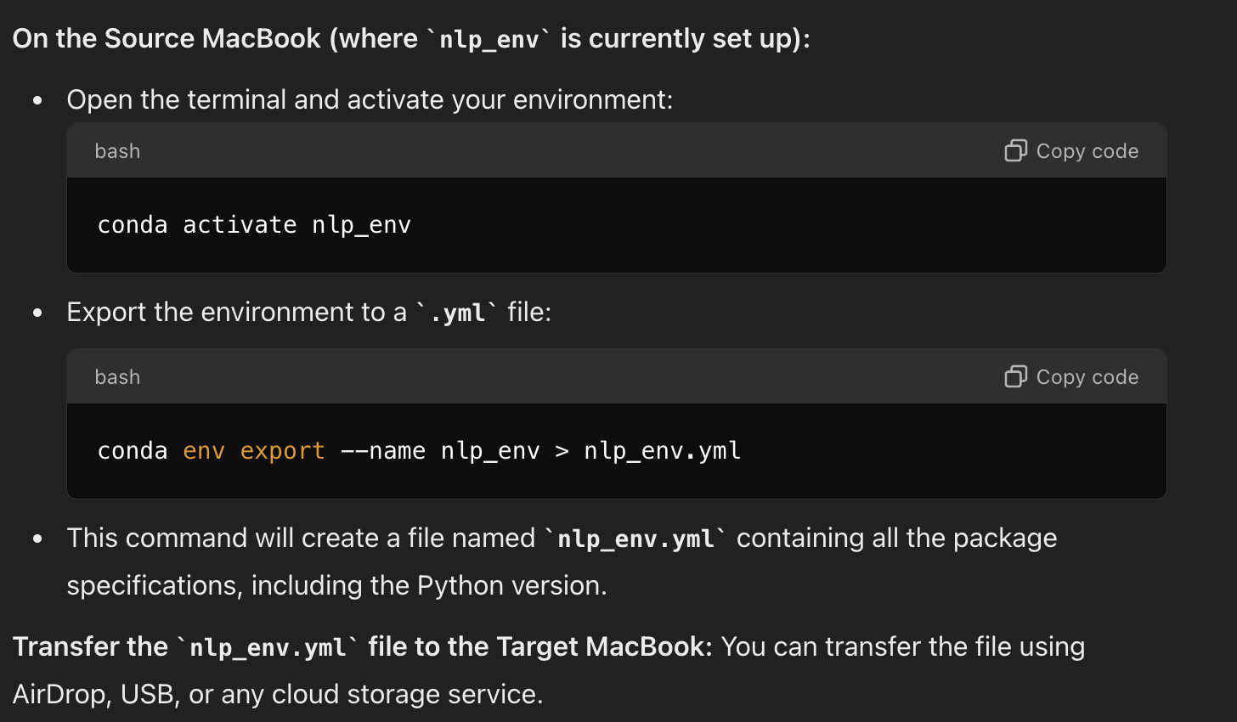
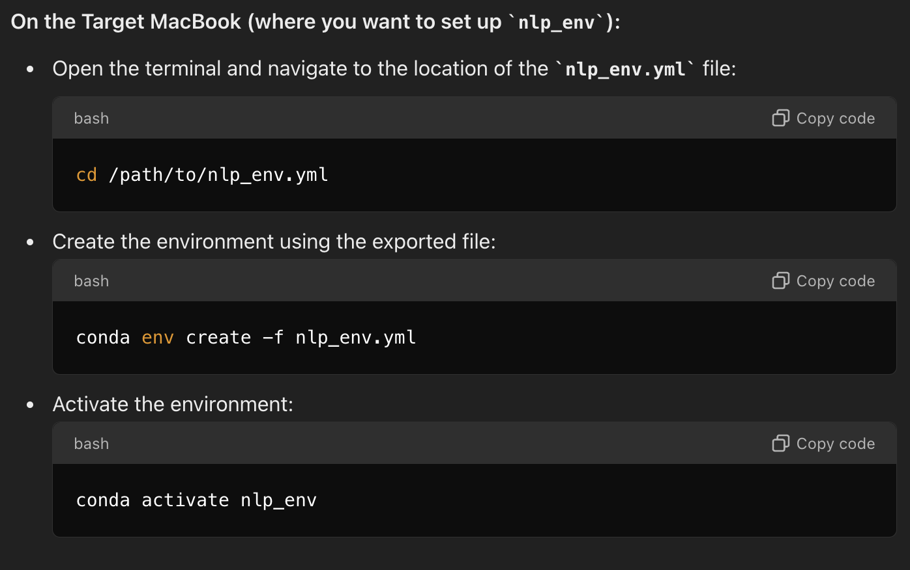
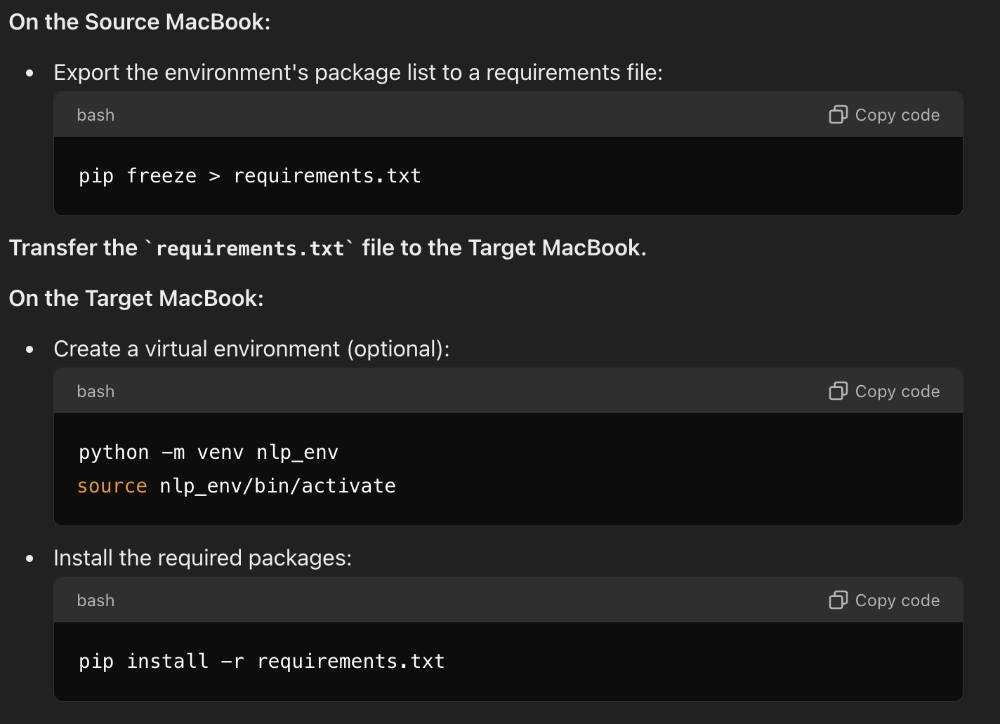
Or import `huggingface_env.yml`

Slide 15

What we did in terms of Hugging Face’s transformers library
1. What is Hugging Face's transformers Library?
Hugging Face’s transformers library is an open-source Python package that provides pre-trained models for tasks like summarization, text generation, translation, and more. These models are based on transformer architectures like BERT, GPT, T5, and more.
The library makes it easy to load these models, fine-tune them on specific tasks, and deploy them in real-world applications.
2. The Pipeline API:
Hugging Face provides the pipeline API, which abstracts away much of the complexity. A pipeline handles everything from tokenizing input text, processing it through a pre-trained model, and returning the results in a user-friendly format.
In our code, the following line sets up a summarization pipeline:
from transformers import pipeline
summarizer = pipeline("summarization")
Task (summarization): This specifies that you want to perform summarization. Hugging Face uses this to select an appropriate pre-trained model.
Default Model: When you don’t specify a model, the pipeline automatically loads a default model for summarization, which in this case is sshleifer/distilbart-cnn-12-6.

Slide 16
What we did in terms of Hugging Face’s transformers library
3. How the Model Works:
The pipeline uses the default model sshleifer/distilbart-cnn-12-6, a lightweight variant of BART (Bidirectional and Auto-Regressive Transformers), designed for summarizing large texts like news articles.
Here’s what happens internally:
Text Tokenization: Your input text is broken down into tokens (individual words or subwords).
Model Processing: The tokens are passed through the pre-trained transformer model, which predicts the summary.
Decoding: The output tokens are decoded back into readable text.
Post-Processing: The output is formatted as a summary according to the constraints you set (like max_length=50).
4. Best Practices for Using Pipelines:
Model Specification: You can specify the exact model you want by passing the model parameter to the pipeline:
summarizer = pipeline("summarization", model="facebook/bart-large-cnn")
Fine-Tuning: If the default models don’t fit your needs, you can fine-tune a model on your specific dataset.
Framework Specification: If you know which framework you want to use (PyTorch or TensorFlow), you can explicitly specify it with framework="pt" (for PyTorch) or framework="tf" (for TensorFlow).

Slide 17
What all these mean? - https://huggingface.co/models
Natural Language Processing (NLP) Tasks:
Text Classification: Sentiment analysis, intent detection, topic classification.
Text Generation: GPT models for generating human-like text (e.g., GPT-2, GPT-3, LLaMA).
Question Answering: Models that can answer questions given a passage of text (e.g., BERT, RoBERTa).
Named Entity Recognition (NER): Extracting entities like names, dates, and locations from text.
Summarization: Condensing long texts into shorter summaries.
Translation: Converting text from one language to another.
Text-to-Speech (TTS): Converting written text into spoken words.
Sentence Similarity: Measuring the semantic similarity between sentences.
Computer Vision Tasks:
Image Classification: Classifying images into predefined categories (e.g., ResNet, ViT).
Object Detection: Detecting objects within images and drawing bounding boxes (e.g., DETR, YOLO).
Image Segmentation: Segmenting images into different regions or objects (e.g., Mask R-CNN).
Image Generation: Generating new images based on input (e.g., DALL-E, Stable Diffusion).
Image-to-Text: Generating captions or descriptions for images.
Audio Processing Tasks:
Speech Recognition: Converting speech to text (e.g., wav2vec 2.0, Whisper).
Audio Classification: Classifying audio clips into different categories.
Speaker Identification: Identifying or verifying speakers from audio.
Speech Synthesis (Text-to-Speech): Generating spoken audio from text.
Audio-to-Audio Translation: Converting one type of audio to another (e.g., accent conversion).
4. Multimodal Tasks:
Image-to-Text Generation: Generating text descriptions from images (e.g., CLIP).
Text-to-Image Generation: Generating images from text prompts (e.g., Stable Diffusion, DALL-E).
Visual Question Answering: Answering questions based on visual input.
5. Tabular Data Tasks:
Tabular Data Analysis: Handling structured data like CSV files for classification, regression, and more.
6. Reinforcement Learning Tasks:
Policy Learning: Training agents to perform tasks in environments (e.g., OpenAI Gym environments).
7. Time Series and Forecasting:
Time Series Prediction: Predicting future values in time-series data.
Anomaly Detection: Detecting outliers or unusual patterns in time-series data.
8. Specialized AI Domains:
Biomedical NLP: Models specialized for healthcare and life sciences (e.g., BioBERT, ClinicalBERT).
Legal NLP: Models tailored for legal document analysis.
Finance NLP: Models for financial forecasting, sentiment analysis of market news, etc.
Creative AI: Poetry generation, creative writing, and artistic style generation.

Slide 18

LM Studio is an application designed to simplify the deployment and interaction with large language models (LLMs) on local machines. It's geared toward users who want to work with powerful LLMs without needing to rely on cloud-based services like OpenAI's GPT-4 or Google's PaLM.
This can be particularly useful for:
Privacy-conscious users who prefer not to send data to external servers.
Researchers and developers who want full control over model behavior and customization.
Enterprises that need to run models locally for compliance or security reasons.
Key Features of LM Studio:
Local Inference
Pre-trained Model Library: The studio often comes with access to a library of pre-trained models (e.g., GPT, LLaMA, Mistral) that you can download and run locally.
Model Customization and Fine-Tuning: You can customize existing models by training them further on your own datasets to specialize them for your specific needs.
User-Friendly Interface
Compatibility with Different Models: While Hugging Face’s transformers library supports many models, LM Studio is designed to be compatible with a wide range of LLM architectures.

