Slide 1
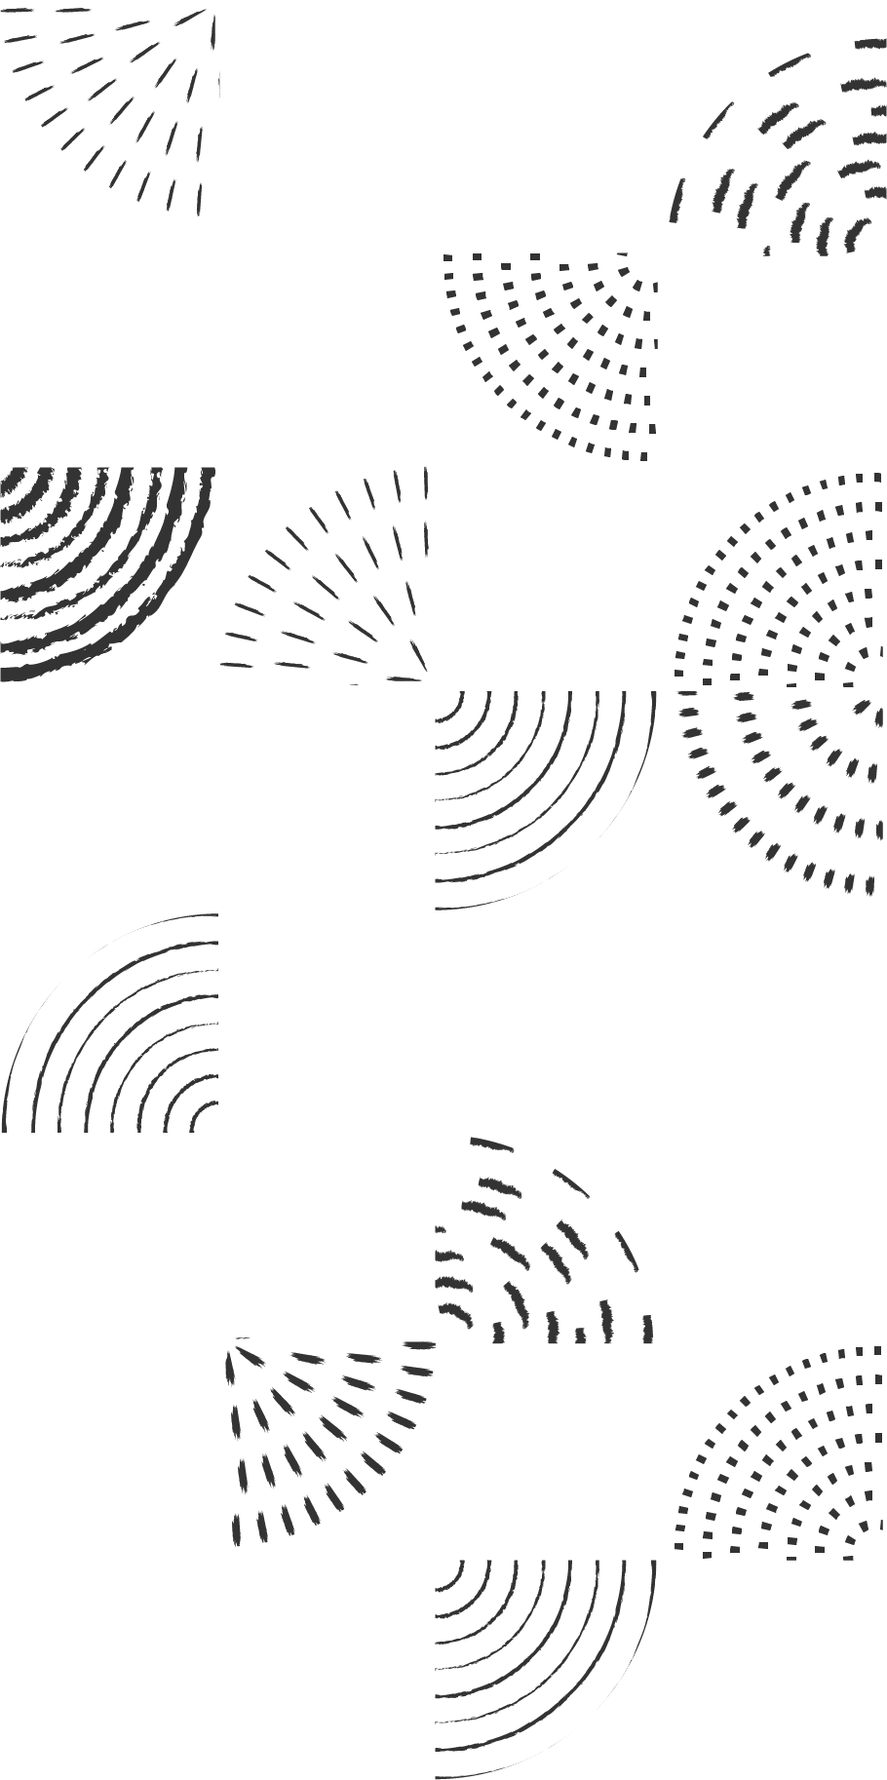
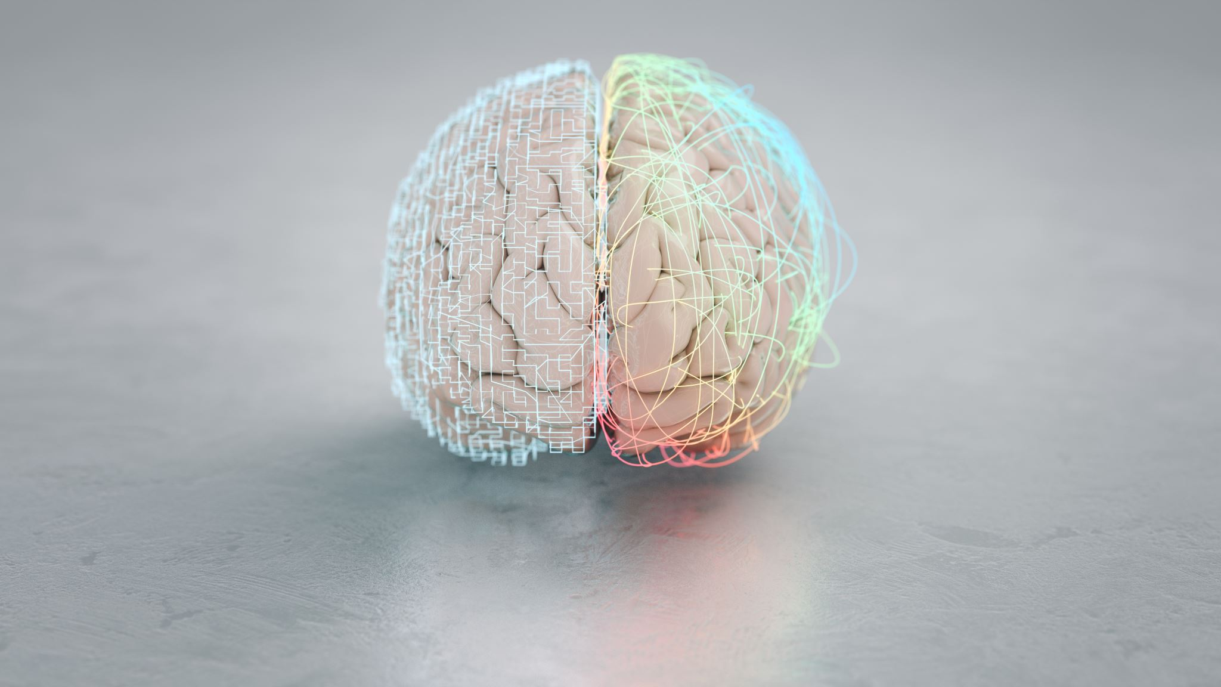
Artificial Neural Network
Basics

Slide 2
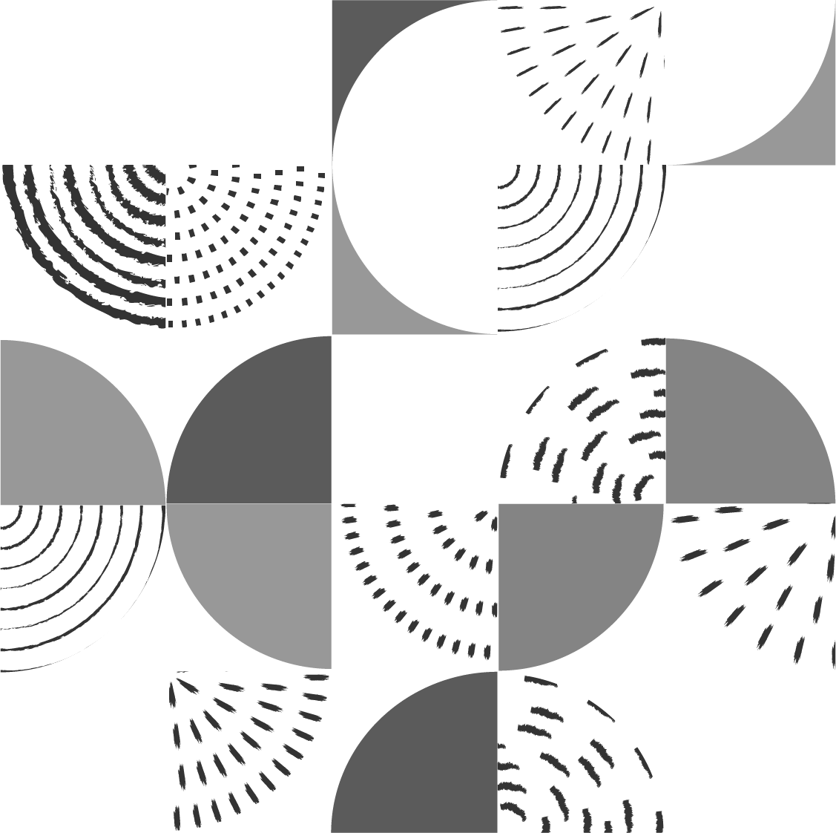
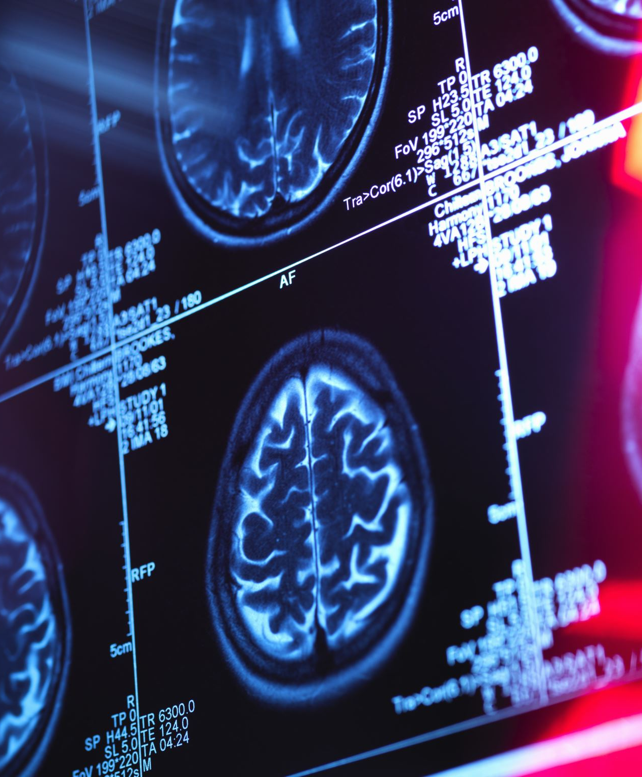
ANN are computational models inspired by the structure and function of biological neurons in the brain.

Slide 3
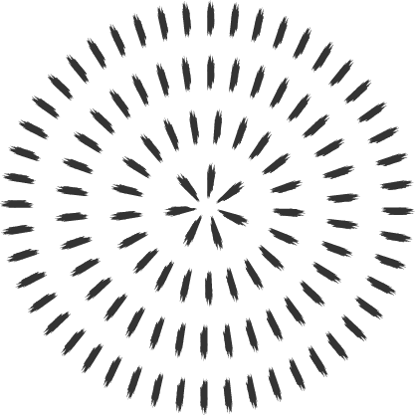
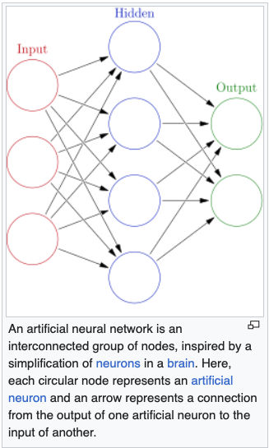
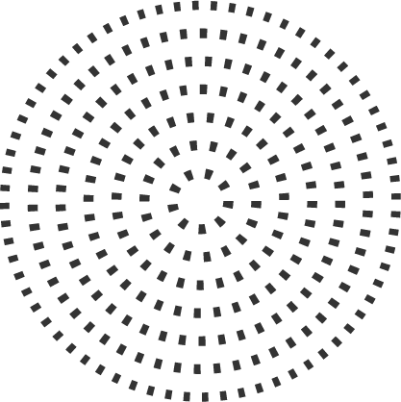
Similarities
Structure: ANN is composed of layers of artificial neurons, inspired by the organization of biological neurons in the brain. Each layer may consist of numerous artificial neurons, just as the brain contains billions of interconnected biological neurons.
Connection and Communication: In ANN, artificial neurons connect to others through weighted connections, like how biological neurons connect through synapses. The strength of these connections represents the weights in ANN, while in the brain, it represents the efficacy of the synapses.
Learning: Both biological neurons and ANN learn from experience. In the brain, learning occurs through changes in synaptic strength, following a process called synaptic plasticity. In ANN, learning is achieved through adjusting the weights of the connections using algorithms like backpropagation.

Slide 4


Starting point
Let’s start with a predictive model with a single input (covariate). The simplest model could be a linear model:
Since this model could be a quite restrictive, we can have a more flexible one by a polynomial regression:
The polynomial regression is based on fixed components, or bases:

Slide 5
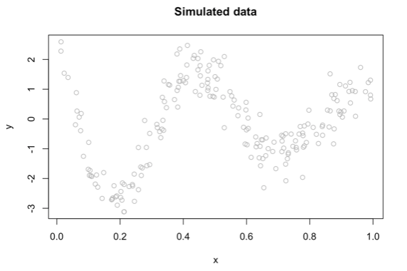
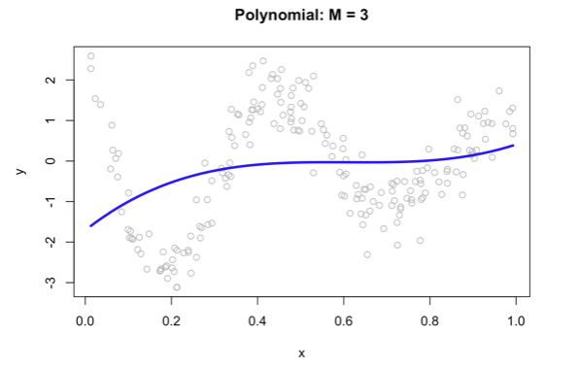
Simulated data
We can fit a polynomial regression with M=3.

Slide 6

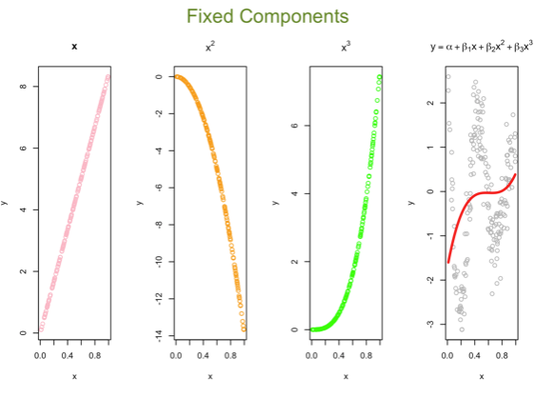
Polynomial Fitting
Now, we can think of the line as weighted sum of fixed components:

Slide 7


Parametric embedding
The artificial neural net replaces these fixed components with adjustable ones or bases

Slide 8
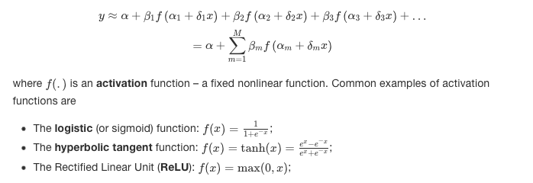
Activation function

Slide 9
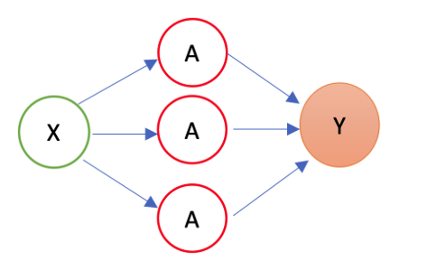
A simple one-input ANN
The first layer is the source layer (with X). The second layer is called as hidden layer with three “neurons” each of which has an activation function (A). The last layer is the “sink” or output layer.

Slide 10

ANN for our simulated data

Slide 11
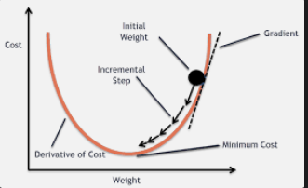
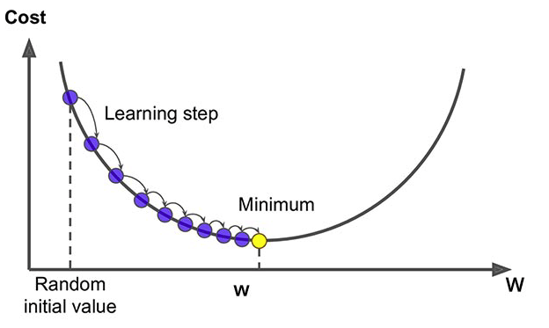
Backpropagation (Chain Rule)
The get the best ANN, we need to find the set of parameters that minimize the cost function.
Analytical solutions are not efficient
We use algorithmic approach: Gradient Descent (GD)
ANN uses more efficient GD: Stochastic Gradient Descent (SGD)

Slide 12
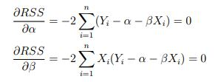

Gradient Descent on OLS
Cost function
Gradients (F.O.C)
Iterations until it converges

Slide 13
Is GD efficient?
Say we have 10,000 data points and 10 features.
The sum of squared residuals consists of as many terms as there are data points, so 10000 terms in our case.
We need to compute the derivative of this function with respect to each of the features, so in effect we will be doing 10000 * 10 = 100,000 computations per iteration.
It is common to take 1000 iterations, in effect we have 100,000 * 1000 = 100000000 computations to complete the algorithm.
That is pretty much an overhead and hence gradient descent is slow on huge data.

Slide 14

Learning rate?
Yes, the main question is how do we find out what the learning rate should be?
A general suggestion is to keep it small and tune it within the training process.
Obviously, we can have an adaptive learning rate that changes at each iteration depending on the change in the MSE.

Slide 15

Adjustable Learning Rate
There are various learning rate scheduler strategies:
Exponential decay: The learning rate is multiplied by a fixed decay rate at each iteration or epoch, as demonstrated in the previous example.
Step decay: The learning rate is reduced by a fixed factor at specific intervals, such as every N epochs. For example, the learning rate could be reduced by a factor of 0.5 every 10 epochs.
Time-based decay: The learning rate is reduced according to a function of the elapsed training time or the number of iterations. For example, the learning rate could be reduced by a factor proportional to the inverse of the square root of the number of iterations.
Cosine annealing: The learning rate is reduced following a cosine function, which allows for periodic “restarts” of the learning rate, helping the optimization process escape local minima or saddle points.
Cyclic learning rates: The learning rate is varied cyclically within a predefined range, allowing the model to explore different areas of the loss surface more effectively.
Adaptive learning rates: These learning rate schedulers adjust the learning rate based on the progress of the optimization process, such as the improvement in the loss function or the validation accuracy. Some well-known adaptive learning rate methods include AdaGrad, RMSprop, and Adam.

Slide 16
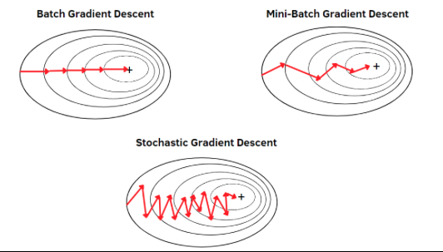
Efficient GD Algorithms for ANN
There are three main types of gradient descent:
Batch Gradient Descent: In batch gradient descent, the gradient is computed using the entire dataset. This means that we calculate the average gradient for all the samples in the dataset and then update the model parameters accordingly. This can be computationally expensive for large datasets but usually provides stable convergence.
Stochastic Gradient Descent (SGD): In SGD, the gradient is computed using a single data point or sample, randomly picked from the dataset. This leads to faster computation times but noisier updates, which can sometimes result in a less stable convergence.
Mini-batch Gradient Descent: This is a compromise between batch gradient descent and SGD. The gradient is computed using a small subset or batch of the dataset, typically containing 10 to 1000 samples. This provides a balance between computational efficiency and convergence stability.

Slide 17
ANN with different dimensions
Multi-input
Multi-hidden layer
Multi-output

Slide 18
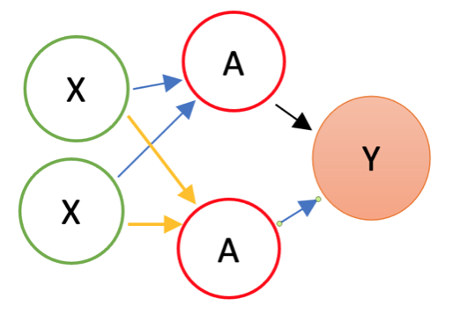
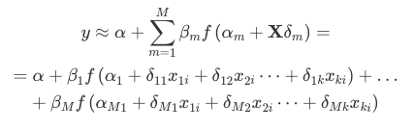
Multi-input ANN

Slide 19
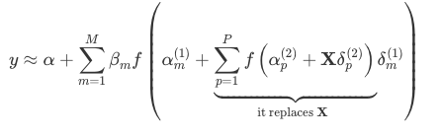
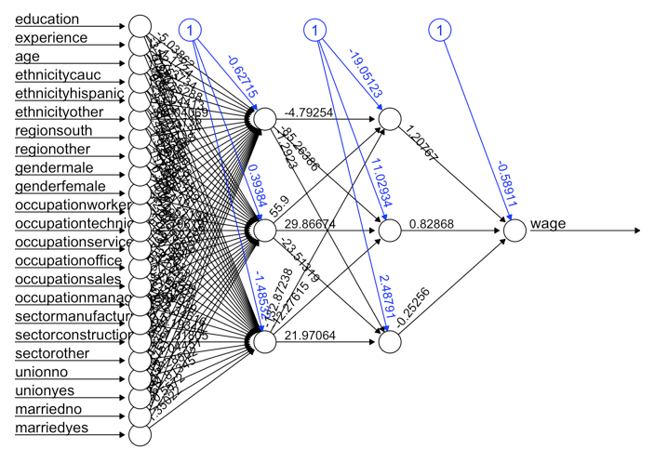
Deep Learning – Multi-layer ANN

Slide 20
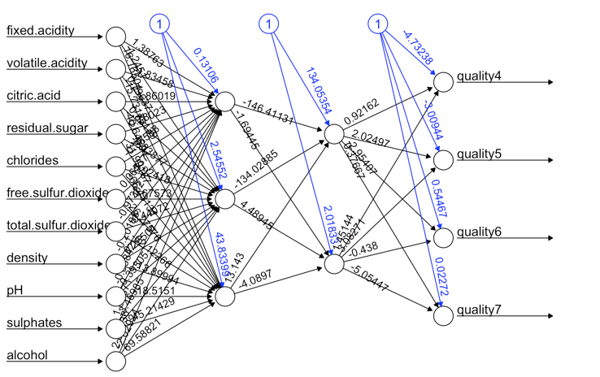
Multi-output ANN

Slide 21

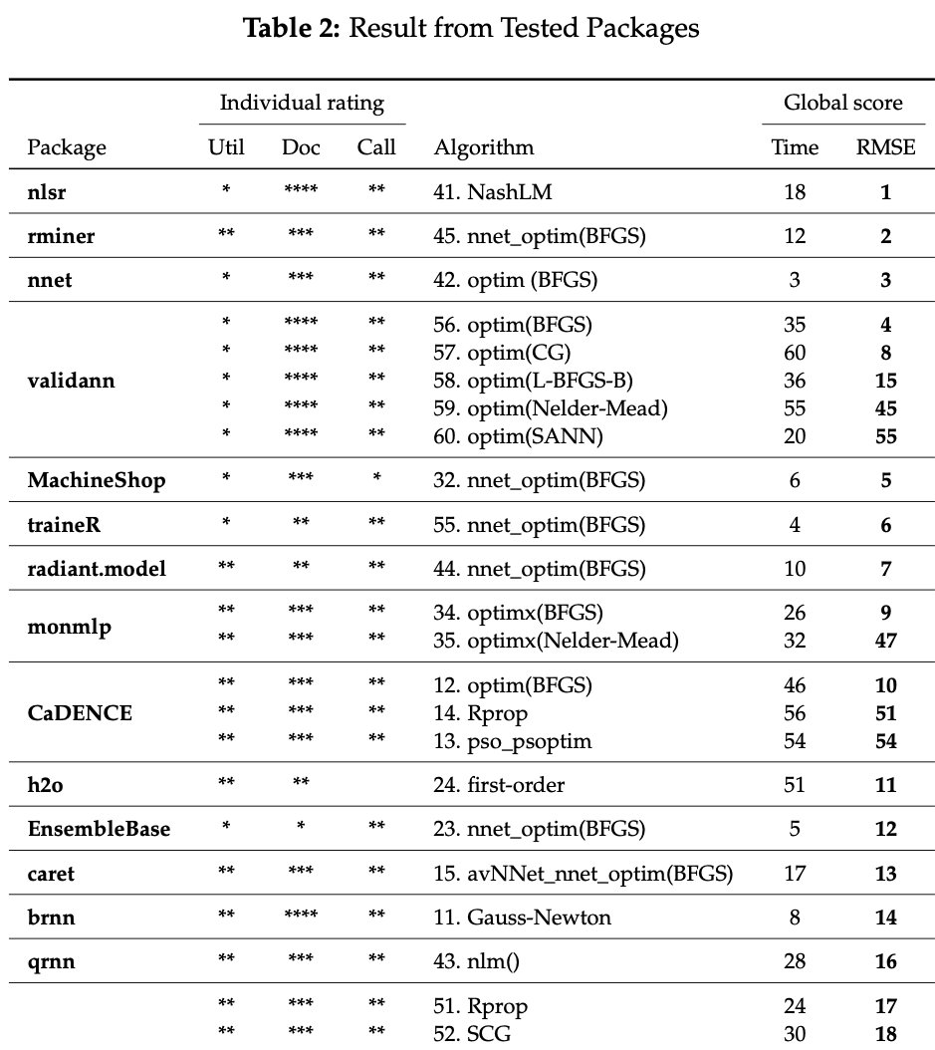
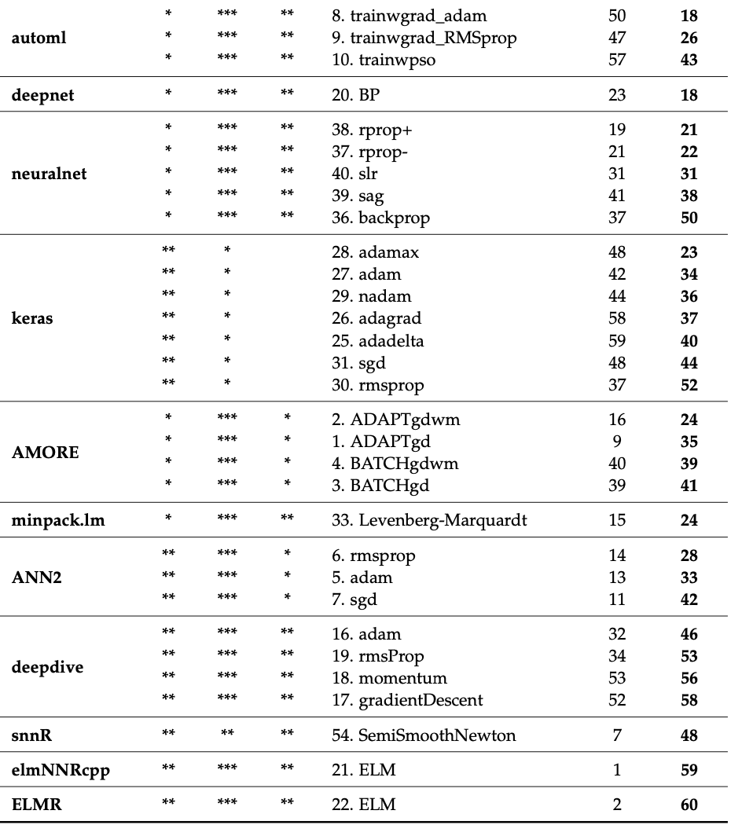
Packages
A Review of R Neural Network Packages (with NNbenchmark): Accuracy and Ease
of Use

Slide 22


KERAS & PyTorch
PyTorch is Developed by Facebook's AI Research lab (FAIR).
PyTorch uses dynamic computation graphs (also known as define-by-run paradigm), which means the graph is built on the fly as operations are executed. This feature provides a more intuitive approach for dynamic models and iterative processes, making debugging easier and more interactive.
It seamlessly integrates with the Python data science stack (e.g., NumPy, SciPy) and supports native Python debugging tools. Its API and model definitions are very Pythonic, so it feels more like writing standard Python code.
PyTorch provides strong support for CUDA and cuDNN, allowing efficient and easy GPU computation. Initially favored more by researchers due to its flexibility and dynamic graph feature, which is ideal for experimental projects and rapid prototyping.
KERAS is managed by Google.
Since TensorFlow 2.0, Keras has been integrated more deeply into TensorFlow as tf.keras.
It focuses on being user-friendly, modular, and extensible. It provides high-level building blocks for developing deep learning models with a few lines of code, making it accessible for beginners.
TensorFlow (and thereby Keras, when used with TensorFlow as the backend) primarily uses static computation graphs, meaning the model's structure is defined and compiled before it's run. This approach can lead to faster execution and easier deployment of models but might be less intuitive for dynamic model adjustments.
Due to its simplicity and TensorFlow's strong support, Keras has seen wide adoption in the industry for developing and deploying production models.

Slide 23
Keras & TensorFlow
TensorFlow is an end-to-end, open-source machine learning platform. You can think of it as an infrastructure layer for differentiable programming. It combines four key abilities:
Efficiently executing low-level tensor operations on CPU, GPU, or TPU.
Computing the gradient of arbitrary differentiable expressions.
Scaling computation to many devices, such as clusters of hundreds of GPUs.
Exporting programs ("graphs") to external runtimes such as servers, browsers, mobile and embedded devices.
Keras is the high-level API of the TensorFlow platform: an approachable, highly-productive interface for solving machine learning problems, with a focus on modern deep learning.
Keras empowers engineers and researchers to take full advantage of the scalability and cross-platform capabilities of the TensorFlow platform: you can run Keras on TPU or on large clusters of GPUs, and you can export your Keras models to run in the browser or on a mobile device.

