Slide 1
Key Concepts in Natural Language Processing (NLP)
Text Preprocessing, Vectorization Techniques, and Word Embeddings
Dr. Aydede – August 28, 2024
NLP & LLM Workshop

Slide 2
The session’s agenda:
Text Preprocessing: Tokenization, Stemming, Lemmatization
Vectorization Techniques: Bag of Words, TF-IDF
Introduction to Word Embeddings: word2vec, GloVe
Hands-on Session using NLTK and Gensim

Slide 3
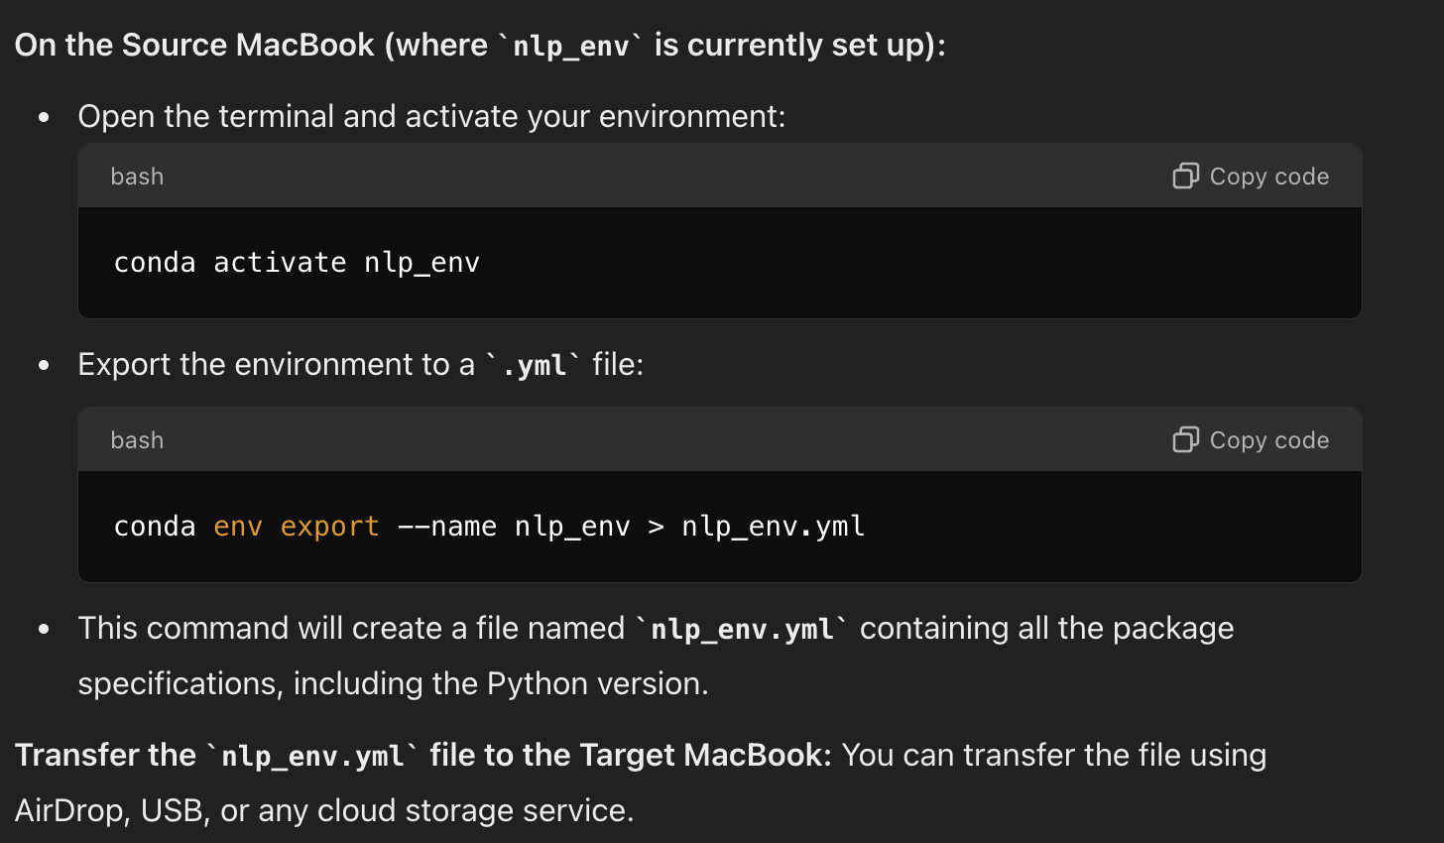
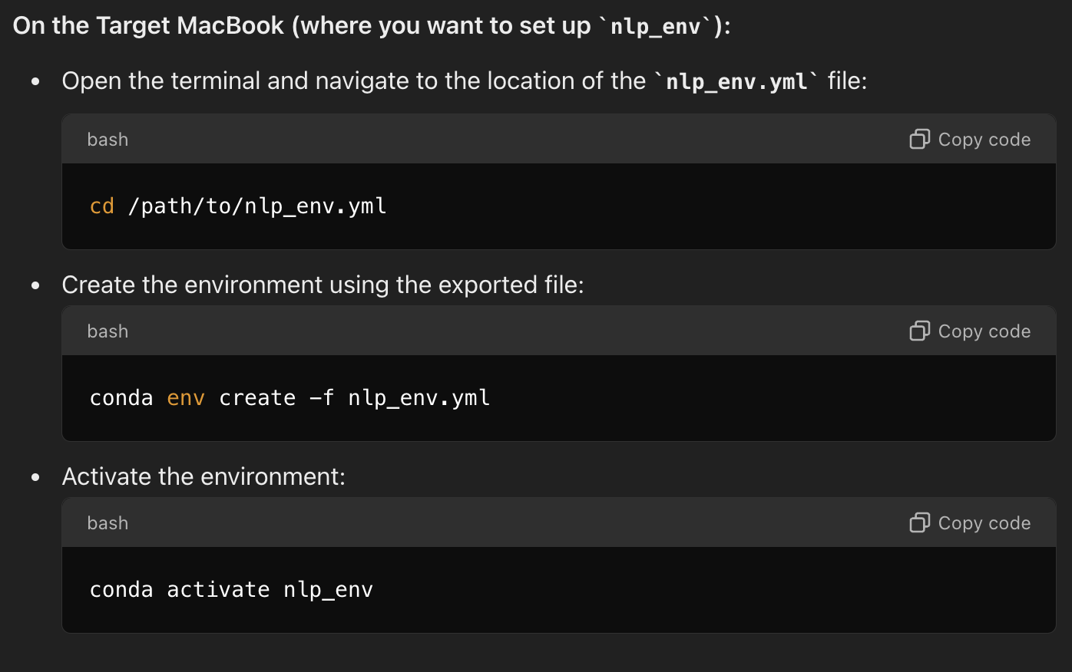
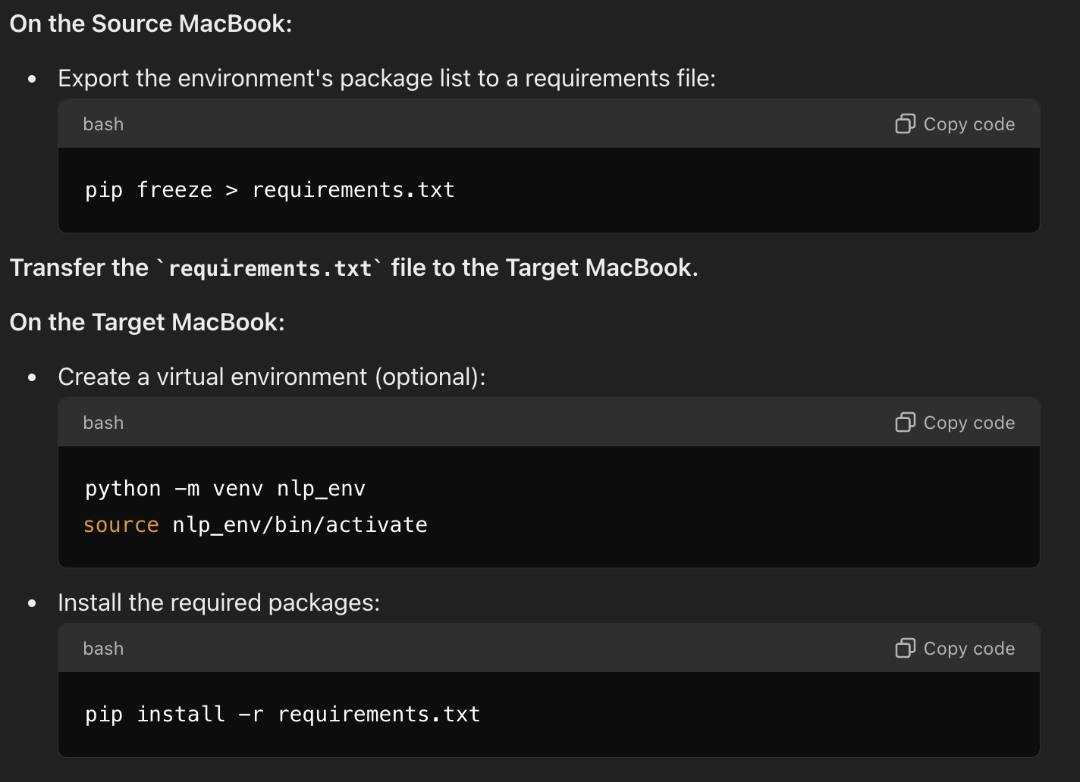
Follow me on NLP_v1.ipynb – Remember☺

Slide 4
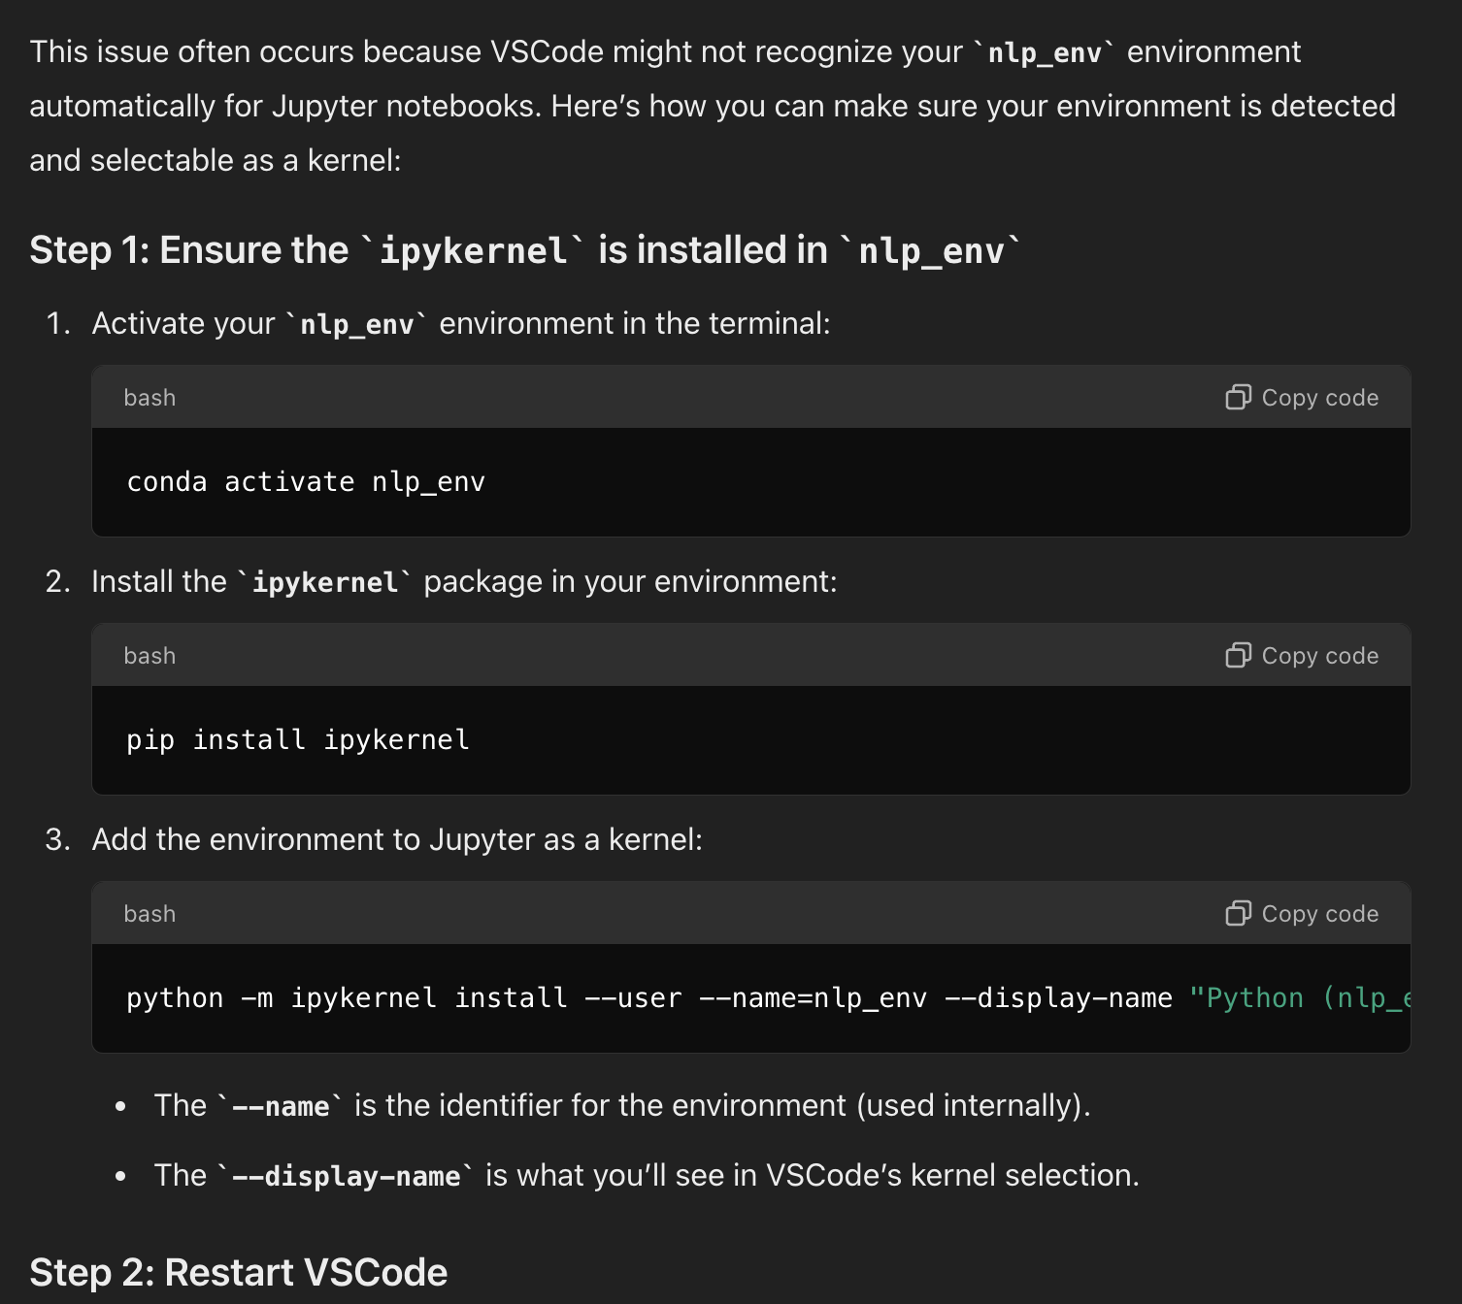
If you cannot see it on your VSCode

Slide 5

Think on it
You have a text
We need to read the text and predict what it is saying …
Models used in NLP and LLM are statistical methods and accept numbers not text
How do we convert text to numbers?
That’s the preprocessing concept

Slide 6
Text Preprocessing in NLP
The process of cleaning and transforming raw text into a format that models can work with.
Improves model accuracy and performance.
Key Techniques:
Tokenization: Breaking text into words, sentences, or smaller units.
Stemming: Reducing words to their root forms (e.g., "running" → "run").
Lemmatization: Converting words to their base forms using context (e.g., "better" → "good").

Slide 7
Tokenization in NLP and LLM
Tokenization in NLP
In traditional NLP tasks like text classification, sentiment analysis, and word embeddings (like Word2Vec), tokenization primarily focuses on breaking text into meaningful units—words, subwords, or even characters—that can be processed further.
Word-Level Tokenization: The text is split into individual words based on spaces and punctuation. For example:
Input: “I love NLP.”
Tokens: [“I”, “love”, “NLP”]
Subword-Level Tokenization: To handle out-of-vocabulary words (words that aren’t in the model’s vocabulary), NLP models may use subword tokenization like Byte Pair Encoding (BPE) or WordPiece. This method splits uncommon or unknown words into smaller, more frequent components.
Input: “unhappiness”
Tokens: [“un”, “happiness”]
Character-Level Tokenization: In some cases, especially with highly inflected languages, models tokenize at the character level.
Input: “cat”
Tokens: [“c”, “a”, “t”]
Vectorization for NLP: After tokenization, these tokens are often converted into numerical vectors for processing by models like Word2Vec, GloVe, or FastText. The goal is to capture semantic relationships between words (e.g., similar words have similar vectors).

Slide 8
NLP vs. LLM Objectives
NLP Objectives: In traditional NLP tasks, tokenization breaks text into components (words, subwords) which are then converted into numerical vectors. These vectors capture the meaning or context of the words. The goal is not necessarily to predict the next word but to create word representations that can be used for various tasks like classification, translation, sentiment analysis, etc.
Word2Vec uses sequential information to learn word embeddings (by considering nearby words), the output is a fixed vector for each word. This vector can then be used for various NLP tasks like clustering, sentiment analysis, etc. Once the vector is learned, it no longer depends on the sequence of tokens—it’s more about the word’s overall context in the dataset.
LLM Objectives: In large language models, the primary goal is often sequence prediction—predicting the next token based on the previous sequence. The sequential order of tokens is crucial because LLMs rely on this order to model language patterns and generate coherent text.
Tokenization and Sequential Order: LLM tokenization splits text into subwords or tokens that are then mapped to integers. The sequence of these tokens is preserved and directly affects the model’s predictions. The model uses the sequential information to predict the next token, which is critical for tasks like text generation, translation, and conversation.

Slide 9
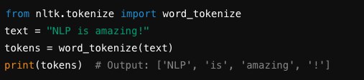
Tokenization
Converting a sentence into a list of words.
Types of Tokenization:
Word Tokenization: Splitting text into individual words.
Sentence Tokenization: Splitting text into sentences.
Python Libraries: NLTK, spaCy, Hugging Face Tokenizers

Slide 10
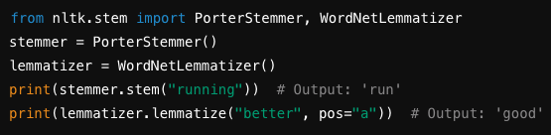
Stemming & Lemmatization
Stemming
Reduces words to their base or root form.
Example: "playing", "played" → "play”
Common algorithms: Porter, Snowball
Lemmatization
Considers context and grammar.
Example: "better" → "good”
Requires a dictionary or vocabulary.

Slide 11
Vectorization Techniques
Converting text into numerical data (vectors) for machine learning models.
Bag of Words (BoW): Represents text by word counts or occurrences.
TF-IDF (Term Frequency-Inverse Document Frequency): Weighs words based on frequency and importance.
When using more advanced techniques like word2vec, GloVe, or other word embedding methods, you generally don’t need to use traditional vectorization methods like Bag of Words (BoW) or TF-IDF.

Slide 12
When Should You Use BoW/TF-IDF?
While word embeddings are generally more powerful, BoW and TF-IDF are still useful in some scenarios, especially when:
You need a simple, interpretable model (e.g., a quick baseline).
You have a small dataset, where training word embeddings may be unnecessary.
The task is simple and does not require capturing complex word relationships.
Spam Email Classification: In spam detection, the mere presence of certain keywords (e.g., “free”, “win”, “money”, “urgent”) is often a strong indicator of spam. You don’t necessarily need complex word relationships or context to make a good prediction.

Slide 13
Why Word2Vec Replaces BoW/TF-IDF
Contextual Representation:
BoW and TF-IDF treat each word independently and ignore the context or order of words in a sentence. These methods create sparse vectors (with many zeros) and do not capture semantic relationships between words.
Dimensionality Reduction:
BoW and TF-IDF can create high-dimensional vectors (one dimension per unique word), leading to inefficiencies, especially with large vocabularies.
Word2Vec reduces the dimensionality by mapping words to a fixed-size, lower-dimensional vector space, typically 50 to 300 dimensions, while still retaining useful information.
Word2Vec captures relationships between words, such as analogies (e.g., “king - man + woman = queen”), which are not possible with BoW or TF-IDF.

Slide 14
from sklearn.feature_extraction.text import CountVectorizer
from sklearn.model_selection import train_test_split
from sklearn.naive_bayes import MultinomialNB
from sklearn.metrics import accuracy_score
# Example dataset
emails = [
"Win money now", "Get a free gift card", "Urgent! Your account is compromised",
"Meeting at 10 AM", "Lunch tomorrow?", "Can we reschedule the call?",
"Congratulations! You won a lottery", "Earn cash easily"
]
labels = [1, 1, 1, 0, 0, 0, 1, 1] # 1 = spam, 0 = not spam
# Convert text to BoW representation
vectorizer = CountVectorizer()
X = vectorizer.fit_transform(emails)
# Train a simple classifier
X_train, X_test, y_train, y_test = train_test_split(X, labels, test_size=0.3, random_state=42)
model = MultinomialNB()
model.fit(X_train, y_train)
# Predict and evaluate
y_pred = model.predict(X_test)
print("Accuracy:", accuracy_score(y_test, y_pred))

Slide 15
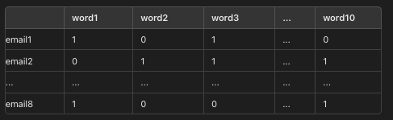
Example BoW Matrix Structure
Each row represents an email.
Each column represents a unique word.
Each cell contains the count of that word in the email.

Slide 16
Introduction to Word Embeddings
Dense vectors representing words in continuous vector space.
Captures semantic meaning and context.
Popular Models:
word2vec: Predicts surrounding words in a context.
GloVe (Global Vectors for Word Representation): Uses co-occurrence statistics.

Slide 17
Generating Word Embeddings with Python
word2vec Example (Gensim):
>>>
>>> from gensim.models import Word2Vec
>>> sentences = [["NLP", "is", "amazing"], ["NLP", "is", "fun"]]
>>> model = Word2Vec(sentences, vector_size=50, window=2, min_count=1)
>>> print(model.wv["NLP"]) # Output: Vector representation of 'NLP'
[-0.01631583 0.0089916 -0.00827415 0.00164907 0.01699724 -0.00892435
0.009035 -0.01357392 -0.00709698 0.01879702 -0.00315531 0.00064274
-0.00828126 -0.01536538 -0.00301602 0.00493959 -0.00177605 0.01106732
-0.00548595 0.00452013 0.01091159 0.01669191 -0.00290748 -0.01841629
0.0087411 0.00114357 0.01488382 -0.00162657 -0.00527683 -0.01750602
-0.00171311 0.00565313 0.01080286 0.01410531 -0.01140624 0.00371764
0.01217773 -0.0095961 -0.00621452 0.01359526 0.00326295 0.00037983
0.00694727 0.00043555 0.01923765 0.01012121 -0.01783478 -0.01408312
0.00180291 0.01278507]
How do we get these numbers and what do they mean?

Slide 18
Word2Vec - Details
Word2Vec (Google), GloVe (Stanford), and FastText (Facebook) are different in their approaches to generating word embeddings, though they share the common goal of representing words as vectors in a continuous vector space.
Word2Vec is a popular technique for generating word embeddings, which are dense vector representations of words in a continuous vector space.
There are two main approaches within Word2Vec:
Continuous Bag of Words (CBOW)
Skip-gram.

Slide 19
CBoW
CBoW predicts the current word based on the context words surrounding it. It uses a sliding window of fixed size to capture the context around the target word. The model learns to predict the target word given the context words.
How CBOW works:
Context Window: Select a context window size (e.g., 2 words on either side of the target word).
Context Words: For a given target word, identify the words within the context window.
Prediction: Use the context words as input to predict the target word.
Learning: The neural network adjusts its weights to minimize the prediction error.
Sentence: "The quick brown fox jumps over the lazy dog"
Context window size = 2
Target word = "brown"
Context words = ["The", "quick", "fox", "jumps"]
The CBOW model would take the context words ("The", "quick", "fox", "jumps") as input and try to predict the target word "brown".

Slide 20
CBoW with Word2Vec
Suppose we have 5 sentences each has different numbers of words
The process involves creating context-target pairs for each sentence individually.
General Approach
Tokenization: Each sentence is broken down into individual words.
Vocabulary Creation: A vocabulary of unique words across all sentences is created. Each word is assigned a unique index.
One-Hot Encoding: Each word in the vocabulary is represented as a one-hot encoded vector.
The CBOW model processes each sentence independently, generating context-target pairs based on the chosen context window size. Let's illustrate this with an example

Slide 21
Example
Example Sentences
1. "I love natural language processing."
2. "Word2Vec is a popular algorithm."
3. "CBOW and Skip-gram are two models."
4. "Training word embeddings is important."
5. "Handling different sentence lengths."
First, we tokenize each sentence:
1. ["I", "love", "natural", "language", "processing"]
2. ["Word2Vec", "is", "a", "popular", "algorithm"]
3. ["CBOW", "and", "Skip-gram", "are", "two", "models"]
4. ["Training", "word", "embeddings", "is", "important"]
5. ["Handling", "different", "sentence", "lengths"]

Slide 22
Corpus (Vocabulary)
Then, we create a vocabulary (Assume each word is assigned an index based on its order in the vocabulary):
"I", "love", "natural", "language", "processing", "Word2Vec", "is", "a", "popular", "algorithm", "CBOW", "and", "Skipgram", "are", "two", "models", "Training", "word", "embeddings", "important", "Handling", "different", "sentence", "lengths"

Slide 23
Context-Target Pairs
For each sentence, context-target pairs are generated based on the chosen context window size. Let's assume the context window size is 2.
Sentence 1: "I love natural language processing."
1. Target: "natural" | Context: ["I", "love"]
2. Target: "language" | Context: ["love", "natural"]
3. Target: "processing" | Context: ["natural", "language"]
Sentence 2: "Word2Vec is a popular algorithm."
1. Target: "is" | Context: ["Word2Vec"]
2. Target: "a" | Context: ["Word2Vec", "is"]
3. Target: "popular" | Context: ["is", "a"]
4. Target: "algorithm" | Context: ["a", "popular"]

Slide 24
Understanding the Input Matrix for CBOW
Sentence 1: "I love natural language processing."
Pairs:
1. Target: "natural" | Context: ["I", "love"]
2. Target: "language" | Context: ["love", "natural"]
3. Target: "processing" | Context: ["natural", "language"]
Sentence 2: "Word2Vec is a popular algorithm."
Pairs:
1. Target: "is" | Context: ["Word2Vec"]
2. Target: "a" | Context: ["Word2Vec", "is"]
3. Target: "popular" | Context: ["is", "a"]
4. Target: "algorithm" | Context: ["a", "popular"]

Slide 25
Context Matrix Structure
Assume you have the sentence: "the cat sat on the mat” and your vocabulary consists of 5 words: "the”, "cat”, "sat”, "on”, "mat”
The one-hot encoded vectors for these words are:
"the": [1, 0, 0, 0, 0]
"cat": [0, 1, 0, 0, 0]
"on": [0, 0, 0, 1, 0]
"the": [1, 0, 0, 0, 0]
Summing these vectors, we get the input (context) vector: [2, 1, 0, 1, 0].
In essence, while the summed context vectors deviate from the pure one-hot encoding format, they remain a valuable and informative input representation for the CBOW model. The neural network's learning process adapts to this representation, allowing it to effectively leverage the context information for predicting the target word.

Slide 26
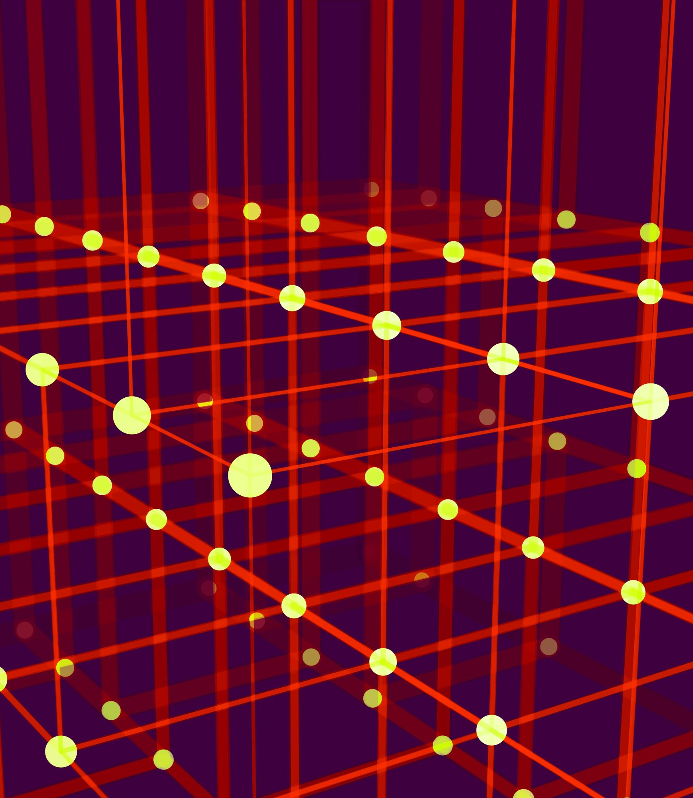
Neural Network used in the CBOW model
The CBOW neural network typically employs a simple feed-forward architecture with the following layers:
Input Layer: This layer receives the summed context vector as input. The number of neurons in this layer is equal to the vocabulary size (V).
Hidden Layer: This layer is a fully connected layer that processes the input from the input layer. The number of neurons in this hidden layer is a hyperparameter (H) that you can choose. A common choice is to have a hidden layer size smaller than the vocabulary size to create a compressed representation.
Output Layer: This is also a fully connected layer with the number of neurons equal to the vocabulary size (V). It produces a probability distribution over all the words in the vocabulary. The word with the highest probability is considered the predicted target word.

Slide 27
Application will be after the break

