Slide 1

Sequential Data

Slide 2
What’s different?
One key difference between time series forecasting and other types of machine learning tasks is the presence of temporal dependencies in the data.
In time series data, the value at a particular time point is often influenced by the values that came before it, which means that the order in which the data points are presented is important.
This can make time series forecasting more challenging, as the model must take into account the relationships between past and future values in order to make accurate predictions.

Slide 3
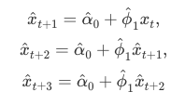
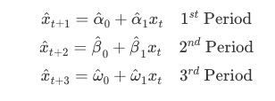
Forecasting
In general, forecasting models use either recursive forecasting:
Recursive forecasting requires a parametric model and would face increasing forecasting error when the underlying model is not linear.
or direct forecasting
Direct forecasting, however, can be achieved by a nonparametric predictive algorithm, while it may have a higher variance as the forecast horizon gets longer.

Slide 4

Embedding for Direct Forecast
For direct forecasting, we need to rearrange the data in a way that we can estimate 7 models for forecasting ahead each day of 7 days;
And we need to decide how many days we go back

Slide 5
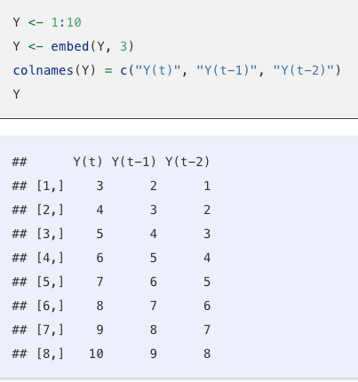
embed()
If the past 2 days are the main predictors of the current value, i.e., AR(2), embedding removes the temporal dependence in the data.
Hence, we can use conventional ML methods, like Random Forest or ANN (not RNN)

Slide 6
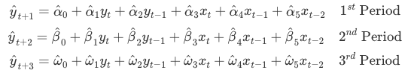
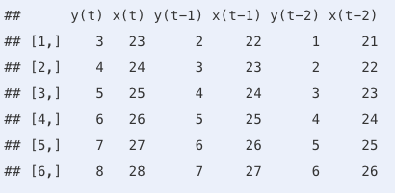
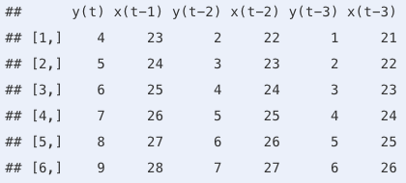
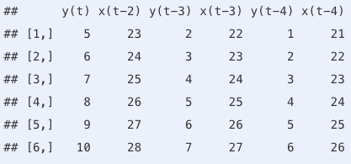
3-day direct forecast
Can we get the 2nd and 3rd data embedding from the 1st?

Slide 7
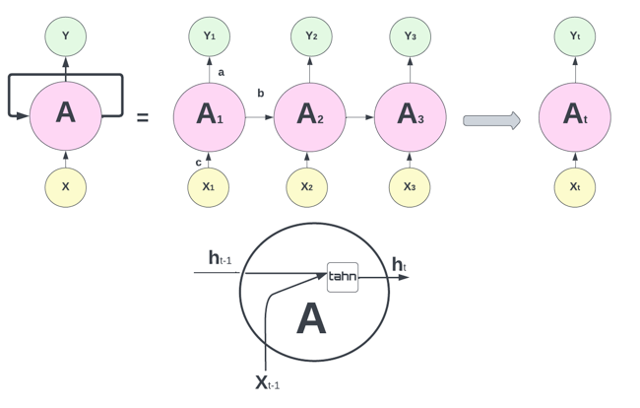
Recurrent Neural Networks (RNN)
RNNs are a type of ANN that are particularly well-suited for processing sequential data
They are called “recurrent” because they perform the same task for every element in a sequence, with the output being dependent on the previous computations.

Slide 8
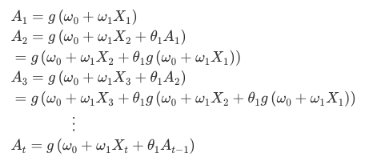

Again … Parametric embedded functions
Note that weights are the same in each sequence. Although each output layer produces a prediction, the final output is the network’s prediction.

Slide 9

Keras & TensorFlow
TensorFlow is an end-to-end, open-source machine learning platform. You can think of it as an infrastructure layer for differentiable programming. It combines four key abilities:
Efficiently executing low-level tensor operations on CPU, GPU, or TPU.
Computing the gradient of arbitrary differentiable expressions.
Scaling computation to many devices, such as clusters of hundreds of GPUs.
Exporting programs ("graphs") to external runtimes such as servers, browsers, mobile and embedded devices.
Keras is the high-level API of the TensorFlow platform: an approachable, highly-productive interface for solving machine learning problems, with a focus on modern deep learning.
Keras empowers engineers and researchers to take full advantage of the scalability and cross-platform capabilities of the TensorFlow platform: you can run Keras on TPU or on large clusters of GPUs, and you can export your Keras models to run in the browser or on a mobile device.

Slide 10
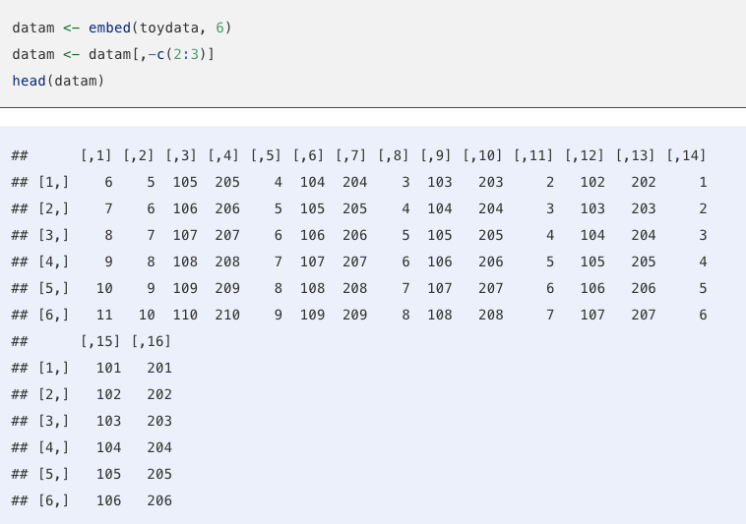
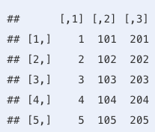
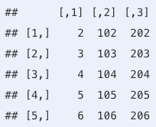
Input Tensors
Suppose that we try to make 1-day-ahead forecasting with daily data. In preparing the input tensor, we need to decide how many earlier days we need to predict the next day’s value. Suppose that we decide on 5 days. As we seen before, we transform the data by embedding to a new structure:
We should have 100 - 5 = 95 samples, in each one we have 3 features and 5 timesteps. The first two samples, each is a matrix of 5×3, are shown below:
We store them in an array (tensor):
samples x timesteps x features

Slide 11
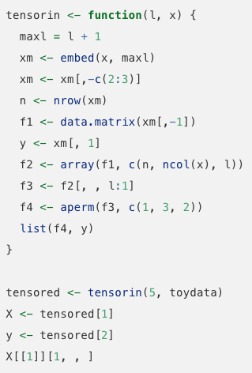
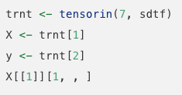
Plain RNN: step1 - Input Tensor
Note that this type of data transformation can be achieved several different ways. We can apply it to our COVID-19 data for 7-day windows:

Slide 12
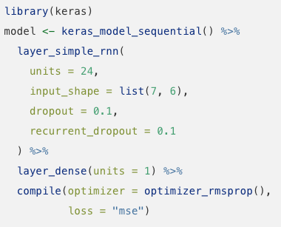
Plain RNN: step2 – Design the network

Slide 13
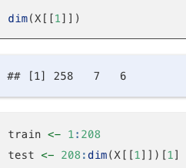
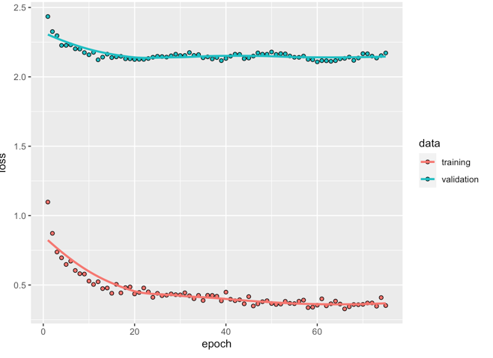
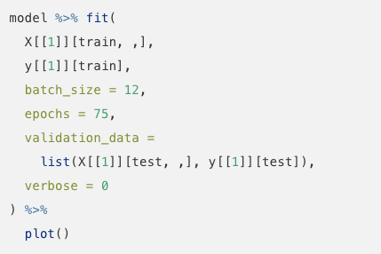
Plain RNN: step3 – Split the data & Fit the model

Slide 14
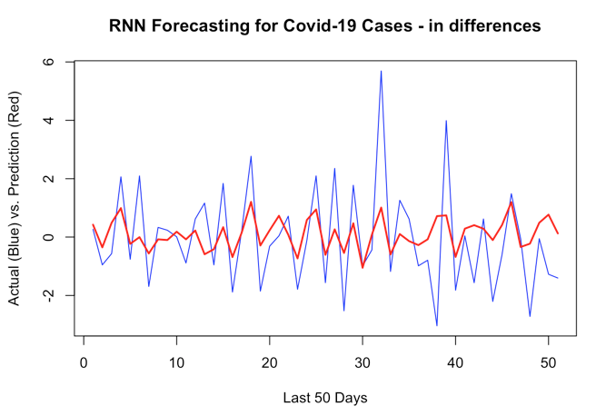
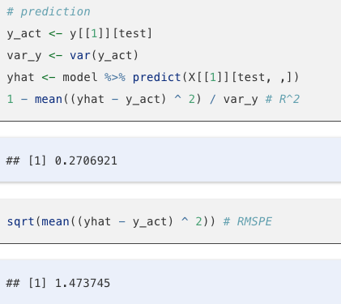
Plain RNN: step4 – Predict

Slide 15
LSTM
One issue with RNN is that, although it can retain information through time by its recurrent network, it quickly forgets long-term dependencies. This problem is called the vanishing gradient problem
If we only need to look at recent information to predict the present, RNN would be fine even with this problem.
But, the gap between the relevant information to predict the present could be very large and RNN quickly forgets those long-term dependencies.
Long Short-Term Memory network (LSTM) layers in RNN are designed to solve this problem.

Slide 16
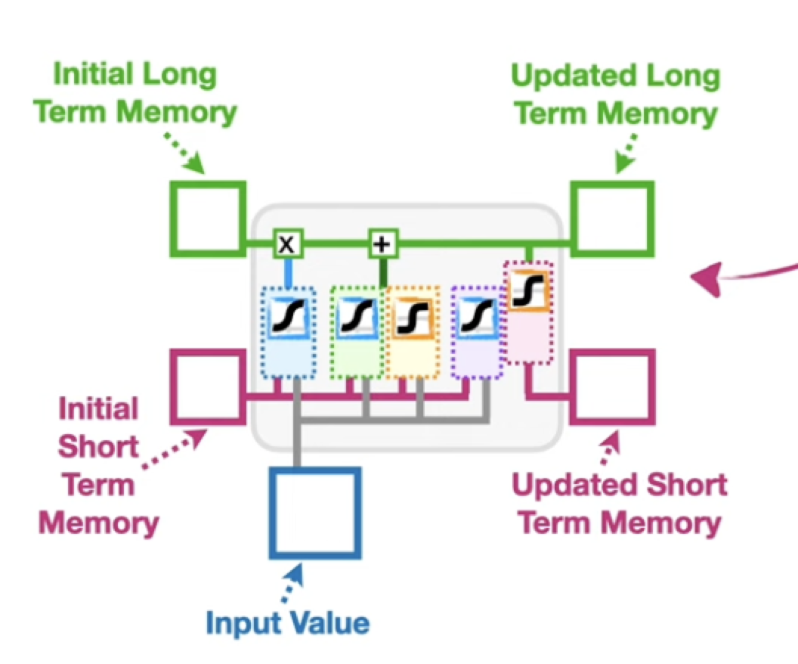

Slide 17
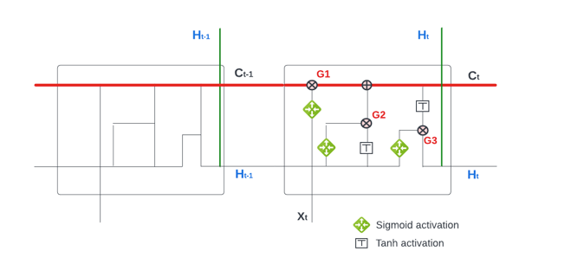
LSTM: conveyor belt

Slide 18




LSTM: Gates
The 1st gate (G1) is the Forget Gate
The 2nd gate (G2) is the Input Gate
The first two gates are about regulating the cell state (Ct),
The last one (G3) is the Output Gate

Slide 19
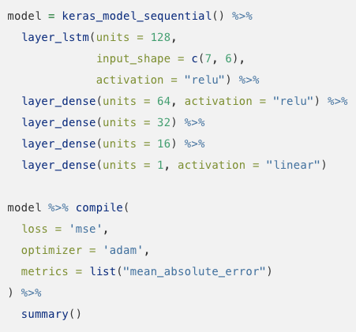
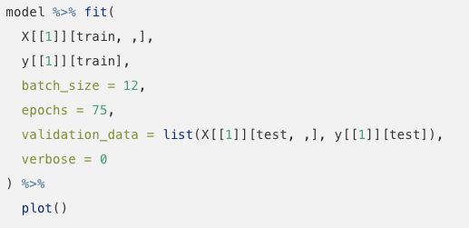
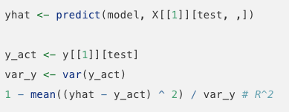
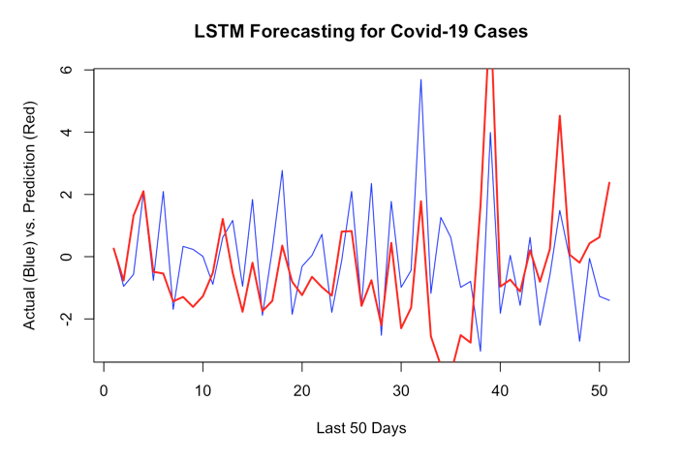
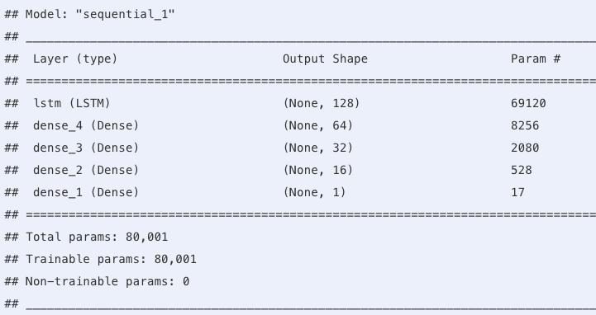



Example

