Slide 1
Application
NLP with Amazon Reviews
Dr. Aydede
NLP & LLM Workshop – August 28, 2024

Slide 2
Goal and Dataset
The goal is to perform NLP tasks using a dataset of Amazon reviews. The reviews are from the Cell Phones & Accessories category.
Dataset: A subset of Amazon reviews from the Cell Phones & Accessories category.
Key Features:
The main text content of the review.
The rating provided by the customer (1 to 5 stars).
Details about the product being reviewed.
Objective:
Focus on analyzing the text data to derive insights, such as sentiment analysis.

Slide 3
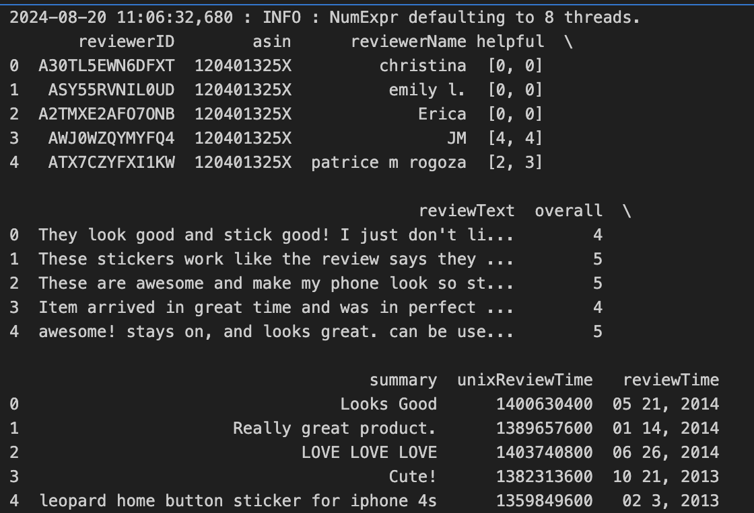

Slide 4
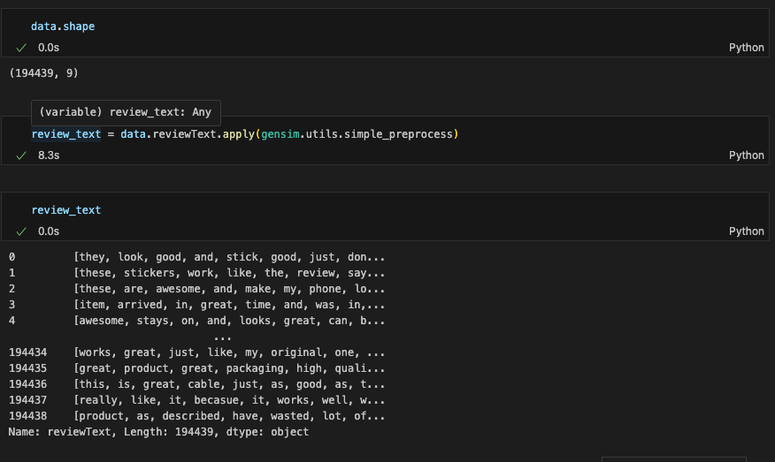
What Gensim’s simple preprocess Does:
Tokenization: It splits the text into individual words (tokens).
Lowercasing: Converts all words to lowercase.
Filtering:
Removes tokens that are too short (fewer than 2 characters).
Removes tokens that are too long (more than 15 characters).
Punctuation Removal: Filters out punctuation and special characters.

Slide 5
So What?
1. Product Recommendation Systems:
If you’re working on a product recommendation engine, finding words similar to a target word (like “phone”) could help identify related products.
2. Contextual Understanding in Chatbots:
In a chatbot or virtual assistant, understanding words similar to "phone" could help the bot interpret user intent better.
3. Synonym Expansion in Search Queries:
When users search for something, they might use different terms. For example, someone might search for "mobile" instead of "phone." The Word2Vec model helps by expanding search queries to include synonyms or related terms, improving search engine results and enhancing user experience.
4. Content Categorization and Tagging:
For content management systems or social media platforms, automatically tagging content based on similar words is valuable. If a post mentions "phone," it can be tagged with related topics like "smartphone," "device," or "mobile technology."

Slide 6
So What?
5. Understanding Customer Sentiment and Reviews:
Analyzing customer reviews or social media comments often involves understanding the context around key terms. For example, if "phone" is frequently associated with terms like "battery," "camera," or "price," it gives insights into what aspects of the phone customers care about most.
6. Text Summarization and Topic Modeling:
Finding related terms can be useful in summarizing text or identifying key topics within a large corpus. If “phone” is a central term, similar words can help build a more cohesive summary or topic cluster.
7. Building Thesauruses or Keyword Databases:
You can use Word2Vec results to build a dynamic thesaurus or expand a keyword database for specific industries or niches. For example, in the tech industry, knowing that "phone" is related to "smartphone," "handset," and "mobile" provides domain-specific vocabulary.

Slide 7
Why would we train it sometimes separately?
We don’t need to call model.train() again because you already trained the model during the initialization with the sentences=sentences parameter. If you aren’t introducing new data or doing incremental learning, the previous workflow is perfectly fine without the additional train step. Just proceed with using the model for tasks like finding similar words or accessing word vectors.
The train method is used separately when:
Incremental Training (Online Learning): You want to continue training your model on new data without starting from scratch. In that case, you can load an already trained model and then call train with additional data.
Custom Vocabulary Building: Sometimes, users prefer to separate the vocabulary-building phase and training phase. They might want to inspect the vocabulary or adjust the training parameters after building the vocabulary.
Fine-Tuning a Pre-Trained Model: You might load a pre-trained model and fine-tune it on domain-specific data using train.

Slide 8
Sentiment Analysis
Recommended Approaches for Sentiment Analysis
Lexicon-Based Approaches (like VADER or TextBlob):
These are fast and effective for general sentiment analysis, especially when labeled data isn’t available.
They provide direct sentiment scores (positive, negative, neutral) based on predefined word lists and rules.
Supervised Machine Learning:
When you have labeled data, using models like Logistic Regression, SVM, or even deep learning models (e.g., BERT) can give very accurate sentiment predictions.
Pre-Trained Transformer Models:
Fine-tuning pre-trained transformer models like BERT for sentiment analysis is a powerful approach if you have labeled data.
These models understand context and can handle more nuanced sentiment expressions.

