Slide 1
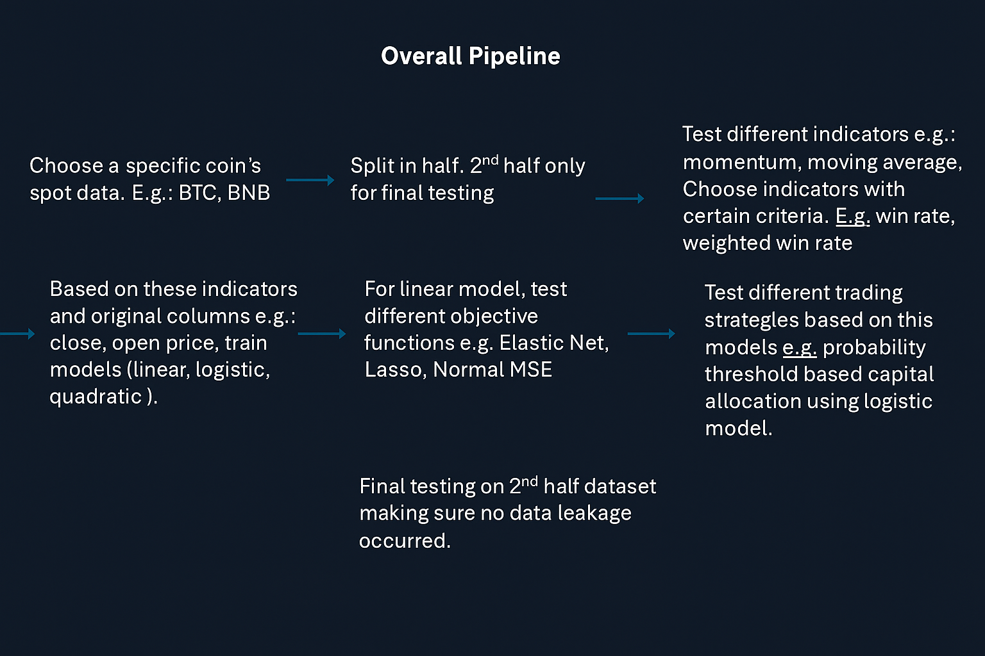

Slide 2

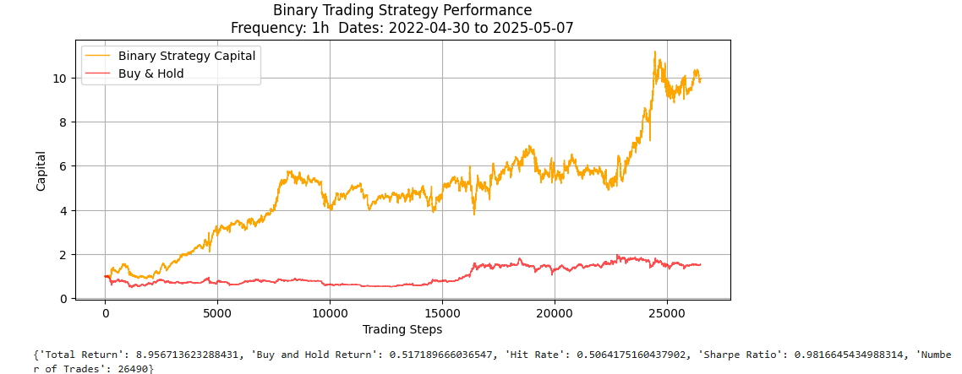
symbols=['BNB', 'BTC', 'ETH','TRX','XRP']

Slide 3
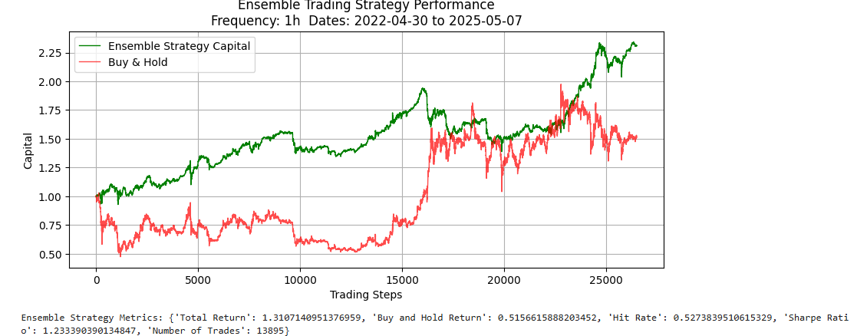

Slide 4
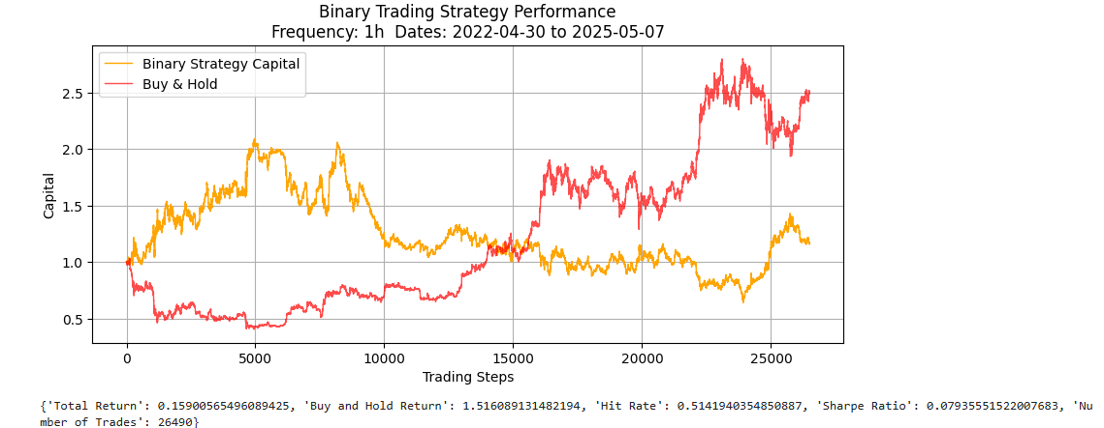

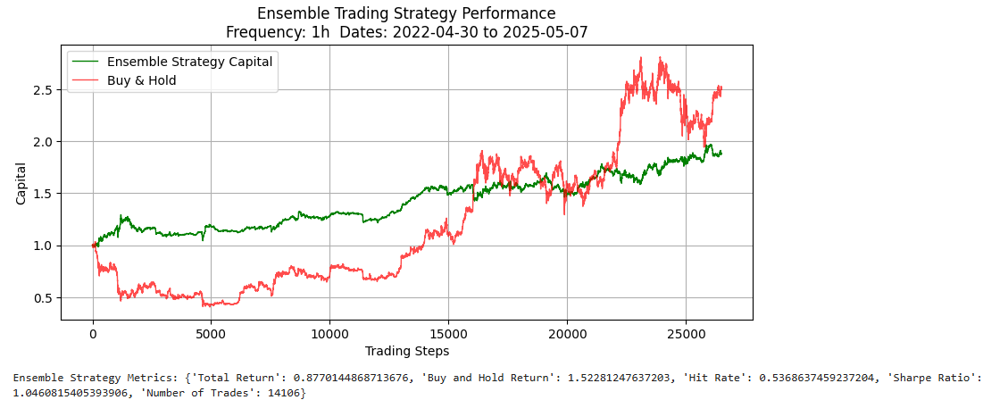

Slide 5
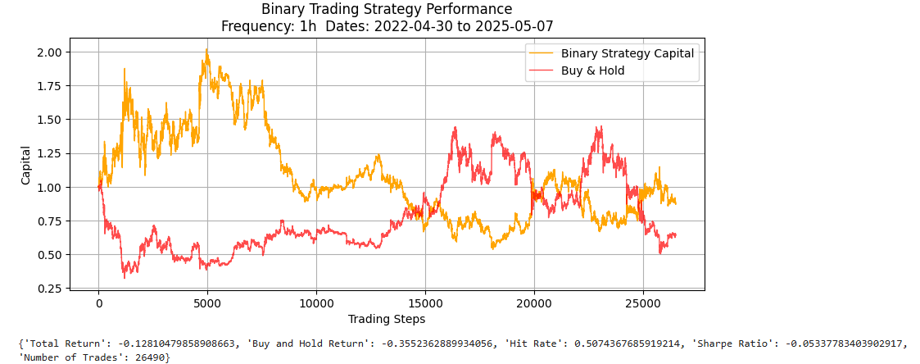
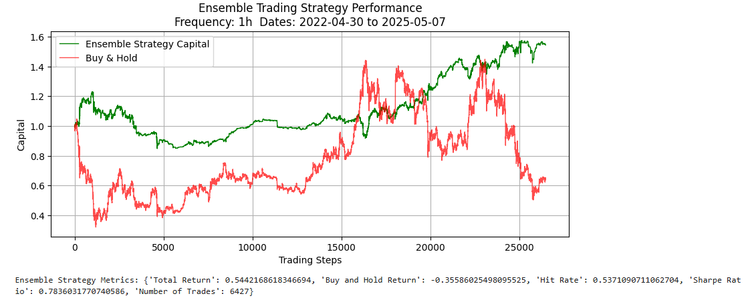

Slide 6
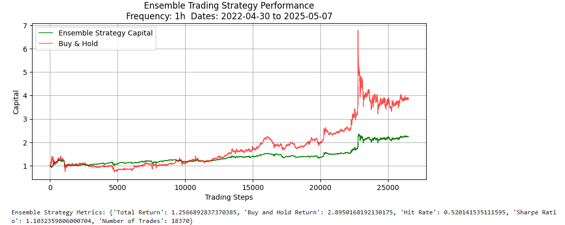
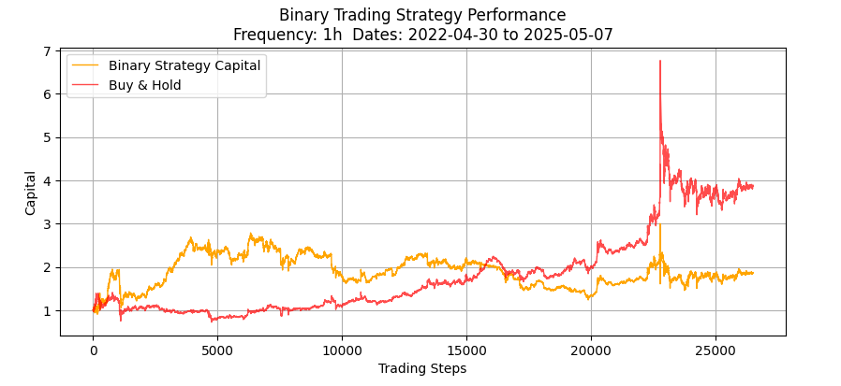

Slide 7
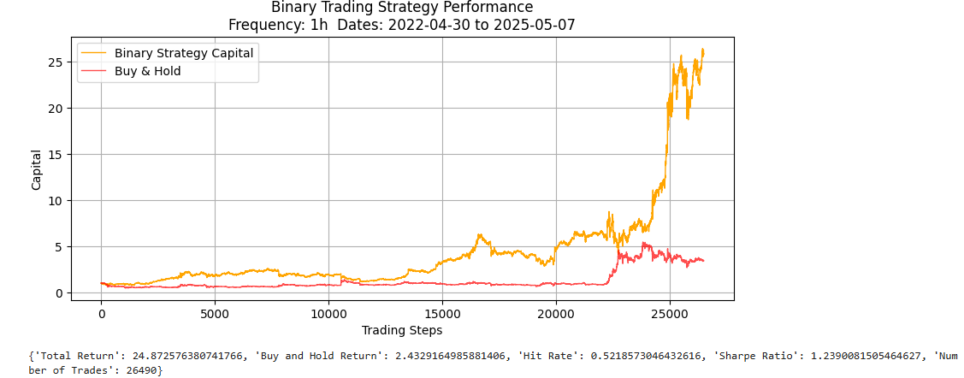
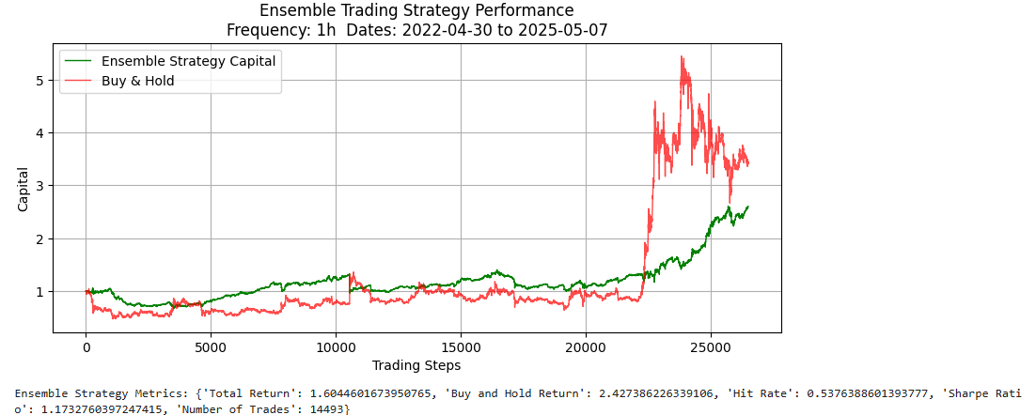

Slide 8
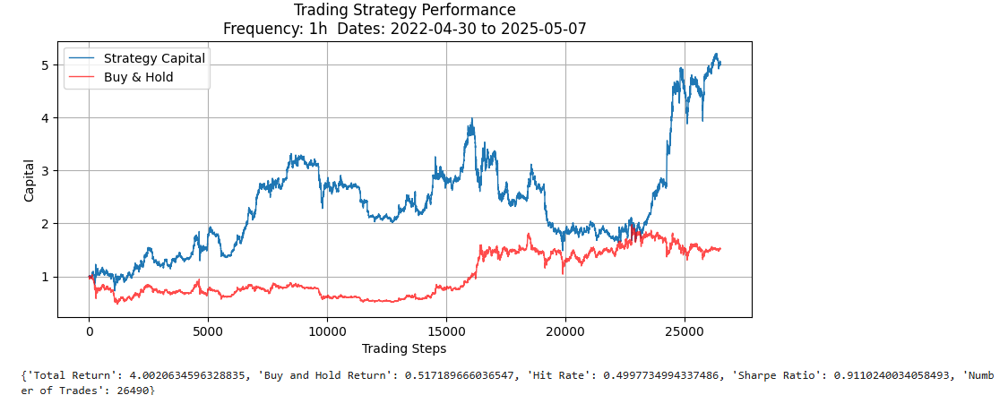

Slide 9
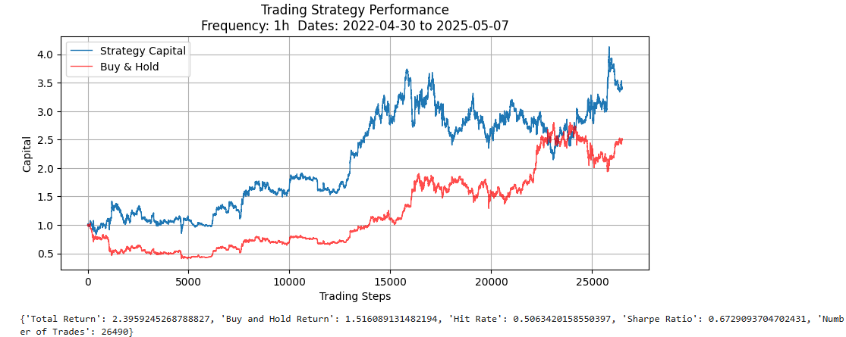

Slide 10
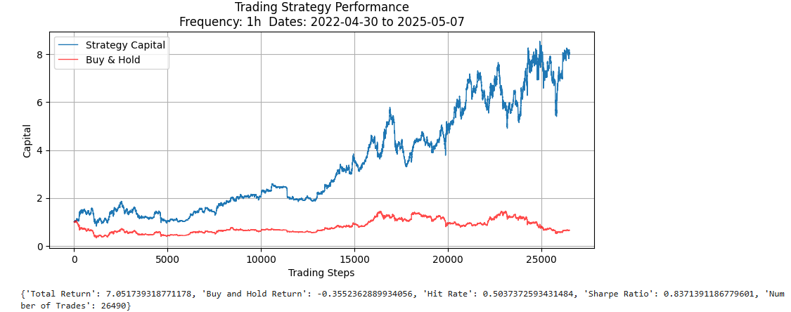

Slide 11
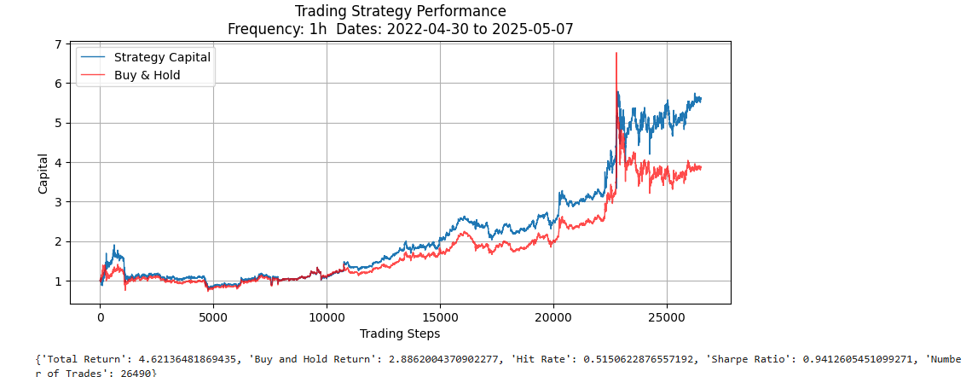

Slide 12
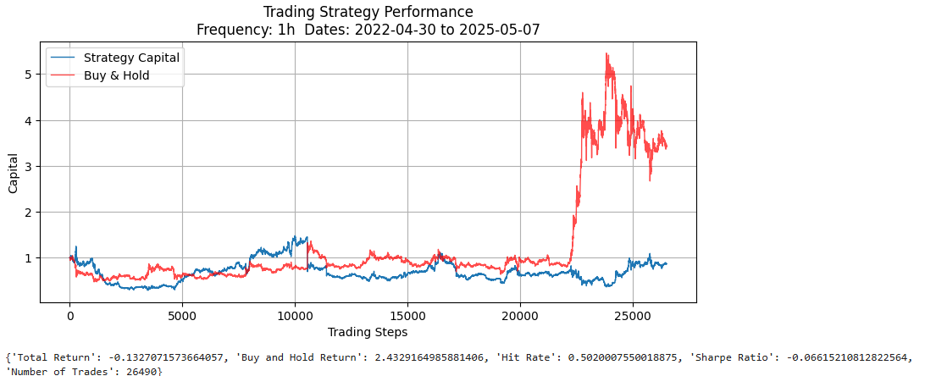

Slide 13
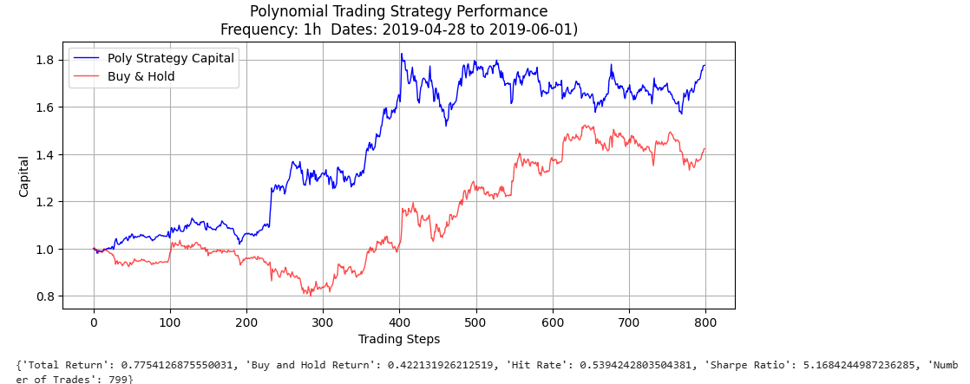

Slide 14
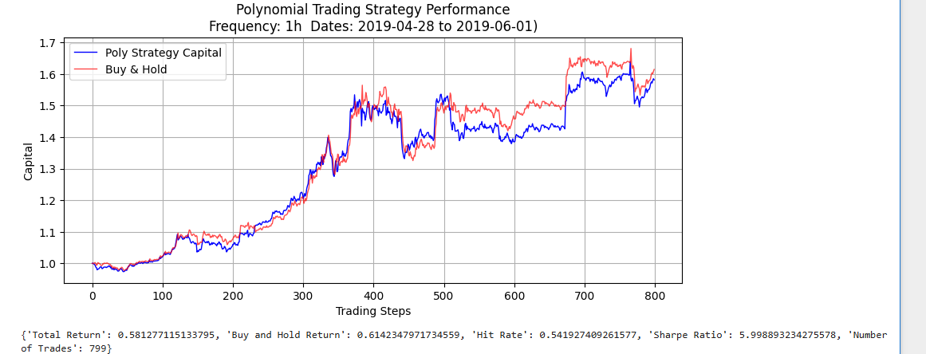

Slide 15
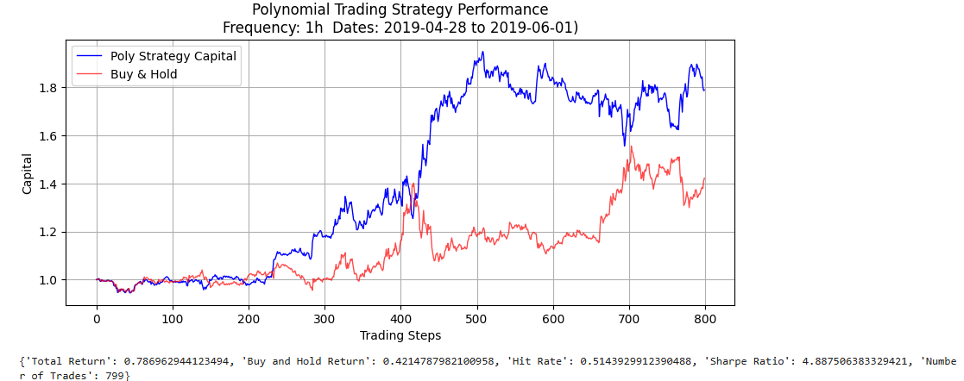

Slide 16
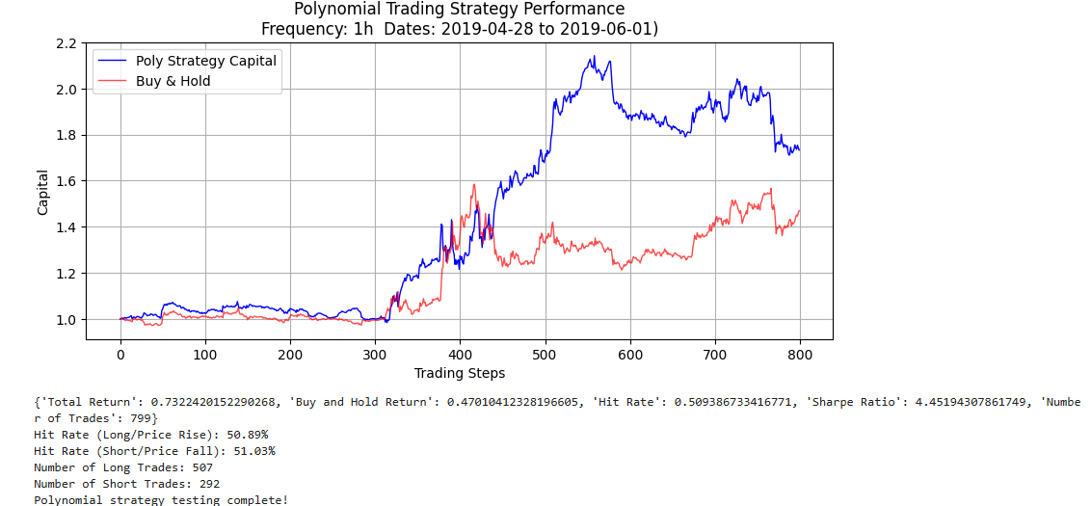

Slide 18
Overall Pipeline
Test different indicators e.g.: momentum, moving average. Choose indicators with certain criteria. E.g. win rate, weighted win rate
Split in half. 2nd half only for final testing
Choose a specific coin’s spot data. E.g.: BTC, BNB
For linear model, test different objective functions e.g. Elastic Net, Lasso, Normal MSE
Test different trading strategies based on this models e.g. probability threshold based capital allocation using logistic model.
Based on these indicators and original columns e.g.: close, open price, train models (linear, logistic, quadratic ).
Final testing on 2nd half dataset making sure no data leakage occurred.

