Slide 1

Parkinson’s Pose Estimation Dataset
Yankai Zhao
2025.01.29
Source: https://github.com/limi44/Parkinson-s-Pose-Estimation-Dataset/tree/master

Slide 2

Objective: Analyze Parkinson’s disease movement patterns and severity using deep learning. Data Source: From Parkinson’s assessment videos using Convolutional Pose Machines (CPM). (https://arxiv.org/abs/1602.00134) Key dataset: Trajectories(communication/drinking),Ratings(UDysRS,UPDRS,CAPSIT),Subject numbers
Notes:
Assessments were performed every 15–30 min using tasks from standard clinical rating scales for parkinsonism and LID for a period of 2–4 h. Nine participants (5 men, median age 64 years) completed the study.

Slide 3
Subject Correspond trail number
Subject 1 (severe-moderate) : ['1', '15', '16', '17', '20', '21', '22', '23', '27', '29', '30', '62', '74', '78', '82', '86’]
Subject 2 (mild-mild) : ['2', '3', '4', '5', '6', '7', '8', '9', '11', '18', '37', '40', '79', '81', '83', '85', '87', '88', '94', '96’]
Subject 4 (mild-severe) : ['10', '12', '13', '14', '25', '28', '32', '33', '34', '36', '80', '84', '89', '90', '91', '92', '93', '95', '97’]
Subject 5 (severe-severe) : ['19', '24', '26', '31', '35', '63', '67’]
Subject 6 (mild-moderate) : ['38', '39', '41', '42', '43', '50', '51', '52', '53', '54', '55', '56', '57', '58', '59', '60’]
Subject 7 (mild-mild) : ['203', '206', '256', '257', '259', '261', '264', '282’]
Subject 8 (moderate-moderate) : ['212', '220', '223', '232', '233', '234', '236', '238', '240', '260', '265', '266', '273', '275', '276', '278', '280', '284', '285', '287’]
Subject 10(severe-moderate): ['248', '250', '263', '283', '288', '289', '290', '291’]
Subject 11 (moderate-mild) : ['217', '225', '226', '228', '230', '239', '244', '247', '255', '258', '262', '267', '268', '269', '270', '272', '274', '277', '279', '281’]

Slide 4
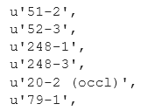

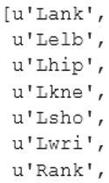
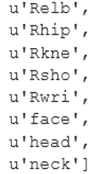
A. Communication/Drinking Tasks: Communication_all_export.txt
Key：
position or resp:
Value:
'position' is the trajectory of each joint and 'resp' is the confidence from CPM. These are each provided for 15 joints (key point):
trial number - segment number (noise type)
Notes:
240-3 confidence score low. {"26-1":{"position":{"head":[[328.0188293457,61.9355926514],[328.0690307617,61.9809417725],

Slide 5
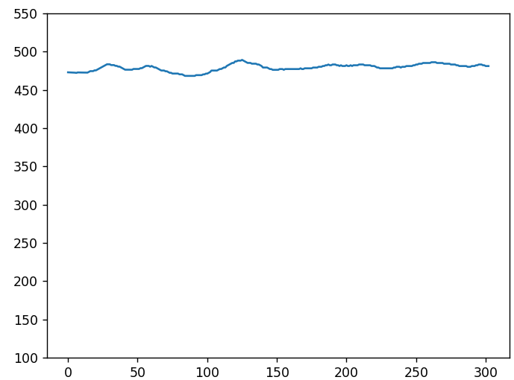
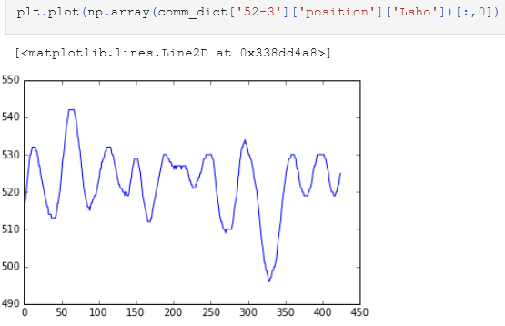
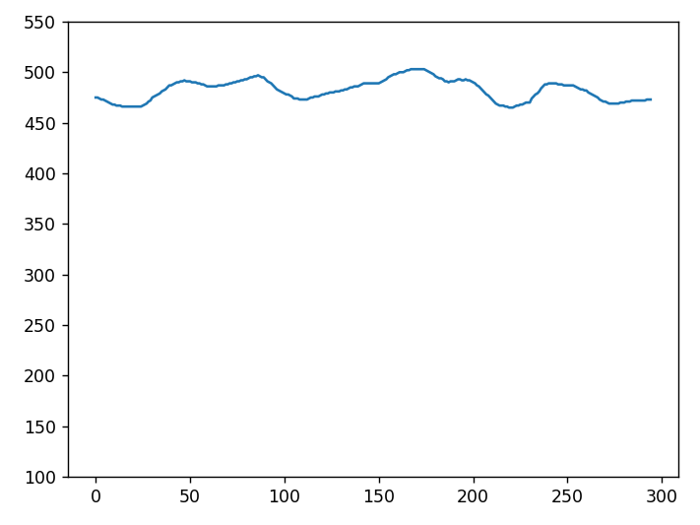
Figure: 51-1 Rsho
Figure: 52-3 Lsho
Figure: 51-3 Rsho
Notes:
217/248

Slide 6
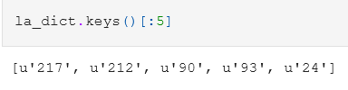

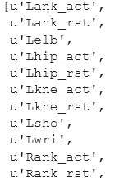
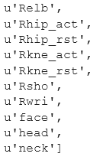
B. Leg Agility Task: LA_split_all_export.txt
Trajectories:
position and resp (as with communication task) and idx, an index of the frame number.
Key：
Value:
For the lower limbs, trajectory are split into active ('_act') and rest ('_rst'), indicating whether the leg agility task is being performed by that leg.
Trials are not separated into segments like for the communication task. However, noise type may need to be stripped from keys (use St. Split()).
6
Notes:
Repetitive movements, 217 ancle little waggle, hip big waggle, head stand still, (212 head, face big waggle , knee big waggle rst. 217 worse than 21

Slide 7
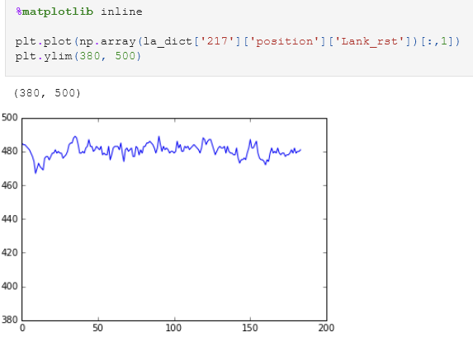
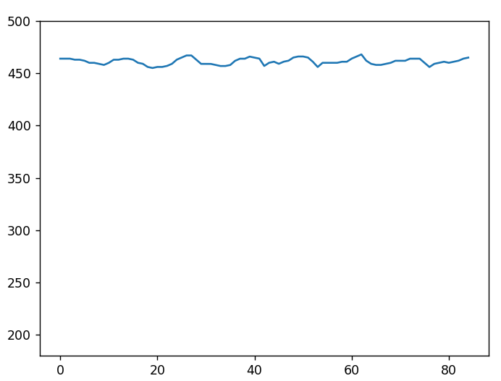
Figure: 217 Lank rest
Figure: 248 Lank rest
Notes:
217/248

Slide 8
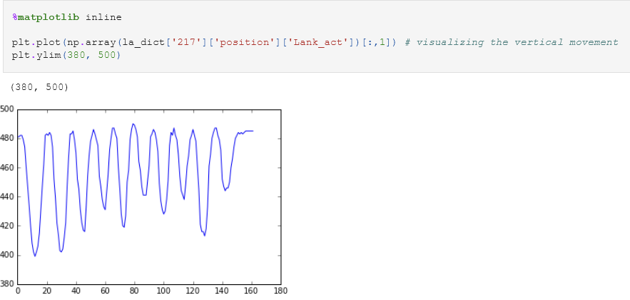
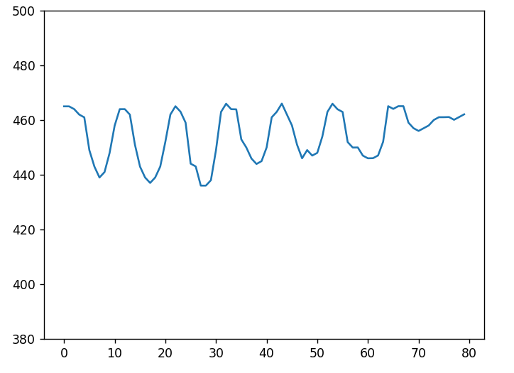
Figure: 217 Lank act
Figure: 248 Lank act

Slide 9

C. Toe Tapping Task: TT_opt_flow_export.txt
Trajectories:
There are two flows available, for the left foot and right foot. Flow bounding boxes were based on left and right ankle locations from CPM.
Key：
Value:
For the lower limbs, trajectory are split into active ('_act') and rest ('_rst'), indicating whether the leg agility task is being performed by that leg. There is difference between active and rest by plotting the trajectories.
Trials are not separated into segments like for the leg agility task.
9

Slide 10
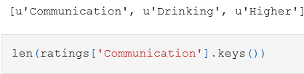
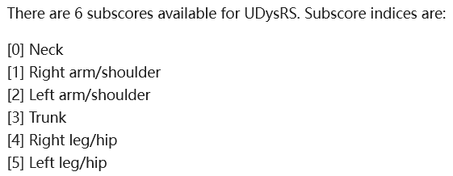
A. UDysRS-Unified Dyskinesia Rating Scale: UDysRs.txt
Ratings:
Score range:
0 -10: No or only very mild movement disorders (dyskinesia).
11-20: Mild dysplasia that occasionally interferes with daily activities.
21-40: Moderate dysplasia that significantly affects daily activities.
41-70: Severe dyskinesia, severely impaired motor function.
40-60: Severe Parkinson's disease, requiring nursing assistance, limited movement.
Rating keys：
Within each rating is the subscores:
There are three parts available in this UDysRS rating - ratings for the communication task, the drinking task, and the highest rating across all tasks that were used.
10

Slide 11
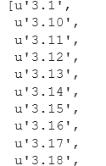
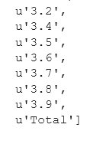
B. UPDRS-Unified Parkinson's Disease Rating Scale: UPDRS.txt
Ratings:
Score range:
0 -20 Basically normal, with very mild symptoms.
20-40 Moderate Parkinson's disease, affecting motor ability and daily living
40-60 Severe Parkinson's disease, requiring nursing assistance, limited movement.
For the UPDRS, the rating keys correspond to the item number in the MDS-UPDRS. For items where there are two ratings, the first rating is the right side and the second is the left. For item 3.17 (rest tremor amplitude), the items in order are right upper extremity, left upper extremity, right lower extremity, left lower extremity, and lip/jaw. The total score is also included.
11
Notes:
Movement Disorder Society - Unified Parkinson's Disease Rating Scale. 3.1speech 3.2 facial expression 3.3 rigidity… 15<30<50

Slide 12
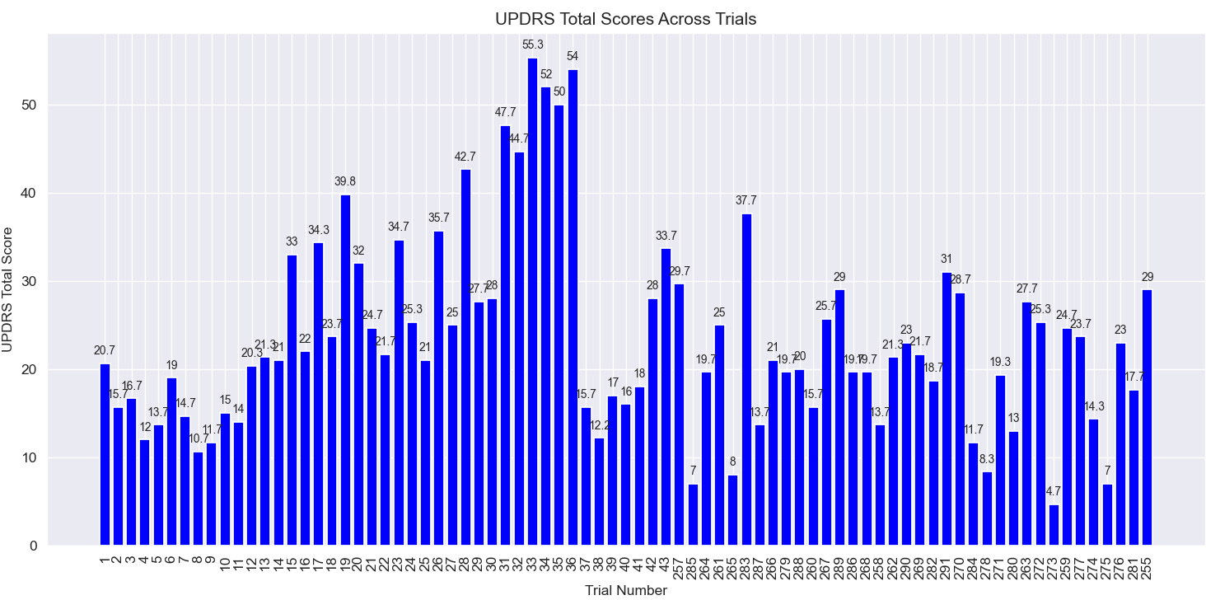

Slide 13
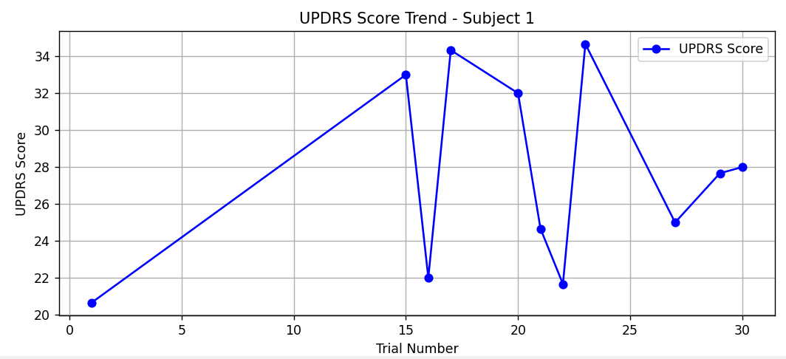
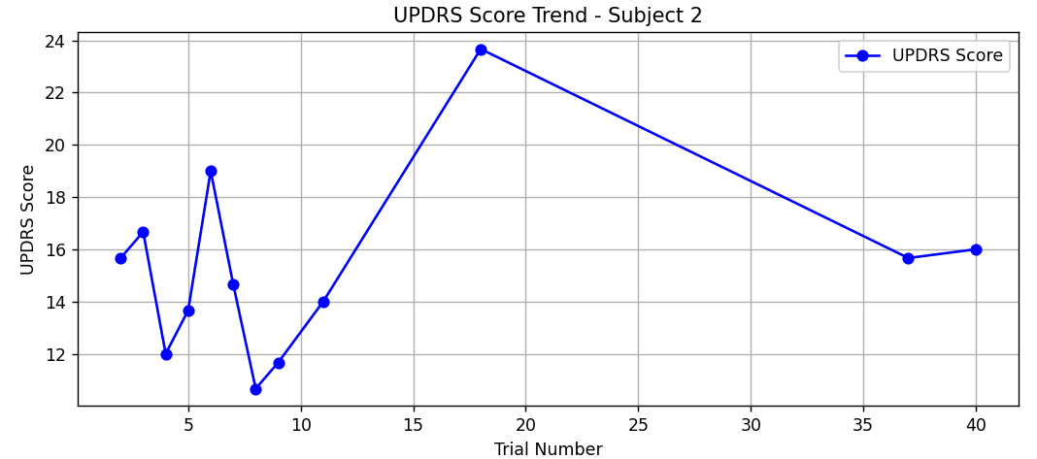
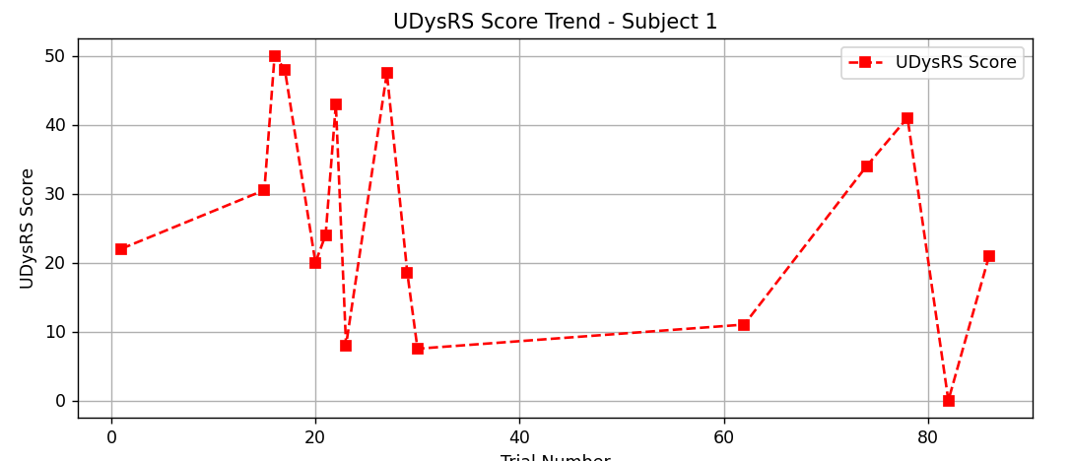
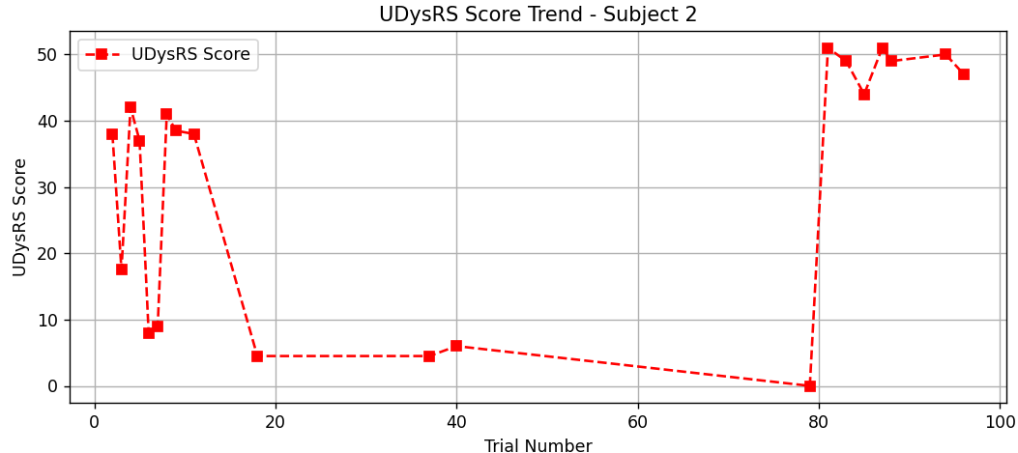
Symptom Analysis:
UDysRS: Peaks at 50, decreases to 10-30 in some trials.
UPDRS : Fluctuates between 20-40, moderate condition.
Medication Response:
UDysRS: partial improvement, reduced involuntary movements in some trails.
UPDRS: fluctuates significantly, with some trials improving and others not.
Conclusion:
Medication helps to reduce involuntary movement, but the overall condition is still moderate and the efficacy is not stable.
Symptom Analysis:
UDysRS: Peaks at 50,then decreases significantly before fluctuating again.
UPDRS : 10-24, indicating mild Parkinson’s.
Medication Response:
UDysRS: Initially effective, but loses effectiveness later.
UPDRS: Trends high in some trials.
Conclusion:
Symptoms fluctuate greatly, Potential therapeutic adjustments are required.

Slide 14
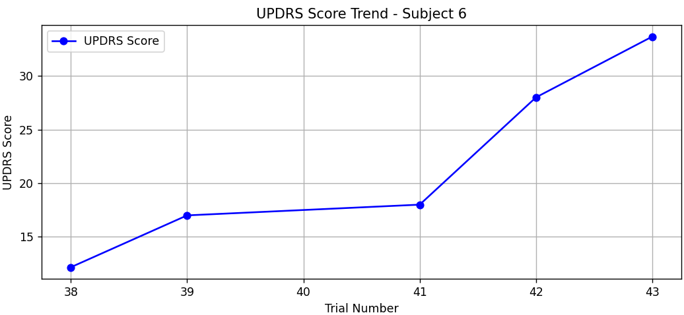
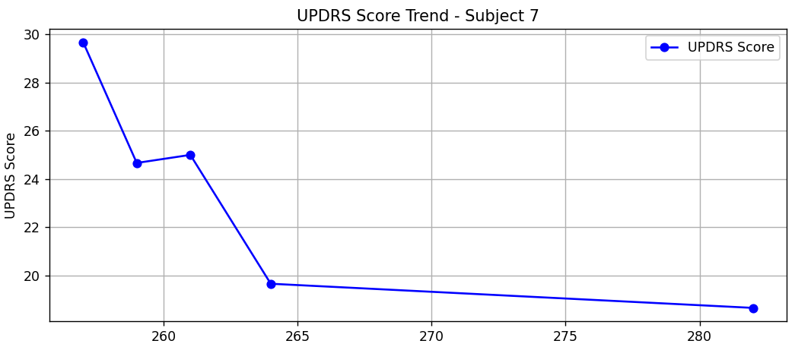
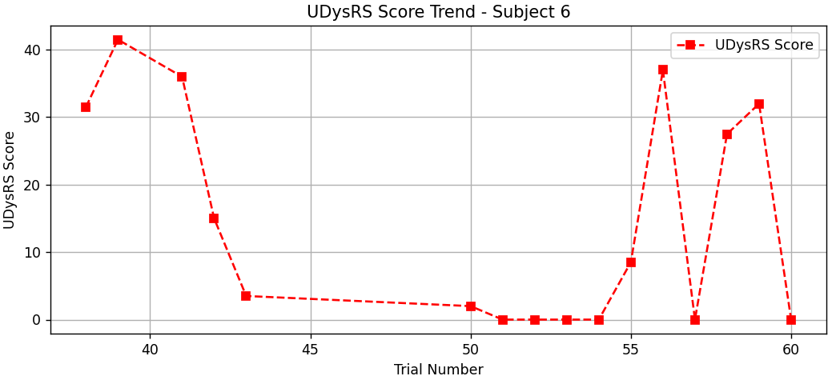
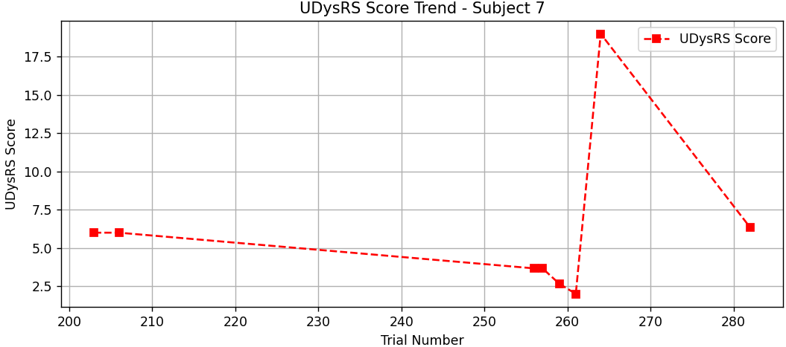
Symptom Analysis:
UDysRS: Gradually increases from 10 to over 30, indicating worsening symptoms.
UPDRS : Initial high, drops to zero then spikes again.
Medication Response:
UDysRS: Significant reduction in involuntary movements, but with irregular spikes.
UPDRS: Worsening trend. Medication may not control overall symptoms effectively.
Conclusion:
Treatment may require reassessment or stronger medication.
Symptom Analysis:
UDysRS: a clear downward trend, decreasing from 30 to below 20.
UPDRS : Initially low but peaks before dropping again.
Medication Response:
UDysRS: levodopa effects severe in some training sessions.
UPDRS: Improvement over trials, indicating a potential positive response to medication.
Conclusion:
The patient may have benefited significantly from the prescribed treatment.

Slide 15
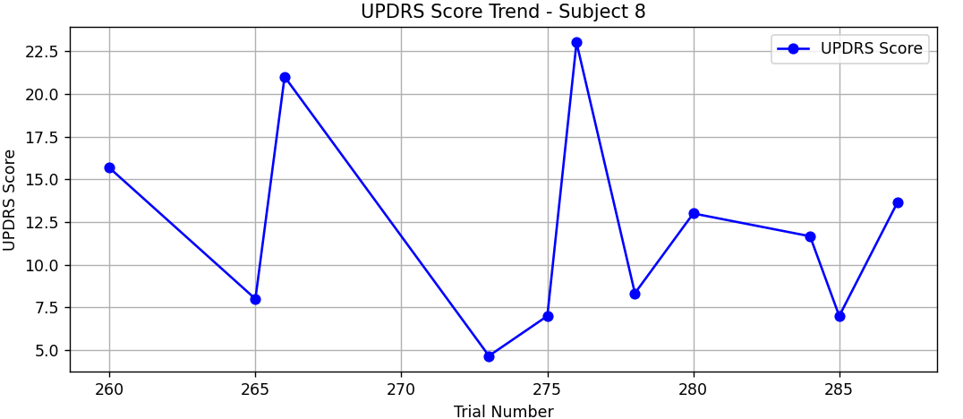
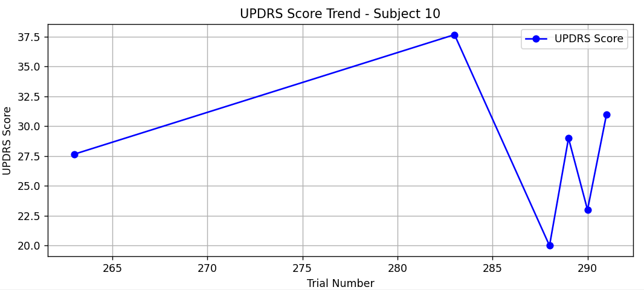
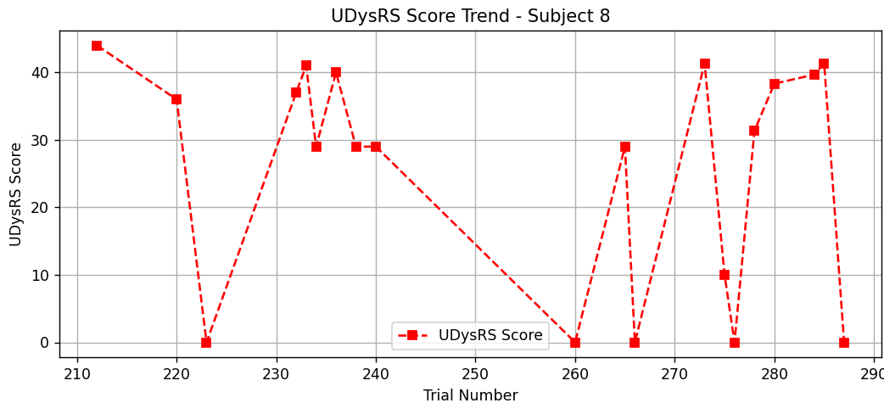
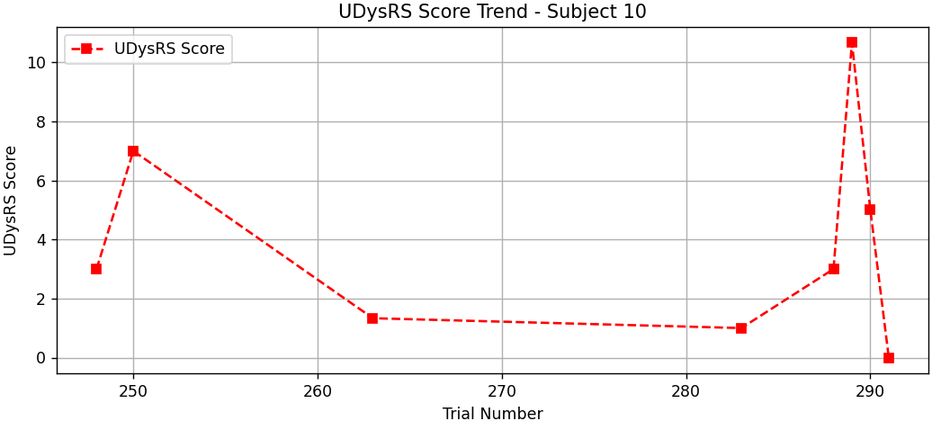
Symptom Analysis:
UDysRS: Highly fluctuating, with values ranging between 5 and 20.
UPDRS : Initial high, drops to zero then fluctuates
Medication Response:
UDysRS: Episodes of significant improvement, but also periods of worsening.
UPDRS: Unstable trend, suggesting unpredictable symptom control.
Conclusion:
Medication effectiveness is inconsistent.Further evaluation is needed to stabilize the treatment effects.
Symptom Analysis:
UDysRS: Shows a rising trend, peaking at nearly 40 before dropping.
UPDRS : Generally low but spikes at later trials.
Medication Response:
UDysRS: Controlled at first, but later increases unexpectedly.
UPDRS: Early increase, but later trials show a possible response.
Conclusion:
Symptoms are not stable.The medication may have delayed effects, or adjustments are needed.

Slide 16
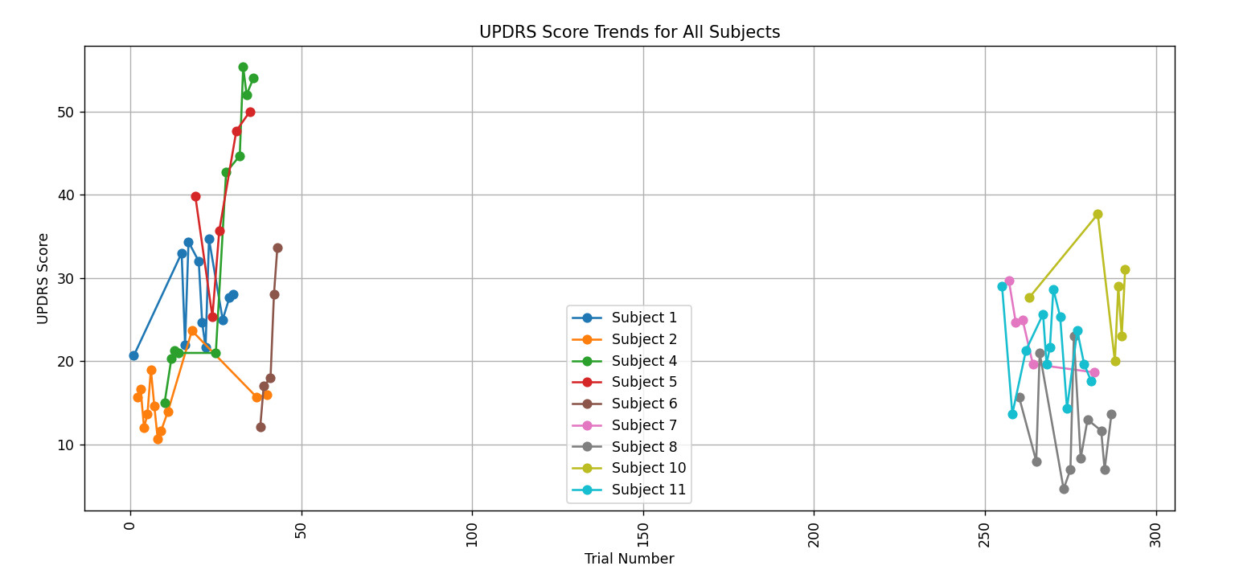

Slide 17
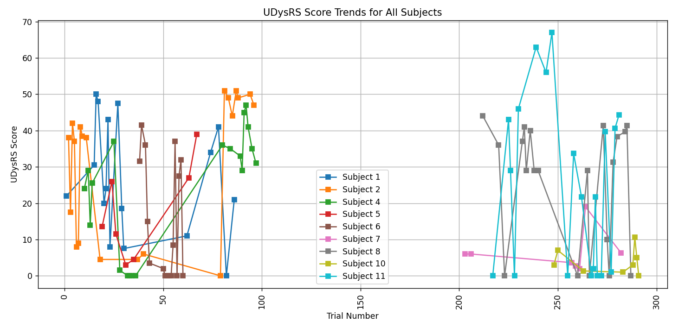

Slide 18
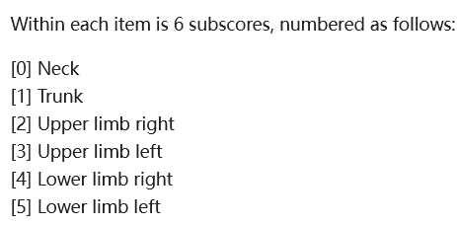
C.CAPSIT(the suitability of patients with Parkinson's disease for surgery):
Ratings:
Rating keys：
For the CAPSIT, rating keys also correspond to items from the MDS-UPSRS
"3.10":{"1":[0,0,0,0,2,1.5,3.5])
---- trail number: 6 sub score 1total score
18
Notes:
"274":[2,1,1,1,1,1,8]. 6subcores and a total "274":[2,1,1,1,1,1,8]

Slide 19
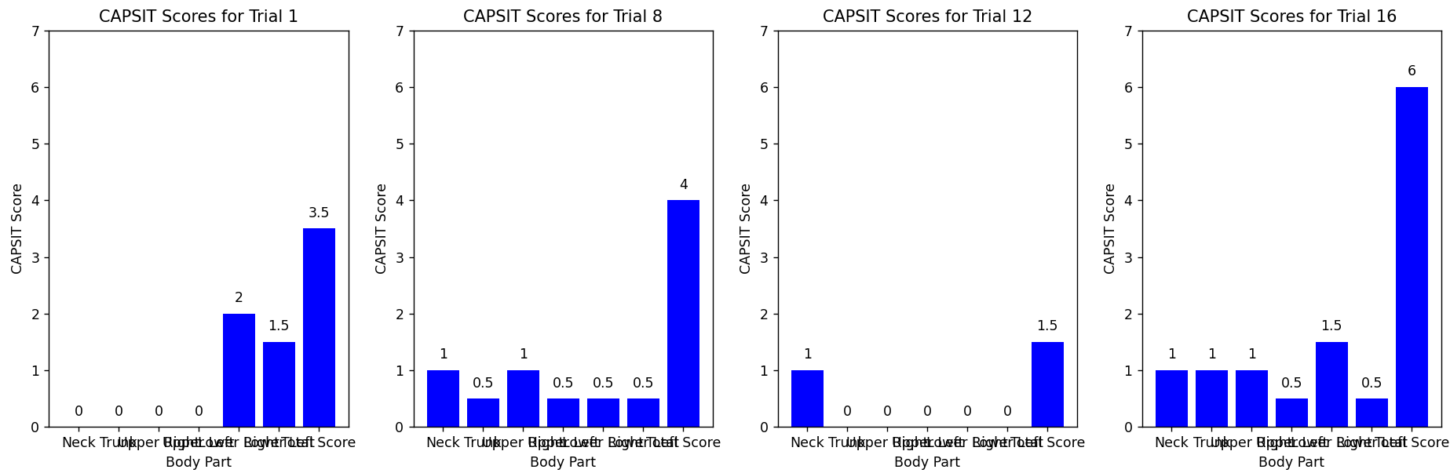

Slide 20

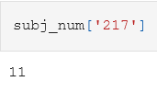
Key(Trial number) Value(Subject number)
"1":1,"2":2,"3":2,"4":2,"5":2,"6":2,"7":2,"8":2,"9":2,"10":4,
----“Trail number ”: subject number
---- 241 trails, 11 subjects

Slide 21
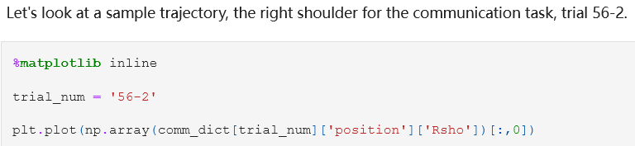
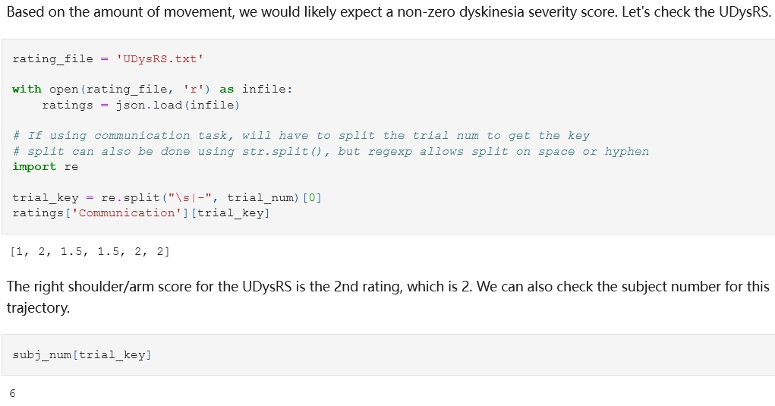

Slide 22
Thank you

