Slide 2

CHAPTER 16 OUTLINE
16.1 General Equilibrium Analysis
16.2 Efficiency in Exchange
16.3 Equity and Efficiency
16.4 Efficiency in Production
16.5 The Gains from Free Trade
16.6 An Overview—The Efficiency of
Competitive Markets
16.7 Why Markets Fail

Slide 3

GENERAL EQUILIBRIUM ANALYSIS
16.1
● partial equilibrium analysis Determination of equilibrium prices and quantities in a market independent of effects from other markets.
● general equilibrium analysis Simultaneous determination of the prices and quantities in all relevant markets, taking feedback effects into account.

Slide 4
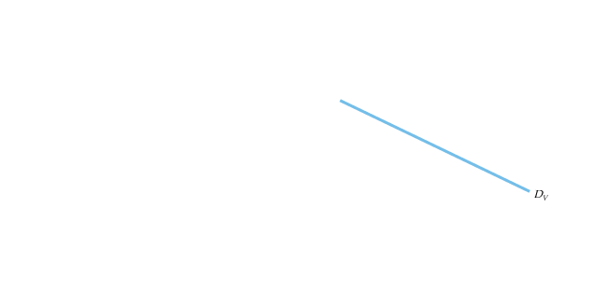
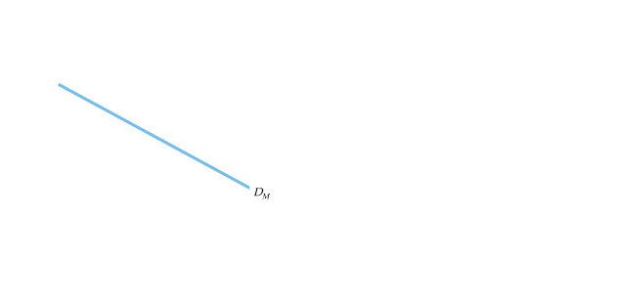



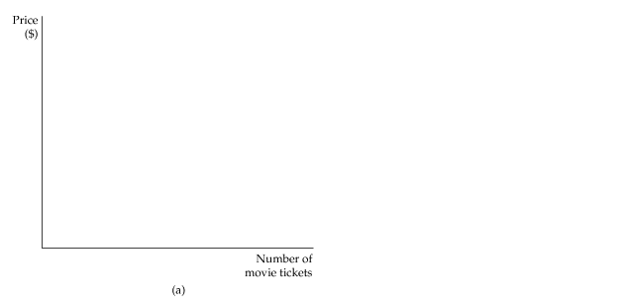
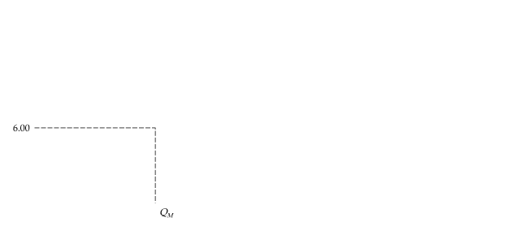
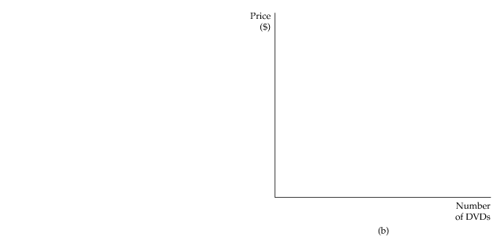
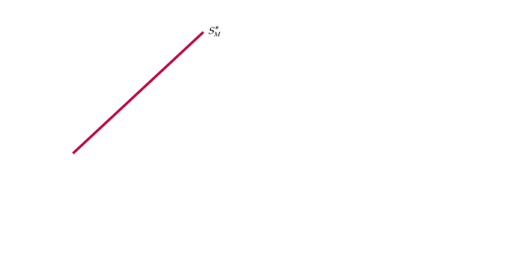
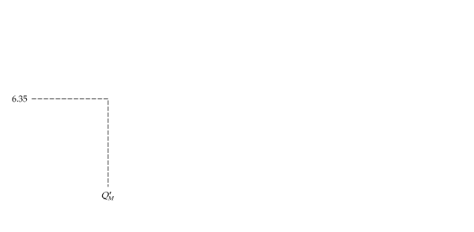
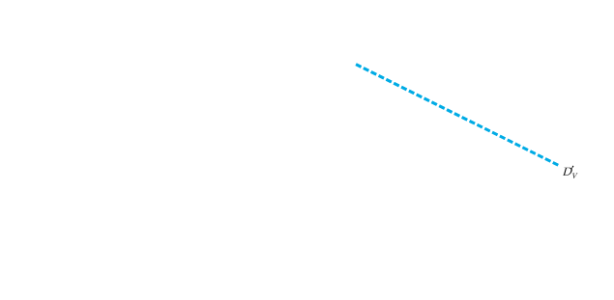
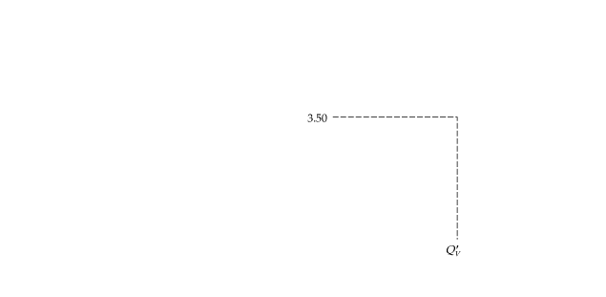
GENERAL EQUILIBRIUM ANALYSIS
16.1
Two Interdependent Markets—Moving to
General Equilibrium
Figure 16.1
Two Interdependent Markets: (a) Movie Tickets and (b) DVD Rentals
When markets are interdependent, the prices of all products must be simultaneously determined.
Here a tax on movie tickets shifts the supply of movies upward from S_{M} to S*_{M}, as shown in (a).
The higher price of movie tickets ($6.35 rather than $6.00) initially shifts the demand for DVDs upward (from D_{V} to D’_{V} ), causing the price of DVDs to rise (from $3.00 to $3.50), as shown in (b).

Slide 5
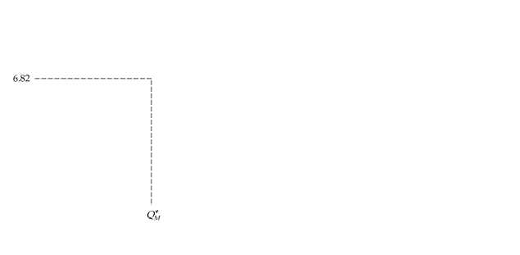
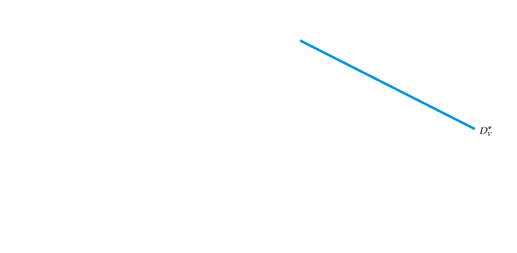
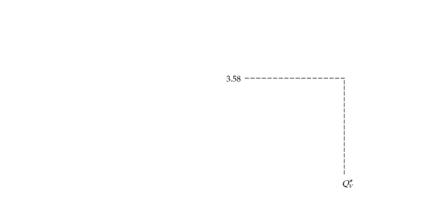
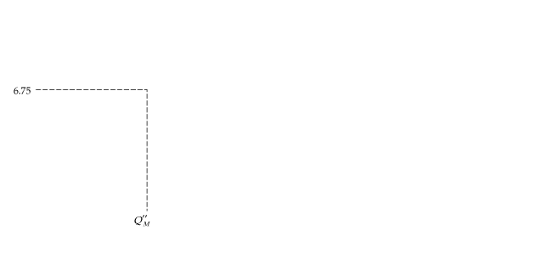
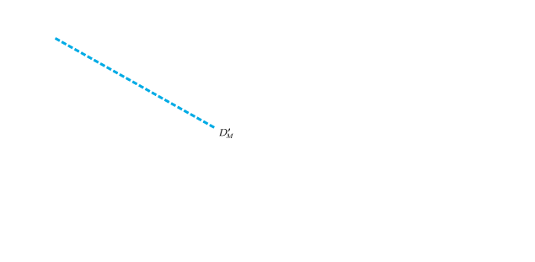
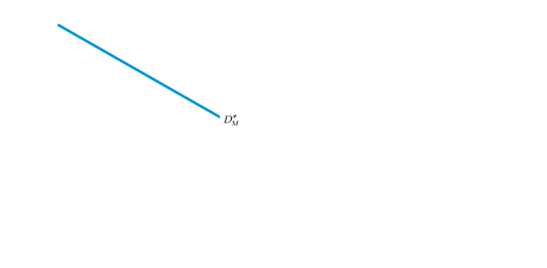
GENERAL EQUILIBRIUM ANALYSIS
16.1
Two Interdependent Markets—Moving to
General Equilibrium
Figure 16.1 (continued)
Two Interdependent Markets: (a) Movie Tickets and (b) DVD Rentals
The higher video price feeds back into the movie ticket market, causing demand to shift from D_{M} to D’_{M} and the price of movies to increase from $6.35 to $6.75.
This continues until a general equilibrium is reached, as shown at the intersection of D*_{M} and S*_{M} in (a), with a movie ticket of $6.82, and the intersection of D*_{V} and S_{V} in (b), with a DVD price of $3.58.

Slide 6
GENERAL EQUILIBRIUM ANALYSIS
16.1
Reaching General Equilibrium
To find the general equilibrium prices (and quantities) in practice, we must simultaneously find two prices that equate quantity demanded and quantity supplied in all related markets.
For our two markets, we need to find the solution to four equations (supply of movie tickets, demand for movie tickets, supply of DVDs, and demand for DVDs).
Movies and DVDs are substitute goods. If the goods in question are complements, a partial equilibrium analysis will overstate the impact of a tax.

Slide 7

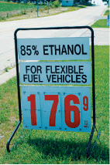
GENERAL EQUILIBRIUM ANALYSIS
16.1
The world ethanol market is dominated by Brazil and the
United States, which accounted for over 90 percent of world production in 2005.
In 2007, about 40 percent of all Brazilian automobile fuel was ethanol, a response to the skyrocketing growth in the demand for flex-fuel cars.
The Energy Policy Act of 2005 required that U.S. fuel production include a minimum amount of renewable fuel each year—a stipulation which essentially mandated a baseline level of ethanol production.
The U.S. regulation of its own ethanol market can significantly affect Brazil’s market. This global interdependence was made evident by the Energy Security Act of 1979, by which the U.S. offered a tax credit of $0.51 per gallon of ethanol.
To prevent foreign ethanol producers from reaping the benefits of this tax credit, the U.S. government imposed a $0.54 per gallon tax on imported ethanol.
While this policy has benefited corn producers, it is not in the interests of U.S. ethanol consumers. It is estimated that whereas Brazil can export ethanol for less than $0.90 per gallon, it costs $1.10 to produce a gallon of ethanol from Iowa corn.

Slide 8

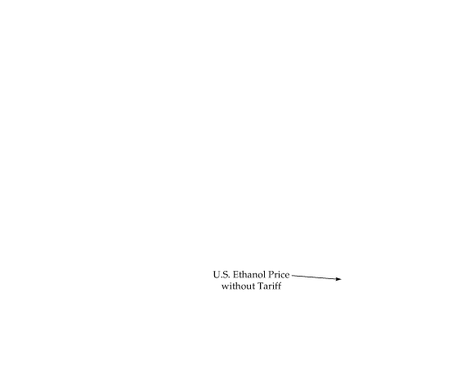
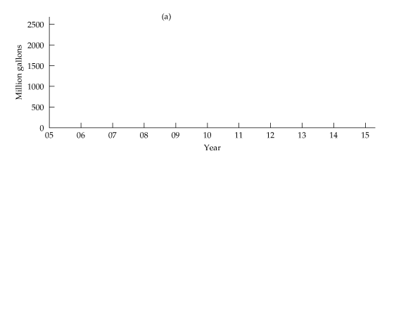

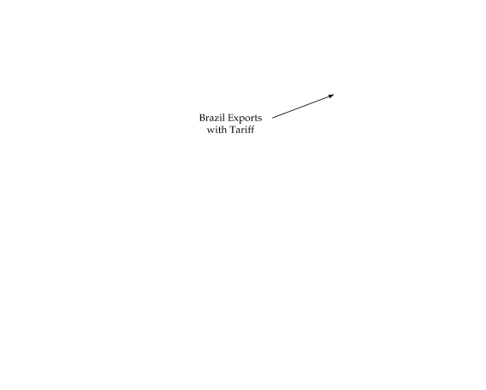
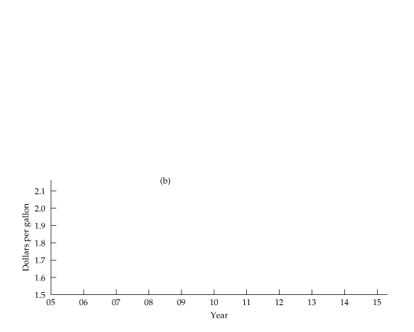
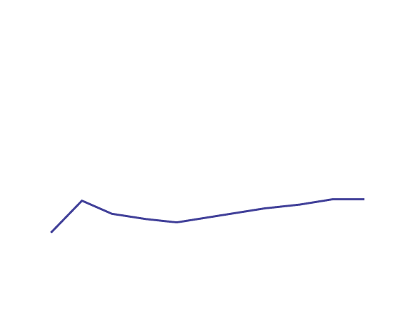


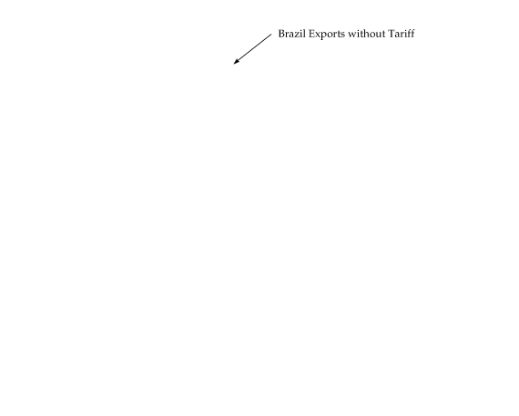

GENERAL EQUILIBRIUM ANALYSIS
16.1
Figure 16.2
Removing the Ethanol Tariff on Brazilian Exports
If U.S. tariffs on ethanol produced abroad were to be removed, Brazil would export much more ethanol to the United States, displacing much of the more expensive corn-based ethanol produced domestically.
As a result, the price of ethanol in the U.S. would fall, benefiting U.S. consumers.

Slide 9
EFFICIENCY IN EXCHANGE
16.2
● exchange economy Market in which two or more consumers trade two goods among themselves.
● efficient (or Pareto efficient) allocation Allocation of goods in which no one can be made better off unless someone else is made worse off.

Slide 10
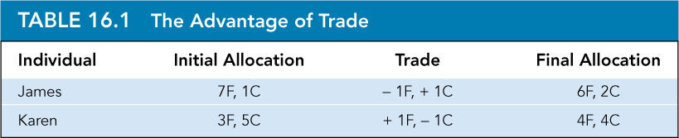
EFFICIENCY IN EXCHANGE
16.2
The Advantages of Trade
The Edgeworth Box Diagram
● Edgeworth box Diagram showing all possible allocations of either two goods between two people or of two inputs between two production processes.

Slide 11
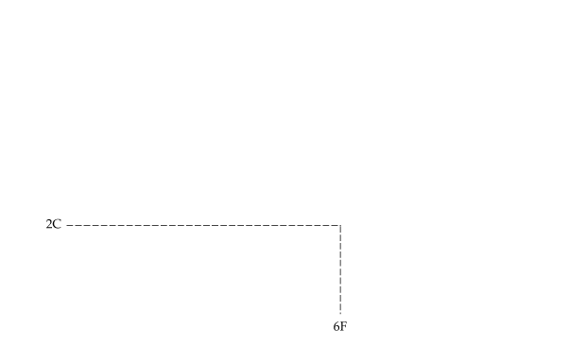
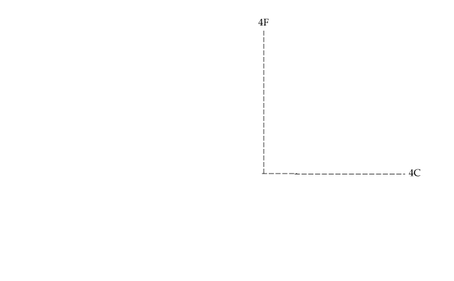
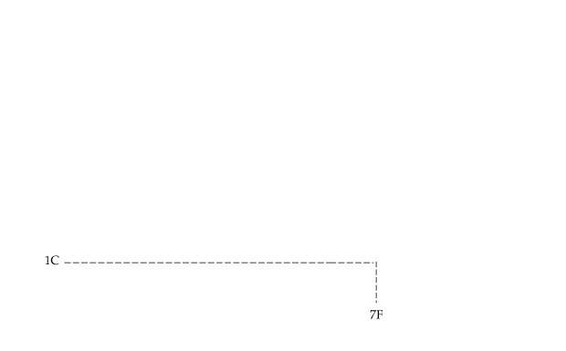
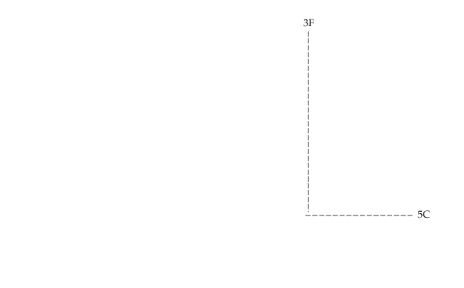


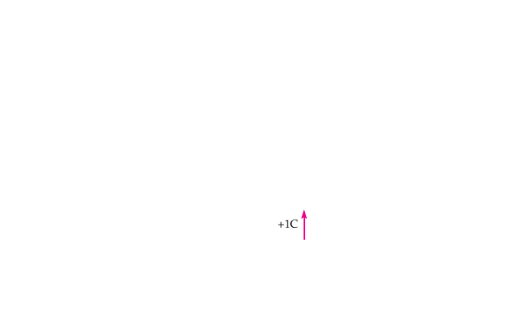


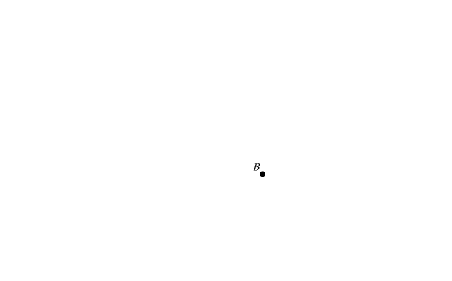
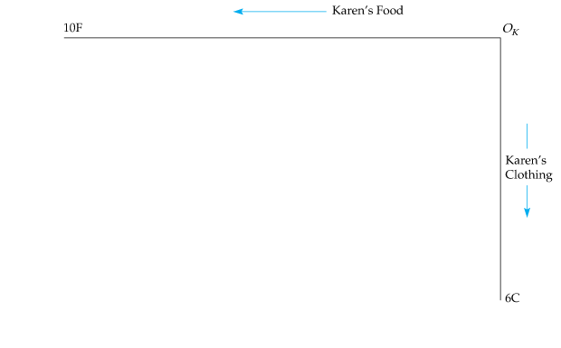
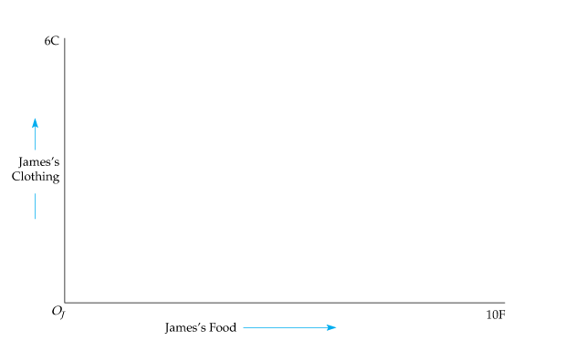
EFFICIENCY IN EXCHANGE
16.2
The Edgeworth Box Diagram
Figure 16.3
Exchange in an Edgeworth Box
Each point in the Edgeworth box simultaneously represents James’s and Karen’s market baskets of food and clothing.
At A, for example, James has 7 units of food and 1 unit of clothing,
and Karen 3 units of food and 5 units of clothing.

Slide 12

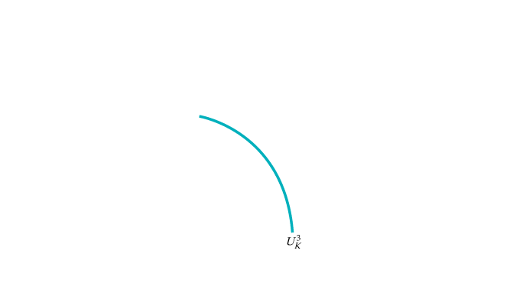
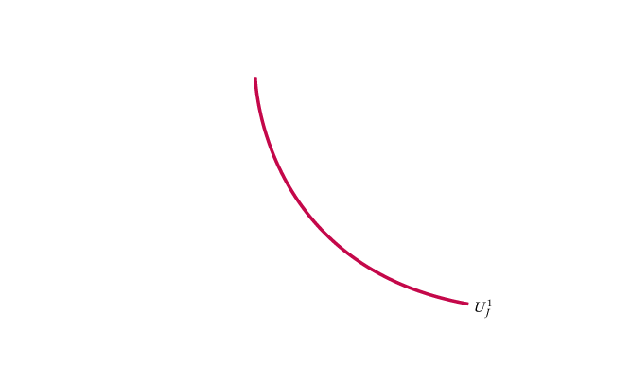
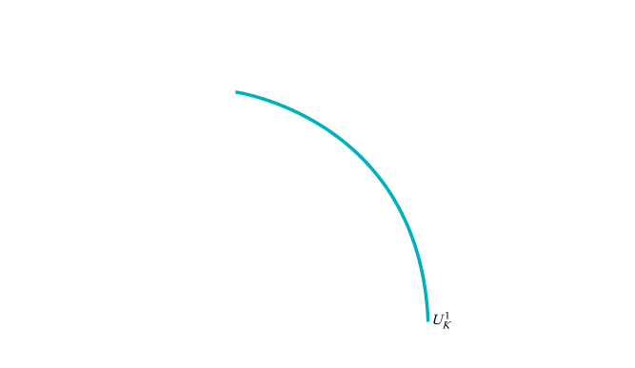
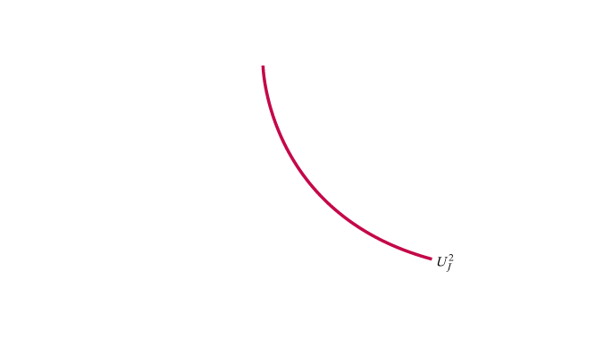

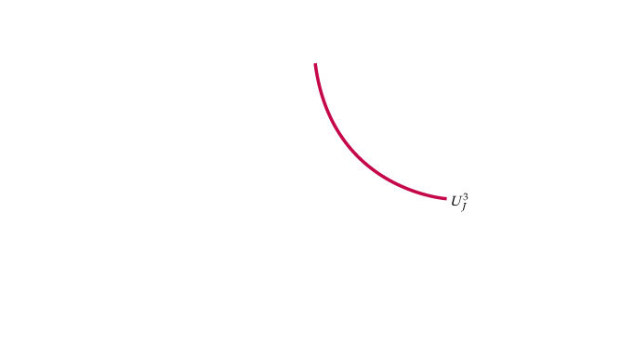




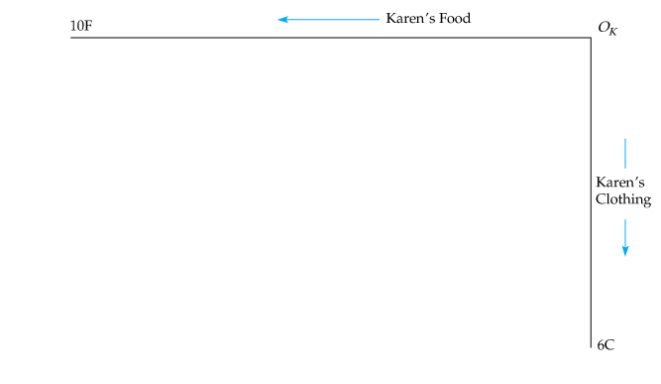
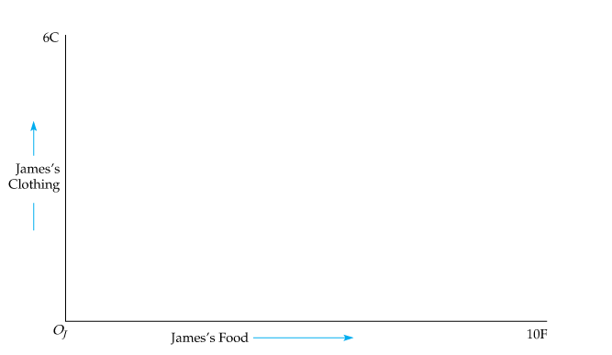
EFFICIENCY IN EXCHANGE
16.2
Efficient Allocations
Figure 16.4
Efficiency in Exchange
The Edgeworth box illustrates the possibilities for both consumers to increase their satisfaction by trading goods.
If A gives the initial allocation of resources, the shaded area describes all mutually beneficial trades.

Slide 13
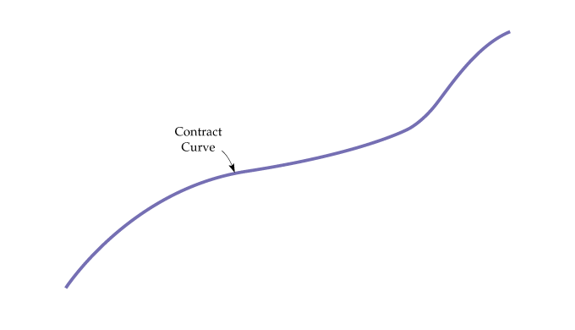









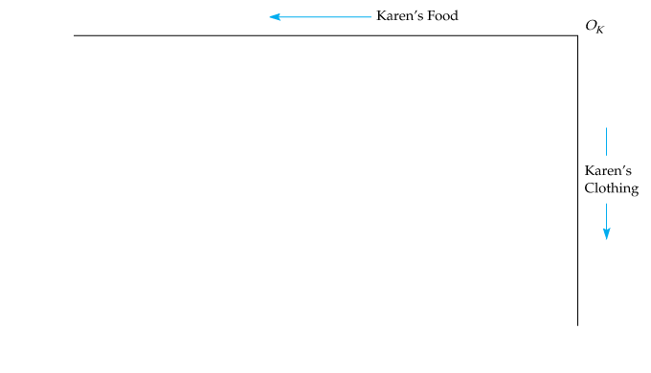
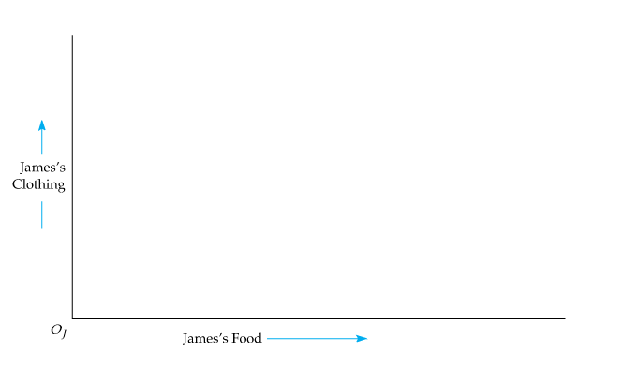
EFFICIENCY IN EXCHANGE
16.2
The Contract Curve
Figure 16.5
The Contract Curve
The contract curve contains all allocations for which consumers’ indifference curves are tangent.
Every point on the curve is efficient because one person cannot be made better off without making the other person worse off.
● contract curve Curve showing all efficient allocations of goods between two consumers, or of two inputs between two production functions.

Slide 14

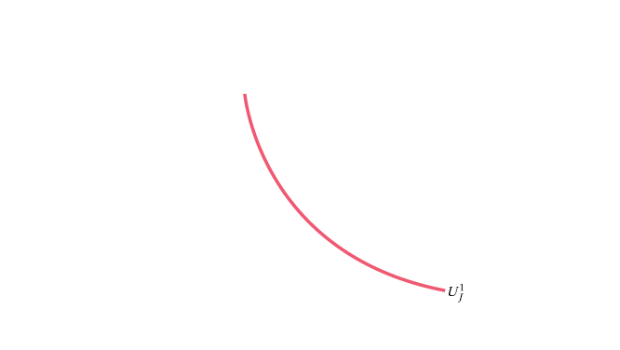
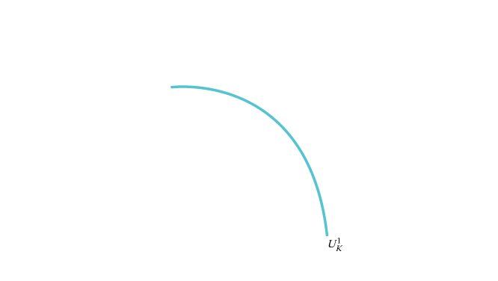
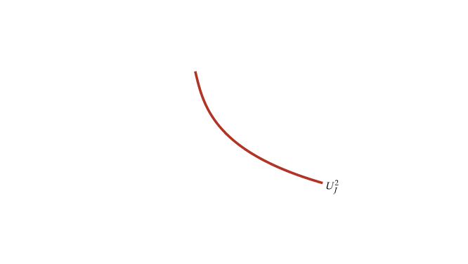
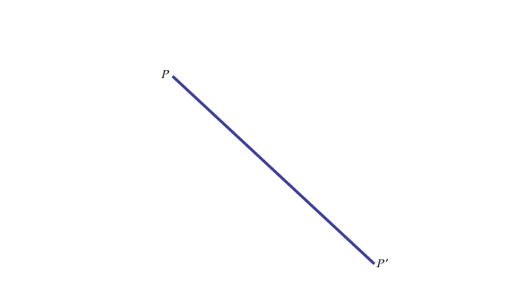
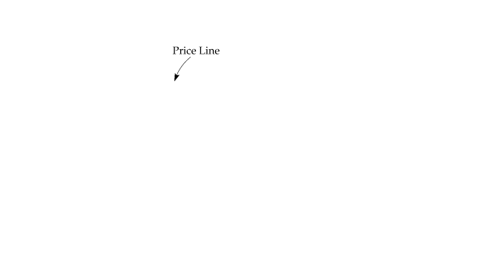

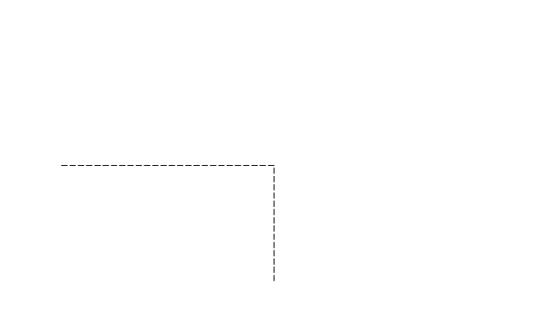


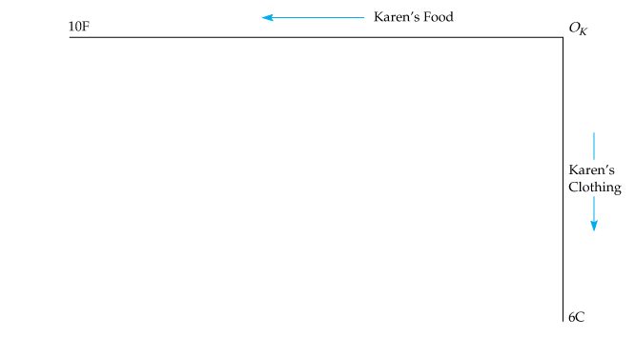
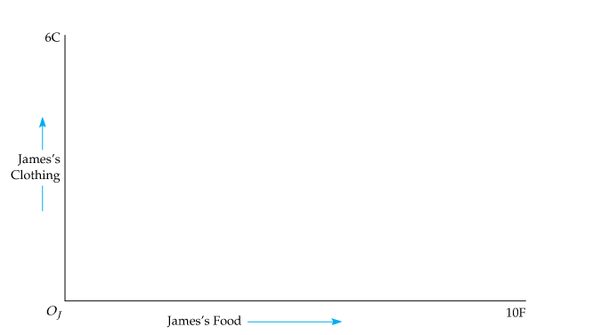
EFFICIENCY IN EXCHANGE
16.2
Consumer Equilibrium in a Competitive Market
Figure 16.6
Competitive Equilibrium
In a competitive market the prices of the two goods determine the terms of exchange among consumers.
If A is the initial allocation of goods and the price line PP′ represents the ratio of prices, the competitive market will lead to an equilibrium at C, the point of tangency of both indifference curves.
As a result, the competitive equilibrium is efficient.

Slide 15
EFFICIENCY IN EXCHANGE
16.2
Consumer Equilibrium in a Competitive Market
● excess demand When the quantity demanded of a good exceeds the quantity supplied.
● excess supply When the quantity supplied of a good exceeds the quantity demanded.

Slide 16

EFFICIENCY IN EXCHANGE
16.2
The Economic Efficiency of Competitive Markets
● welfare economics Normative evaluation of markets and economic policy
If everyone trades in the competitive marketplace, all mutually beneficial trades will be completed and the resulting equilibrium allocation of resources will be economically efficient.
Let’s summarize what we know about a competitive equilibrium from the consumer’s perspective:
1. Because the indifference curves are tangent, all marginal rates of substitution between consumers are equal.
2. Because each indifference curve is tangent to the price line, each person’s MRS of clothing for food is equal to the ratio of the prices of the two goods.
(16.1)

Slide 17
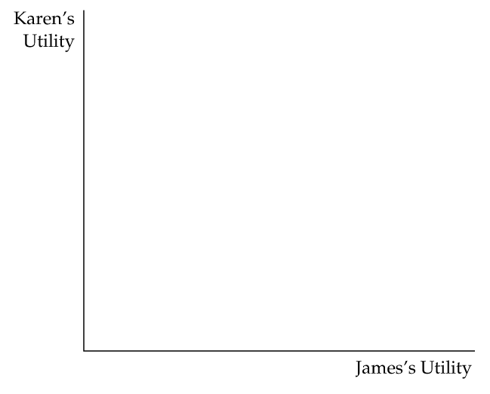










EQUITY AND EFFICIENCY
16.3
The Utility Possibilities Frontier
Figure 16.7
Competitive Equilibrium
The utility possibilities frontier shows the levels of satisfaction that each of two people achieve when they have traded to an efficient outcome on the contract curve.
Points E, F, and G correspond to points on the contract curve and are efficient.
Point H is inefficient because any trade within the shaded area will make one or both people better off.

Slide 18

EQUITY AND EFFICIENCY
16.3
The Utility Possibilities Frontier
● utility possibilities frontier Curve showing all efficient allocations of resources measured in terms of the utility levels of two individuals.
Social Welfare Functions
● social welfare function Measure describing the well-being of society as a whole in terms of the utilities of individual members.

Slide 19
EQUITY AND EFFICIENCY
16.3
Equity and Perfect Competition
If individual preferences are convex, then every efficient allocation (every point on the contract curve) is a competitive equilibrium for some initial allocation of goods.
Literally, this theorem tells us that any equilibrium deemed to be equitable can be achieved by a suitable distribution of resources among individuals and that such a distribution need not in itself generate inefficiencies.
Unfortunately, all programs that redistribute income in our society are economically costly.

Slide 20


EFFICIENCY IN PRODUCTION
16.4
Input Efficiency
● technical efficiency Condition under which firms combine inputs to produce a given output as inexpensively as possible.
If producers of food and clothing minimize production costs, they will use combinations of labor and capital so that the ratio of the marginal products of the two inputs is equal to the ratio of the input prices:
But we also showed that the ratio of the marginal products of the two inputs is equal to the marginal rate of technical substitution of labor for capital MRTS_{LK}. As a result,
(16.2)

Slide 21









EFFICIENCY IN PRODUCTION
16.4
The Production Possibilities Frontier
● production possibilities frontier Curve showing the combinations of two goods that can be produced with fixed quantities of inputs.
Figure 16.8
Production Possibilities Frontier
The production possibilities frontier shows all efficient combinations of outputs.
The production possibilities frontier is concave because its slope (the marginal rate of transformation) increases as the level of production of food increases.

Slide 22

EFFICIENCY IN PRODUCTION
16.4
The Production Possibilities Frontier
Marginal Rate of Transformation
● marginal rate of transformation Amount of one good that must be given up to produce one additional unit of a second good.
At every point along the frontier, the following condition holds:
(16.3)

Slide 23








EFFICIENCY IN PRODUCTION
16.4
Output Efficiency
An economy produces output efficiently only if, for each consumer,
(16.4)
Figure 16.9
Output Efficiency
The efficient combination of outputs is produced when the marginal rate of transformation between the two goods (which measures the cost of producing one good relative to the other) is equal to the consumer’s marginal rate of substitution (which measures the marginal benefit of consuming one good relative to the other).

Slide 24



EFFICIENCY IN PRODUCTION
16.4
Efficiency in Output Markets
When output markets are perfectly competitive, all consumers
allocate their budgets so that their marginal rates of substitution between two goods are equal to the price ratio. For our two goods, food and clothing,
At the same time, each profit-maximizing firm will produce its output up to the point at which price is equal to marginal cost. Again, for our two goods,
and
Because the marginal rate of transformation is equal to the ratio of the marginal costs of production, it follows that
(16.5)

Slide 25









EFFICIENCY IN PRODUCTION
16.4
Efficiency in Output Markets
Figure 16.10
Competition and Output Efficiency
In a competitive output market, people consume to the point where their marginal rate of substitution is equal to the price ratio.
Producers choose outputs so that the marginal rate of transformation is equal to the price ratio.
Because the MRS equals the MRT, the competitive output market is efficient.
Any other price ratio will lead to an excess demand for one good and an excess supply of the other.

Slide 26

THE GAINS FROM FREE TRADE
16.5
Comparative Advantage
● comparative advantage Situation in which Country 1 has an advantage over Country 2 in producing a good because the cost of producing the good in 1, relative to the cost of producing other goods in 1, is lower than the cost of producing the good in 2, relative to the cost of producing other goods in 2.
● absolute advantage Situation in which Country 1 has an advantage over Country 2 in producing a good because the cost of producing the good in 1 is lower than the cost of producing it in 2.

Slide 27
THE GAINS FROM FREE TRADE
16.5
Comparative Advantage
What Happens when Nations Trade
The comparative advantage of each country determines what happens when they trade.
The outcome will depend on the price of each good relative to the other when trade occurs.

Slide 28











THE GAINS FROM FREE TRADE
16.5
An Expanded Production Possibilities Frontier
Figure 16.11
The Gains from Trade
Without trade, production and consumption are at point A, where the price of wine is twice the price of cheese.
With trade at a relative price of 1 cheese to 1 wine, domestic production is now at B, while domestic consumption is at D. Free trade has allowed utility to increase from U₁ to U₂.

Slide 29

THE GAINS FROM FREE TRADE
16.5

Slide 30


THE GAINS FROM FREE TRADE
16.5

Slide 31


AN OVERVIEW—THE EFFICIENCY
OF COMPETITIVE MARKETS
16.6
It is essential to review our understanding of the workings of the
competitive process. We thus list the conditions required for economic efficiency in exchange, in input markets, and in output markets.
1. Efficiency in exchange: All allocations must lie on the exchange contract curve so that every consumer’s marginal rate of substitution of food for clothing is the same:
A competitive market achieves this efficient outcome because, for consumers, the tangency of the budget line and the highest attainable indifference curve assure that:

Slide 32


AN OVERVIEW—THE EFFICIENCY
OF COMPETITIVE MARKETS
16.6
2. Efficiency in the use of inputs in production: Every producer’s
marginal rate of technical substitution of labor for capital is equal in the production of both goods:
A competitive market achieves this efficient outcome because each producer maximizes profit by choosing labor and capital inputs so that the ratio of the input prices is equal to the marginal rate of technical substitution:

Slide 33





AN OVERVIEW—THE EFFICIENCY
OF COMPETITIVE MARKETS
16.6
3. Efficiency in the output market: The mix of outputs must be
chosen so that the marginal rate of transformation between outputs is equal to consumers’ marginal rates of substitution:
A competitive market achieves this efficient outcome because profit-maximizing producers increase their output to the point at which marginal cost equals price:
As a result,
But consumers maximize their satisfaction in competitive markets only if
Therefore,
(for all consumers)
(for all consumers)

Slide 34
WHY MARKETS FAIL
16.7
Market Power
Suppose that unions gave workers market power over the
supply of their labor in the production of food.
Too little labor would then be supplied to the food industry at too high a wage and too much labor to the clothing industry at too low a wage.
In the clothing industry, the input efficiency conditions would be satisfied. In the food industry, the wage paid would be greater than the wage paid in the clothing industry.
The result is input inefficiency because efficiency requires that the marginal rates of technical substitution be equal in the production of all goods.
Incomplete Information
If consumers do not have accurate information about market prices or product quality, the market system will not operate efficiently.
This lack of information may give producers an incentive to supply too much of some products and too little of others.
In other cases, while some consumers may not buy a product even though they would benefit from doing so, others buy products that leave them worse off.

Slide 35
WHY MARKETS FAIL
16.7
Externalities
Sometimes, however, market prices do not reflect the activities
of either producers or consumers.
There is an externality when a consumption or production activity has an indirect effect on other consumption or production activities that is not reflected directly in market prices.
Public Goods
Market failure arises when the market fails to supply goods that many consumers value.
● public good Nonexclusive, nonrival good that can be made available cheaply but which, once available, is difficult to prevent others from consuming.

