Slide 1

NBA ALL-STAR CLASSIFICATION
Samet Yazak
Notes:
NOTE:
To change the image on this slide, select the picture and delete it. Then click the Pictures icon in the placeholder to insert your own image.

Slide 2
Outline
Project Definition
Data
Feature Selection
Algorithms and Comparison
Result

Slide 3

Project Definition
The aim of this project is to predict whether an NBA player is all-star or not? It is a binary classification task.
All-Star players are best players in NBA those are selected by fans and coaches every year for an exibition game. It is prestigous for a player to be selected as all-star.

Slide 4
Data
Field Name | Explanation | Data Type
Player | player Name | İdentity text
Games | games played | numerical
Min | average minutes per game | numerical
Pts | average point per game | numerical
OReb | average offensive rebounds per game | numerical
Dreb | average defensive rebounds per game | numerical
Reb | average total rebounds per game | numerical
Ast | average assists per game | numerical
Stl | average steals per game | numerical
Field Name | Explanation | Data Type
Blk | average blocks per game | numerical
TO | average turnovers per game | numerical
PF | average personal fouls per game | numerical
FGM | average field goals made per game | numerical
FGA | average field goals attempt per game | numerical
FG% | average field goal percentage | numerical
3PTM | average 3-point shot made per game | numerical
3PTA | average 3-point shot attempt per game | numerical

Slide 5
Data
Data has 20 fields and 4120 records where 215 players are categorized as all-stars.
It is extracted from http://www.basketball-reference.com
Player statistics from 2000 to 2017.

Slide 6
Pre-Processing
Extracted data has duplicate and missing values, first thing to do is to remove/adjust these values.
Player name is the identity field, so fixing each player’s name is crucial. Mostly, father/son NBA players with same name has confusing statistics. One has all-star statistics, one not, like Tim Hardaway. In this case, eleminate statistics of father since we only have 2000s data.
All fields except player name are numerical data, 1-of-C coding is not necessary but data should be scaled.
Balancing data?

Slide 7
Feature Selection
Feature selection processed is done through correlation values of fields according to target «IsAllStar» class with balanced data.
It is not suprise that points, rebounds and assists are highly correlated with target class.
We can notice turnover suprisingly highly correlated wtih target, we can conclude that all-star players have ball too much on their hands, so they are most likely to lose it.
Field goal made and Free Throw made statistics are highly correlated with target but we will omit those because they are similiar with Points. Ex; much more fields made means, better avarage points per game.
Field | Correlation
Games | 0.19362651954
Minutes | 0.37118485219
Points | 0.51761020897
Rebound | 0.34957348974
Assist | 0.36374357265
Steal | 0.32176438550
Block | 0.24253395097
Turnover | 0.43403979948
Personal Foul | 0.17889546228
Field Goal Made | 0.50121407031
3-points Made | 0.19633734464
F.Throw Made | 0.54251463647

Slide 8
Feature Selection
With correlation values, to find best feature combination that has best fit for classification algorithms, K-NN is used.
The reason of using K-NN algorithm; it is simple to implement, so it can be run parallel for feature selection procedure while other complex algorithms are being implemented.
Also, it is good reference to compare other algorithms for classification task.

Slide 9
Algorithms and Comparison
MLP
Balanced Set
Selected Features
RBF
Result
UnBalanced Set
Full Set Features
KNN

Slide 10
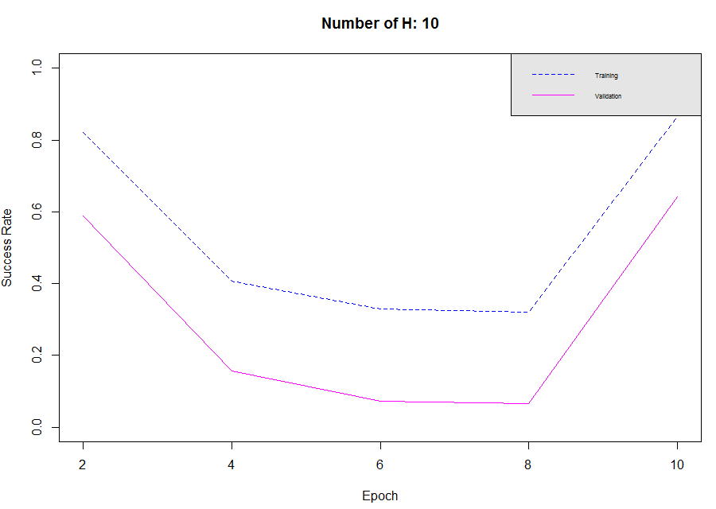
Multi Layer Perceptron - Backpropagation
It takes too much time to finish multi layer perceptron network with full feature set and balanced data with duplicating minority class.
So, here is a sample result with only 10 epochs and 10 hidden units.

Slide 11
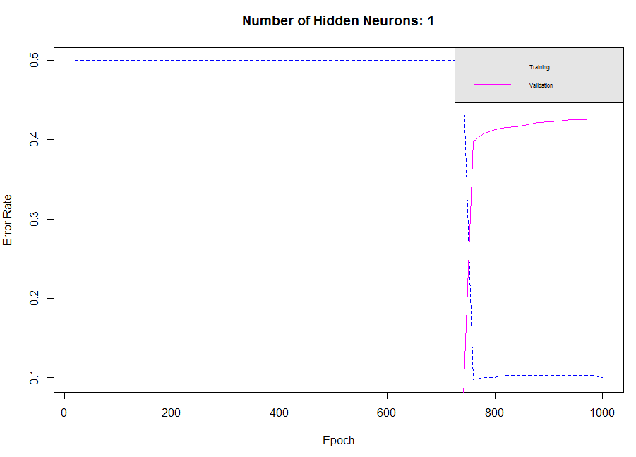
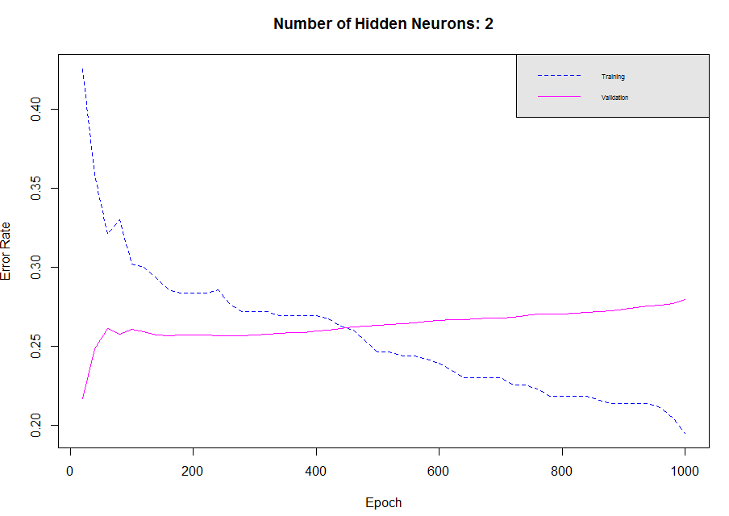
Multi Layer Perceptron - Backpropagation
Balanced data with majority deletion

Slide 12
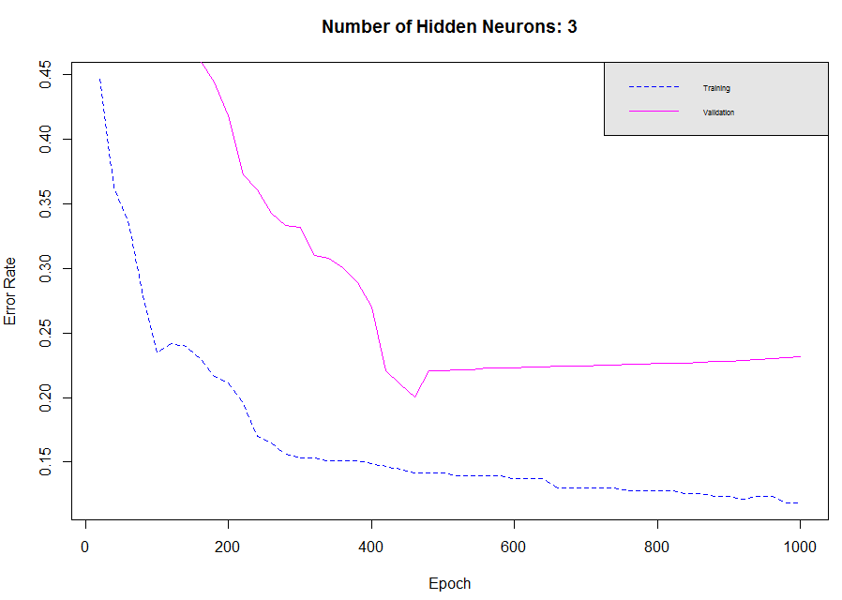
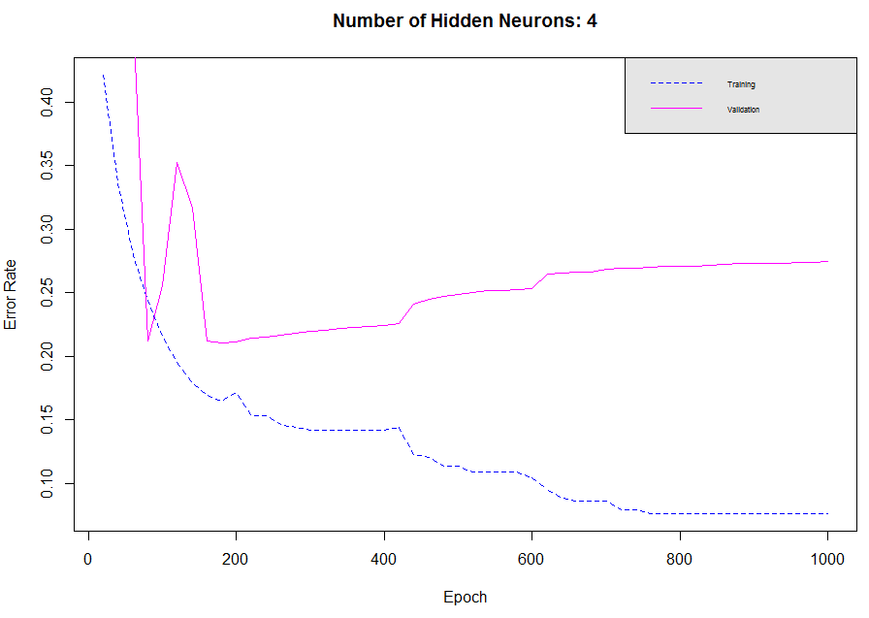
Multi Layer Perceptron - Backpropagation

Slide 13
Multi Layer Percetron - Result
It takes too much time to train MLP with full set of features. If there is limited time, using selected features and minimizing number of records is essential.
Using selected feature set and balanced data produces applicable results.
For this experiment, using 3 hidden neurons produces best fit.
Unbalanced data; not tested

Slide 14
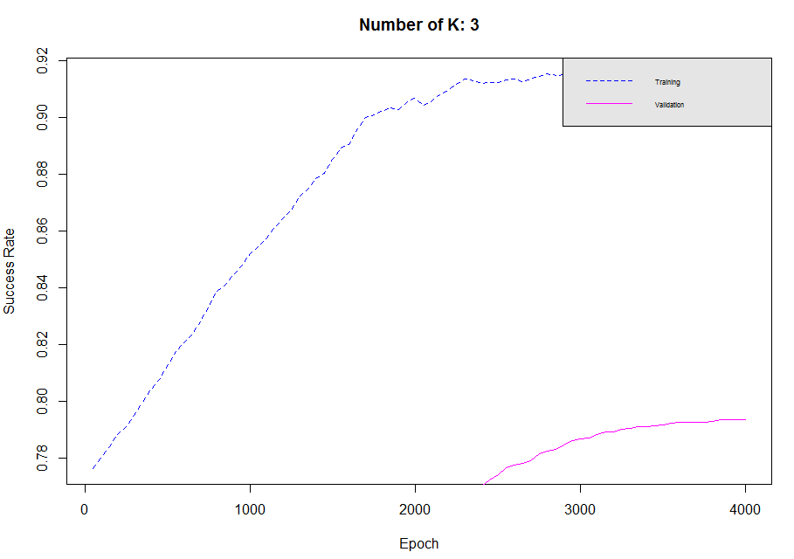
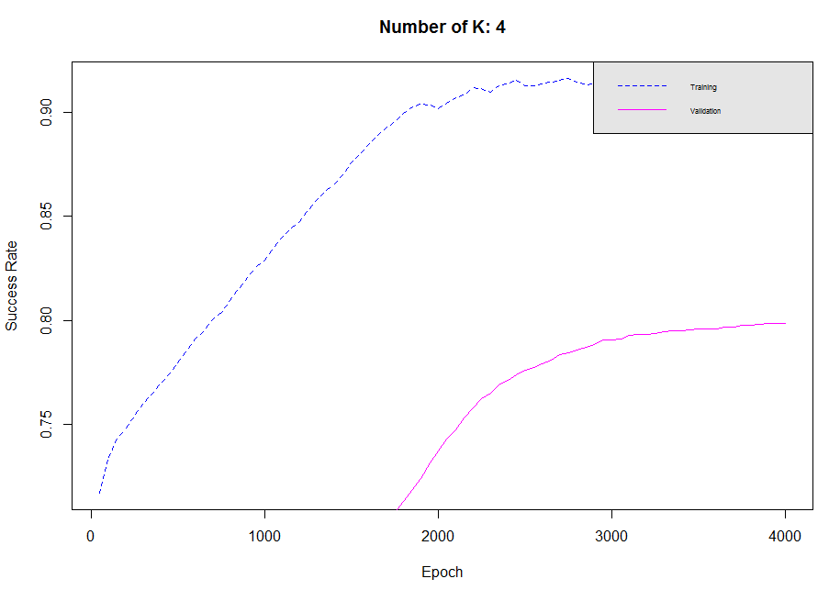
Radial Basis Function
Using balanced data that is created with duplication minority class.
Executed with K from 3 to 9. All has similiar results.

Slide 15
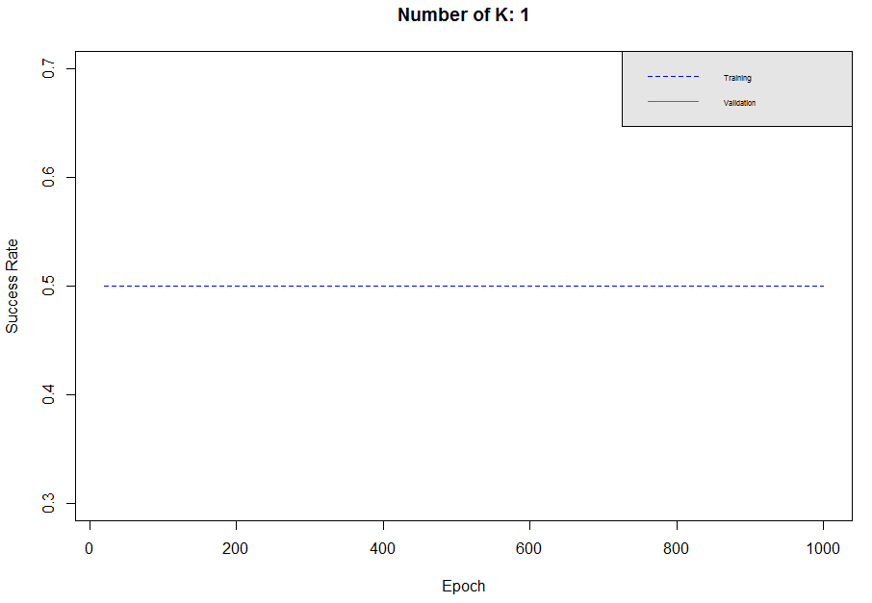
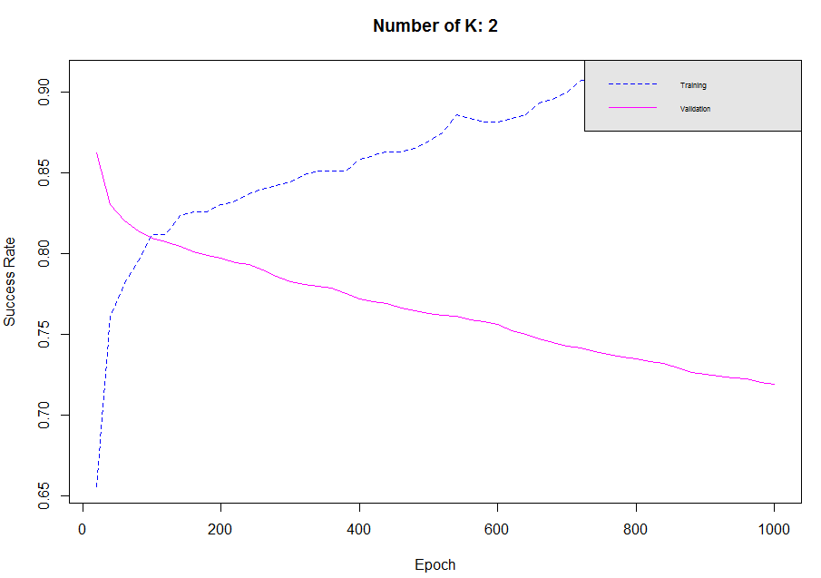
Radial Basis Function
Using balanced data that is created with deleting majority class.
Executed with K from 1 to 4.

Slide 16
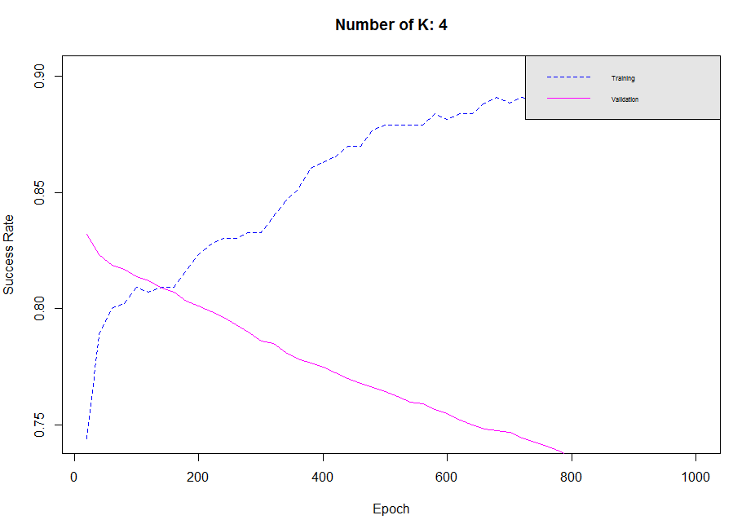
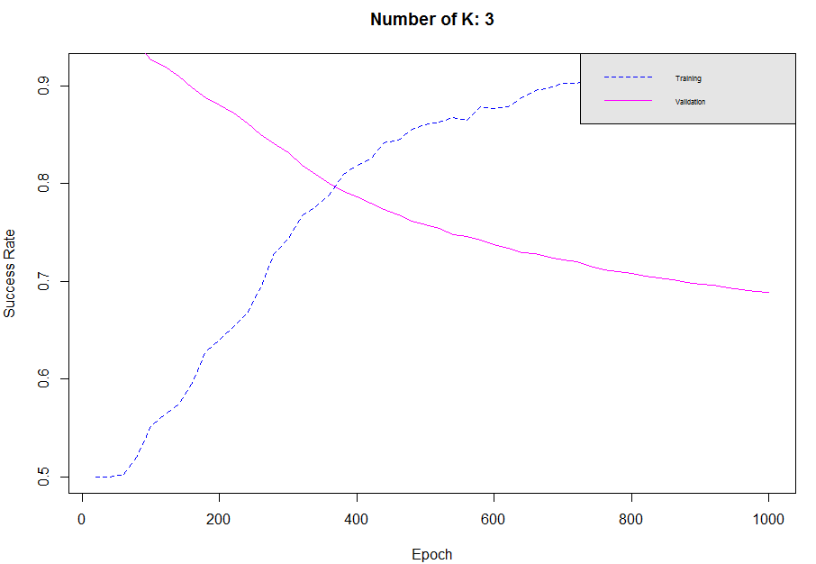
Radial Basis Function

Slide 17
Radial Basis Function
These results show some interesting statistics. Although validation success seems to be decreasing as iteration increases, model does learn how to classify a player as an all-star. First let’s look at the truly/falsely classified records.
K | epoch | TP | FP | TN | FN | %
3 | 20 | 0 | 0 | 215 | 215 | 0,5
3 | 40 | 0 | 0 | 215 | 215 | 0,5
3 | 60 | 1 | 0 | 215 | 214 | 0,502326
3 | 80 | 9 | 0 | 215 | 206 | 0,52093
3 | 100 | 22 | 0 | 215 | 193 | 0,551163
3 | 120 | 27 | 0 | 215 | 188 | 0,562791
3 | 140 | 32 | 0 | 215 | 183 | 0,574419
3 | 160 | 41 | 0 | 215 | 174 | 0,595349
3 | 180 | 55 | 0 | 215 | 160 | 0,627907
3 | 200 | 60 | 0 | 215 | 155 | 0,639535
3 | 220 | 67 | 1 | 214 | 148 | 0,653488
3 | 240 | 74 | 2 | 213 | 141 | 0,667442
3 | 260 | 85 | 2 | 213 | 130 | 0,693023
K | epoch | TP | FP | TN | FN | %
3 | 20 | 0 | 0 | 3904 | 216 | 0,947573
3 | 40 | 0 | 0 | 3904 | 216 | 0,947573
3 | 60 | 110 | 77 | 3827 | 106 | 0,955583
3 | 80 | 149 | 164 | 3740 | 67 | 0,943932
3 | 100 | 160 | 245 | 3659 | 56 | 0,926942
3 | 120 | 176 | 287 | 3617 | 40 | 0,920631
3 | 140 | 184 | 340 | 3564 | 32 | 0,909709
3 | 160 | 189 | 392 | 3512 | 27 | 0,898301
3 | 180 | 195 | 439 | 3465 | 21 | 0,88835
3 | 200 | 204 | 482 | 3422 | 12 | 0,880097
3 | 220 | 210 | 522 | 3382 | 6 | 0,871845
3 | 240 | 211 | 565 | 3339 | 5 | 0,86165
3 | 260 | 213 | 615 | 3289 | 3 | 0,85

Slide 18
Radial Basis Function
These results show that although success rate of valdiation process decreases, model learns how to classify all-star records.
The reason of high success rate in the starting point of validation, is because of dominance of non all-star players.
There are also missclassified non all-star players as all-star. The reason is, there can be only 12 all-star players in a year. Although a player has a all-star statistics, he may not be selected as one. So, model thinks he is an all-star player.

Slide 19
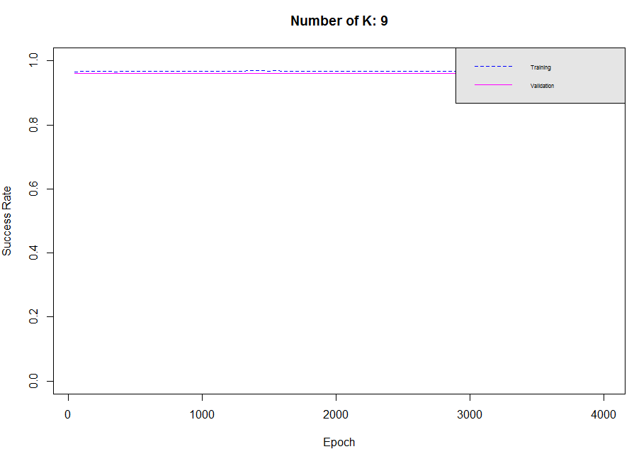
Radial Basis Function - UnBalanced
It seems it has a great success rate, considering 1.0 as the highest. But, the result is caused by dominant non-all-star players.
As seen in the plot, success rate doesn’t fluctuate at all, this means it does not learn how to classify an all-star player.

Slide 20
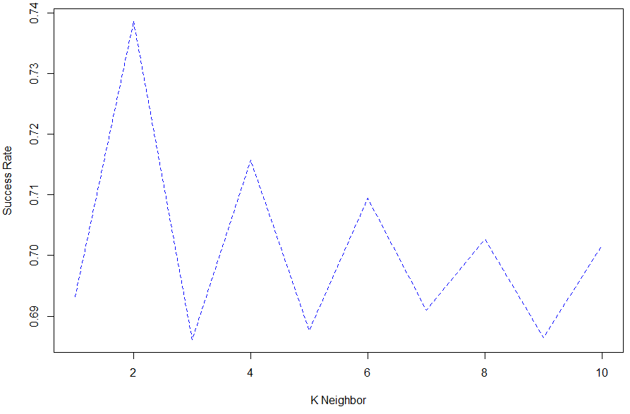
K-Nearest Neighbor
K-NN is quite a simple algorithm compared to 2 previously discussed one; MLP, RBF.
As shown in the plot, it generates best result with K=2.
But despite its simplicity and good success rate, It doesn’t produce as good as MLP and RBF.
Plot is generated with only selected features.

Slide 21
Result
All results of all experiments are better and faster with data balancing.
In MLP, feature selection part is essential if you are running algorithms with limited hardware on personal computers.
There can be some situations where success rate is decreasing although algorithm learns how to classify correctly.
As compared to limited MLP experiments, I can say that RBF converges faster than MLP and produces similiar success rate with MLP.
KNN has similiar structure, good results but not as good as RBF or MLP.

