Slide 1
Supplements
Chapter 3

Slide 2
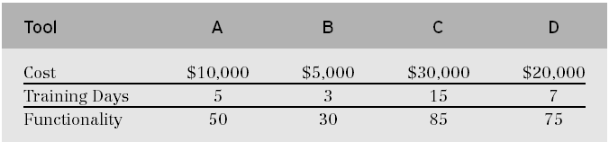
Tool Cost/Training/Functionality Data
Copyright 2004 by Pearson Education, Inc.

Slide 3
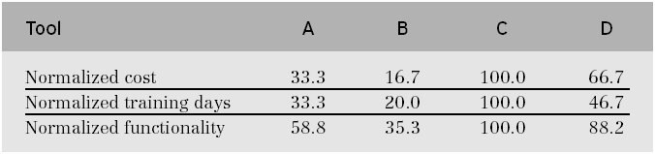
Normalized Tool Cost/Training/Functionality Data
Copyright 2004 by Pearson Education, Inc.

Slide 4
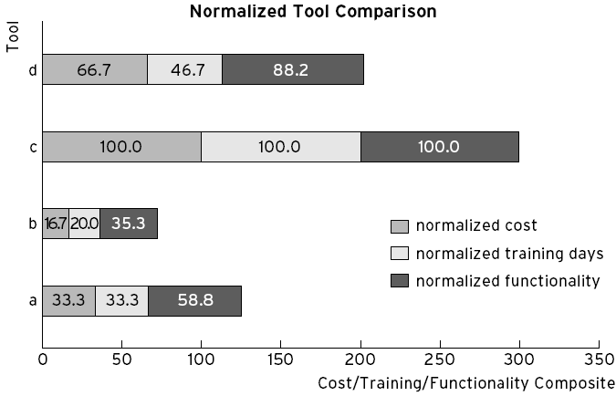
Normalized Tool Comparison Graph
Copyright 2004 by Pearson Education, Inc.

Slide 5
Software Project management Tools
Microsoft Project
  A project management software program developed and sold by Microsoft.
  It is designed to assist project managers in developing plans, assigning resources to tasks, tracking progress, managing budgets and analyzing workloads.
  Creating path schedule and charts.
Copyright 2004 by Pearson Education, Inc.

Slide 6
Software project management Tools
JIRA
  an agile project management tool that supports different agile methodology.
  It helps plan, collaborate, report, track, and manage all agile software development projects from a single tool.
  Project templates, timelines, assigning tasks and responsibilities, monitoring progress, team communication.
Copyright 2004 by Pearson Education, Inc.

Slide 7
Software project management Tools
ClickUp
  ClickUp is a cloud-based project management software with workplace collaboration tools in a single platform.
  ClickUp tools serve planning, brainstorming, development, tracking, Gantt charts, tasks visualization, human resources, marketing, and business operations, AI suuport
Copyright 2004 by Pearson Education, Inc.

Slide 8
Version Control Software Tools
  Track and manage changes during development and maintenance of any long-lived set of files. They tell you who changed what, when.
    Git: Git is a distributed version control system that tracks versions of files. It is often used to control source code by programmers who are developing software collaboratively.
Copyright 2004 by Pearson Education, Inc.

Slide 9
Version Control Software Tools
    IBM DevOps Code ClearCase: It features parallel development support, automated workspace management, baseline management, secure version management, reliable build auditing, and flexible access virtually anytime, anywhere
Copyright 2004 by Pearson Education, Inc.

Slide 10
Documentation Generation Software Tools
JavaDoc
  A tool that reads Java source code and generates documentation in HTML format.
NDoc
  automatically generates documentation for .NET environment
Doxygen
  It automates the generation of documentation from source code comments, parsing information about classes, functions, and variables to produce output in formats like HTML and PDF.
Copyright 2004 by Pearson Education, Inc.

Slide 11
Bug tracking Software Tools
Allow users to enter bug reports or used only internally in a company doing software development.
A major component is database that records facts about known bugs:
  the time a bug was reported
  its severity
  the identity of the person who reported it and any programmers who may be working on fixing it.
Examples: Trac, BugZilla, Jira, Redmine
Copyright 2004 by Pearson Education, Inc.

