Slide 1
Library Noise Detection
Senior Project I
Supervisor:
Dr. Sami Awad
Prepared by:
Aysar Wishahi-CSE-201610888
Yazan Jarrar-CSE-201610711
Yazan Khalaf-CSE-201611675

Slide 2
Introduction:
A library is a place to study, research, and read books and it is meant to be quiet and not noisy, so keeping it that way is part of a librarian's job. Sometime a noisy crowd would visit the library which may trigger the librarian to warn them of the noise level. Our system solves this problem for the librarians by installing sensor (detection) devices on tables that would indicate the level of noise of that table then represent the loudness level via LEDs which are placed on the device and warn the librarian by sending a notification via our mobile application.

Slide 3
Aims and Objectives:
The main objective of this system is to give the visitors an indicators of the loudness of their voices, make the librarian's job easier give the judgment of librarian more fairness and make the library a better place for study and reading.
This all will be achieved through a device that will be placed on every table that when some conditions are met will notify the librarian of the noisy table.

Slide 4
Problem Statement:
In most libraries there is no noise detection system even in libraries that has one it is a big sensor placed on every hall cell and is wired connected to the librarian computer the problem is that this way is not flexible for librarian and sometimes the librarian does not know for sure the specific source of noise and does not give the visitors the ability to self-monitor their selves.

Slide 5
Existing System:
1)Noise Detector with Automatic Recording System Using Arduino With the IoT:
This uses a set of components that work together in order to achieve the goal of quiet and reasonably unobtrusive sound so the system use a noise detector that consists of the power of the Arduino and connect the Bluetooth with the app When your sound level crosses the threshold value, the Noise Detector device will buzz to notify about it and at the same time the app will start recording the sound and it will go on recording until the noise level comes down below the threshold level.

Slide 6
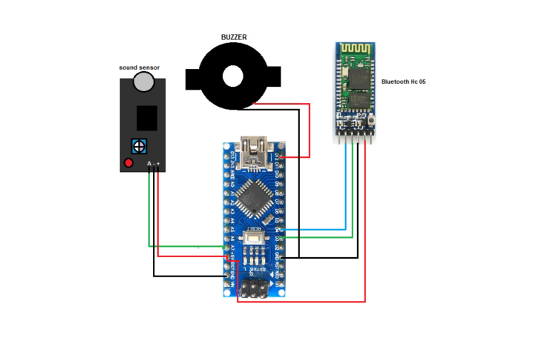
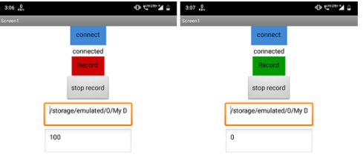
Advantages:
1- It can record voice for one minute and save it.
2- It is connected to the android device using an application wirelessly.
Disadvantages:
1- The distance between mobile and device should be small due to the Bluetooth connection.
2- Can’t connect more than one device due to Bluetooth limitations.
3- It has a buzzer so it’s annoying.

Slide 7
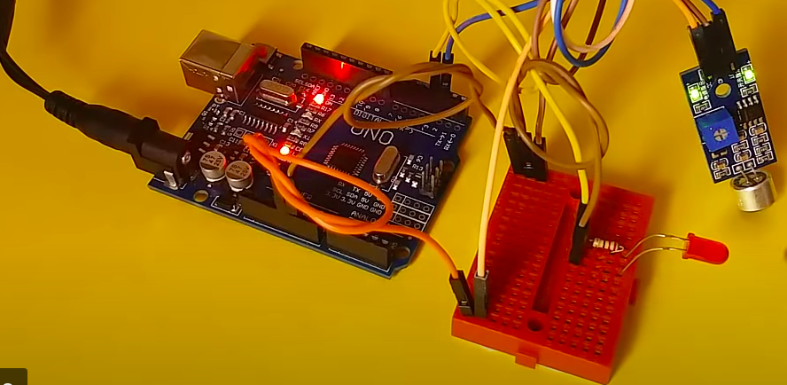
2)Design and Construction of noise detector in Library:
This project is for the design and construction of the NOISE DETECTOR IN LIBRARY. This device is able to detect the noise, compare the intensity of louder sound, and hence producing the warning signal to the librarian. This system is very economical and helpful in maintaining peace in the library.

Slide 8
Advantages:
1- It is simple.
Disadvantages:
1- It should be wired all through the library.
2- If there is a big number of devices it will take a big space like a wall of lids.
3- Librarian can’t moves around freely.
4- One level of indicator.

Slide 9
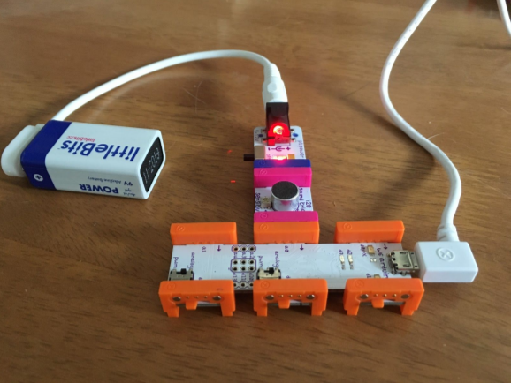
3)Noise alarm:
This project creates a visual noise detector, using Little Bits sensors to relay noise information via an Arduino board through to our Processing-based software system that will visually indicate when the noise has been detected.

Slide 10
Advantages:
1- It is simple.
2- Multiple levels of indicators.
Disadvantages:
1- It should be wired all through the library.
2- If there is a big number of devices it will take a big space like a wall of lids.
3- Librarian can’t moves around freely.

Slide 11
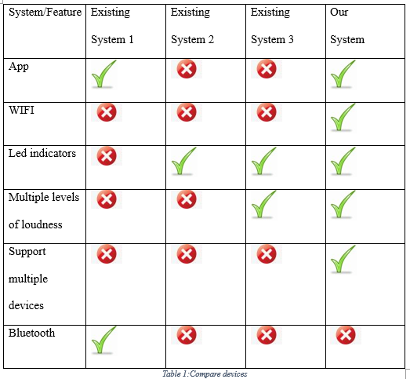
System Analysis:

Slide 12
User Requirements:
The devices should be connected to the network wirelessly.
The librarian should get notified of the loud table via an application.
The librarian should be able change the number of the devices (Tables) via the application.
The library should be able to add new devices to new tables.
The library visitors should be able to see their voices loudness via LEDS placed on the devices.

Slide 13
Functional Requirements:
The system should keep sensing voices continuously.
The system should be able stay working day and night (all the time).
The system should compare the detected voices to decide loudness level.
The system should notify the librarian of the loud table via an application.
The system should display the voice loudness for the library visitors via LEDS.
The system should allow to librarian to change device number via the application.
The system should be able to acquire the IP address from router DHCP to the devices.

Slide 14
Non-Functional Requirements:
Speed: Response time for the noise should not exceed 1 second.
Size: device size should be acceptable, small size is preferred to be placed on the desks.
Ease of use: the application should be easy enough for users to use without training and device easy to install.
Reliability: It should give the correct information about the table number that has level three loudness.
Cost: the system should be cheap because it needs multiple device one for each table.
Portability: the librarian should be able move inside library freely and still get notification from devices.

Slide 15
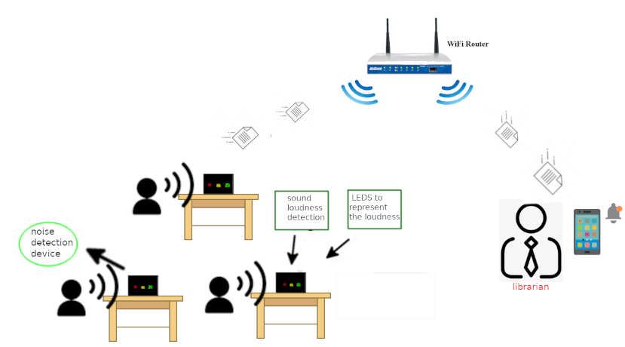
Noise Detection System Diagram:

Slide 16
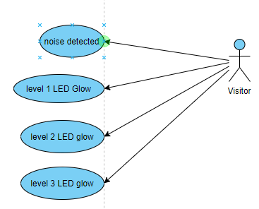
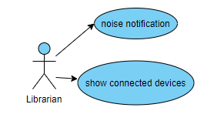
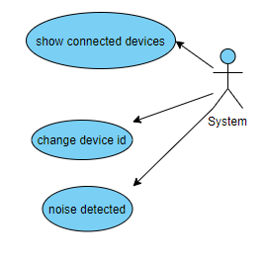
Use Case Diagram:

Slide 17
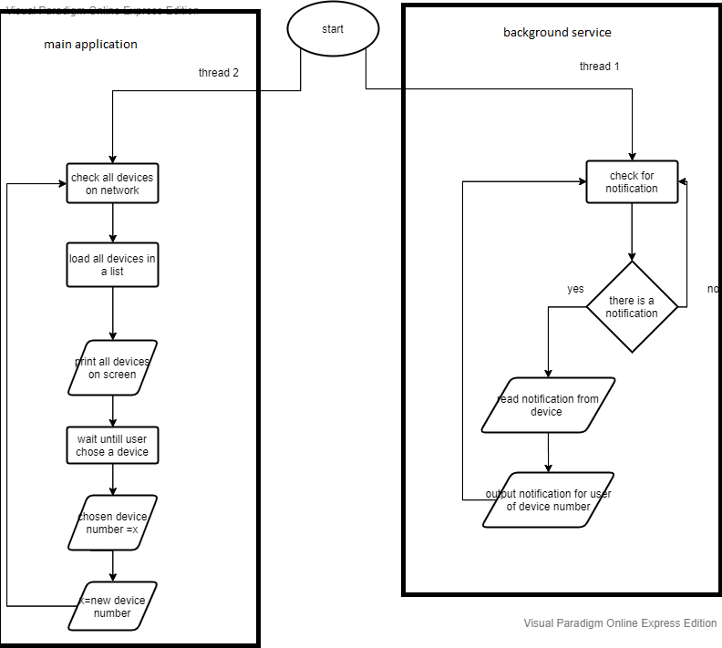
Flowchart:
1)Application:

Slide 18
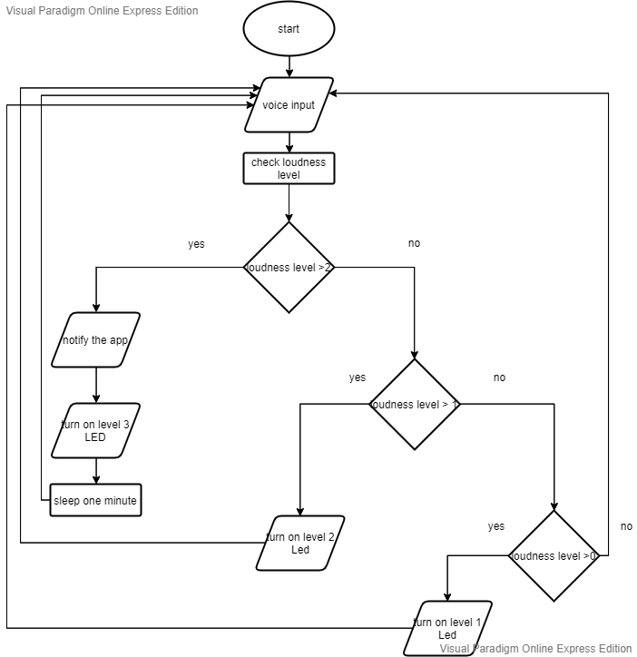
2)Device:

Slide 19
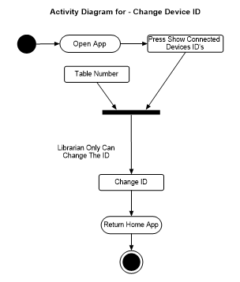
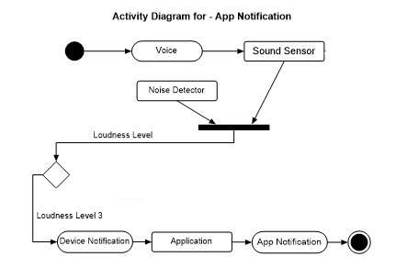
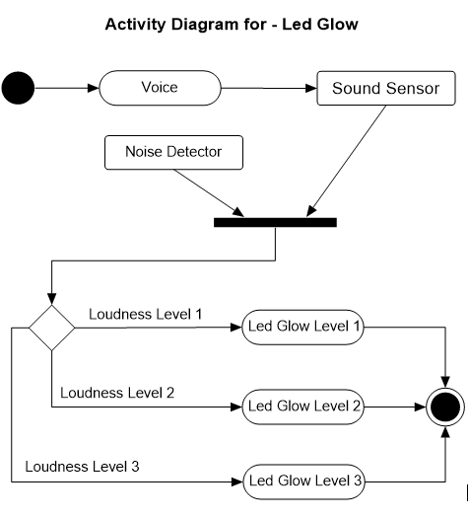
Activity Diagram:

Slide 20
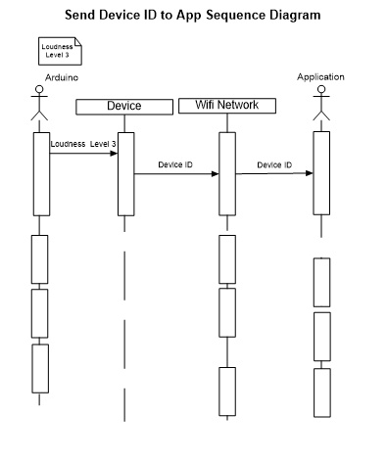
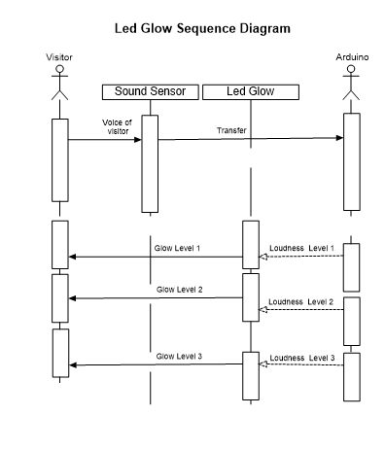
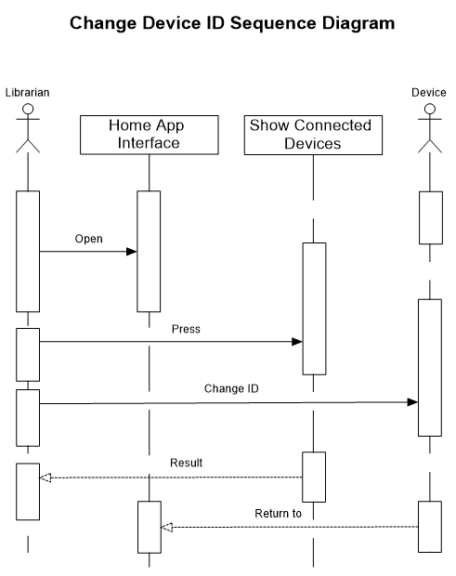
Sequence Diagram:

Slide 21
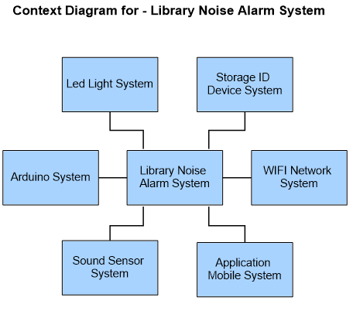
Context Diagram:

Slide 22
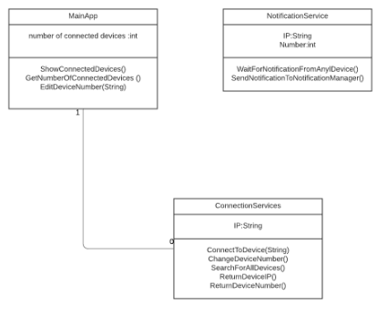
Class Diagram:

Slide 23

Software Component:
Flutter (Dart):

Slide 24
Software Description:
Flutter: Offering cross-platform, native-like, and superior experiences, Flutter has emerged as one of the top choices for cross-platform app development. (we chosen flutter over other option because it is strongest cross platform for smart phone application programing).

Slide 25
Hardware Components:
1) Arduino Uno
2) Wi-Fi Module
3) SD Card Module
4) SD Card
5) LED
6) Microphone Sound Detection Sensor Module

Slide 26
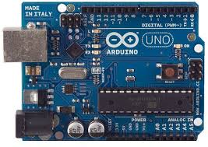
Hardware Description:
1)Arduino Uno: Is an open-source microcontroller the board is equipped with sets of digital and analog input/output pins that may be interfaced to various expansion boards and other circuits and it can be programed using C++.

Slide 27
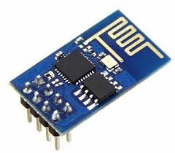
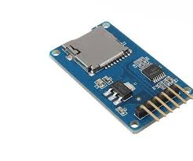
2) Wi-Fi Module : Self-contained SOC with integrated TCP/IP protocol that can give any Arduino access to Wi-Fi network.
3) SD Card Module : It is an interface to give ability to add SD Card to the Arduino.

Slide 28


4) SD Card: It is a form of small non-volatile memory.
5) LED: Is a semiconductor light source that emits light.

Slide 29
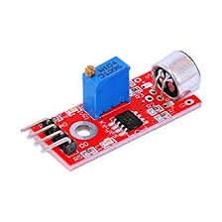
6) Microphone (Sound Detection Sensor) Module: It gives a measurement of how loud a sound is.

Slide 30
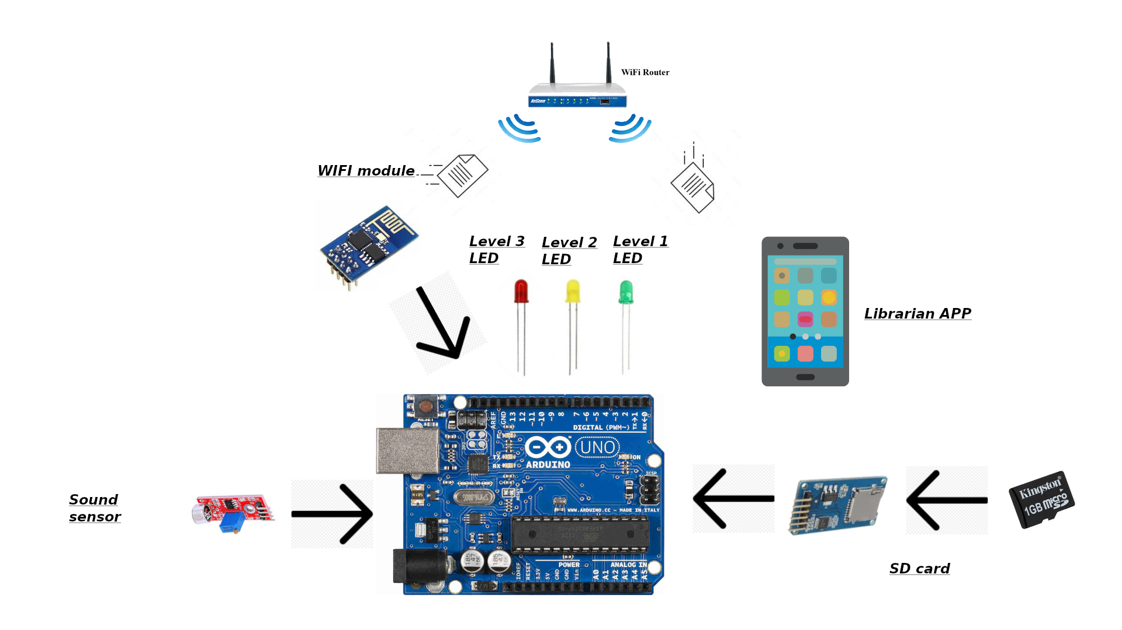
System Architecture and Algorithms:

Slide 31
Voice Loudness Levels:
In this section we will decide the loudness levels in real world value and represent them as Decibels.
Loudness Level:
Level 1: 50 dB
Level 2: 60 dB
Level 3: 70 dB

Slide 32
Conclusion:
In this project, we have provided an initial design for a system that should help to keep library quiet for visitors so it provides a healthy learning atmosphere. Make the librarian job easier by adding IOT to his job, all of that will be achieved by our system that will give the visitors a self-monitoring by keep them in track of their voices loudness via LEDs and notify the librarian if the visitor got so noisy.

Slide 33


Thank you for listening
Any questions

