Slide 1
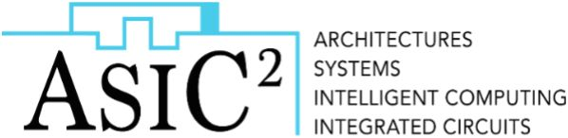
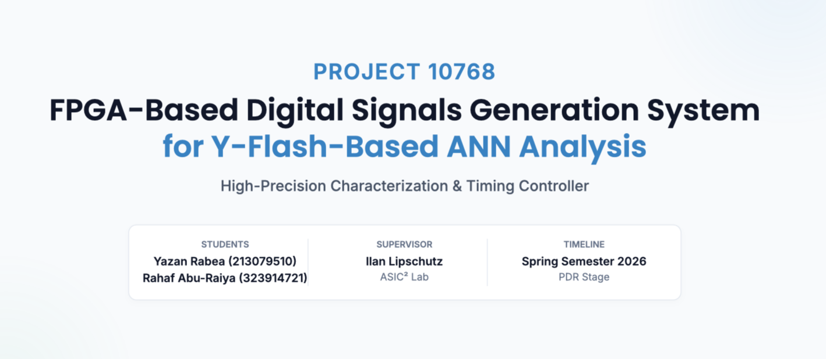

Slide 2
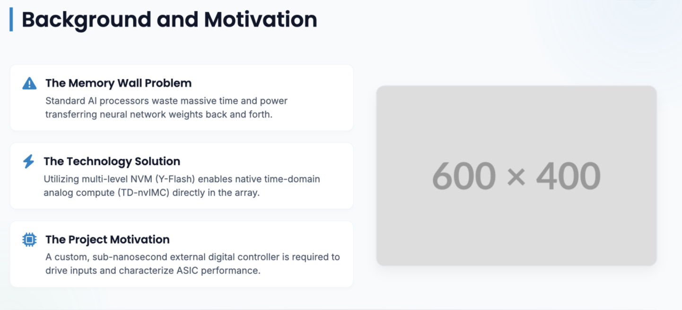
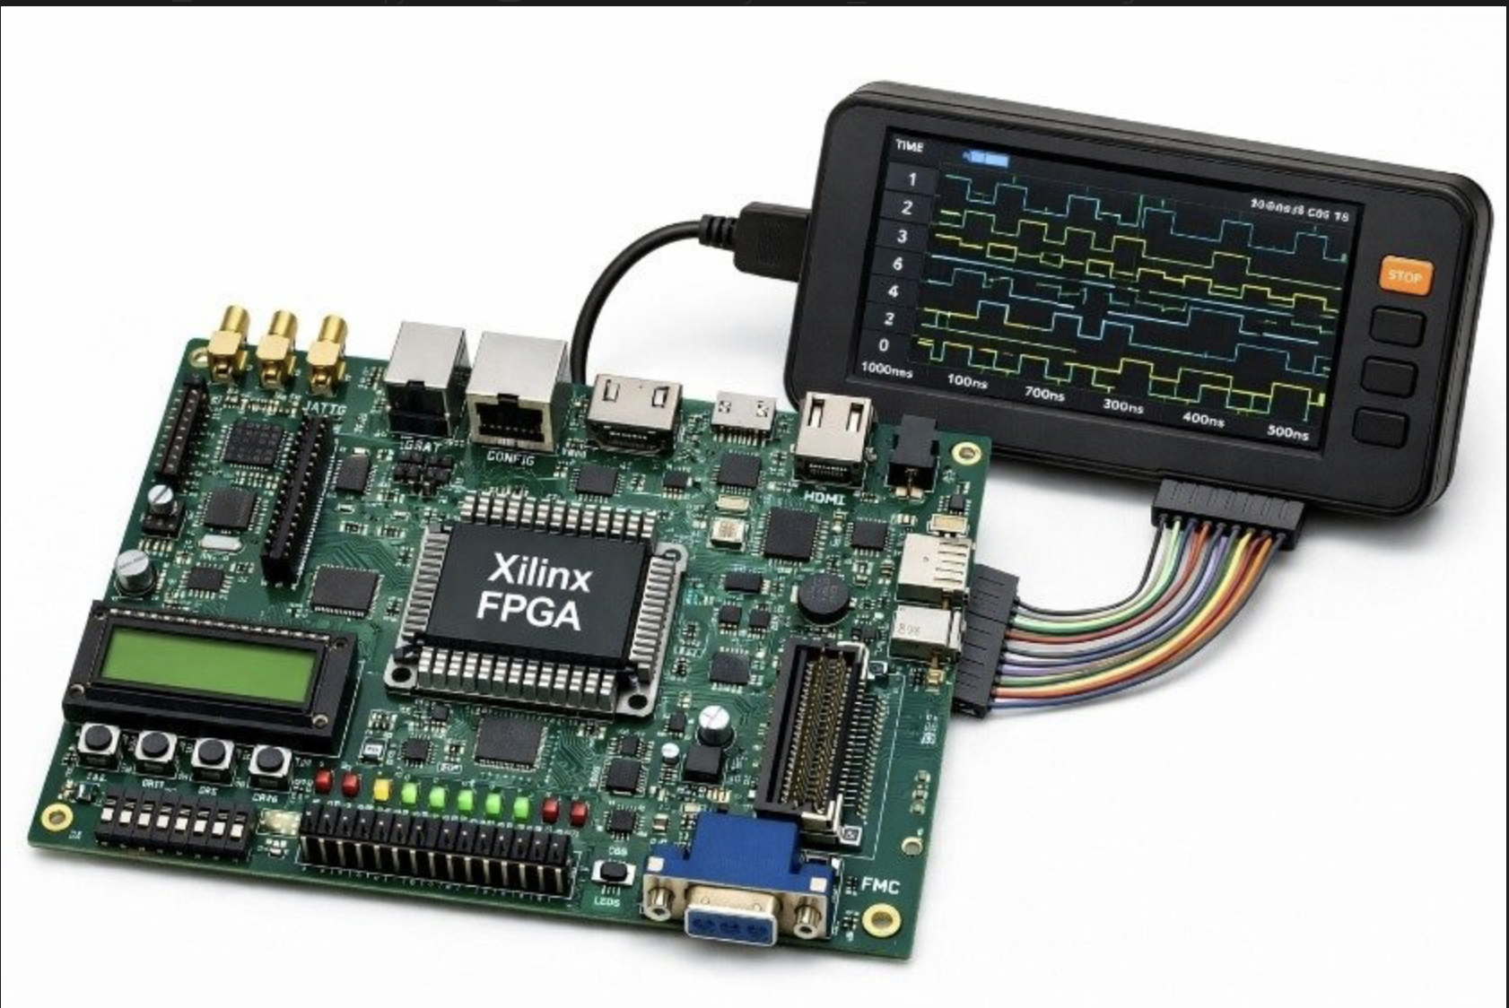
Notes:
The Problem (The Memory Wall): Standard AI processors waste massive amounts of time and power moving neural network weights back and forth between separate memory and processing units.
The Technology (The Solution): Utilizing multi-level non-volatile memory (Y-Flash) allows the system to perform analog computations directly inside the memory array in the time domain (TD-nvIMC).
The Project Motivation: The lab's experimental ASIC needs a highly precise, reliable, and custom external digital controller to drive its inputs so the researchers can physically measure and characterize its performance.

Slide 3
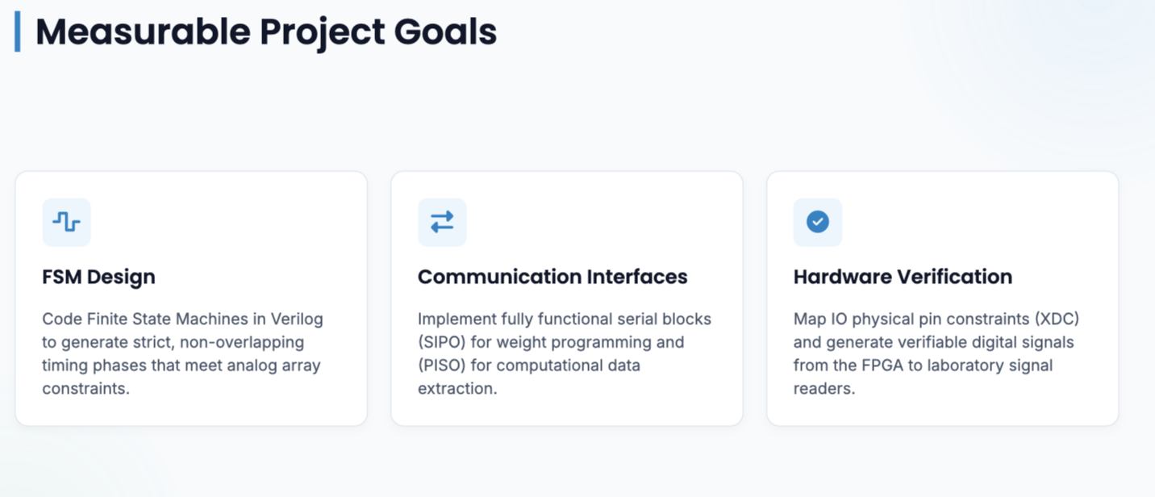
Notes:
FSM Design: Code Finite State Machines in Verilog to generate strict, non-overlapping timing phases that meet constraints of the analog memory array.
Communication Interfaces: Implement fully functional digital serial communication blocks to drive the chip's (SIPO) for weight programming and (PISO) for data extraction.
Hardware Verification: Successfully map the IO constraints (XDC) and generate verifiable physical signals from the Xilinx FPGA, validated via signal readers.

Slide 4
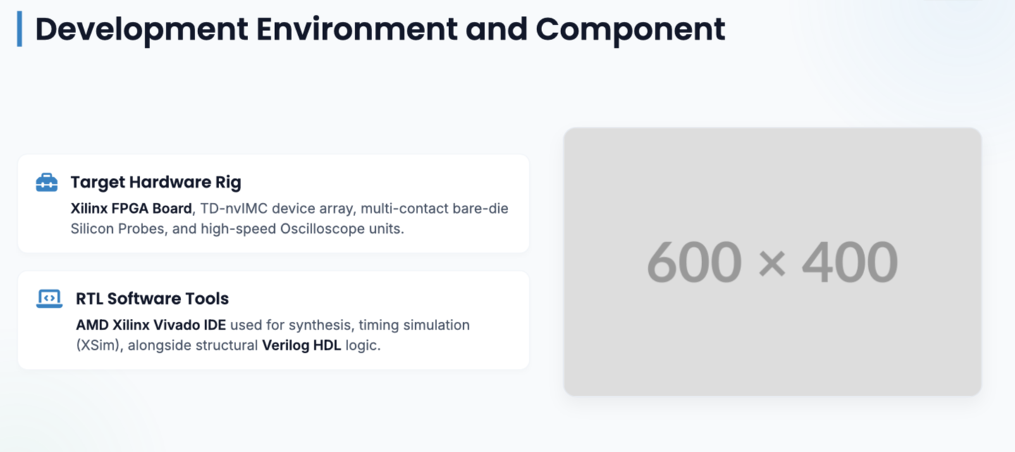
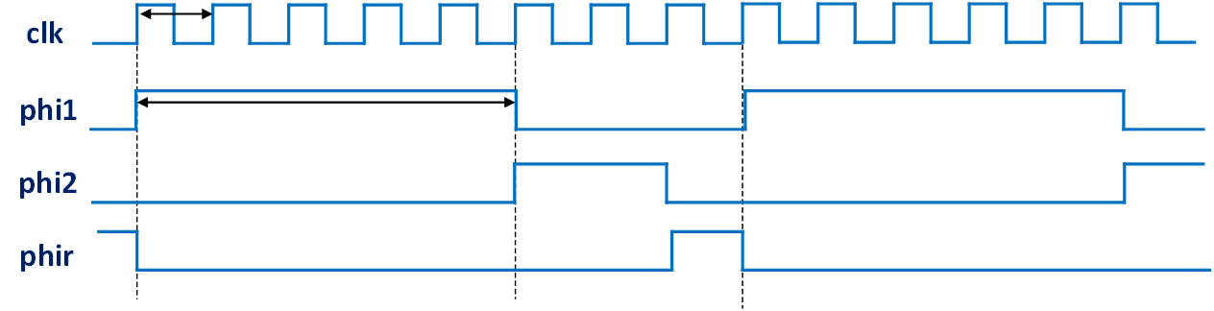
Notes:
Hardware:
Xilinx FPGA Development Board.
Target Device: TD-nvIMC.
Test Fixture: multi-contact Probe for bare-die silicon contact.
External Lab Equipment: Power supplies and an oscilloscope.
Software:
AMD Xilinx Vivado: The primary IDE for RTL synthesis, XSim simulation, and bitstream generation.
Verilog: The Hardware Description Language (HDL) used to write the digital logic.
Alright, so this slide shows our actual setup, which basically connects our digital code to the physical world. On the software side, we’re keeping things standard—using AMD Xilinx Vivado to handle our synthesis and simulations, and writing all of our core logic in Verilog. The real hardware challenge is on the other side of the slide. Our target device is the lab's experimental Y-Flash chip. Since it’s bare silicon and doesn't have standard packaging pins, we have to use a specialized multi-contact probe card to physically touch the microscopic pads on the die. If you look at the waveform on the right, this is exactly what our code is driving. Our state machines have to generate completely non-overlapping timing phases. If these phases overlap by even a tiny bit, we risk shorting or messing up the data inside the analog memory array.

Slide 5
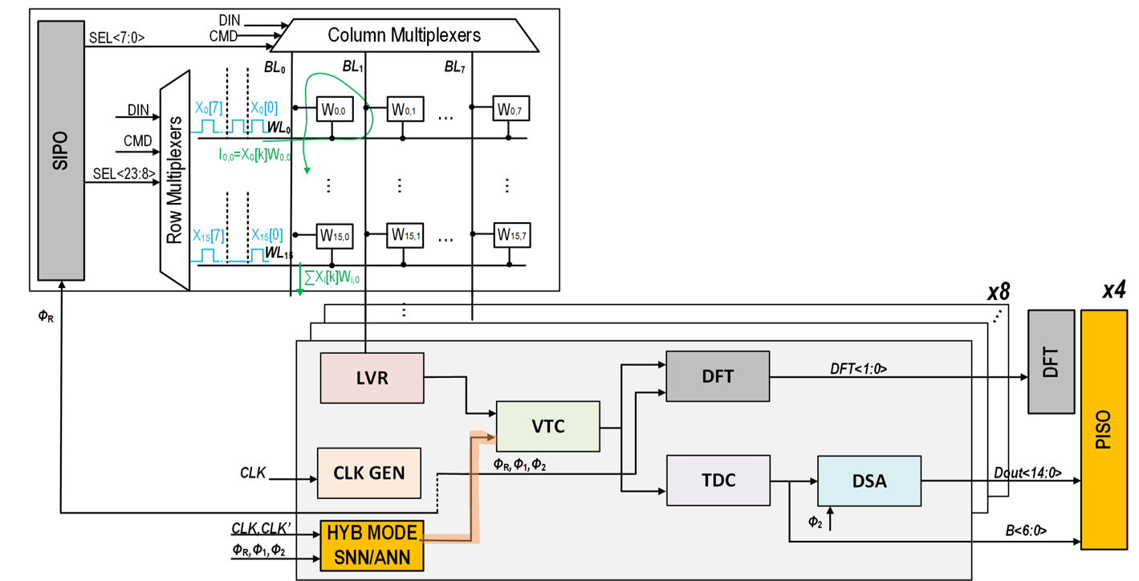
Block Diagram
FPGA

Slide 6
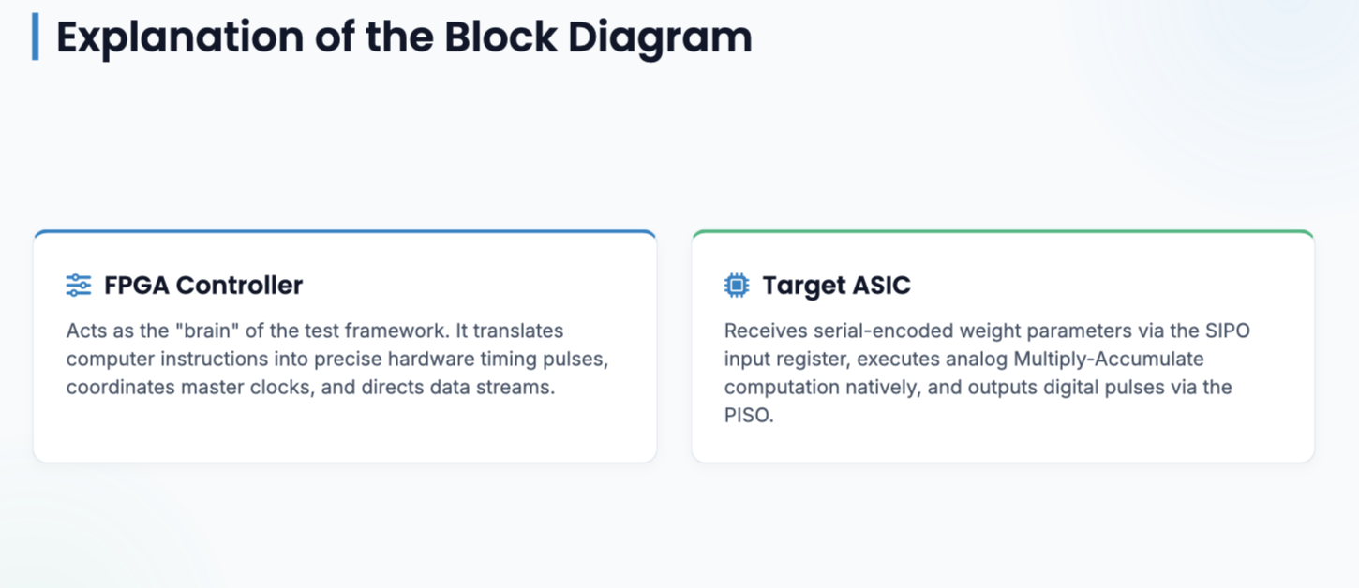
Notes:
FPGA Controller: The "brain" of the test framework. It translates PC commands into precise hardware pulses, synchronizes the master clocks, and dictates the exact flow of data into and out of the ASIC.
Target ASIC: Passively receives the serial weight data via the SIPO, performs analog Multiply-Accumulate (MAC) operations in the time domain, and shifts the final digital results back to the FPGA via the PISO.

Slide 7
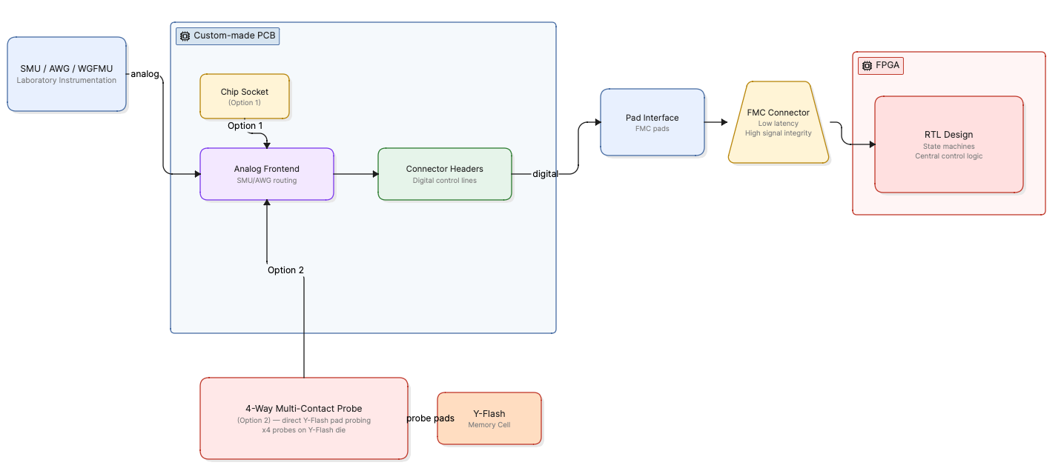
Example of functional chip analysis setup
Notes:
This slide illustrates the complete, zoomed-out signal path from the memory cell to our controller. To test the Y-Flash, our system supports two physical configurations: we can either probe the Y-Flash pads directly using a 4-way multi-contact probe station routed to a Custom-made PCB, or utilize a dedicated chip socket on the PCB itself. This custom PCB interfaces with external measurement units (SMU, AWG, WGFMU) for analog testing. Form there, the digital control lines are routed through connector headers out to a dedicated pad interface, which links directly to our FPGA via a FMC connector which gurantees low latency and high signla integrity. Finally, the signals land on our FPGA, where our RTL design acts as the central brain—managing the state machines, etc…

Slide 8
Mid-Semester Milestone
RTL Design Completion (Verilog): Implement Finite State Machines (FSMs) for strict, non-overlapping timing phases and integrate clock/timer modules.
Interface Coding: Complete Verilog blocks for the SIPO (weight programming) and PISO (data extraction) communication interfaces.
Behavioral Testbench: Set up a simulation environment in AMD Xilinx Vivado to model the target TD-nvIMC ASIC.
Feasibility Deliverable: Achieve successful Functional RTL Simulations (XSim). Present clear simulation waveforms proving synchronized data flow and timing accuracy before moving to physical hardware.
Notes:
For our mid-semester milestone, we want to have a completely verified design in simulation before we touch any expensive lab hardware. By the time we hit the middle of the semester, we plan to have all of our core Verilog code written—meaning the main state machines, timers, and clock blocks. We’ll also have the digital communication interfaces ready to go: specifically, the SIPO block to stream the neural network weights into the chip, and the PISO block to pull the calculated results back out. The ultimate goal here is to show you a solid behavioral testbench in Vivado. We want to show clear waveforms proving that our timing is rock-solid and everything is perfectly synchronized before we push anything to the physical FPGA.

Slide 9
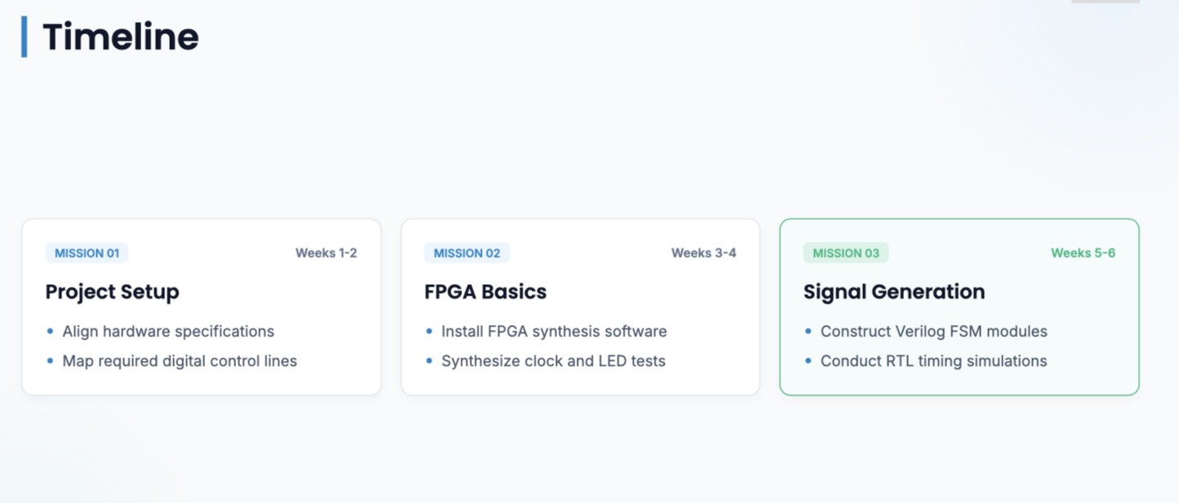
Notes:
Here is how we’re breaking down the first half of the semester, which covers weeks one through six. We’re starting out right now with project setup—basically locking down the exact hardware specs with Ilan and mapping out every single digital control line we need to drive. Moving into weeks three and four, we’re getting our hands dirty with the FPGA basics. We’ll get the tools installed, program our target Xilinx board, and test out basic things like clock dividers and flashing LEDs just to make sure our physical constraints are correct. Then, weeks five and six are all about signal generation, where we’ll dive deep into writing the actual Verilog FSMs and running our first serious timing simulations.

Slide 10
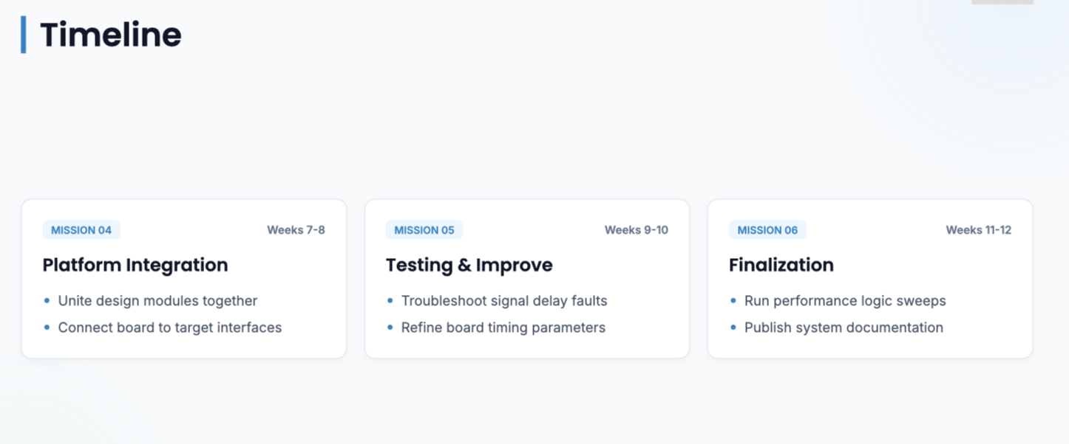
Notes:
The second half of the semester is where we shift from simulation to actual integration. In weeks seven and eight, we’ll stitch all of our separate digital blocks together and physically plug the FPGA into the lab's testing hardware. Weeks nine and ten are going to be a major testing and debugging window. We fully expect to deal with real-world noise and signal delays coming from the probe card lines, so we’ve allocated this time to troubleshoot those timing issues and tune our FSM parameters. Finally, in weeks eleven and twelve, we’ll run full performance sweeps, clean up our technical documentation, and hand over a reliable, finished system to the lab.

