Slide 1
ASP.NET CORE MVC · .NET 6 PROJECT
To-Do List Web Application
A simple web app where a user can sign up, sign in, and manage a personal to-do list. Built with ASP.NET Core MVC, Entity Framework Core and an SQLite database, using session state for login.
Group Members
Project Links (GitHub)
[ Full Name ] ID: [ Student ID ]
Source code:
[ GitHub repository link ]
[ Full Name ] ID: [ Student ID ]
Database file:
[ Full Name ] ID: [ Student ID ]
[ GitHub database file link ]

Slide 2
WHAT IT DOES
Functional Requirements
1
Sign up
2
Sign in
Create a new account (username + password).
Log in; the user is stored in a session.
3
Log out
4
Add task
Clear the session and return to sign in.
Add a new to-do item with a title.
5
Mark / delete
6
Search
Toggle a task Done/Pending, or delete it.
Find your tasks by title.
7
Change password
8
My details
Update the account password.
View the logged-in user's information.

Slide 3
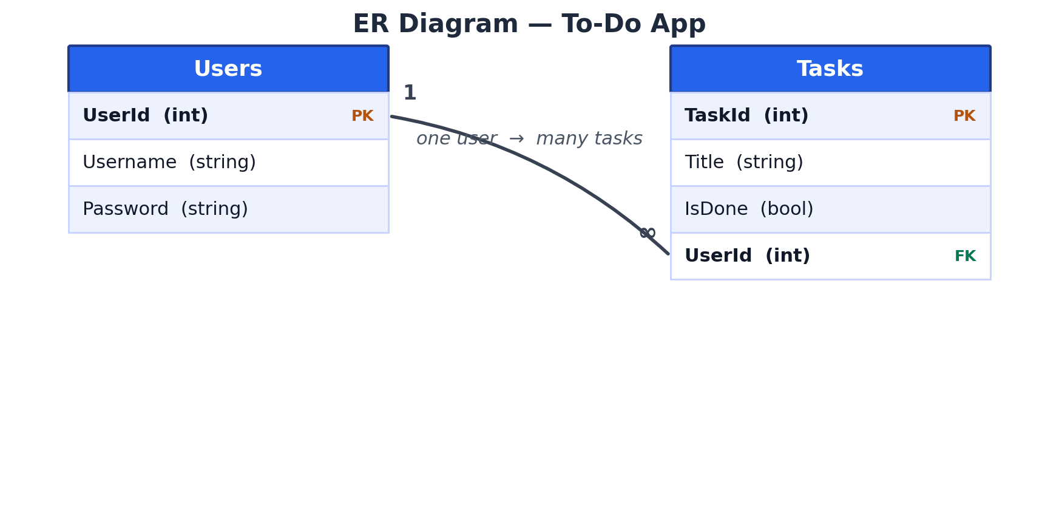
DATABASE
ER Diagram & Relational Tables
Two related tables
Users
UserId (PK), Username, Password
Tasks
TaskId (PK), Title, IsDone, UserId (FK → Users)
Relationship
One user has many tasks (1 : ∞).

Slide 4
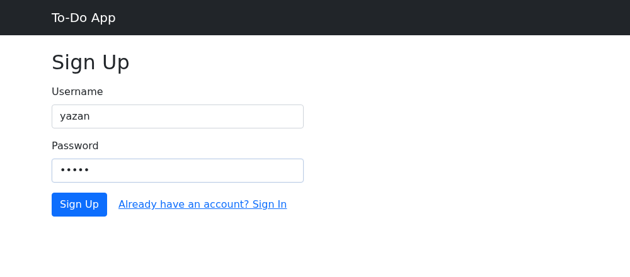
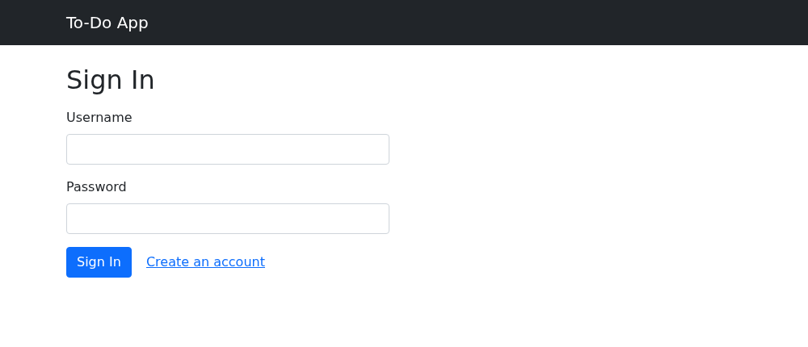
SCREENSHOTS
Sign Up & Sign In
Sign Up — create a new account
Sign In — log in to the app

Slide 5
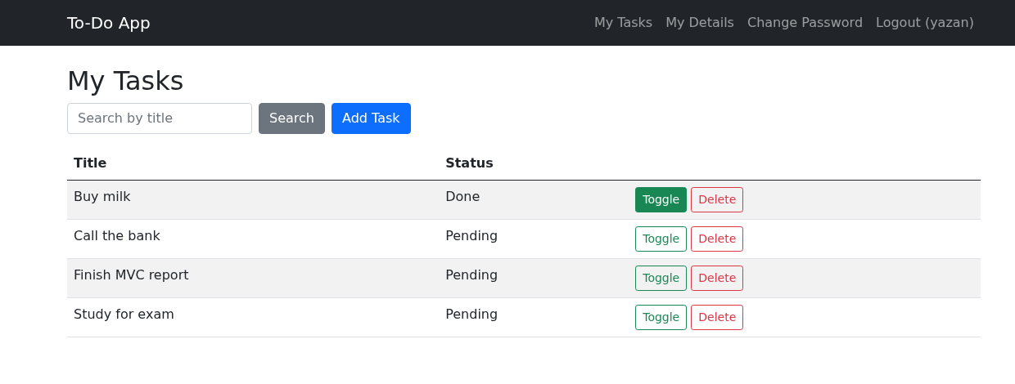
SCREENSHOTS
My Tasks — List, Toggle & Delete
The signed-in user's tasks. Each can be toggled Done/Pending or deleted.

Slide 6
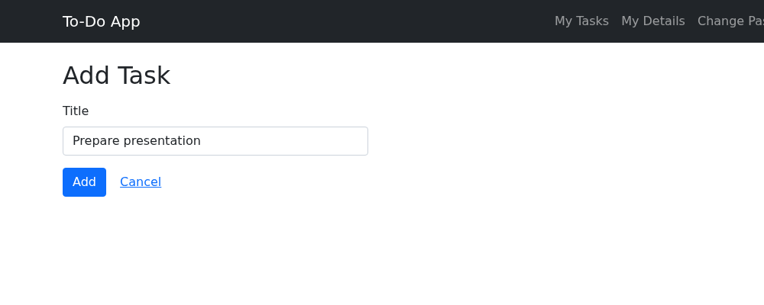
SCREENSHOTS
Add a New Task
Adding a task by typing its title, then pressing Add.

Slide 7
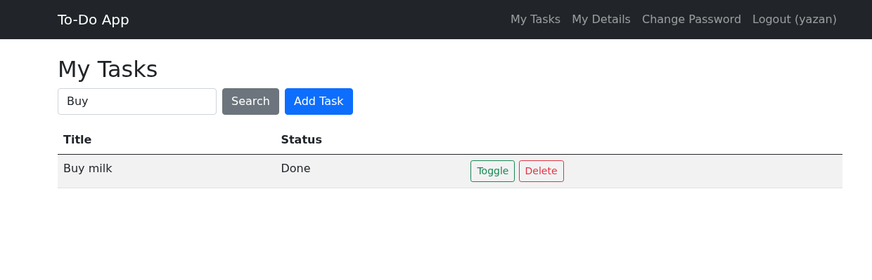
SCREENSHOTS
Search Tasks by Title
Searching for "Buy" shows only the matching tasks.

Slide 8
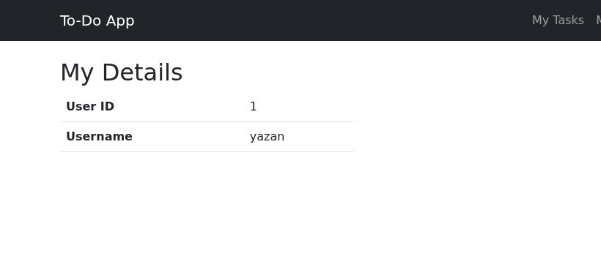
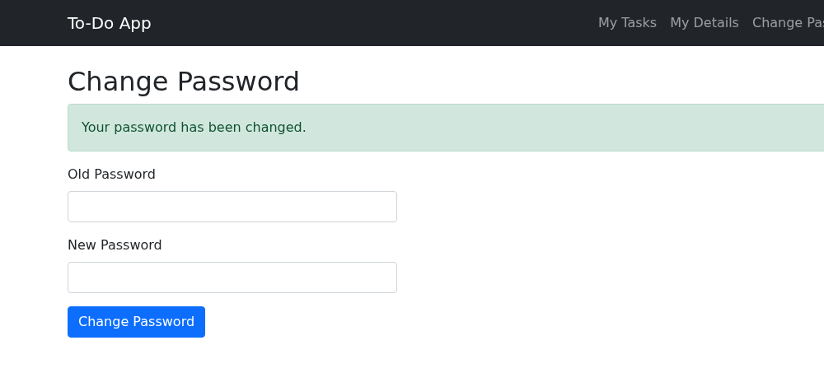
SCREENSHOTS
My Details & Change Password
My Details — the logged-in user's info
Change Password — updated successfully

