Slide 1

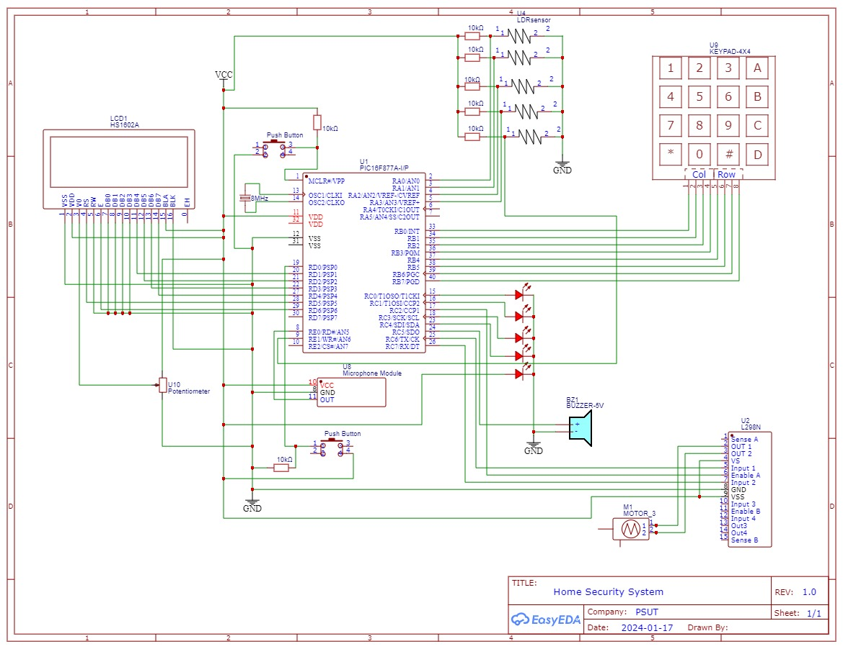
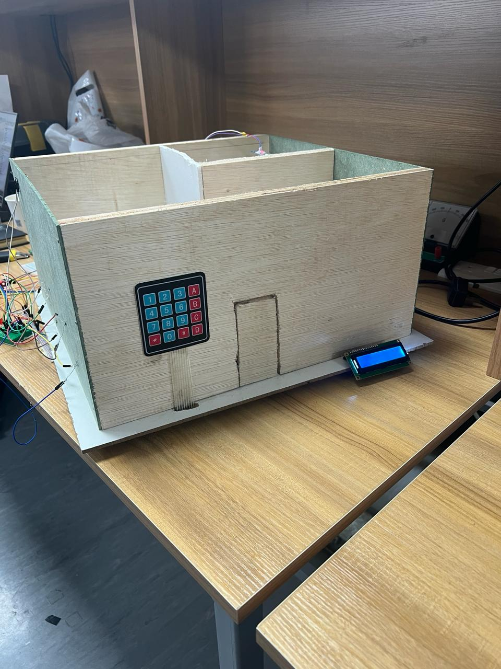
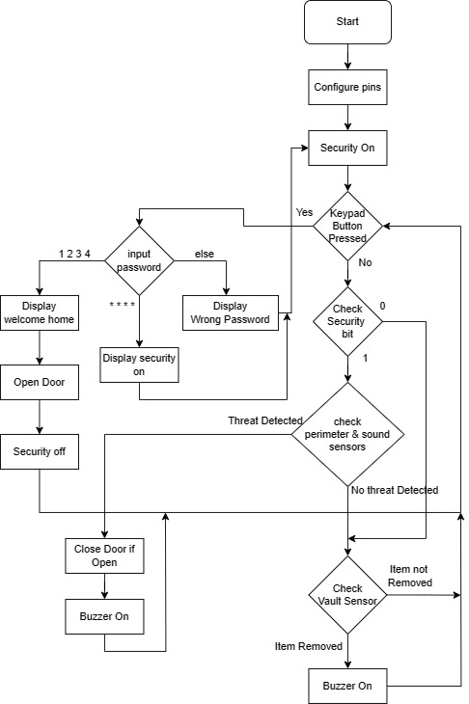
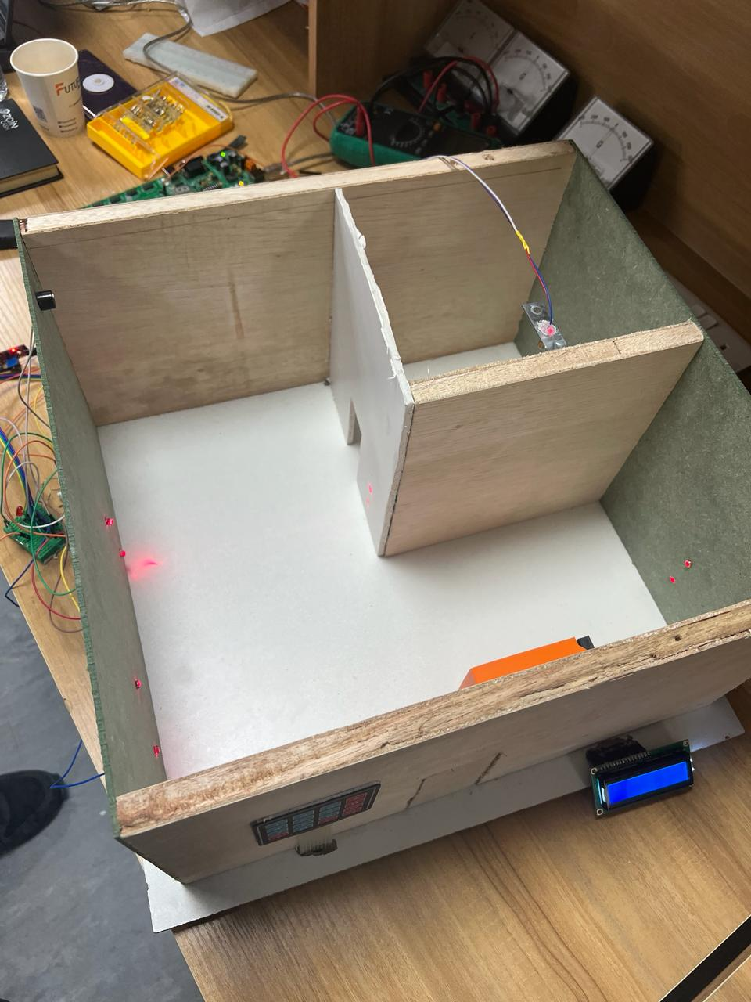
Home Security System
M.abdalaziz, Y. Abughazah, O. Shunnar
Supervisor: Dr. Belal Sababha Embedded Systems Final Design Project, Fall 2024 King Abdullah II School of Engineering
Princess Sumaya University for Technology
Design
Circuit for our home security system that contains all sensors and actuators.
Introduction
This report delves into an innovative smart home security system powered by the PIC16F877A microcontroller. Integrating LDR sensors, lasers, buzzer, door lock, microphone, keypad, and LCD display, the system offers a comprehensive solution for modern residential security. Emphasizing both effectiveness and user-friendliness, this introduction sets the stage for a closer examination of its key components and functionalities.
Results
The project aimed to design and implement a Home Security system using a PIC16F877A microcontroller. The design contained perimeter sensors(ldr’s), microphone sensor, keypad, and LCD that provided a secure home with all the necessary precautions.
Figure 1: Electrical design
Figure 3. The house from outside
Figure 2: Software Design
Figure 4. From inside
Conclusion
In conclusion, our smart home security system combines cutting-edge technologies for a comprehensive defense. The strategic placement of microphones for threat detection, a user-friendly keypad for access control, and the use of Light Dependent Resistors (LDRs) and lasers for perimeter detection showcase our commitment to proactive security.
The integration of a servo motor with the door lock system allows for unrestricted movement, ensuring secure and convenient door access. This system not only prioritizes safety and responsiveness but also exemplifies a user-friendly approach to modern smart home security with the use of an interactive LCD.

