Slide 1
ADE Practical Quick-start Guide
James Kramer
Artificial Intelligence and Robotics Laboratory
Department of Computer Science and Engineering
University of Notre Dame
Notre Dame, IN 46556, USA http://www.cse.nd.edu/~airolab/

Slide 2

ADE Overview
What: A framework for developing and executing distributed robotic architectures
Why: Easy to use, flexible, extensible, robust, and secure development system
How: Java RMI
When: right now...

Slide 3
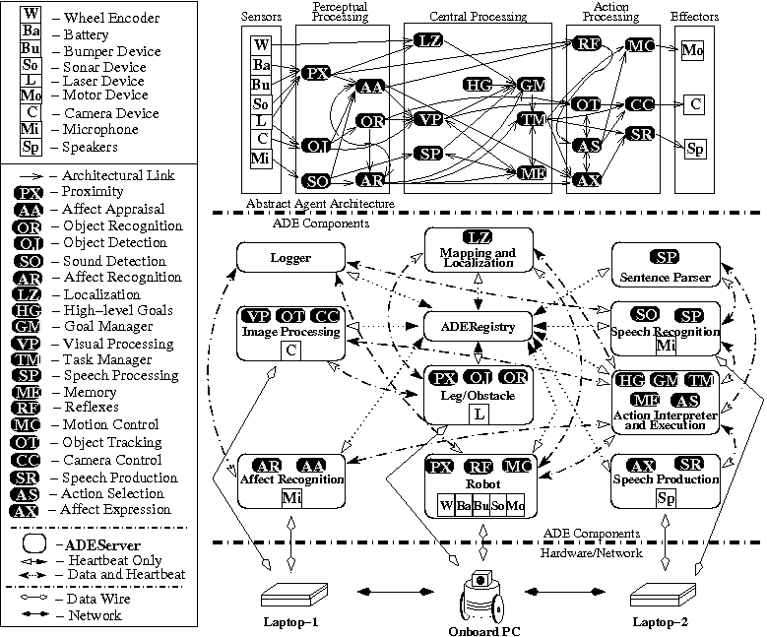
A Complex Example:
The DIARC Architecture

Slide 4

Demo #1a: TestServer
Overview
Demonstrates: Command-line startup, system execution, failure recovery, shutdown
In particular:
  Java: startup parameters and (class)paths
  ADERegistry: command-line switches, .config files, .hosts file
  ADEServer: command-line switches, remote method calls, connection actions

Slide 5
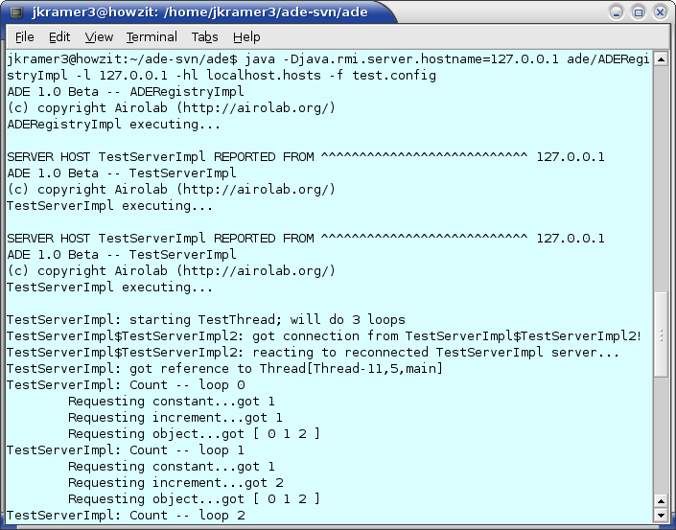
Demo #1a: TestServer
Execution

Slide 6

Demo #1a: TestServer
Startup
java -Djava.rmi.server.hostname=127.0.0.1 \ ade/ADERegistryImpl -l 127.0.0.1 -hl \ localhosts.hosts -f test.config
Starts an ADERegistry, using IP address of 127.0.0.1
  Note the Java RMI (-D) and ADE (-l) switches
Known hosts and their configurations in localhosts.hosts file
“Startup script” test.config contains information about two TestServerImpl servers

Slide 7
Demo #1a: TestServer
ADEServers, Interfaces
The ADEServerImpl is the base class of all remote objects, implementing the methods in the ADEServer interface to make them available for remote execution:
public class ADEServerImpl extends UnicastRemoteObject implements ADEServer {
public class ADEServer extends Remote, BasicObjectInterface {
The TestServerImpl subclasses ADEServerImpl, implementing the methods of the TestSensorServer interface, which extends the ADEServer interface:
public class TestServerImpl extends ADEServerImpl implements TestServer {
public class TestServer extends TestSensorServer {
public interface TestSensorServer extends ADEServer {

Slide 8
Demo #1a: TestServer
Obtaining a remote reference
To obtain a remote reference to an ADEServer:
Object testServer;
try {
testServer = getClient(“TestServerImpl”);
} catch (RemoteException re) {
System.err.println(“Exception obtaining client“);
System.err.println(re);
}
The returned object is not an actual remote reference, for improved timing, security, and failure detection/recovery reasons

Slide 9
Demo #1a: TestServer
Remote method calls
Implementation of the getPrimitive(int i) method
(as found in TestServerImpl.java):
public int getPrimitive(int i) throws RemoteException {
return (i+1);
}
Calling the getPrimitive(int i) method:
Object testServer;
int retint;
System.out.print(“\tRequesting increment...”);
retint = (Integer)call(testServer, “getPrimitive”, 3);
System.out.println(“got “+ retint);

Slide 10
Demo #1a: TestServer
Configuration files
Selected .config file options:
STARTSERVER
host 127.0.0.1
type com.test.TestServerImpl
startdirectory ade-svn/ade/
startcommand java ... com/test/TestServerImpl -cl
restarts 1
ENDSERVER
Selected .hosts file options:
STARTHOST
ip 127.0.0.1
cpuKHz 850
adehome /home/jkramer3/ade-svn/ade/
sshlogin jkramer3
ENDHOST

Slide 11
Demo #1b: TestServer
Overview
Demonstrates: ADEGuiServer interface
In particular:
  GUI: under revision
  ADEServerInfo: sundry server information
  ADEHostInfo: sundry host information

Slide 12
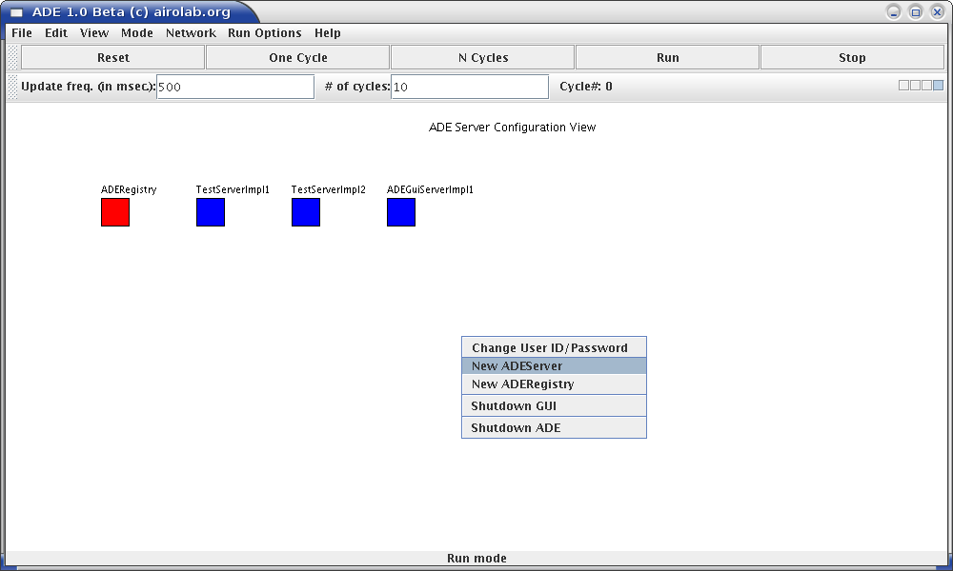
Demo #1b: TestServer
Execution
java -Djava.rmi.server.hostname=127.0.0.1 \ ade/ADERegistryImpl -l 127.0.0.1 -hl \ localhosts.hosts -f testandgui.config
Same as Demo #1a, with the addition of an ADEGuiServer startup

Slide 13
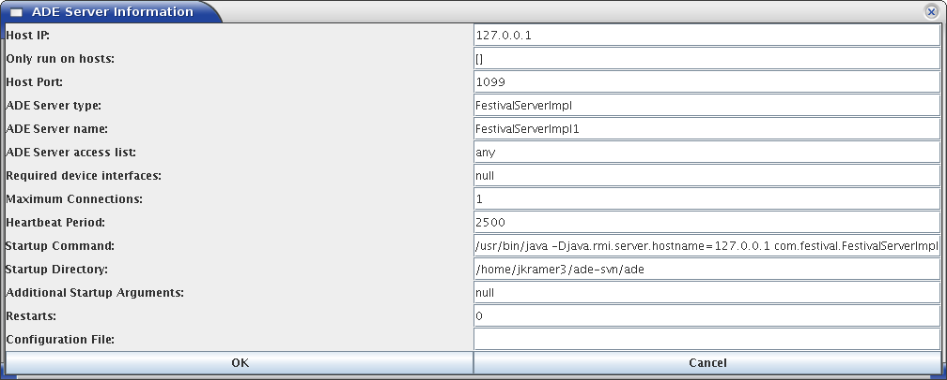
Demo #1b: TestServer
ADEServerInfo
The ADEServerInfoGui (shows selected ADEServerInfo fields):

Slide 14
Demo #1b: TestServer
ADEHostInfo
Selected ADEHostInfo fields (no GUI yet):
public String hostip;
int hostcpus;
int hostcpuKHz;
int hostmemKB;
double hostLoad;
String adehome;
String javahome;
HashSet<String> devices;
Set<String> servers;
String shellcmd;
String[] shellargs;
String sshcmd;
String sshargs;
String sshusername;

Slide 15
Demo #2: StageServer
Overview
Demonstrates: Introductory robot data, automation, and non-server clients
In particular:
  Sensor/effector Interfaces: sonar, laser, motors
  RMI calls: ADERemoteCallTimer
  Non-Java processes: ADELocalProcessStarter
  Direct client connections: good for testing; must implement a Heartbeat, thus lose functionality

Slide 16
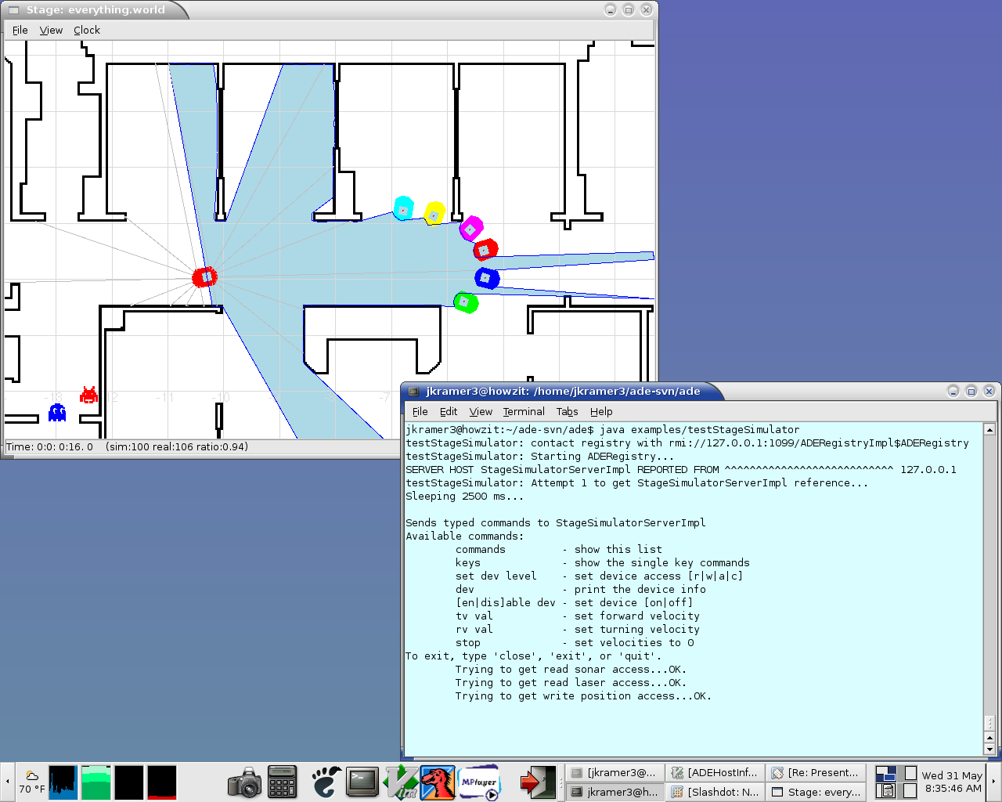
Demo #2: StageSimulator
Execution

Slide 17
Demo #2: StageSimulator
Interfaces
The StageSimulatorServerImpl subclasses ADEServerImpl, implementing the methods of the StageSimulatorServer interface, which extends the SonarSensorServer, LaserSensorServer, and VelocityEffectorServer
public class StageSimulatorServerImpl extends ADEServerImpl implements
StageSimulatorServer, SonarSensorServer, LaserSensorServer,
VelocityEffectorServer {
public class StageSimulatorServer extends ADEServer, SonarSensorServer,
LaserSensorServer, VelocityEffectorServer {
StageSimulatorServer can contain “custom” methods above and beyond those found in the sensor/effector interfaces

Slide 18

Available ADEServers
AffRecServer: voice affect recognition
FestivalServer: voice production
FieldServer: “imaginary” location
SickLaserServer: SICK LMS hardware
LoggerServer: create log files
MAMServer: robot movement control
ParserServer: semantic analysis
PioneerServer: robot hardware
PrologServer: interface to Prolog
SonicServer: voice recognition
StageSimulatorServer: Stage simulator
TTServer: high-level cognitive architecture
VisionServer: various vision functionality

Slide 19
Conclusion
ADE is a framework that provides an environment for secure, distributed, fault-tolerant robotic architectures
References:
Scheutz, M. (2006). ADE - steps towards a distributed development and
runtime environment for complex robotic agent architectures. Applied
Artificial Intelligence, 20(4-5).
Kramer, J and Scheutz, M. (2006) ADE: Filling a Gap Between Single and
Multiple Agent Systems. In 18th European Meeting on Cybernetics and
Systems Research, Vienna, Austria.

