Slide 1
Data analytics
Session 01

Slide 2
What is OOP
OOP stands for Object-Oriented Programming, which is a programming paradigm or style that organizes code and data into reusable and self-contained objects. In OOP, software is designed and structured around objects, which are instances of classes. Objects represent real-world entities, concepts, or things and encapsulate both data (attributes or properties) and behaviors (methods or functions) related to those entities. OOP provides a way to model complex systems and promote code reusability and maintainability.

Slide 3
Vehicle
Car
Plane
Ship
Van
Truck
Jet
AirBus
Cruise
Boat

Slide 4
OOP Principles
Encapsulation: Encapsulation is the concept of bundling data (attributes) and the methods that operate on that data into a single unit (an object). It hides the internal details of an object and exposes a well-defined interface for interaction.
Abstraction: Abstraction involves simplifying complex reality by modeling classes based on the essential properties and behaviors of real-world entities. It allows developers to focus on relevant details and hide unnecessary complexities.
Inheritance: Inheritance is a mechanism that allows one class (the subclass or derived class) to inherit the attributes and methods of another class (the superclass or base class). It supports the creation of hierarchies and the reuse of code.
Polymorphism: Polymorphism allows objects of different classes to be treated as objects of a common base class. It enables dynamic method binding, where the appropriate method implementation is determined at runtime based on the actual object type.

Slide 5
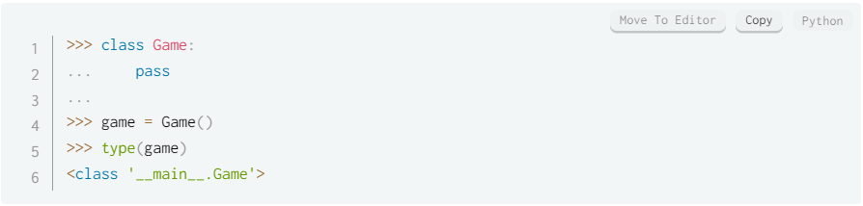
OOP in Python
Class :

Slide 6
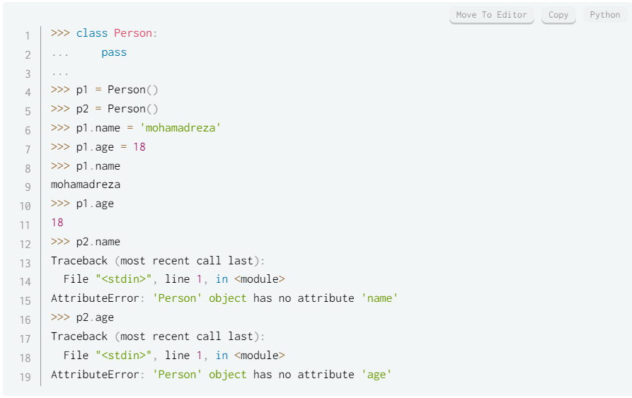
Property

Slide 7
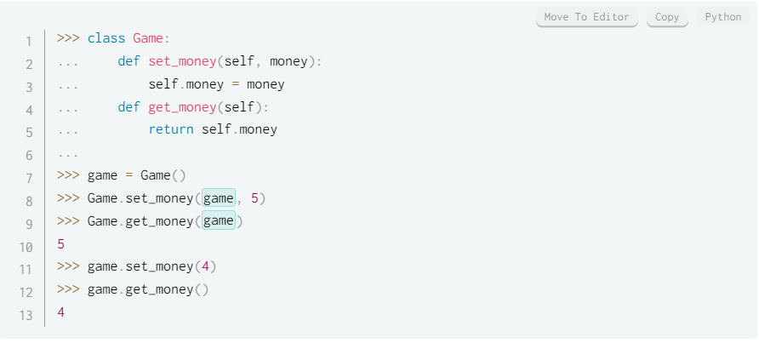
Methods

Slide 8
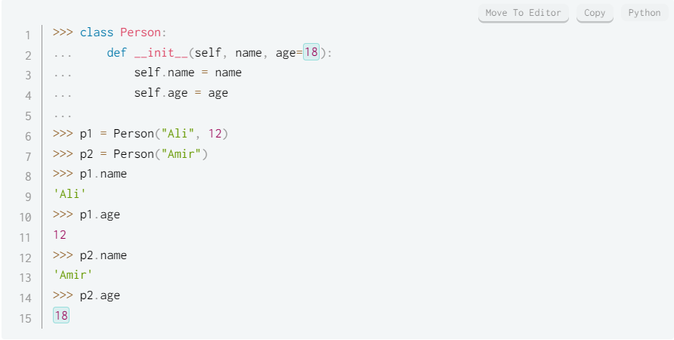
Constructor

Slide 9
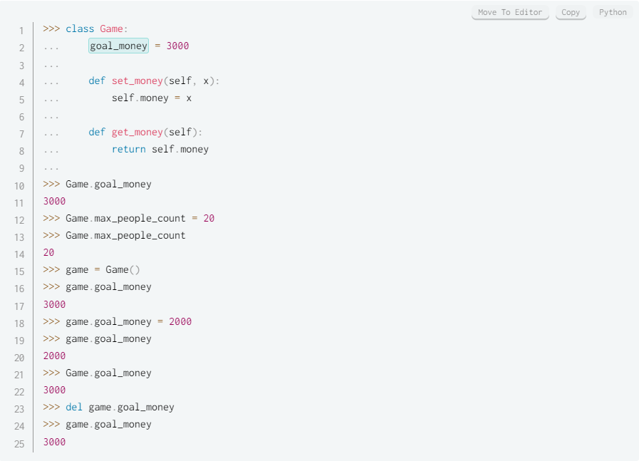
Static Variable

Slide 10
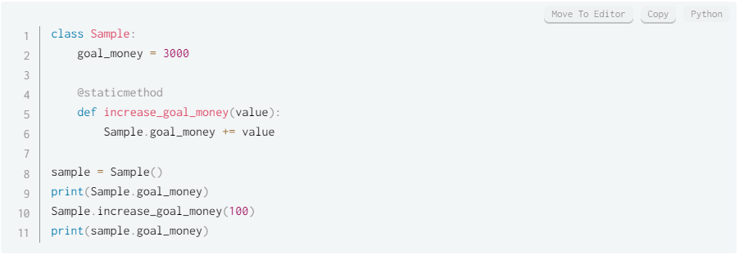
Static Methods

Slide 11
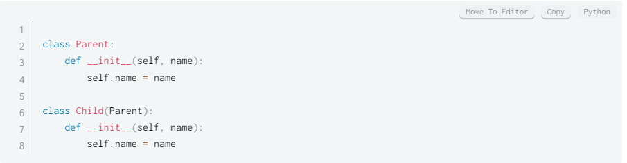
Inheritance

Slide 12
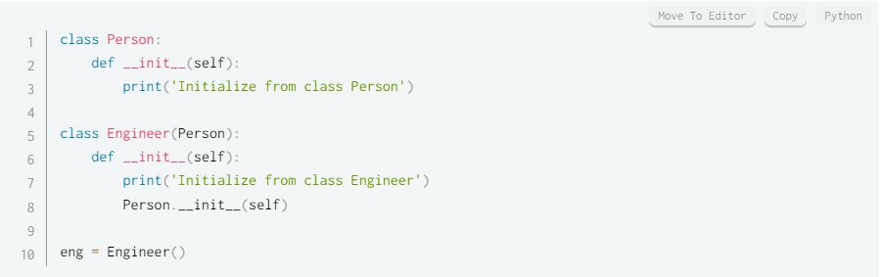
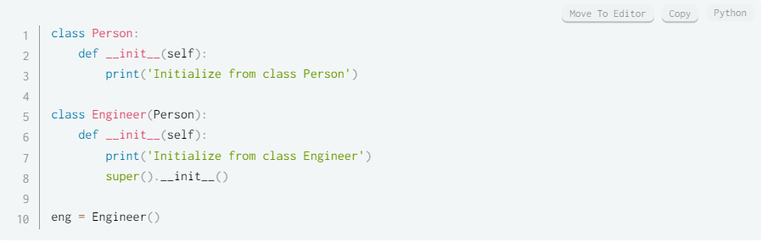

Super

Slide 13
