Slide 1
Data analytics
Session 02

Slide 2
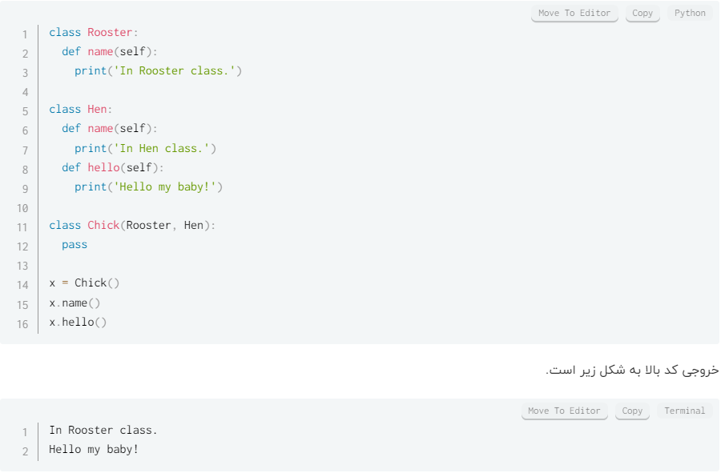
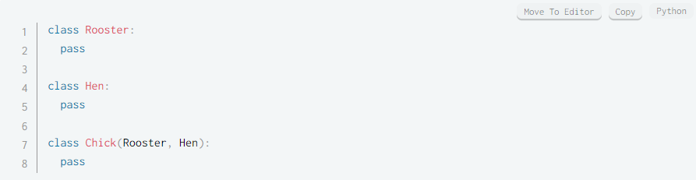
Multiple Inheritance

Slide 3
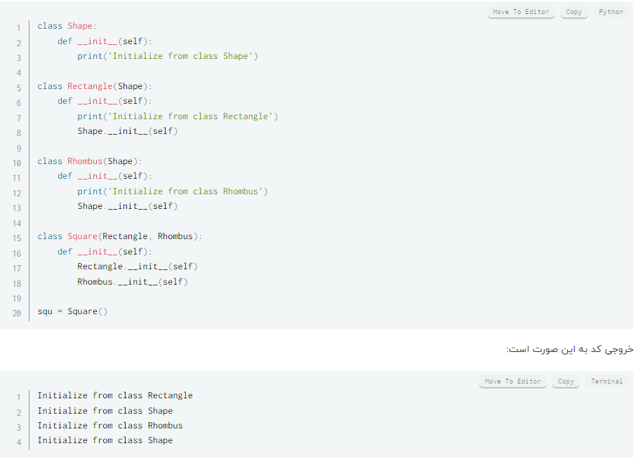
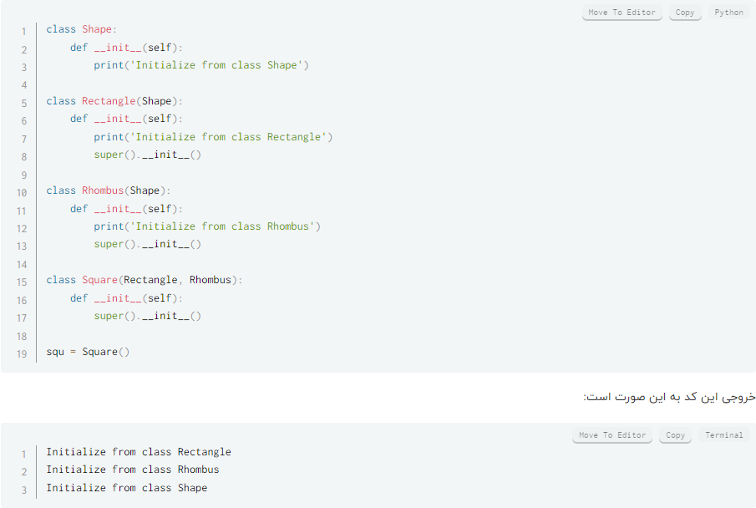
Super in Multiple Inheritance
Without Super
With Super

Slide 4
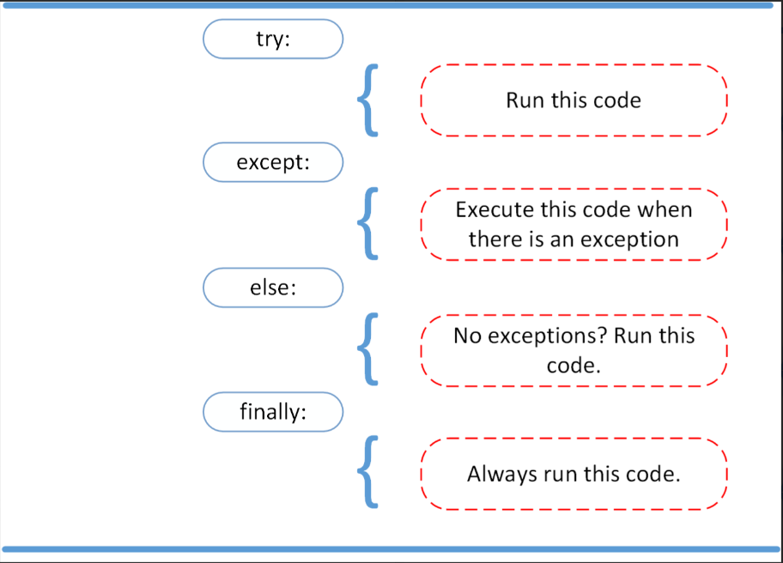
Exception Handling
Structure
Exception : An exception is an abnormal or unexpected event that occurs during the execution of a program, disrupting the normal flow of the program's instructions. Exceptions represent errors or exceptional conditions that may prevent the program from functioning correctly. In programming, exceptions are typically categorized into different types based on the nature of the error they represent.

Slide 5
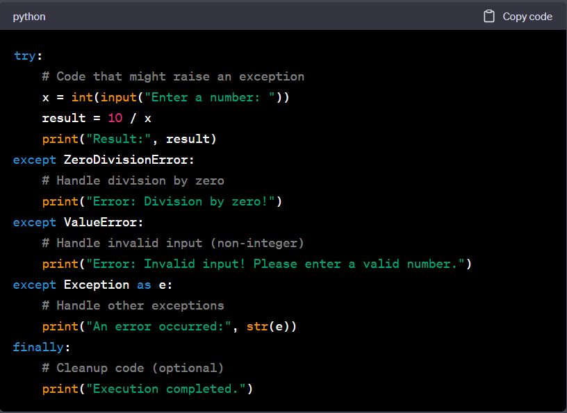
Example

Slide 6
Some of Exceptions
SyntaxError: This occurs when the code violates the rules of the programming language's syntax. It often indicates a typo or a mistake in the code structure that prevents it from being parsed and executed.
IndentationError: In Python, this error occurs when there are issues with the indentation of code blocks, such as inconsistent use of spaces or tabs. Proper indentation is crucial in Python for defining code blocks.
NameError: This error occurs when a variable or function is used before it is defined or if it is not within the current scope. It can also occur if a variable's name is misspelled.
TypeError: A TypeError occurs when an operation is performed on an object of an inappropriate data type. For example, trying to perform arithmetic on a string or attempting to access an index of a non-indexable object can result in a TypeError.
ValueError: A ValueError occurs when an operation or function receives an argument of the correct data type but with an inappropriate value. For instance, trying to convert a non-numeric string to an integer will result in a ValueError.

Slide 7
Some of the Exceptions
ZeroDivisionError: This exception is raised when an attempt is made to divide a number by zero, which is mathematically undefined.
FileNotFoundError: It occurs when an attempt to open or access a file fails because the specified file does not exist at the given path.
IndexError: This exception is raised when attempting to access an index that is outside the valid range of an iterable, such as a list or tuple.
KeyError: A KeyError is raised when attempting to access a dictionary with a key that does not exist in the dictionary.
AttributeError: This error occurs when an attempt is made to access an attribute or method of an object that does not have that attribute or method.
IOError: It represents input/output errors, such as file read or write failures due to various reasons, like a file being read-only or not found.

Slide 8
Accessing Modifiers in Python
In Python, access levels for class members (attributes and methods) are determined using naming conventions and access modifiers. Python follows a principle known as "name mangling" to achieve access control, but it doesn't have explicit access modifiers like some other languages.
Public
Access Modifiers in Python
Protected
Private

Slide 9
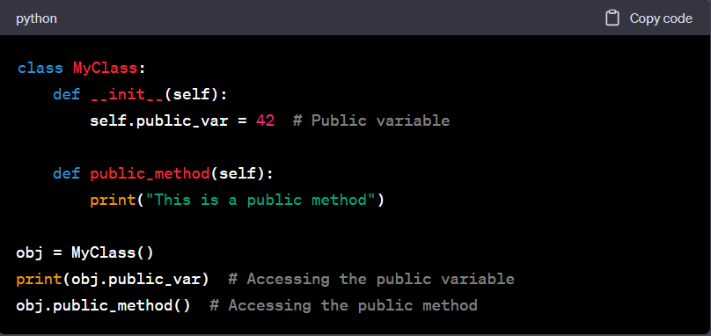
Public
Members with no special naming convention are considered public and can be accessed from anywhere, both inside and outside the class.

Slide 10
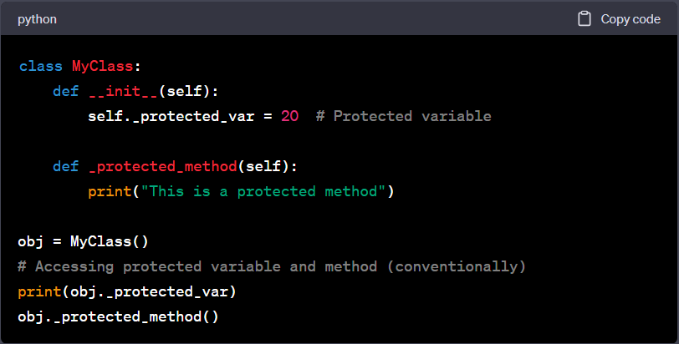
Protected
Protected (Conventional): Python doesn't have a strict "protected" access level, but it follows a convention by prefixing member names with a single underscore _ (underscore). These members are considered non-public and should be treated as protected. However, they are still accessible from outside the class.

Slide 11
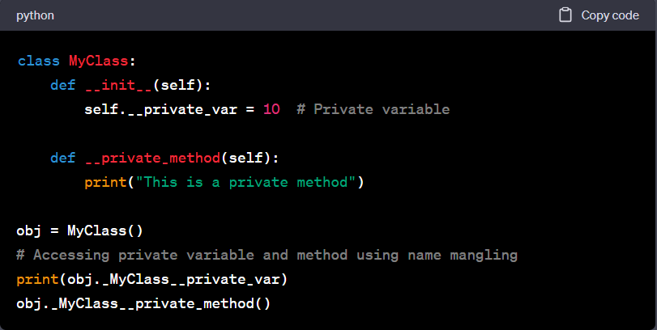
Private
Private (Name Mangling): Python doesn't have truly private members, but it uses name mangling to make members less accessible from outside the class. Private members are prefixed with a double underscore __ (two underscores) but are still accessible using name mangling.
Note: Accessing private members using name mangling is not recommended and goes against the principle of encapsulation. It's generally considered a best practice to avoid accessing private members from outside the class.

Slide 12
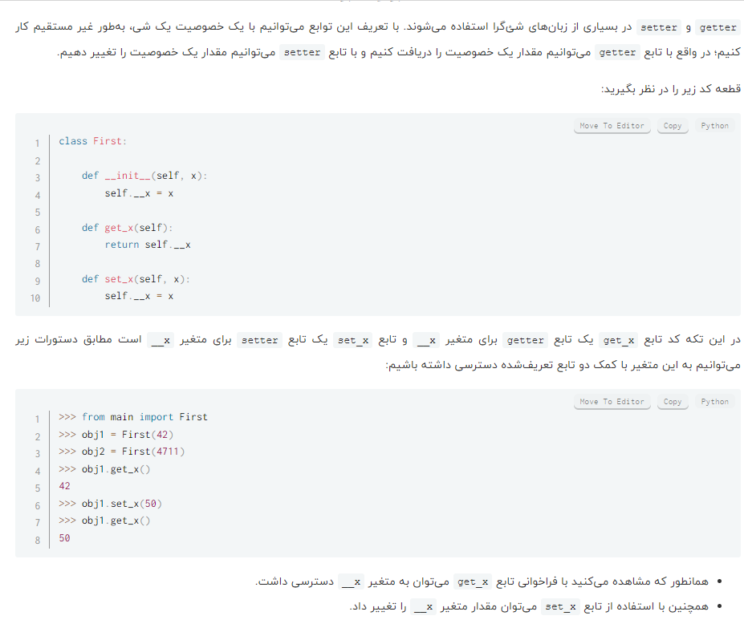
Property (more Details)
In Python, a property is a special attribute that allows you to control the access, modification, and deletion of an object's attribute as if it were a regular attribute, while providing custom behavior through getter, setter, and deleter methods. Properties are used to ensure that certain actions take place when an attribute is accessed, modified, or deleted, without directly exposing the underlying data.
Properties are often used to implement the concept of "getter" and "setter" methods in other programming languages, but they provide a more Pythonic and elegant way of achieving the same functionality.

Slide 13
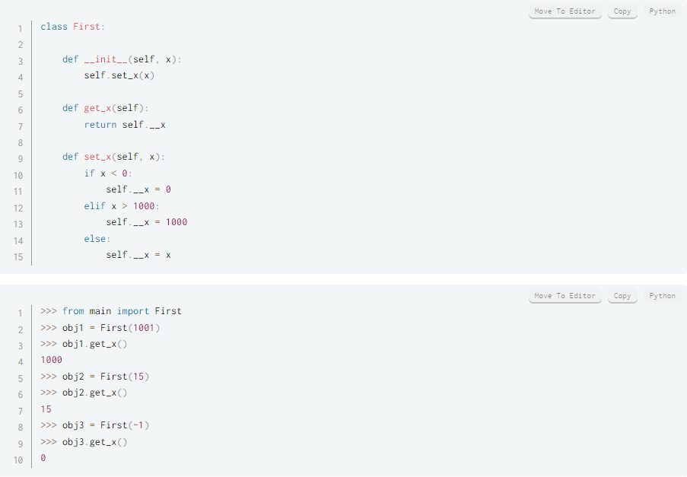
Property (more Details)

Slide 14
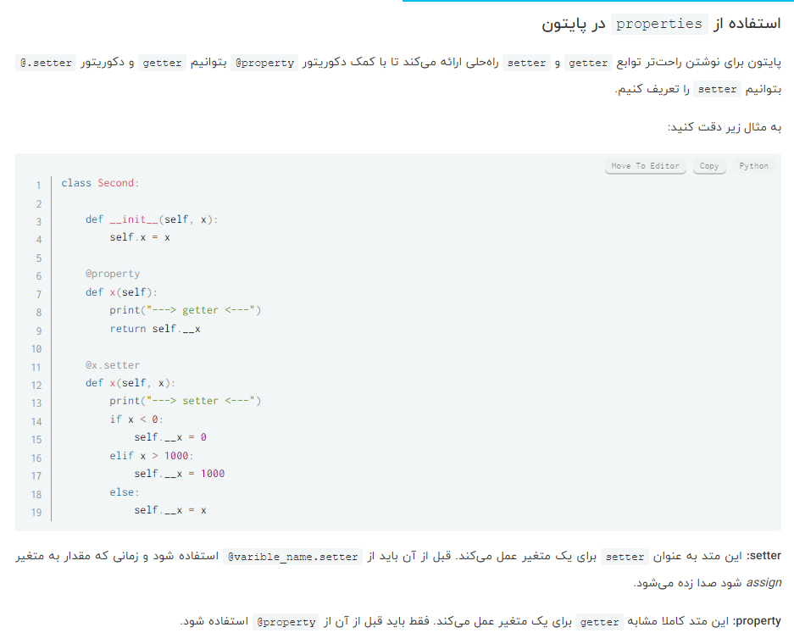
Property (more Details)
Using @property and @[variable].setter decorators to define a property in python

Slide 15
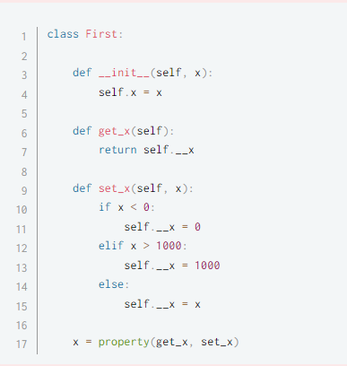
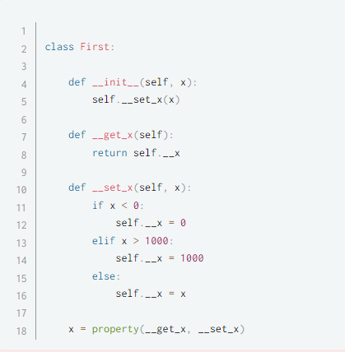
Property (more Details)
Another Way of Defining
Using Property Keyword
Make getter and setter private
*NOTE: Using decorators is better than both of these

Slide 16
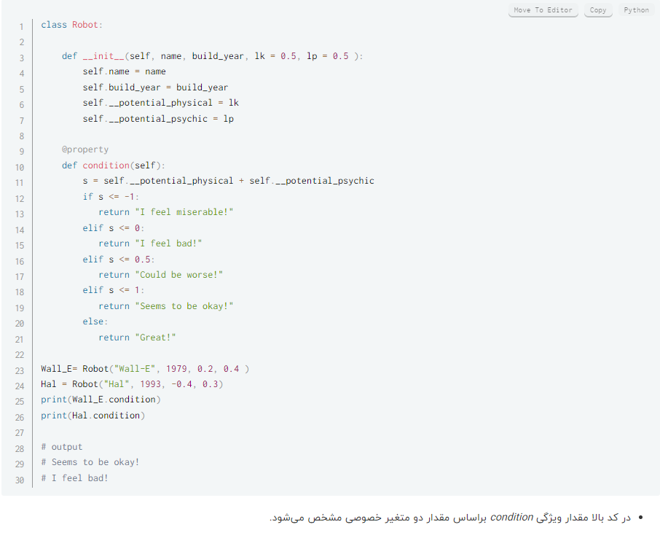
Property (more Details)
Another Example:
NOTE: Condition is NOT a method, it is a property and it behaves like a property.

Slide 17
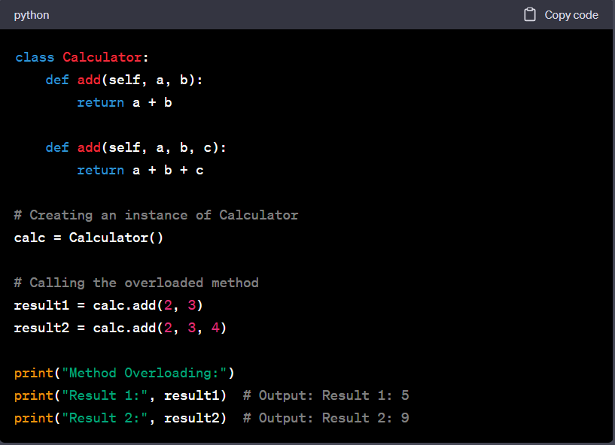
Method Overloading
Method overloading refers to the ability to define multiple methods in a class with the same name but different parameter lists (number or types of parameters). Python does not support method overloading in the traditional sense (as in some other languages like Java or C++), where the appropriate method is chosen at compile-time based on the method signature. However, you can achieve method overloading in Python by using default parameter values or variable-length argument lists (e.g., *args or **kwargs).

Slide 18
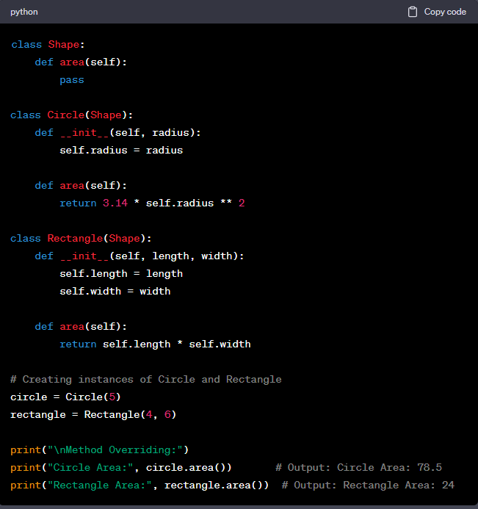
Method Overriding
Method overriding is the ability to provide a new implementation (override) for a method in a subclass that is already defined in its superclass. It allows a subclass to provide a specific behavior for a method that is inherited from its superclass.

Slide 19
Comparison
Method overloading is about defining multiple methods with the same name in the same class, differing in parameter lists. In Python, only the last definition is considered, effectively overriding previous definitions.
Method overriding is about providing a new implementation for a method in a subclass that is already defined in its superclass. It allows you to customize the behavior of inherited methods.
In Python, method overriding is a fundamental concept used for building class hierarchies and implementing polymorphism, while method overloading is not natively supported in the traditional sense. Developers often achieve method overloading using default parameter values, variable-length arguments, or other techniques to handle different parameter lists in a single method.

