Slide 1
Data analytics
Session 08

Slide 2
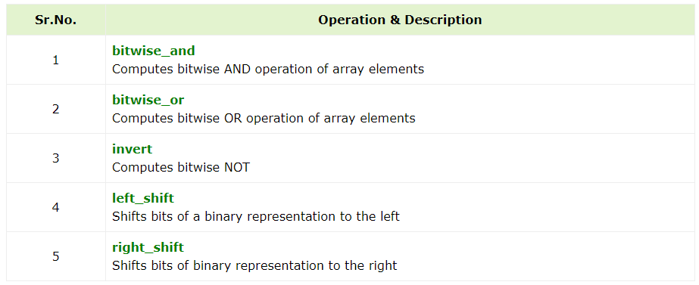
Binary Operators

Slide 3
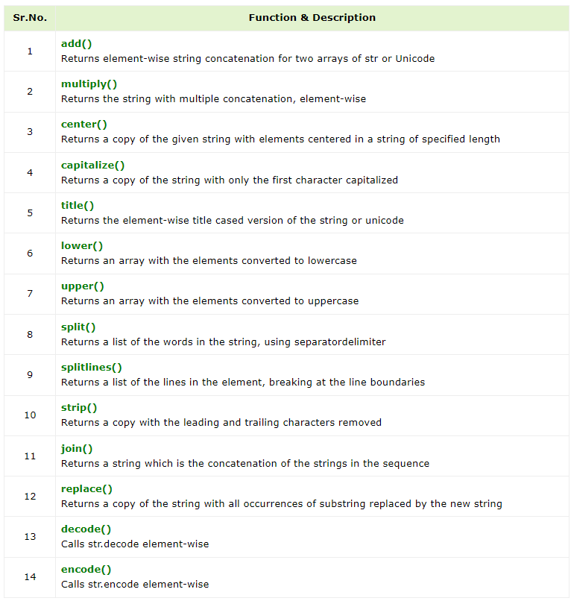

String Methods
Methods to miniplate string in Numpy arrays

Slide 4
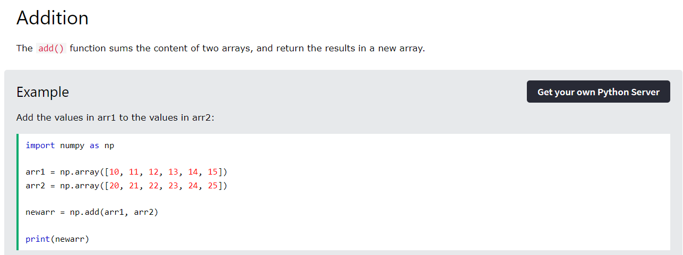
Arithmetic Functions

Slide 5
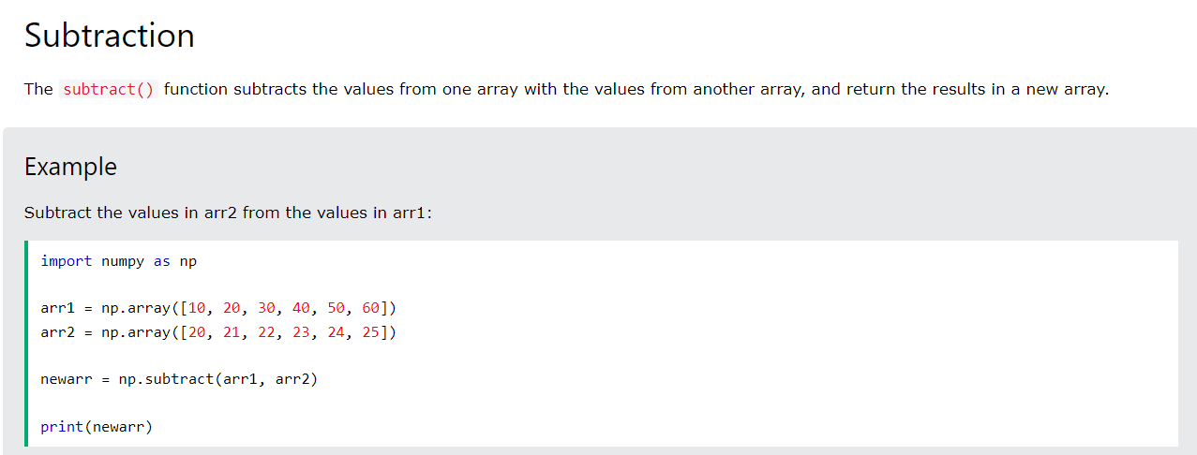
Arithmetic Functions

Slide 6
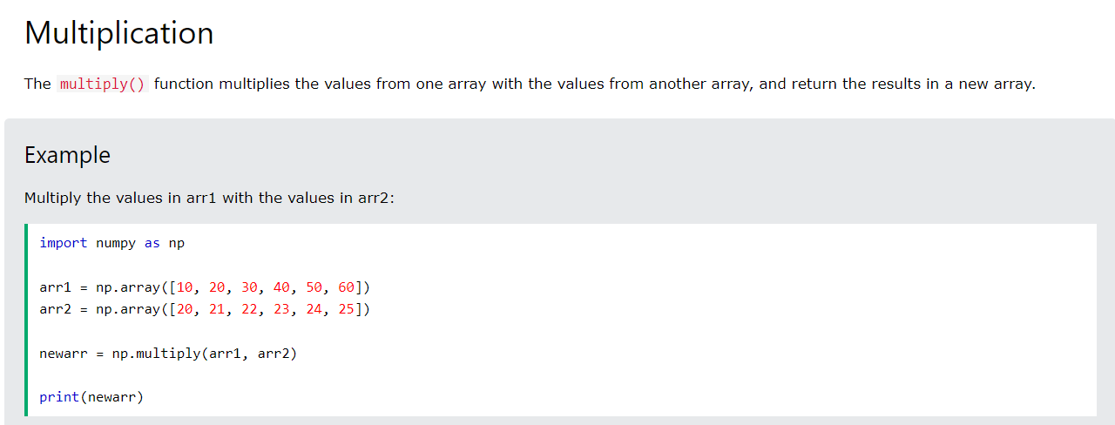
Arithmetic Functions

Slide 7
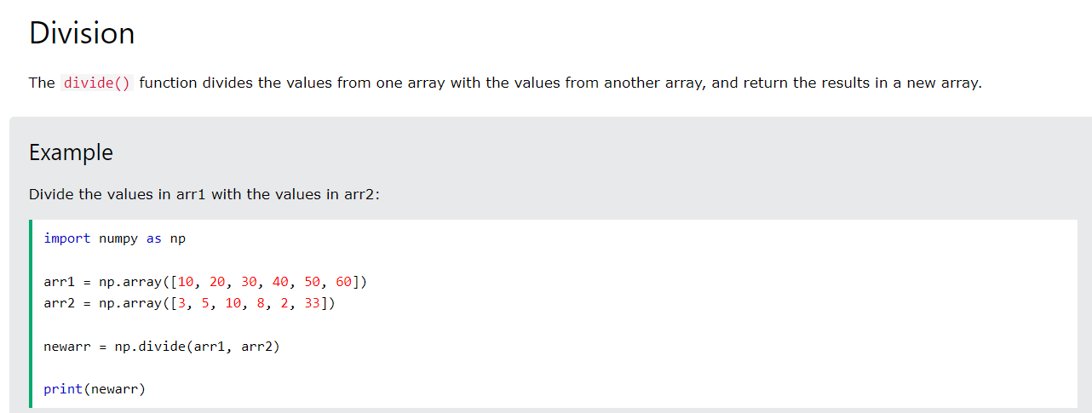
Arithmetic Functions

Slide 8
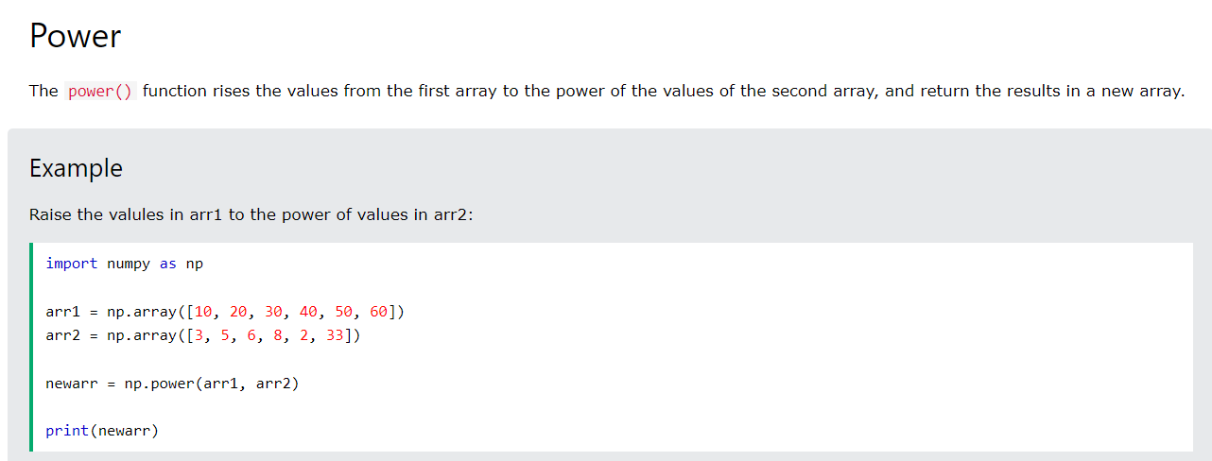
Arithmetic Functions

Slide 9
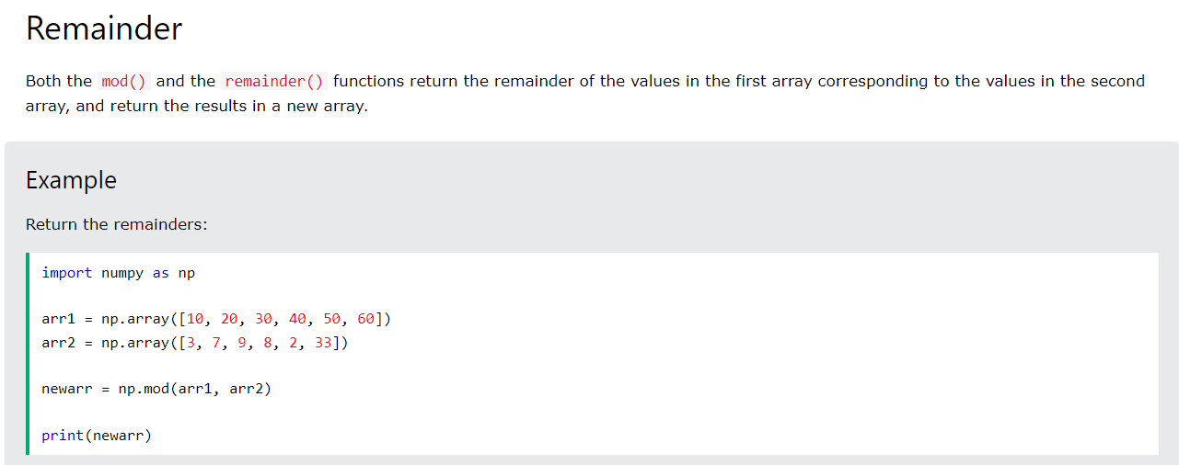
Arithmetic Functions

Slide 10
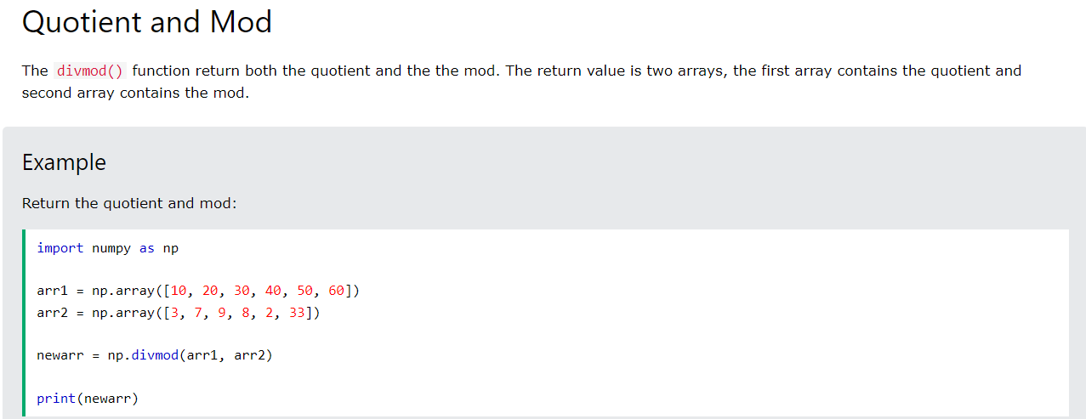
Arithmetic Functions

Slide 11

Rounding Functions

Slide 12

Rounding Functions

Slide 13
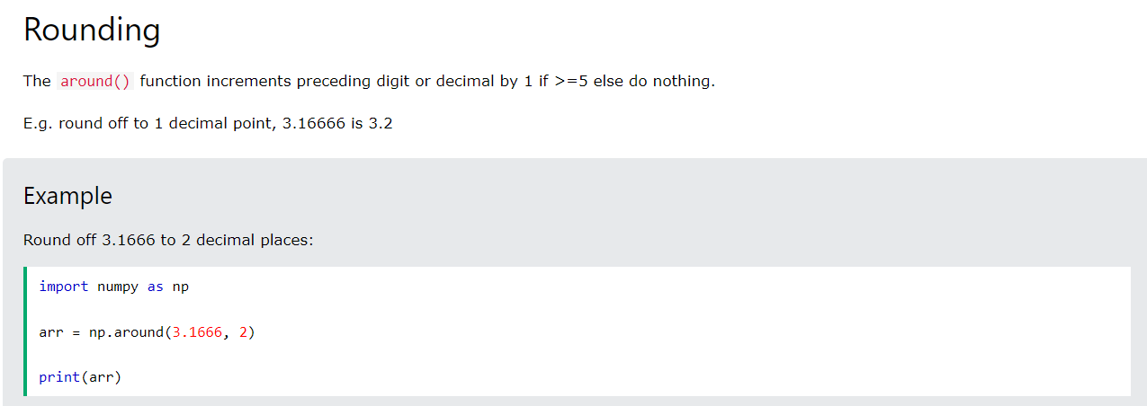
Rounding Functions

Slide 14
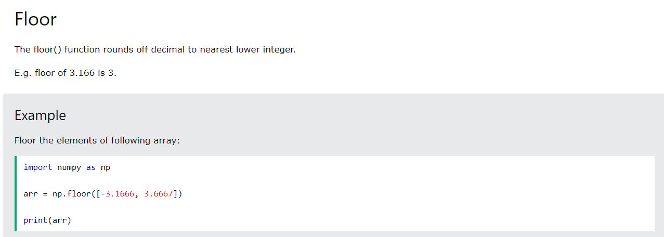
Rounding Functions

Slide 15
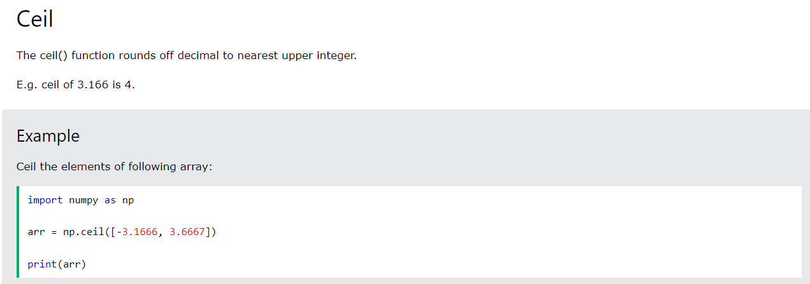
Rounding Functions

Slide 16

Log Functions

Slide 17

Log Functions

Slide 18

Log Functions

Slide 19

Log Functions

Slide 20
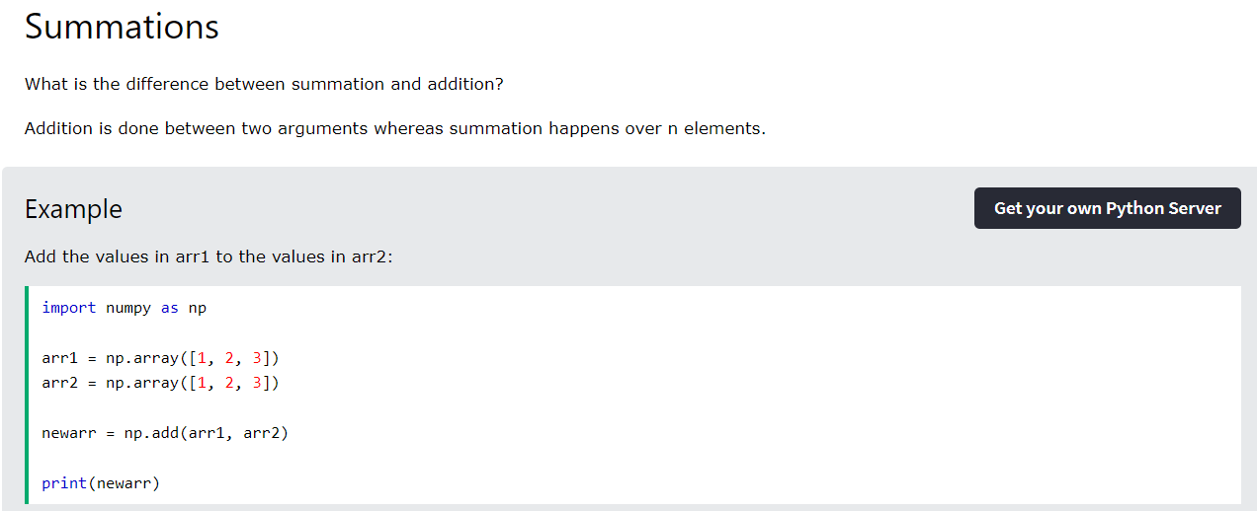
Summation Functions

Slide 21

Summation Functions

Slide 22
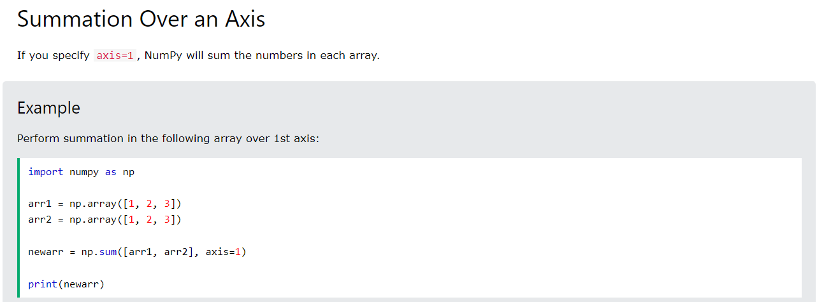
Summation Functions

Slide 23
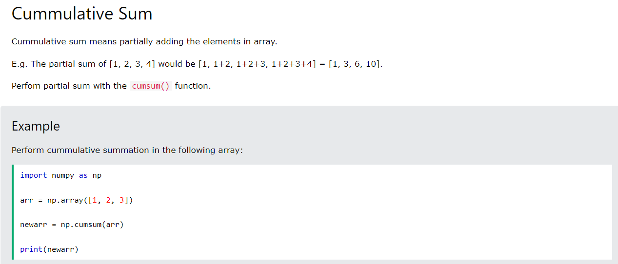
Summation Functions

Slide 24
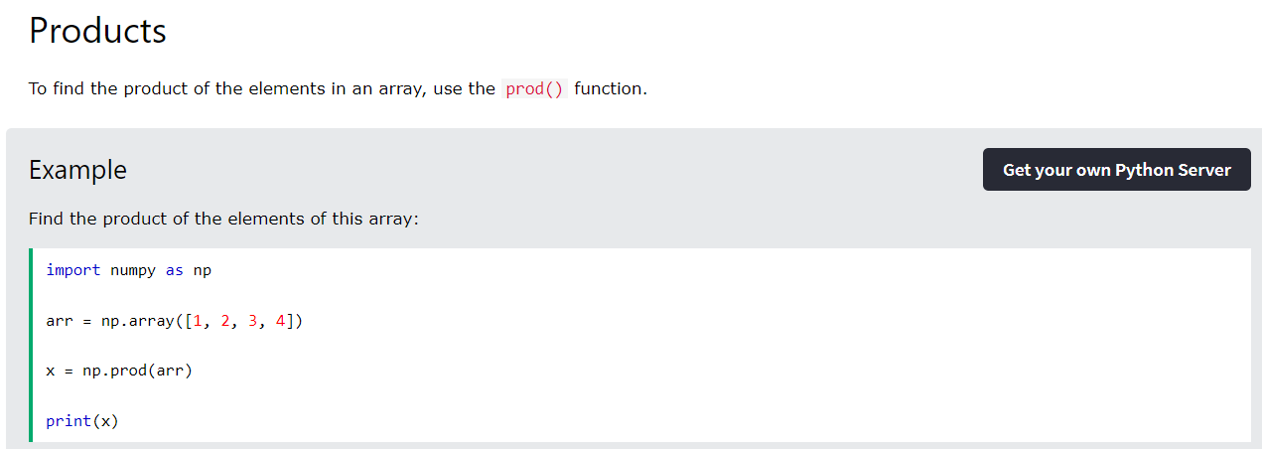
Product Functions

Slide 25

Product Functions

Slide 26
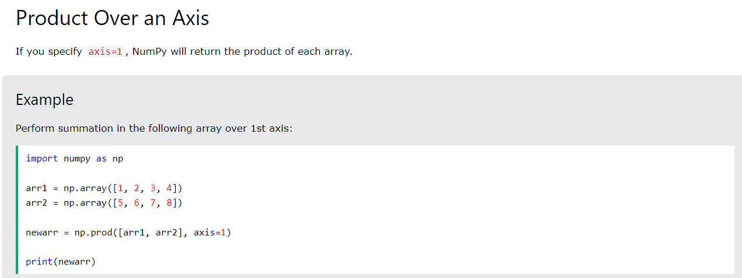
Product Functions

Slide 27
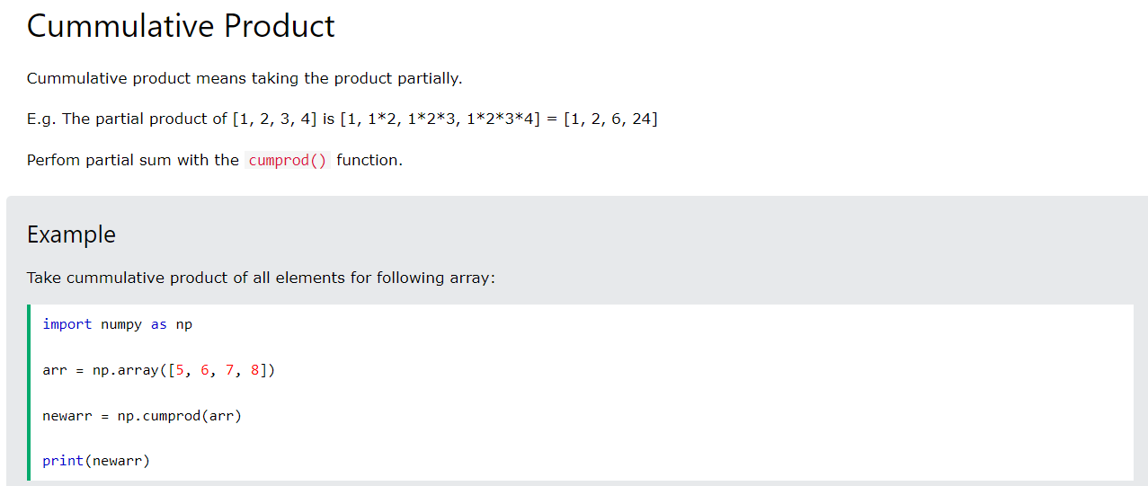
Product Functions

Slide 28
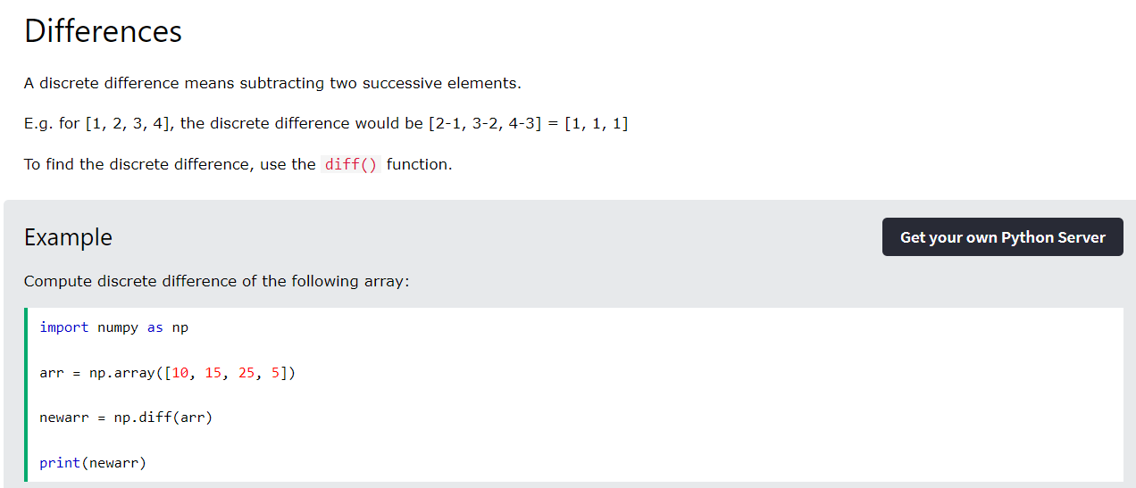
Differences Functions

Slide 29
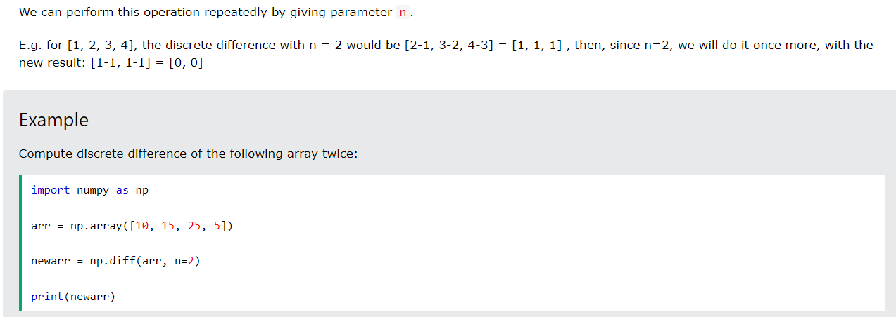
Differences Functions

Slide 30
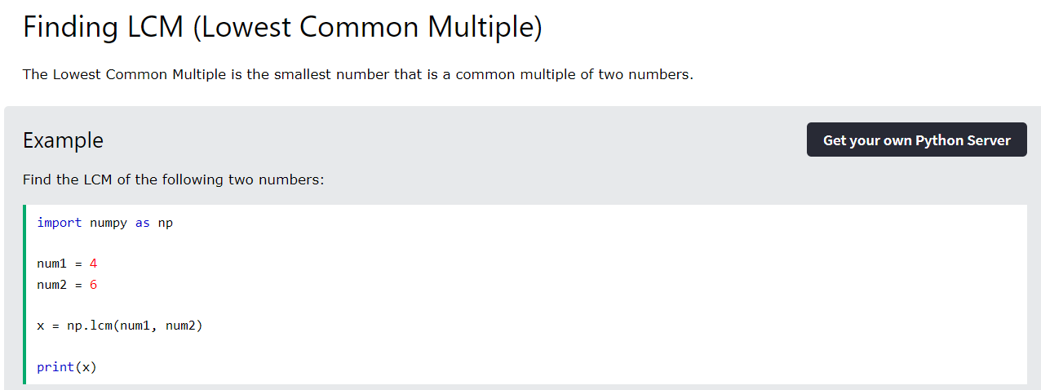
Finding LCM

Slide 31
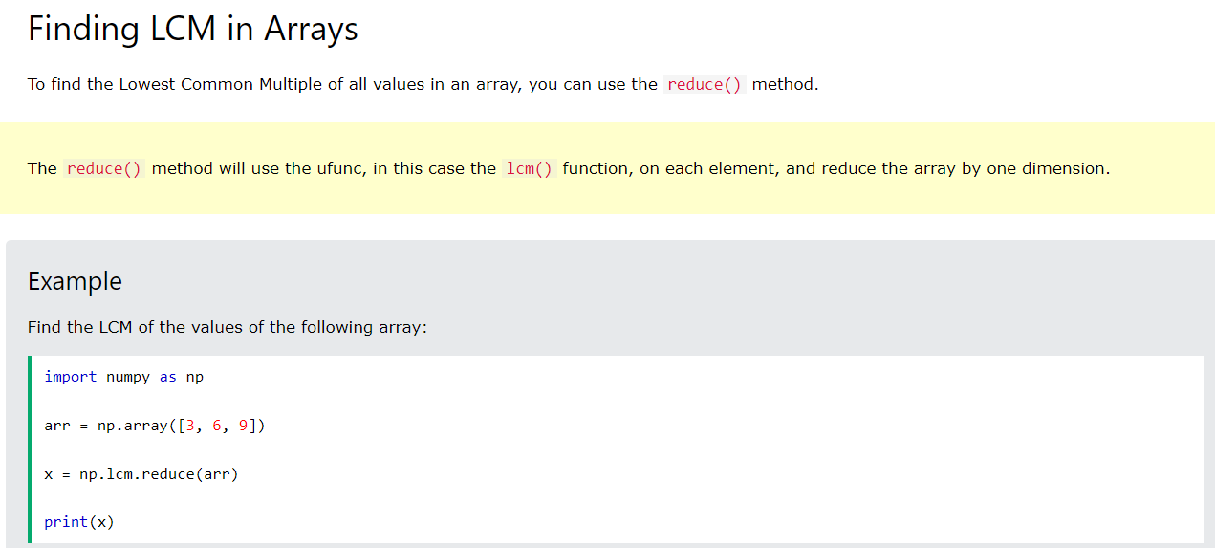
Finding LCM

Slide 32

Finding LCM

Slide 33
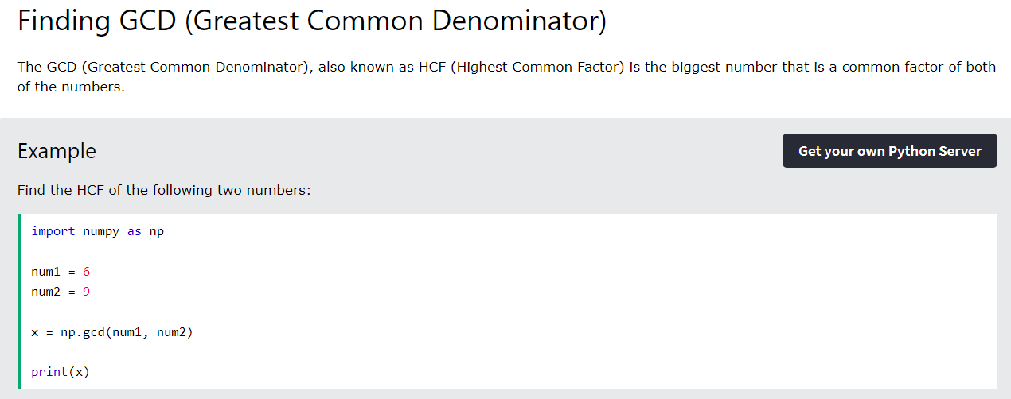
Finding GCD

Slide 34
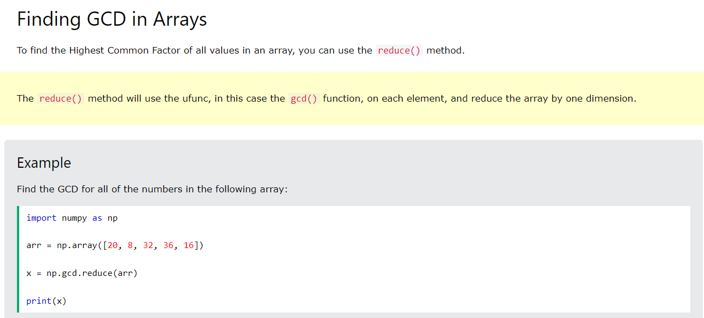
Finding GCD

Slide 35
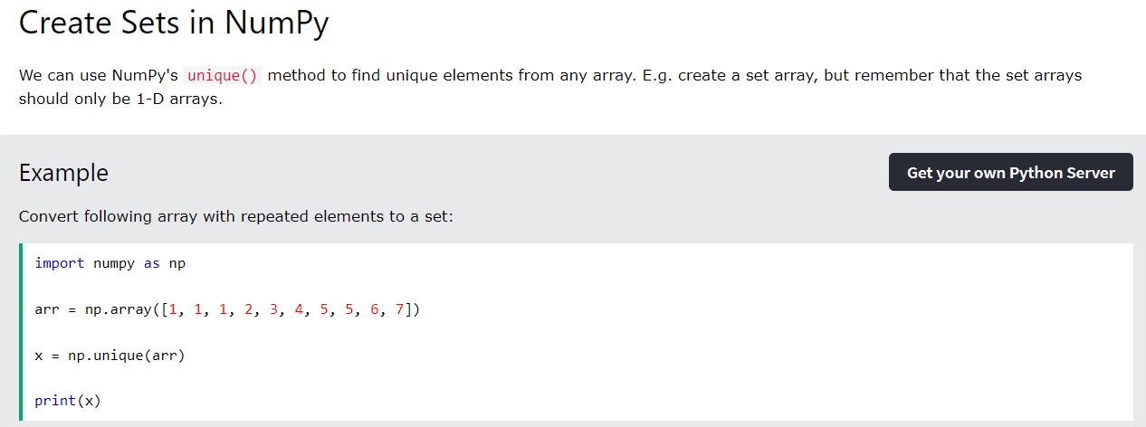
Set Operations

Slide 36
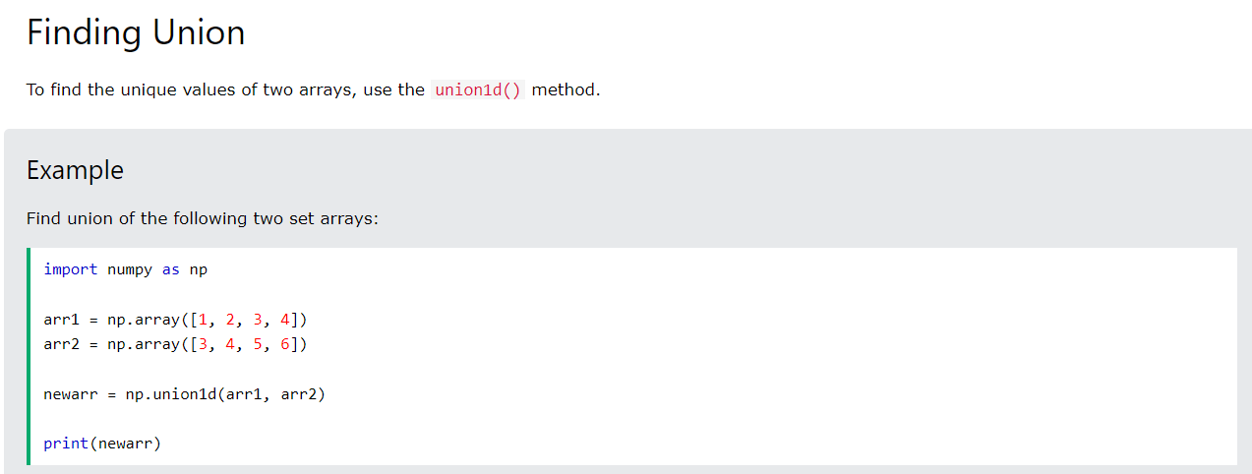
Set Operations

Slide 37
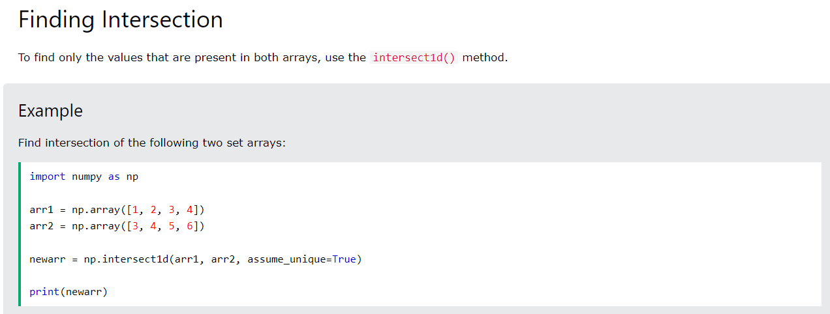
Set Operations

Slide 38
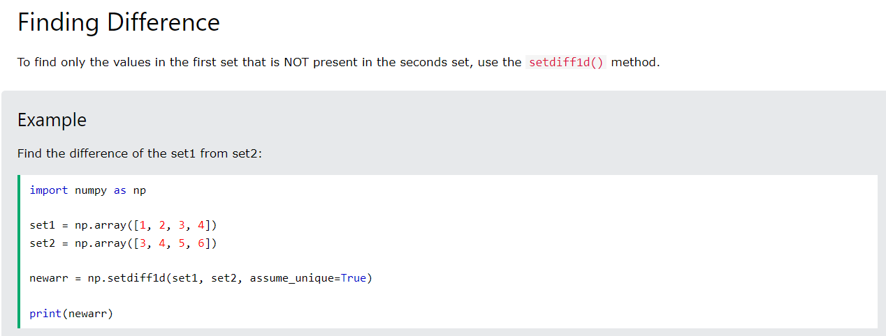
Set Operations

Slide 39
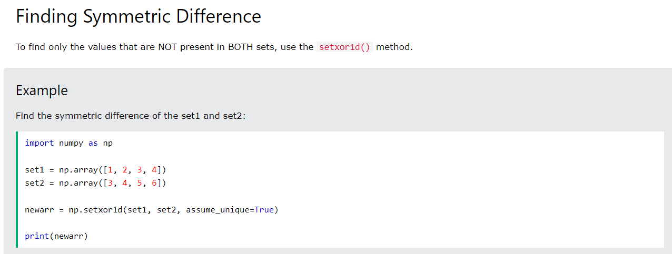
Set Operations

