Slide 1
Data analytics
OOP session 05

Slide 2
What is Interactive Python?
Ipython typically refers to the practice of using Python in an interactive manner, where you can enter and execute Python code incrementally, line by line, or in small blocks, and immediately see the results. This interactive style of working with Python is facilitated by various tools and environments, including:
Python REPL
IDEs
Online Python Interpreters
Debugging Tools

Slide 3
What is Jupyter?
Project Jupyter is a suite of software products used in interactive computing. IPython was originally developed by Fernando Perez in 2001 as an enhanced Python interpreter. A web based interface to IPython terminal in the form of IPython notebook was introduced in 2011. In 2014, Project Jupyter started as a spin-off project from IPython.
Packages under jupyter project include:
Jupyter notebook : A web based interface to programming environments of Python, Julia, R and many others
QtConsole : Qt based terminal for Jupyter kernels similar to IPython
nbviewer : Facility to share Jupyter notebooks
JupyterLab : Modern web based integrated interface for all products.

Slide 4
Features of Ipython
Offers a powerful interactive Python shell.
Acts as a main kernel for Jupyter notebook and other front end tools of Project Jupyter.
Possesses object introspection ability. Introspection is the ability to check properties of an object during runtime.
Syntax highlighting.
Stores the history of interactions.
Tab completion of keywords, variables and function names.
Magic command system useful for controlling Python environment and performing OS tasks. (e.g. %timeit 2**10)
Ability to be embedded in other Python programs.
Provides access to Python debugger.

Slide 5
Installation
Jupyter Lab:
Create a Virtual Environment
Install jupyterlab
Run jupyterlab
Opens your browser and start coding!!!
Ipython in CMD:
Create a Virtual Environment
Install Ipython
Run Ipython
Code in CMD!!!
Ipython in Anaconda CMD:
Create a Virtual Environment
Install Ipython
Run Ipython
Code in CMD!!!
VS Code:
Install jupyter extention
Create a kernel (python virtual environment)
Start coding!!!

Slide 6
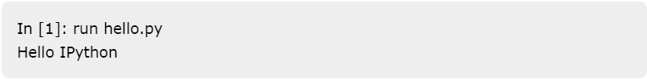
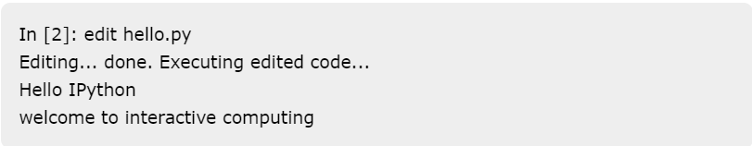
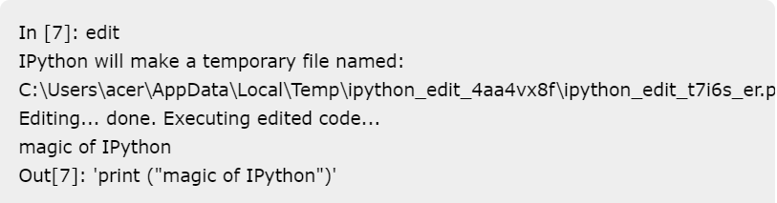
Basic Commands
Run Command
Edit Command
With file name
Without file name

Slide 7
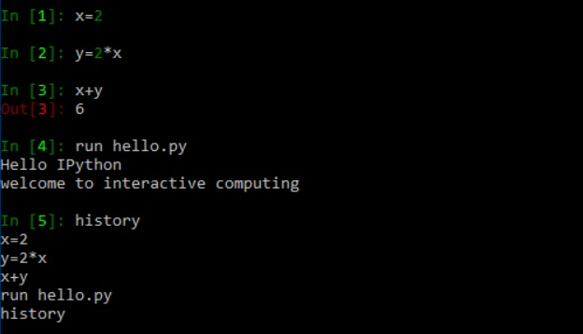
Basic Commands
History Command

Slide 8
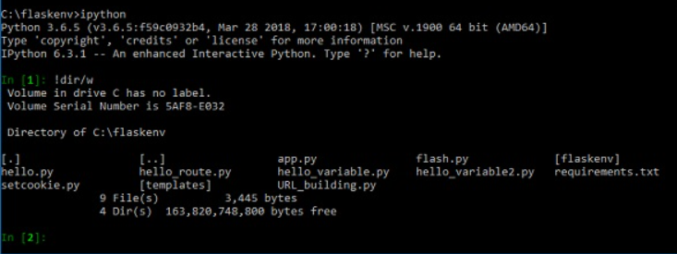
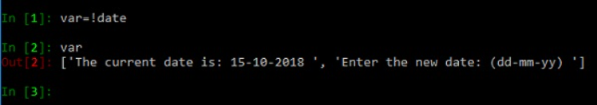
System Commands
!Dir Command (!Ls for Linux)
!Date Command

Slide 9
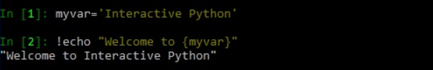
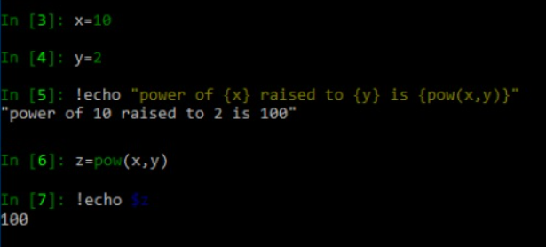
System Commands
!Echo Command

Slide 10
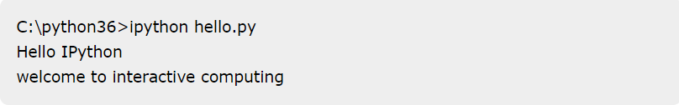
Invoking Ipython Program
Invoking Pattern
e.g.

Slide 11
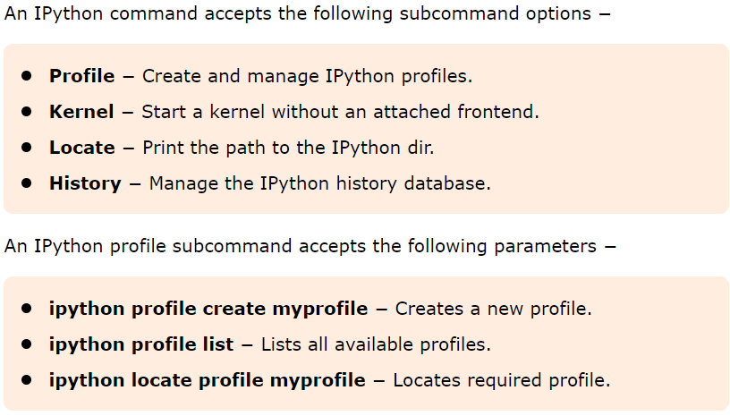
Other Options

Slide 12
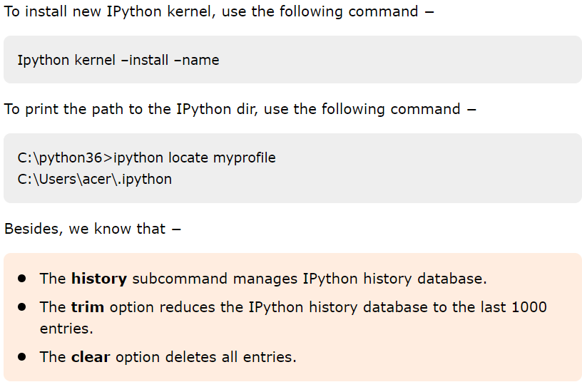
Other Options

Slide 13
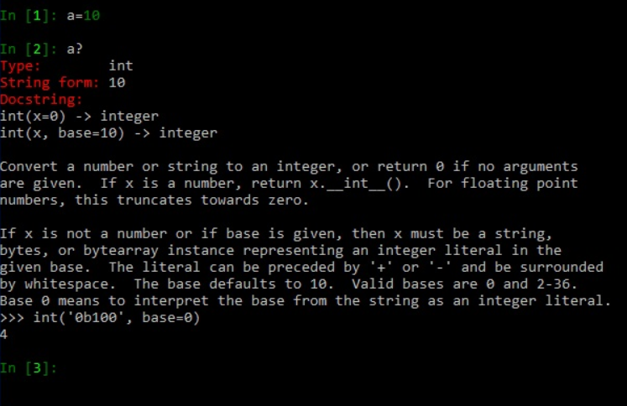
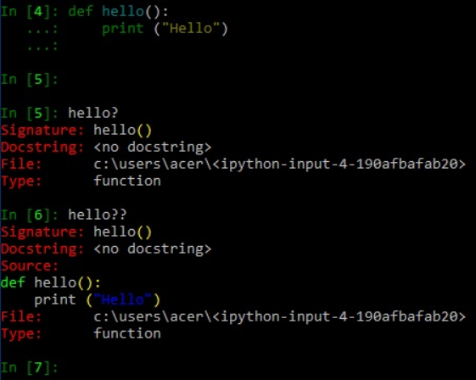
Dynamic Objects Introspection
? And ?? Commands

Slide 14
IO Catching
The input and output cells on IPython console are numbered incrementally. In this chapter, let us look into IO caching in Python in detail. In IPython, inputs are retrieved using up arrow key. Besides, all previous inputs are saved and can be retrieved. The variables _i, __i, and ___i always store the previous three input entries. In addition, In and _in variables provides lists of all inputs. Obviously _in[n] retrieves input from nth input cell.
Similarly, single, double and triple underscores act as variables to store previous three outputs. Also Out and _oh form a dictionary object of cell number and output of cells performing action (not including assignment statements). To retrieve contents of specific output cell, use Out[n] or _oh[n]. You can also use slicing to get output cells within a range.

Slide 15
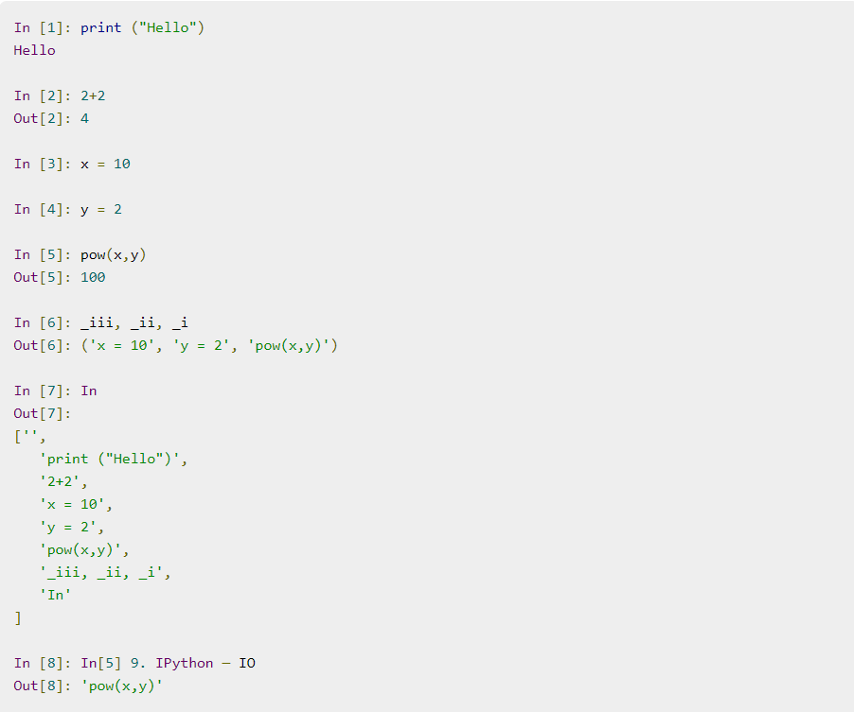
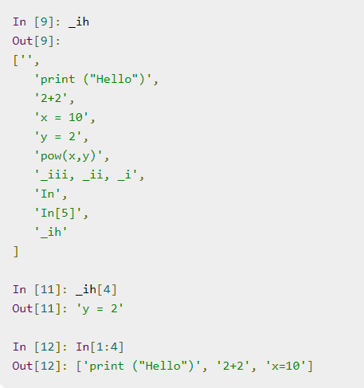
IO Catching
Inputs
Example

Slide 16
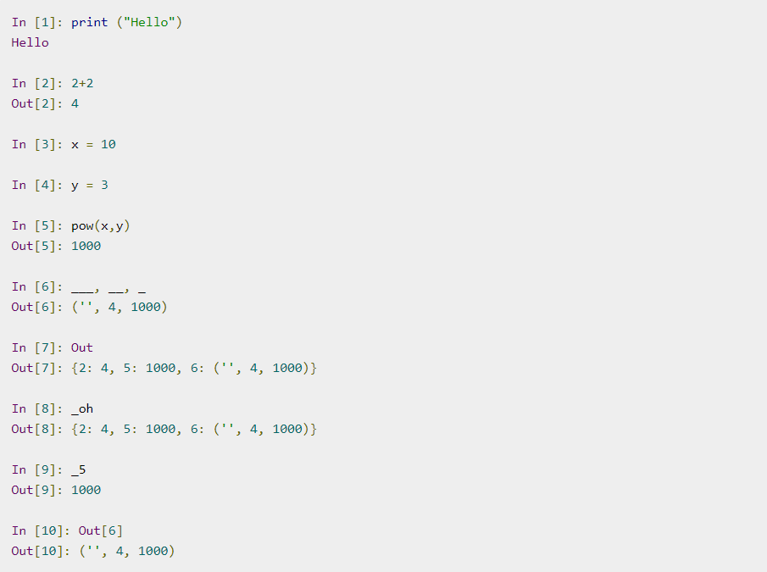
IO Catching
Outputs
Example

Slide 17
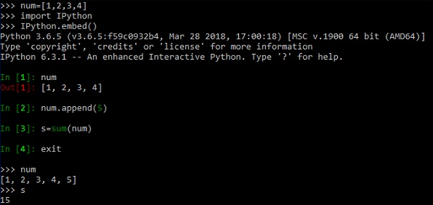
Embedding Ipython
The embed() function of IPython module makes it possible to embed IPython in your Python codes’ namespace. Thereby you can leverage IPython features like object introspection and tab completion, in default Python environment.

Slide 18
Magic Commands
Magic commands or magic functions are one of the important enhancements that IPython offers compared to the standard Python shell. These magic commands are intended to solve common problems in data analysis using Python. In fact, they control the behaviour of IPython itself. Magic commands act as convenient functions where Python syntax is not the most natural one. They are useful to embed invalid python syntax in their work flow.
Line Magics
Starts with %
Magic Commands
Cell Magics
Starts with %%

Slide 19
Magic Commands
Line Magics: They are similar to command line calls. They start with % character. Rest of the line is its argument passed without parentheses or quotes. Line magics can be used as expression and their return value can be assigned to variable.
Cell Magics: They have %% character prefix. Unlike line magic functions, they can operate on multiple lines below their call. They can in fact make arbitrary modifications to the input they receive, which need not even be a valid Python code at all. They receive the whole block as a single string.

Slide 20
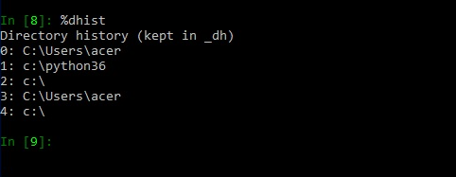
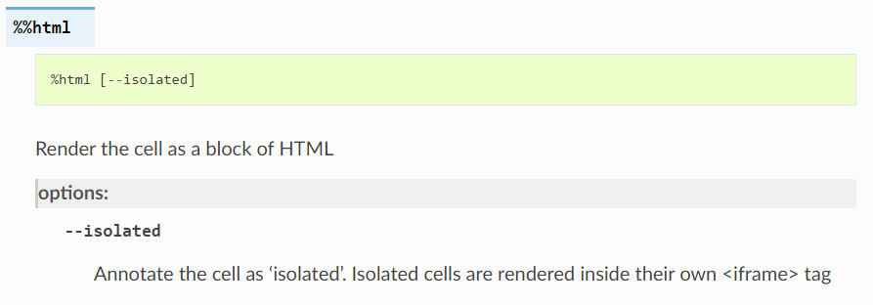
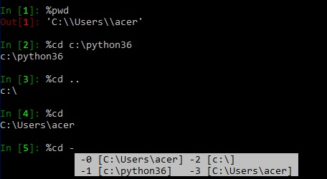
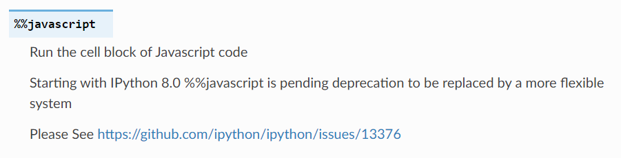
Magic Commands
Line Magics Examples
Cell Magics Examples

Slide 21
Exercise
Write a desired sorting algorithm in a python file name sort.py and calculate the execution time of and also get the information of that method and its variables too, in Ipython by using magic commands.
Do the above exercise for below program too. Write a program to get n as input and print the nth number of prime numbers, for example if input is 3 the 3th prime number is 5.

Slide 22
References
Tutorialspoint.com

