Slide 1
Data Quality
What kinds of data quality problems?
How can we detect problems with the data?
What can we do about these problems?
Examples of data quality problems:
Noise and outliers
missing values
duplicate data

Slide 2
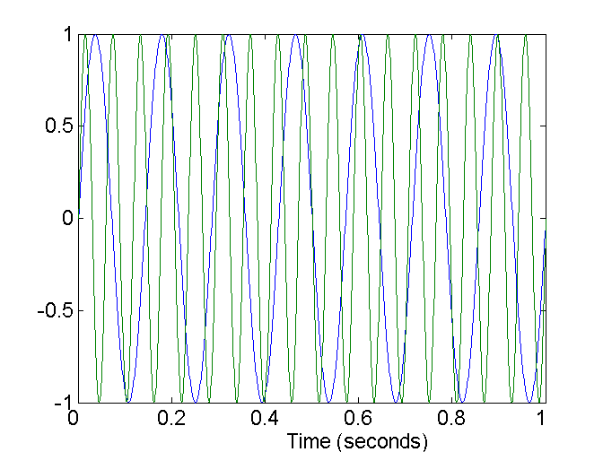
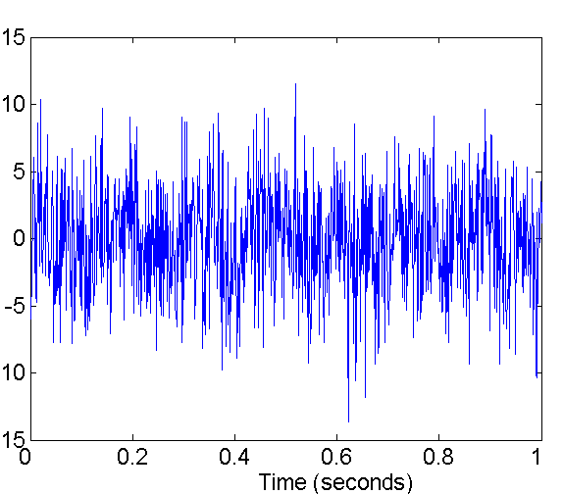
Noise
Noise refers to modification of original values
Examples: distortion of a person’s voice when talking on a poor phone and “snow” on television screen
Two Sine Waves
Two Sine Waves + Noise

Slide 3
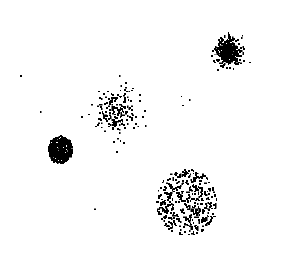
Outliers
Outliers are data objects with characteristics that are considerably different than most of the other data objects in the data set

Slide 4
Missing Values
Reasons for missing values
Information is not collected (e.g., people decline to give their age and weight)
Attributes may not be applicable to all cases (e.g., annual income is not applicable to children)
Handling missing values
Eliminate Data Objects
Estimate Missing Values
Ignore the Missing Value During Analysis
Replace with all possible values (weighted by their probabilities)

Slide 5
Duplicate Data
Data set may include data objects that are duplicates
Major issue when merging data from heterogeous sources
Examples:
Same person with multiple email addresses
Data cleaning
Process of dealing with duplicate data issues

Slide 6
Data Preprocessing
Aggregation تجمیع-انبوهش
Sampling
Dimensionality Reduction
Feature subset selection
Feature creation
Discretization and Binarization
Attribute Transformation
Normalization

Slide 7
Aggregation
Combining two or more attributes (or objects) into a single attribute (or object)
Purpose
Data reduction
Reduce the number of attributes or objects
Change of scale
Cities aggregated into regions, states, countries, etc
More “stable” data
Aggregated data tends to have less variability

Slide 8
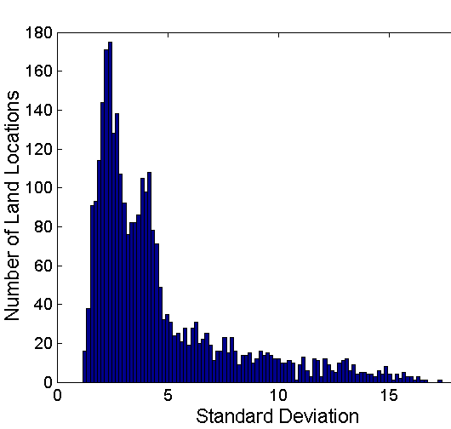
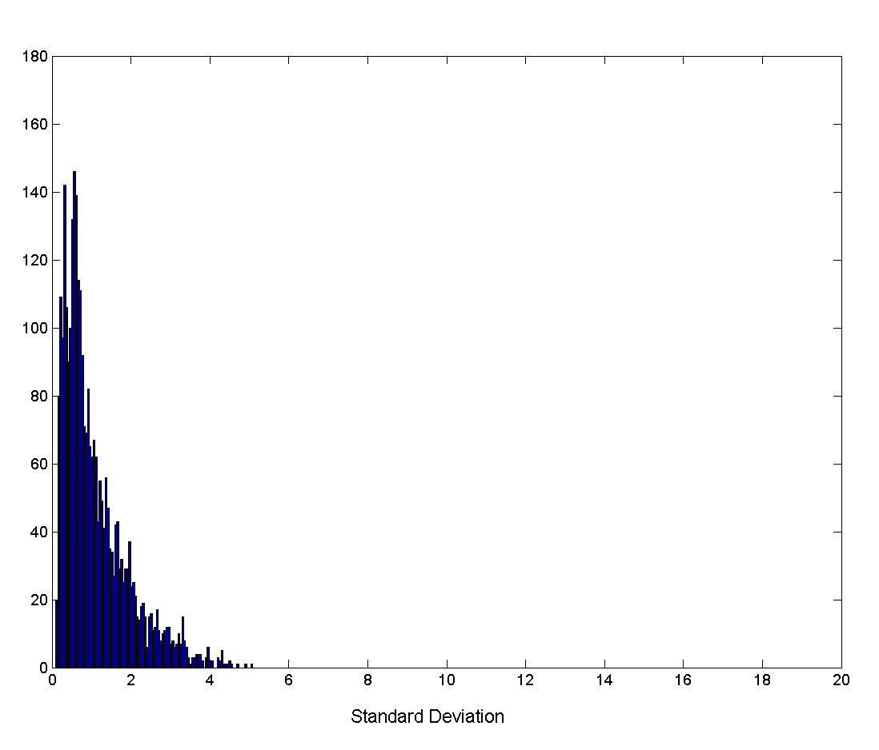
Aggregation
Variation of Precipitation in Australia
Standard Deviation of Average Monthly Precipitation
Standard Deviation of Average Yearly Precipitation
Notes:
Precipitation بارش

Slide 9
Sampling
Sampling is the main technique employed for data selection.
It is often used for both the preliminary investigation of the data and the final data analysis.
Statisticians sample because obtaining the entire set of data of interest is too expensive or time consuming.
Sampling is used in data mining because processing the entire set of data of interest is too expensive or time consuming.

Slide 10
Sampling …
The key principle for effective sampling is the following:
using a sample will work almost as well as using the entire data sets, if the sample is representative
A sample is representative if it has approximately the same property (of interest) as the original set of data

Slide 11
Types of Sampling
Simple Random Sampling
There is an equal probability of selecting any particular item
Sampling without replacement
As each item is selected, it is removed from the population
Sampling with replacement
Objects are not removed from the population as they are selected for the sample.
In sampling with replacement, the same object can be picked up more than once
Stratified sampling نمونه برداری طبقه ای یا دسته ای
Split the data into several partitions; then draw random samples from each partition

Slide 12

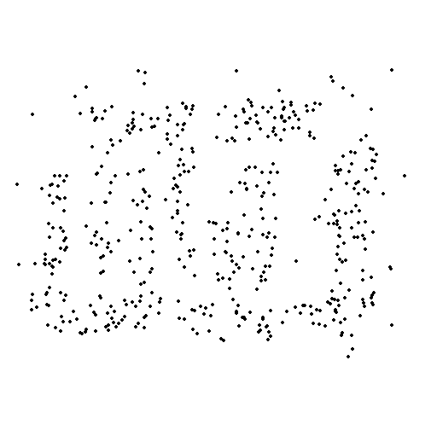
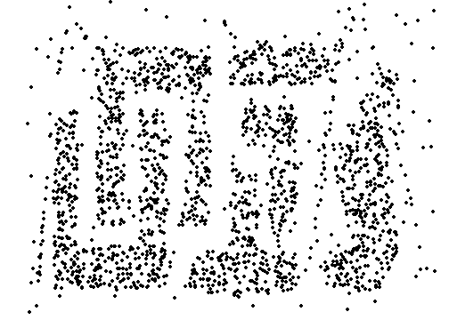
Sample Size
8000 points 2000 Points 500 Points

Slide 13
Curse of Dimensionality
When dimensionality increases, data becomes increasingly sparse in the space that it occupies
Definitions of density and distance between points, which is critical for clustering and outlier detection, and other data mining tasks become less meaningful

Slide 14
Dimensionality Reduction
Purpose:
Avoid curse of dimensionality
Reduce amount of time and memory required by data mining algorithms
Allow data to be more easily visualized
May help to eliminate irrelevant features or reduce noise
Techniques
Principle Component Analysis
Singular Value Decomposition
Others: supervised and non-linear techniques

Slide 15
Feature Subset Selection
Another way to reduce dimensionality of data
Redundant features
duplicate much or all of the information contained in one or more other attributes
Example: purchase price of a product and the amount of sales tax paid
Irrelevant features
contain no information that is useful for the data mining task at hand
Example: students' ID is often irrelevant to the task of predicting students' GPA

Slide 16
Feature Subset Selection
Techniques:
Embedded approaches:
Feature selection occurs naturally as part of the data mining algorithm
Filter approaches:
Features are selected before data mining algorithm is run
Wrapper approaches:انحصاری
Use the data mining algorithm as a black box to find best subset of attributes

Slide 17
Feature Creation
Create new attributes that can capture the important information in a data set much more efficiently than the original attributes
Three general methodologies:
Feature Extraction استخراج ویژگی از تصویر صدا متن فیلم
domain-specific
Mapping Data to New Space
Feature Construction
combining features

Slide 18


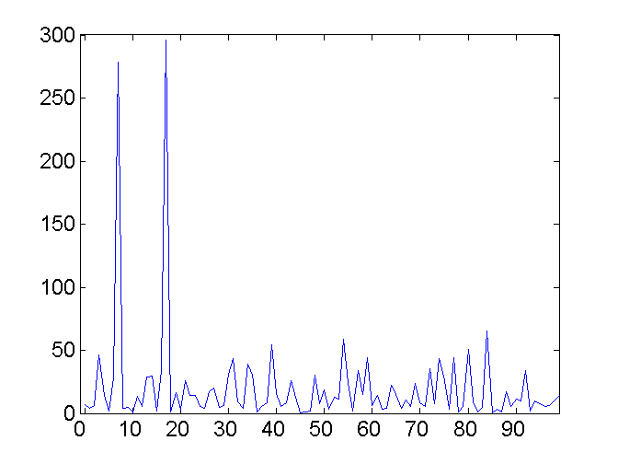
Mapping Data to a New Space
Fourier transform
Wavelet transform
Two Sine Waves
Two Sine Waves + Noise
Frequency

Slide 19
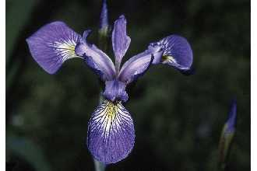
Iris Sample Data Set
Many of the exploratory data techniques are illustrated with the Iris Plant data set.
Can be obtained from the UCI Machine Learning Repository http://www.ics.uci.edu/~mlearn/MLRepository.html
From the statistician Douglas Fisher
Three flower types (classes):
Setosa
Virginica
Versicolour
Four (non-class) attributes
Sepal width and length
Petal width and length
Virginica. Robert H. Mohlenbrock. USDA NRCS. 1995. Northeast wetland flora: Field office guide to plant species. Northeast National Technical Center, Chester, PA. Courtesy of USDA NRCS Wetland Science Institute.

Slide 20
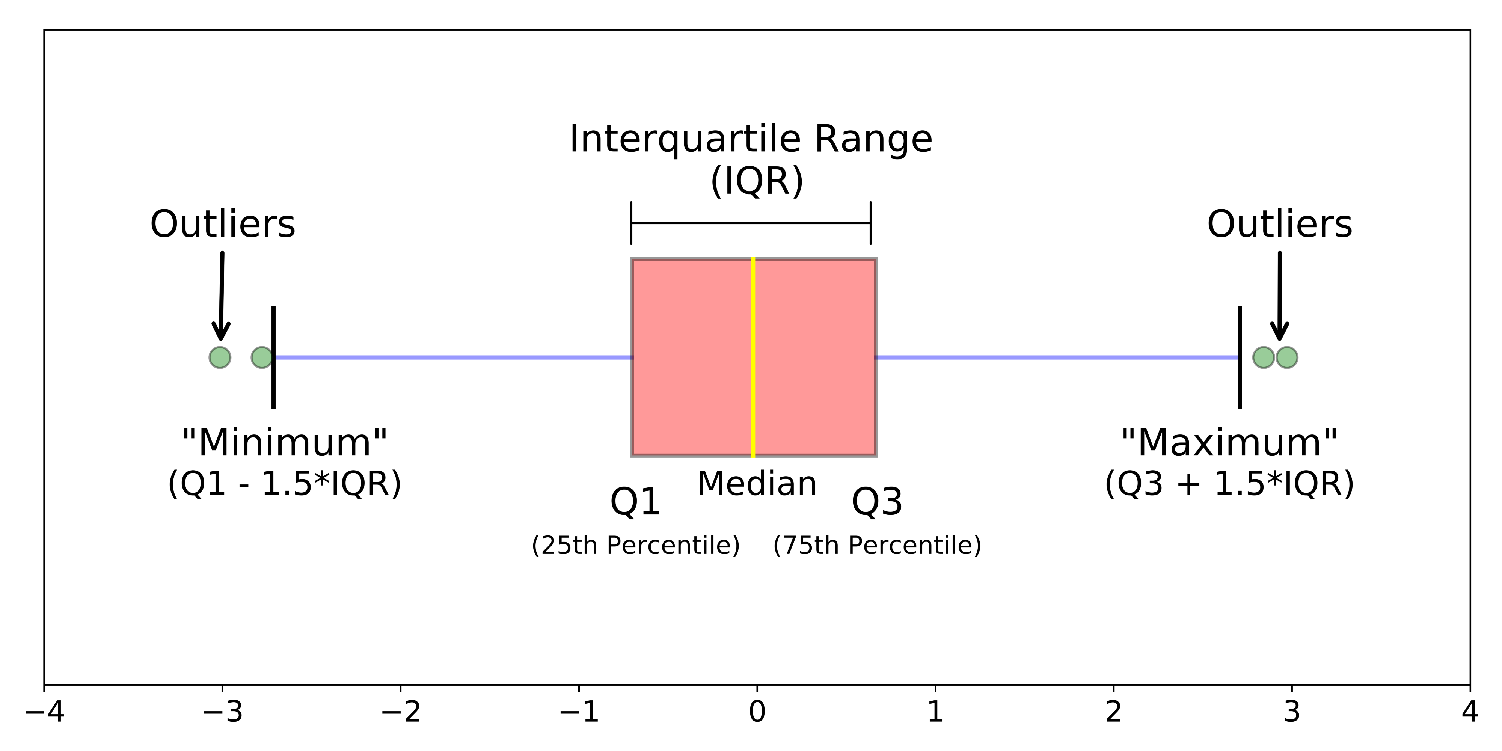
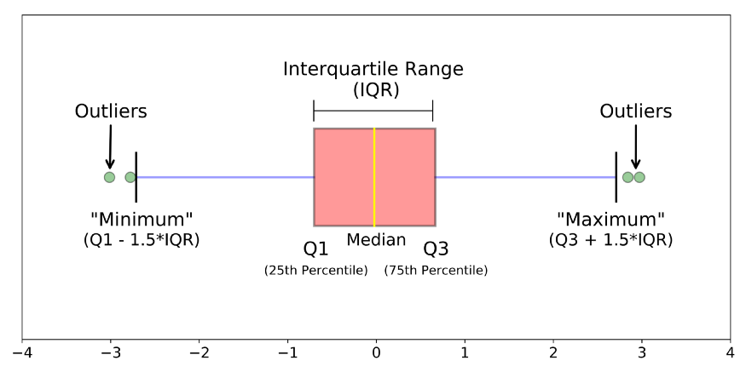
Visualization Techniques: Box Plots
Box Plots
Invented by J. Tukey
Away of displaying the distribution of data
Following figure shows the basic part of a box plot
outlier
90th percentile
75th percentile
50th percentile
25th percentile
10th percentile

Slide 21
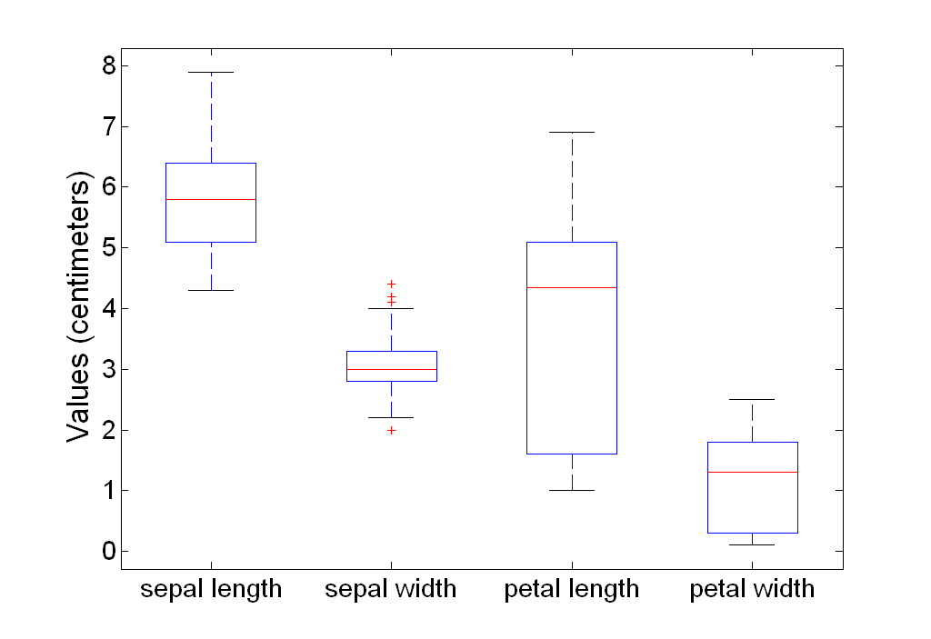
Example of Box Plots
Box plots can be used to compare attributes

Slide 22
Visualization Techniques: Scatter Plots
Scatter plots
Attributes values determine the position
Two-dimensional scatter plots most common, but can have three-dimensional scatter plots
Often additional attributes can be displayed by using the size, shape, and color of the markers that represent the objects
It is useful to have arrays of scatter plots can compactly summarize the relationships of several pairs of attributes
See example on the next slide

Slide 23
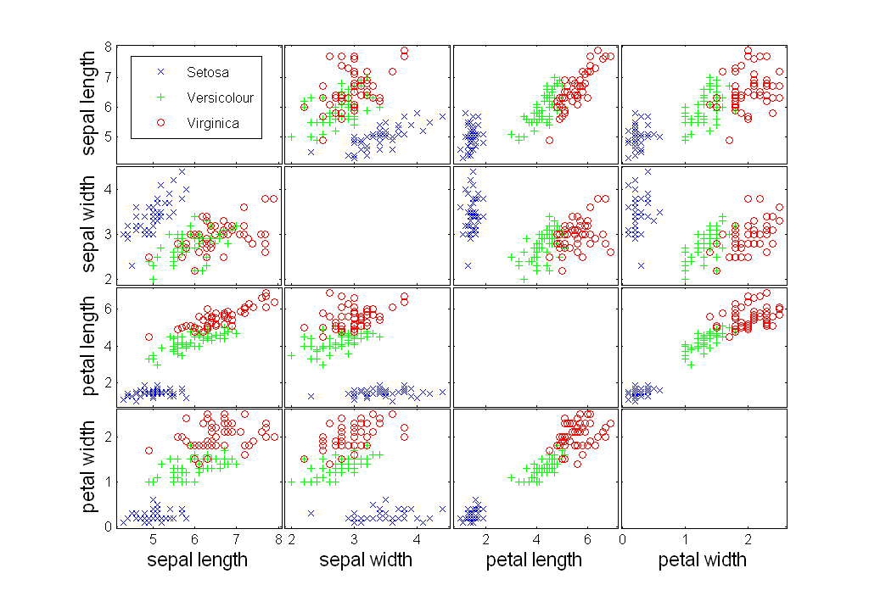
Scatter Plot Array of Iris Attributes

