Slide 1
Data analytics
Session 07

Slide 2
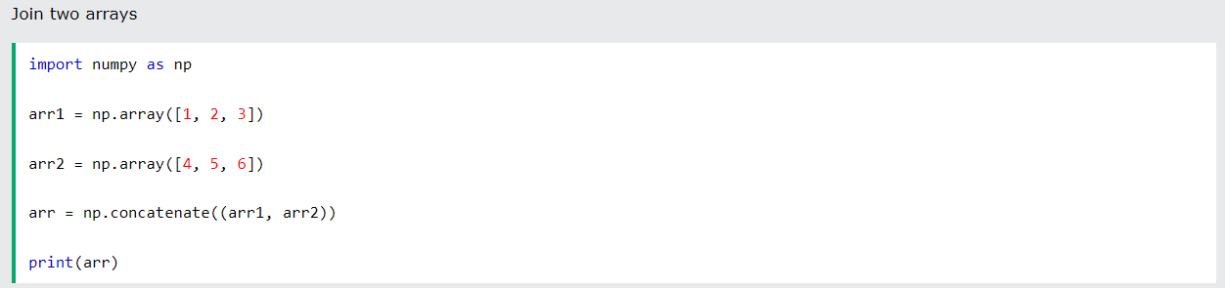

Joining Numpy Array
Joining means putting contents of two or more arrays in a single array.
In SQL we join tables based on a key, whereas in NumPy we join arrays by axes.
We pass a sequence of arrays that we want to join to the concatenate() function, along with the axis. If axis is not explicitly passed, it is taken as 0.

Slide 3
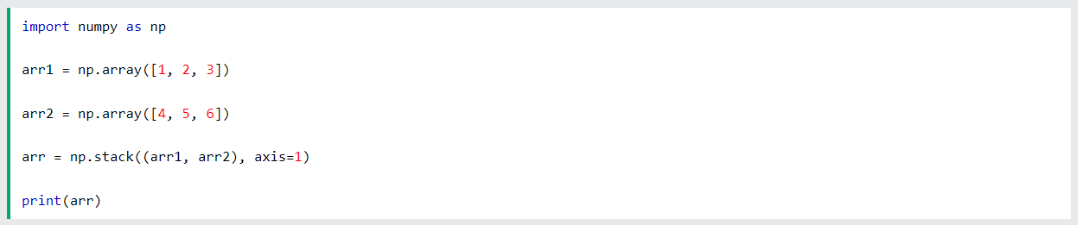

Joining Numpy Array

Slide 4
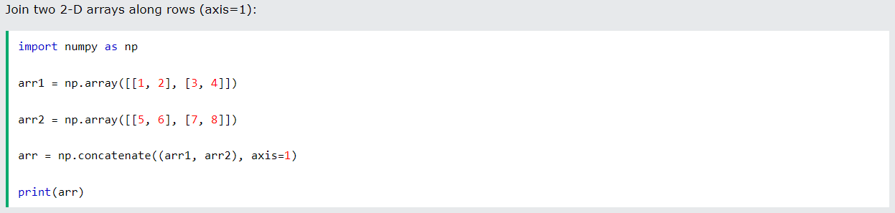

Joining Numpy Array

Slide 5
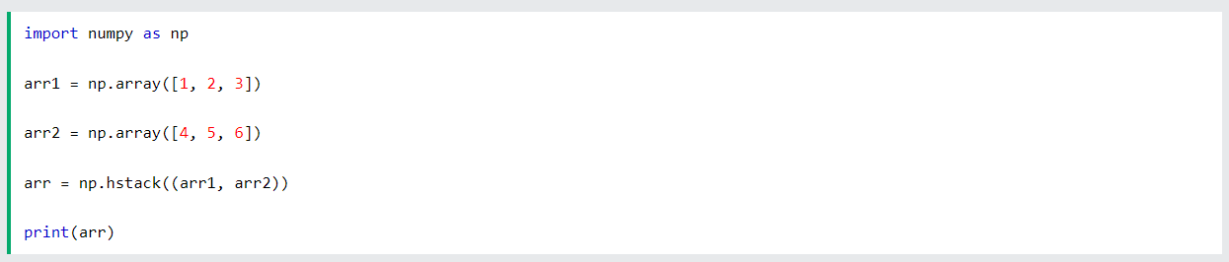
Joining Numpy Array
Stacking along rows with hstack()

Slide 6
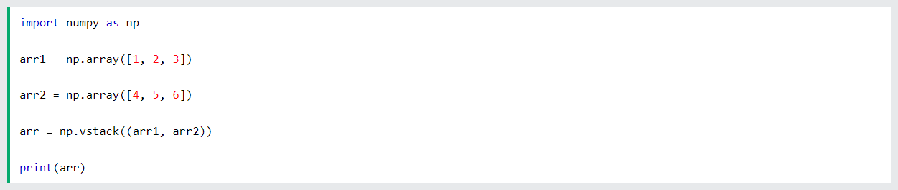
Joining Numpy Array
Stacking along columns with vstack()

Slide 7

Joining Numpy Array
Stacking along height with dstack()

Slide 8
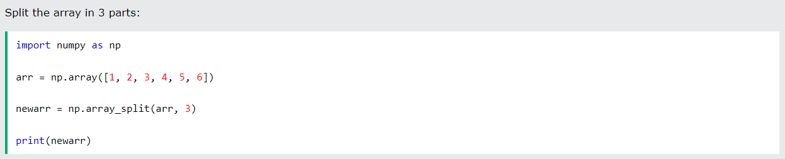

Splitting Numpy Arrays
Splitting is reverse operation of Joining.
Joining merges multiple arrays into one and Splitting breaks one array into multiple.
We use array_split() for splitting arrays, we pass it the array we want to split and the number of splits.

Slide 9
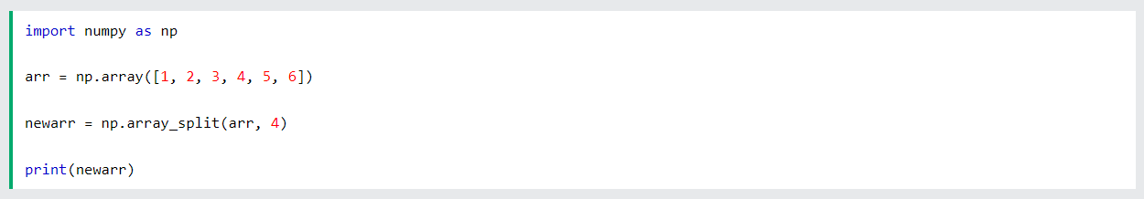
Splitting Numpy Arrays

Slide 10
Splitting Numpy Arrays

Slide 11
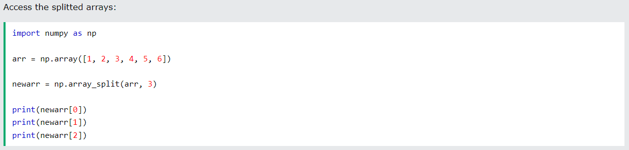
Splitting Numpy Arrays
The return value of the array_split() method is an array containing each of the split as an array.
If you split an array into 3 arrays, you can access them from the result just like any array element:

Slide 12
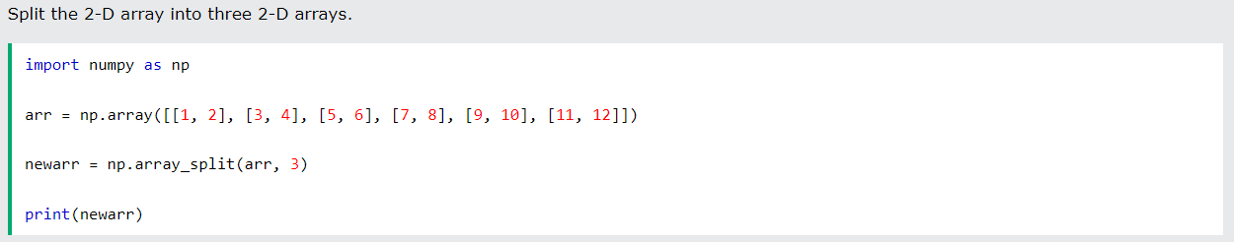
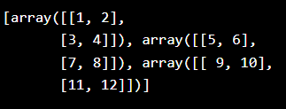
Splitting Numpy Arrays

Slide 13
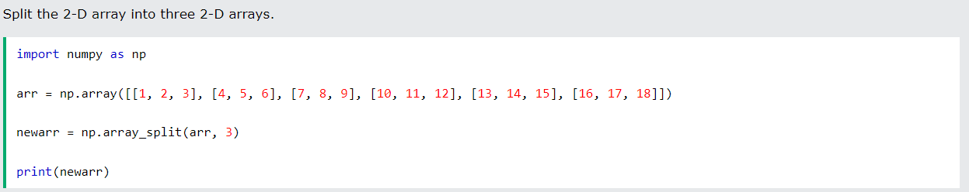
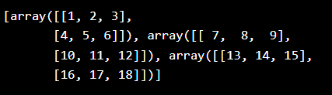
Splitting Numpy Arrays

Slide 14
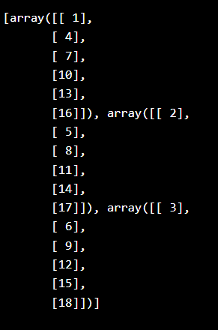
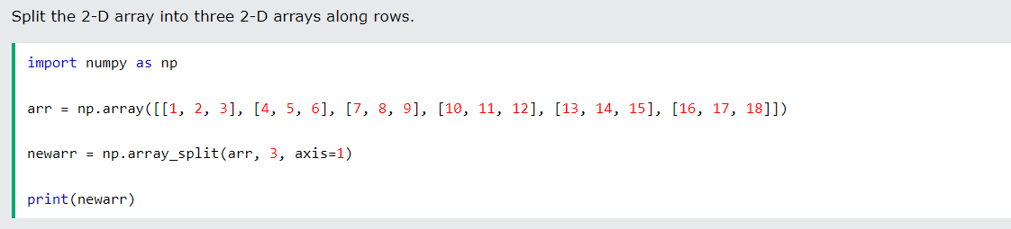
Splitting Numpy Arrays

Slide 15
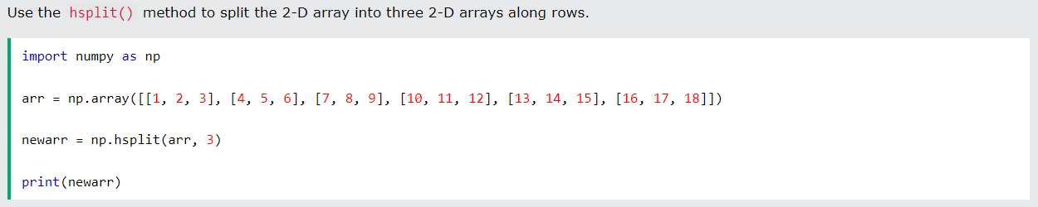
Splitting Numpy Arrays
An alternate solution is using hsplit() opposite of hstack()
Note: Similar alternates to vstack() and dstack() are available as vsplit() and dsplit().

Slide 16
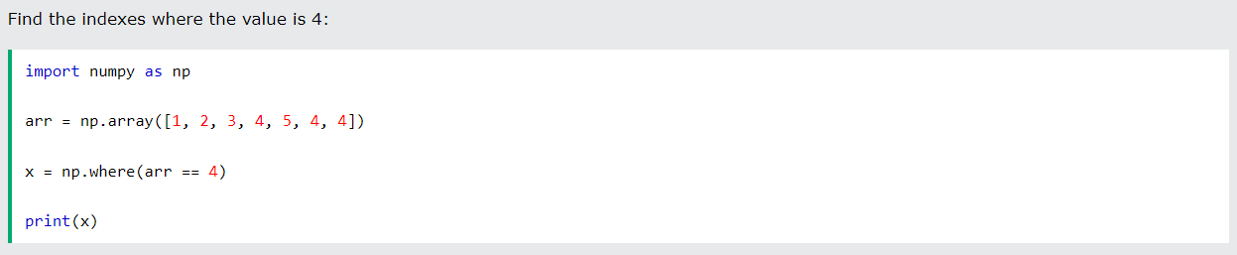

Searching Arrays
You can search an array for a certain value, and return the indexes that get a match.
To search an array, use the where() method.

Slide 17
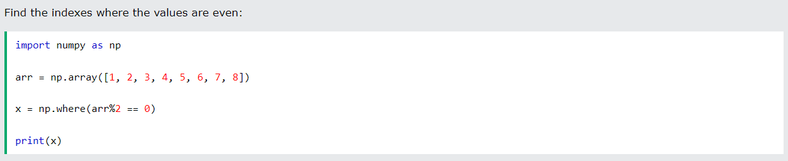
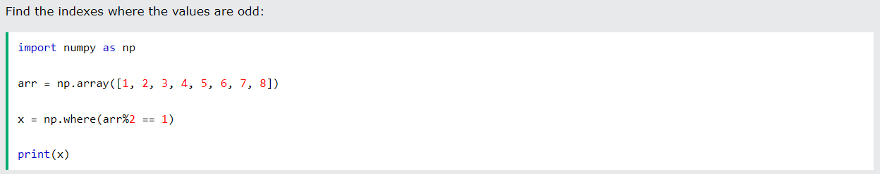
Searching Arrays

Slide 18
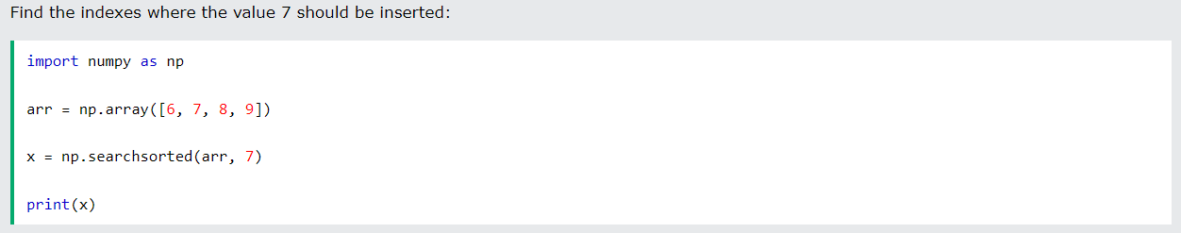
Searching Arrays
Search Sorted
There is a method called searchsorted() which performs a binary search in the array, and returns the index where the specified value would be inserted to maintain the search order.
Note : The searchsorted() method is assumed to be used on sorted arrays.

Slide 19
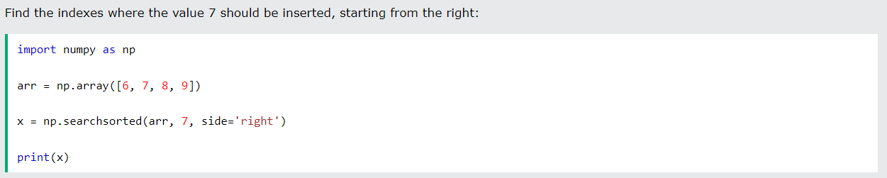
Searching Arrays
Search From the Right Side
By default the left most index is returned, but we can give side='right' to return the right most index instead.

Slide 20
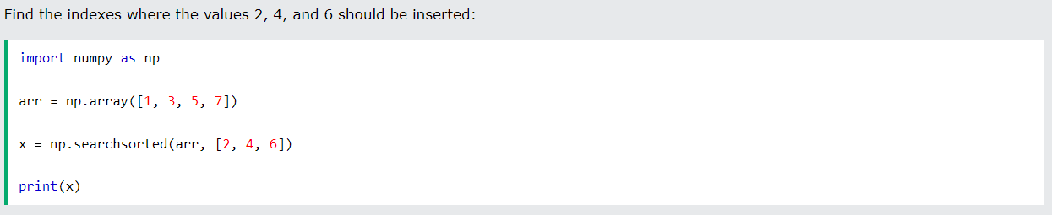
Searching Arrays
Multiple Values
To search for more than one value, use an array with the specified values.

Slide 21
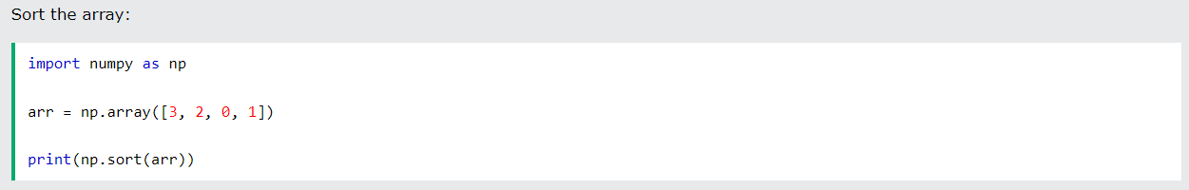
Numpy Sorting Arrays
Sorting means putting elements in an ordered sequence.
Ordered sequence is any sequence that has an order corresponding to elements, like numeric or alphabetical, ascending or descending.
The NumPy ndarray object has a function called sort(), that will sort a specified array.
Note: This method returns a copy of the array, leaving the original array unchanged.

Slide 22
Numpy Sorting Arrays
Sorting means putting elements in an ordered sequence.
Ordered sequence is any sequence that has an order corresponding to elements, like numeric or alphabetical, ascending or descending.
The NumPy ndarray object has a function called sort(), that will sort a specified array.
Note: This method returns a copy of the array, leaving the original array unchanged.

Slide 23
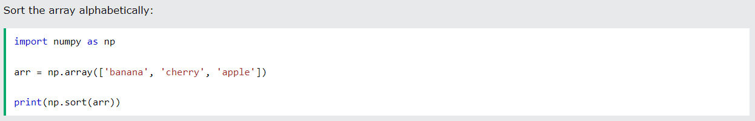
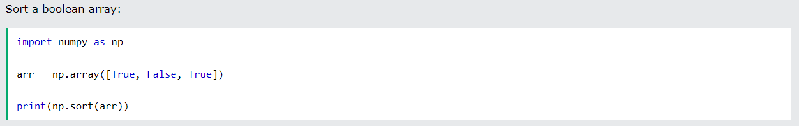
Numpy Sorting Arrays

Slide 24
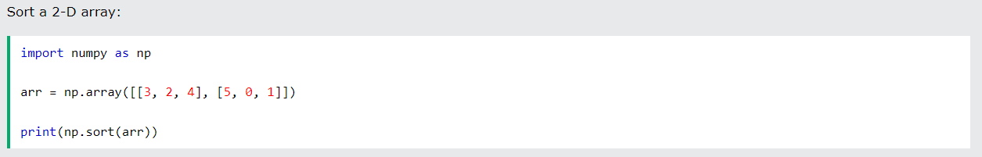

Numpy Sorting Arrays

Slide 25
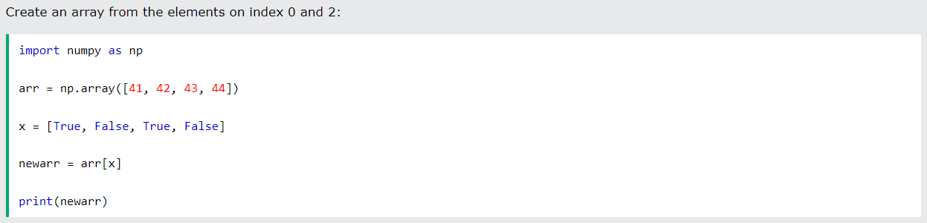
Numpy Filter Arrays
Getting some elements out of an existing array and creating a new array out of them is called filtering.
In NumPy, you filter an array using a boolean index list.
A boolean index list is a list of booleans corresponding to indexes in the array.
If the value at an index is True that element is contained in the filtered array, if the value at that index is False that element is excluded from the filtered array.

Slide 26
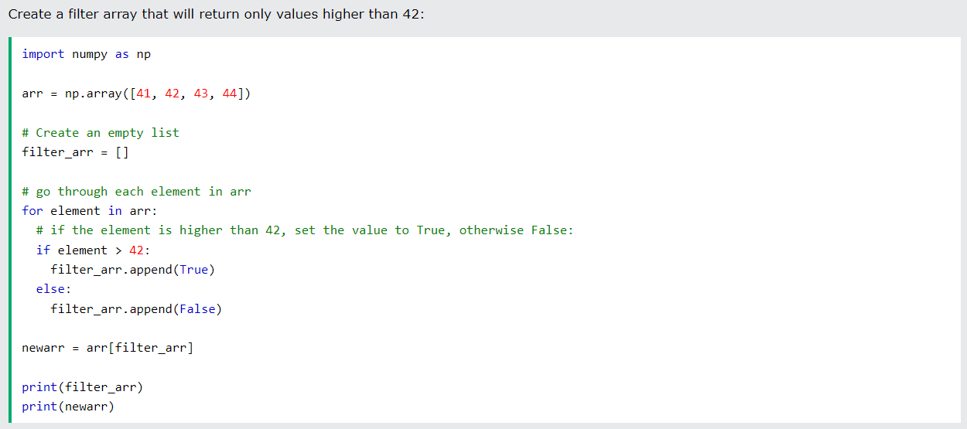
Numpy Filter Arrays
Creating the filter Arrays

Slide 27
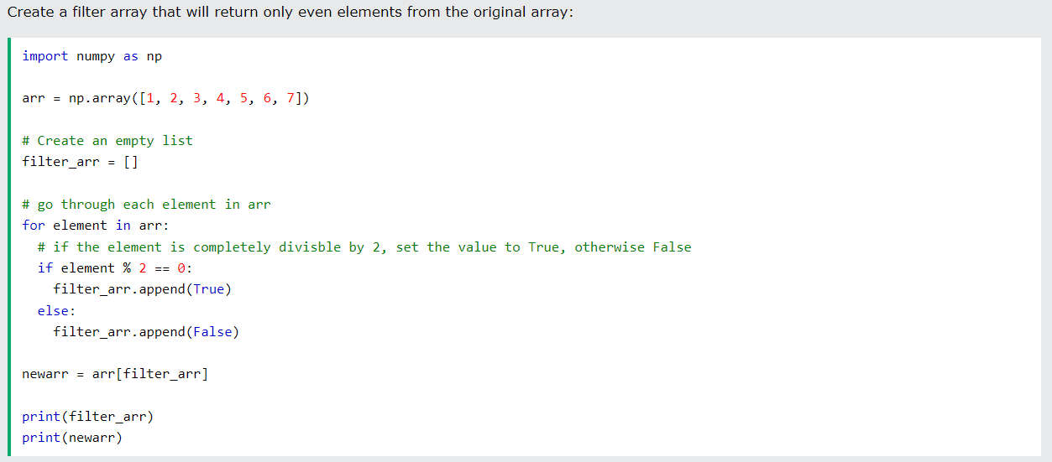
Numpy Filter Arrays

Slide 28
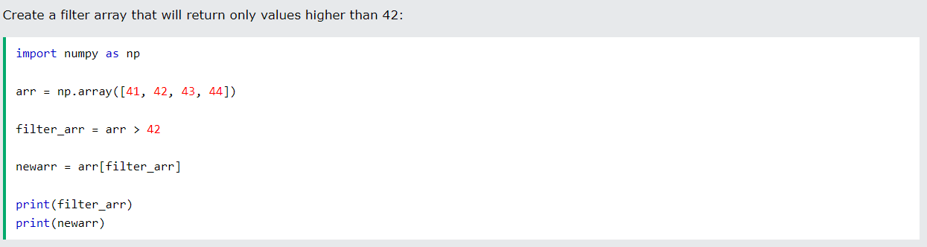
Numpy Filter Arrays
Creating Filter Directly From Array
The above example is quite a common task in NumPy and NumPy provides a nice way to tackle it.
We can directly substitute the array instead of the iterable variable in our condition and it will work just as we expect it to.

Slide 29
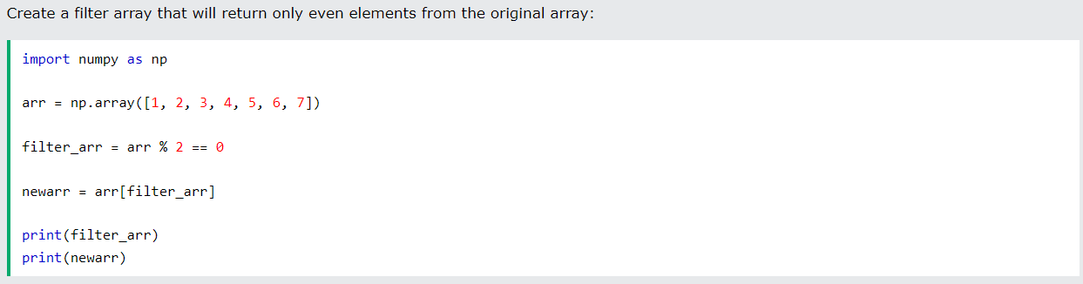
Numpy Filter Arrays

