Slide 1
Data analytics
Session 04

Slide 2
Functions are First Class Objects
In Python, functions are first class objects which means that functions in Python can be used or passed as arguments.
Properties of First Class Objects
A function is an instance of the Object type.
You can store the function in a variable.
You can pass the function as a parameter to another function.
You can return the function from a function.
You can store them in data structures such as hash tables, lists, …

Slide 3
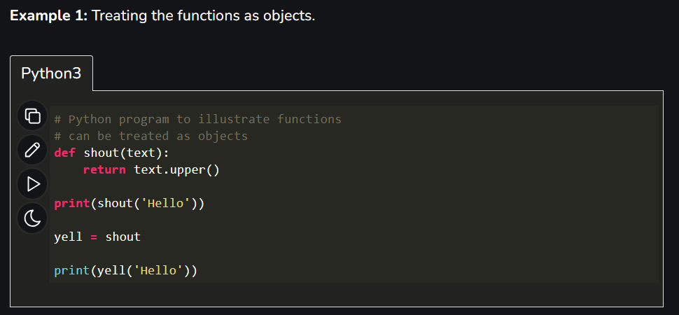
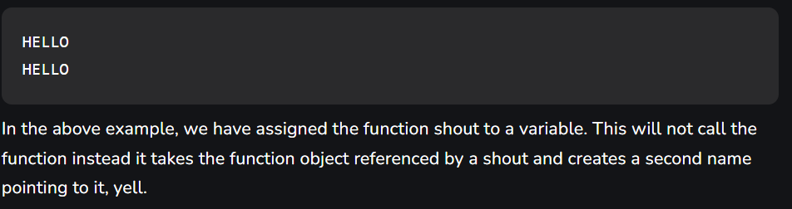
Functions are First Class Objects

Slide 4
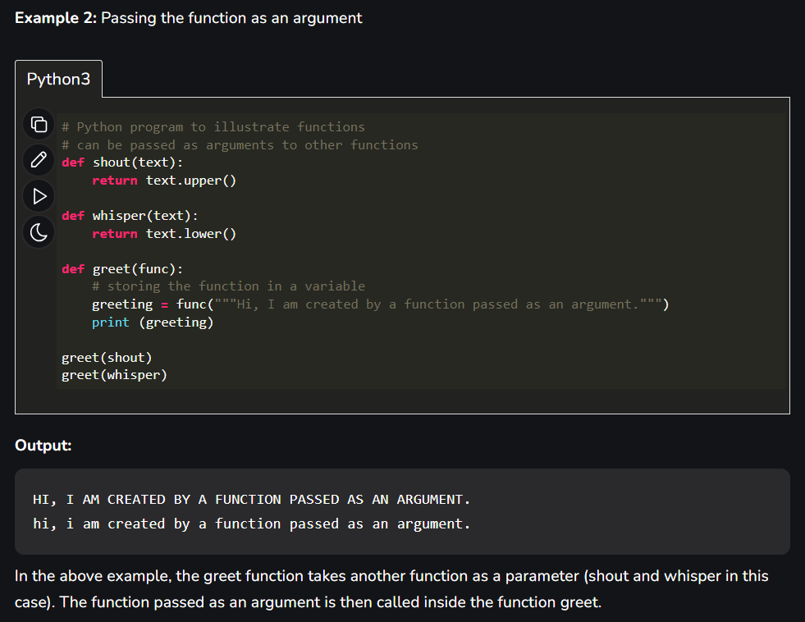
Functions are First Class Objects

Slide 5
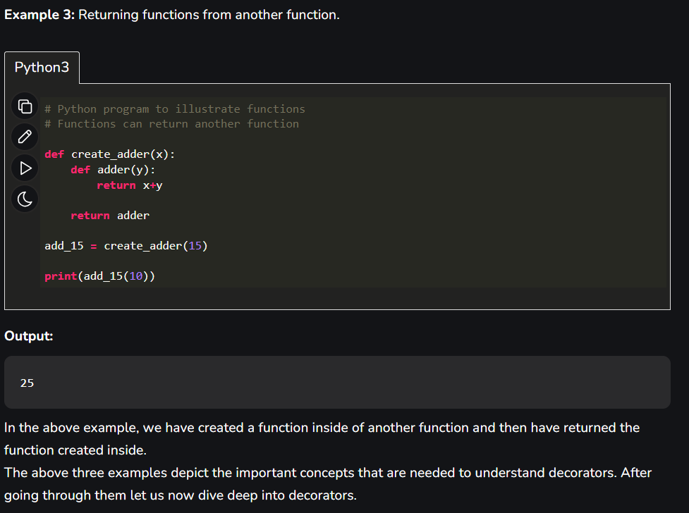
Functions are First Class Objects

Slide 6
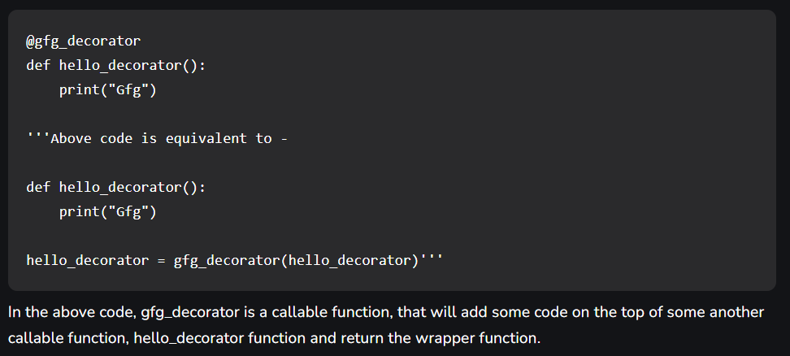
Decorators
Decorators are a powerful and flexible feature in Python that allow you to modify or enhance the behavior of functions or methods without changing their source code. They are often used for tasks such as logging, authentication, caching, and more. Decorators are functions that take another function as input and return a new function that typically extends or modifies the behavior of the original function. Decorators are applied using the "@" symbol followed by the decorator function's name above the target function definition.
Hypothetical Decorator

Slide 7
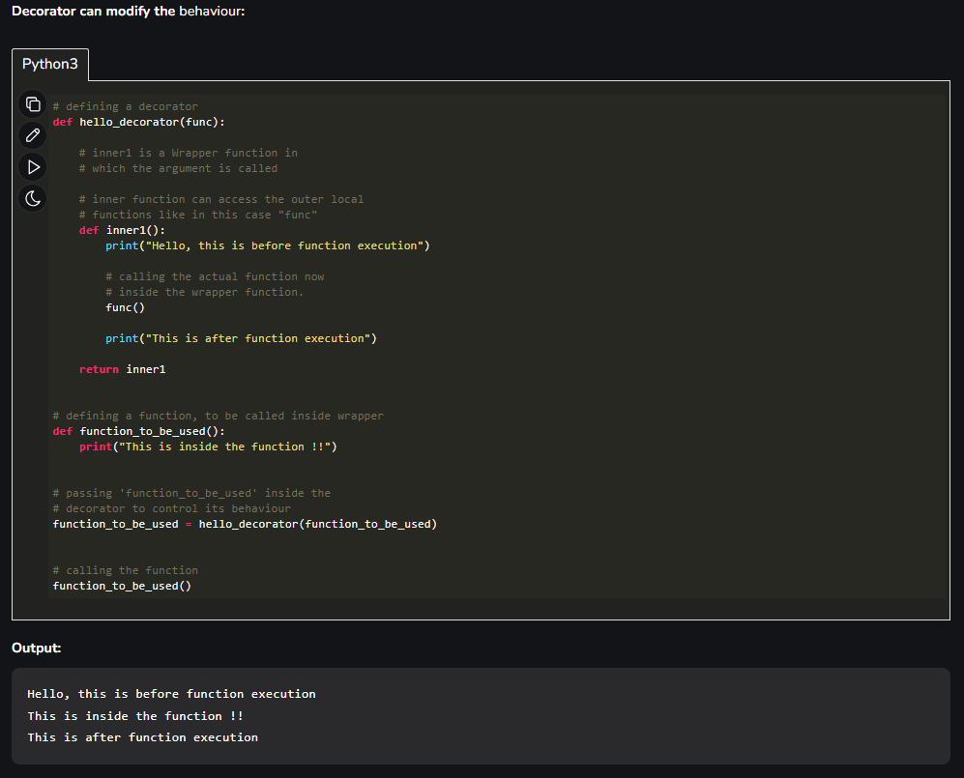
Decorators
You can see the decorator is a nested function with another function.

Slide 8
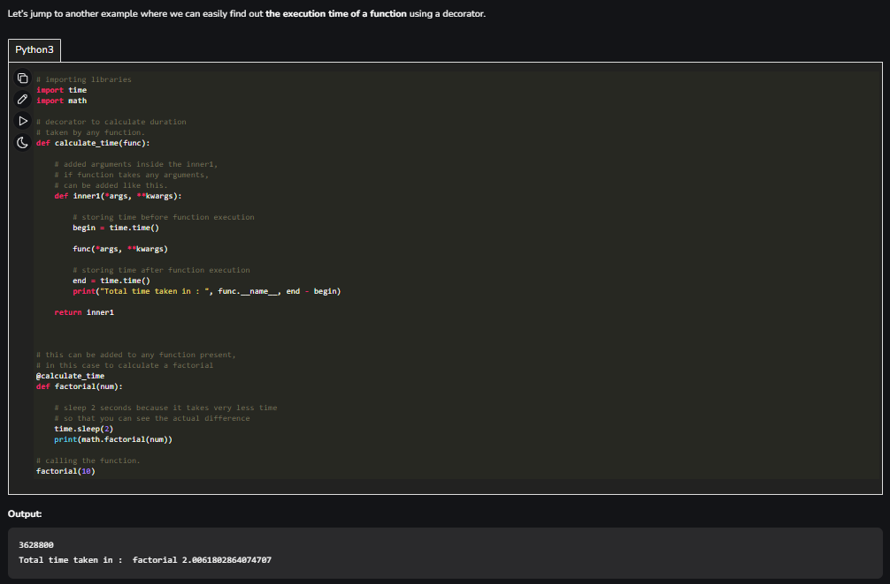
Decorators
In this example, we want to calculate the execution time of a method by defining a decorator.

Slide 9
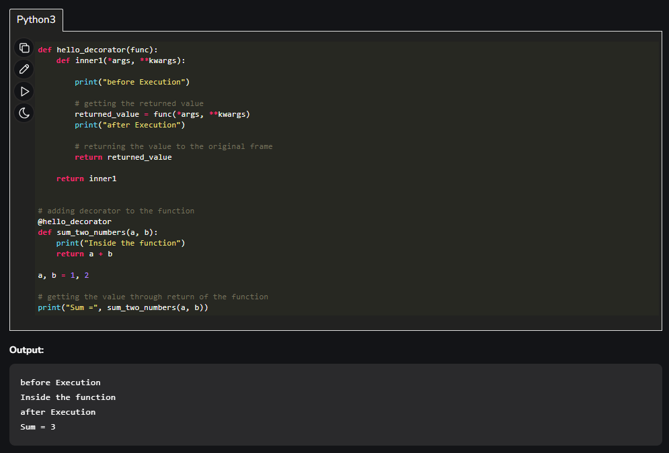
Decorators
What if a function returns something or an argument is passed to the function?
In all the above examples the functions didn’t return anything so there wasn’t an issue, but one may need the returned value.
In the above example, you may notice a keen difference in the parameters of the inner function. The inner function takes the argument as *args and **kwargs which means that a tuple of positional arguments or a dictionary of keyword arguments can be passed of any length. This makes it a general decorator that can decorate a function having any number of arguments.

Slide 10
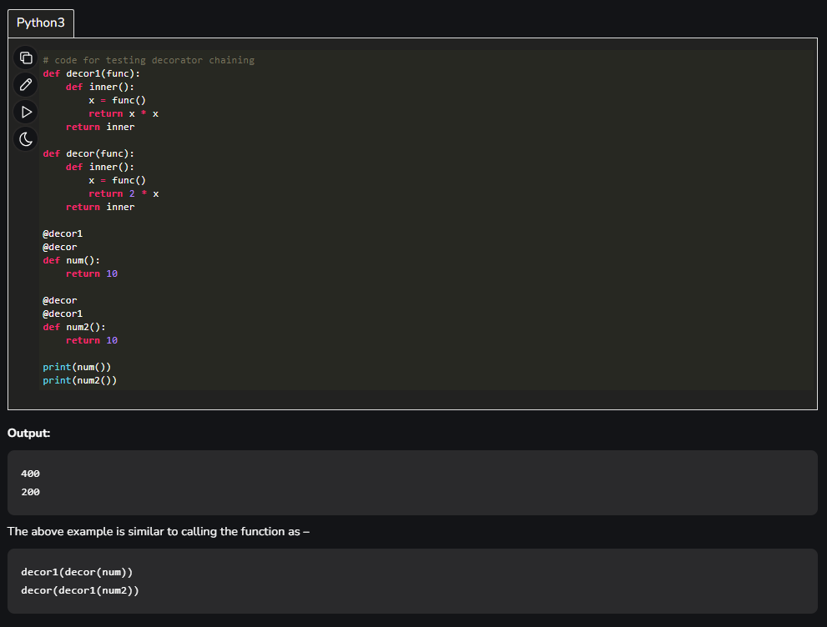
Decorators
Chaining Decorators
In simpler terms chaining decorators means decorating a function with multiple decorators.

Slide 11
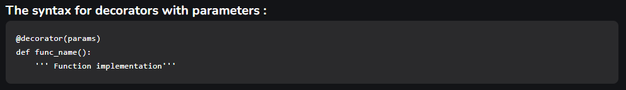
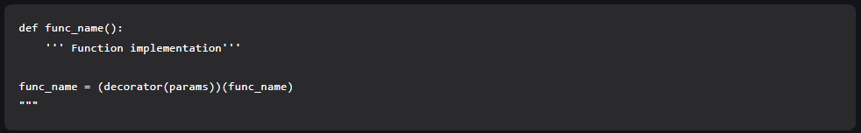
Decorators with Parameters
As the execution starts from left to right decorator(params) is called which returns a function object fun_obj. Using the fun_obj the call fun_obj(fun_name) is made. Inside the inner function, required operations are performed and the actual function reference is returned which will be assigned to func_name. Now, func_name() can be used to call the function with decorator applied on it.

Slide 12
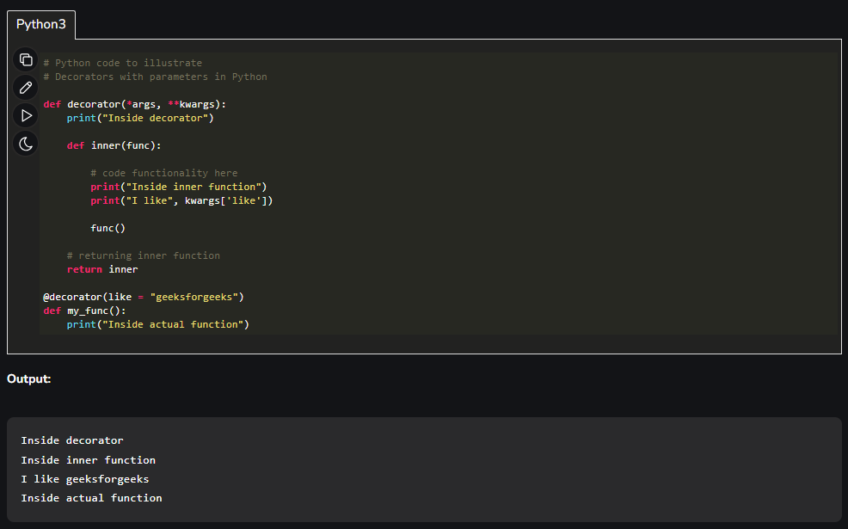
Decorators with Parameters

Slide 13
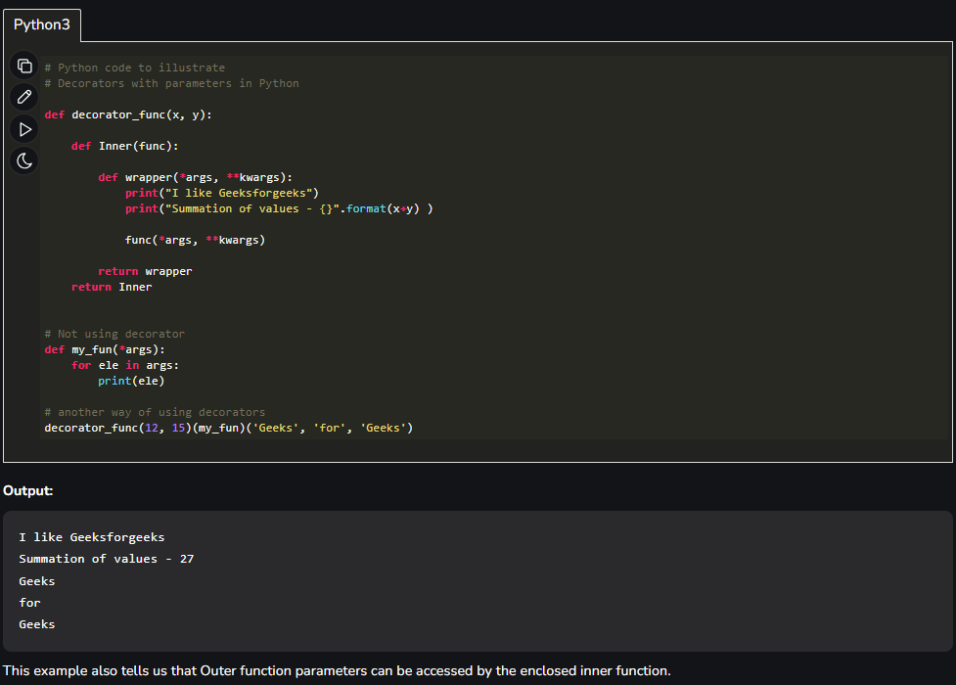
Decorators with Parameters

Slide 14
Coding Exercises
Write a Python program to create a class representing a stack data structure and queue data structure. Include methods for pushing and popping elements.
Write a Python program to create a class that represents a shape. Include methods to calculate its area and perimeter. Implement subclasses for different shapes like circle, triangle, and square.
Write a Python program to create a class representing float data type, and implement attributes as much as you can for this class, such as operators (Dunder methods), Casting to other types and etc.

