Slide 1
Data analytics
Session 09

Slide 2
What is Pandas
Pandas is an open-source Python Library providing high-performance data manipulation and analysis tool using its powerful data structures. The name Pandas is derived from the word Panel Data – an Econometrics from Multidimensional data.
In 2008, developer Wes McKinney started developing pandas when in need of high performance, flexible tool for analysis of data.
Prior to Pandas, Python was majorly used for data munging and preparation. It had very little contribution towards data analysis. Pandas solved this problem. Using Pandas, we can accomplish five typical steps in the processing and analysis of data, regardless of the origin of data — load, prepare, manipulate, model, and analyze.
Python with Pandas is used in a wide range of fields including academic and commercial domains including finance, economics, Statistics, analytics, etc.

Slide 3
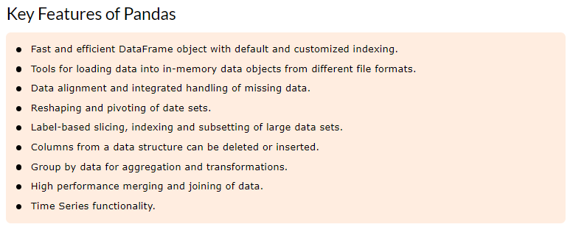
What is Pandas

Slide 4
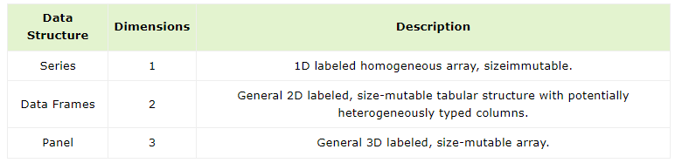
Pandas Data Structures

Slide 5
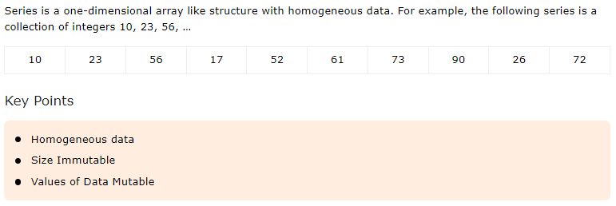
Series

Slide 6
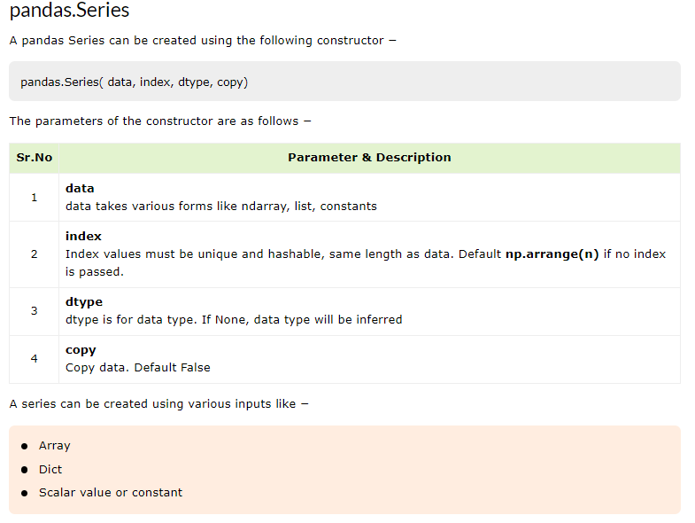
Series

Slide 7
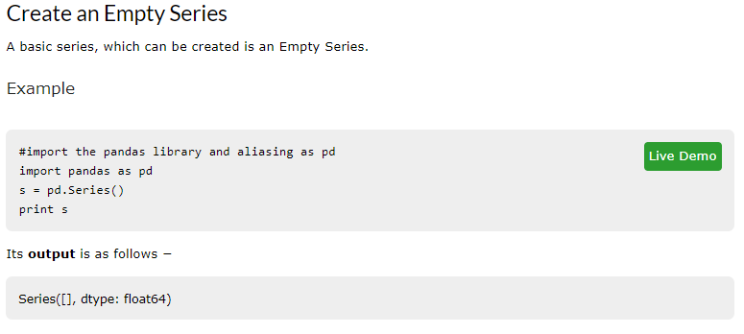
Series

Slide 8
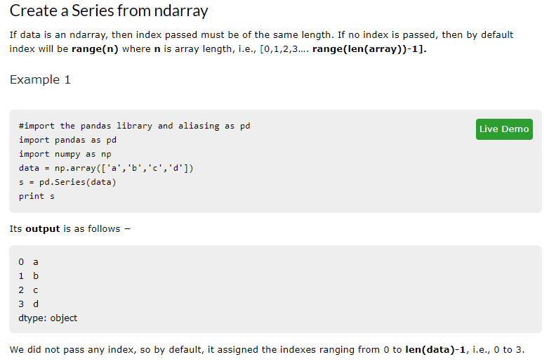
Series

Slide 9
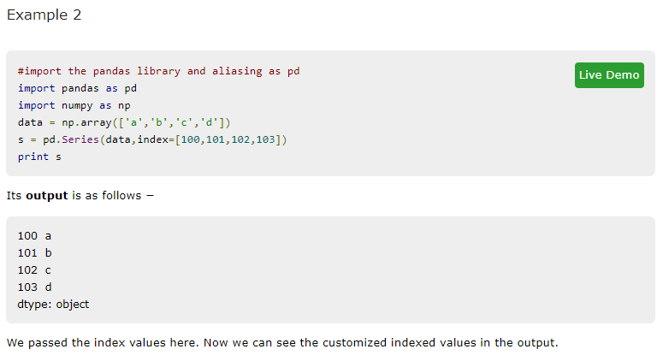
Series

Slide 10
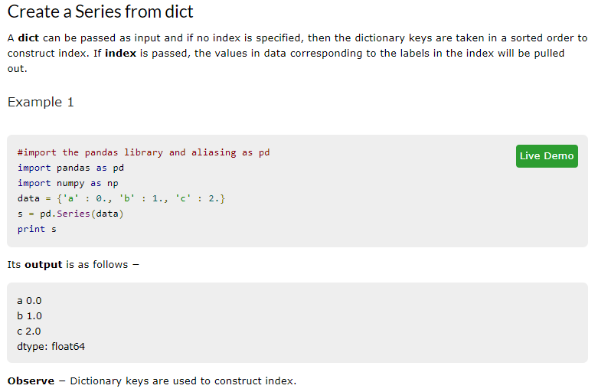
Series

Slide 11
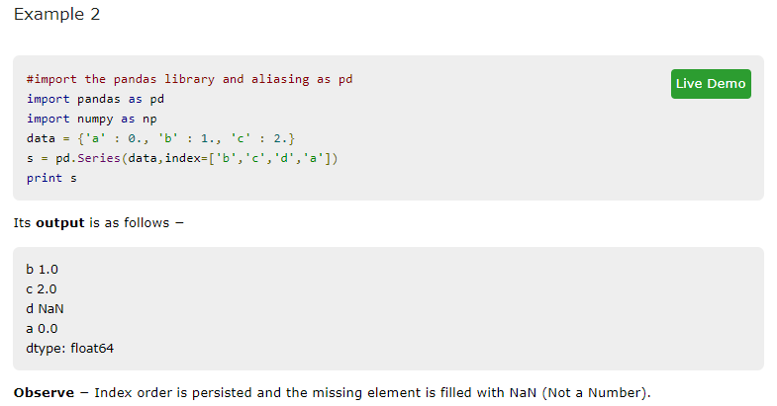
Series

Slide 12
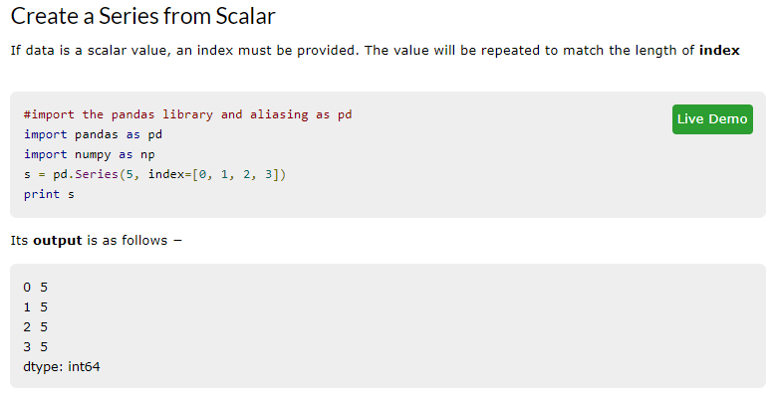
Series

Slide 13
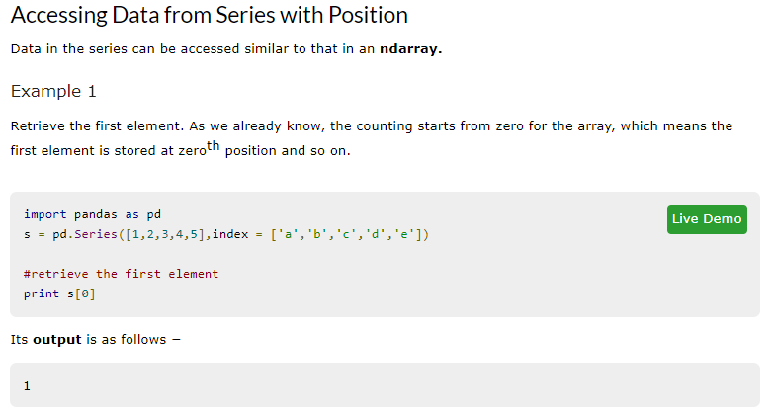
Series

Slide 14
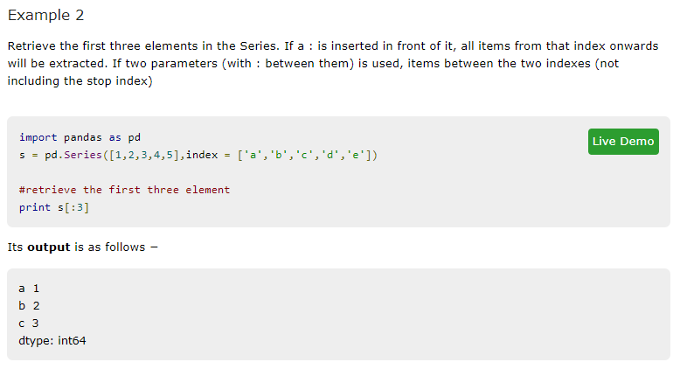
Series

Slide 15
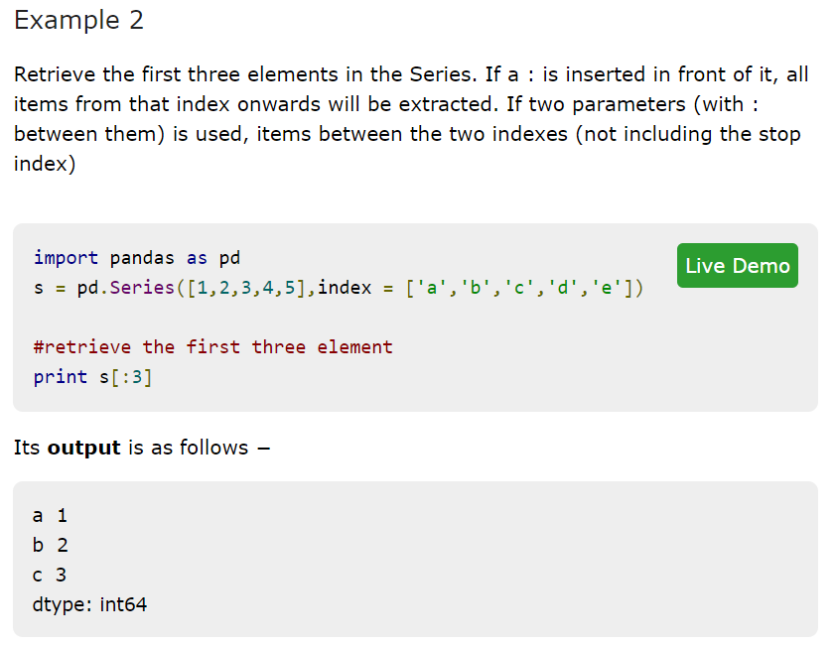
Series

Slide 16
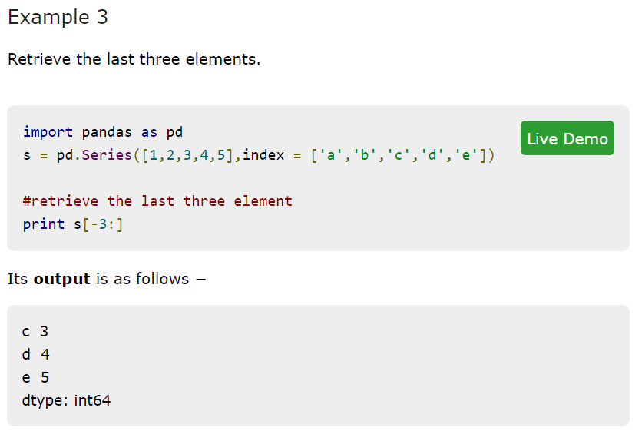
Series

Slide 17
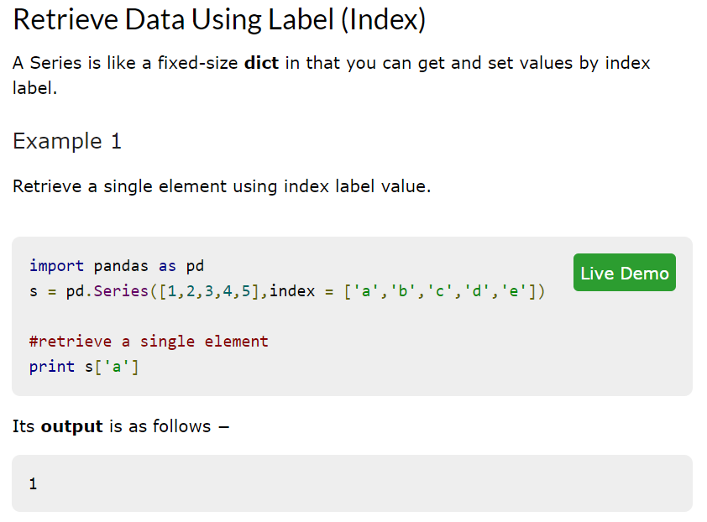
Series

Slide 18
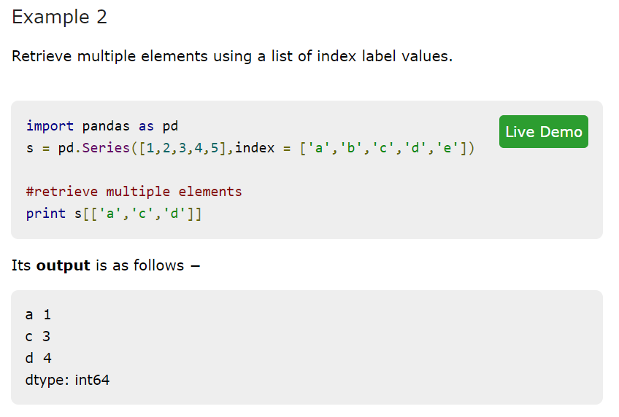
Series

Slide 19
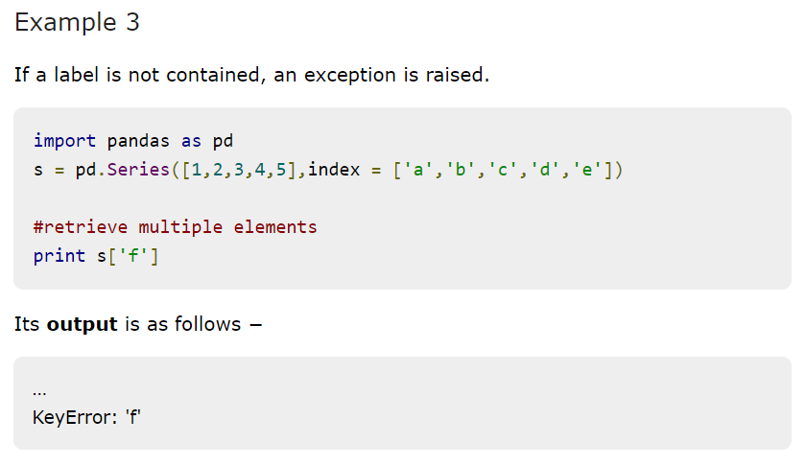
Series

Slide 20
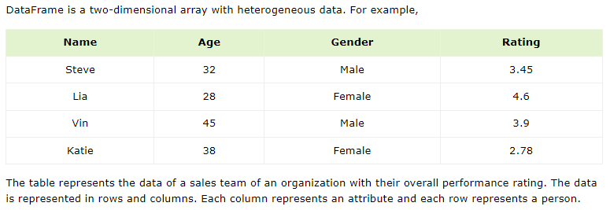
Data Frames

Slide 21
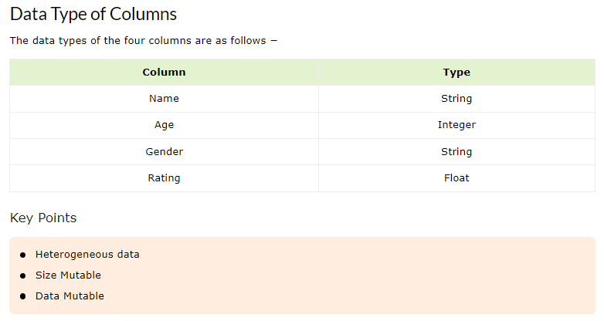
Data Frames

Slide 22
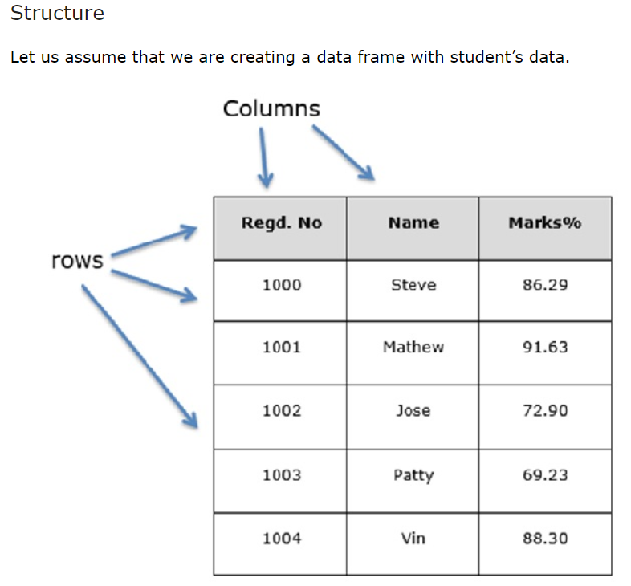
Data Frames

Slide 23
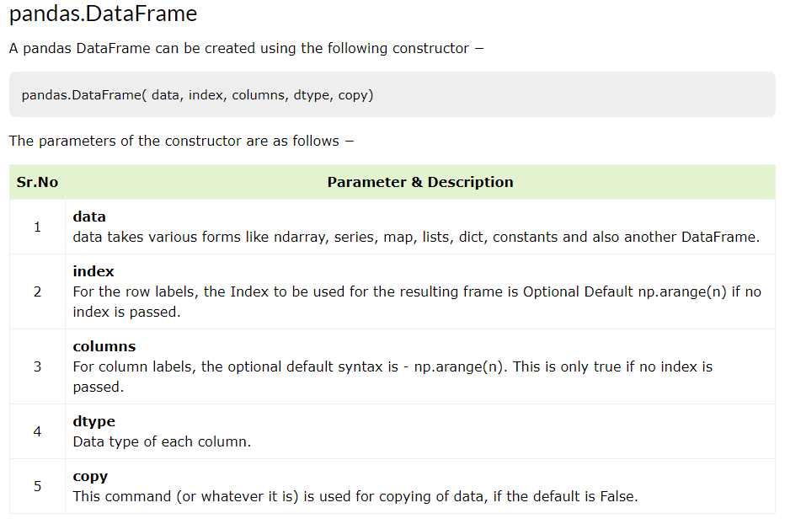
Data Frames

Slide 24
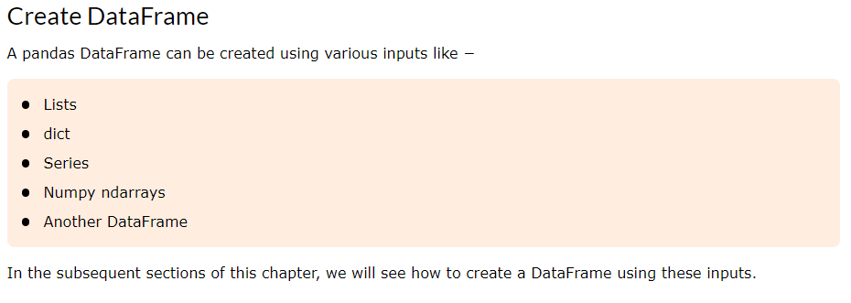
Data Frames

Slide 25
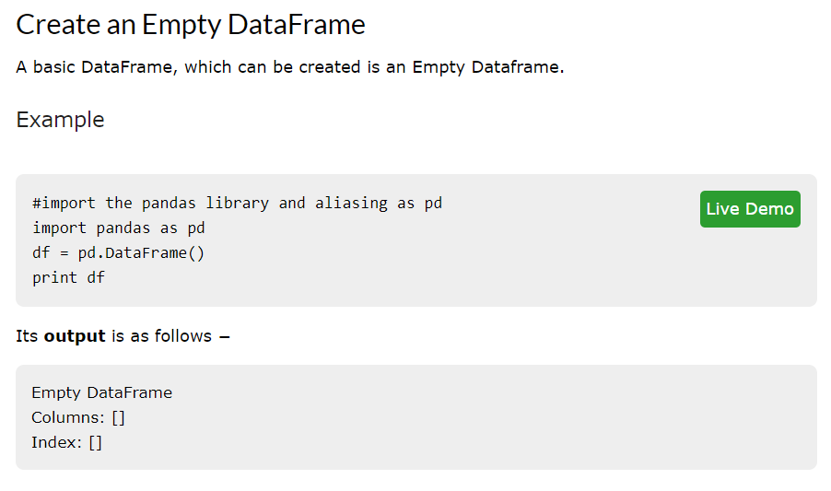
Data Frames

Slide 26
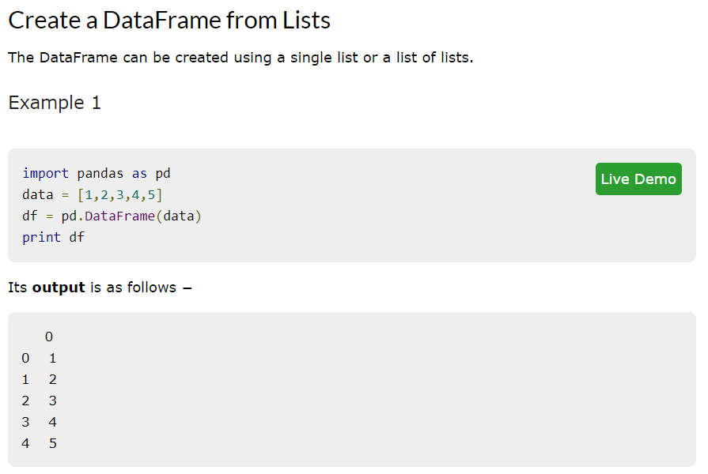
Data Frames

Slide 27
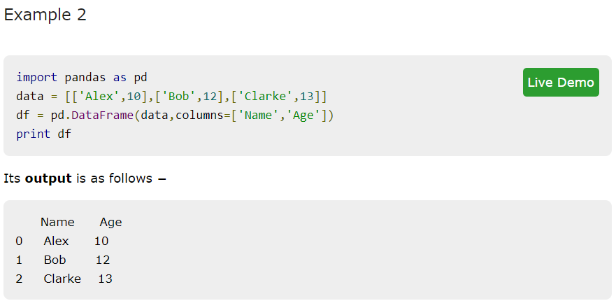
Data Frames

Slide 28
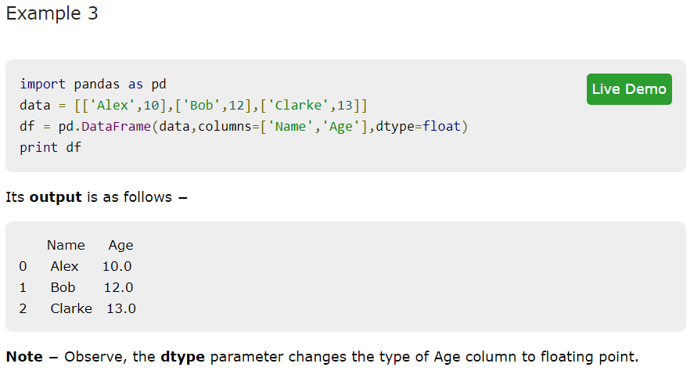
Data Frames

Slide 29
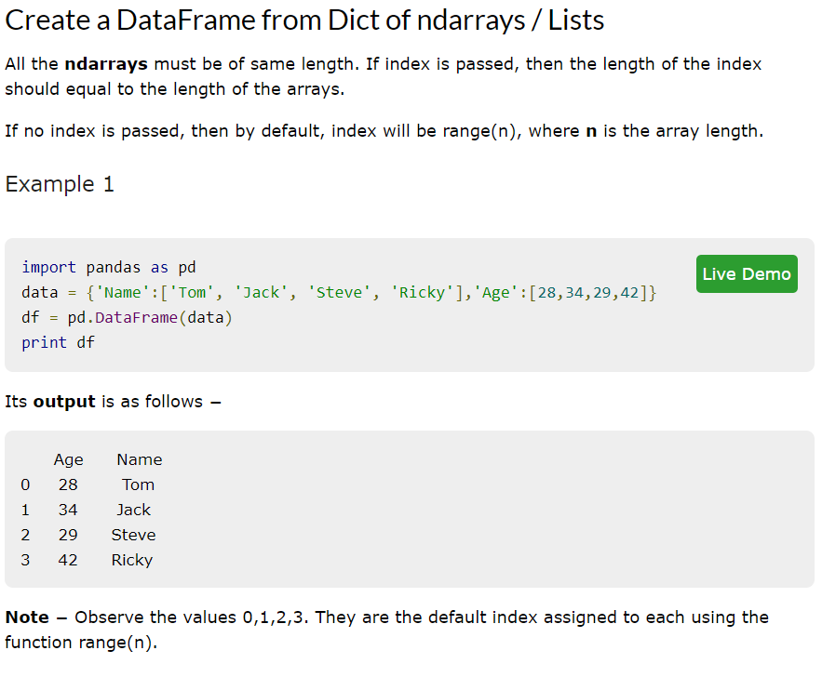
Data Frames

Slide 30
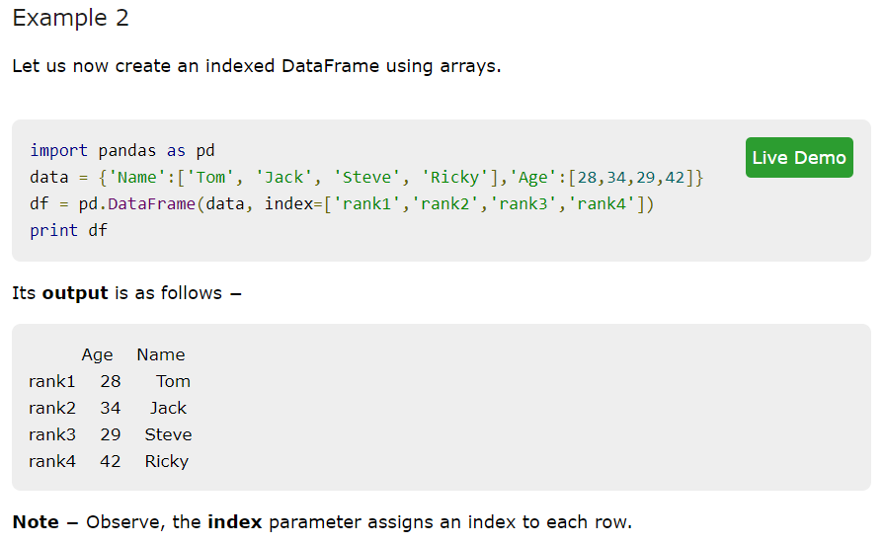
Data Frames

Slide 31
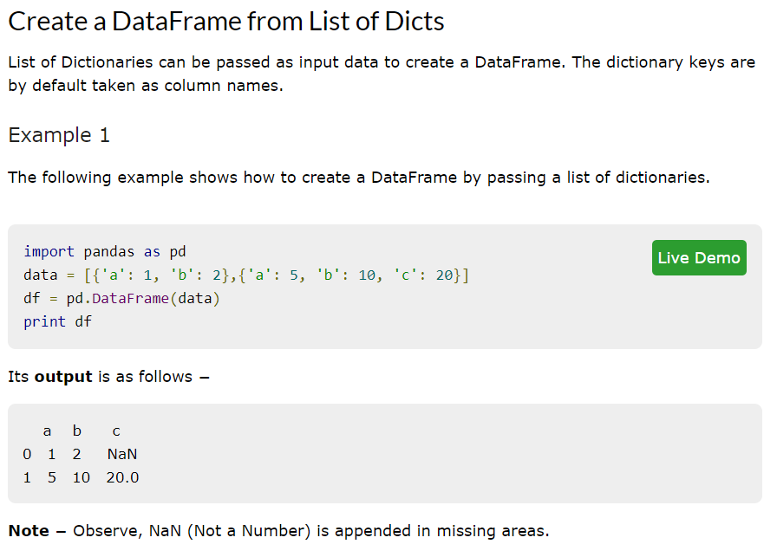
Data Frames

Slide 32
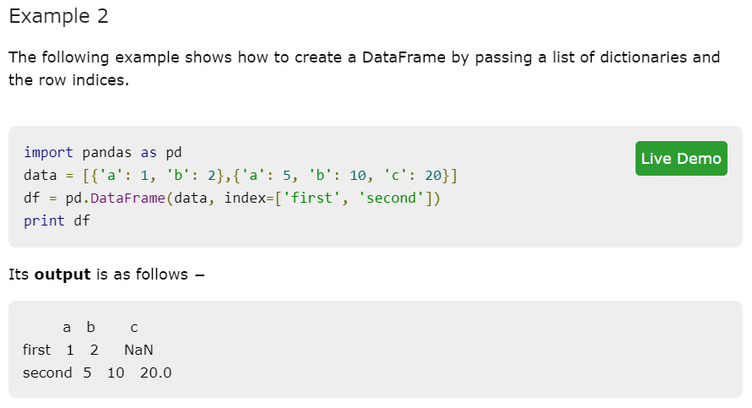
Data Frames

Slide 33
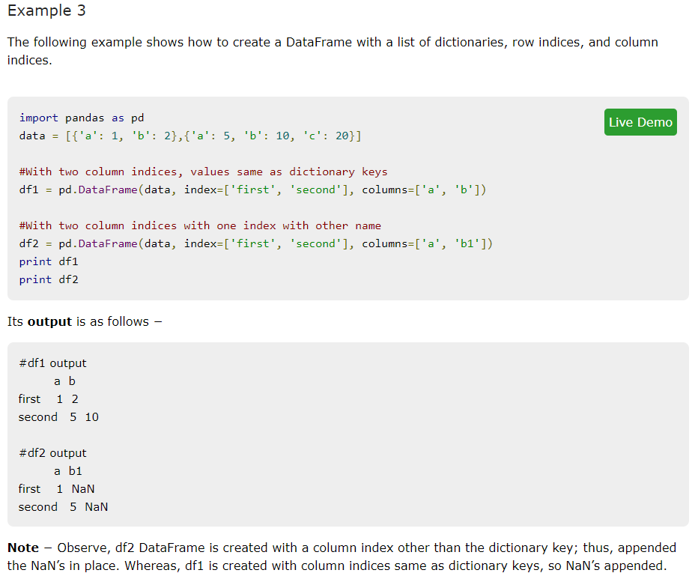
Data Frames

Slide 34
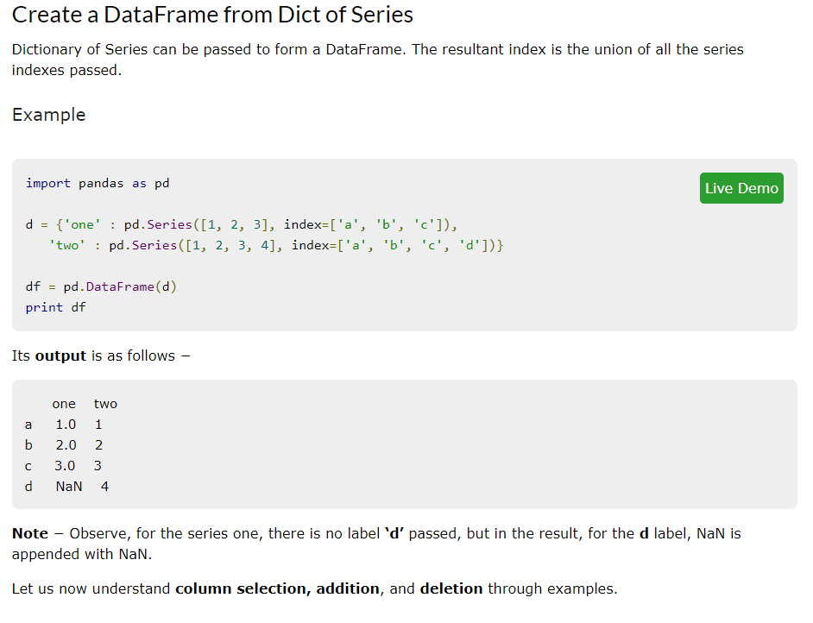
Data Frames

Slide 35
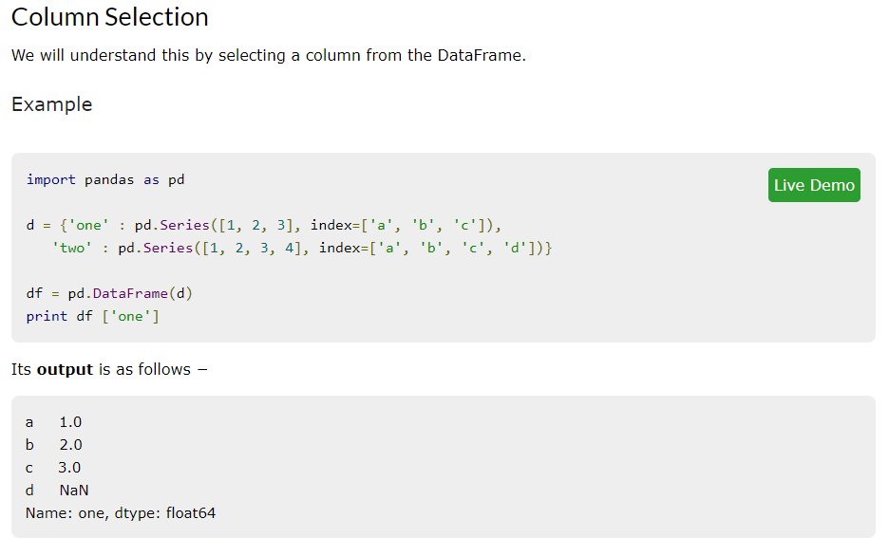
Data Frames

Slide 36
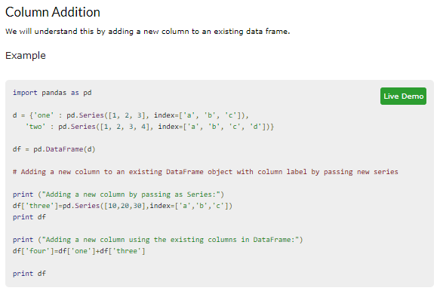
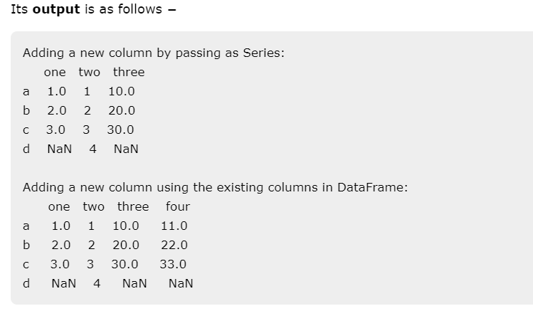
Data Frames

Slide 37
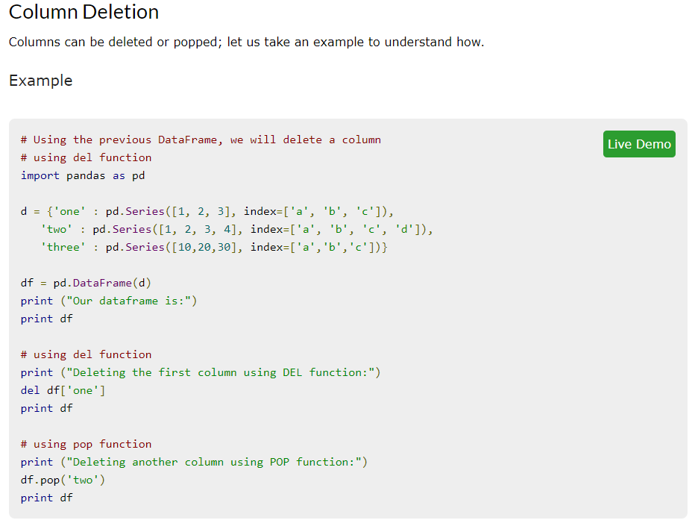
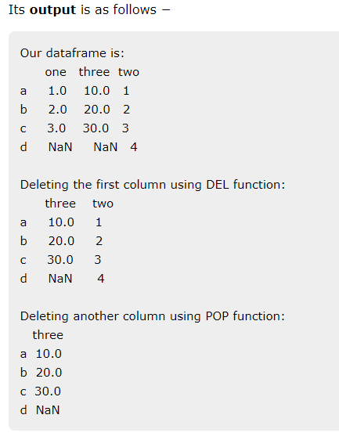
Data Frames

Slide 38
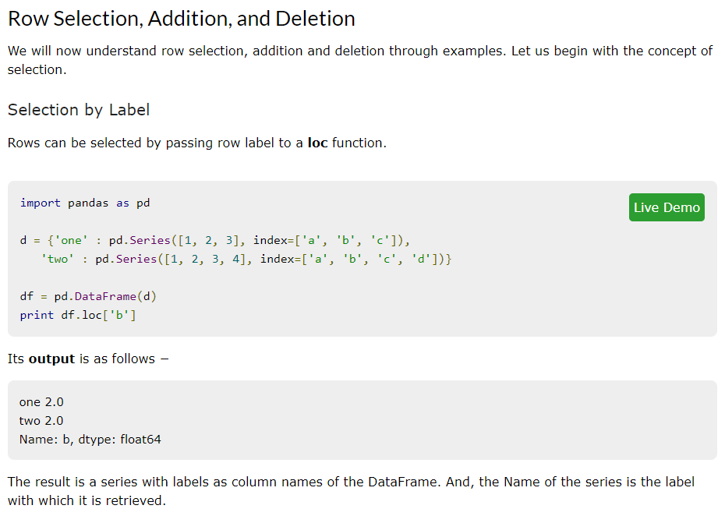
Data Frames

Slide 39
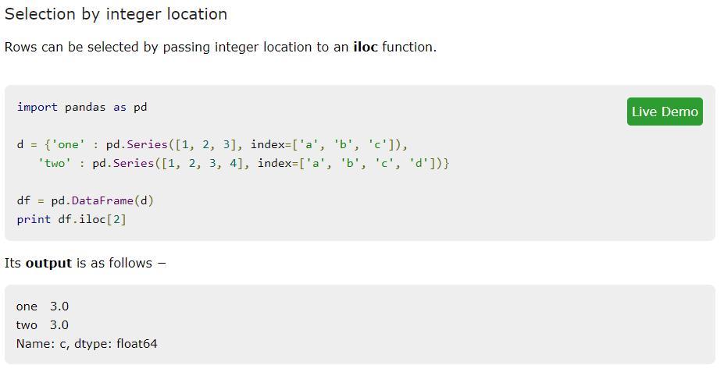
Data Frames

Slide 40
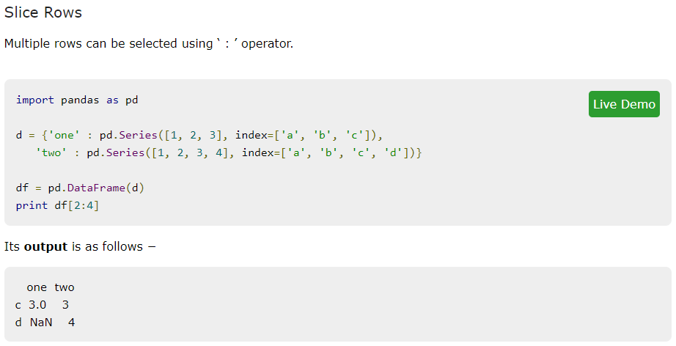
Data Frames

Slide 41
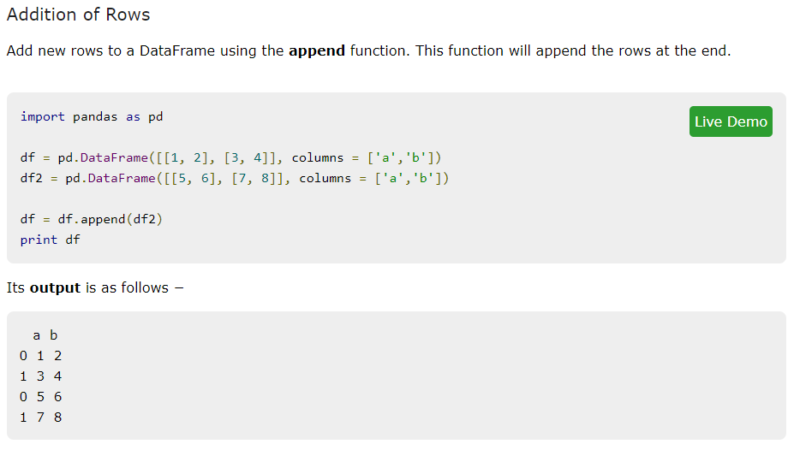
Data Frames

Slide 42
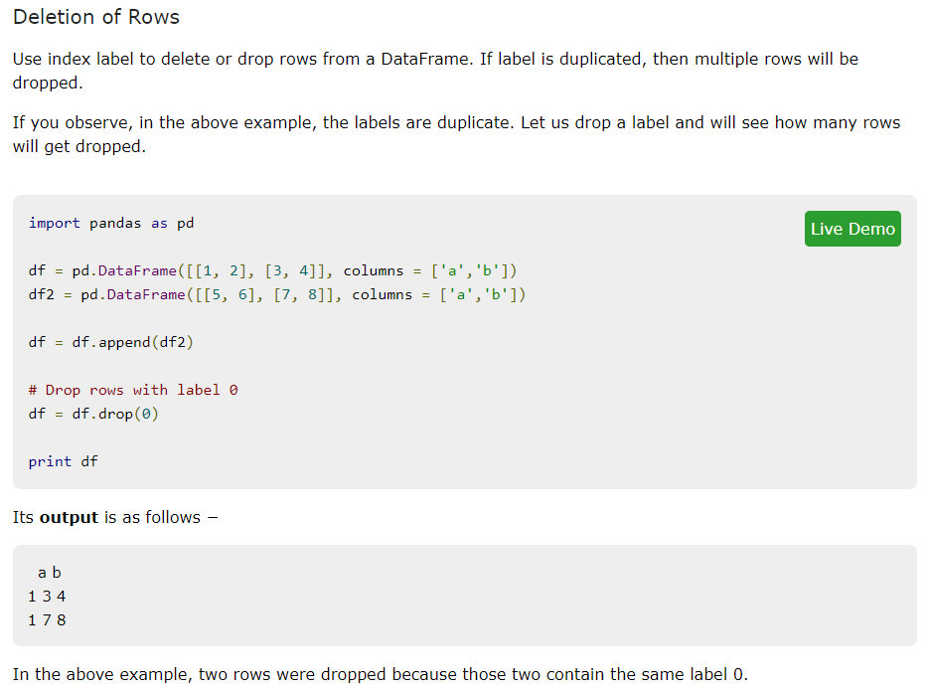
Data Frames

Slide 43
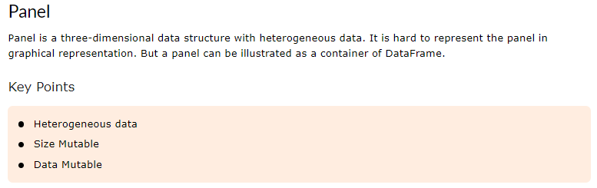
Panels

Slide 44
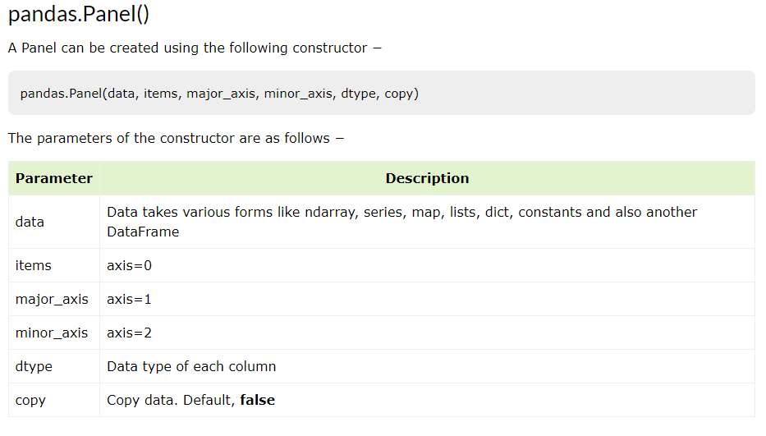
Panels

Slide 45
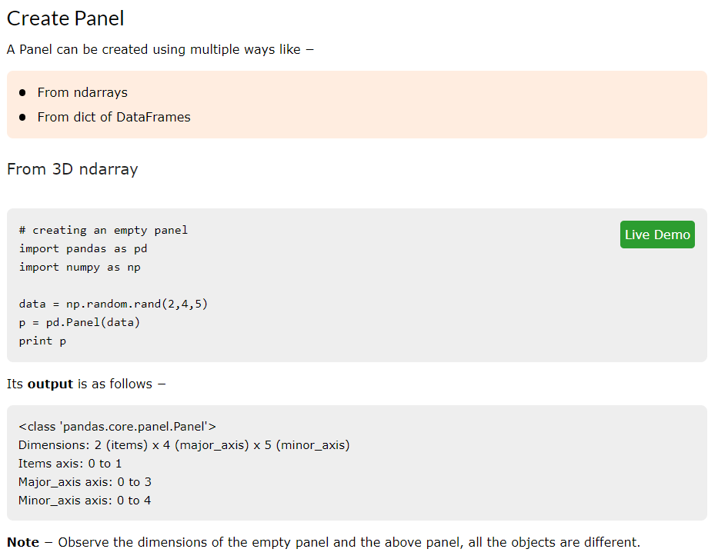
Panels

Slide 46
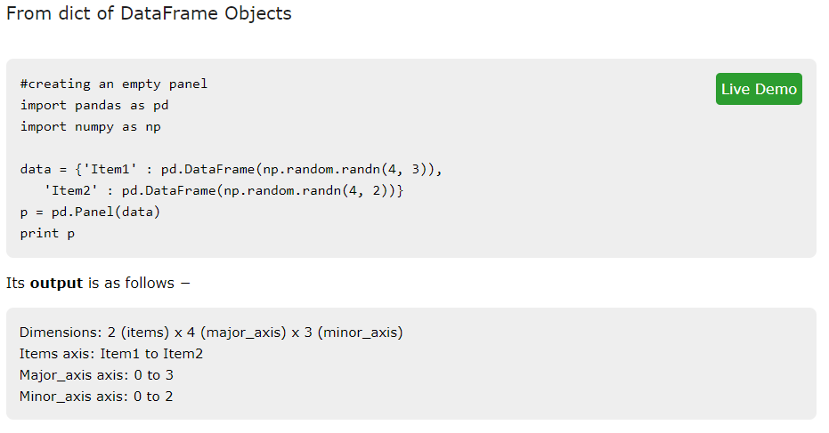
Panels

Slide 47
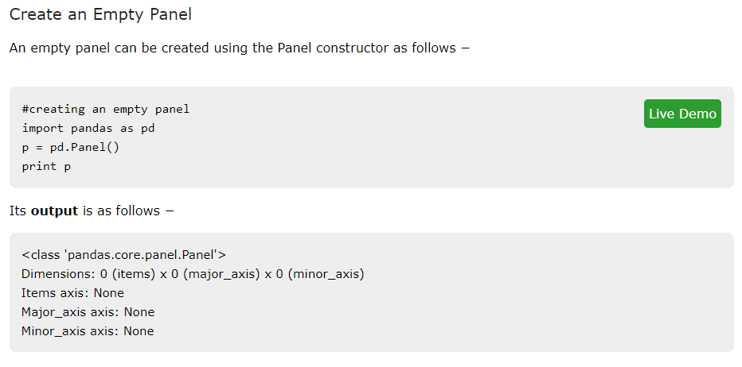
Panels

Slide 48
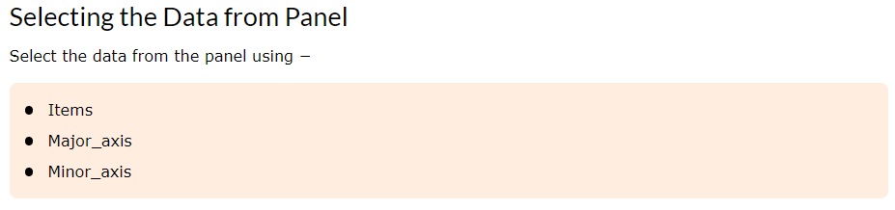
Panels

Slide 49
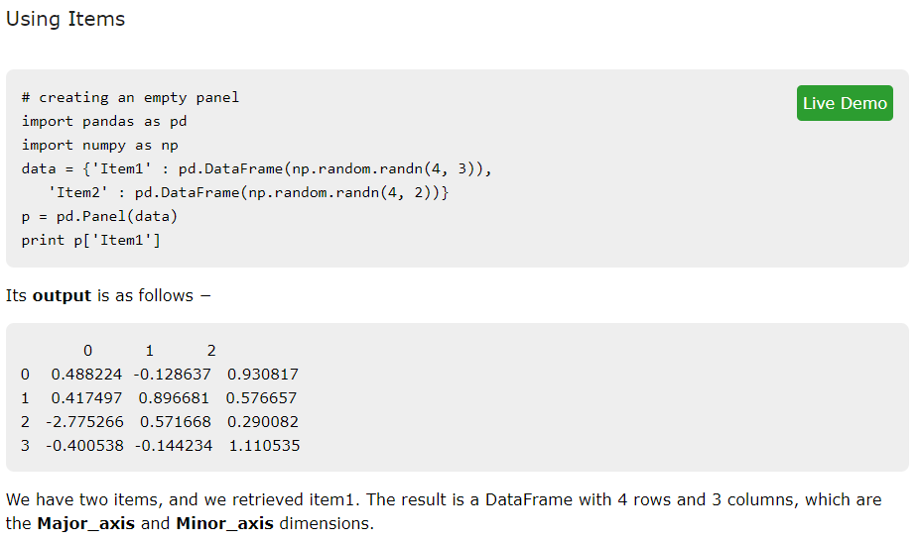
Panels

Slide 50
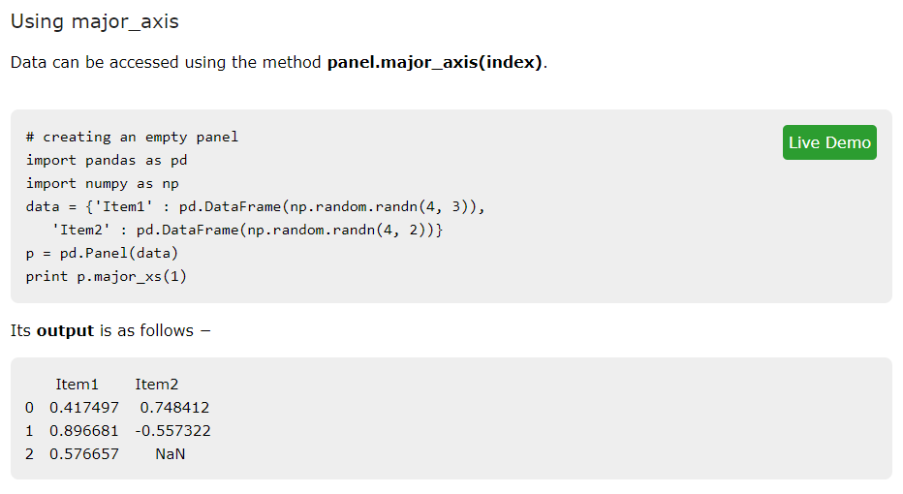
Panels

Slide 51

Panels

