Slide 1
Data analytics
session 06

Slide 2
What is Numpy?
NumPy is a Python library used for working with arrays.
It also has functions for working in domain of linear algebra, fourier transform, and matrices.
NumPy was created in 2005 by Travis Oliphant. It is an open source project and you can use it freely.
NumPy stands for Numerical Python.

Slide 3
Why Numpy?
In Python we have lists that serve the purpose of arrays, but they are slow to process.
NumPy aims to provide an array object that is up to 50x faster than traditional Python lists.
The array object in NumPy is called ndarray, it provides a lot of supporting functions that make working with ndarray very easy.
Arrays are very frequently used in data science, where speed and resources are very important.

Slide 4
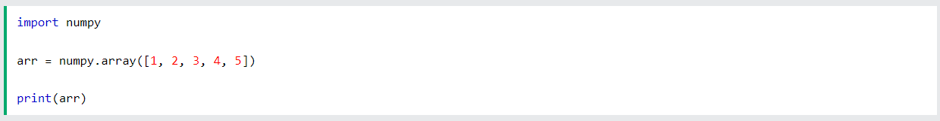
Getting Started
Installation of NumPy
Importing Numpy
Simple Example of Numpy

Slide 5
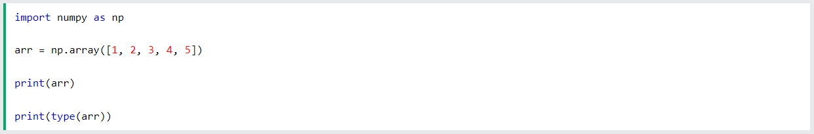
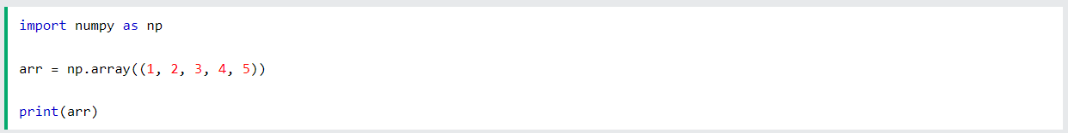
Creating Arrays
NumPy is used to work with arrays. The array object in NumPy is called ndarray.
We can create a NumPy ndarray object by using the array() function.
To create an ndarray, we can pass a list, tuple or any array-like object into the array() method, and it will be converted into an ndarray

Slide 6
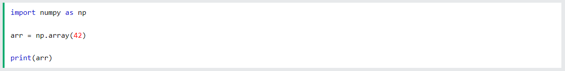
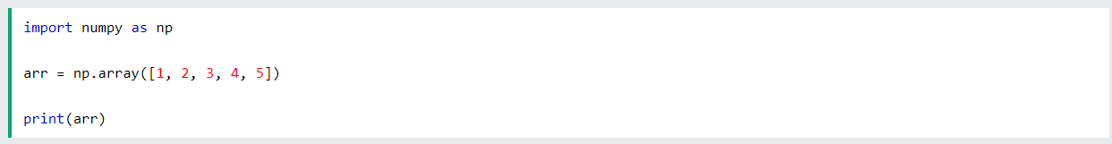
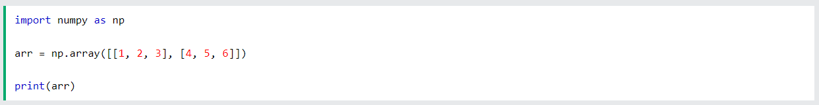
Dimensions in Arrays
0-D Arrays
1-D Arrays
2-D Arrays

Slide 7
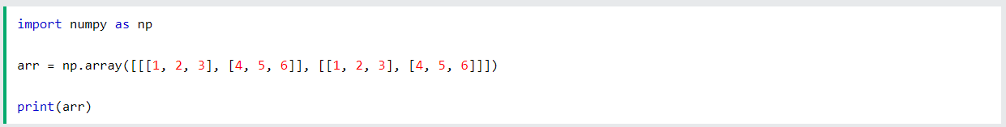
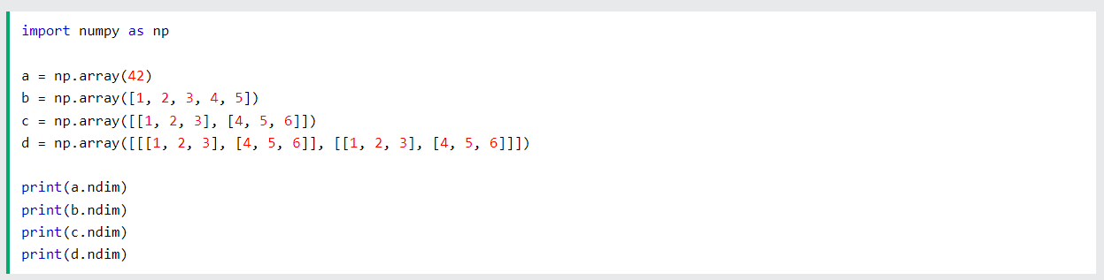
Dimensions in Arrays
3-D Arrays
Dimension Checking

Slide 8
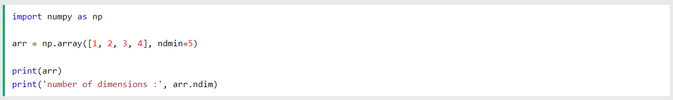
Dimensions in Arrays
Desired Dimensions

Slide 9
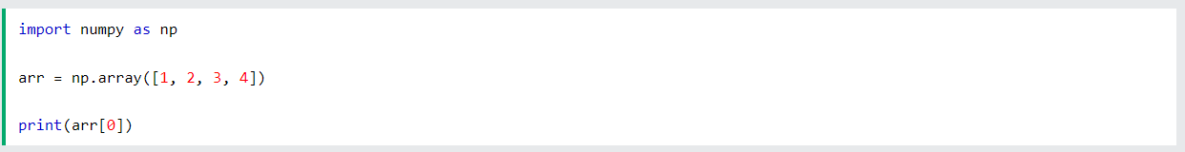
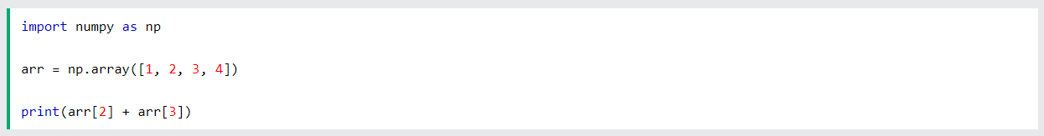
Array Indexing
Array indexing is the same as accessing an array element.
You can access an array element by referring to its index number.
The indexes in NumPy arrays start with 0, meaning that the first element has index 0, and the second has index 1 etc.

Slide 10
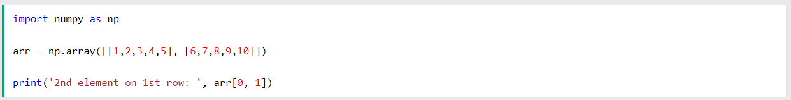
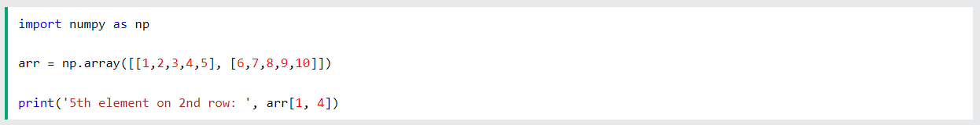
Array Indexing
Accessing 2-D Arrays

Slide 11
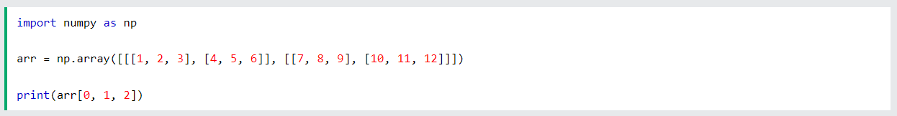
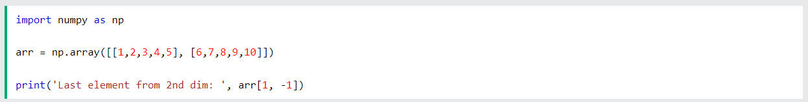
Array Indexing
Accessing 3-D Arrays
Negative Indexing

Slide 12
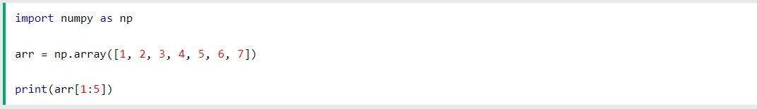
Array Slicing
Slicing in python means taking elements from one given index to another given index.
We pass slice instead of index like this: [start:end].
We can also define the step, like this: [start:end:step].
If we don't pass start its considered 0
If we don't pass end its considered length of array in that dimension
If we don't pass step its considered 1

Slide 13
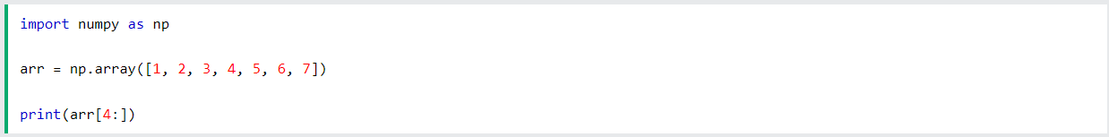
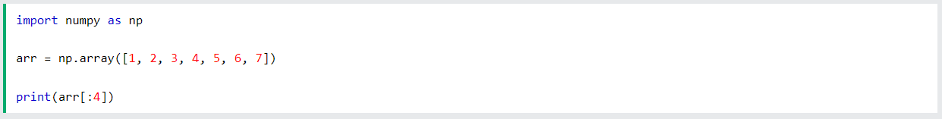
Array Slicing
Starts
Ends

Slide 14
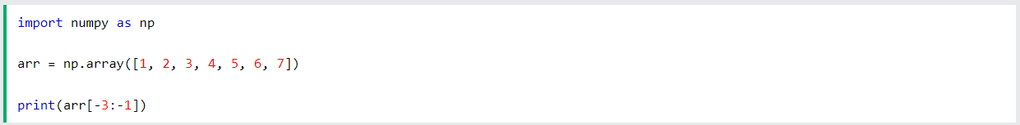
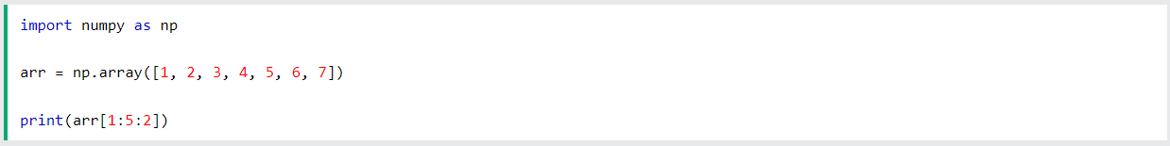
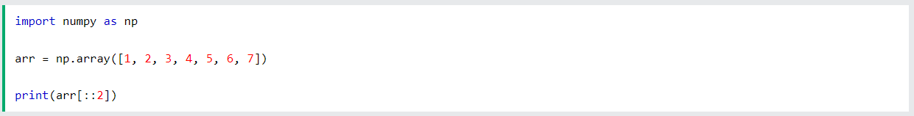
Array Slicing
Negative Slicing
Steps

Slide 15
Data Types in Numpy
V-Void
i-Integer
m-Time Delta
U-Unicode String
M-Date Time
Numpy
S-String
u-Unsigned Integer
O-Object
C-Complex Float
b-Boolean
f-Float

Slide 16
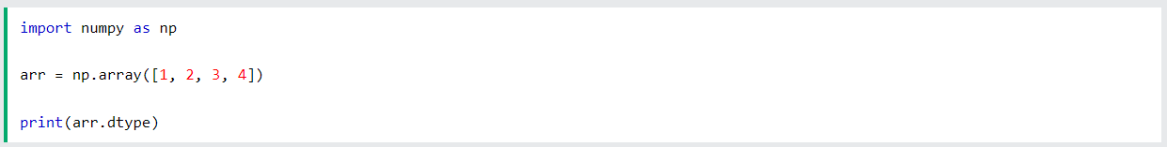
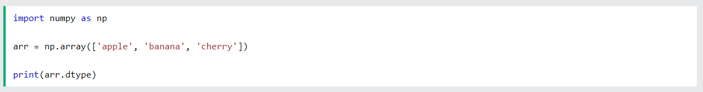
Checking Data Types in Arrays
Checking

Slide 17
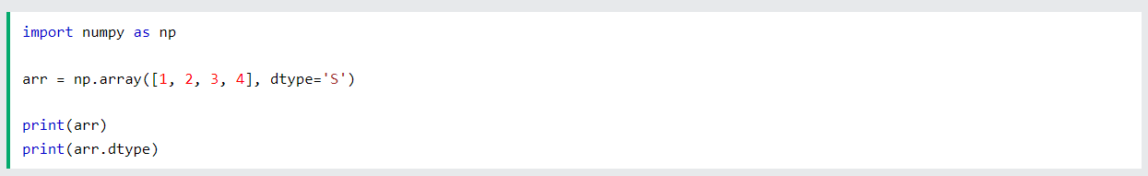
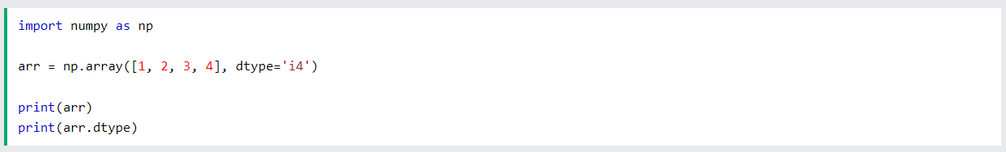
Checking Data Types in Arrays
Creating an Array with a defined data type

Slide 18
Checking Data Types in Arrays
What if can not be converted

Slide 19
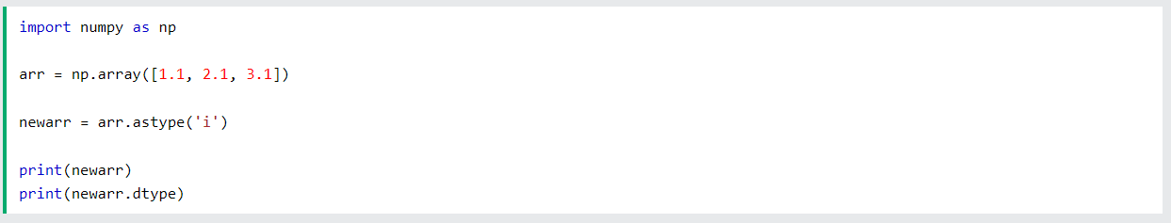
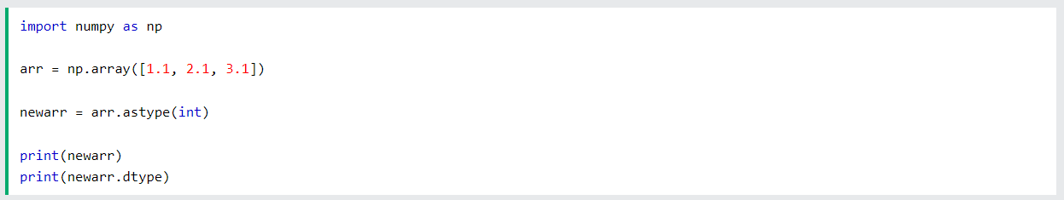
Checking Data Types in Arrays
Converting data type on ta existing array

Slide 20
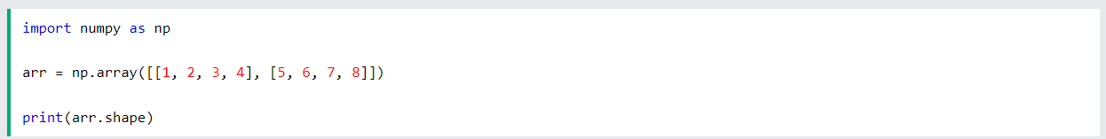
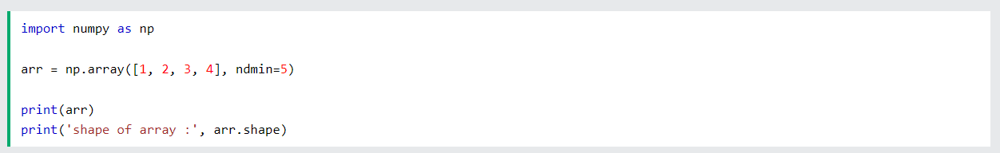
Numpy Array Shape
Checking the shape of an array

Slide 21
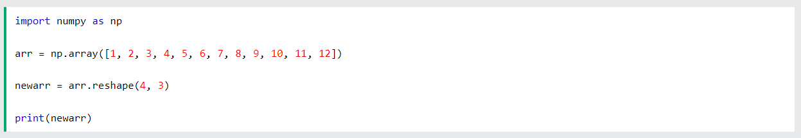
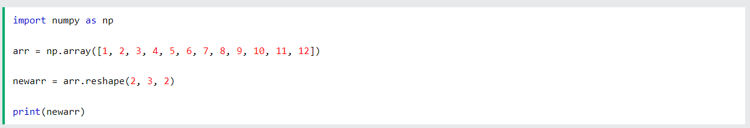
Numpy Array ReShaping
Reshape 1-D to 2-D
Reshape 1-D to 3-D

Slide 22
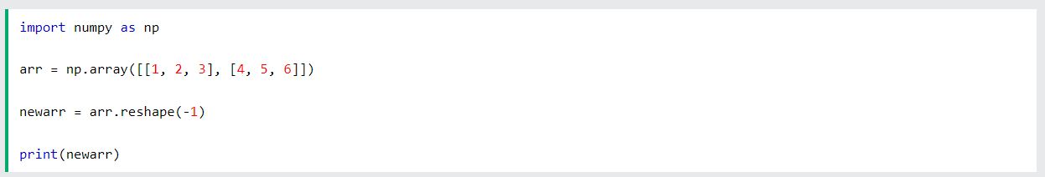
Numpy Array ReShaping
Flattening an array

Slide 23
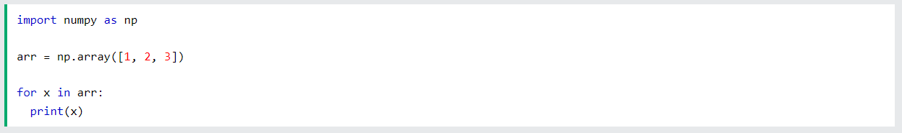
Numpy Array Iterating
Iterating in 1-D array

Slide 24
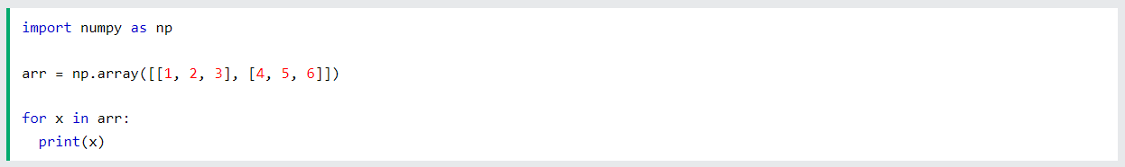
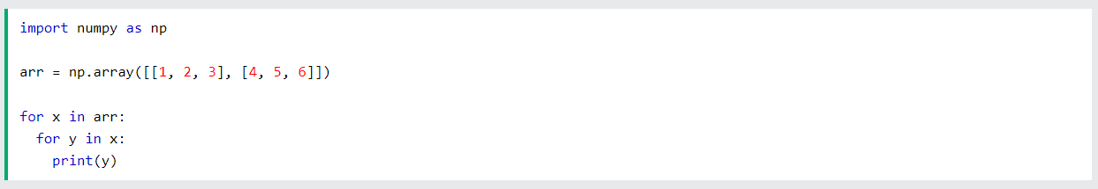
Numpy Array Iterating
Iterating in 2-D array

Slide 25
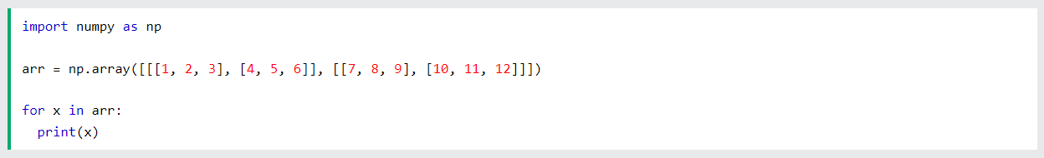
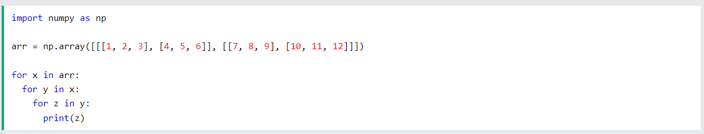
Numpy Array Iterating
Iterating in 3-D array

Slide 26
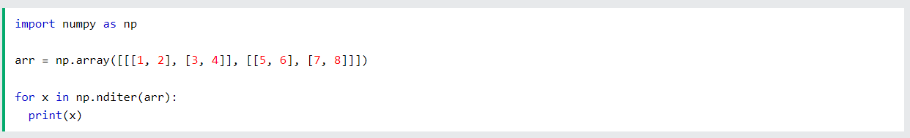

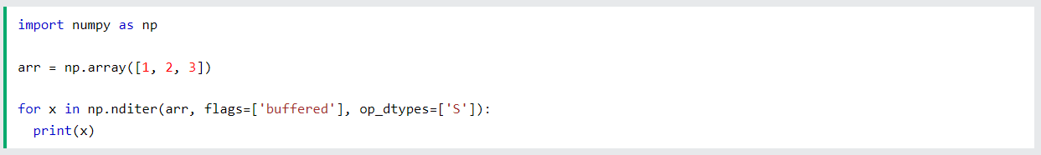

Numpy Array Iterating
Iterating Arrays using nditer()
Iterating in arrays with different data types

Slide 27
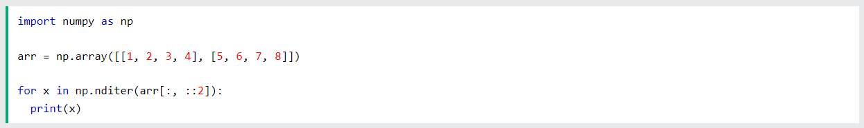

Numpy Array Iterating
Iterating with different step size

Slide 28
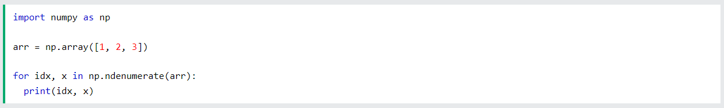

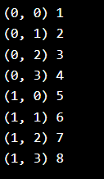
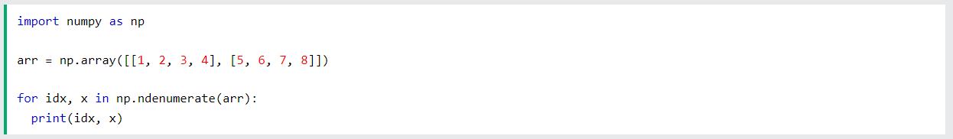
Numpy Array Iterating
Iterating arrays using ndenumerate()

