Slide 1
Data analytics
OOP exercises

Slide 2
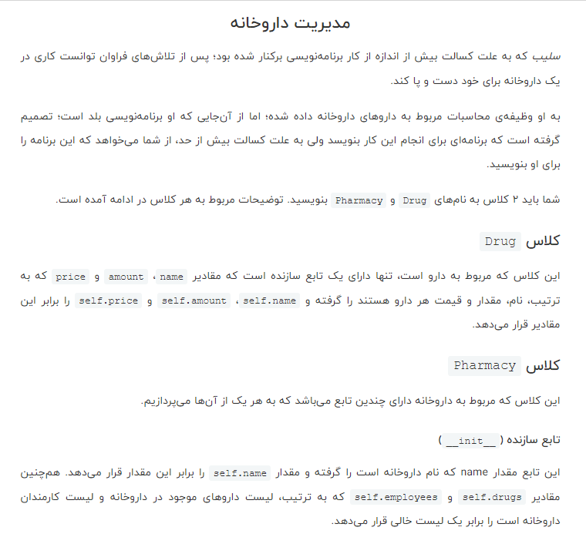
Exercise no1

Slide 3
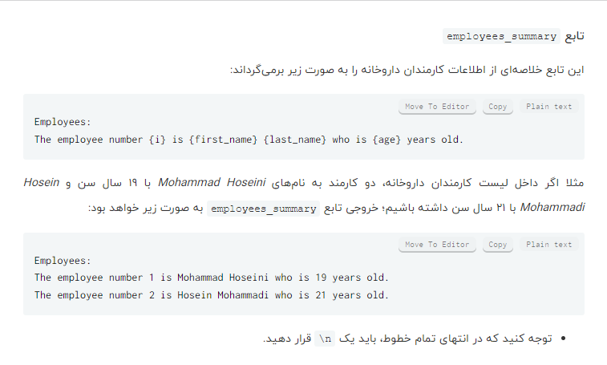
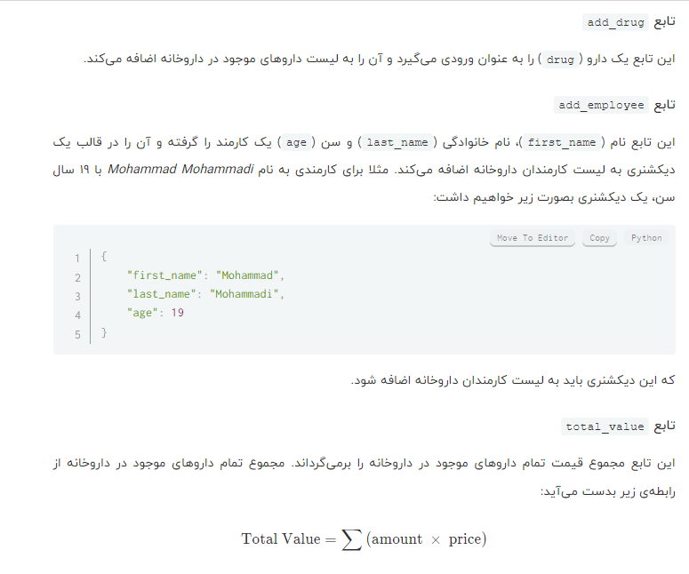

Slide 4
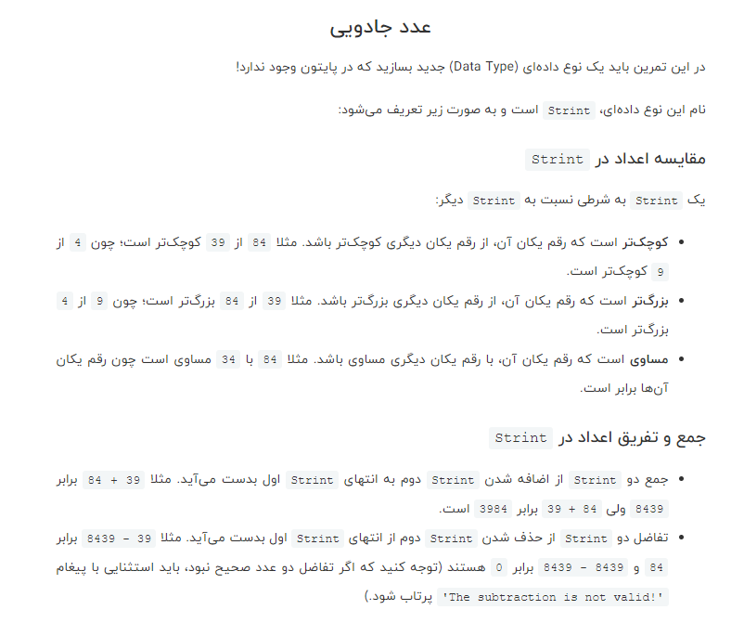
Exercise no2

Slide 5

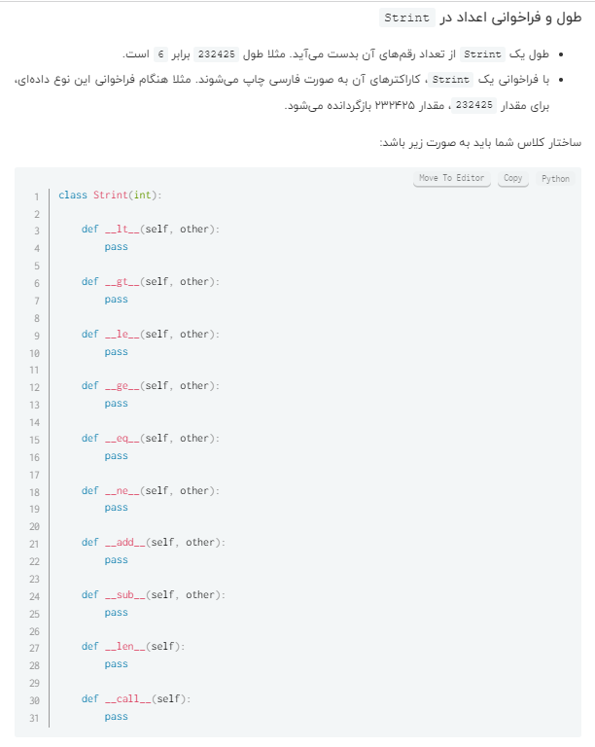

Slide 6
References
Quera College (Advanced Python Course)

