Slide 1
Data analytics
Session 03

Slide 2
Polymorphism
The word polymorphism means having many forms. In programming, polymorphism means the same function name (but different signatures) being used for different types. The key difference is the data types and number of arguments used in function.

Slide 3
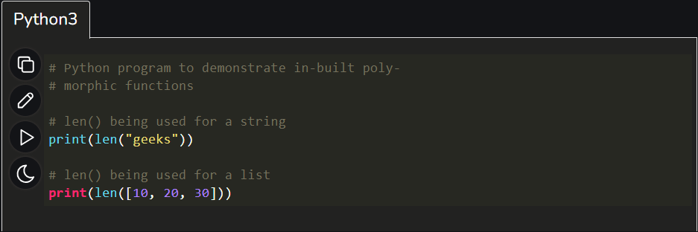
Polymorphism
Simple Example

Slide 4
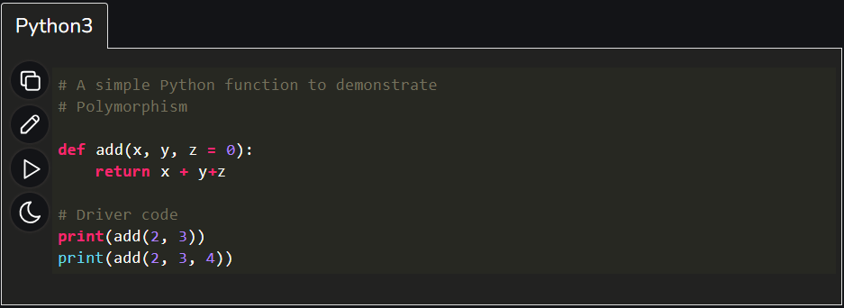
Polymorphism
Simple Example

Slide 5
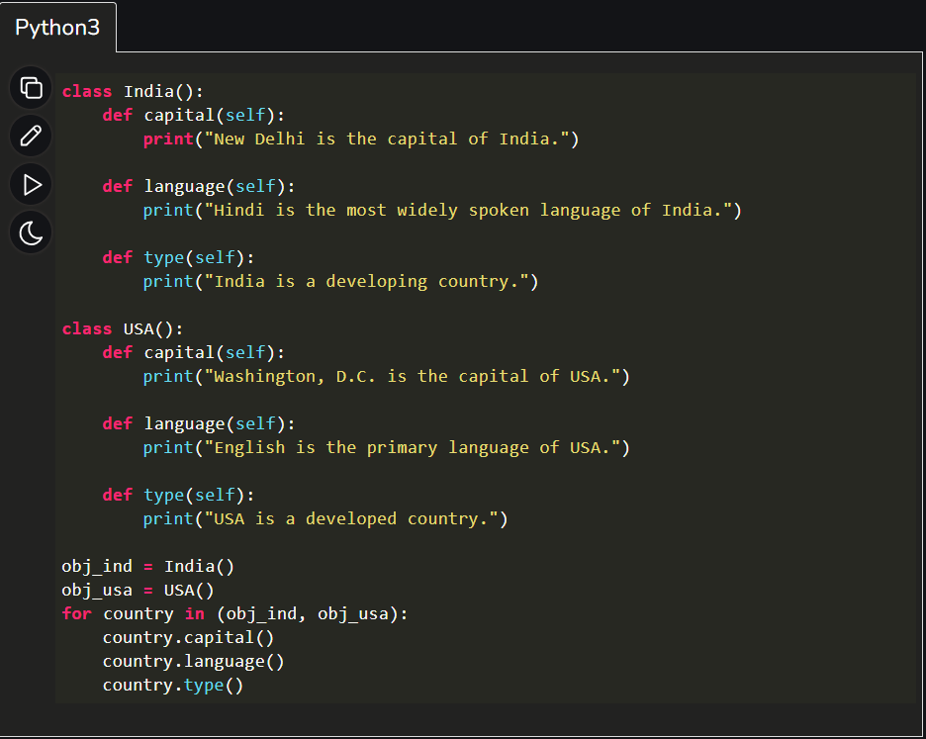
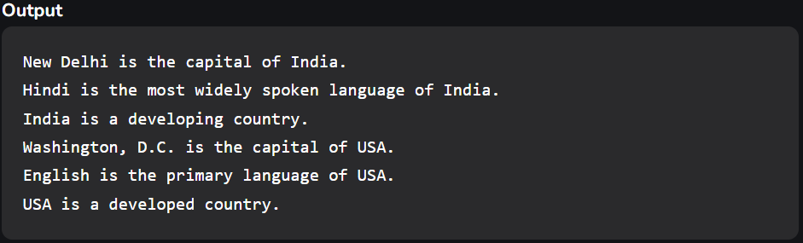
Polymorphism
Polymorphism with class methods:
The below code shows how Python can use two different class types, in the same way. We create a for loop that iterates through a tuple of objects. Then call the methods without being concerned about which class type each object is. We assume that these methods actually exist in each class.

Slide 6
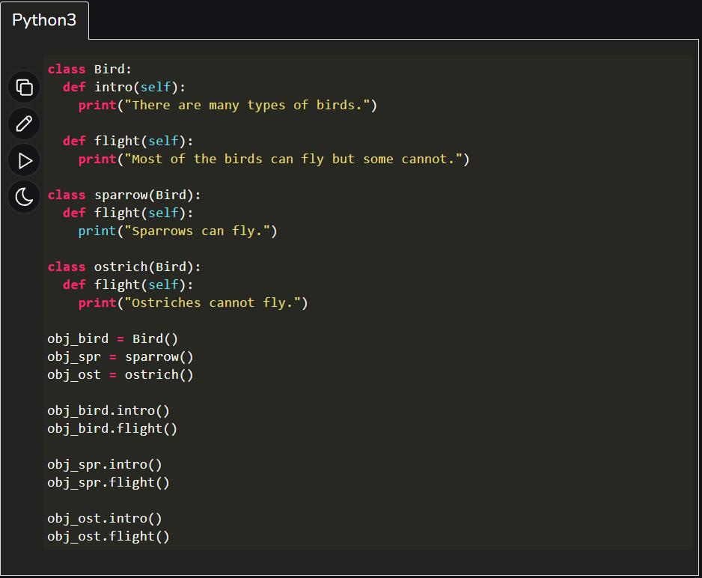
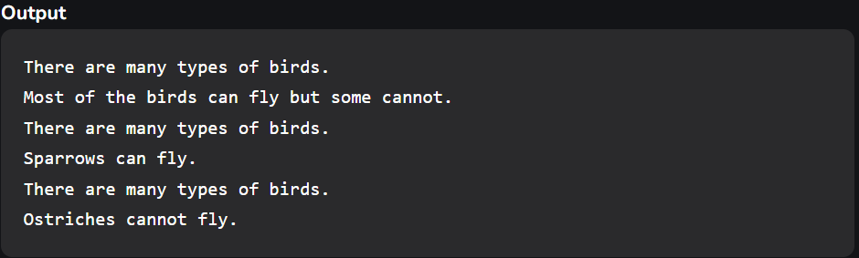
Polymorphism
Polymorphism with Inheritance:
In Python, Polymorphism lets us define methods in the child class that have the same name as the methods in the parent class. In inheritance, the child class inherits the methods from the parent class. However, it is possible to modify a method in a child class that it has inherited from the parent class. This is particularly useful in cases where the method inherited from the parent class doesn’t quite fit the child class. In such cases, we re-implement the method in the child class. This process of re-implementing a method in the child class is known as Method Overriding.

Slide 7
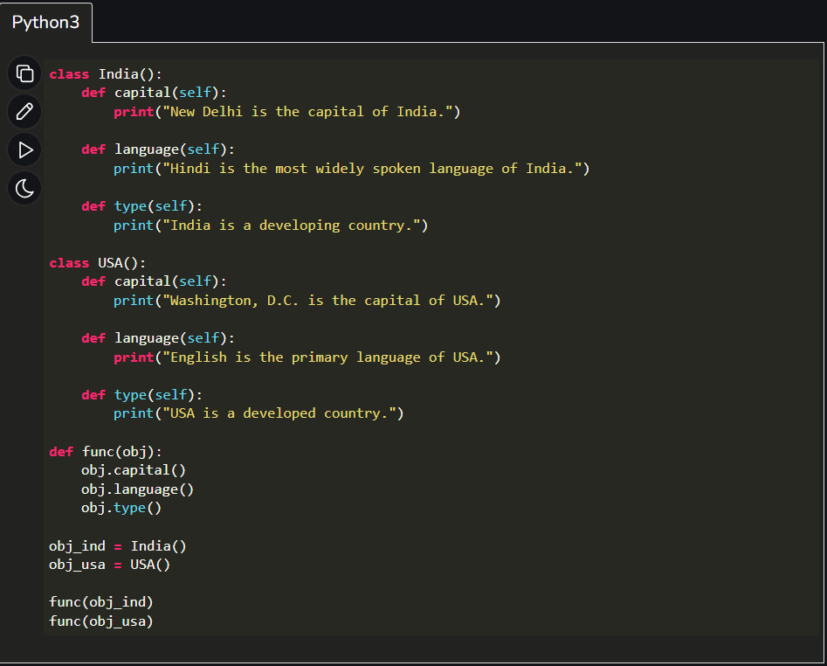
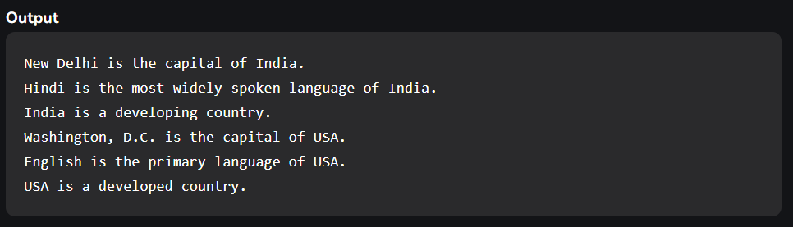
Polymorphism
Polymorphism with a Function and objects:
It is also possible to create a function that can take any object, allowing for polymorphism. In this example, let’s create a function called “func()” which will take an object which we will name “obj”. Though we are using the name ‘obj’, any instantiated object will be able to be called into this function. Next, let’s give the function something to do that uses the ‘obj’ object we passed to it. In this case, let’s call the three methods, viz., capital(), language() and type(), each of which is defined in the two classes ‘India’ and ‘USA’. Next, let’s create instantiations of both the ‘India’ and ‘USA’ classes if we don’t have them already. With those, we can call their action using the same func() function:

Slide 8
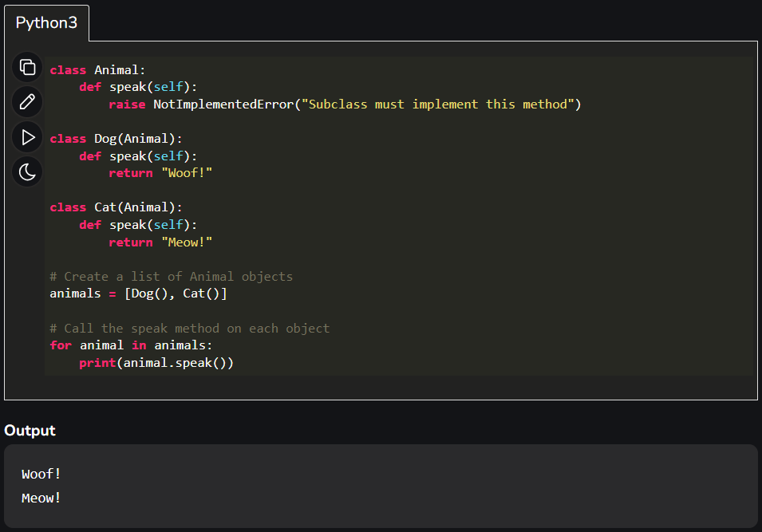
Polymorphism
Another Example

Slide 9
Dunder or Magic Methods
"Dunder" is a colloquial term used in Python to refer to special methods or double-underscore methods, often denoted by double underscores before and after the method name. These special methods are also known as "magic methods" or "dunder methods" because of their unique names, and they have specific purposes and behaviors in Python.
Dunder methods are used to define how objects of a class behave when certain built-in operations are performed on them. For example, when you add two instances of a custom class, Python uses the __add__ dunder method to perform the addition operation. Dunder methods allow you to customize the behavior of your objects in a way that makes them work seamlessly with Python's built-in functionality.

Slide 10
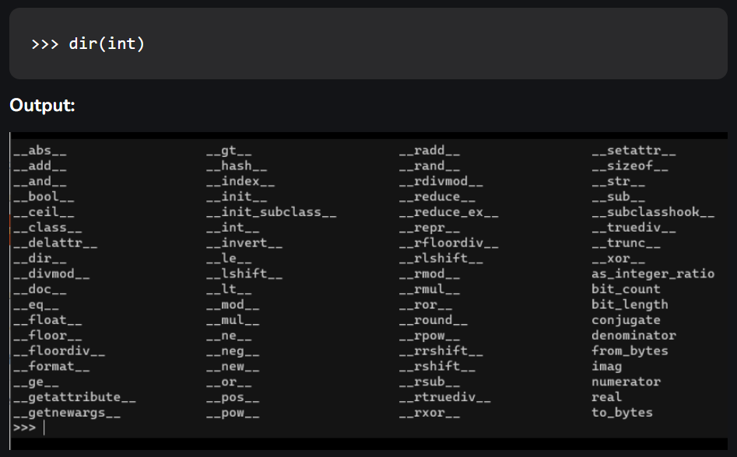
Dunder or Magic Methods

Slide 11
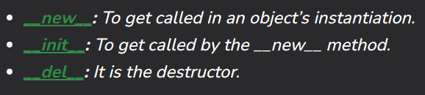
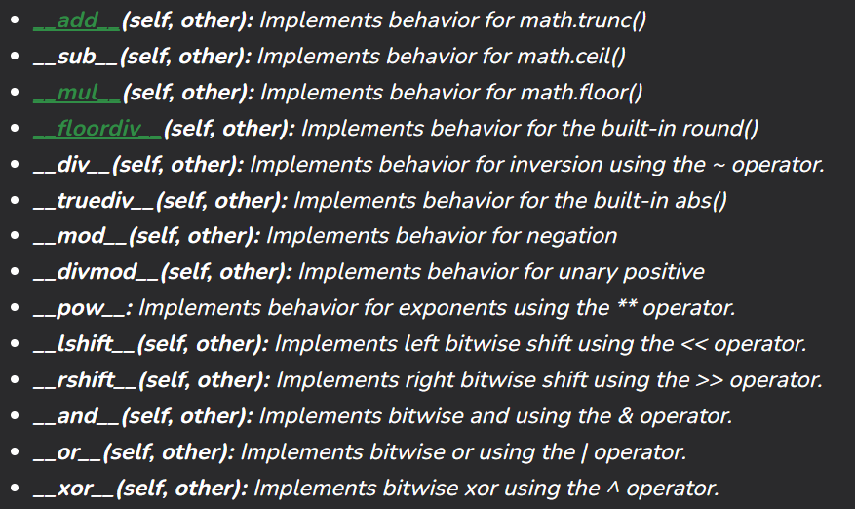
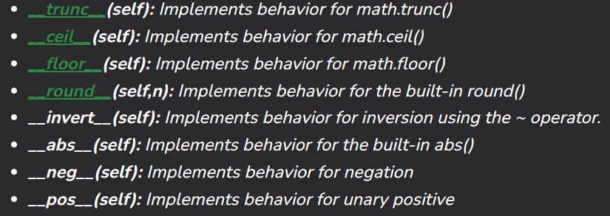
Dunder or Magic Methods
Initialization and Construction
Arithmetic operators
Numeric magic methods

Slide 12
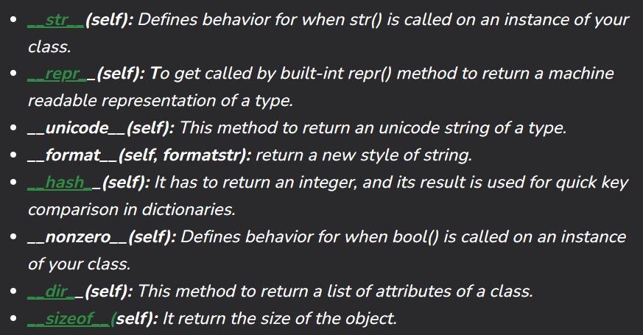
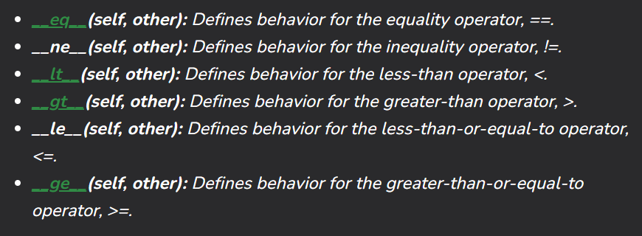
Dunder or Magic Methods
String Magic Methods
Comparison magic methods

Slide 13
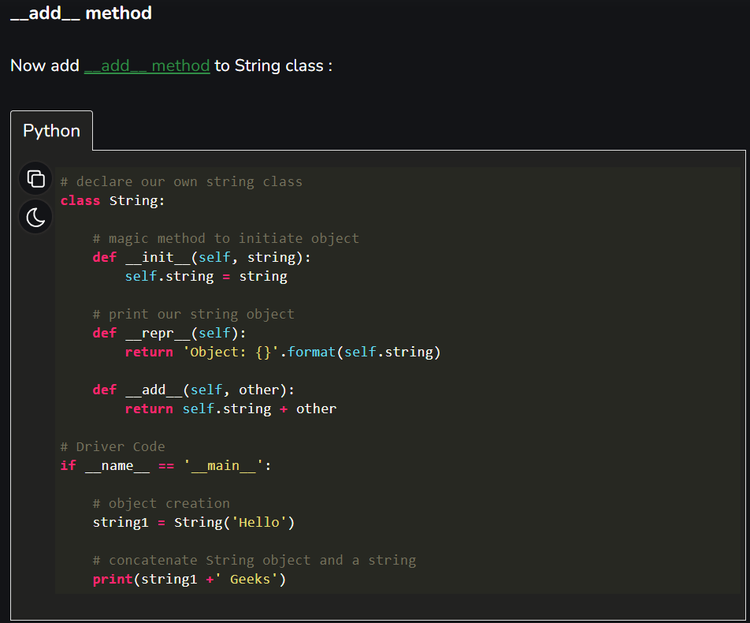

Dunder or Magic Methods
Example
Explanation
You can see now the operator ‘+’ is defined fot this class and you can add instances out of this class to each other

