Slide 1

design and implementation Chapter 7
Presented By Shahriar Yazdipour
November 2019
Software & Systems Engineering Students Talk
Prof. Dr.-Ing. Armin Zimmermann

Slide 2
Agenda
Design and implementation
Object-oriented design using UML
Design patterns
Implementation issues
Open source development

Slide 3

Design and implementation

Slide 4
Design and implementation
Software design & implementation is the stage in the software engineering process that an executable software system is developed.
Software design is a creative activity in which you identify software components and their relationships, based on a customer’s requirements.
Implementation is the process of realizing the design as a program.
Notes:
the stage that an executable software system is developed.

Slide 5
Build or buy
In a wide range of domains, it is possible to buy off-the-shelf systems (COTS) that can be adapted and tailored to the users’ requirements.
e.g for implement a medical records system, we can buy a package that is already used in hospitals vs developing a system. One can be cheaper and one faster ...
* COTS = Commercial off-the-shelf
Notes:
One of the most important implementation decisions that has to be made at an early stage of a software project is whether or not you should buy or build the application software.
* When you develop an application in this way, the design process becomes concerned with how to use the configuration features of that system to deliver the system requirements.

Slide 6

Object-oriented design

Slide 7
object-oriented design process
It involves developing a number of different system models.
They require a lot of effort for development and maintenance which for small systems this may not be cost-effective. However, for large systems developed by different groups design models are an important communication mechanism for team members.
Notes:
process of object-oriented design involves developing different models. Which they require lots of effort for developing and maintenance which for small systems, may not be cost effective, but, for larger systems it is an important communication mechanism for team members.

Slide 8
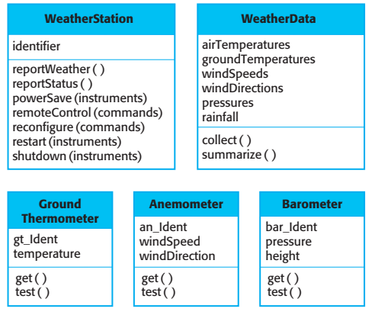
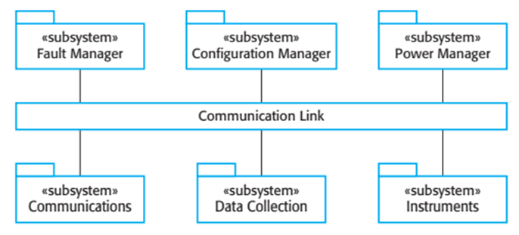
Object class
High-level architecture

Slide 9
Object class

Slide 10
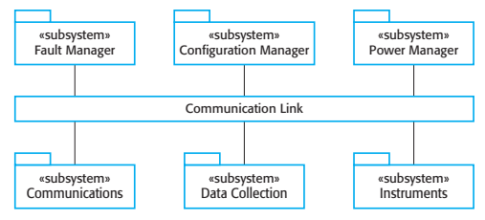
High-level architecture
Notes:
Each subsystem listens for messages on that Infrastructure and picks up the messages that are intended for them. This is
another commonly used architectural style in addition to those described in Chapter 6.
For example, when the communications subsystem receives a control command, such as shutdown, the command is picked up by each of the other subsystems, which then shut themselves down in the correct way. The key benefit of this
architecture is that it is easy to support different configurations of subsystems
because the sender of a message does not need to address the message to a particular subsystem.
-----------
You identify the major components that make up the system and their interactions, and then may organize the components using an architectural pattern such as a layered or client–server model. However, this is not essential at this stage. The high-level architectural design for the weather station software is shown in Figure 7.4. The weather station is composed of independent subsystems that communicate by broadcasting messages on a common infrastructure, shown as the Communication link in Figure 7.4. Each subsystem listens for messages on that infrastructure and picks up the messages that are intended for them. This is another commonly used architectural style in addition to those described in Chapter 6. For example, when the communications subsystem receives a control command, such as shutdown, the command is picked up by each of the other subsystems, which then shut themselves down in the correct way. The key benefit of this architecture is that it is easy to support different configurations of subsystems because the sender of a message does not need to address the message to a particular subsystem.

Slide 11
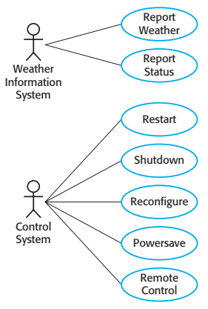
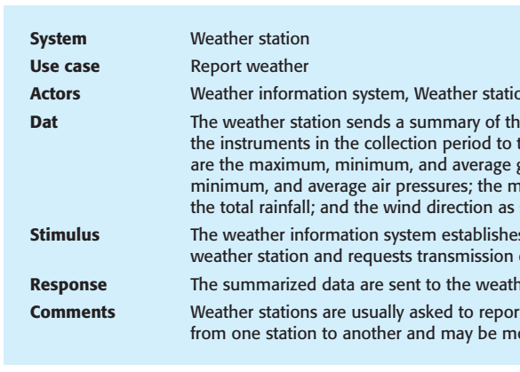
Weather station use cases
Notes:
Each of these use cases should be described in structured natural language. This
helps designers identify objects in the system and gives them an understanding of
what the system is intended to do. I use a standard format for this description that clearly identifies what information is exchanged, how the interaction is initiated, and so on.

Slide 12
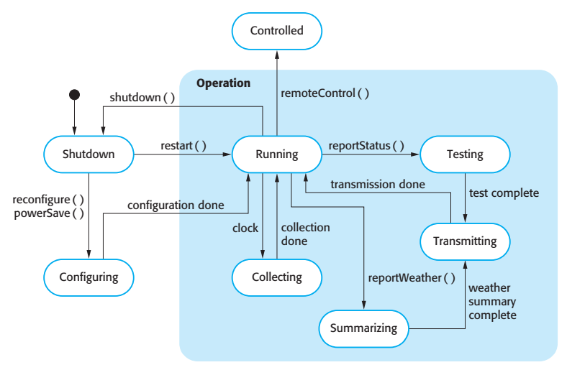
state diagram
Notes:
State diagrams are useful high-level models of a system or an object’s operation.
You don’t usually need a state diagram for all of the objects in the system. Many of the objects in a system are relatively simple and a state model adds unnecessary detail to the design

Slide 13

Design patterns

Slide 14
Design patterns
A way of reusing abstract knowledge about a common problem and its solution.
Patterns are a great idea but you need experience of software design to use them effectively.
You have to recognize situations where a pattern can be applied.
Notes:
Design patterns were derived from ideas put forward by Christopher Alexander
(Alexander et al., 1977), who suggested that there were certain common patterns of
building design that were inherently pleasing and effective.

Slide 15
Design Patterns
Creational Patterns
Object Pool / Resource Pool
Prototype
Factory Method (Abstract Factory Similar)
Singleton
Builders
Structural Patterns
Adapter
Decorator
Bridge (Handle-Body Pattern)
Composite
Facade
Flyweight
Proxy
Behavioral Patterns
Chain of Responsibility
Command
Interpreter
Mediator
Memento
Template
Visitor
Null Object
Iterator/Collection
State
Observer
Strategy
https://yazdipour.github.io/notes/#/principles/design-patterns

Slide 16
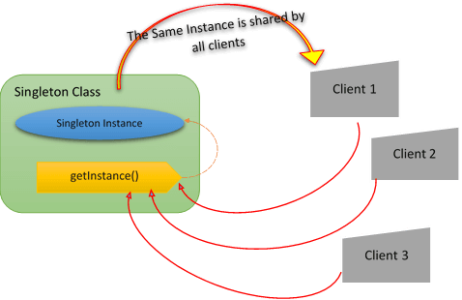
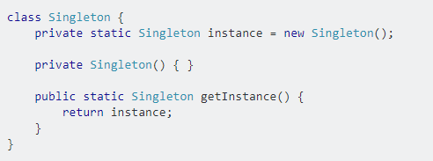
SINGLETON
When? When the application needs an object frequently, and the object itself is very computationally expensive.
When not a good idea? When we using it in multi-thread scenario.
https://www.javagists.com/singleton-design-pattern

Slide 17

Implementation issues

Slide 18
Implementation issues
Reuse
Make as much use as possible of existing code.
Configuration management
During the development process, you have to keep track of the many different versions of each software component in a configuration management system.
Host-target development
Production software does not usually execute on the same computer as the software development environment
Notes:
Incompatablity

Slide 19
Reuse levels
The abstraction level
The object level
The component level
The system level
Notes:
The abstraction level
At this level, you don’t reuse software directly but use knowledge of successful abstractions in the design of your software.
The object level
At this level, you directly reuse objects from a library rather than writing the code yourself.
The component level
Components are collections of objects and object classes that you reuse in application systems.
The system level
At this level, you reuse entire application systems.

Slide 20

Open source development

Slide 21
Open source
Is an approach that we publish our source code and volunteers are invited to participate in the development process
ISSUES
Should we make use of open source components?
Should an open source approach be used for the software’s development?
business
Open source projects business model is not reliant on selling a software product but on selling support for that product.
It is believed that involving the open source community will allow software to be developed more cheaply, more quickly and will create a community of users for the software.
LICENSE: GPL, LGPL, BSD, …

Slide 22
License models
The GNU General Public License (GPL)
If you use open source software that is licensed under the GPL license, then you must make that software open source.
The GNU Lesser General Public License (LGPL)
You can write components that link to open source code without having to publish the source of these components.
The Berkley Standard Distribution (BSD) License
You are not obliged to re-publish any changes or modifications made to open source code. You can include the code in proprietary systems that are sold.
Notes:
MIT, A short, permissive software license. Basically, you can do whatever you want as long as you include the original copyright and license notice in any copy of the software/source. There are many variations of this license in use.
https://tldrlegal.com/license/mit-license

Slide 23
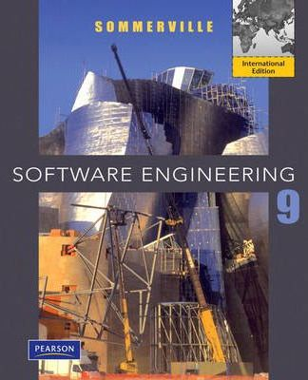
Software Engineering Sommerville
Reference

Slide 24
Thank You for your attention.

