Slide 1

design and implementation Chapter 7
Presented By Shahriar Yazdipour
November 2019
Software & Systems Engineering Students Talk
Prof. Dr.-Ing. Armin Zimmermann

Slide 2
Agenda
Objectives
Design and implementation
Object-oriented design using UML
Design patterns
Implementation issues
Open source development

Slide 3

Objectives

Slide 4
Objectives
To understand the most important activities in object-oriented design process.
To understand different models to document an object-oriented design.
To understand design patterns and how these are a way of reusing knowledge and experience.
To understand key issues when implementing software, reusing software and open-source development.

Slide 5

Design and implementation

Slide 6
Design and implementation
Software design & implementation is
the stage in the software engineering process that an executable software system is developed.
Software design & implementation activities are always closely linked.
Software design is a creative activity in which you identify software components and their relationships, based on a customer’s requirements.
Implementation is the process of realizing the design as a program.

Slide 7
Build or buy
In a wide range of domains, it is possible to buy off-the-shelf systems (COTS) that can be adapted and tailored to the users’ requirements.
e.g for implement a medical records system, we can buy a package that is already used in hospitals vs developing a system. One can be cheaper and one faster ...
When developing an application in this way, the design process becomes concerned with how to use the configuration features of that system to deliver the system requirements.
* COTS = Commercial off-the-shelf
Notes:
One of the most important implementation decisions that we have to make at an early stage of a project is whether or not you should buy or build the software.
* When you develop an application in this way, the design process becomes concerned with how to use the configuration features of that system to deliver the system requirements.

Slide 8

Object-oriented design using UML

Slide 9
object-oriented design process
It involves developing a number of different system models.
They require a lot of effort for development and maintenance which for small systems this may not be cost-effective. However, for large systems developed by different groups design models are an important communication mechanism.
Notes:
process of object-oriented design involves developing different models. Which they require lots of effort for developing and maintenance which for small systems, may not be cost effective, but, for larger systems it is an important communication mechanism for team members.

Slide 10
object-oriented design process
To develop a system design from concept to OODesign, there are several steps:
Define the context and the external interactions with the system.
A system context model is a structural model that demonstrates the other systems in the environment of the system being developed.
An interaction model is a dynamic model that shows how the system interacts with its environment as it is used.
Design the system architecture.
Identify the principal objects in the system.
Develop design models.
Specify interfaces.
Notes:
* Understanding the relationships between the software that is being designed and its external environment is essential for deciding how to provide the required system functionality and how to structure the system to communicate with its environment.
* Understanding of the context also lets you establish the boundaries of the system. Setting the system boundaries helps you decide what features are implemented in the system being designed and what features are in other associated systems.
* A system context model is a structural model that demonstrates the other systems in the environment of the system being developed.
* An interaction model is a dynamic model that shows how the system interacts with its environment as it is used.

Slide 11
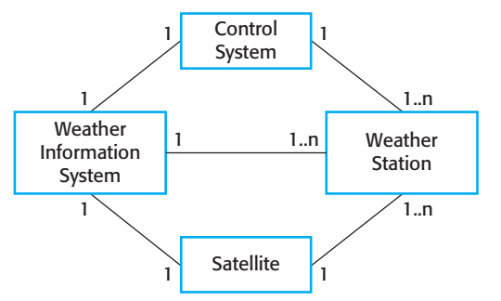
System context Model for weather station
Notes:
System context model is a structural model that demonstrates the other systems in the environment of the system being developed.
An interaction model is a dynamic model that shows how the system interacts with its environment as it is used.
---
the systems in the environment of each weather station are a weather information system, an onboard satellite system, and a control system. The cardinality information on the link shows that there is one control system but several weather stations, one satellite, and one general weather information system.
When you model the interactions of a system with its environment you should use an abstract approach that does not include too much detail.
Each possible interaction is named in an ellipse and the
external entity involved in the interaction is represented by a stick figure.

Slide 12
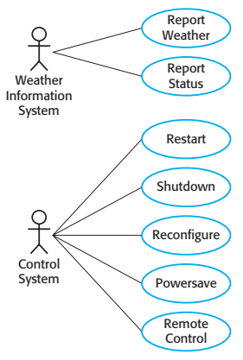
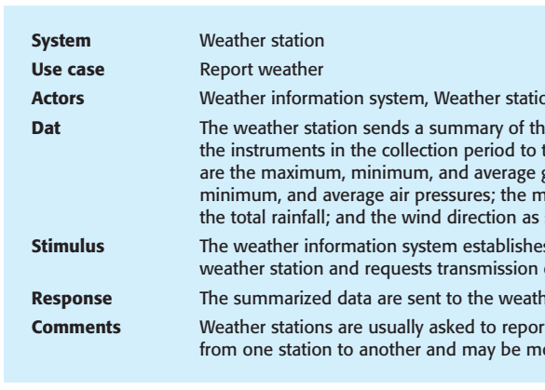
Weather station use cases
Notes:
Stickman
We got an table next to these drawings which it describes use cases and gives us detailed information on how the process is done.
---Each of these use cases should be described in structured natural language. This
helps designers identify objects in the system and gives them an understanding of
what the system is intended to do. I use a standard format for this description that clearly identifies what information is exchanged, how the interaction is initiated, and so on.

Slide 13
Architectural design
Use it after understanding interactions between the system and its environment
We identify the major components that make up the system and their interactions.
e.g. The weather station is composed of independent subsystems that communicate by broadcasting messages on a common infrastructure.

Slide 14
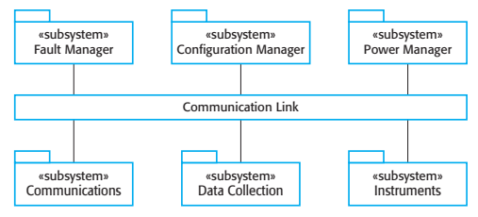
High-level architecture of the weather station
Notes:
Handles that and this

Slide 15
Object class identification
Identifying object classes is to often a difficult part of object oriented design.
Object identification is an iterative process. We are unlikely to get it right first time.
We define Classes, attributes, and operations.
Can be a starting point for the system design.
Notes:
Further information
from application domain knowledge or scenario analysis may then be used to refine And extend the initial objects. This information can be collected from requirements
documents, discussions with users, or from analyses of existing systems.

Slide 16
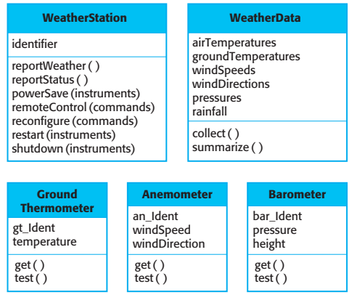
Weather station objects

Slide 17
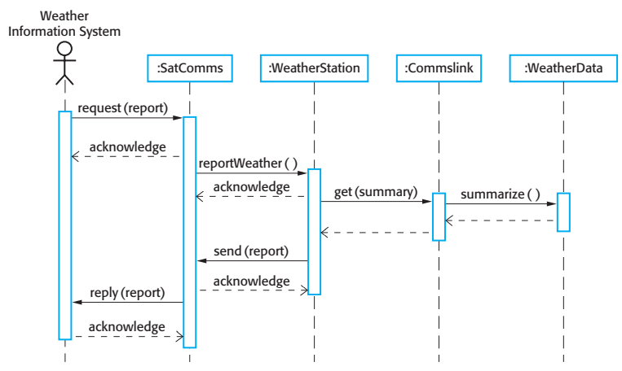
Sequence diagram
Notes:
Dynamic models describe the dynamic interactions between objects.
Sequence model
Shows the sequence of object interactions.
We arranged objects horizontally and time, vertically
Interactions are represented by labelled arrows,
->object is the controlling object in the system.

Slide 18
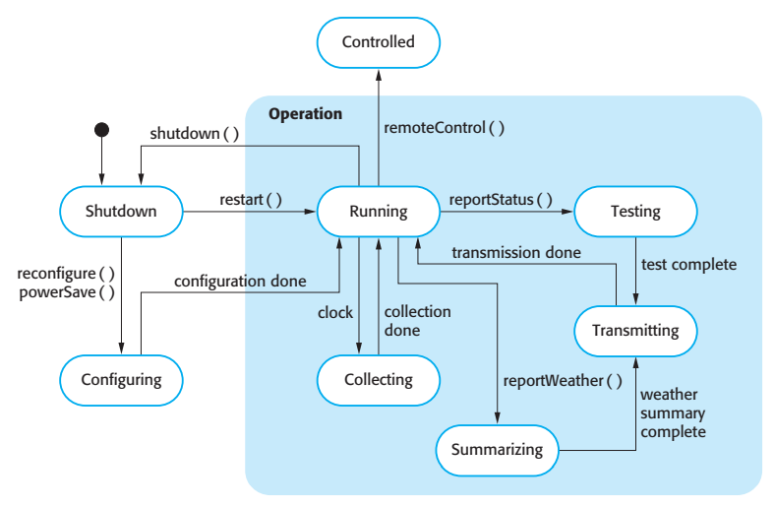
state diagram
Notes:
Shows how individual objects change their state in response to events.
useful high-level models of a system
You don’t usually need a state diagram for all of the objects in the system.
Many of the objects in a system are relatively simple and a state model adds unnecessary detail to the design

Slide 19
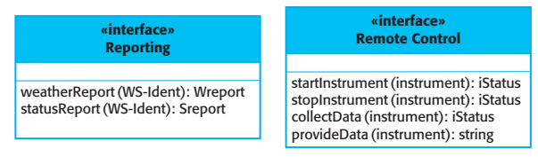
Interface specification
Notes:
Should not include details of the data representation
Include operations to access and update data

Slide 20

Design patterns

Slide 21
Design patterns
A way of reusing abstract knowledge about a common problem and its solution.
Patterns are a great idea but you need experience of software design to use them effectively.
You have to recognize situations where a pattern can be applied.
Notes:
Design patterns were derived from ideas put forward by Christopher Alexander
(Alexander et al., 1977), who suggested that there were certain common patterns of
building design that were inherently pleasing and effective.

Slide 22
Design Patterns
Creational Patterns
Object Pool / Resource Pool
Prototype
Factory Method (Abstract Factory Similar)
Singleton
Builders
Structural Patterns
Adapter
Decorator
Bridge (Handle-Body Pattern)
Composite
Facade
Flyweight
Proxy
Behavioral Patterns
Chain of Responsibility
Command
Interpreter
Mediator
Memento
Template
Visitor
Null Object
Iterator/Collection
State
Observer
Strategy
https://yazdipour.github.io/notes/#/principles/design-patterns

Slide 23
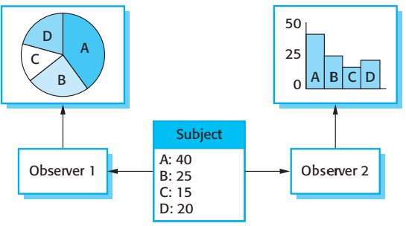
Observer pattern
Notes:
Multiple displays

Slide 24
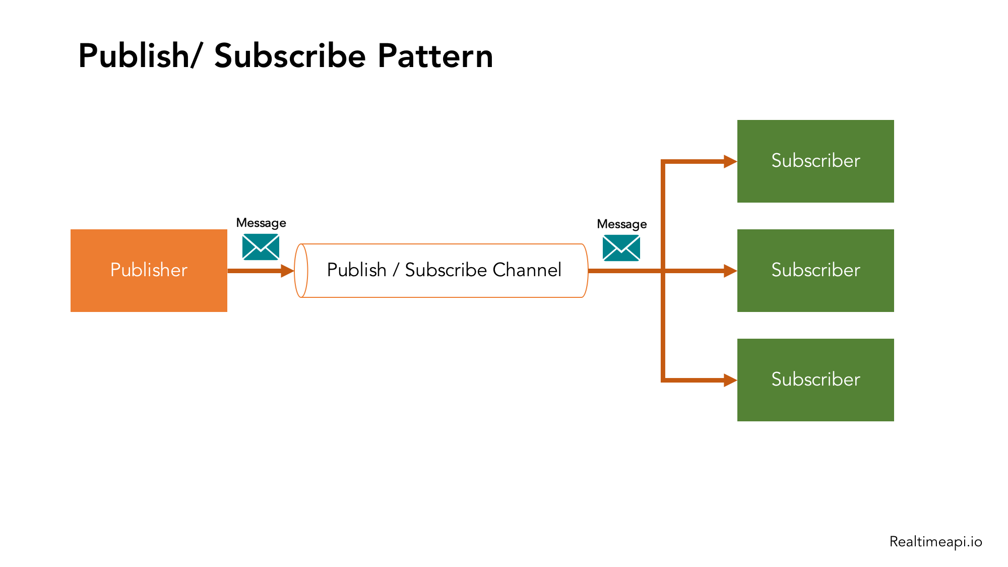
Observer pattern
Notes:
mvvm

Slide 25

Implementation issues

Slide 26
Implementation issues
Reuse
Most modern software is constructed by reusing existing components or systems.
Make as much use as possible of existing code.
Configuration management
During the development process, you have to keep track of the many different versions of each software component in a configuration management system.
Host-target development
Production software does not usually execute on the same computer as the software development environment
Notes:
Incompatablity

Slide 27
Reuse levels
The abstraction level
The object level
The component level
The system level
Notes:
The abstraction level
At this level, you don’t reuse software directly but use knowledge of successful abstractions in the design of your software.
The object level
At this level, you directly reuse objects from a library rather than writing the code yourself.
The component level
Components are collections of objects and object classes that you reuse in application systems.
The system level
At this level, you reuse entire application systems.

Slide 28
Reuse costs
Time spent in looking for software to reuse and assessing whether or not it meets your needs.
Buying the reusable software. For large off-the-shelf systems, these costs can be very high.
Costs of adapting and configuring the reusable software components or systems to reflect the requirements
Costs of integrating reusable software elements with each

Slide 29
Configuration management activities
Version management, where support is provided to keep track of the different versions of software components.
System integration, where support is provided to help developers define what versions of components are used to create each version of a system. This description is then used to build a system automatically by compiling and linking the required components.!!!
Problem tracking, where support is provided to allow users to report bugs and other problems.

Slide 30
Development tools
An integrated compiler [JVM, Roslyn,…]
Syntax-directed editing system [VSCode,…]
A language debugging system [VS,…]
Graphical editing tools, such as tools to edit UML models [IBM Rational Rose]
Testing tools [JUnit, xUnit,..]
Project support tools that help you organize the code for different development projects. [Trello, Jira,…]

Slide 31

Open source development

Slide 32
Open source development
Open source development is an approach to software development in which the source code of a software system is published and volunteers are invited to participate in the development process
Its roots are in the Free Software Foundation (www.fsf.org), which advocates that source code should not be proprietary but rather should always be available for users to examine and modify as they wish.
Open source software extended this idea by using the Internet to recruit a much larger population of volunteer developers. Many of them are also users of the code.

Slide 33
Open source systems
The best-known open source product is, of course, the Linux operating system which is widely used as a server system and, increasingly, as a desktop environment.
Other important open source products are Java, the Apache web server and the mySQL database management system.

Slide 34
Open source issues
Should the product that is being developed make use of open source components?
Should an open source approach be used for the software’s development?

Slide 35
Open source business
More and more product companies are using an open source approach to development.
Their business model is not reliant on selling a software product but on selling support for that product.
They believe that involving the open source community will allow software to be developed more cheaply, more quickly and will create a community of users for the software.

Slide 36
Open source licensing
Afundamental principle of open-source development is that source code should be freely available, this does not mean that anyone can do as they wish with that code.
Legally, the developer of the code (either a company or an individual) still owns the code. They can place restrictions on how it is used by including legally binding conditions in an open source software license.
Some open source developers believe that if an open source component is used to develop a new system, then that system should also be open source.
Others are willing to allow their code to be used without this restriction. The developed systems may be proprietary and sold as closed source systems.

Slide 37
License models
The GNU General Public License (GPL). This is a so-called ‘reciprocal’ license that means that if you use open source software that is licensed under the GPL license, then you must make that software open source.
The GNU Lesser General Public License (LGPL) is a variant of the GPL license where you can write components that link to open source code without having to publish the source of these components.
The Berkley Standard Distribution (BSD) License. This is a non-reciprocal license, which means you are not obliged to re-publish any changes or modifications made to open source code. You can include the code in proprietary systems that are sold.

Slide 38
License management
Establish a system for maintaining information about open-source components that are downloaded and used.
Be aware of the different types of licenses and understand how a component is licensed before it is used.
Be aware of evolution pathways for components.
Educate people about open source.
Have auditing systems in place.
Participate in the open source community.

Slide 39
Key points
Software design and implementation are inter-leaved activities. The level of detail in the design depends on the type of system and whether you are using a plan-driven or agile approach.
The process of object-oriented design includes activities to design the system architecture, identify objects in the system, describe the design using different object models and document the component interfaces.
A range of different models may be produced during an object-oriented design process. These include static models (class models, generalization models, association models) and dynamic models (sequence models, state machine models).
Component interfaces must be defined precisely so that other objects can use them. A UML interface stereotype may be used to define interfaces.

Slide 40
Key points
When developing software, you should always consider the possibility of reusing existing software, either as components, services or complete systems.
Configuration management is the process of managing changes to an evolving software system. It is essential when a team of people are cooperating to develop software.
Most software development is host-target development. You use an IDE on a host machine to develop the software, which is transferred to a target machine for execution.
Open source development involves making the source code of a system publicly available. This means that many people can propose changes and improvements to the software.

Slide 41
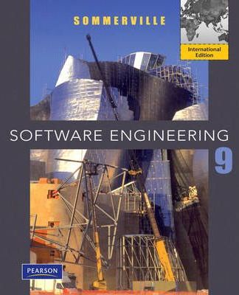
Software Engineering Sommerville
Reference

Slide 42
Q&A
Thank You for your attention.

