Slide 1

design and implementation Chapter 7
Presented By Shahriar Yazdipour
November 2019
Software & Systems Engineering Students Talk
Prof. Dr.-Ing. Armin Zimmermann

Slide 2
Agenda
Design and implementation
Object-oriented design using UML
Design patterns
Implementation issues
Open source development

Slide 3

Design and implementation

Slide 4
Design and implementation
Software design & implementation is
the stage in the software engineering process that an executable software system is developed.
Software design & implementation activities are always closely linked.
Software design is a creative activity in which you identify software components and their relationships, based on a customer’s requirements.
Implementation is the process of realizing the design as a program.
Notes:
the stage that an executable software system is developed.

Slide 5
Build or buy
In a wide range of domains, it is possible to buy off-the-shelf systems (COTS) that can be adapted and tailored to the users’ requirements.
e.g for implement a medical records system, we can buy a package that is already used in hospitals vs developing a system. One can be cheaper and one faster ...
* COTS = Commercial off-the-shelf
Notes:
One of the most important implementation decisions that has to be made at an early stage of a software project is whether or not you should buy or build the application software.
* When you develop an application in this way, the design process becomes concerned with how to use the configuration features of that system to deliver the system requirements.

Slide 6

Object-oriented design using UML

Slide 7
object-oriented design process
It involves developing a number of different system models.
They require a lot of effort for development and maintenance which for small systems this may not be cost-effective. However, for large systems developed by different groups design models are an important communication mechanism.
Notes:
process of object-oriented design involves developing different models. Which they require lots of effort for developing and maintenance which for small systems, may not be cost effective, but, for larger systems it is an important communication mechanism for team members.

Slide 8
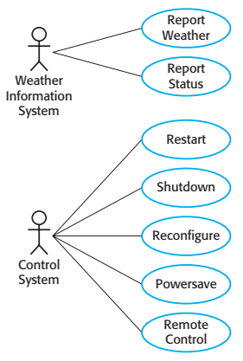
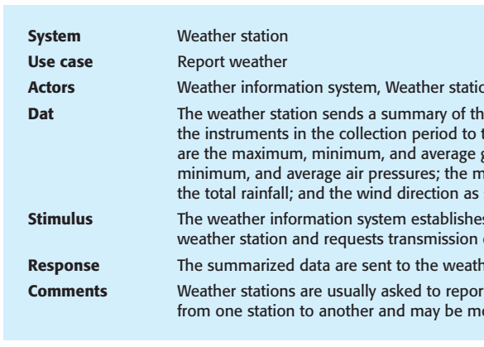
Weather station use cases
Notes:
Each of these use cases should be described in structured natural language. This
helps designers identify objects in the system and gives them an understanding of
what the system is intended to do. I use a standard format for this description that clearly identifies what information is exchanged, how the interaction is initiated, and so on.

Slide 9
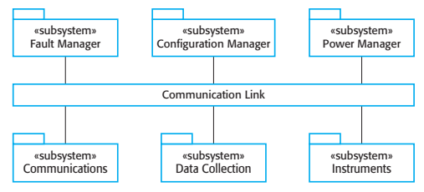
High-level architecture of the weather station
Notes:
Each subsystem listens for messages on that
infrastructure and picks up the messages that are intended for them. This is
another commonly used architectural style in addition to those described in
Chapter 6.
For example, when the communications subsystem receives a control command, such as shutdown, the command is picked up by each of the other subsystems, which then shut themselves down in the correct way. The key benefit of this
architecture is that it is easy to support different configurations of subsystems
because the sender of a message does not need to address the message to a particular subsystem.

Slide 10
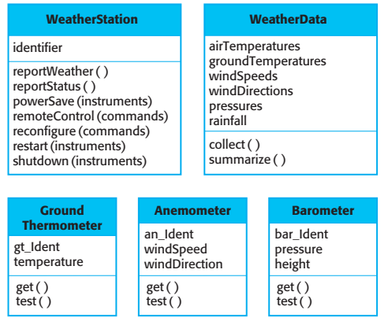
Weather station Object class identification

Slide 11
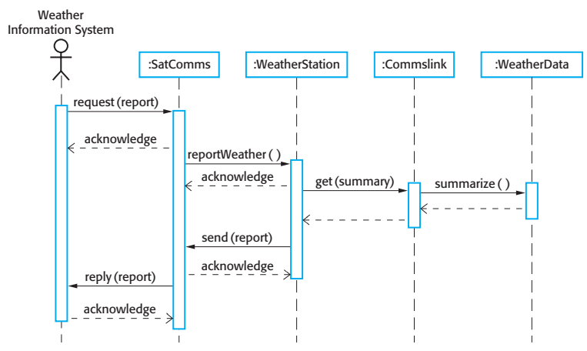
Sequence diagram
Notes:
Objects are arranged horizontally across the top;
Time is represented vertically so models are read top to bottom;
Interactions are represented by labelled arrows, Different styles of arrow represent different types of interaction;
A thin rectangle in an object lifeline represents the time when the object is the controlling object in the system.

Slide 12
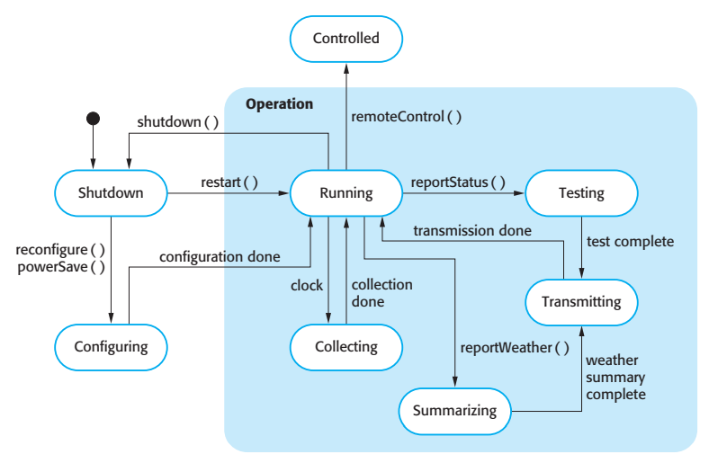
state diagram
Notes:
State diagrams are useful high-level models of a system or an object’s operation.
You don’t usually need a state diagram for all of the objects in the system. Many of the objects in a system are relatively simple and a state model adds unnecessary detail to the design

Slide 13

Design patterns

Slide 14
Design patterns
A way of reusing abstract knowledge about a common problem and its solution.
Patterns are a great idea but you need experience of software design to use them effectively.
You have to recognize situations where a pattern can be applied.
Notes:
Design patterns were derived from ideas put forward by Christopher Alexander
(Alexander et al., 1977), who suggested that there were certain common patterns of
building design that were inherently pleasing and effective.

Slide 15
Design Patterns
Creational Patterns
Object Pool / Resource Pool
Prototype
Factory Method (Abstract Factory Similar)
Singleton
Builders
Structural Patterns
Adapter
Decorator
Bridge (Handle-Body Pattern)
Composite
Facade
Flyweight
Proxy
Behavioral Patterns
Chain of Responsibility
Command
Interpreter
Mediator
Memento
Template
Visitor
Null Object
Iterator/Collection
State
Observer
Strategy
https://yazdipour.github.io/notes/#/principles/design-patterns

Slide 16
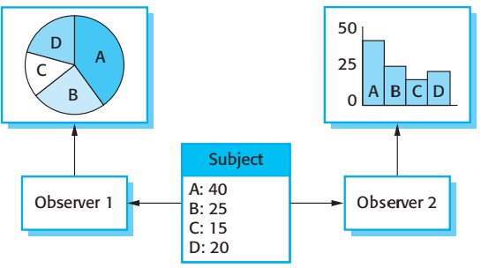
Observer pattern
Notes:
Multiple displays

Slide 17
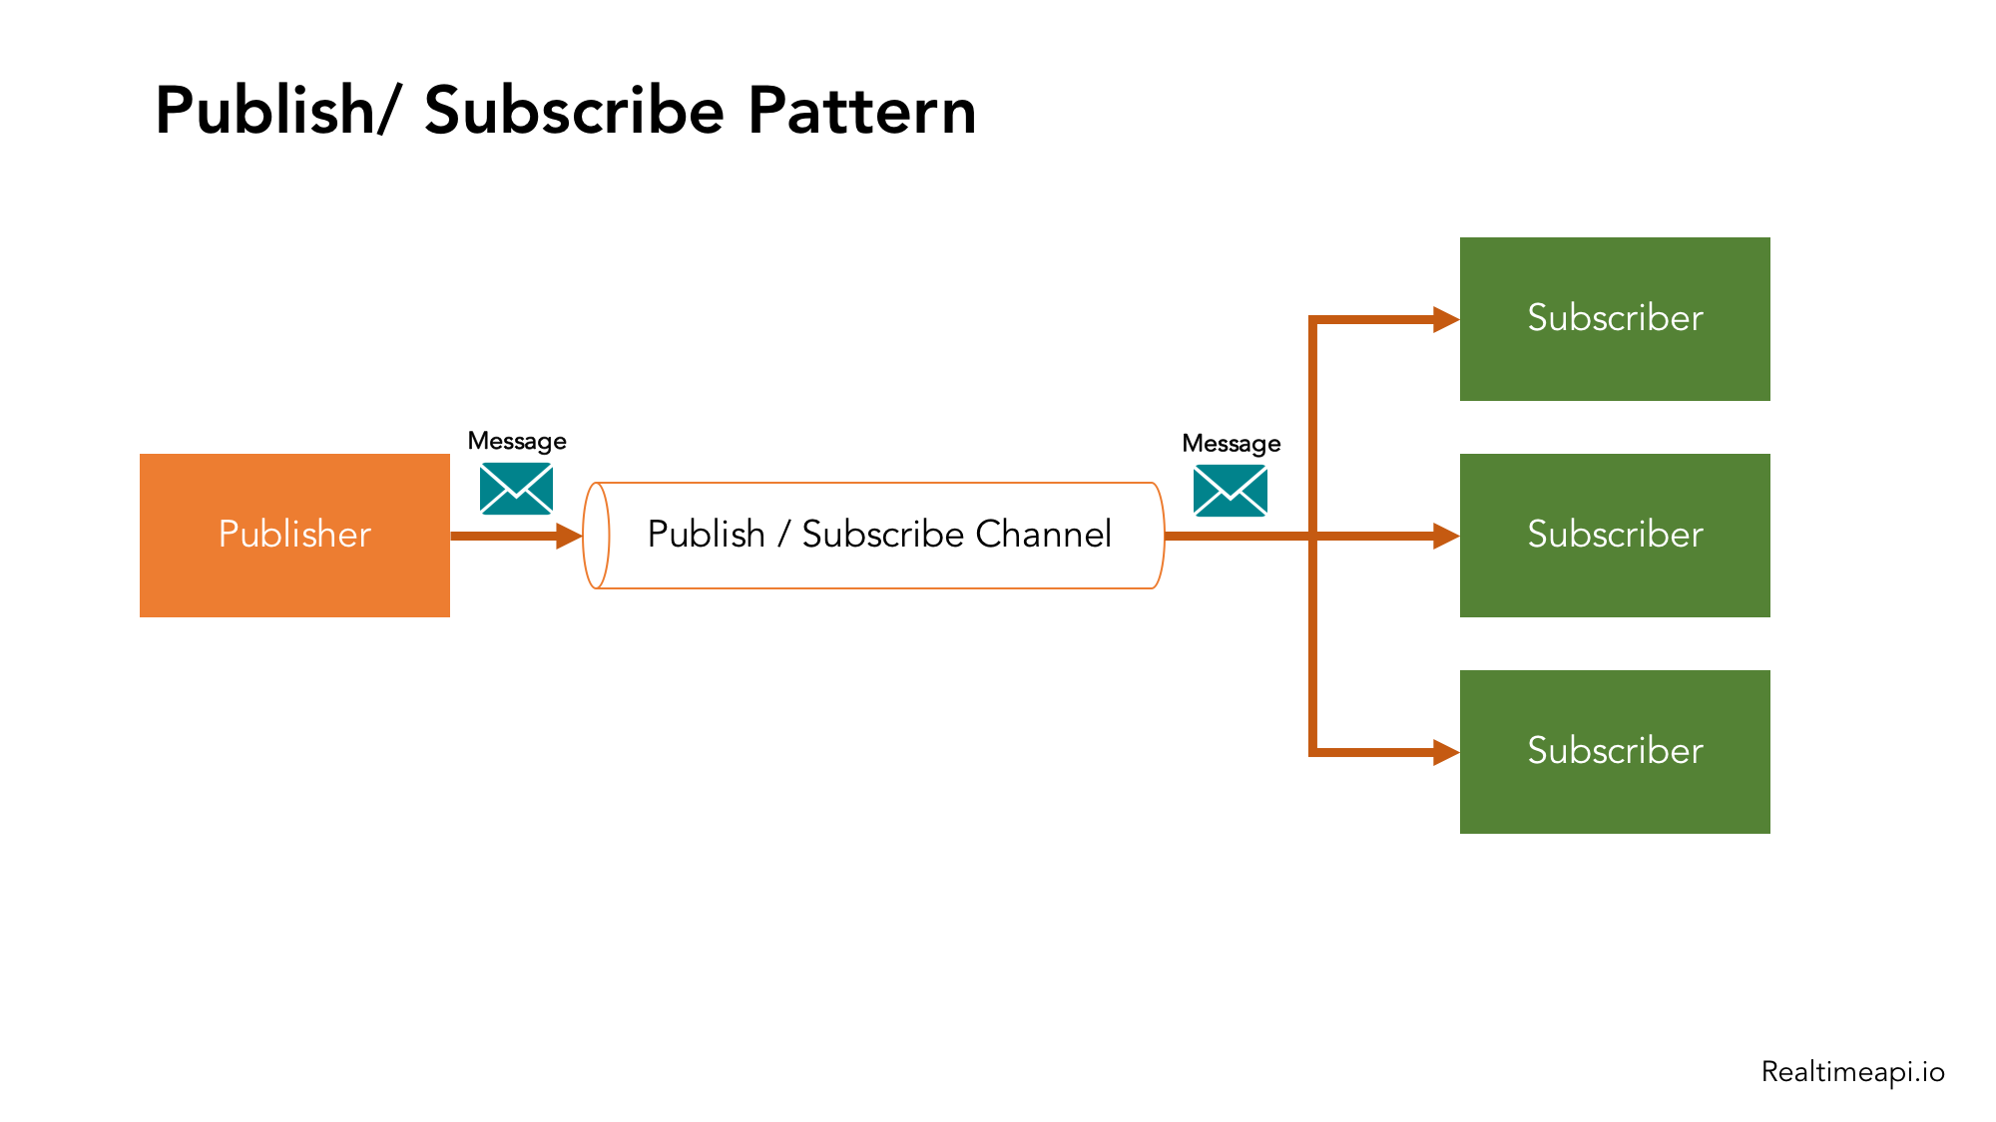
Observer pattern
Notes:
mvvm

Slide 18

Implementation issues

Slide 19
Implementation issues
Reuse
Most modern software is constructed by reusing existing components or systems.
Make as much use as possible of existing code.
Configuration management
During the development process, you have to keep track of the many different versions of each software component in a configuration management system.
Host-target development
Production software does not usually execute on the same computer as the software development environment
Notes:
Incompatablity

Slide 20
Reuse levels
The abstraction level
The object level
The component level
The system level
Notes:
The abstraction level
At this level, you don’t reuse software directly but use knowledge of successful abstractions in the design of your software.
The object level
At this level, you directly reuse objects from a library rather than writing the code yourself.
The component level
Components are collections of objects and object classes that you reuse in application systems.
The system level
At this level, you reuse entire application systems.

Slide 21
Reuse costs
Time spent in looking for software to reuse and assessing whether or not it meets your needs.
Buying the reusable software. For large off-the-shelf systems, these costs can be very high.
Costs of adapting and configuring the reusable software components or systems to reflect the requirements
Costs of integrating reusable software elements with each

Slide 22
Development tools
An integrated compiler [JVM, Roslyn,…]
Syntax-directed editing system [VSCode,…]
A language debugging system [VS,…]
Graphical editing tools, such as tools to edit UML models [IBM Rational Rose]
Testing tools [JUnit, xUnit,..]
Project support tools that help you organize the code for different development projects. [Trello, Jira,…]

Slide 23

Open source development

Slide 24
Open source development
Open source development is an approach to software development in which the source code of a software system is published and volunteers are invited to participate in the development process
Its roots are in the Free Software Foundation (fsf.org), which advocates that source code should not be proprietary but rather should always be available for users to examine and modify as they wish.

Slide 25
Open source
ISSUES
Should the product that is being developed make use of open source components?
Should an open source approach be used for the software’s development?
business
Open source projects business model is not reliant on selling a software product but on selling support for that product.
It is believed that involving the open source community will allow software to be developed more cheaply, more quickly and will create a community of users for the software.

Slide 26
Open source licensing
A fundamental principle of open-source development is that source code should be freely available, this does not mean that anyone can do as they wish with that code.
Legally, the developer of the code (either a company or an individual) still owns the code. They can place restrictions on how it is used by including legally binding conditions in an open source software license.
Some open source developers believe that if an open source component is used to develop a new system, then that system should also be open source.
Others are willing to allow their code to be used without this restriction. The developed systems may be proprietary and sold as closed source systems.

Slide 27
License models
The GNU General Public License (GPL). This is a so-called ‘reciprocal’ license that means that if you use open source software that is licensed under the GPL license, then you must make that software open source.
The GNU Lesser General Public License (LGPL) is a variant of the GPL license where you can write components that link to open source code without having to publish the source of these components.
The Berkley Standard Distribution (BSD) License. This is a non-reciprocal license, which means you are not obliged to re-publish any changes or modifications made to open source code. You can include the code in proprietary systems that are sold.

Slide 28
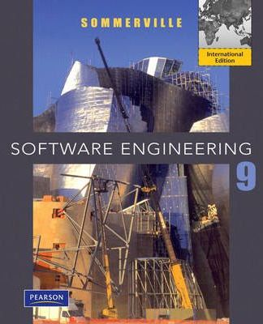
Software Engineering Sommerville
Reference

Slide 29
Thank You for your attention.
Q&A

