Slide 1
Lecture 10: Design Theory I
Lecture 10

Slide 2
Announcement
Lecture 10
ERD Assignment will be out today.
Deadline: in two weeks

Slide 3
Today’s Lecture
Lecture 10
Normal forms & functional dependencies
ACTIVITY: Finding FDs
Finding functional dependencies
Closures, superkeys & keys
ACTIVITY: The key or a key?

Slide 4
1. Normal forms & functional dependencies
Lecture 10 > Section 1

Slide 5
What you will learn about in this section
Lecture 10 > Section 1
Overview of design theory & normal forms
Data anomalies & constraints
Functional dependencies
ACTIVITY: Finding FDs

Slide 6
Design Theory (تئوری طراحی)
Lecture 10 > Section 1 > Overview
Design theory is about how to represent your data to avoid anomalies.
تئوری طراحی در مورد چگونگی نمایش داده‌ها برای جلوگیری از آنومالی‌هاست.
It is a mostly mechanical process – یک پروسه‌ی مکانیکی هست
Tools can carry out routine portions – ابزارها می‌توانند کمک زیادی بکنند
We have a notebook implementing all algorithms!
We’ll play with it in the activities!

Slide 7
Normal Forms
Lecture 10 > Section 1 > Overview
1st Normal Form (1NF) = All tables are flat
2nd Normal Form = disused
Boyce-Codd Normal Form (BCNF)
3rd Normal Form (3NF)
4th and 5th Normal Forms = see text books
DB designs based on functional dependencies, intended to prevent data anomalies
Our focus in this lecture + next ones

Slide 8
1st Normal Form (1NF)
Lecture 10 > Section 1 > Overview
Student | Courses
Mary | CS145
Mary | CS229
Joe | CS145
Joe | CS106
Student | Courses
Mary | {CS145,CS229}
Joe | {CS145,CS106}
… | …
Violates 1NF.
In 1st NF
1NF Constraint: Types must be atomic!

Slide 9
Data Anomalies & Constraints
Lecture 10 > Section 1 > Data anomalies & constraints

Slide 10
Constraints Prevent (some) Anomalies in the Data
Lecture 10 > Section 1 > Data anomalies & constraints
A poorly designed database causes anomalies:
Student | Course | Room
Mary | CS145 | B01
Joe | CS145 | B01
Sam | CS145 | B01
.. | .. | ..
If every course is in only one room, contains redundant information!

Slide 11
Constraints Prevent (some) Anomalies in the Data
Lecture 10 > Section 1 > Data anomalies & constraints
A poorly designed database causes anomalies:
Student | Course | Room
Mary | CS145 | B01
Joe | CS145 | C12
Sam | CS145 | B01
.. | .. | ..
If we update the room number for one tuple, we get inconsistent data = an update anomaly

Slide 12
Constraints Prevent (some) Anomalies in the Data
Lecture 10 > Section 1 > Data anomalies & constraints
A poorly designed database causes anomalies:
Student | Course | Room
.. | .. | ..
If everyone drops the class, we lose what room the class is in! = a delete anomaly

Slide 13
Constraints Prevent (some) Anomalies in the Data
Lecture 10 > Section 1 > Data anomalies & constraints
A poorly designed database causes anomalies:
Student | Course | Room
Mary | CS145 | B01
Joe | CS145 | B01
Sam | CS145 | B01
.. | .. | ..
Similarly, we can’t reserve a room without students = an insert anomaly
… | CS229 | C12

Slide 14
Constraints Prevent (some) Anomalies in the Data
Lecture 10 > Section 1 > Data anomalies & constraints
Is this form better?
Redundancy?
Update anomaly?
Delete anomaly?
Insert anomaly?
Student | Course
Mary | CS145
Joe | CS145
Sam | CS145
.. | ..
Course | Room
CS145 | B01
CS229 | C12
Today: develop theory to understand why this design may be better and how to find this decomposition…

Slide 15
Functional Dependencies
Lecture 10 > Section 1 > Functional dependencies

Slide 16
Functional Dependency (وابستگی تابعی)
Lecture 10 > Section 1 > Functional dependencies
Def: Let A,B be sets of attributes
We write A → B or say A functionally determines B if, for any tuples t₁ and t₂:
t₁[A] = t₂[A] implies t₁[B] = t₂[B]
and we call A → B a functional dependency
A->B means that
“whenever two tuples agree on A then they agree on B.”

Slide 17
A Picture Of FDs
Lecture 10 > Section 1 > Functional dependencies
Defn (again):
Given attribute sets A={A₁,…,A_{m}} and B = {B₁,…B_{n}} in R,
 | A₁ | … | A_{m} |  | B₁ | … | B_{n}

Slide 18
A Picture Of FDs
Lecture 10 > Section 1 > Functional dependencies
Defn (again):
Given attribute sets A={A₁,…,A_{m}} and B = {B₁,…B_{n}} in R,
The functional dependency A→ B on R holds if for any t_{i},t_{j} in R:
 | A₁ | … | A_{m} |  | B₁ | … | B_{n}
t_{i}
t_{j}

Slide 19
A Picture Of FDs
Lecture 10 > Section 1 > Functional dependencies
Defn (again):
Given attribute sets A={A₁,…,A_{m}} and B = {B₁,…B_{n}} in R,
The functional dependency A→ B on R holds if for any t_{i},t_{j} in R:
t_{i}[A₁] = t_{j}[A₁] AND t_{i}[A₂]=t_{j}[A₂] AND … AND t_{i}[A_{m}] = t_{j}[A_{m}]
 | A₁ | … | A_{m} |  | B₁ | … | B_{n}
t_{i}
t_{j}
If t1,t2 agree here..

Slide 20
A Picture Of FDs
Lecture 10 > Section 1 > Functional dependencies
Defn (again):
Given attribute sets A={A₁,…,A_{m}} and B = {B₁,…B_{n}} in R,
The functional dependency A→ B on R holds if for any t_{i},t_{j} in R:
if t_{i}[A₁] = t_{j}[A₁] AND t_{i}[A₂]=t_{j}[A₂] AND … AND t_{i}[A_{m}] = t_{j}[A_{m}]
then t_{i}[B₁] = t_{j}[B₁] AND t_{i}[B₂]=t_{j}[B₂] AND … AND t_{i}[B_{n}] = t_{j}[B_{n}]
 | A₁ | … | A_{m} |  | B₁ | … | B_{n}
t_{i}
t_{j}
If t1,t2 agree here..
…they also agree here!

Slide 21
FDs for Relational Schema Design
Lecture 10 > Section 1 > Functional dependencies
High-level idea: why do we care about FDs?
ایده‌ی سطح بالا: چرا وابستگی‌های تابعی برایمان مهم است؟
Start with some relational schema
از یک شمای رابطه‌ای شروع کنید
Find out its functional dependencies (FDs)
وابستگی‌های تابعی را بیابید.
Use these to design a better schema
از این وابستگی‌های تابعی برای طراحی بهتر شما استفاده کنید
One which minimizes the possibility of anomalies
آن شمایی بهتر است که آنومالی‌های کمتری در آن ممکن باشد

Slide 22
Functional Dependencies as Constraints وابستگی‌های تابعی بعنوان محدودیت
Lecture 10 > Section 1
A functional dependency is a form of constraint
یک وابستگی تابعی در واقع نوعی از محدودیت است
Holds on some instances (but not others) – can check whether there are violations
Part of the schema, helps define a valid instance
Student | Course | Room
Mary | CS145 | B01
Joe | CS145 | B01
Sam | CS145 | B01
.. | .. | ..
Note: The FD {Course} -> {Room} holds on this instance
Recall: an instance of a schema is a multiset of tuples conforming to that schema, i.e. a table

Slide 23
Functional Dependencies as Constraints
Lecture 10 > Section 1
Note that:
You can check if an FD is violated by examining a single instance;
میتوان تخطی از یک وابستگی تابعی را با نگاه کردن به محتویات یک جدول متوجه شد
However, you cannot prove that an FD is part of the schema by examining a single instance.
This would require checking every valid instance
ولی نمیتوان با نگاه کردن به محتویات یک جدول ثابت کرد که یک وابستگی تابعی وجود دارد.
Student | Course | Room
Mary | CS145 | B01
Joe | CS145 | B01
Sam | CS145 | B01
.. | .. | ..
However, cannot prove that the FD {Course} -> {Room} is part of the schema

Slide 24
More Examples
Lecture 10 > Section 1 > Functional dependencies
An FD is a constraint which holds, or does not hold on an instance:
یک وابستگی تابعی، محدودیتی است که می‌تواند بر روی یک نمونه جدول برقرار باشد یا نباشد.
EmpID | Name | Phone | Position
E0045 | Smith | 1234 | Clerk
E3542 | Mike | 9876 | Salesrep
E1111 | Smith | 9876 | Salesrep
E9999 | Mary | 1234 | Lawyer

Slide 25
More Examples
Lecture 10 > Section 1 > Functional dependencies
EmpID | Name | Phone | Position
E0045 | Smith | 1234 | Clerk
E3542 | Mike | 9876 ← | Salesrep
E1111 | Smith | 9876 ← | Salesrep
E9999 | Mary | 1234 | Lawyer
{Position} → {Phone}

Slide 26
More Examples
Lecture 10 > Section 1 > Functional dependencies
EmpID | Name | Phone | Position
E0045 | Smith | 1234 → | Clerk
E3542 | Mike | 9876 | Salesrep
E1111 | Smith | 9876 | Salesrep
E9999 | Mary | 1234 → | Lawyer
but not {Phone} → {Position}

Slide 27
ACTIVITY
Lecture 10 > Section 1 > ACTIVITY
Find at least three FDs which are violated on this instance:
A | B | C | D | E
1 | 2 | 4 | 3 | 6
3 | 2 | 5 | 1 | 8
1 | 4 | 4 | 5 | 7
1 | 2 | 4 | 3 | 6
3 | 2 | 5 | 1 | 8
{ } → { }
{ } → { }
{ } → { }

Slide 28
2. Finding functional dependencies پیدا کردن وابستگی‌های تابعی
Lecture 10 > Section 2

Slide 29
What you will learn about in this section
Lecture 10 > Section 2
“Good” vs. “Bad” FDs: Intuition – وابستگی تابعی خوب یا بد
Finding FDs – پیدا کردن وابستگی‌های تابعی
Closures
ACTIVITY: Compute the closures

Slide 30
“Good” vs. “Bad” FDs
Lecture 10 > Section 2 > Good vs. Bad FDs
We can start to develop a notion of good vs. bad FDs:
EmpID | Name | Phone | Position
E0045 | Smith | 1234 | Clerk
E3542 | Mike | 9876 | Salesrep
E1111 | Smith | 9876 | Salesrep
E9999 | Mary | 1234 | Lawyer
Intuitively:
EmpID -> Name, Phone, Position is “good FD”
Minimal redundancy, less possibility of anomalies

Slide 31
“Good” vs. “Bad” FDs
Lecture 10 > Section 2 > Good vs. Bad FDs
We can start to develop a notion of good vs. bad FDs:
EmpID | Name | Phone | Position
E0045 | Smith | 1234 | Clerk
E3542 | Mike | 9876 | Salesrep
E1111 | Smith | 9876 | Salesrep
E9999 | Mary | 1234 | Lawyer
Intuitively:
EmpID -> Name, Phone, Position is “good FD”
But Position -> Phone is a “bad FD”
Redundancy! Possibility of data anomalies

Slide 32
“Good” vs. “Bad” FDs
Lecture 10 > Section 2 > Good vs. Bad FDs
Student | Course | Room
Mary | CS145 | B01
Joe | CS145 | B01
Sam | CS145 | B01
.. | .. | ..
Returning to our original example… can you see how the “bad FD” {Course} -> {Room} could lead to an:
Update Anomaly
Insert Anomaly
Delete Anomaly
…
Given a set of FDs (from user) our goal is to:
Find all FDs, and
Eliminate the “Bad Ones".

Slide 33
FDs for Relational Schema Design
Lecture 10 > Section 1 > Finding FDs
High-level idea: why do we care about FDs?
ایده‌ی سطح بالا: چرا وابستگی‌های تابعی برایمان مهم است؟
Start with some relational schema
از یک شمای رابطه‌ای شروع کنید
Find out its functional dependencies (FDs)
وابستگی‌های تابعی را بیابید.
Use these to design a better schema
از این وابستگی‌های تابعی برای طراحی بهتر شما استفاده کنید
One which minimizes the possibility of anomalies
آن شمایی بهتر است که آنومالی‌های کمتری در آن ممکن باشد
This part can be tricky!

Slide 34
Finding Functional Dependencies
Lecture 10 > Section 2 > Finding FDs
There can be a very large number of FDs…
How to find them all efficiently?
We can’t necessarily show that any FD will hold on all instances…
How to do this?
We will start with this problem:
Given a set of FDs, F, what other FDs must hold?

Slide 35
Finding Functional Dependencies
Lecture 10 > Section 2 > Finding FDs
Equivalent to asking: Given a set of FDs, F = {f₁,…f_{n}}, does an FD g hold?
Inference problem: How do we decide?

Slide 36
Finding Functional Dependencies
Lecture 10 > Section 2 > Finding FDs
Example:
Products
Provided FDs:
Name | Color | Category | Dep | Price
Gizmo | Green | Gadget | Toys | 49
Widget | Black | Gadget | Toys | 59
Gizmo | Green | Whatsit | Garden | 99
1. {Name} → {Color}
2. {Category} → {Department}
3. {Color, Category} → {Price}
Given the provided FDs, we can see that {Name, Category} → {Price} must also hold on any instance…
Which / how many other FDs do?!?

Slide 37
Finding Functional Dependencies
Lecture 10 > Section 2 > Finding FDs
Equivalent to asking: Given a set of FDs, F = {f₁,…f_{n}}, does an FD g hold?
Inference problem: How do we decide?
Answer: Three simple rules called Armstrong’s Rules.
Split/Combine,
Reduction, and
Transitivity… ideas by picture
قوانین استنتاج آرمسترانگ

Slide 38
1. Split/Combine
Lecture 10 > Section 2 > Finding FDs
 | A₁ | … | A_{m} |  | B₁ | … | B_{n}
A₁, …, A_{m} → B₁,…,B_{n}

Slide 39
1. Split/Combine
Lecture 10 > Section 2 > Finding FDs
 | A₁ | … | A_{m} |  | B₁ | … | B_{n}
A₁, …, A_{m} → B₁,…,B_{n}
… is equivalent to the following n FDs…
A₁,…,A_{m} → B_{i} for i=1,…,n

Slide 40
1. Split/Combine (تجزیه/ترکیب)
Lecture 10 > Section 2 > Finding FDs
 | A₁ | … | A_{m} |  | B₁ | … | B_{n}
And vice-versa, A₁,…,A_{m} → B_{i} for i=1,…,n
… is equivalent to …
A₁, …, A_{m} → B₁,…,B_{n}

Slide 41
Reduction/Trivial (کاهش/بدیهی)
Lecture 10 > Section 2 > Finding FDs
 | A₁ | … | A_{m}
A₁,…,A_{m} → A_{j} for any j=1,…,m

Slide 42
3. Transitive Closure (تعدی بستار)
Lecture 10 > Section 2 > Finding FDs
 | A₁ | … | A_{m} |  | B₁ | … | B_{n} |  | C₁ | … | C_{k}
A₁, …, A_{m} → B₁,…,B_{n} and
B₁,…,B_{n} → C₁,…,C_{k}

Slide 43
3. Transitive Closure
Lecture 10 > Section 2 > Finding FDs
 | A₁ | … | A_{m} |  | B₁ | … | B_{n} |  | C₁ | … | C_{k}
A₁, …, A_{m} → B₁,…,B_{n} and
B₁,…,B_{n} → C₁,…,C_{k}
implies
A₁,…,A_{m} → C₁,…,C_{k}

Slide 44
Finding Functional Dependencies
Lecture 10 > Section 2 > Finding FDs
Example:
Products
Provided FDs:
Name | Color | Category | Dep | Price
Gizmo | Green | Gadget | Toys | 49
Widget | Black | Gadget | Toys | 59
Gizmo | Green | Whatsit | Garden | 99
1. {Name} → {Color}
2. {Category} → {Department}
3. {Color, Category} → {Price}
Which / how many other FDs hold?

Slide 45
Finding Functional Dependencies
Lecture 10 > Section 2 > Finding FDs
Example:
Inferred FDs:
Provided FDs:
Inferred FD | Rule used
4. {Name, Category} -> {Name} | ?
5. {Name, Category} -> {Color} | ?
6. {Name, Category} -> {Category} | ?
7. {Name, Category -> {Color, Category} | ?
8. {Name, Category} -> {Price} | ?
1. {Name} → {Color}
2. {Category} → {Dept.}
3. {Color, Category} → {Price}
Which / how many other FDs hold?

Slide 46
Finding Functional Dependencies
Lecture 10 > Section 2 > Finding FDs
Example:
Inferred FDs:
Provided FDs:
Inferred FD | Rule used
4. {Name, Category} -> {Name} | Trivial
5. {Name, Category} -> {Color} | Transitive (4 -> 1)
6. {Name, Category} -> {Category} | Trivial
7. {Name, Category -> {Color, Category} | Split/combine (5 + 6)
8. {Name, Category} -> {Price} | Transitive (7 -> 3)
1. {Name} → {Color}
2. {Category} → {Dept.}
3. {Color, Category} → {Price}
Can we find an algorithmic way to do this?

Slide 47
Closures (بستار)
Lecture 10 > Section 2 > Closures

Slide 48
Closure of a set of Attributes
Lecture 10 > Section 2 > Closures
Given a set of attributes A₁, …, A_{n} and a set of FDs F:
Then the closure, {A₁, …, A_{n}}⁺ is the set of attributes B s.t. {A₁, …, A_{n}} → B
Example: F =
{name} → {color}
{category} → {department}
{color, category} → {price}
Example Closures:
{name}⁺ = {name, color}
{name, category}⁺ =
{name, category, color, dept, price}
{color}⁺ = {color}

Slide 49
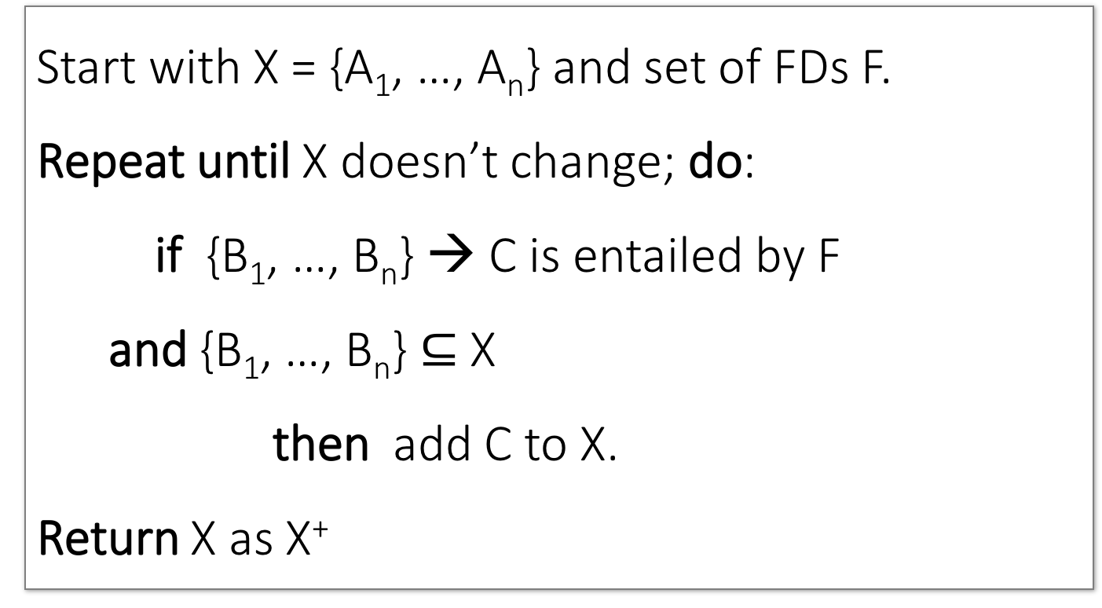
Closure Algorithm
Lecture 10 > Section 2 > Closures
Start with X = {A₁, …, A_{n}} and set of FDs F.
Repeat until X doesn’t change; do:
if {B₁, …, B_{n}} → C is entailed by F
and {B₁, …, B_{n}} $⊆$ X
then add C to X.
Return X as X⁺

Slide 50
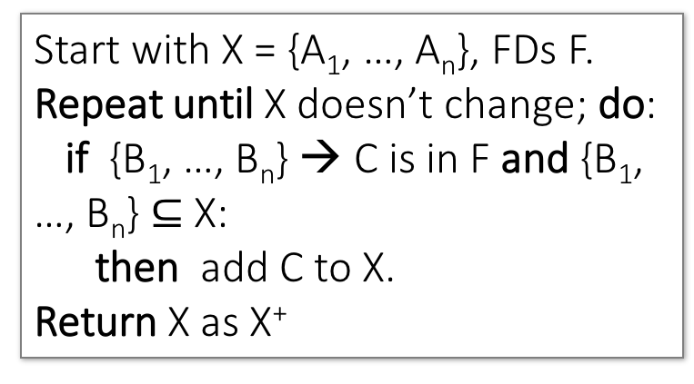
Closure Algorithm
Lecture 10 > Section 2 > Closures
Start with X = {A₁, …, A_{n}}, FDs F.
Repeat until X doesn’t change; do:
if {B₁, …, B_{n}} → C is in F and {B₁, …, B_{n}} $⊆$ X:
then add C to X.
Return X as X⁺
{name, category}⁺ =
{name, category}
F =
{name} → {color}
{category} → {dept}
{color, category} → {price}

Slide 51
Closure Algorithm
Lecture 10 > Section 2 > Closures
Start with X = {A₁, …, A_{n}}, FDs F.
Repeat until X doesn’t change; do:
if {B₁, …, B_{n}} → C is in F and {B₁, …, B_{n}} $⊆$ X:
then add C to X.
Return X as X⁺
{name, category}⁺ =
{name, category}
{name, category}⁺ =
{name, category, color}
F =
{name} → {color}
{category} → {dept}
{color, category} → {price}

Slide 52
Closure Algorithm
Lecture 10 > Section 2 > Closures
Start with X = {A₁, …, A_{n}}, FDs F.
Repeat until X doesn’t change; do:
if {B₁, …, B_{n}} → C is in F and {B₁, …, B_{n}} $⊆$ X:
then add C to X.
Return X as X⁺
{name, category}⁺ =
{name, category}
{name, category}⁺ =
{name, category, color}
F =
{name, category}⁺ =
{name, category, color, dept}
{name} → {color}
{category} → {dept}
{color, category} → {price}

Slide 53
Closure Algorithm
Lecture 10 > Section 2 > Closures
Start with X = {A₁, …, A_{n}}, FDs F.
Repeat until X doesn’t change; do:
if {B₁, …, B_{n}} → C is in F and {B₁, …, B_{n}} $⊆$ X:
then add C to X.
Return X as X⁺
{name, category}⁺ =
{name, category}
{name, category}⁺ =
{name, category, color}
F =
{name, category}⁺ =
{name, category, color, dept}
{name} → {color}
{category} → {dept}
{color, category} → {price}
{name, category}⁺ =
{name, category, color, dept, price}

Slide 54
Example
Lecture 10 > Section 2 > Closures
R(A,B,C,D,E,F)
{A,B} → {C}
{A,D} → {E}
{B} → {D}
{A,F} → {B}
Compute {A,B}⁺ = {A, B, }
Compute {A, F}⁺ = {A, F, }

Slide 55
Example
Lecture 10 > Section 2 > Closures
R(A,B,C,D,E,F)
{A,B} → {C}
{A,D} → {E}
{B} → {D}
{A,F} → {B}
Compute {A,B}⁺ = {A, B, C, D }
Compute {A, F}⁺ = {A, F, B }

Slide 56
Example
Lecture 10 > Section 2 > Closures
R(A,B,C,D,E,F)
{A,B} → {C}
{A,D} → {E}
{B} → {D}
{A,F} → {B}
Compute {A,B}⁺ = {A, B, C, D, E}
Compute {A, F}⁺ = {A, B, C, D, E, F}

