Slide 1
Lecture 7 Activity Solutions
Lecture 7 > Section 1 > ACTIVITY > SOLUTIONS

Slide 2
Activity 1
Lecture 7 > Section 1 > ACTIVITY > SOLUTIONS
Note that various ER diagrams could work, not just the following one!

Slide 3
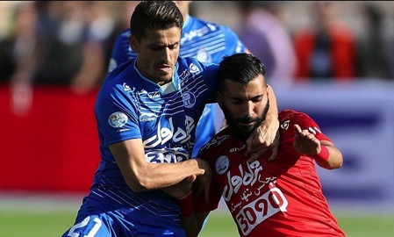
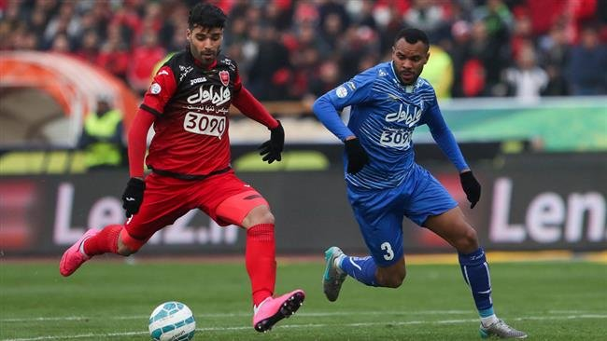

به نمودار موجودیت-رابطه‌تان فلش اضافه کنید!
Lecture 7 > Section 2 > ACTIVITY
همچنین، مفاهیم جدید که زیرشان خط کشیده شده است را هم اضافه کنید
یک بازیکن فقط می‌تواند متعلق به یک تیم باشد
یک حرکت (مثل پاس گل یا کرنر زدن) فقط میتواند در یک بازی باشد.
بازیکنان می‌توانند یک رکورد شخصی داشته باشند که به یک بازی و حرکت مشخص مرتبط است.
بازیکنان می‌توانند یک وزن داشته باشند که در طول فصل و در خارج از فصل تغییر می‌کند.

Slide 4

Add arrows to your E/R diagram!
Lecture 7 > Section 1 > ACTIVITY
Also make sure to add (new concepts underlined):
A player can only belong to one team, a play can only be in one game, a pass/run..?
Players can achieve a Personal Record linked to a specific Game and Play
Players have a weight which changes in on vs. off-season

Slide 5
Lecture 7 > Section 1 > ACTIVITY > SOLUTIONS
Team ID
date
location
name
Player ID
Teams
MemberOf
PlayingAway
Players
PlayingHome
Games
Participation Type
OccurIn
Plays
ParticipateIn
A player can only belong to one team, a play can only be in one game, a pass/run..?
Play ID
Yardage Diff
Touchdown

Slide 6
Lecture 7 > Section 1 > ACTIVITY > SOLUTIONS
Team ID
date
location
name
Player ID
Teams
MemberOf
PlayingAway
Players
PlayingHome
Games
Participation Type
ParticipateIn
OccurIn
Plays
PRIn
Play ID
Yardage Diff
Touchdown
Players can achieve a Personal Record linked to a specific Game and Play

Slide 7
Lecture 7 > Section 1 > ACTIVITY > SOLUTIONS
Team ID
date
location
name
Player ID
Teams
MemberOf
PlayingAway
Players
Players might have different weights at different times
WeightOf
PlayingHome
Games
Participation Type
Weight
ParticipateIn
OccurIn
Weight
Plays
Player ID
Time Period
PRIn
Note: point here is that different players might have different numbers of training / weight phases- hence should represent as new entity!
Play ID
Yardage Diff
Touchdown

Slide 8
Lecture 7 > Section 1 > ACTIVITY > SOLUTIONS
Team ID
date
location
name
Player ID
Teams
MemberOf
PlayingAway
Players
WeightOf
PlayingHome
Games
Participation Type
Players might have different weights at different times
Weight
ParticipateIn
OccurIn
Weight
Plays
Player ID
Time Period
PRIn
Play ID
Yardage Diff
Touchdown

