Slide 1
Lecture 11: Design Theory II
Lecture 11

Slide 2
Today’s Lecture
Lecture 11
Closures, superkeys & keys
ACTIVITY: The key or a key?
Boyce-Codd Normal Form
ACTIVITY
Decompositions & 3NF
ACTIVITY
MVDs
ACTIVITY

Slide 3
Closures (بستار)
Lecture 10 > Section 2 > Closures

Slide 4
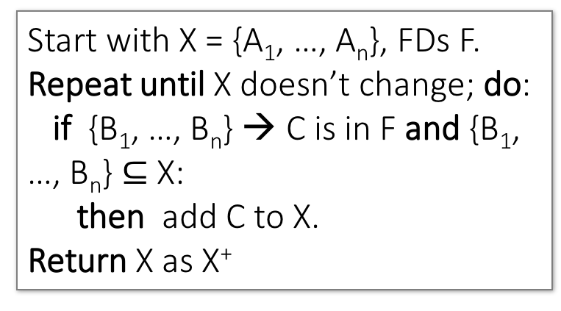
Closure Algorithm
Lecture 10 > Section 2 > Closures
Start with X = {A₁, …, A_{n}}, FDs F.
Repeat until X doesn’t change; do:
if {B₁, …, B_{n}} → C is in F and {B₁, …, B_{n}} $⊆$ X:
then add C to X.
Return X as X⁺
{name, category}⁺ =
{name, category}
F =
{name} → {color}
{category} → {dept}
{color, category} → {price}

Slide 5
Closure Algorithm
Lecture 10 > Section 2 > Closures
Start with X = {A₁, …, A_{n}}, FDs F.
Repeat until X doesn’t change; do:
if {B₁, …, B_{n}} → C is in F and {B₁, …, B_{n}} $⊆$ X:
then add C to X.
Return X as X⁺
{name, category}⁺ =
{name, category}
{name, category}⁺ =
{name, category, color}
F =
{name} → {color}
{category} → {dept}
{color, category} → {price}

Slide 6
Closure Algorithm
Lecture 10 > Section 2 > Closures
Start with X = {A₁, …, A_{n}}, FDs F.
Repeat until X doesn’t change; do:
if {B₁, …, B_{n}} → C is in F and {B₁, …, B_{n}} $⊆$ X:
then add C to X.
Return X as X⁺
{name, category}⁺ =
{name, category}
{name, category}⁺ =
{name, category, color}
F =
{name, category}⁺ =
{name, category, color, dept}
{name} → {color}
{category} → {dept}
{color, category} → {price}

Slide 7
Closure Algorithm
Lecture 10 > Section 2 > Closures
Start with X = {A₁, …, A_{n}}, FDs F.
Repeat until X doesn’t change; do:
if {B₁, …, B_{n}} → C is in F and {B₁, …, B_{n}} $⊆$ X:
then add C to X.
Return X as X⁺
{name, category}⁺ =
{name, category}
{name, category}⁺ =
{name, category, color}
F =
{name, category}⁺ =
{name, category, color, dept}
{name} → {color}
{category} → {dept}
{color, category} → {price}
{name, category}⁺ =
{name, category, color, dept, price}

Slide 8
Example
Lecture 10 > Section 2 > Closures
R(A,B,C,D,E,F)
{A,B} → {C}
{A,D} → {E}
{B} → {D}
{A,F} → {B}
Compute {A,B}⁺ = {A, B, }
Compute {A, F}⁺ = {A, F, }

Slide 9
Example
Lecture 10 > Section 2 > Closures
R(A,B,C,D,E,F)
{A,B} → {C}
{A,D} → {E}
{B} → {D}
{A,F} → {B}
Compute {A,B}⁺ = {A, B, C, D }
Compute {A, F}⁺ = {A, F, B }

Slide 10
Example
Lecture 10 > Section 2 > Closures
R(A,B,C,D,E,F)
{A,B} → {C}
{A,D} → {E}
{B} → {D}
{A,F} → {B}
Compute {A,B}⁺ = {A, B, C, D, E}
Compute {A, F}⁺ = {A, B, C, D, E, F}

Slide 11
1. Closures, Superkeys & Keys
Lecture 11 > Section 1

Slide 12
What you will learn about in this section
Lecture 11 > Section 1
Closures Pt. II
Superkeys & Keys
ACTIVITY: The key or a key?

Slide 13
Why Do We Need the Closure?
Lecture 11 > Section 1 > Closures Pt. II
With closure we can find all FD’s easily
To check if X → A
Compute X⁺
Check if A ∈ X⁺
Note here that X is a set of attributes, but A is a single attribute. Why does considering FDs of this form suffice?
Recall the Split/combine rule:
X → A₁, …, X → A_{n}
implies
X → {A₁, …, A_{n}}

Slide 14
Using Closure to Infer ALL FDs
Lecture 11 > Section 1 > Closures Pt. II
Example:
Given F =
{A,B} → C {A,D} → B
{B} → D
Step 1: Compute X⁺, for every set of attributes X:
{A}⁺ = {A}
{B}⁺ = {B,D}
{C}⁺ = {C}
{D}⁺ = {D}
{A,B}⁺ = {A,B,C,D}
{A,C}⁺ = {A,C}
{A,D}⁺ = {A,B,C,D}
{A,B,C}⁺ = {A,B,D}⁺ = {A,C,D}⁺ = {A,B,C,D} {B,C,D}⁺ = {B,C,D}
{A,B,C,D}⁺ = {A,B,C,D}
No need to compute all of these- why?

Slide 15
Using Closure to Infer ALL FDs
Lecture 11 > Section 1 > Closures Pt. II
Example:
Given F =
{A,B} → C {A,D} → B
{B} → D
Step 1: Compute X⁺, for every set of attributes X:
{A}⁺ = {A}, {B}⁺ = {B,D}, {C}⁺ = {C}, {D}⁺ = {D}, {A,B}⁺ = {A,B,C,D}, {A,C}⁺ = {A,C}, {A,D}⁺ = {A,B,C,D}, {A,B,C}⁺ = {A,B,D}⁺ = {A,C,D}⁺ = {A,B,C,D}, {B,C,D}⁺ = {B,C,D}, {A,B,C,D}⁺ = {A,B,C,D}
Step 2: Enumerate all FDs X → Y, s.t. Y ⊆ X⁺ and X ∩ Y = ∅:
{A,B} → {C,D}, {A,D} → {B,C},
{A,B,C} → {D}, {A,B,D} → {C},
{A,C,D} → {B}

Slide 16
Using Closure to Infer ALL FDs
Lecture 11 > Section 1 > Closures Pt. II
Example:
Given F =
{A,B} → C {A,D} → B
{B} → D
Step 1: Compute X⁺, for every set of attributes X:
{A}⁺ = {A}, {B}⁺ = {B,D}, {C}⁺ = {C}, {D}⁺ = {D}, {A,B}⁺ = {A,B,C,D}, {A,C}⁺ = {A,C}, {A,D}⁺ = {A,B,C,D}, {A,B,C}⁺ = {A,B,D}⁺ = {A,C,D}⁺ = {A,B,C,D}, {B,C,D}⁺ = {B,C,D}, {A,B,C,D}⁺ = {A,B,C,D}
Step 2: Enumerate all FDs X → Y, s.t. Y ⊆ X⁺ and X ∩ Y = ∅:
“Y is in the closure of X”
{A,B} → {C,D}, {A,D} → {B,C},
{A,B,C} → {D}, {A,B,D} → {C},
{A,C,D} → {B}

Slide 17
Using Closure to Infer ALL FDs
Lecture 11 > Section 1 > Closures Pt. II
Example:
Given F =
{A,B} → C {A,D} → B
{B} → D
Step 1: Compute X⁺, for every set of attributes X:
{A}⁺ = {A}, {B}⁺ = {B,D}, {C}⁺ = {C}, {D}⁺ = {D}, {A,B}⁺ = {A,B,C,D}, {A,C}⁺ = {A,C}, {A,D}⁺ = {A,B,C,D}, {A,B,C}⁺ = {A,B,D}⁺ = {A,C,D}⁺ = {A,B,C,D}, {B,C,D}⁺ = {B,C,D}, {A,B,C,D}⁺ = {A,B,C,D}
Step 2: Enumerate all FDs X → Y, s.t. Y ⊆ X⁺ and X ∩ Y = ∅:
The FD X → Y is non-trivial
{A,B} → {C,D}, {A,D} → {B,C},
{A,B,C} → {D}, {A,B,D} → {C},
{A,C,D} → {B} , {B} → {D}

Slide 18
Superkeys and Keys
Lecture 11 > Section 1 > Superkeys & Keys

Slide 19
Keys and Superkeys
Lecture 11 > Section 1 > Superkeys & Keys
A superkey is a set of attributes A₁, …, A_{n} s.t.
for any other attribute B in R,
we have {A₁, …, A_{n}} → B
I.e. all attributes are functionally determined by a superkey
A key is a minimal superkey
This means that no subset of a key is also a superkey (i.e., dropping any attribute from the key makes it no longer a superkey)

Slide 20
Finding Keys and Superkeys
Lecture 11 > Section 1 > Superkeys & Keys
For each set of attributes X
Compute X⁺
If X⁺ = set of all attributes then X is a superkey
If X is minimal, then it is a key

Slide 21
Example of Finding Keys
Lecture 11 > Section 1 > Superkeys & Keys
Product(name, price, category, color)
{name, category} → price
{category} → color
What is a key?

Slide 22
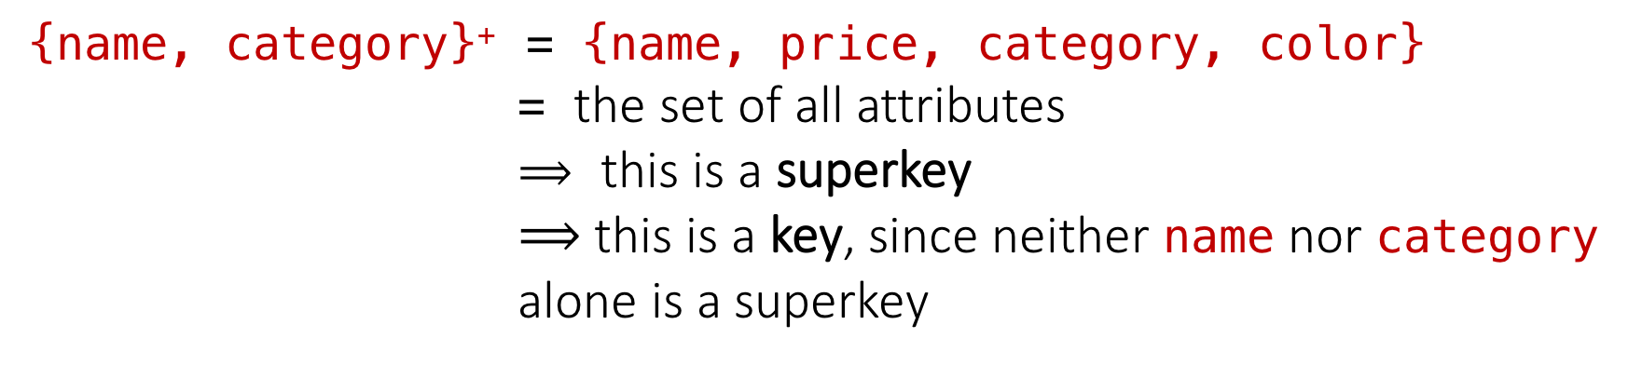
Example of Keys
Lecture 11 > Section 1 > Superkeys & Keys
Product(name, price, category, color)
{name, category} → price
{category} → color
{name, category}⁺ = {name, price, category, color}
= the set of all attributes
$⟹$ this is a superkey
$⟹$ this is a key, since neither name nor category alone is a superkey

Slide 23
Activity-11-1.ipynb
Lecture 11 > Section 1 > ACTIVITY

