Slide 1
Lectures 14 & 15: Transactions تراکنش‌ها
Lectures 14 & 15

Slide 2
Goals for this pair of lectures
Lectures 14 & 15
Transactions are a programming abstraction that enables the DBMS to handle recovery and concurrency for users.
Application: Transactions are critical for users
Even casual users of data processing systems!
Fundamentals: The basics of how TXNs work
Transaction processing is part of the debate around new data processing systems
Give you enough information to understand how TXNs work, and the main concerns with using them

Slide 3
Lecture 14: Intro to Transactions & Logging مقدمه‌ای بر تراکنش‌ها و لاگ کردن
Lecture 14

Slide 4
Today’s Lecture
Lecture 14
Transactions – تراکنش‌ها
Properties of Transactions: ACID – ویژگی‌های تراکنش‌ها
Logging – لاگ کردن

Slide 5
1. Transactions – تراکنش‌ها
Lecture 14 > Section 1

Slide 6
What you will learn about in this section
Lecture 14 > Section 1
Our “model” of the DBMS / computer – مدل ما از سیستم پایگاه‌داده و رایانه
Transactions basics – پایه‌های تراکنش‌ها
Motivation: Recovery & Durability – انگیزه: بازیابی و ثبات
Motivation: Concurrency [next lecture] – انگیزه: همزمانی

Slide 7
High-level: Disk vs. Main Memory
Lecture 14 > Section 3 > Our model
Disk:
Slow - کند
Sequential access
(although fast sequential reads)
Durable - پایا
We will assume that once on disk, data is safe!
Cheap - ارزان
Cylinder
Spindle
Disk head
Tracks
Sector
Arm movement
Platters
Arm assembly

Slide 8
Lecture 14 > Section 3 > Our model
High-level: Disk vs. Main Memory
Random Access Memory (RAM) or Main Memory:
Fast - سریع
Random access, byte addressable
~10x faster for sequential access
~100,000x faster for random access!
Volatile - فرّار
Data can be lost if e.g. crash occurs, power goes out, etc!
Expensive - گران
For $100, get 16GB of RAM vs. 2TB of disk!

Slide 9
Our model: Three Types of Regions of Memory
Lecture 14 > Section 3 > Our model
 | Local | Global
Main Memory (RAM)
Disk
Local: In our model each process in a DBMS has its own local memory, where it stores values that only it “sees”
Global: Each process can read from / write to shared data in main memory
Disk: Global memory can read from / flush to disk
Log: Assume on stable disk storage- spans both main memory and disk…
1
2
4
3
Log is a sequence from main memory -> disk
“Flushing to disk” = writing to disk from main memory

Slide 10
Lecture 14 > Section 3 > Our model
High-level: Disk vs. Main Memory
Keep in mind the tradeoffs here as motivation for the mechanisms we introduce
Main memory: fast but limited capacity, volatile
Vs. Disk: slow but large capacity, durable
How do we effectively utilize both ensuring certain critical guarantees?

Slide 11
Transactions – تراکنش‌ها
Lecture 14 > Section 1 > Transactions Basics

Slide 12
Transactions: Basic Definition
Lecture 14 > Section 1 > Transactions Basics
A transaction (“TXN”) is a sequence of one or more operations (reads or writes) which reflects a single real-world transition.
In the real world, a TXN either happened completely or not at all
START TRANSACTION
UPDATE Product SET Price = Price – 1.99 WHERE pname = ‘Gizmo’
COMMIT

Slide 13
Transactions: Basic Definition
Lecture 14 > Section 1 > Transactions Basics
A transaction (“TXN”) is a sequence of one or more operations (reads or writes) which reflects a single real-world transition.
In the real world, a TXN either happened completely or not at all
Examples:
Transfer money between accounts
Purchase a group of products
Register for a class (either waitlist or allocated)

Slide 14
Transactions in SQL
Lecture 14 > Section 1 > Transactions Basics
In “ad-hoc” SQL:
Default: each statement = one transaction
In a program, multiple statements can be grouped together as a transaction:
START TRANSACTION
UPDATE Bank SET amount = amount – 100
WHERE name = ‘Bob’
UPDATE Bank SET amount = amount + 100
WHERE name = ‘Joe’
COMMIT

Slide 15
Model of Transaction for Our Class
Lecture 14 > Section 1 > Transactions Basics
Note: For our class, we assume that the DBMS only sees reads and writes to data
User may do much more
In real systems, databases do have more info...

Slide 16
Motivation for Transactions
Lecture 14 > Section 1 > Motivation
Grouping user actions (reads & writes) into transactions helps with two goals:
Recovery & Durability (بازیابی و پایایی): Keeping the DBMS data consistent (سازگار) and durable (پایا) in the face of crashes, aborts, system shutdowns, etc.
Concurrency (همزمانی): Achieving better performance by parallelizing TXNs without creating anomalies
This lecture!
Next lecture

Slide 17
Motivation
Lecture 14 > Section 1 > Motivation: Recovery & Durability
1. Recovery & Durability of user data is essential for reliable DBMS usage
The DBMS may experience crashes (e.g. power outages, etc.)
Individual TXNs may be aborted (e.g. by the user)
Idea: Make sure that TXNs are either durably stored in full, or not at all; keep log to be able to “roll-back” TXNs

Slide 18
Protection against crashes / aborts
Lecture 14 > Section 1 > Motivation: Recovery & Durability
Client 1:
INSERT INTO SmallProduct(name, price) SELECT pname, price FROM Product
WHERE price <= 0.99
DELETE Product WHERE price <=0.99
Crash / abort!
What goes wrong?

Slide 19
Protection against crashes / aborts
Lecture 14 > Section 1 > Motivation: Recovery & Durability
Client 1:
START TRANSACTION
INSERT INTO SmallProduct(name, price) SELECT pname, price FROM Product
WHERE price <= 0.99
DELETE Product WHERE price <=0.99
COMMIT OR ROLLBACK
Now we’d be fine! We’ll see how / why this lecture

Slide 20
Motivation
Lecture 14 > Section 1 > Motivation: Concurrency
2. Concurrent execution of user programs is essential for good DBMS performance.
Disk accesses may be frequent and slow- optimize for throughput (# of TXNs), trade for latency (time for any one TXN)
Users should still be able to execute TXNs as if in isolation and such that consistency is maintained
Idea: Have the DBMS handle running several user TXNs concurrently, in order to keep CPUs humming…

Slide 21
Multiple users: single statements
Lecture 14 > Section 1 > Motivation: Concurrency
Client 1: UPDATE Product SET Price = Price – 1.99 WHERE pname = ‘Gizmo’ Client 2: UPDATE Product
SET Price = Price*0.5 WHERE pname=‘Gizmo’
Two managers attempt to discount products concurrently- What could go wrong?

Slide 22
Multiple users: single statements
Lecture 14 > Section 1 > Motivation: Concurrency
Client 1: START TRANSACTION
UPDATE Product SET Price = Price – 1.99 WHERE pname = ‘Gizmo’
COMMIT Client 2: START TRANSACTION
UPDATE Product SET Price = Price*0.5 WHERE pname=‘Gizmo’
COMMIT
Now works like a charm- we’ll see how / why next lecture…

Slide 23
2. Properties of Transactions ویژگی‌های تراکنش‌ها
Lecture 14 > Section 2

Slide 24
What you will learn about in this section
Lecture 14 > Section 2
Atomicity – تجزیه‌ناپذیری
Consistency - سازگاری
Isolation - انزوا
Durability - پایایی
ACTIVITY?

Slide 25
Transaction Properties: ACID
Lecture 14 > Section 2
Atomic – تجزیه ناپذیر
State shows either all the effects of txn, or none of them
Consistent - سازگار
Txn moves from a state where integrity holds, to another where integrity holds
Isolated - منزوی
Effect of txns is the same as txns running one after another (ie looks like batch mode)
Durable - پایا
Once a txn has committed, its effects remain in the database
ACID continues to be a source of great debate!

Slide 26
ACID: Atomicity
Lecture 14 > Section 2 > Atomicity
TXN’s activities are atomic: all or nothing
Intuitively: in the real world, a transaction is something that would either occur completely or not at all
Two possible outcomes for a TXN
It commits: all the changes are made
It aborts: no changes are made

Slide 27
ACID: Consistency
Lecture 14 > Section 2 > Consistency
The tables must always satisfy user-specified integrity constraints
Examples:
Account number is unique
Stock amount can’t be negative
Sum of debits and of credits is 0
How consistency is achieved:
Programmer makes sure a txn takes a consistent state to a consistent state
System makes sure that the txn is atomic

Slide 28
ACID: Isolation
Lecture 14 > Section 2 > Isolation
A transaction executes concurrently with other transactions
Isolation: the effect is as if each transaction executes in isolation of the others.
E.g. Should not be able to observe changes from other transactions during the run

Slide 29
ACID: Durability
Lecture 14 > Section 2 > Durability
The effect of a TXN must continue to exist (“persist”) after the TXN
And after the whole program has terminated
And even if there are power failures, crashes, etc.
And etc…
Means: Write data to disk
Change on the horizon? Non-Volatile Ram (NVRam). Byte addressable.

Slide 30
Challenges for ACID properties
Lecture 14 > Section 2
In spite of failures: Power failures, but not media failures
Users may abort the program: need to “rollback the changes”
Need to log what happened
Many users executing concurrently
Can be solved via locking (we’ll see this next lecture!)
This lecture
Next lecture
And all this with… Performance!!

Slide 31
A Note: ACID is contentious!
Lecture 14 > Section 2
Many debates over ACID, both historically and currently
Many newer “NoSQL” DBMSs relax ACID
In turn, now “NewSQL” reintroduces ACID compliance to NoSQL-style DBMSs…
ACID is an extremely important & successful paradigm, but still debated!

Slide 32
Goal for this lecture: Ensuring Atomicity & Durability
Lecture 14 > Section 3 > Motivation & basics
ACID
Atomicity:
TXNs should either happen completely or not at all
If abort / crash during TXN, no effects should be seen
TXN 1
Crash / abort
No changes persisted
Durability:
If DBMS stops running, changes due to completed TXNs should all persist
Just store on stable disk
TXN 2
All changes persisted
We’ll focus on how to accomplish atomicity (via logging)

Slide 33
The Log
Lecture 14 > Section 3 > Motivation & basics
Is a list of modifications
Log is duplexed and archived on stable storage.
Can force write entries to disk
A page goes to disk.
All log activities handled transparently by the DBMS.
Assume we don’t lose it!

Slide 34
Basic Idea: (Physical) Logging
Lecture 14 > Section 3 > Motivation & basics
Record UNDO information for every update!
Sequential writes to log
Minimal info (diff) written to log
The log consists of an ordered list of actions
Log record contains:
<XID, location, old data, new data>
This is sufficient to UNDO any transaction!
Notes:
7

Slide 35
Why do we need logging for atomicity?
Lecture 14 > Section 3 > Motivation & basics
Couldn’t we just write TXN to disk only once whole TXN complete?
Then, if abort / crash and TXN not complete, it has no effect- atomicity!
With unlimited memory and time, this could work…
However, we need to log partial results of TXNs because of:
Memory constraints (enough space for full TXN??)
Time constraints (what if one TXN takes very long?)
We need to write partial results to disk!
…And so we need a log to be able to undo these partial results!
Notes:
7

Slide 36
3. Atomicity & Durability via Logging
Lecture 14 > Section 3

Slide 37
What you will learn about in this section
Lecture 14 > Section 3
Logging: An animation of commit protocols

Slide 38
A Picture of Logging
Lecture 14 > Section 3 > Logging commit protocol

Slide 39
A picture of logging
Lecture 14 > Section 3 > Logging commit protocol
T: R(A), W(A)
T
Main Memory
A=0
Log
B=5
Data on Disk
Log on Disk
A=0

Slide 40
A picture of logging
Lecture 14 > Section 3 > Logging commit protocol
T: R(A), W(A)
A: 0→1
Main Memory
T
A=1
Log
B=5
Data on Disk
Log on Disk
A=0

Slide 41
A picture of logging
Lecture 14 > Section 3 > Logging commit protocol
T: R(A), W(A)
A: 0→1
Main Memory
T
A=1
Log
Operation recorded in log in main memory!
B=5
Data on Disk
Log on Disk
A=0

Slide 42
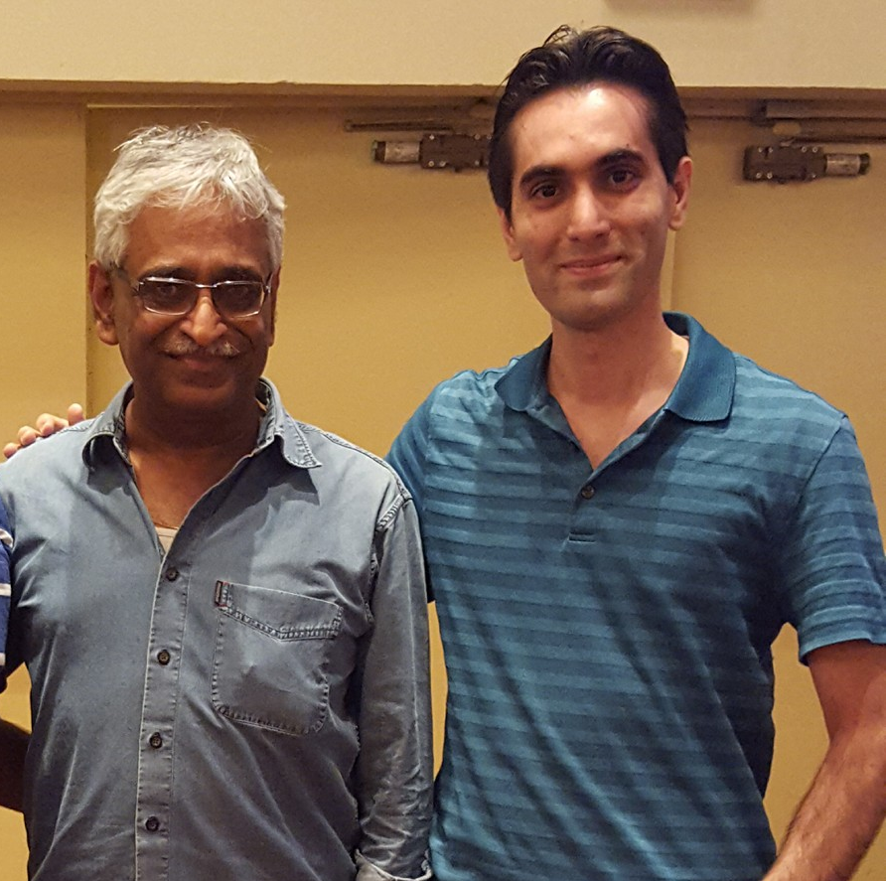
What is the correct way to write this all to disk?
We’ll look at the Write-Ahead Logging (WAL) protocol
We’ll see why it works by looking at other protocols which are incorrect!
Remember: Key idea is to ensure durability while maintaining our ability to “undo”!

Slide 43
Write-Ahead Logging (WAL) TXN Commit Protocol
Lecture 14 > Section 3 > Logging commit protocol

Slide 44
Transaction Commit Process
Lecture 14 > Section 3 > Logging commit protocol
FORCE Write commit record to log
All log records up to last update from this TX are FORCED
Commit() returns
Transaction is committed once commit log record is on stable storage

Slide 45
Incorrect Commit Protocol #1
Lecture 14 > Section 3 > Logging commit protocol
Let’s try committing before we’ve written either data or log to disk…
T: R(A), W(A)
A: 0→1
Main Memory
T
A=1
Log
OK, Commit!
B=5
If we crash now, is T durable?
Data on Disk
Log on Disk
Lost T’s update!
A=0

Slide 46
Incorrect Commit Protocol #2
Lecture 14 > Section 3 > Logging commit protocol
Let’s try committing after we’ve written data but before we’ve written log to disk…
T: R(A), W(A)
A: 0→1
Main Memory
T
A=1
Log
OK, Commit!
B=5
If we crash now, is T durable? Yes! Except…
Data on Disk
Log on Disk
How do we know whether T was committed??
A=0

Slide 47
Improved Commit Protocol (WAL)
Lecture 14 > Section 3 > Logging commit protocol

Slide 48
Write-ahead Logging (WAL) Commit Protocol
Lecture 14 > Section 3 > Logging commit protocol
This time, let’s try committing after we’ve written log to disk but before we’ve written data to disk… this is WAL!
T: R(A), W(A)
A: 0→1
Main Memory
T
A=1
Log
B=5
OK, Commit!
If we crash now, is T durable?
Data on Disk
Log on Disk
A=0

Slide 49
Write-ahead Logging (WAL) Commit Protocol
Lecture 14 > Section 3 > Logging commit protocol
This time, let’s try committing after we’ve written log to disk but before we’ve written data to disk… this is WAL!
T: R(A), W(A)
T
Main Memory
OK, Commit!
A: 0→1
If we crash now, is T durable?
Data on Disk
Log on Disk
A=0
A=1
USE THE LOG!

Slide 50
Write-Ahead Logging (WAL)
Lecture 14 > Section 3 > Logging commit protocol
DB uses Write-Ahead Logging (WAL) Protocol:
Must force log record for an update before the corresponding data page goes to storage
Must write all log records for a TX before commit
Each update is logged! Why not reads?
→ Atomicity
→ Durability

Slide 51
Logging Summary
Lecture 14 > Section 3 > Logging commit protocol
If DB says TX commits, TX effect remains after database crash
DB can undo actions and help us with atomicity
This is only half the story…

