Slide 1


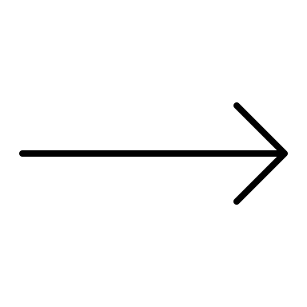



Treatment A
Treatment B

Slide 2

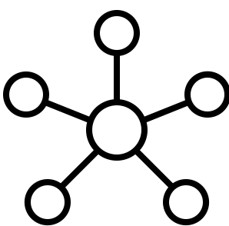


Slide 3
Gene | Frequency in runs
PDRM1O | 4
MED17 | 4
HEATR5B | 4
DDX6 | 4
ESR2 | 4
Gene | Frequency in runs
CAPZA1 | 2
NOLC1 | 2
RRS1 | 2
PRPF8 | 2
VHL | 2
From gene level data
From transcript level data

