Slide 1
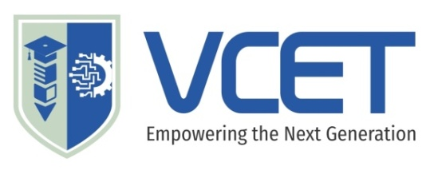

VELALAR COLLEGE OF ENGINEERING AND TECHNOLOGY (AUTONOMOUS)
THINDAL, ERODE-638012
DEPARTMENT OF COMPUTER SCIENCE AND ENGINEERING
AI – Powered Distributed Personal Data Vault
ZEROTH REVIEW
TEAM MEMBERS :
NIKKITHA ROSINI AMSHAVEL(23CSR062)
YAZHINI D (23CSR116)
SHARMILA P(23CSR088)
UNDER THE GUIDANCE OF:
N.SEETHA
AP/CSE

Slide 2
TITLE
AI – Powered Distributed Personal Data Vault
Domain : Artificial Intelligence And Machine Learning , Cloud and Distributed System

Slide 3
ABSTRACT
The AI-Powered Distributed Personal Data Vault is a unified platform that integrates personal data from multiple cloud services, local devices, and productivity applications into a single intelligent system.
By combining distributed storage, AI-powered semantic search, Retrieval-Augmented Generation (RAG), and secure synchronization, the platform enables efficient data retrieval, intelligent organization, fault-tolerant storage, and seamless management across heterogeneous data sources.

Slide 4
SCOPE AND OBJECTIVE
Scope
Integrate data from multiple platforms into one system.
Enable AI-powered natural language search.
Ensure reliable distributed storage.
Automate file organization and storage optimization
.
Objectives
Develop a unified personal data vault.
Implement intelligent AI-based file retrieval.
Provide fault-tolerant data management.
Improve storage efficiency and user productivity.

Slide 5
EXISTING SYSTEM
Data is stored across multiple independent platforms (Google Drive, Dropbox, OneDrive, GitHub, Notion, local storage), making management difficult.
Existing systems provide only platform-specific, keyword-based search, with no unified search across all data sources.
Storage management is manual, with no AI-based file organization, duplicate detection, or storage optimization.
Limited reliability and fault tolerance, as most existing solutions depend on individual service providers and lack intelligent data replication.

Slide 6
PROPOSED WORK
Develop a centralized AI-powered personal data vault to manage data from multiple cloud platforms, local devices, and applications.
Implement AI-based semantic search for quick and accurate file retrieval using natural language.
Build a secure distributed storage system with authentication, encryption, and data backup for reliability.
Add intelligent features like automatic file organization, duplicate detection, version control, AI summaries, and storage optimization.

Slide 7
THANK YOU

