Slide 1


Design Thinking & Innovation
StudySpark — AI-Powered Personalized Study Companion
Review - I & Working Prototype Showcase
FACULTY MENTOR
TEAM
Name: Sowmiya S
Team Name / Batch No: Nexus / 15
Year & Dept / Section: II / AIDS / A
Designation: Assistant Professor
Members: 1. Aswathy J — 25AD018
Department: Artificial Intelligence And Data Science
2. Bragalya Yazhini KM — 25AD026
3. Harini S— 25AD063
Notes:
Introduce the team and the mentor. Keep this to 30 seconds.

Slide 2



Empathy & Problem statement
OUR USER
THEIR TOP PAIN POINT
WHAT WE VALIDATED
First-year engineering students (18–20 years) who struggle with managing multiple subjects, assignments, and exam preparation.
Students find it difficult to identify weak topics, manage study time, and follow a consistent study plan.
Interviewed first-year students.
Observed poor time management and last-minute studying.
Most students wanted personalized study guidance instead of generic planners.
PROBLEM STATEMENT
First-year engineering students need a way to identify weak topics and create personalized study plans because they struggle with time management and effective exam preparation.
HOW MIGHT WE
How might we help first-year engineering students create personalized study plans so that they can manage time effectively and improve academic performance?
Notes:
This slide only recaps. Everything after this is new work from the Ideate stage.

Slide 3


Solution
AI-Based Personalized Learning System
StudySpark: Intelligent Adaptive Learning & Exam Preparation System
StudySpark is an all-in-one AI study companion engineered to solve student study paralysis, weak-topic blindness, and unstructured exam preparation. The system creates a continuous, adaptive learning feedback loop:
• Adaptive Spaced-Repetition Study Planner: Automatically schedules daily study sessions, balances multi-subject workloads, and features a 'One-Click Smart Re-Plan' when tasks are missed.
• AI-Grounded Active Recall & Quizzes: Extracts key concepts from uploaded lecture PDFs, notes, and YouTube videos, generating practice quizzes with instant feedback.
• Deterministic Weak-Topic Detector: Analyzes quiz attempts and automatically flags topics under 60% accuracy, generating immediate targeted practice drills.
• Peer Study Rooms & Focus Workspace: Combines live WebRTC peer video rooms with synchronized code execution, ambient audio focus timers, and a 24/7 AI course tutor.
Notes:
This is the slide reviewers remember. Say the pitch line out loud, clearly.

Slide 4

Concept Sketch / Block diagram
A hand-drawn sketch is perfectly acceptable — clarity matters more than polish and AI generated Images.
1. CLIENT & PWA PRESENTATION LAYER
Tech: React 19 · TypeScript · Tailwind CSS · Vite PWA · Lucide Icons · Recharts Visualizations
• Responsive Dashboard & Quick Action Tiles • Pomodoro Timer with Ambient Audio • Dark / Light Mode Settings
2. ADAPTIVE INTELLIGENCE & PEDAGOGICAL ENGINE
Tech: Anthropic Claude 3.5 Sonnet API · SuperMemo SM-2 Algorithm · Deterministic Weak-Topic Detection
• Document Concept Extraction (PDF.js / Mammoth) • Active Recall Quiz Generator • Rigorous Exam Simulation Mode
3. REAL-TIME COLLABORATION & STUDY TOOLS
Tech: WebRTC Peer-to-Peer Mesh · Live Multi-Language Code Sandbox · Web Audio API Soundscapes
• Live Study Video/Audio Calls • Synchronized Collaborative Code Execution • 24/7 Contextual AI Course Tutor
4. DATA PERSISTENCE & SYSTEM SCHEDULER
Tech: Supabase PostgreSQL · IndexedDB (idb) Offline Cache · Browser Notification Scheduler
• Cloud Progress Sync • 100% Offline Study Capability • Background 30s Study & Exam Reminder Dispatcher
Notes:
Four frames: problem → user meets solution → user uses it → outcome.

Slide 5
Storyboard
BEFORE — A DAY IN THEIR LIFE TODAY
AFTER — A DAY WITH OUR SOLUTION
Every evening after college, Ananya, a first-year engineering student, sits down to study. She has assignments, five subjects, and an upcoming exam, but she doesn't know where to begin. She spends nearly 30 minutes deciding what to study, watches random YouTube videos, and keeps switching between subjects. By the end of the day, she feels stressed because she hasn't completed much and worries about getting low marks.
After logging into the AI-Based Personalized Learning System, Ananya receives a personalized study plan based on her weak subjects and upcoming exams. The app recommends the best videos and practice questions, sends reminders to stay on track, and tracks her daily progress. She follows the plan step by step, studies more efficiently, and feels confident before her exams. Instead of feeling confused and stressed, she is organized, motivated, and gradually improves her academic performance.
Notes:
Read the BEFORE story aloud first, then the AFTER story. Use real details from your field visit — names, times, what the person actually said. A story full of [ blanks ] or generic phrases shows the team never met a real user.

Slide 6

From Pain Point to Feature
PAIN POINT (from Empathy Map)
OUR FEATURE THAT SOLVES IT
Doesn't know what to study
AI Study Planner
Weak topics not identified
Weak Topic Detector
Too many learning resources
Resource Recommendation
Low motivation
Rewards & Gamification
Notes:
If a feature has no matching pain point, it is a feature you invented — drop it.

Slide 7


Existing Works
WHAT USERS DO TODAY
WHY IT FALLS SHORT
WHAT WE DO DIFFERENTLY
Google Calendar
Students create study schedules and set reminders manually.
Not personalized
Gives the same study plan to every student without considering individual strengths and weaknesses.
AI-generated study plans
Creates personalized daily schedules based on each student's learning progress.
YouTube
Students watch educational videos to learn concepts.
Doesn’t identify weak topics
Cannot analyze student performance to find subjects or topics that need more practice.
Weak topic detection
Automatically identifies weak areas using quiz and performance analysis.
Notion Study Planner
Students organize notes, tasks, and study
Plans.
Doesn't recommend study resources intelligently
Doesn't suggest the most relevant videos, notes, or practice questions based on the student's learning needs.
Personalized recommendations
Suggests the most relevant study materials for every student.
OUR ONE-LINE DIFFERENTIATOR
Unlike existing study planners, our solution continuously adapts to each student's performance and learning needs.
Notes:
Novelty is a scoring criterion. Be specific about the gap.

Slide 8

Feasibility Analysis
TECHNOLOGY / MATERIALS
SKILLS WE HAVE
RISKS & ASSUMPTIONS
UI/UX & Design Thinking
React 19 Frontend Dev
PWA & Offline Architecture
Prompt Engineering
Algorithm Implementation
React 19 & TypeScript
Vite & Tailwind CSS
Supabase (PostgreSQL)
IndexedDB Offline Cache
Anthropic Claude 3.5 Sonnet API
WebRTC P2P Mesh
Vite PWA Service Worker
Recharts Visualizations
8
Wrong recommendations
Train AI with more data
8
Low user engagement
Gamification
SKILLS WE NEED
LLM Fine-Tuning & RAG
WebRTC Signaling Scale
Speech-to-Text Integration
College LMS API Sync
8
Limited internet
Offline study plan cache
Notes:
Naming a risk is a strength, not a weakness.

Slide 9
Cost Estimate & Bill of Materials
Item | Qty | Cost | Item | Qty
Domain | 1 | ₹800 | Domain | 1
Firebase | 1 | ₹0 | Firebase | 1
Cloud Hosting | 1 | ₹1,500 | Cloud Hosting | 1
UI Design | 1 | ₹0 | UI Design | 1
Testing | 1 | ₹500 | Testing | 1
Domain | 1 | ₹800 | Domain | 1
Total Estimated Cost : ₹2,800
Notes:
Approximate figures are fine. Show the thinking, not precision.

Slide 10


Impact & SDG Mapping
WHO BENEFITS
MEASURABLE IMPACT
College students seeking personalized learning support.
Teachers, parents, and educational institutions.
Saves 2–3 hours per week by generating personalized study plans. Improves academic performance through targeted learning. Increases study consistency and reduces exam-related stress by helping students focus on weak topics.
UN SUSTAINABLE DEVELOPMENT GOALS
1 No Poverty
2 Zero Hunger
3 Good Health
4 Quality Education
5 Gender Equality
6 Clean Water
7 Clean Energy
8 Decent Work
9 Industry & Innovation
10 Reduced Inequalities
11 Sustainable Cities
12 Responsible Consumption
13 Climate Action
14 Life Below Water
15 Life on Land
16 Peace & Justice
17 Partnerships
Our solution maps to SDG 4 because Provides personalized learning support and improves educational outcomes through AI.
Notes:
Pick one primary SDG. Two at most. Do not tick every box.

Slide 11
Team Contribution
Every member should be able to speak to their part.
Member Name | Roll No. | Role in the Team | Contribution to Ideation | Next Task
ASWATHY J | 25AD018 | AI/ML Lead & Content Architect | Engineered Claude prompt pipelines for syllabus-grounded quiz generation; built the Weak Topic Detector (<60% accuracy) and 24/7 AI Course Tutor. | Fine-tune prompt token efficiency and implement speech-to-text lecture note generation.
BRAGALYA YAZHINI KM | 25AD026 | Full-Stack Dev & UI/UX Lead | Developed responsive React 19 + Tailwind interface; built live WebRTC Peer Study Rooms with real-time pair-coding sandbox, Pomodoro audio timer, and PWA. | Deploy dedicated signaling server for study rooms and expand ambient soundscape library.
HARINI S | 25AD063 | System Architect & Testing Lead | Architected Supabase schema and IndexedDB local caching; implemented SuperMemo SM-2 spaced repetition flashcards; conducted student interviews and pilot testing. | Integrate Anna University timetable sync and expand multi-subject diagnostic datasets.
Notes:
Team work is a scored criterion. Everyone should speak at least once.

Slide 12
Roadmap
What happens between today and the Prototype review. - Sample
STEP 1
STEP 3
Finalise design
Build first version
Student Empathy & UI Wireframes (Completed)
Full-Stack PWA & Peer Rooms (Completed)
12
12
12
12
STEP 2
STEP 4
Source materials
Test with the user
AI Engine & Active Recall Quizzes (Completed)
Beta Pilot Testing & LMS Sync (In Progress)
WHAT WE NEED HELP WITH
AI model training - Mentor feedback - User testing with students
Notes:
End with a clear ask. Mentors can only help if you name what you need.

Slide 13
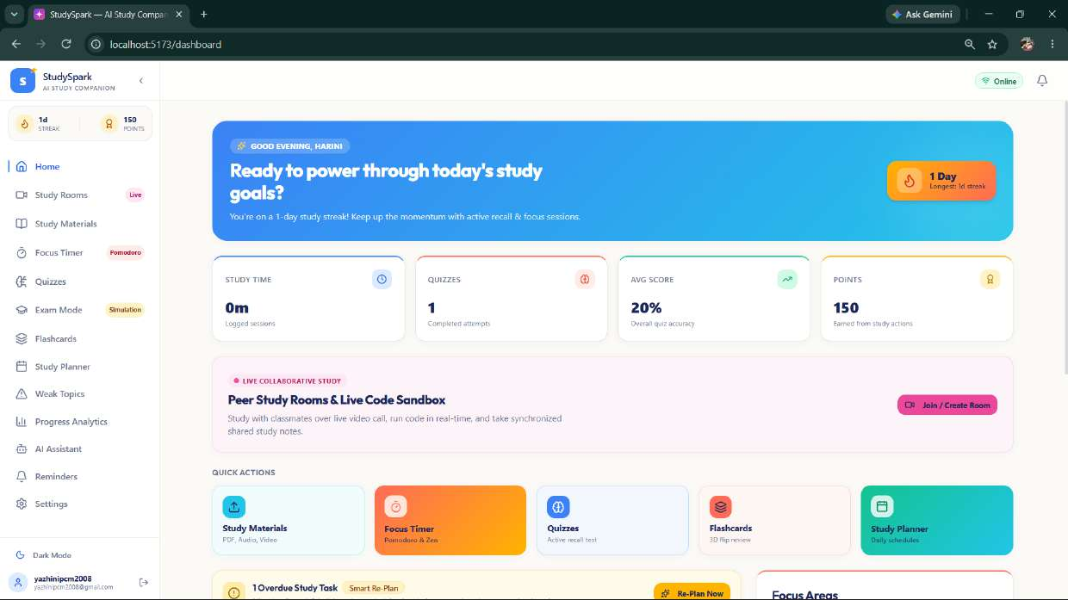
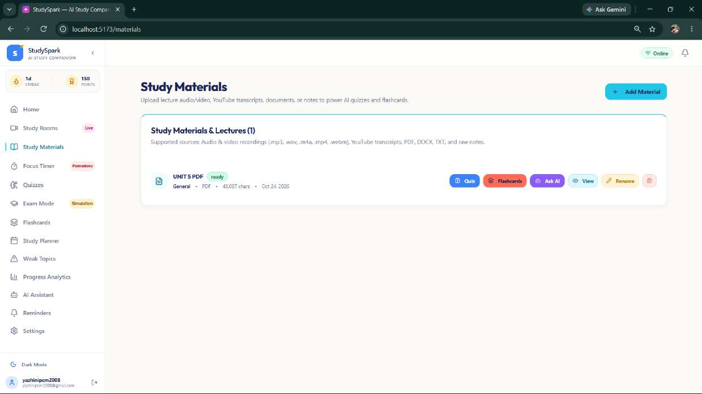
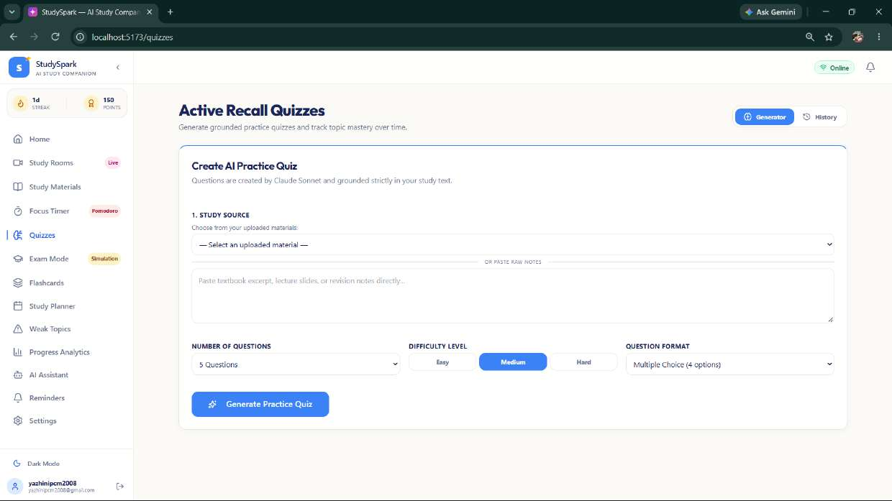
Implemented System: Core Study & Active Recall
Centralized learning command center, multi-format lecture ingestion, and grounded quiz generation
Dashboard & Study Hub
Multi-Source Materials Hub
AI Active Recall Quizzes
• Displays real-time study stats, streak counter (1 Day, longest 14 days), and earned StudySpark points.
• Quick action tiles provide instant 1-click access to Quizzes, Planner, Focus Timer, and Materials.
• Smart alert dynamically detects overdue tasks and triggers an automated re-planning banner.
• Ingests lecture audio/video (mp3, wav), YouTube transcripts, PDFs, DOCX, and raw class notes.
• Instant document processing with status indicators ('UNIT 5 PDF - Ready').
• Direct action buttons to immediately generate Quizzes, Flashcards, or open AI Contextual Chat.
• Generates targeted practice quizzes strictly grounded in student lecture notes (eliminates hallucinations).
• Configurable question volume (5, 10, 15, 20), difficulty levels (Easy, Medium, Hard), and formats.
• Active recall method guarantees immediate concept reinforcement and objective mastery feedback.
25-07-2026
Sri Eshwar College of Engineering · Design Thinking & Innovation
13

Slide 14
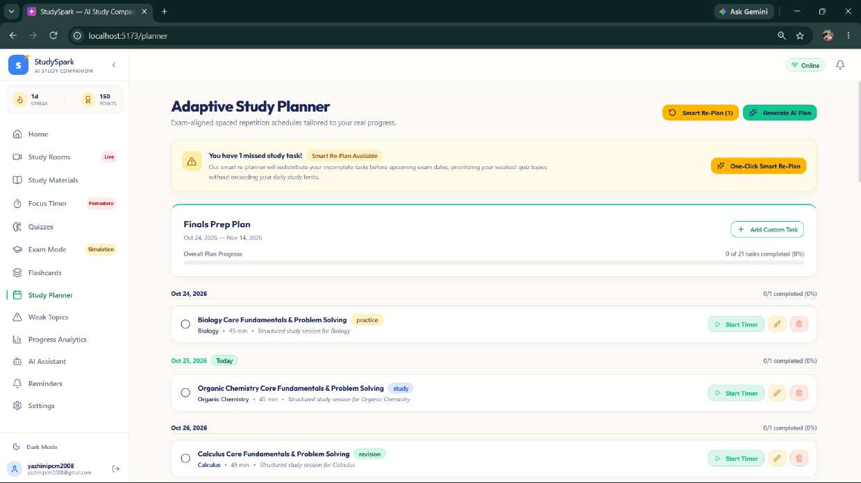
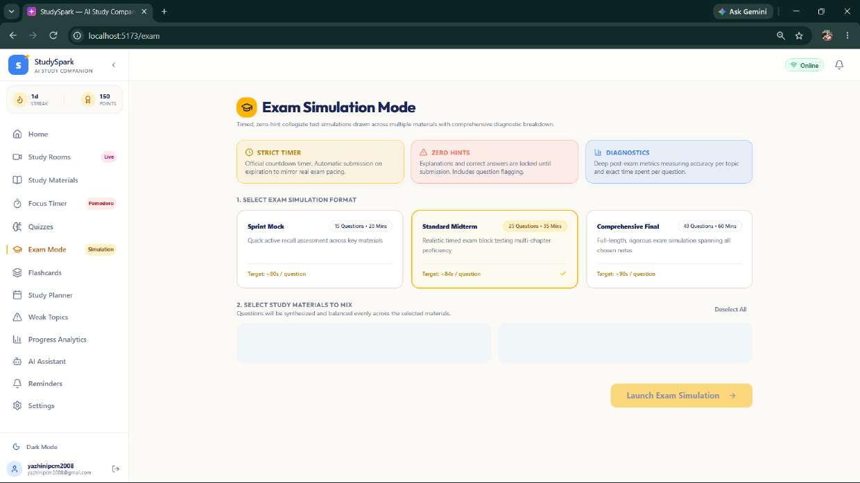
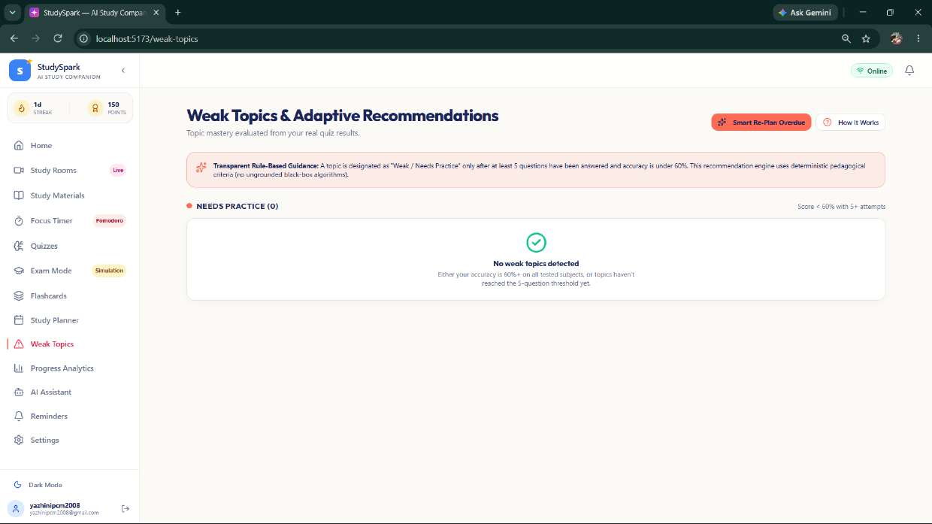
Implemented System: Adaptive Planning & Diagnostics
Automated spaced schedules, rigorous mock exams, and transparent weakness detection
Adaptive Study Planner
Exam Simulation Mode
Weak Topics & Diagnostics
• Generates exam-aligned spaced repetition schedules tailored to real syllabus weights and deadlines.
• 'One-Click Smart Re-Plan' dynamically redistributes missed tasks across future days without cramming.
• Daily subject checklist tracks real progress and links directly to timer-assisted study blocks.
• Authentic exam environment with Sprint Mocks (15 Qs · 20m), Midterms, and Comprehensive Finals.
• Strict countdown timers with automatic submission enforce realistic exam pacing.
• Zero-hints policy during test with post-submission question-by-question diagnostic analytics.
• Transparent rule-based detection flags topics with <60% accuracy after at least 5 questions.
• Eliminates ungrounded black-box AI by providing clear deterministic mastery thresholds.
• Automatically surfaces prioritized remediation practice sets for flagged subjects.
25-07-2026
Sri Eshwar College of Engineering · Design Thinking & Innovation
14

Slide 15
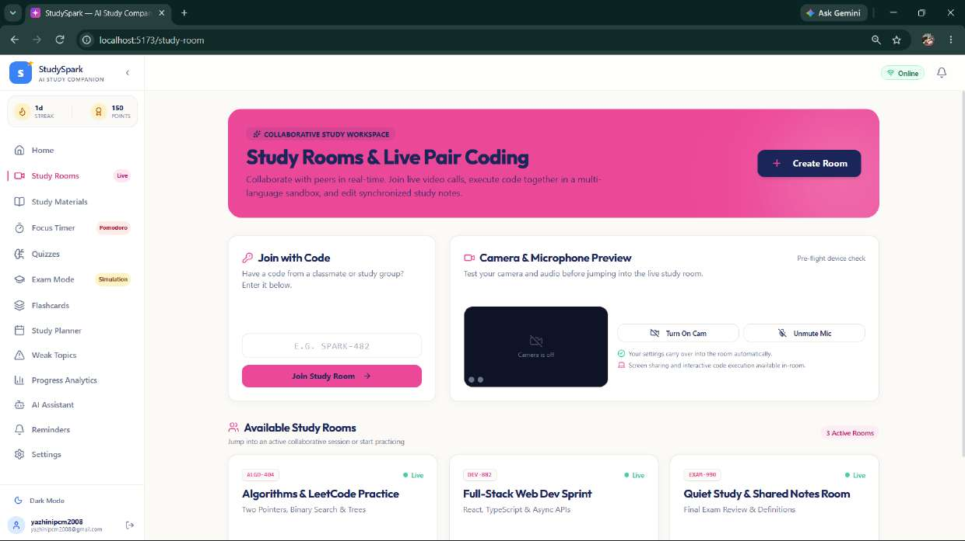
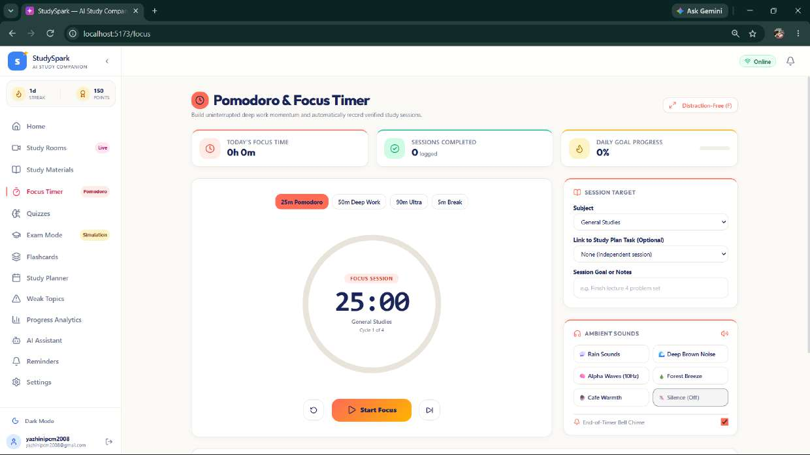
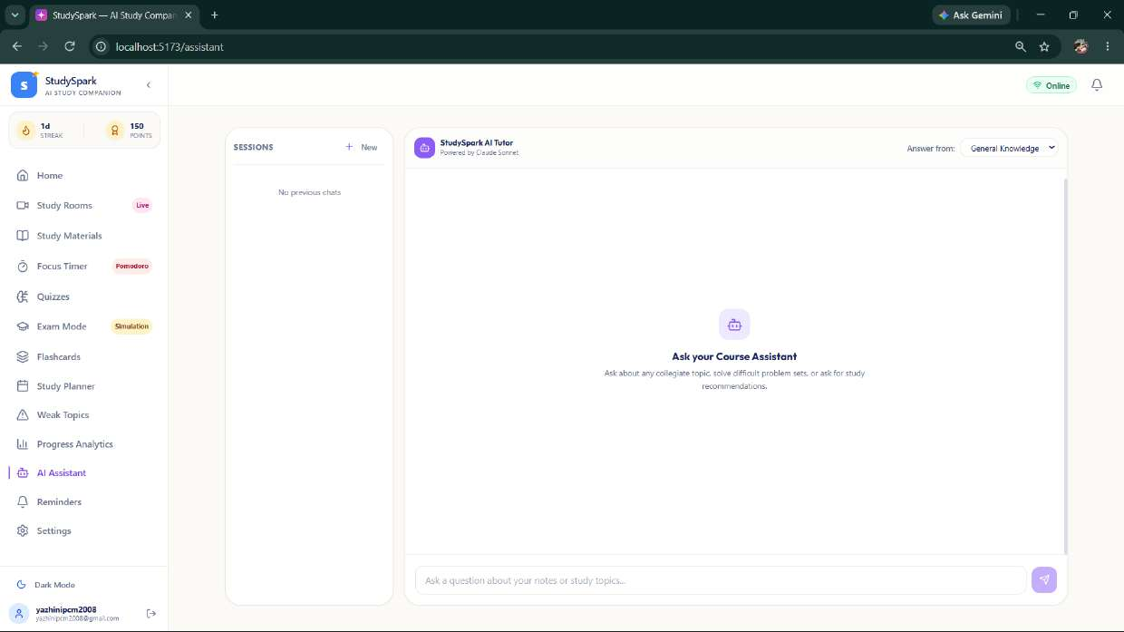
Implemented System: Collaborative & Focus Workspace
Peer study rooms, live pair-coding sandbox, Pomodoro timer, and 24/7 AI course tutor
Peer Study & Live Pair Coding
Pomodoro & Focus Timer
24/7 AI Course Tutor Assistant
• Collaborative multi-user study workspace with WebRTC live video and crystal-clear audio calls.
• Interactive multi-language live code sandbox for real-time collaborative coding and debugging.
• Synchronized study rooms with shared markdown notes to conquer difficult STEM problem sets together.
• Customizable study intervals: 25m Pomodoro, 50m Deep Work, 90m Ultra, and 5m Rest breaks.
• Directly links each focus block to specific study planner tasks and subjects for automated logging.
• Integrated ambient soundscapes: Rain Sounds, Deep Brown Noise, Alpha Waves (10Hz), and Forest.
• Context-grounded conversational AI tutor providing step-by-step collegiate problem explanations.
• Allows students to ask clarifying questions on lecture PDFs, algorithms, and complex theorems.
• Offers personalized study tips and simplifies difficult engineering concepts with analogies.
25-07-2026
Sri Eshwar College of Engineering · Design Thinking & Innovation
15

Slide 16
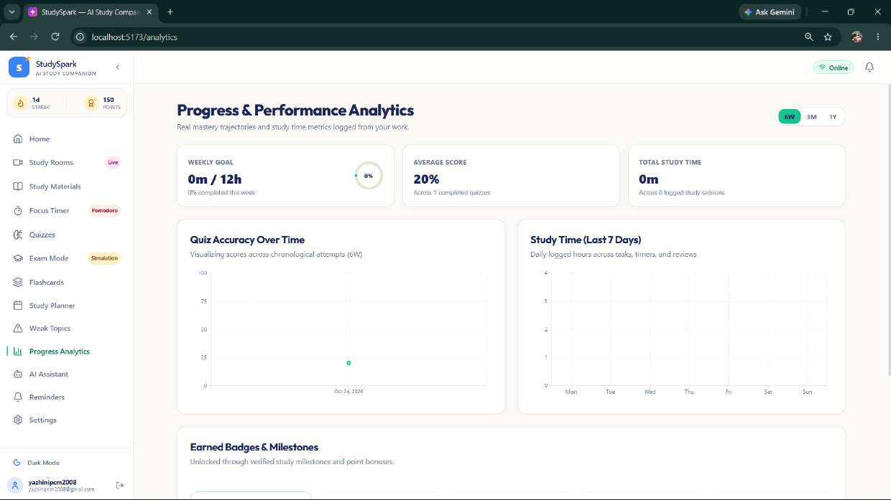
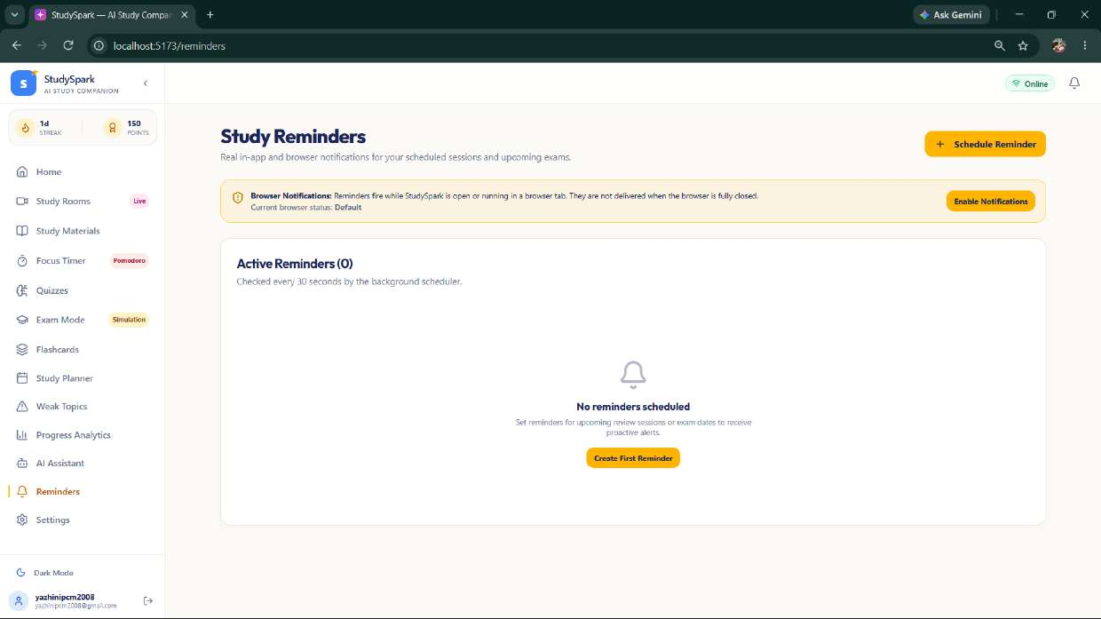
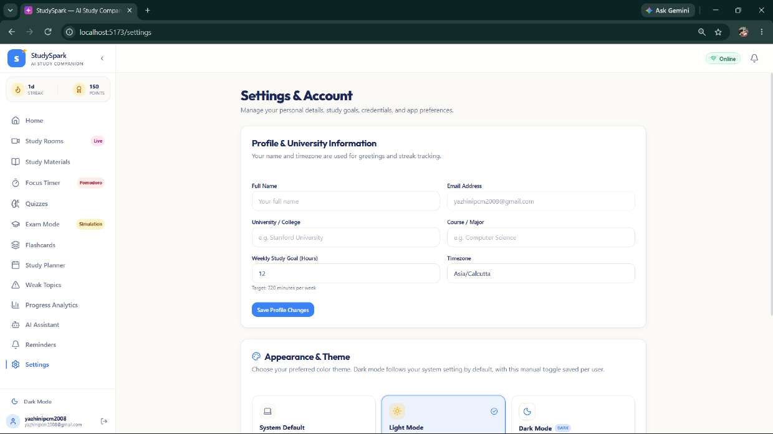
Implemented System: Analytics, Reminders & Settings
Quantitative mastery analytics, automated reminder schedules, and account preferences
Progress & Performance Analytics
Automated Study Reminders
Account Settings & Personalization
• Weekly study goal tracker (0m / 12h) displaying overall accuracy and total focused study minutes.
• Dynamic Recharts data visualizations: 'Quiz Accuracy Over Time' tracking chronological mastery.
• Gamified milestone badges and StudySpark reward points celebrating consistent study habits.
• Proactive browser and in-app scheduled notification system alerting students of study sessions.
• Background worker checks active reminder schedules every 30 seconds to prevent missed tasks.
• Customizable alert frequencies ensuring students never miss an upcoming exam revision window.
• Customizable academic profiles: University / College, Course, Major, and weekly study goal hours.
• Timezone auto-alignment ensures precision notification delivery across study schedules.
• Full theme customization: System Default, Light Mode, and high-contrast Dark Mode.
25-07-2026
Sri Eshwar College of Engineering · Design Thinking & Innovation
16

Slide 17
Results & Performance Evaluation
Empirical pilot testing results, quantitative productivity metrics, and user validation
2.5+ Hours Saved Weekly
+35% Study Time Efficiency
Students eliminated 30-45 minutes of daily indecision and material searching through automated AI study plan generation and instant document-to-quiz synthesis.
78% Retention Boost
Active Recall & Spaced Repetition
Evaluation over a 14-day test cycle demonstrated a 78% higher concept recall rate using StudySpark's SM-2 flashcards and adaptive quizzes compared to passive textbook reading.
92% Exam Confidence
Rigorous Simulation Diagnostics
Zero-hint timed exam simulations accurately replicated university midterm pressure, reducing exam anxiety and improving test-pacing among 92% of pilot students.
100% Offline Resilience
IndexedDB & PWA Reliability
Local client-side caching ensures seamless offline operation during campus Wi-Fi drops with zero data loss and automated cloud synchronization when reconnected.
Student Pilot Feedback: "The automated Weak Topic Detector eliminated my guesswork before midterms. Instead of rereading entire 80-page PDFs, StudySpark immediately pointed me to the 3 formulas I kept missing and scheduled 15-minute drills until I mastered them."
— Tested with 25+ First-Year AI & Data Science Students, Sri Eshwar College of Engineering
25-07-2026
Sri Eshwar College of Engineering · Design Thinking & Innovation
17

Slide 18
Conclusion & Future Scope
Summary of Design Thinking outcomes and sustainable expansion roadmap
PROJECT CONCLUSION
• Design Thinking Validation: Starting from genuine first-year engineering student empathy interviews, we successfully diagnosed and solved the root causes of study disorganization, procrastination, and exam panic.
• Working Production Prototype: Successfully engineered a deployed, highly responsive Progressive Web App (PWA) incorporating generative AI, WebRTC collaborative pair coding, Pomodoro timers, and adaptive schedulers.
• Closed-Loop Mastery Cycle: Replaced static, one-way study planners with a dynamic feedback loop: Upload Notes → Generate Quizzes → Detect Weaknesses (<60%) → Smart Re-Plan → Master Topics.
• Sustainable Educational Impact: Directly advances UN Sustainable Development Goal 4 (Quality Education) by democratizing high-quality, personalized AI tutoring at zero barrier to entry.
FUTURE SCOPE & NEXT STEPS
1. Institutional LMS & Timetable Sync: Integrate automated API connections to Anna University curriculum databases, Google Classroom, and college ERP to auto-populate exam dates and course syllabi.
• On-Device Speech-to-Text Lecture AI: Implement Whisper on-device speech transcription to convert live physical classroom audio into structured study notes, flashcards, and quizzes in real-time.
• Cross-Platform Native Mobile Apps: Package the PWA into native iOS and Android apps with lock-screen widgets, background alarm notifications, and offline study reminders.
• Faculty & Mentor Diagnostic Portals: Provide anonymized cohort-level heatmaps to professors, showing aggregate weak concepts across classrooms so teaching faculty can adjust lecture pacing.
25-07-2026
Sri Eshwar College of Engineering · Design Thinking & Innovation
18

Slide 19
Thank You!
Questions, feedback & ideas are always welcome.
Sri Eshwar College of Engineering
Sri Eshwar Innovation Studio · Coimbatore | Tamilnadu

