Slide 1
Server Virtualization and Its Role in Cloud Computing
TEAM 15
Cloud Computing and Big Data Analytics
  Guided By Students Name
  Dr.A.M.Arul Raj R.Yazhini(192521190)
  Professor S.Magalakshmi(192524144)
  SIMATS Engineering SIMATS Engineering
1
1

Slide 2
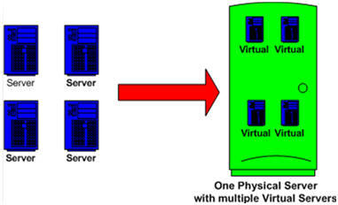
Abstract
Server virtualization is a key technology in modern computing infrastructure.
It enables computing environments to operate independently from physical hardware.
Hypervisors manage virtual machines and underlying resources.
Virtualization supports efficient resource sharing and workload isolation.
It provides a foundation for flexible and scalable cloud infrastructure.
2

Slide 3
Aim and Objectives
OBJECTIVES
Understand the concept and architecture of server virtualization.
Study virtual machines and their components.
Understand the working and role of hypervisors.
Compare physical servers with virtualized server environments.
Analyze the benefits and limitations of virtualization.
Examine real-world applications of virtualization in cloud computing.
3
3

Slide 4
Introduction
Server virtualization creates multiple virtual servers on a single physical server.
Physical resources are abstracted into virtual CPU, memory, storage and network resources.
Each virtual machine can run its own operating system and applications.
A hypervisor manages communication between VMs and physical hardware.
Virtualization provides isolation between different workloads.
It enables efficient and flexible use of computing resources
4
4

Slide 5
TYPES OF VIRTUALIZATION
Server Virtualization: One physical server runs multiple VMs.
Example: Windows VM + Linux VM on one server.
Storage Virtualization: Multiple storage devices appear as one storage system.
Example: Several hard drives combined into one virtual storage pool.
Network Virtualization: One physical network is divided into virtual networks.
Example: Separate virtual networks for employees and guests.
Desktop Virtualization: A desktop runs on a remote server.
Example: Accessing your office desktop from a laptop.
Application Virtualization: An application runs in a virtual environment.
Example: Using an application without fully installing it on the computer.
Data Virtualization: Data from different sources is accessed through one view.
Example: Viewing database and cloud data through one interface.
5
5

Slide 6
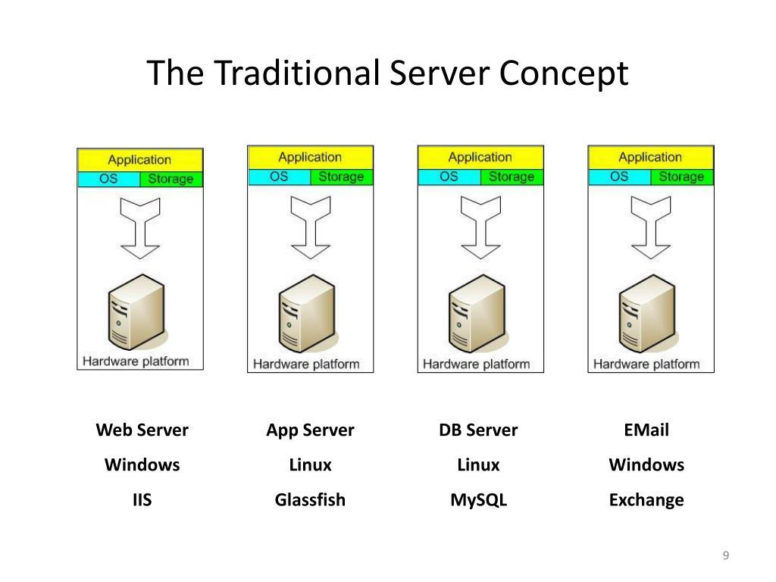
Existing System
Physical Server Model
Each major application is deployed on a dedicated physical server.
CPU and memory may remain unused during low workloads.
New applications generally require additional physical hardware.
Hardware installation and operating system configuration take time.
Maintenance, power and cooling costs increase with more servers.
Scaling the infrastructure is slower and less flexible.
6
6

Slide 7
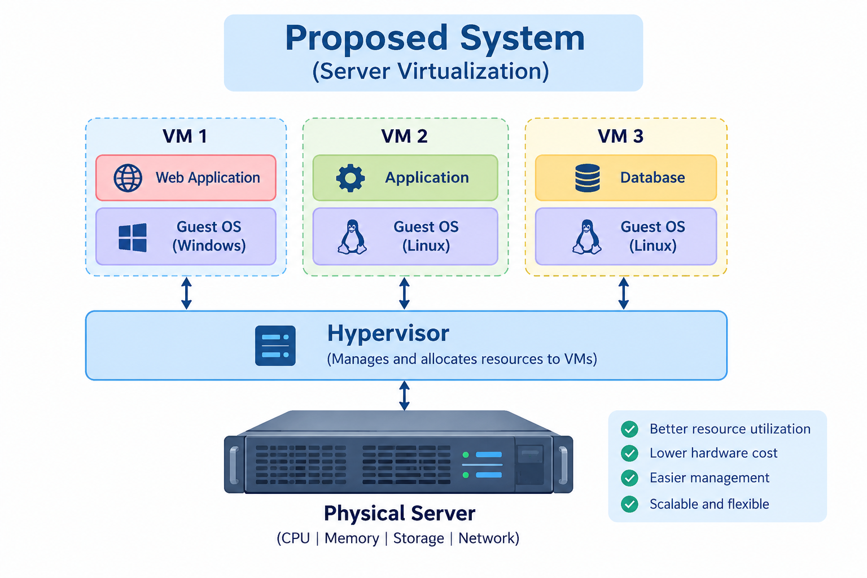
Proposed System
Server Virtualization Model
Multiple virtual machines run on a single physical host.
A hypervisor creates and manages the virtual machines.
CPU, memory, storage and network resources are allocated to VMs.
Each VM provides an isolated environment for its workload.
VMs can be provisioned and scaled faster than physical servers.
Hardware utilization and infrastructure flexibility are improved.
7
7

Slide 8
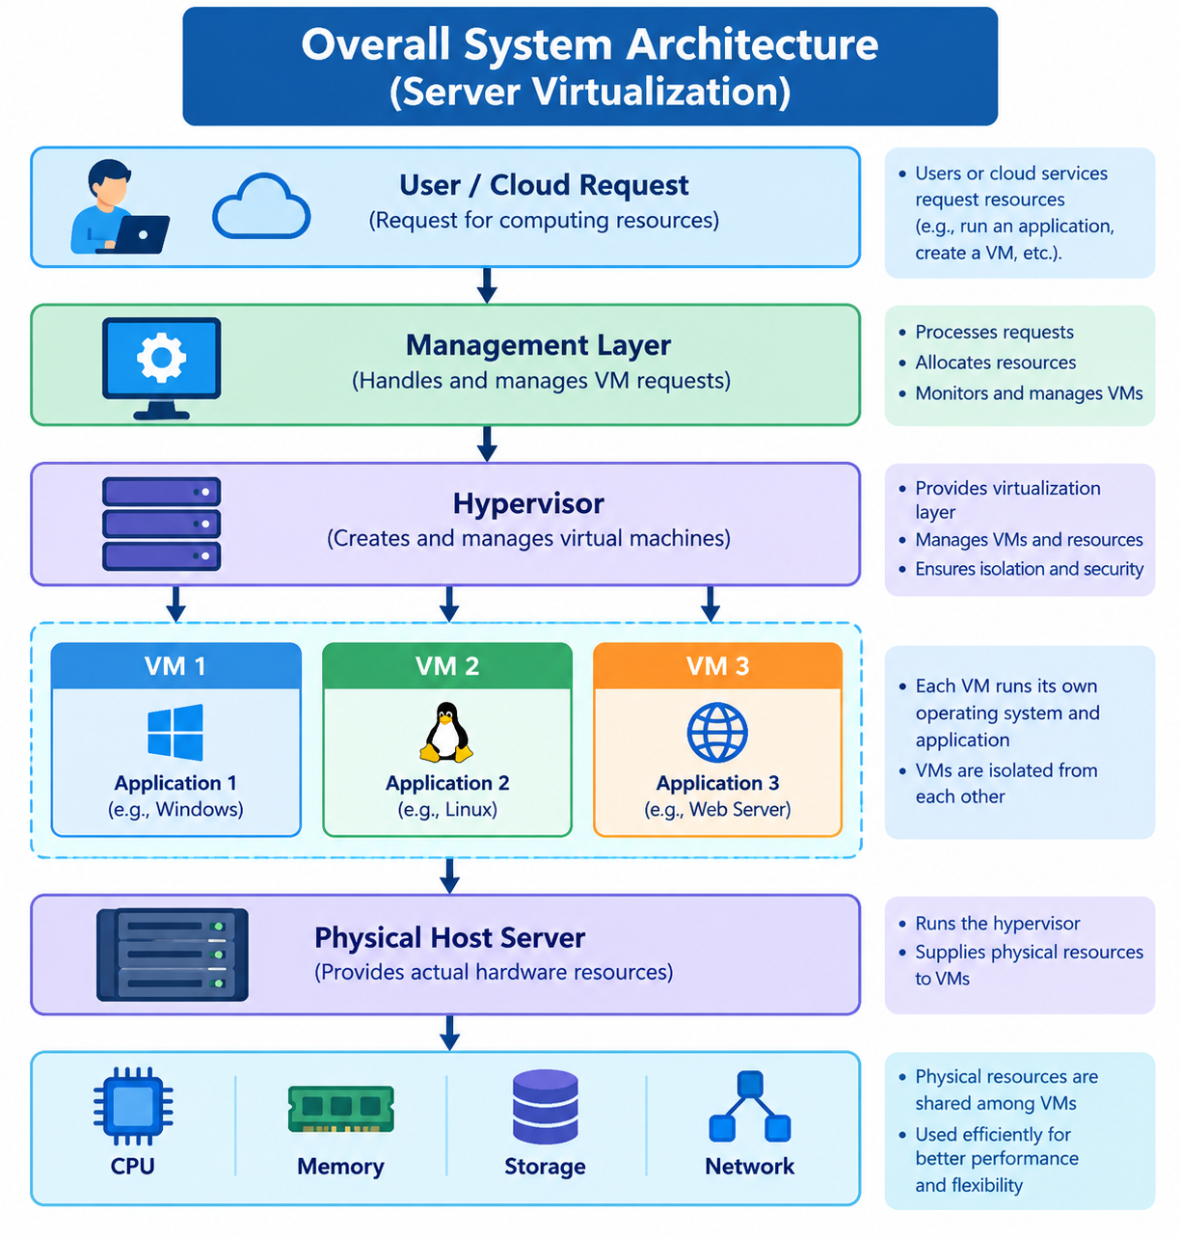
Overall System Architecture
8
8

Slide 9
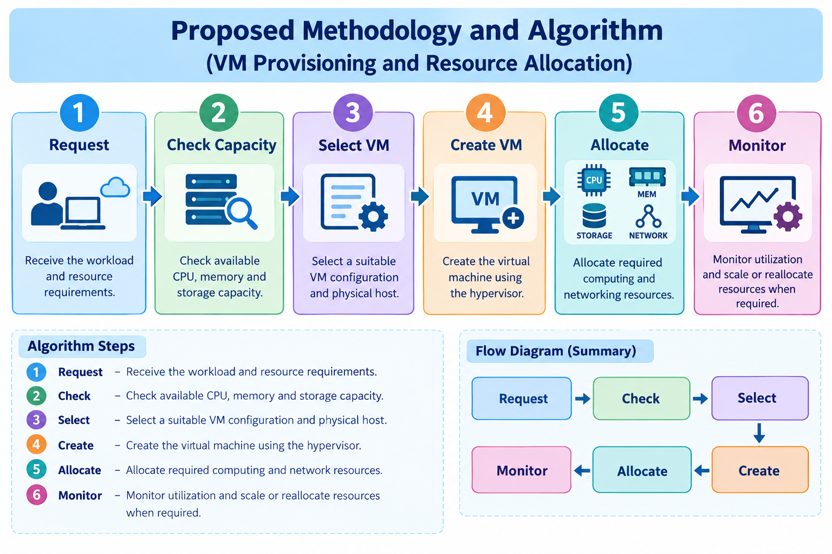
Proposed Methodology and Algorithm
VM Provisioning and Resource Allocation
- Receive the workload and resource requirements.
- Check available CPU, memory and storage capacity.
- Select a suitable VM configuration and physical host.
- Create the virtual machine using the hypervisor.
- Allocate required computing and networking resources.
- Monitor utilization and scale or reallocate resources when required.
9
9

Slide 10
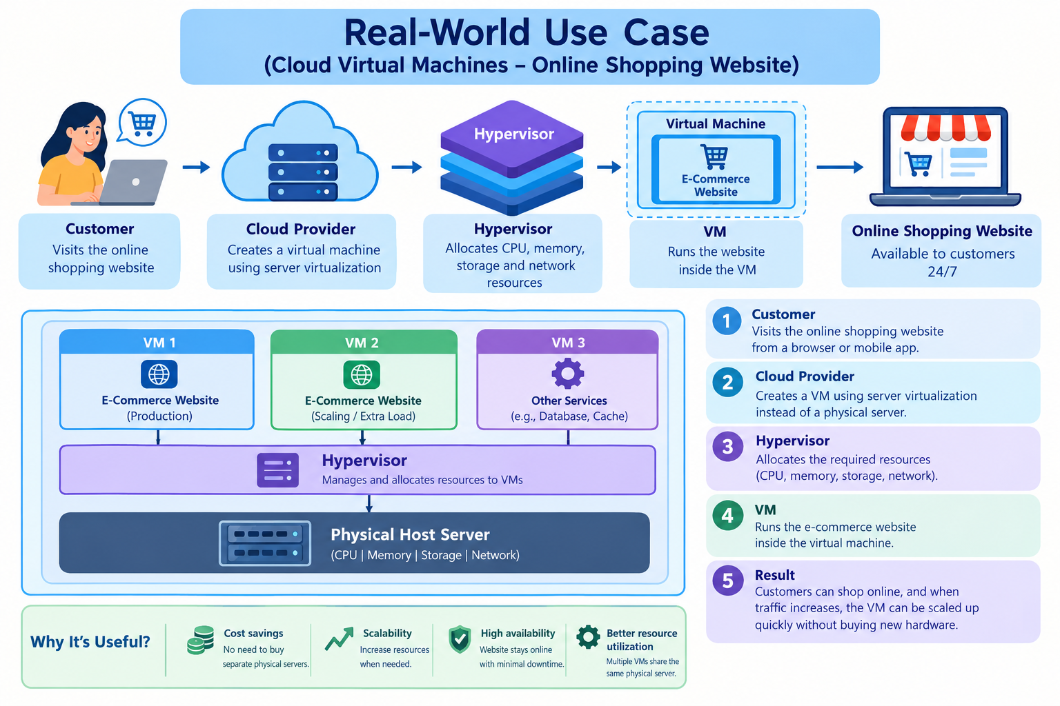
Real-world Use Case
10
10

Slide 11
Conclusion
Server virtualization converts physical resources into flexible virtual resources.
Multiple VMs can share the resources of a single physical server.
Improves CPU, memory, and hardware utilization.
Reduces hardware, power, and maintenance costs.
Enables faster provisioning and flexible resource allocation.
Supports scalability and efficient cloud infrastructure.
Provides workload isolation through virtual machines.
Performance, security, resource contention, and management must be considered.
11
11

Slide 12
References
NIST – The NIST Definition of Cloud Computing, SP 800-145.
NIST – Virtualization and Cloud Computing guidance.
VMware – Server Virtualization and Hypervisor Concepts.
Microsoft Learn – Hyper-V Virtualization Documentation.
Red Hat – Virtualization Fundamentals.
CSA1519 – Cloud Computing and Big Data Analytics course materials.
12
12

