Slide 1
Holography
Chandler
2013/11/8

Slide 2
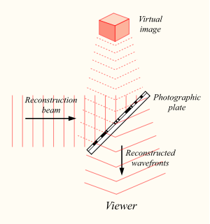
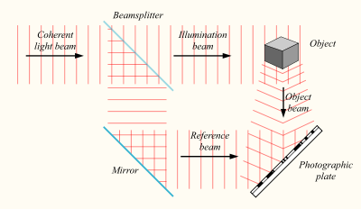
How it works?
Notes:
测量光波在一个平面上的幅度信息，同时利用参考光束干涉的办法间接地记录测量平面上光波的相位信息，然后利用这两种信息成像，得到一种立体图像。

Slide 3
Holography vs. photography
A hologram records scatter waves in a range of directions rather than from only one direction, as in photography.
A photograph is a 2-dimensional representation, but holography can make 3D image with more depth perception cues.

Slide 4
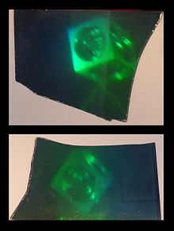
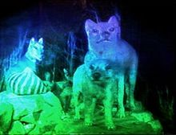
Notes:
右图，可以比较明显看出，由不同角度入射得到的全息图像。

Slide 5
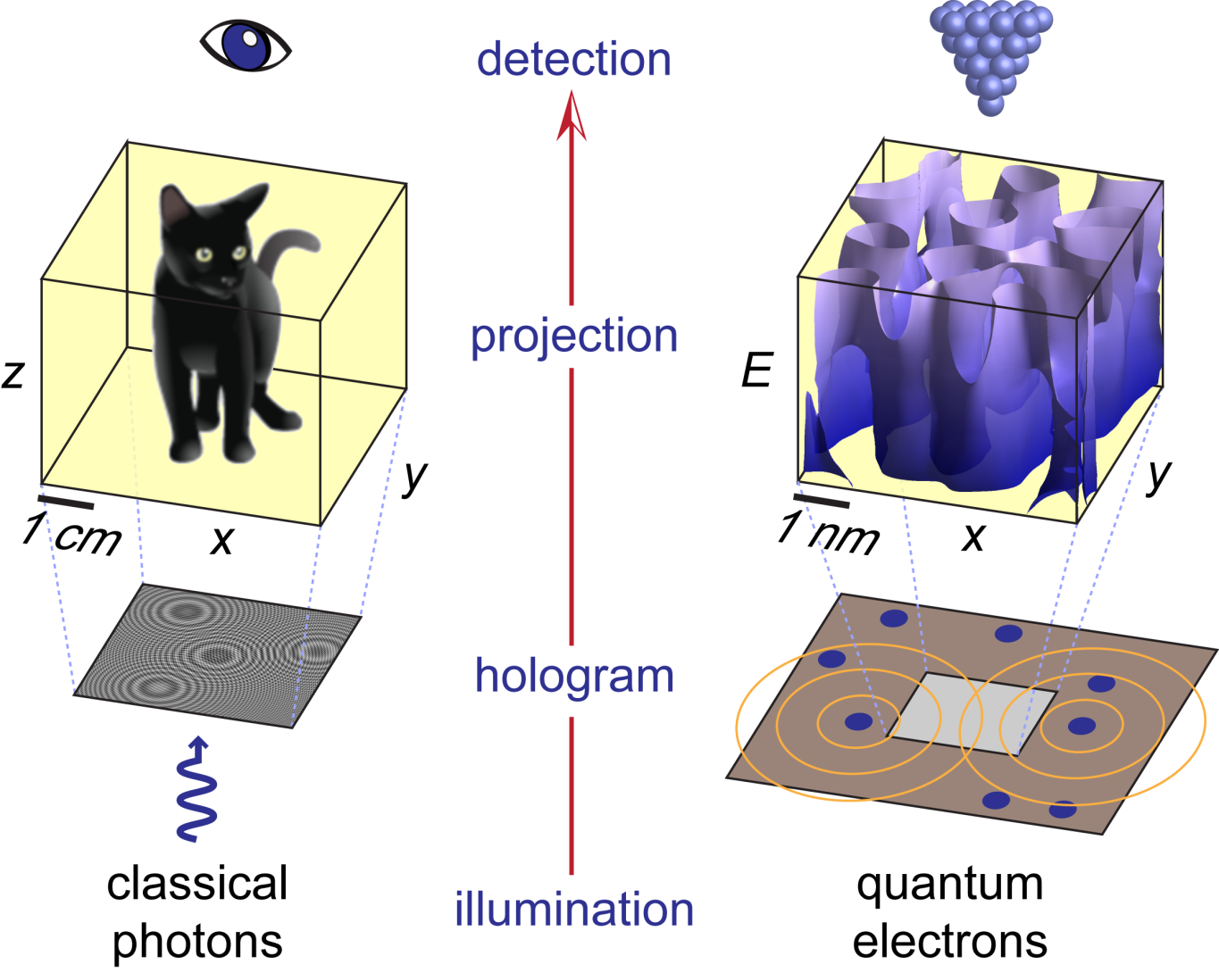
Notes:
由于光波的频率很高，全息成像应用广泛，宏观到微观，甚至是量子学尺度上的成像都有应用。

Slide 6
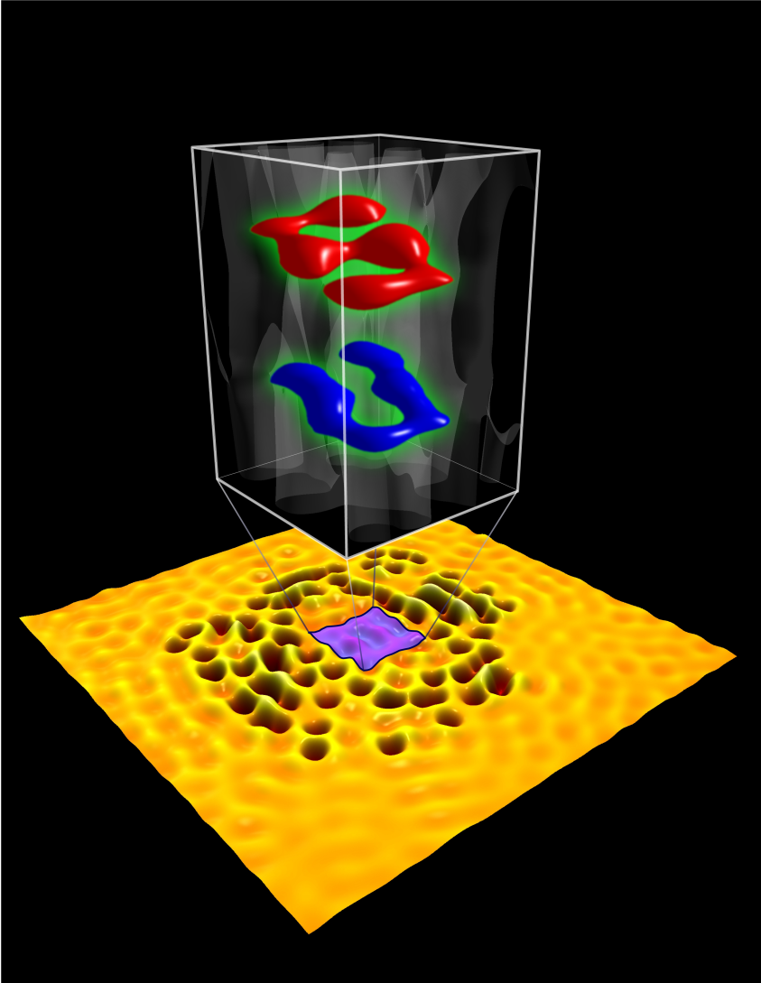
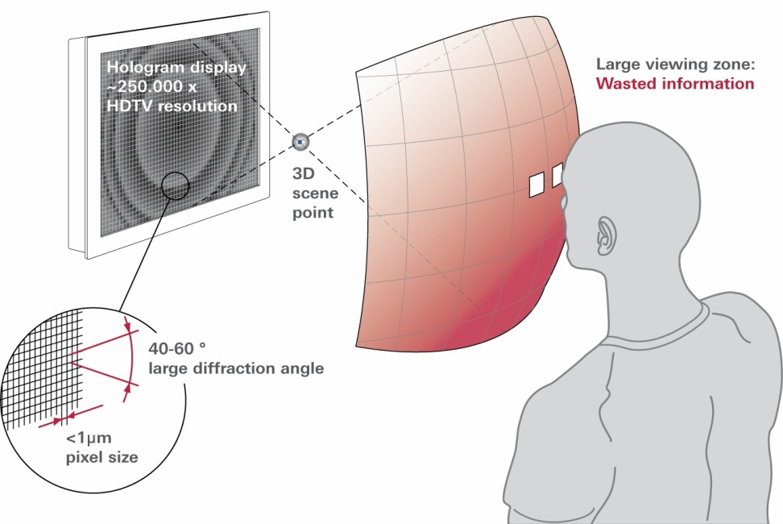
Notes:
3D全息投影，利用干涉和衍射原理记录并再现物体真实的三维图像，与传统的偏振原理的3D投影技术，这是一种无需配戴3D眼镜的技术。

Slide 7
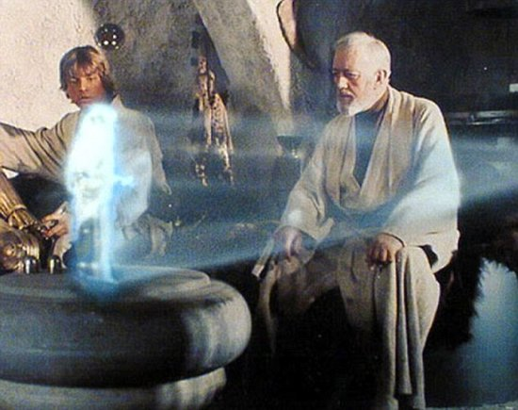
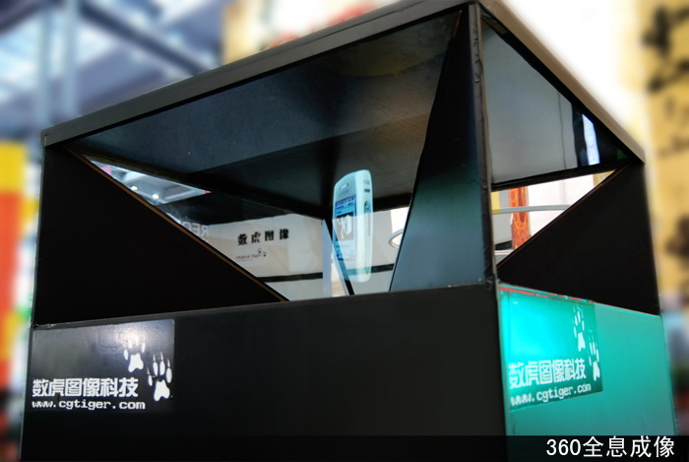

Slide 8
Acoustic holography
In principle, it is possible to make a hologram for any wave.
Acoustic holography is a method used to estimate the sound field near a source by measuring acoustic parameters.
It is popular in NVH, vehicle and aircraft design. It has become a truely accepted engineering tool in industial acoustics.
Notes:
声波的频率比较低，记录振幅与相位信息都比较方便，要用相干处理方法可较易得到图像。由于受光全息成像的影响，一般所说的声全息技术专指用一个平面上测量的声场反推声源辐射的方法。

Slide 9
Notes:
上式表示两个平行平面上的声场关系，因此如果已知声场中一个平面的分布，就可以利用这样一个空间变换式得到另一个平面上的声压分布。
为了测量一个振动声源平面上的声辐射，可以在一定距离之外的一个平行平面上逐点测量声压，然后逆运算得到。
但两个平面的距离不能太大，因为声场可能包含凋落波的成分。

Slide 10
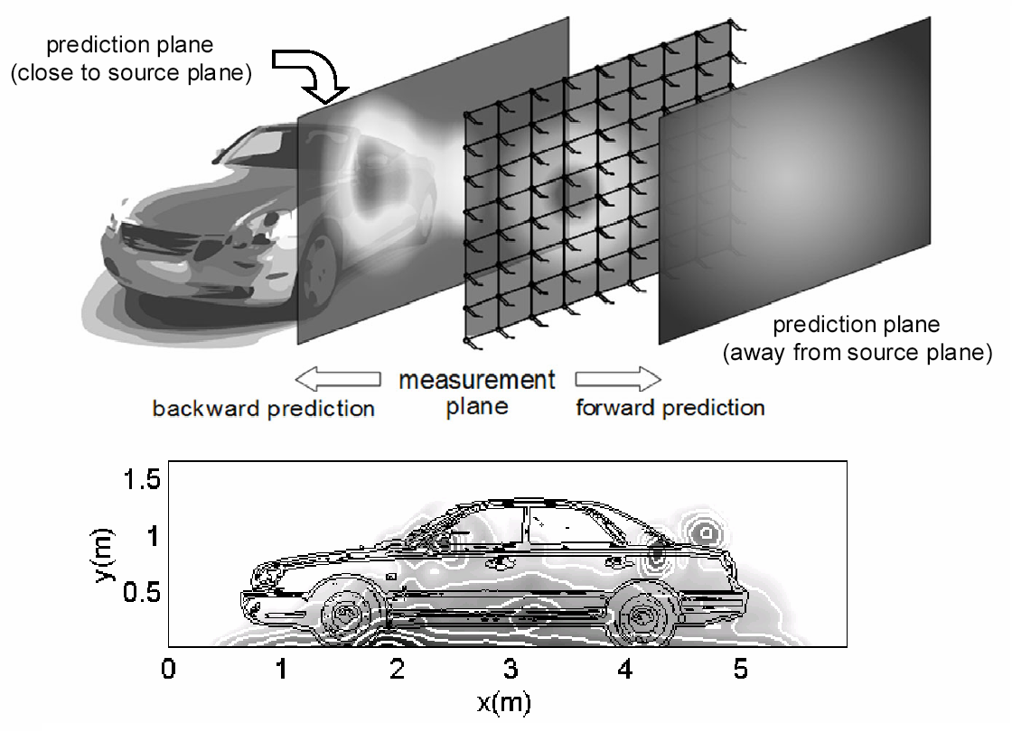

Slide 11
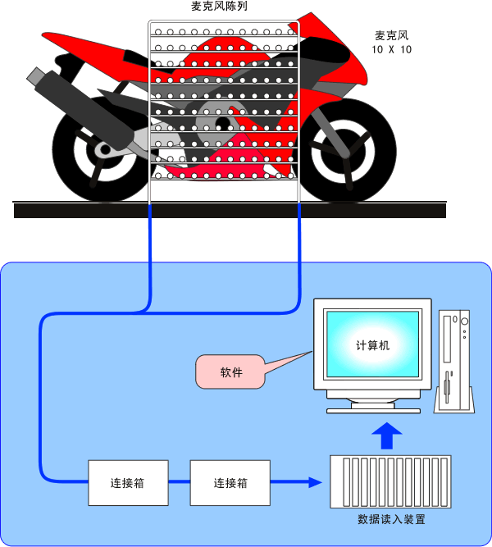

Slide 12
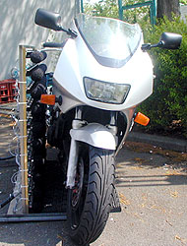
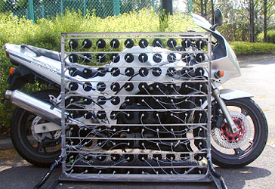

Slide 13
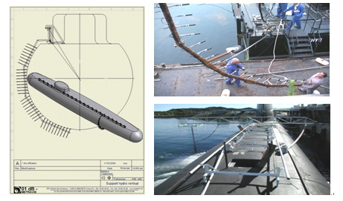

Slide 14
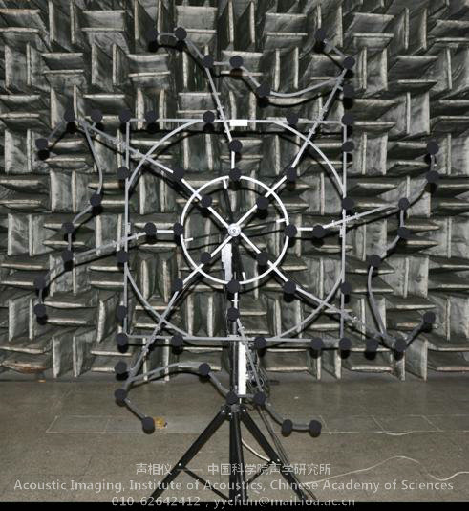

Slide 15
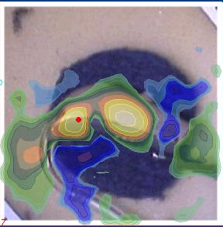
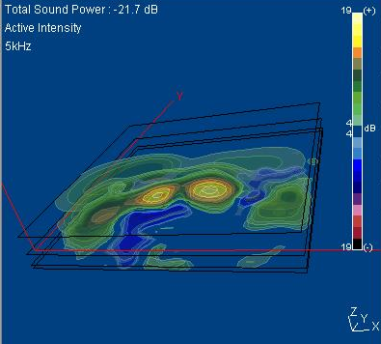
STSF / NAH Introduction
Nearfield Acoustical Holography NAH
B&K terminology: STSF (Spatial Transformation of Soundfields)
Holography means that all information about the sound field is preserved. Similar to optical holography.
Measure pressure only, calculate the remaining soundfield descriptors.
2D
3D
Pressure
Particle Velocity
Intensity

Slide 16
NAH (Cross-spectral Near-field Acoustic Holography)
Measurement plane
p(x,y,800Hz)
p(x,y,630Hz)
p(K_{x},K_{y},630Hz)
z₀
p(x,y,500Hz)
p(x,y,400Hz)
FFT_{x,y}
New
plane
Calculation plane
p(x,y,800Hz)
p(x,y,630Hz)
p(K_{x},K_{y},630Hz)
p(x,y,500Hz)
z
-1
p(x,y,400Hz)
FFT_{x,y}
53

Slide 17
Measurement Technique: Grid spacing d
d
and
D
Wave at highest frequency f_{max}
Notes:
The measurement at discrete positions in space can be seen as a spatial sampling of the sound field. We know from the sampling theorem that the sampling frequency has to be at least two times the highest frequency.
The propagation of the sound field from the source to the measurement plane acts as a natural “anti-aliasing filter” for the spatial sampling process: Close to the source the sound field can exhibit very fast spatial variations - corresponding to a significant content of high spatial frequencies. Outside the near-field region the fastest spatial variation of the sound field is given by the wavelength at the considered temporal frequency.
As a consequence, if we measure outside the near-field region, the sampling theorem requires at least two microphone positions for each wavelength. This requirement must be fulfilled at all temporal frequencies of interest, the highest temporal frequency therefore determining the microphone spacing.
The “anti-aliasing filter” can be shown to provide an acceptable 20 dB attenuation of spatial aliasing components, if the distance from the source to the measurement plane is at least equal to the microphone spacing. In other words, the microphone spacing is not allowed to exceed the source distance (the measurement distance).

Slide 18
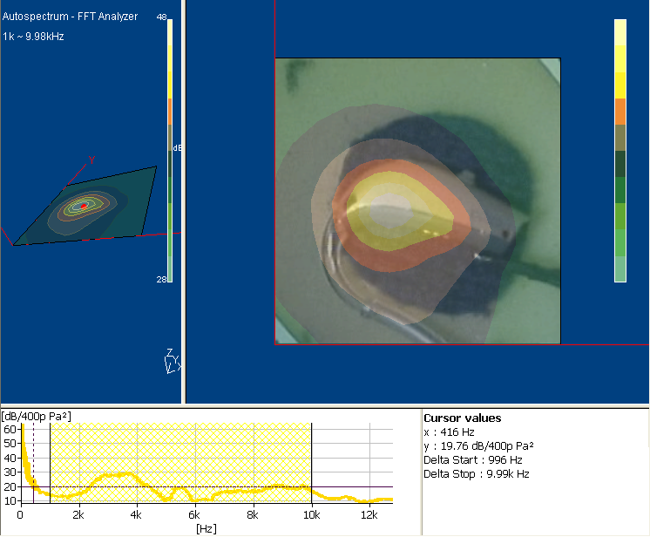
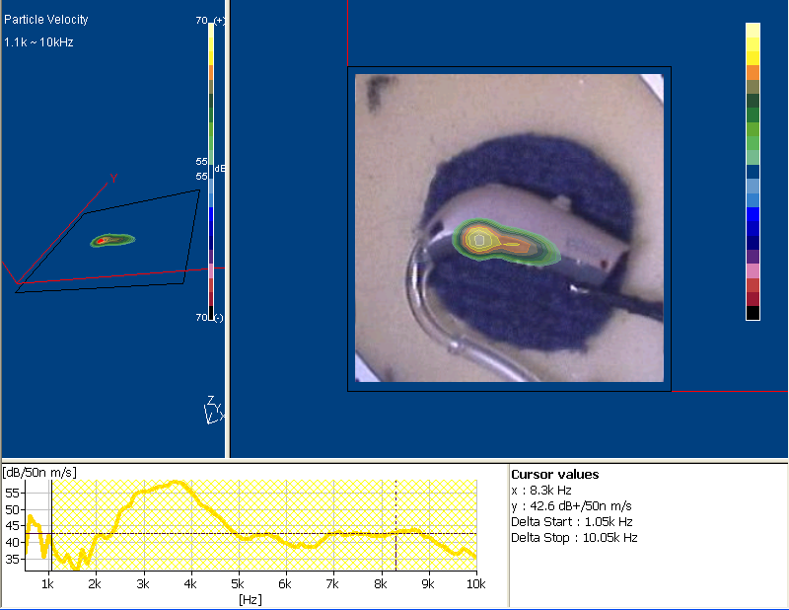
NAH Example on Hearing Aid
Measure pressure (6x6 cm², 3mm intervals), used stimulus Pseudo Random
Noise 4sec. Calculate particle velocity in source plane to show leakages.
Frequency Range: 500 Hz – 10 kHz

Slide 19
SONAH – basic idea
z
r_{n}
Measurement Plane
Calculation point
r
Source Plane
Sound Source
Linear Estimate
Estimation coefficients
Estimate the time harmonic pressure p(r) as a complex linear combination of the measured pressure data p(r_{n}):
Coefficients must provide good estimation for each one of the elementary plane waves:

Slide 20

SONAH – basic idea
z
r_{n}
Plane wave
r
Sound Source
Linear Estimate
Estimation coefficients
Estimate the time harmonic pressure p(r) as a complex linear combination of the measured pressure data p(r_{n}):
Coefficients must provide good estimation for all plane waves:
Notes:
The present page states the basic idea of SONAH.
In the measurement plane we have a set of measurement positions r_{n}. The measurement grid can be irregular. Assume we want to estimate the sound pressure at a given position r on or above the source plane. We assume complex frequency domain data.
The starting point is that the calculated pressure must be a complex linear combination of the measured pressure data. (This holds true for all methods that involve a sequence of linear operations on the vector of measured data) The challenge is to obtain the vector c of coefficients that gives us the best possible estimate at any chosen position.
To get the coefficients, we require that the linear combination formula must provide good estimation for all plane propagating and evanescent wave functions.

Slide 21

SONAH – basic idea
z
r_{n}
Evanescent wave
r
Sound Source
Linear Estimate
Estimation coefficients
Estimate the time harmonic pressure p(r) as a complex linear combination of the measured pressure data p(r_{n}):
.
.
.
Notes:
The present page states the basic idea of SONAH.
In the measurement plane we have a set of measurement positions r_{n}. The measurement grid can be irregular. Assume we want to estimate the sound pressure at a given position r on or above the source plane. We assume complex frequency domain data.
The starting point is that the calculated pressure must be a complex linear combination of the measured pressure data. (This holds true for all methods that involve a sequence of linear operations on the vector of measured data) The challenge is to obtain the vector c of coefficients that gives us the best possible estimate at any chosen position.
To get the coefficients, we require that the linear combination formula must provide good estimation for all plane propagating and evanescent wave functions.

Slide 22
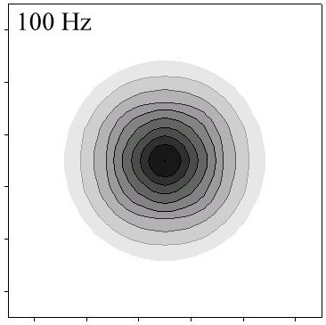
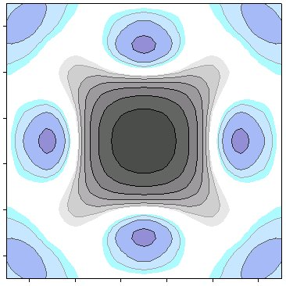
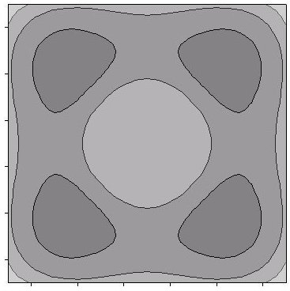
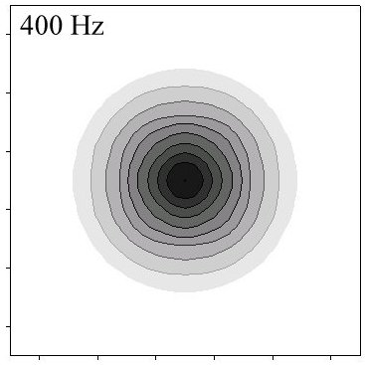
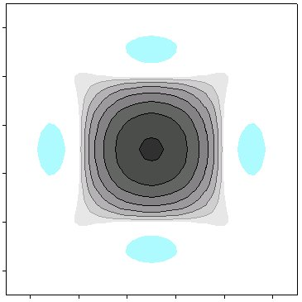
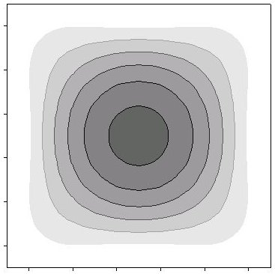
Comparing Intensity, NAH vs. SONAH
Exact
SONAH
NAH (STSF)
100 Hz
400 Hz
50 cm
Positive
Negative
80dB
100dB

Slide 23
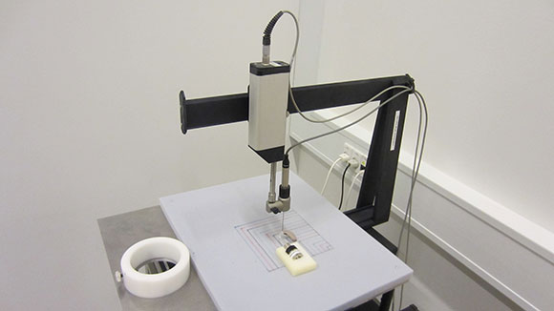
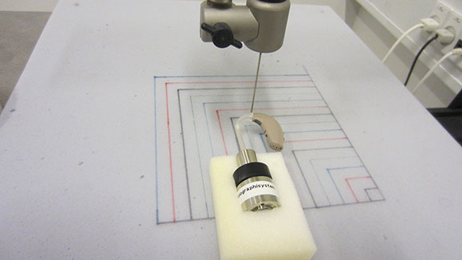
NAH and SONAH applied on Hearing Aid measurement with WT9726

Slide 24
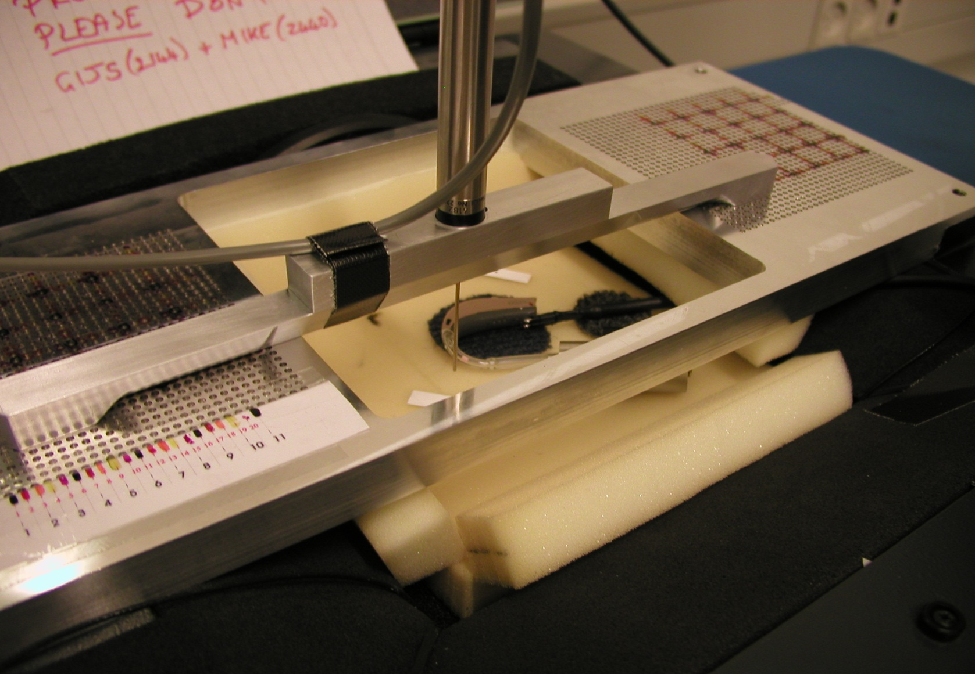
Pre tests for Hearing Aids: Manual Test set up
Notes:
421 measurement points.
Probe microphone: 4182 (relatively high level Self noise but due to cross-spectral implementation of STSF we obtain good results.
20 minutes per 100 points
Background noise audible from ventilation but seemingly not significant on measurement

Slide 25
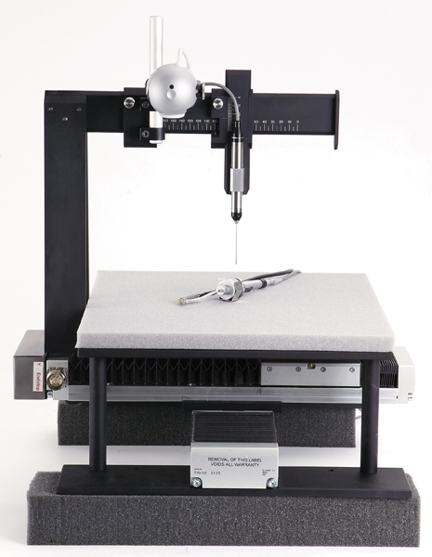

Specifications STSF Robot Type WT 9726-001
Probe Microphone Type 4182
Positionig accuracy better than 0.1mm
Spatially Sampled Dyn. Range 30 dB
Scan Area Max ≈ 20x20 cm²
Adjustable height
Integrated Camera
Robot System Noise floor ≈ 37 dB(A)
Type 2716 Power Amplifier
Type 7539 PULSE Module in B-Frame

Slide 26
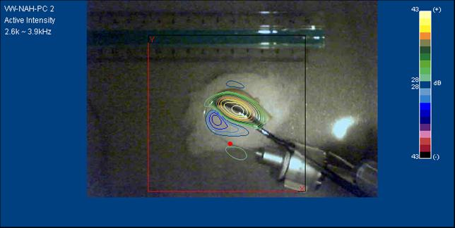
NAH /SONAH Detailed Example: 1

Slide 27
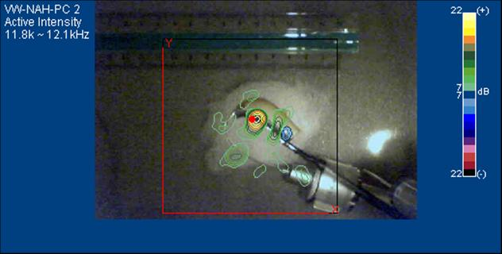
NAH /SONAH Detailed Example: 2

Slide 28
Q & A

