Slide 1
Investigate RHI issue in production
Logan & Chandler
2017.11.30

Slide 2
The problems of RHI found right now
Deviation

Slide 3
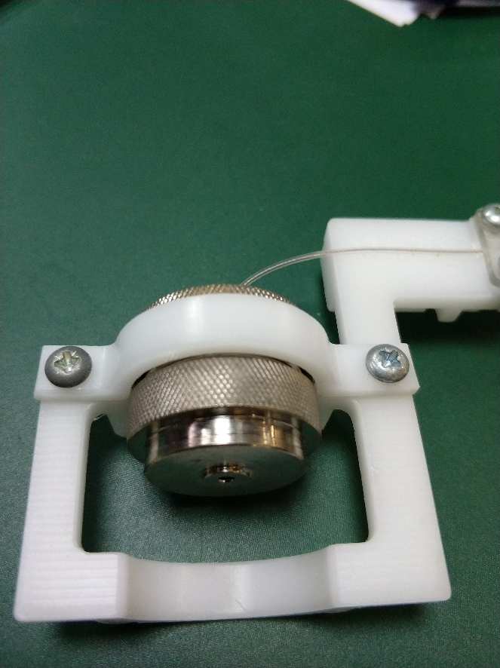
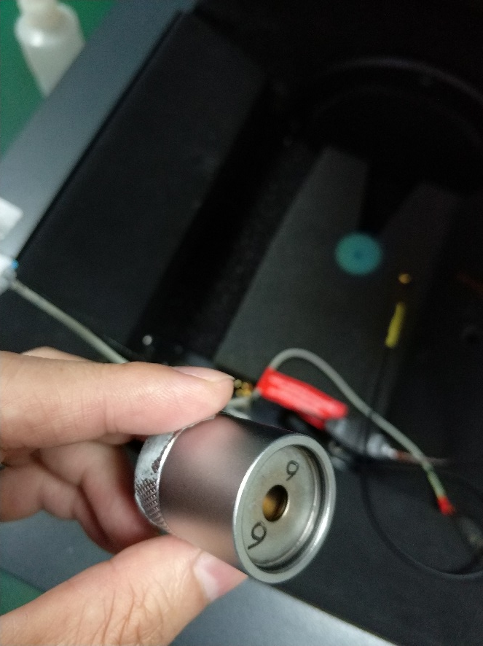
deviation = f( HI, chamber, jig+rec, coupler+rub)
jig+rec
Coupler+rub

Slide 4
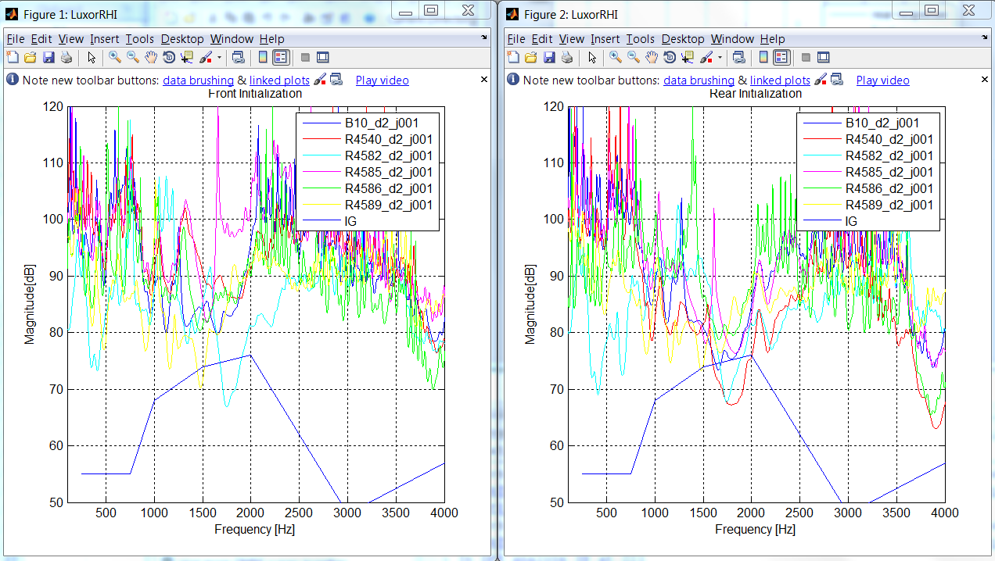
deviation = f( HI, chamber, jig+rec, coupler+rub)
General test

Slide 5
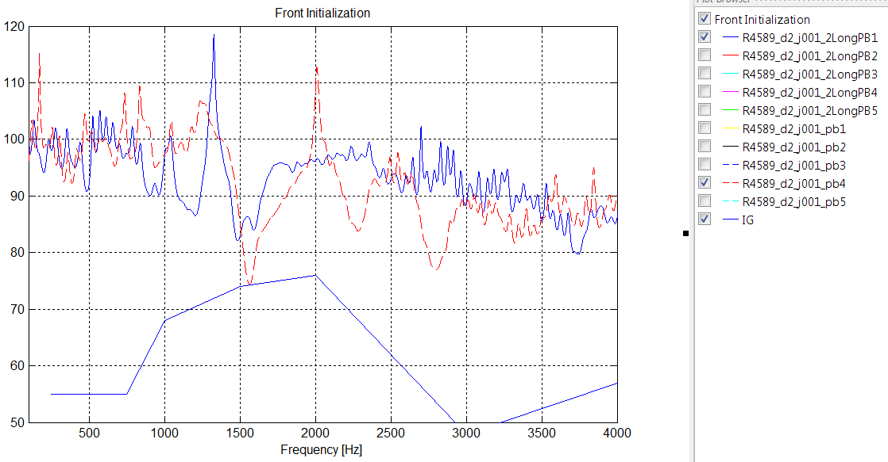
deviation = f( HI, chamber, jig+rec, coupler+rub)
HI:PB, either short or long, will shift the results in two status.
Make a requirement with ME to make sure this is under control.
Notes:
PB will make the deviation, it can be improved by mechanic

Slide 6
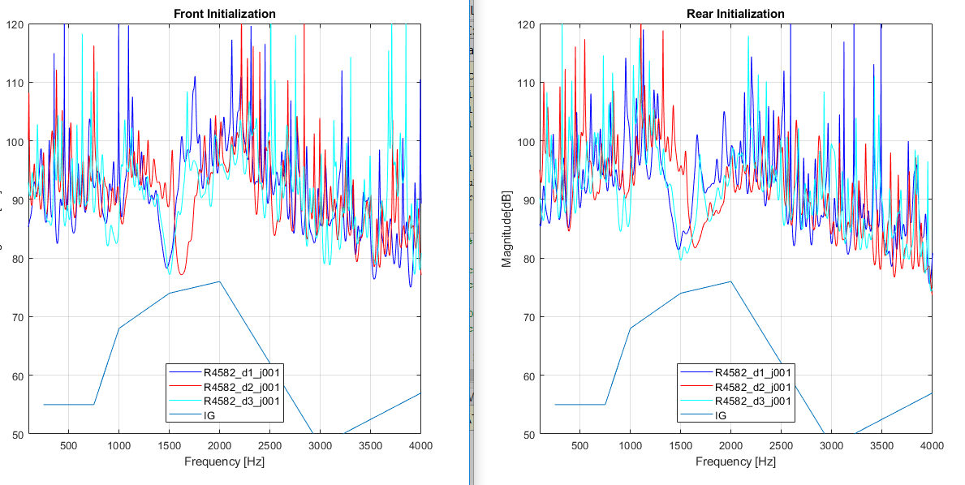
deviation = f( HI, chamber, jig+rec, coupler+rub)
deviation = f( HI, chamber, jig+rec, coupler+rub)
Switch 3 chambers
Notes:
I have translated the jig each test in one same chamber, it seems the peak will shift once the jig is moved, even just translated

Slide 7
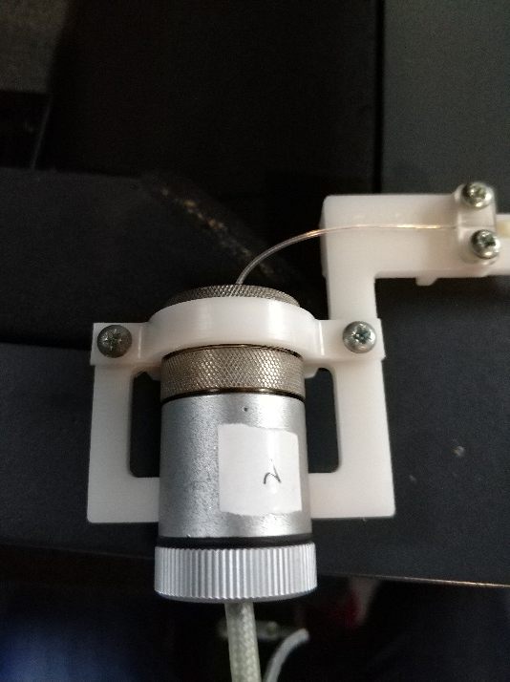
deviation = f( HI, jig+rec, coupler+rub)
Notes:
we think it is not just caused by the jig

Slide 8
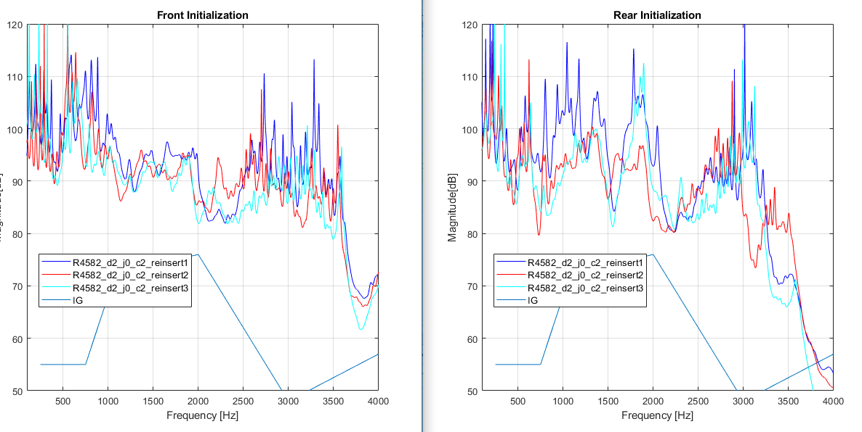
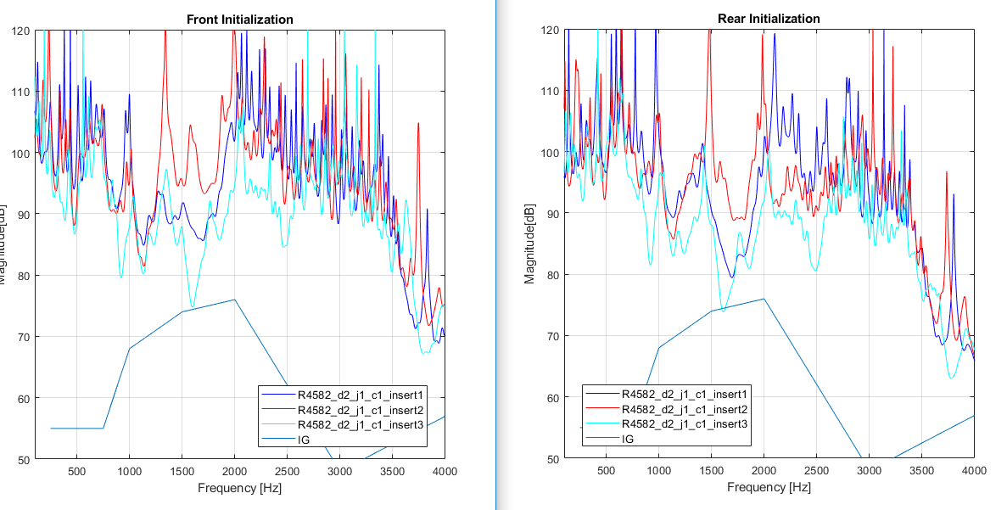
deviation = f( HI, jig+rec, coupler+rub)
reinsert the coupler can make deviation
J0+C1: **
J0+C2: ****
J0+C3: ***
J1+C1: *
J1+C2: *
J1+C3: **
Performance is better in jig0 whatever coupler
we can still find a good group, so maybe it can be avoid by a good jig and coupler.
Notes:
Try different jig and coupler groups, the more star, the better performance of deviation

Slide 9
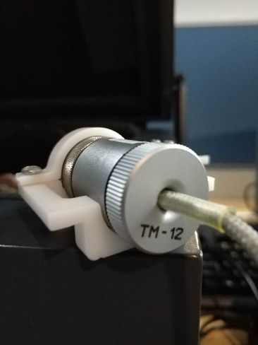
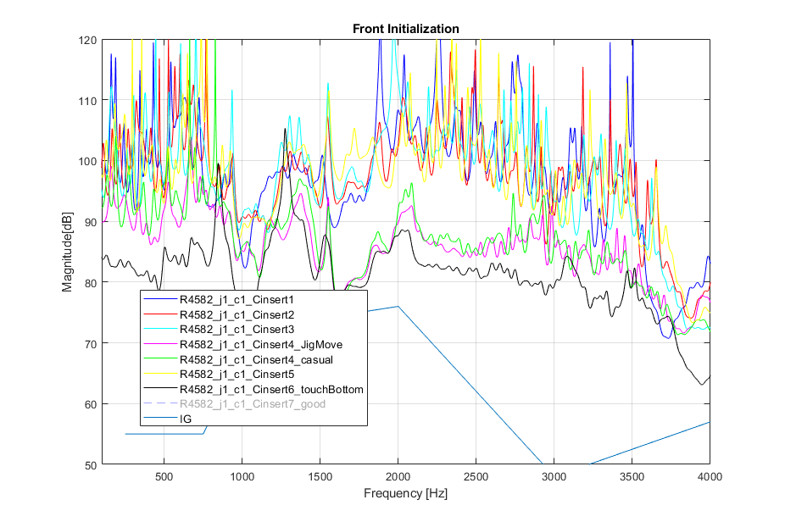
deviation = f( HI, jig+rec, coupler+rub, re-insert)
Notes:
Remember the deviation of this group j1 + c1
Reinsert 3 times, but carefully, the deviation will be smaller
Insert casually, or push the coupler down to touch the holder, or rotate the coupler, the deviation will be go bad.
But, no matter what you do , I can reinsert it hard to make it recover to be good.

Slide 10
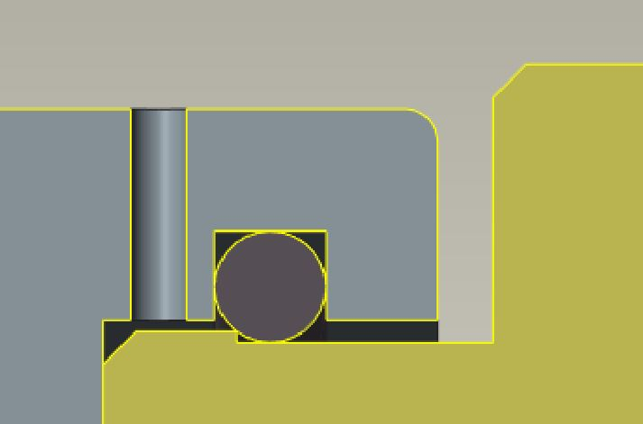
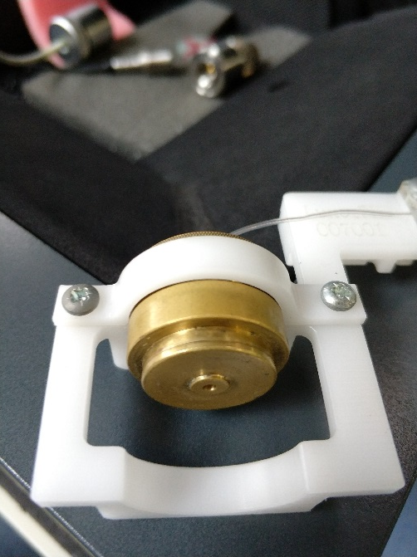
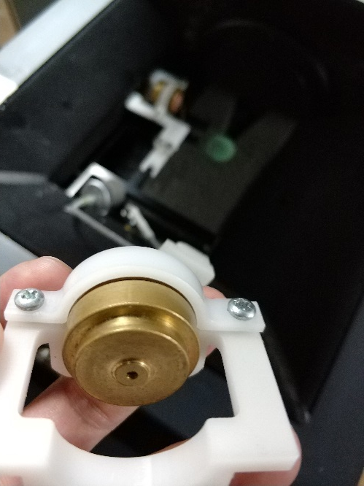

deviation = f( HI, jig+rec, coupler+rub, re-insert)

Slide 11
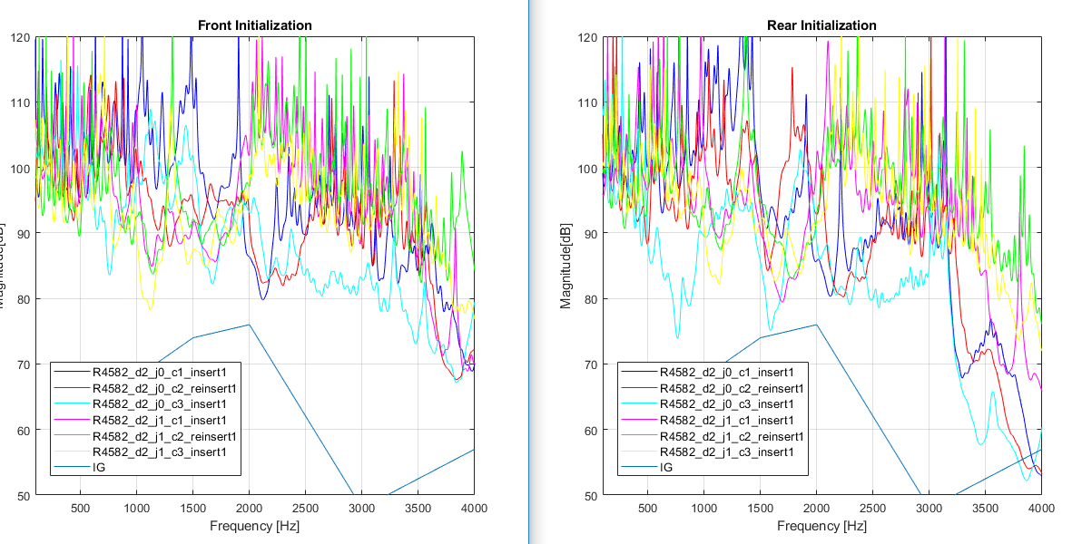
msg = f( HI, jig+rec, coupler+rub)

Slide 12
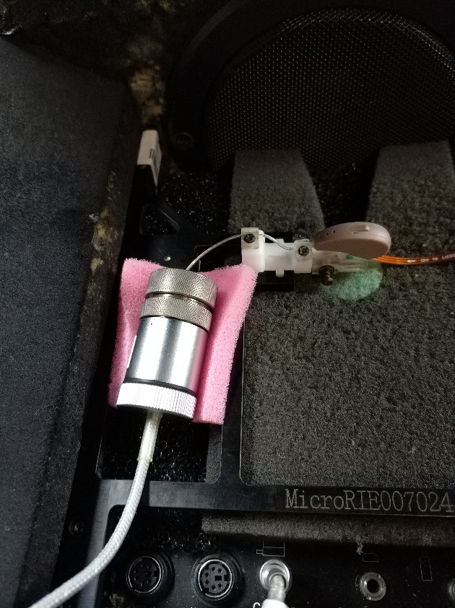
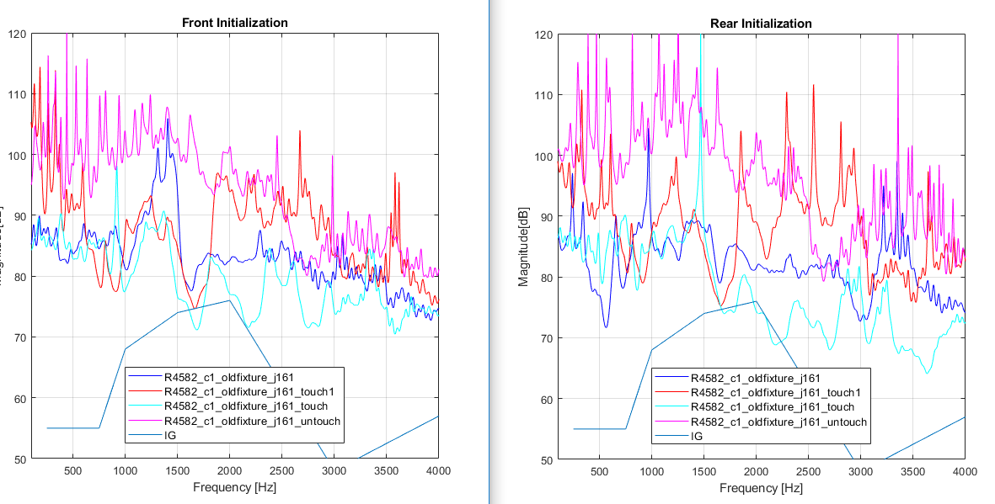
msg = f( HI, jig+rec, coupler+rub)
Old fixture
This discussion is for reference
Notes:
We can confirm: this old fixture is abandoned forever.
So this just for a reference

Slide 13
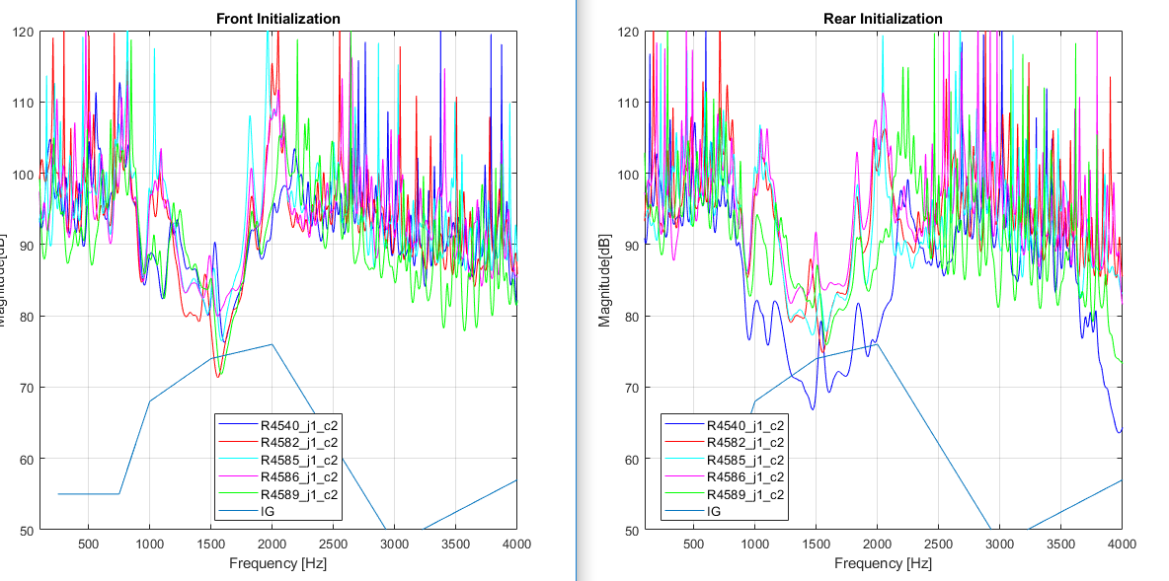
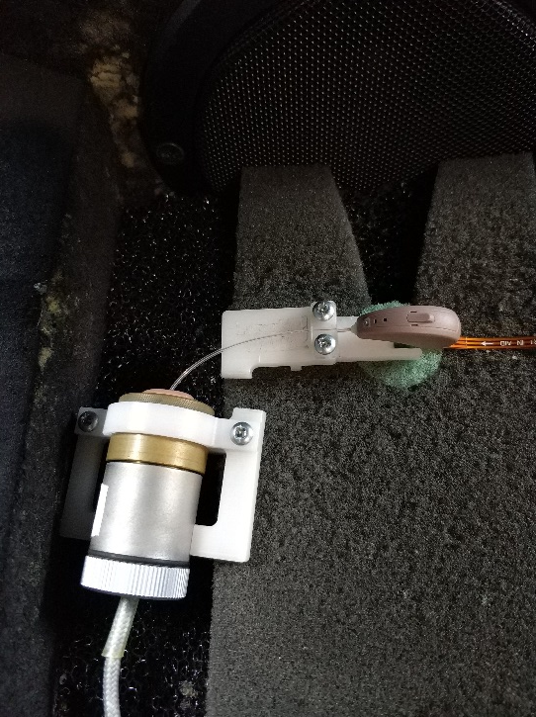
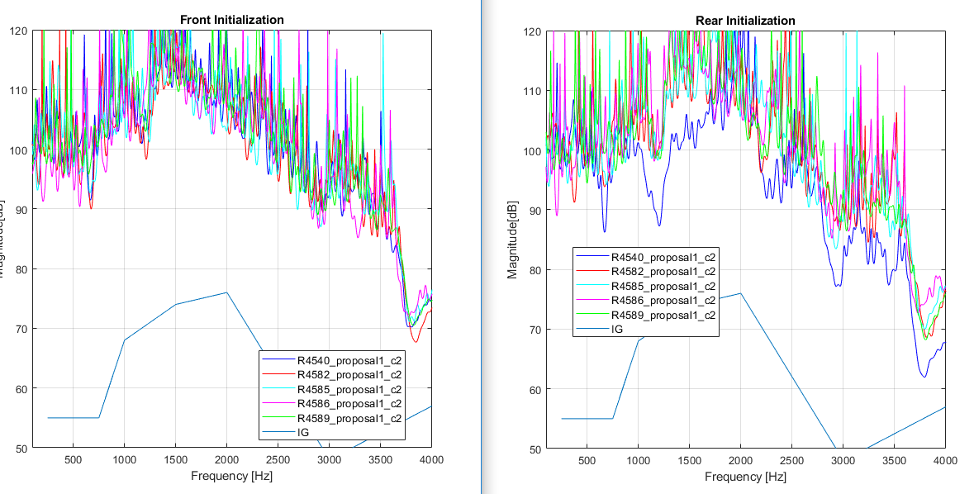
proposal1
Test below is done in a worst setup

Slide 14
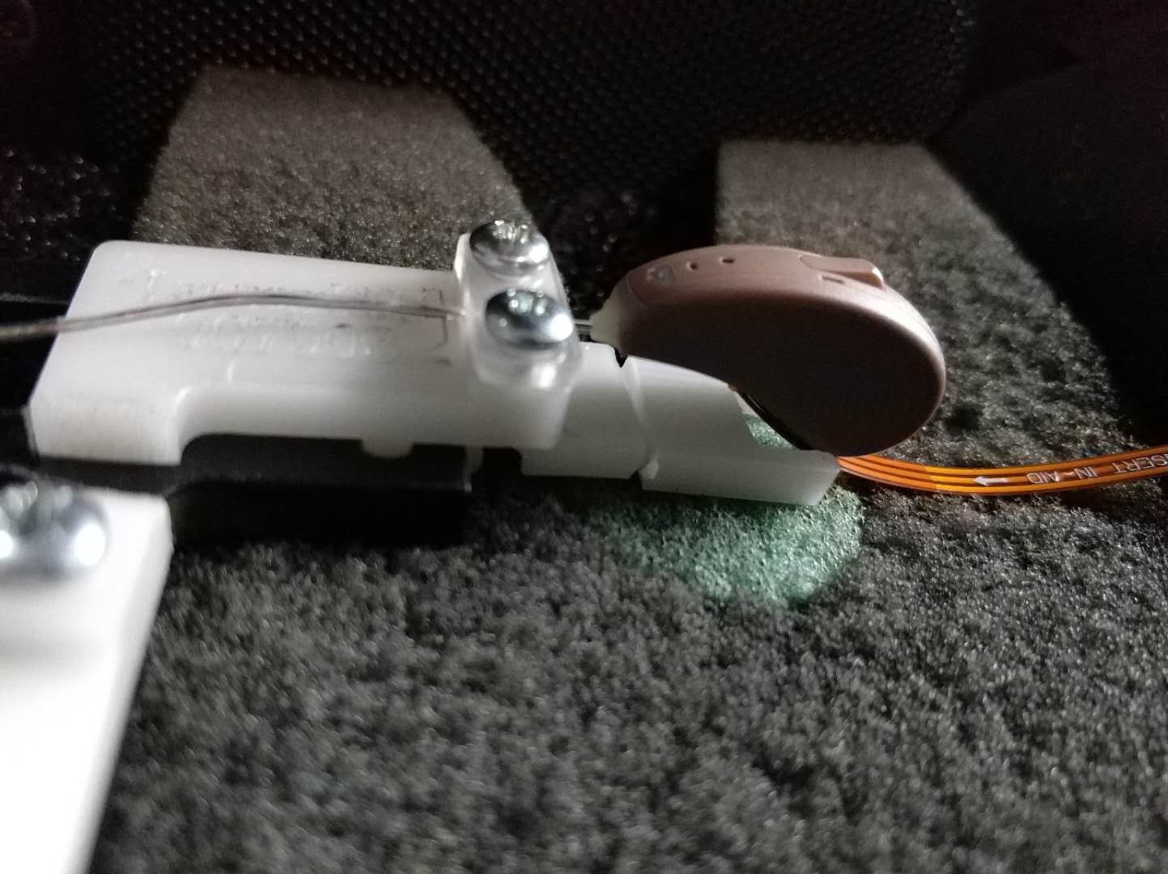
msg = f( HI, jig+rec, coupler+rub)

Slide 15
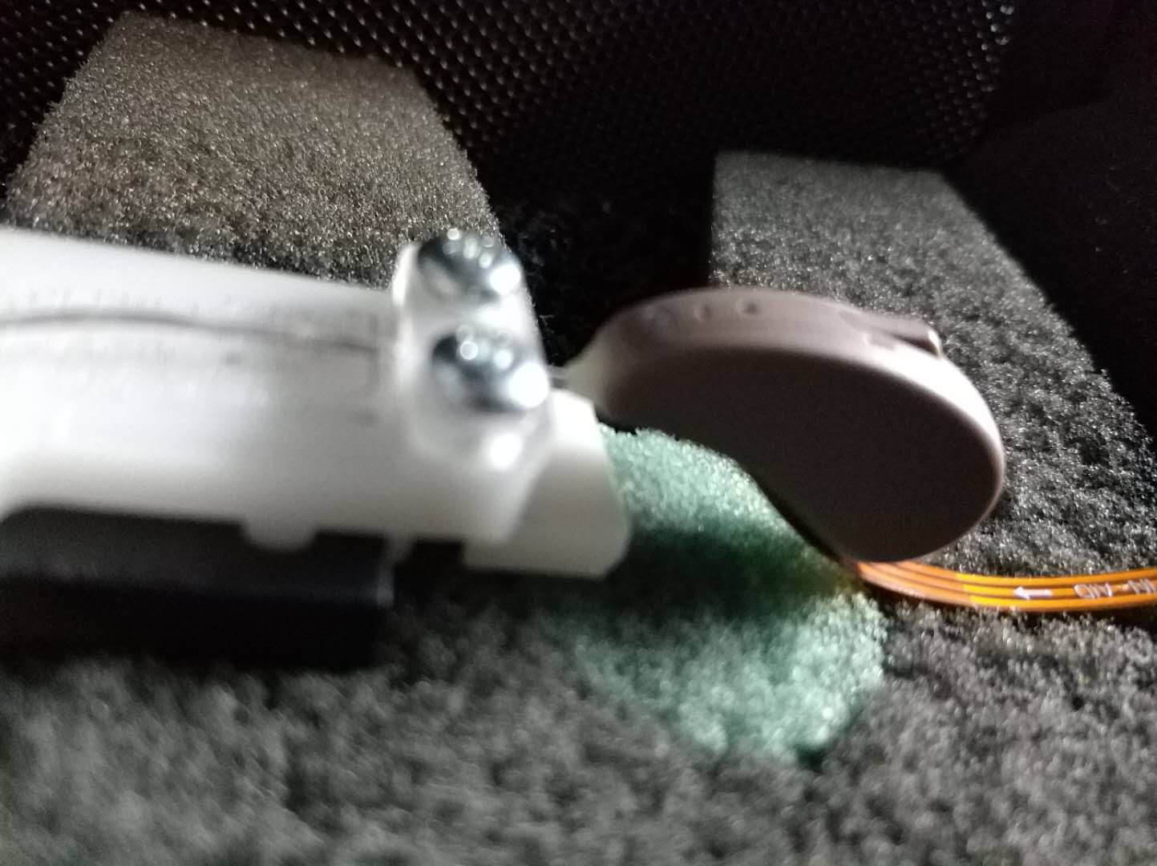
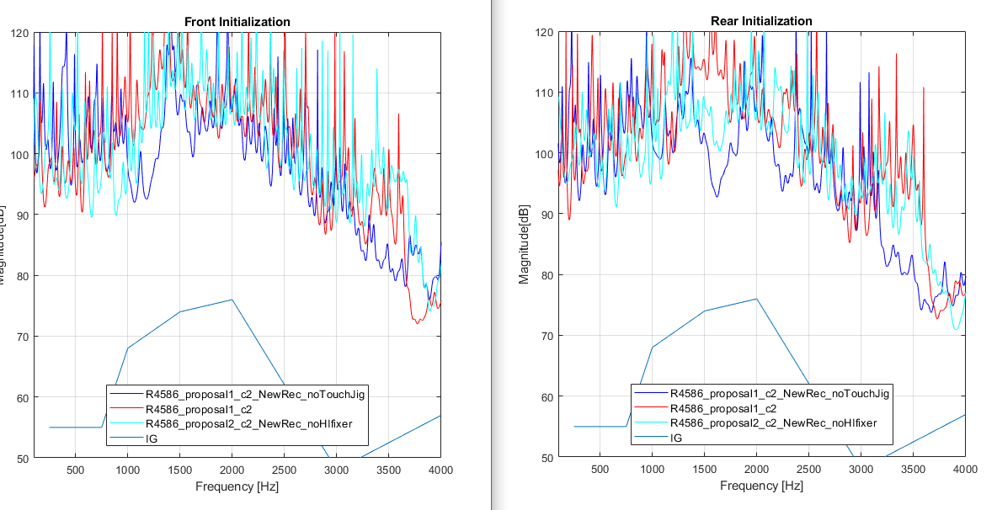
proposal2

