Slide 1
ASSESSING THE SIGNIFICANT MORPHOLOGICAL FACTORS ASSOCIATED WITH DEVELOPMENT OF BREAST CANCER
Yazna Penmetsa
SP24: APLD STAT MTD BIOMED INFORMTCS
PROFESSOR - ZEYANA HAMID

Slide 2
INTRODUCTION
Breast cancer is a significant global health concern.
Early and accurate detection is crucial for effective treatment and improved survival rates (Dua and Graff, 2019).
This challenge often leads to unnecessary biopsies or missed diagnoses (Adorada et al., 2018).
Aim of our study is to analyze the association between morphological characteristics and the likelihood of developing malignant or benign breast cancer.
The research objective is to conduct a statistical analysis to evaluate the relationship between morphological characteristics of breast tumors and the probability of developing malignant or benign breast cancer, elucidating key factors contributing to diagnostic precision and clinical decision-making.
The long-term objective is to improve patient care by improving breast cancer diagnostics, improving risk stratification, and customizing treatment using morphological analysis insights.

Slide 3
RESEARCH QUESTION AND HYPOTHESIS:
RESEARCH QUESTION
Do morphological characteristics of breast tumors have an association with the likelihood of developing malignant or benign breast cancer?
HYPOTHESIS: Null Hypothesis (H0): There is no significant association between morphological characteristics and the likelihood of developing malignant or benign breast cancer .
Alternate Hypothesis (H1): There is a significant association between morphological characteristics and the likelihood of developing malignant or benign breast cancer.

Slide 4
Dataset description
The Wisconsin Diagnostic Breast Cancer (WDBC) dataset contains 569 instances with 30 numerical features extracted from fine needle aspirate (FNA) images and longitudinal measurements.
Data Set contains data related to morphological features and breast cancer as diagnosis.
The data set contains no null values and duplicate values. It is clean and structured with mean values as variables.

Slide 5
VARIABLES DESCRIPTION
Our dataset, initially comprised 9 numerical variables and one categorical variable. We introduced a new categorical variable, complementing our existing numerical variables.
Variable Type | Description
Numerical (27) | These variables capture various morphometric characteristics of breast cell nuclei extracted from Fine Needle Aspirate (FNA) samples.
radius_mean | Measurements related to the size and shape of the nucleus (radius)
texture_mean | Measurements related to the texture of the nucleus (smoothness, uniformity of staining)
perimeter_mean | Measurements related to the perimeter of the nucleus
area_mean | Measurements related to the area of the nucleus
smoothness_mean | Level of smoothness of the nucleus periphery
compactness_mean | Ratio of the nucleus area to its equivalent circle area
symmetry_mean | Degree of symmetry of the nucleus shape
fractal dimension_ mean | Complexity of the nucleus shape
Categorical
Diagnosis | Indicates whether the tumor is malignant (M) or benign (B)
Tumour_size | We have created this variable on assumption of based on quartile ranges in existing numerical variable radius_mean
Assumption :
We created the "tumor_size" variable based on assumption, using quartile ranges from "radius_mean" for enhanced visualizations and analyses, given the absence of literature evidence and lack of units in our mean value variables.

Slide 6
Methodology
DATASET SELECTION
DATA CLEANING
EXPLORATORY DATA ANALYSIS
STATASTICAL ANALYSIS
MACHINE LEARNING MODELS

Slide 7
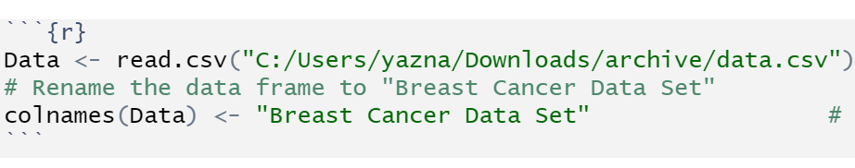
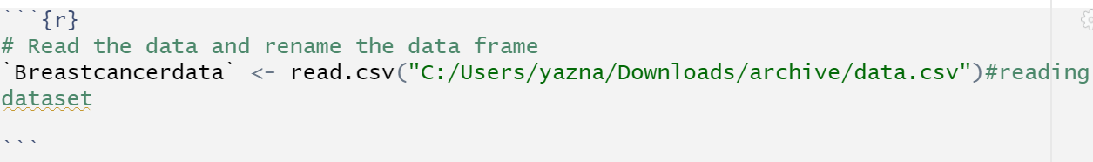
IMPORTING DATA
The CSV file containing Breast Cancer Data Set was uploaded to R and read by using the "read.csv" code.
Reading the data​

Slide 8
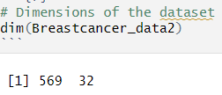
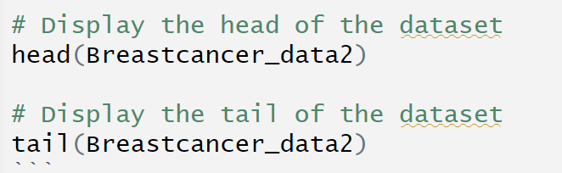
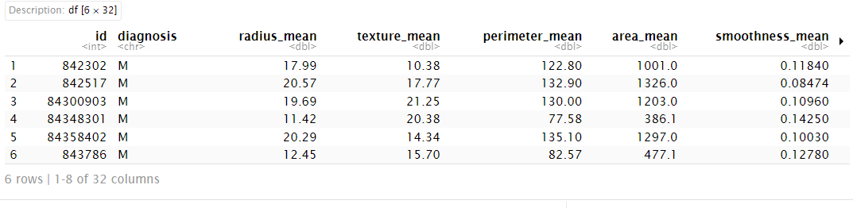
DATA DESCRIPTION
We have used dim function to know the shape of dataset.
Then we printed the head and tail of dataset to know the dataset structure.

Slide 9

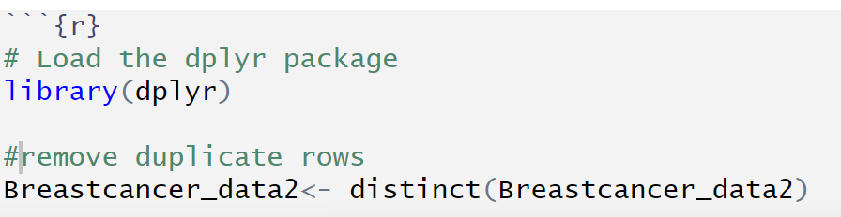
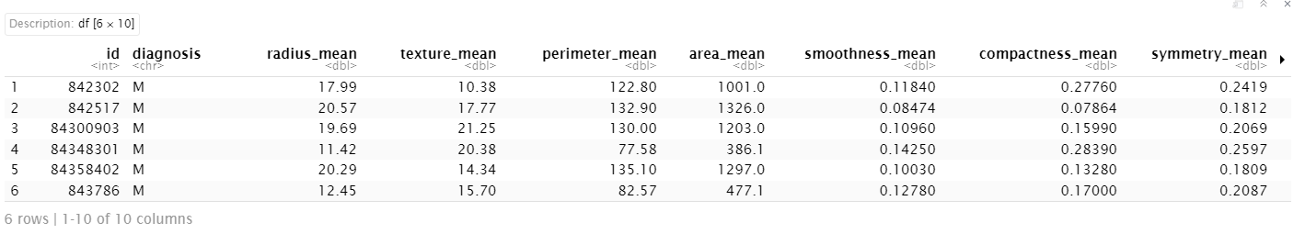
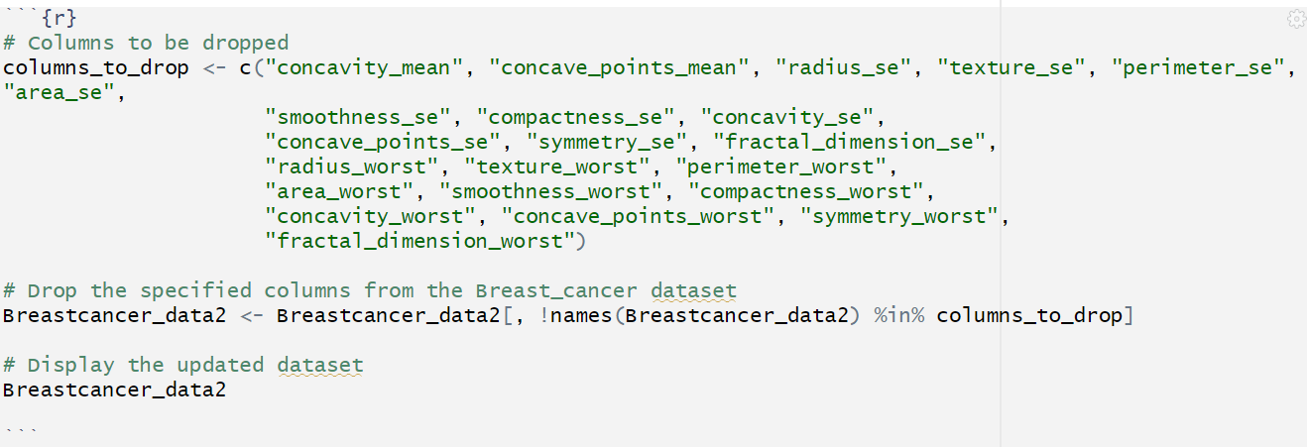
DATA CLEANING

Slide 10
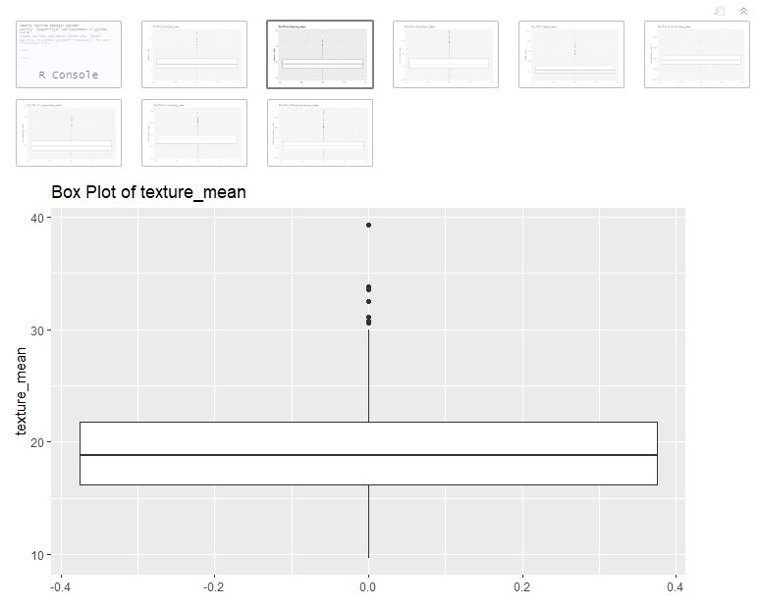
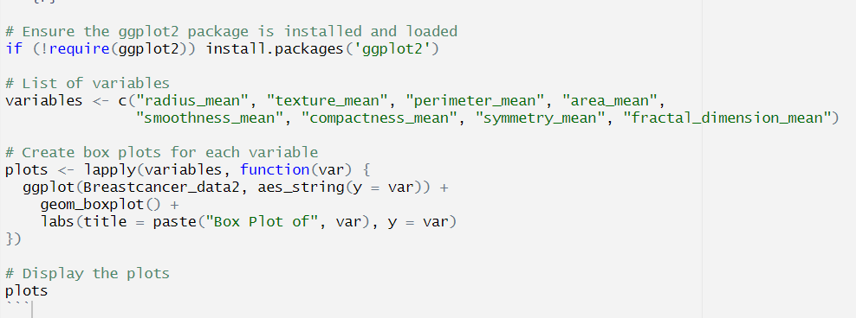
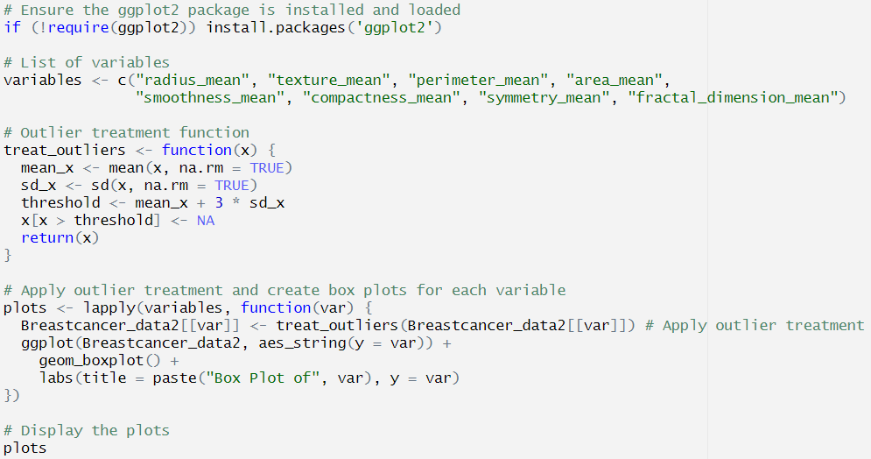
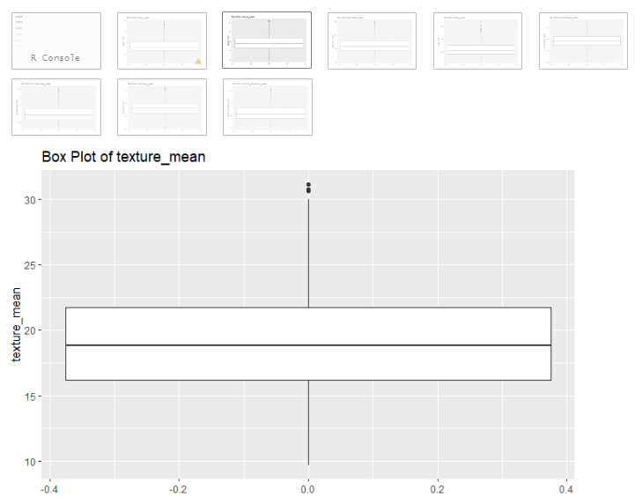
TREATING OUTLIERS
We plotted box plots to identify the outliers and treated them with 3-sigma rule.​

Slide 11

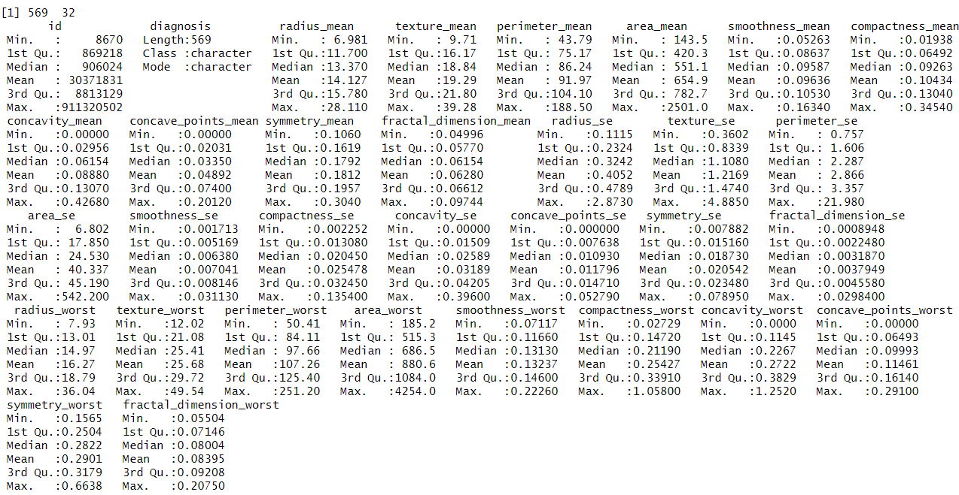
DESCRIPTIVE STATISTICS
We performed descriptive statistics by using the function summary() to obtain quartiles, mean, median of each variable.
For the outcome variable diagnosis which is a categorical variable it gave type of class.

Slide 12
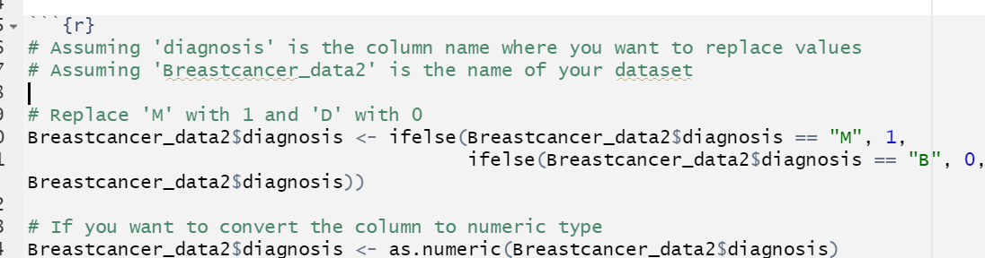
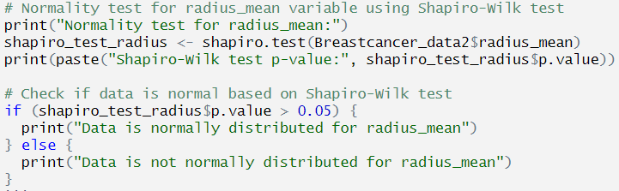

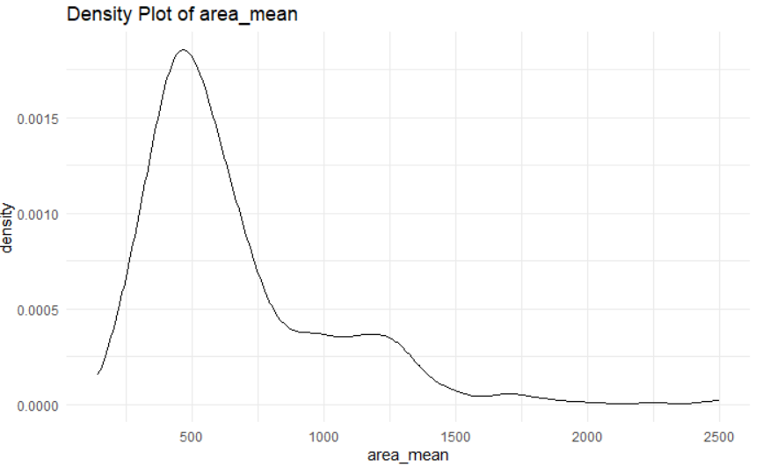
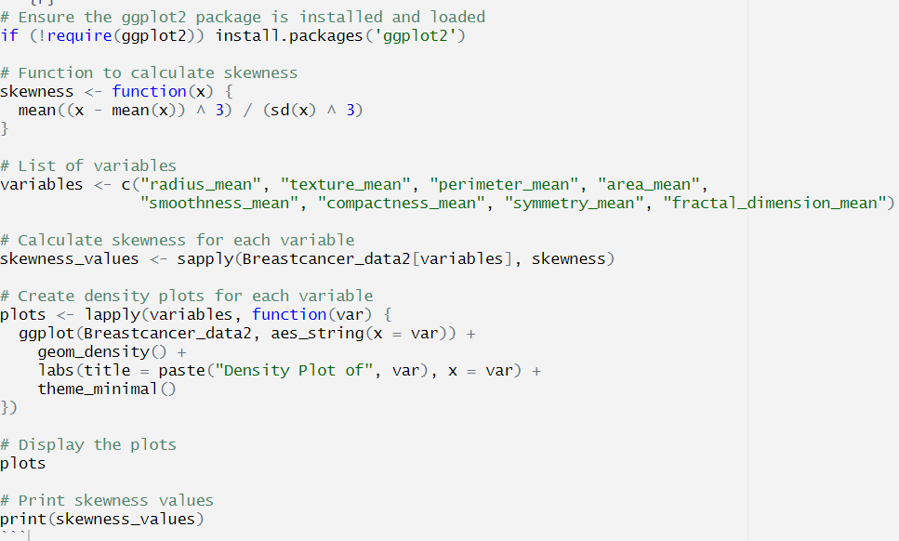
NORMALITY TESTING
After substituting 'M' and 'B' with '1' and '0' respectively in the diagnosis column, we conducted a Shapiro-Wilk test to assess normality, revealing that the variables are non-normally distributed. Then we checked the skewness of data which revealed the right skewness.

Slide 13
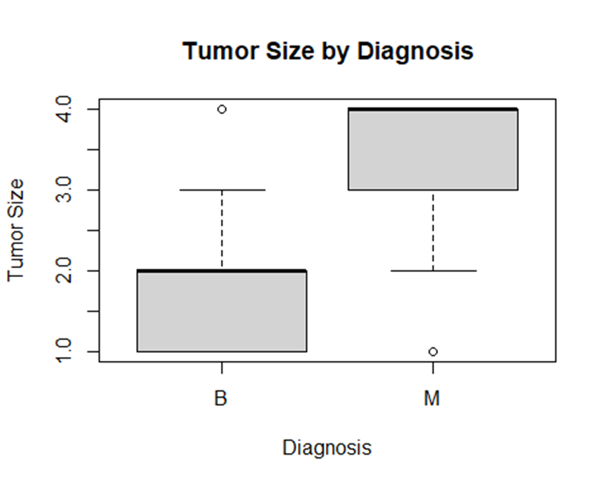
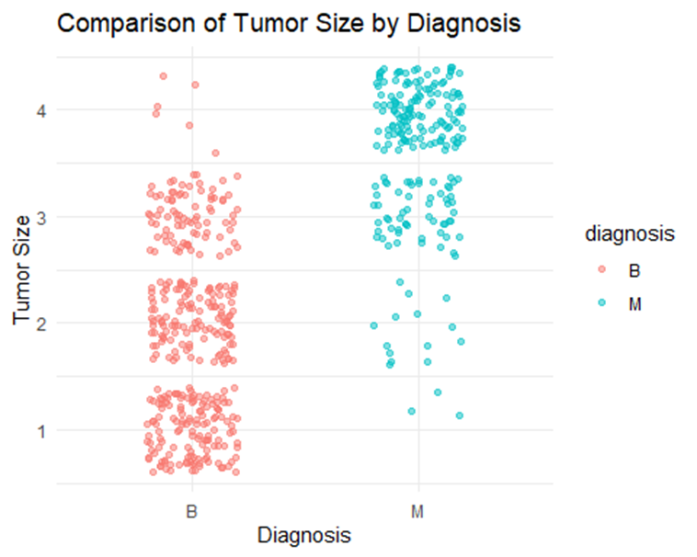
EXPLORATORY DATA ANALYSIS AND DATA VISUALIZATION
We utilized box plots and scatterplots to comprehend the impact, revealing that malignant tumors are more influenced by tumor size compared to benign tumors.

Slide 14
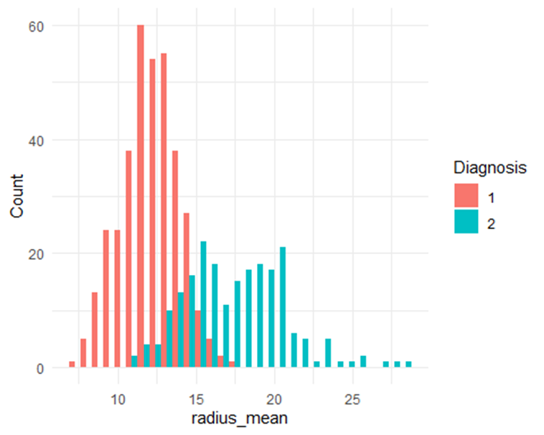
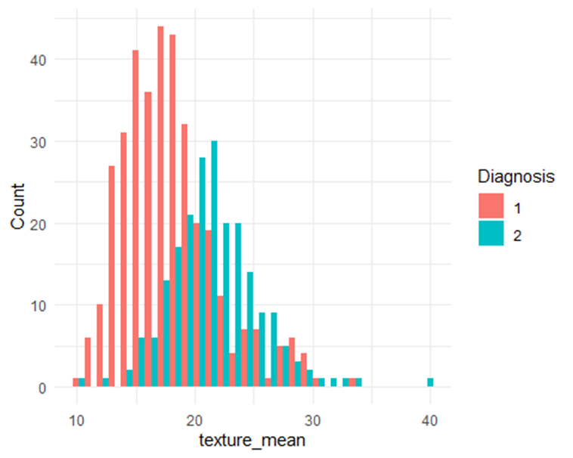
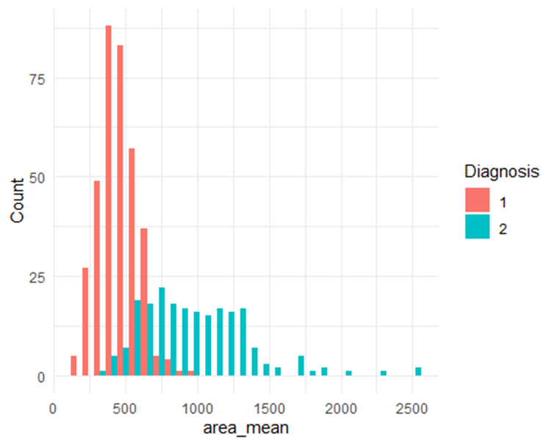
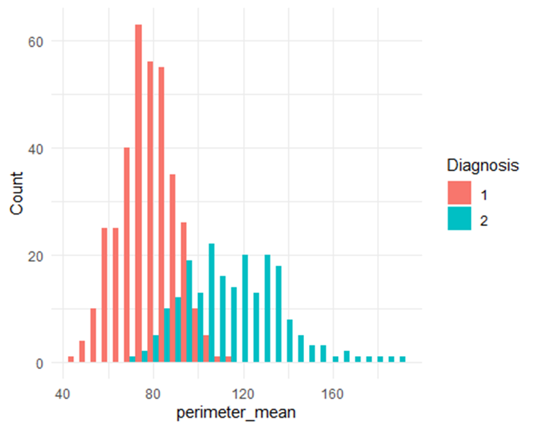
DATA VISUALIZATION
These bar graphs suggest that the outcome variable(diagnosis) distribution with different variables.

Slide 15
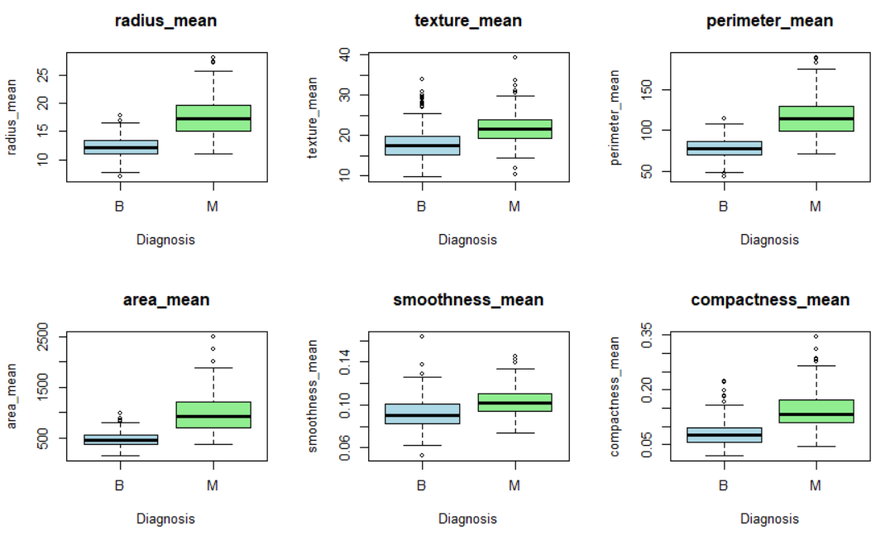
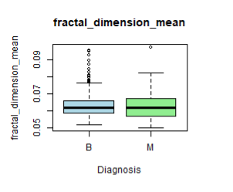
DATA VISUALIZATION
The box plots generated for each variable in relation to the diagnosis illustrate the distribution of malignant and benign tumors across those variables.

Slide 16
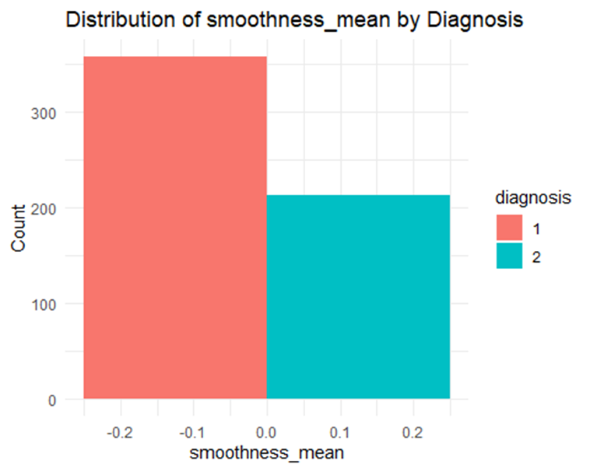
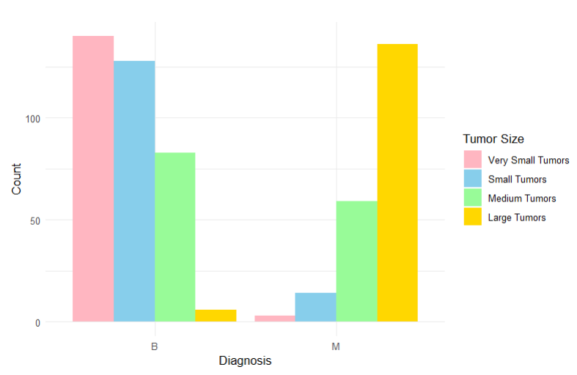
DATA VISUALIZATION
The above histograms for diagnosis and tumour_size depict the malignant and benign tumors based on size. The bar plot between smoothness and diagnosis count depicts that benign tumors have less smoothness than malignant.

Slide 17
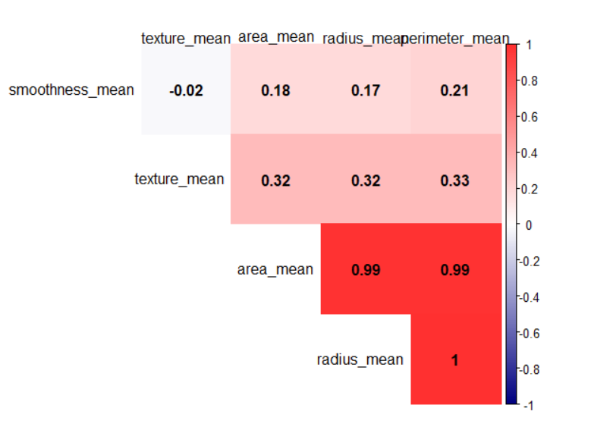
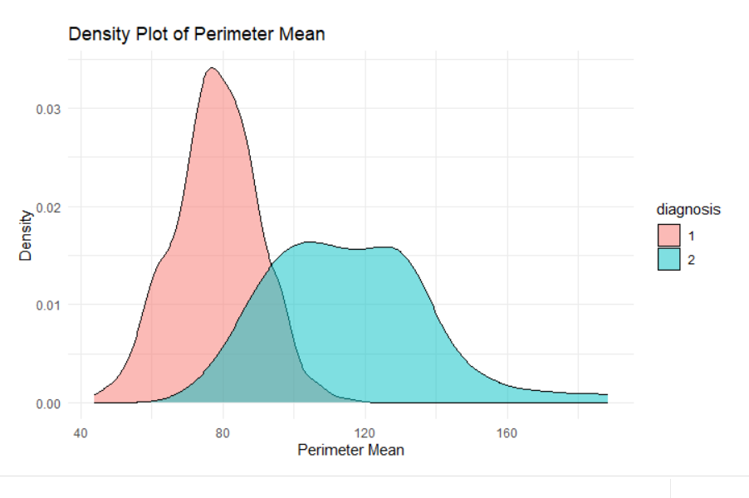
Density Plot :
This plot illustrates the distribution of the 'Perimeter Mean' for two diagnostic groups, shown in red and blue. The separation between the distributions indicates that 'Perimeter Mean' is a pivotal feature in distinguishing between these groups, with larger values potentially linked to one of the categories, likely indicating a trend towards malignancy or benignity.
Heatmap of Feature Correlations:
This heatmap displays the correlation coefficients among various morphological features such as 'radius_mean', 'area_mean', 'perimeter_mean', and others. The strong correlation (0.99) between 'area_mean' and 'radius_mean' suggests these variables might influence each other, impacting their individual predictive power. Such visualizations are crucial for identifying highly correlated features which might affect the effectiveness of predictive models due to multicollinearity.

Slide 18
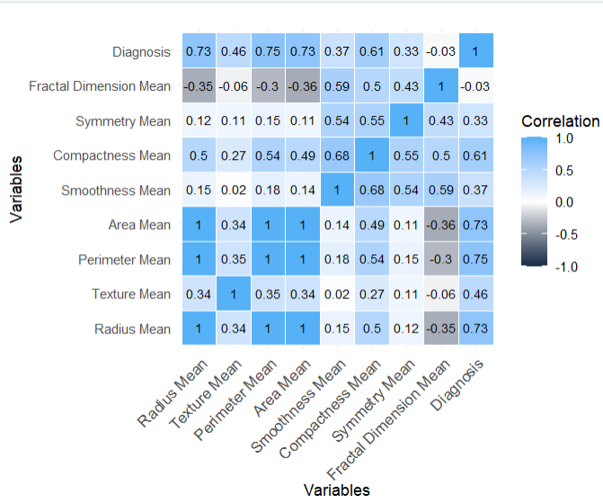
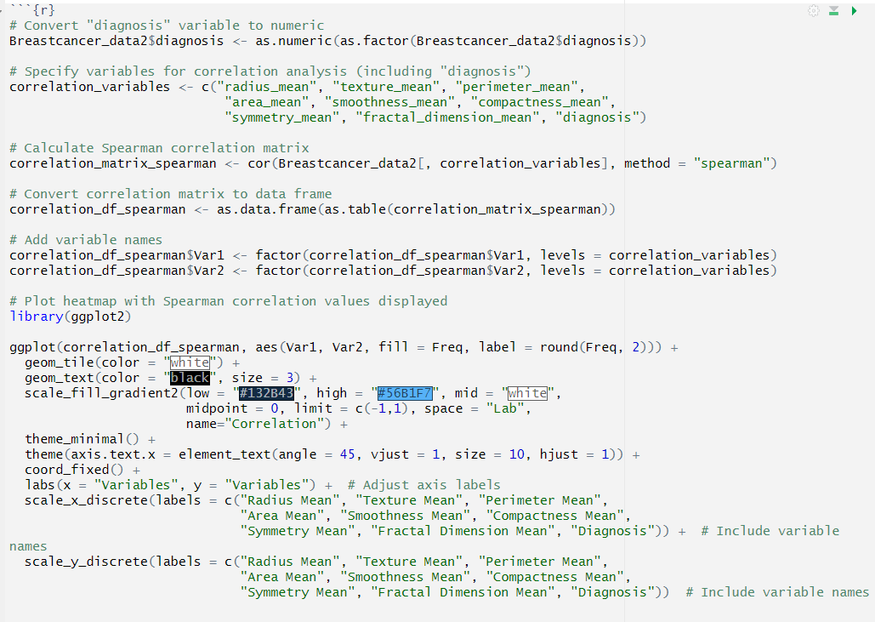
Correlation matrix
We found strong positive correlations between radius_mean, perimeter_mean, area_mean, compactness_mean and diagnosis

Slide 19
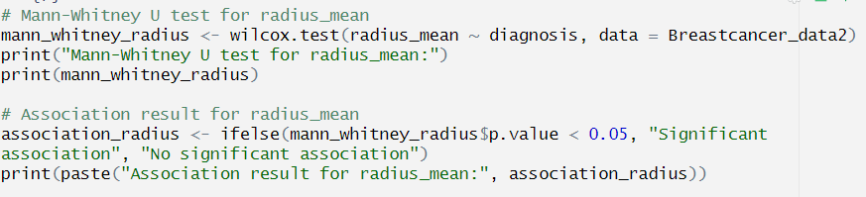
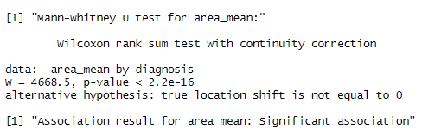
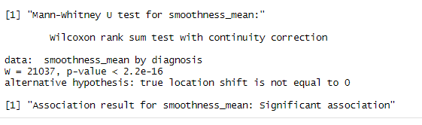
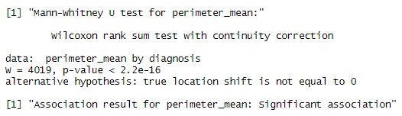
Mann-Whitney U test
We conducted Mann-Whitney for all numerical variables which revealed a of p value < 0.05 for all except fractal_dimension_mean stating significant association with outcome variable "diagnosis."
smoothness_mean perimeter_mean area_mean

Slide 20
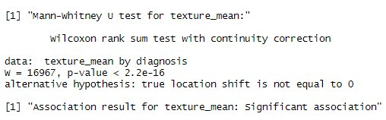
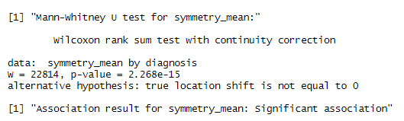
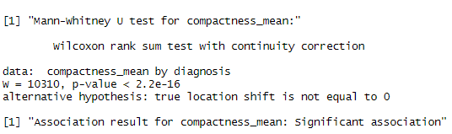
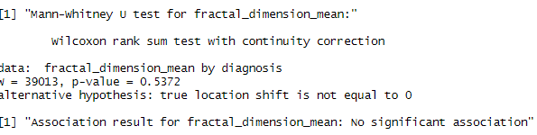
Texture_mean
Symmetry_mean
Compactness_mean
Fractal_dimension_mean

Slide 21
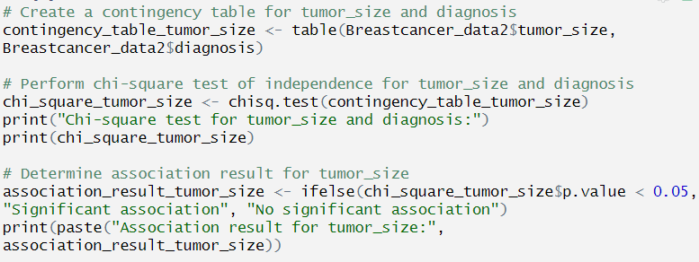
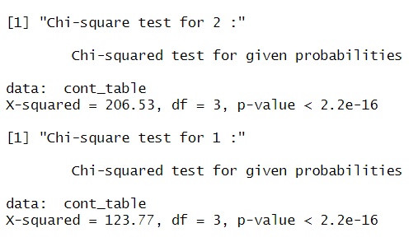
Chi square test
We conducted a chi-square test using our categorical variable "tumor_size" and outcome variable "diagnosis" to examine the individual impact of tumor size on both malignant and benign diagnoses.
The obtained Malignant p-value < 2.2e-16 suggesting a significant association between tumor_size and malignant tumours
The obtained Benign p-value < 2.2e-16 suggesting a significant association between tumor_size and benign tumours

Slide 22
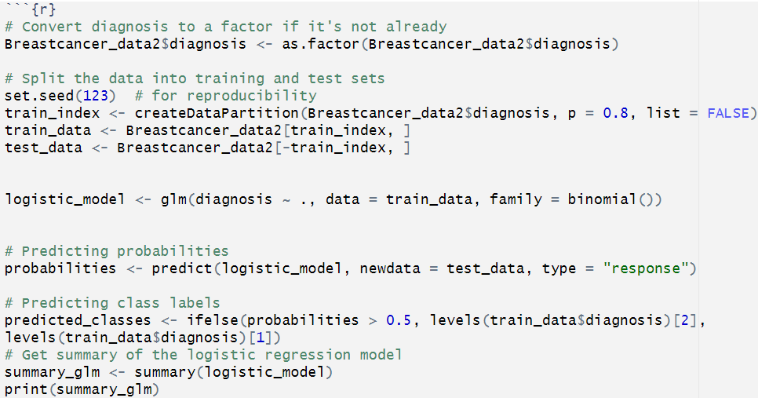
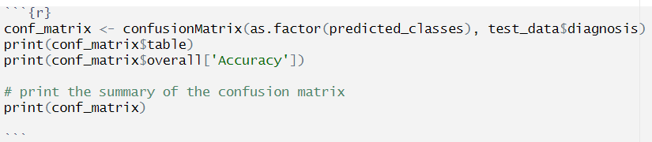
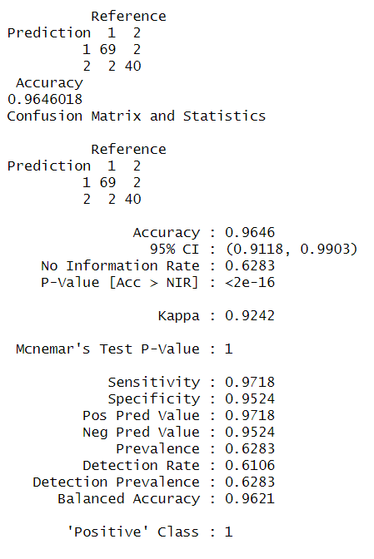
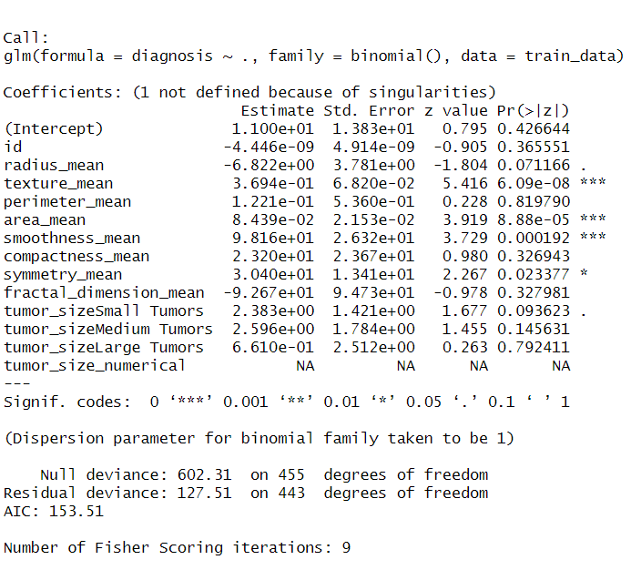
MACHINE LEARNING MODELS Logistic regression

Slide 23
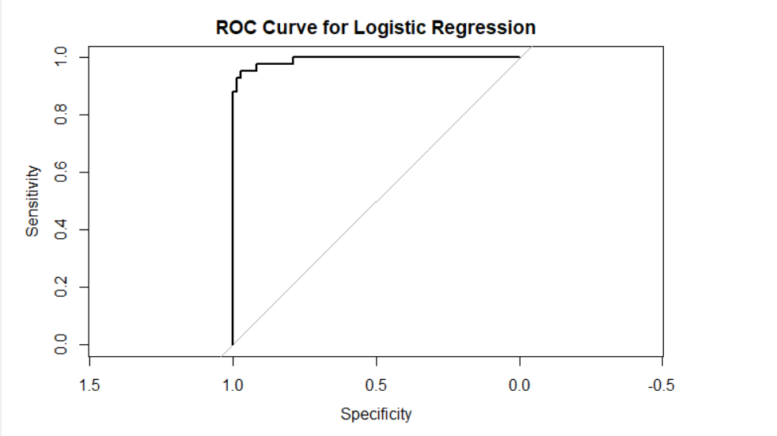
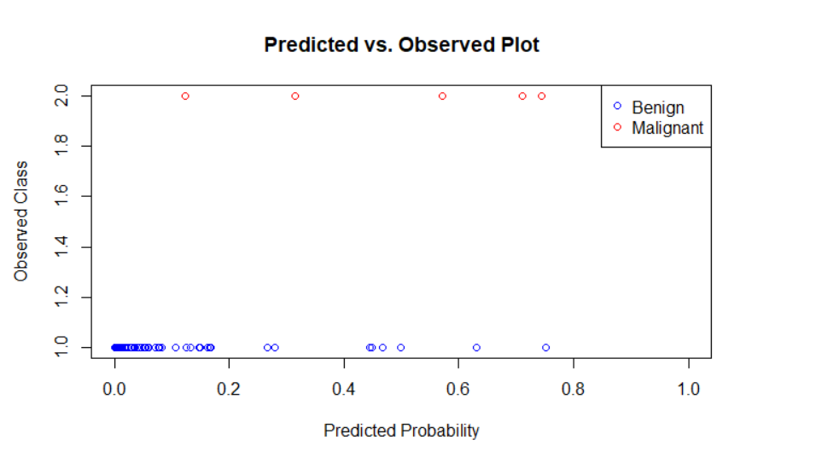
Logistic regression
The logistic regression model exhibits high predictive accuracy, accurately ranking malignant cases with a 99.16% probability, demonstrating its superior ability to differentiate between benign and malignant breast cancer cases.
The scatter plot shows the logistic regression model's predictive accuracy by comparing predicted malignancy probabilities against actual breast cancer diagnoses. The color-coded points indicate the model's strong performance in accurately classifying tumors.

Slide 24
RESULTS AND CONCLUSION
We reject the null hypothesis that there is no significant association between morphological characteristics and the likelihood of developing malignant or benign breast cancer.
We fail to reject the alternate hypothesis that there is a significant association between morphological characteristics and the likelihood of developing malignant or benign breast cancer.
The significant associations observed from the above analysis suggest that some morphological characteristics, such as radius, texture, perimeter, area, smoothness, compactness, and symmetry, play a crucial role in estimating association with the likelihood of developing malignant or benign breast cancer.
However, the fractal_dimension_mean did not significantly correlate with either malignant or benign tumors.
These findings provide evidence supporting the hypothesis that morphological characteristics have a significant association with the likelihood of developing malignant or benign breast cancer.

Slide 25
LIMITATIONS
1. The small sample size significantly restricts the applicability of machine learning models, especially for conducting individualized analyses to association of malignant and benign tumors with predictor variables.
2. The broad nature of the research question adds complexity to the analysis process, potentially requiring more extensive data and computational resources.
3. The absence of units for variables in the dataset presents challenges in interpreting the numerical values accurately. Moreover, the lack of supported literature makes it difficult to validate findings and methodologies effectively.

Slide 26
REFERENCES
Adorada, A., Permatasari, R., Wirawan, P. W., Wibowo, A., & Sujiwo, A. (2018). Support vector machine-recursive feature elimination (svm-rfe) for selection of microrna expression features of breast cancer. 2018 2nd International Conference on Informatics and Computational Sciences (ICICoS).
UCI machine learning repository. (n.d.). Uci.edu. Retrieved May 1, 2024, from https://archive.ics.uci.edu/

Slide 27


