Slide 1

MCO1: Comparing Sorting Algorithms
GROUP 8
David Grasparil
Yazle Sean Ligot

Slide 2
Comparing Sorting Algorithms
Each sorting algorithm works differently by nature thus making each sorting algorithm unique.
The idea of the project is to serve as foundation for algorithm analysis. The materials, specifically the sorting algorithms, are to be analyzed, evaluated, and compared to each algorithm. (both time and space efficiency)
While theoretically speaking, some of the algorithms that are to be tested are fast on paper, this experiment shall determine the performance of each algorithm under the same conditions in order to grasp the qualities of the sorting algorithm.

Slide 3
How Each Algorithm Works
Bubble Sort
Selection Sort
Insertion Sort
Shell Sort
Compares two elements that are side by side
Finds the smallest element from the unsorted array and moves it to the front of the sorted array
Compares two elements and inserted until it meets a value it can not swap with
Compares two elements that are far apart and successively reduces the interval between the elements to be sorted

Slide 4
How Each Algorithm Works
Merge Sort
Quicksort
Splits the elements in half creating a sublist and merges the sublist to a sorted list
Selects a pivot element and partitions the other elements to two subarray and is sorted accordingly

Slide 5
Experiments and Results
The contents of the array are randomly generated
The experiment for each algorithm was tested 10 times and the result of each test is averaged.
The average is then recorded for the said sample size and this is done as each of the size of the array increases

Slide 6
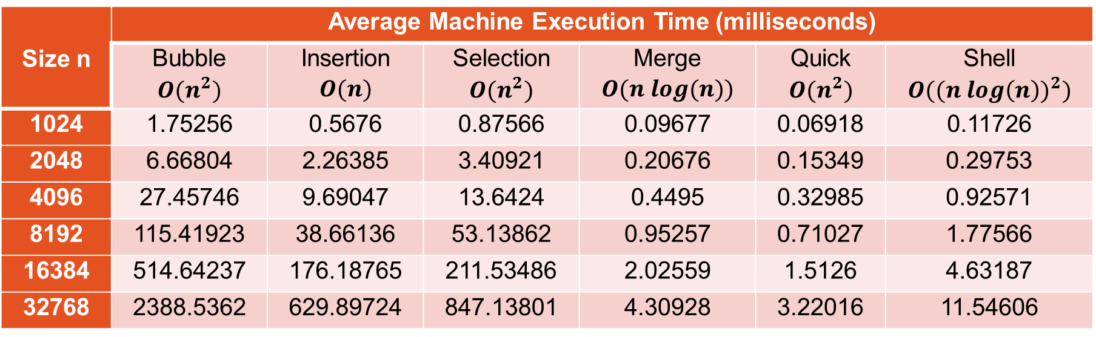
Experiments and Results
Size n | Average Machine Execution Time (milliseconds)
 | Bubble $$O(n^{2})$$ | Insertion $$O(n)$$ | Selection $$O(n^{2})$$ | Merge $$O(n log(n))$$ | Quick $$O(n^{2})$$ | Shell $$O(({n log\left(n\right))}^{2})$$
1024 | 1.75256 | 0.5676 | 0.87566 | 0.09677 | 0.06918 | 0.11726
2048 | 6.66804 | 2.26385 | 3.40921 | 0.20676 | 0.15349 | 0.29753
4096 | 27.45746 | 9.69047 | 13.6424 | 0.4495 | 0.32985 | 0.92571
8192 | 115.41923 | 38.66136 | 53.13862 | 0.95257 | 0.71027 | 1.77566
16384 | 514.64237 | 176.18765 | 211.53486 | 2.02559 | 1.5126 | 4.63187
32768 | 2388.5362 | 629.89724 | 847.13801 | 4.30928 | 3.22016 | 11.54606

Slide 7
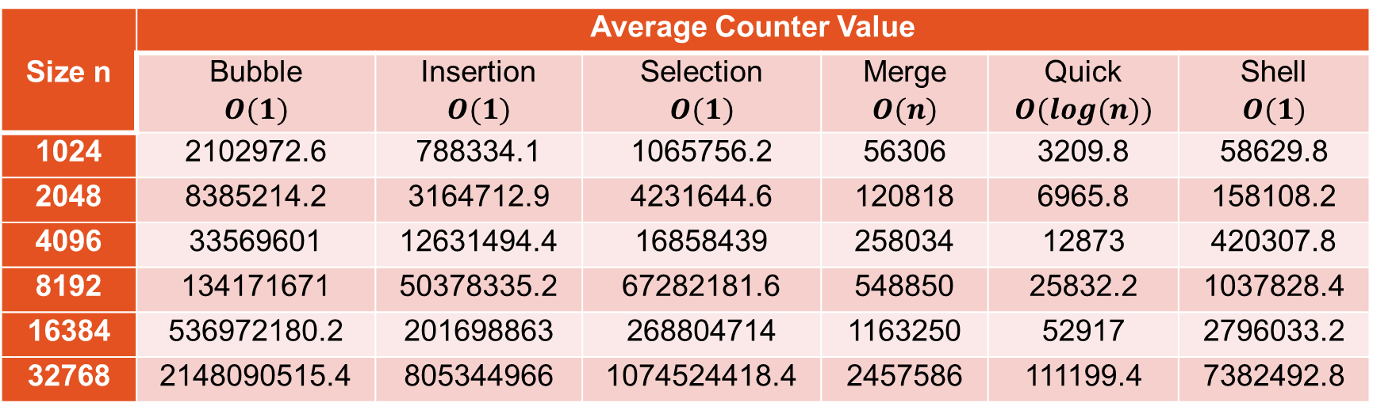
Experiments and Results
Size n | Average Counter Value
 | Bubble $$O(1)$$ | Insertion $$O(1)$$ | Selection $$O(1)$$ | Merge $$O(n)$$ | Quick $$O(log(n))$$ | Shell $$O(1)$$
1024 | 2102972.6 | 788334.1 | 1065756.2 | 56306 | 3209.8 | 58629.8
2048 | 8385214.2 | 3164712.9 | 4231644.6 | 120818 | 6965.8 | 158108.2
4096 | 33569601 | 12631494.4 | 16858439 | 258034 | 12873 | 420307.8
8192 | 134171671 | 50378335.2 | 67282181.6 | 548850 | 25832.2 | 1037828.4
16384 | 536972180.2 | 201698863 | 268804714 | 1163250 | 52917 | 2796033.2
32768 | 2148090515.4 | 805344966 | 1074524418.4 | 2457586 | 111199.4 | 7382492.8

Slide 8
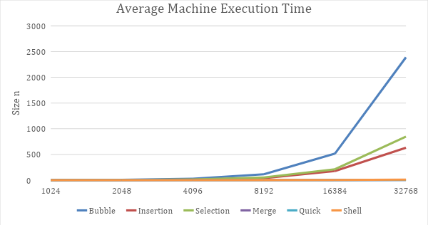
Comparison and Analysis

Slide 9
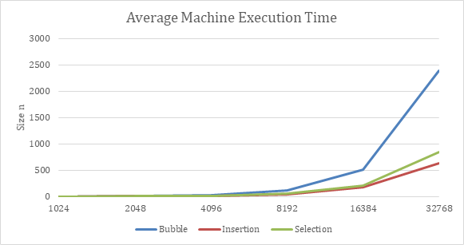
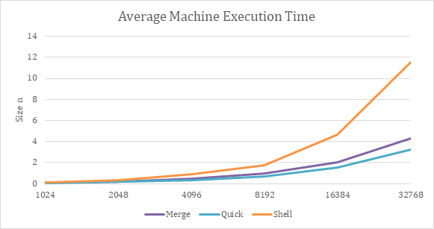
Comparison and Analysis

Slide 10
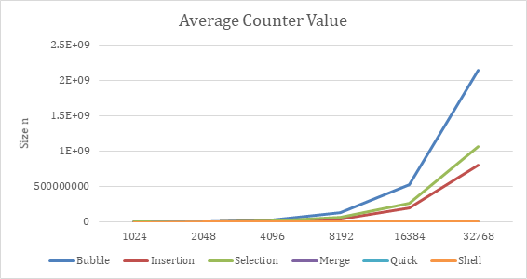
Comparison and Analysis

Slide 11
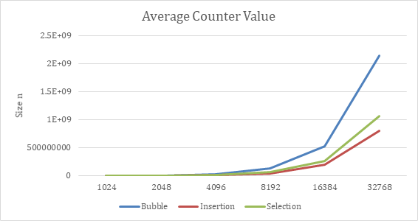
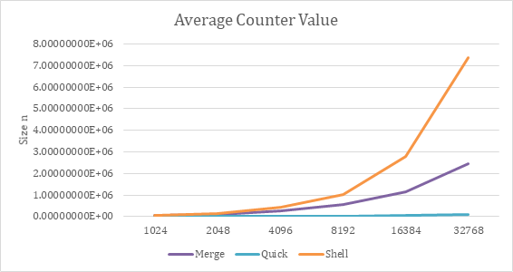
Comparison and Analysis

Slide 12
Conclusion
Despite the variety of sorting algorithms, because of the unique characteristics of the algorithms and the way they are implemented and structured created various results from the experiment, we can say that every algorithm is useful in certain circumstances
There are indeed sorting algorithms that can perform differently but it highlights what they excel on.
For random data, Quicksort was the most efficient, but over time we might want to have a more consistent time to sort vs size ratio, which merge sort gives.
For simple tasks, or demonstration examples especially those that are meant to teach new programmers , bubble/selection sort is the best option.

Slide 13
MCO1: Comparing Sorting Algorithms
GROUP 8
David Grasparil
Yazle Sean Ligot

